Slide 1
Image generation with diffusion models
Made by: Asztrik Vörös, Levente Molnár

Slide 2
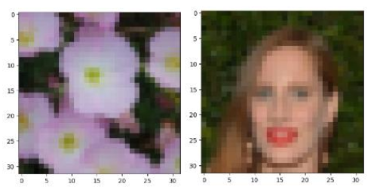
Introduction
Topic: Image generation with diffusion models
Model: DDPM
Datasets: CelebA, Flowers102
Main goal: Generating images of 32x32 pixels

Slide 3

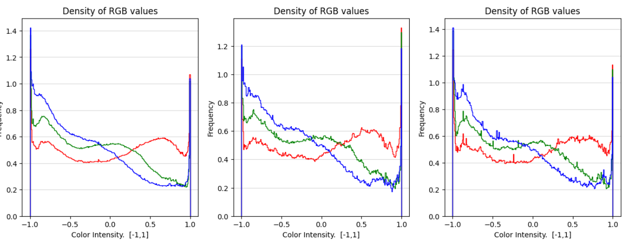
Data analysing, cleansing and preparation
Image dimension size analysis
Rebalancing train, test, validation
Center Cropping, Resizing, Normalization + Reverse
Analysing color density
Train, test, validation separately

Slide 4

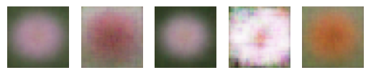
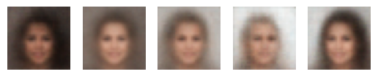
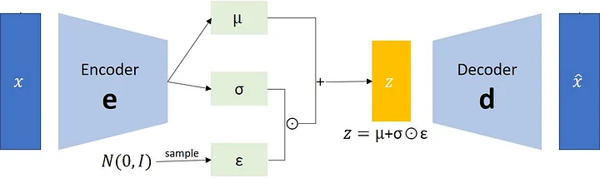
Baseline models
Random
VAE

Slide 5
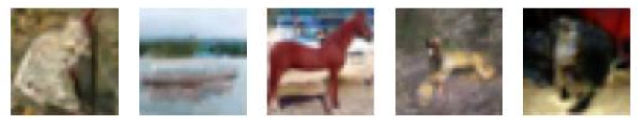
Methods of training
Foundational model: google/ddpm-cifar10-32
Finetuning/Train steps
Random timestep → Scaled noise with Scheduler
Predict original noise with U-Net
MSE loss: original noise vs predicted noise
Early Stopping, Model Checkpoint
Gradient Accumulation, Weight Decay
Hyperoptimization: Wandb Sweep
Eval only mode: Loads last Sweep’s best model

Slide 6
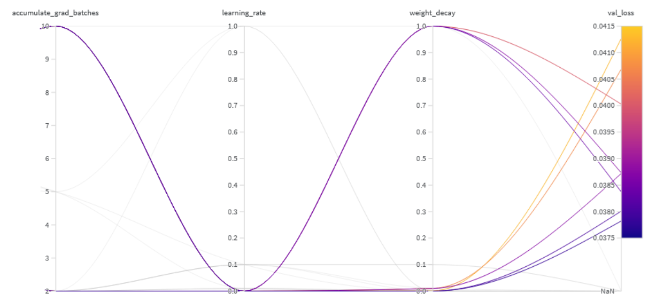
Methods of training

Slide 7

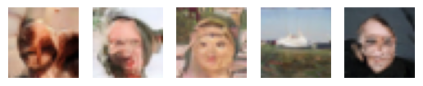
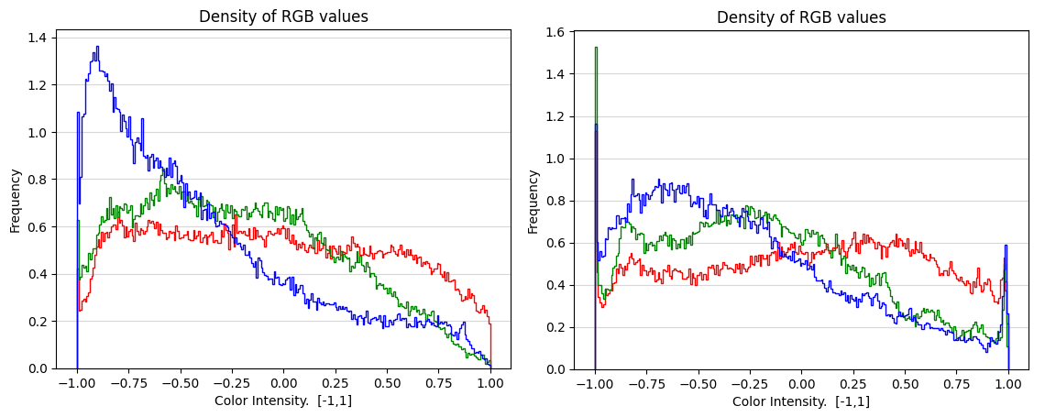
Model evaluation
Image Generation
Random noise
For timesteps in schedulers do
Predict noise with U-NET
Denoise with Scheduler

Slide 8
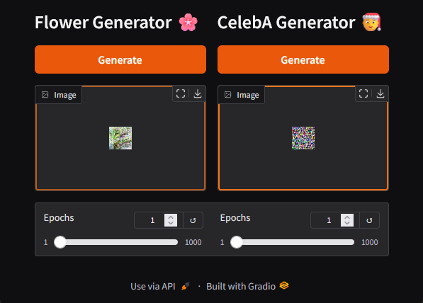
ML as service – UI
Gradio interface
Live image generation
Updating the displayed image after every denoising step
Slider to view any step after completion

Slide 9
ML as service – UI

Slide 10
Conclusion
FID: Original vs Generated image
Lower is better
Inception: Only using Generated image
Higher mean is better with lower std
Approach | Inception score |  | FID Flowers102 | FID CelebA
 | mean | std
Random noise baseline | 1.0844 | 0.0582 | 50.4702
VAE baseline | 1.4691 | 0.1964 | 3.2527 | 2.4564
Diffusion model | 1.6420 | 0.1707 | 2.0693 | 1.0349

Slide 11
Questions
Kérdés: „Csak 32x32 felbontás. Hogyan lehetett volna megoldani, hogy magasabb felbontáson is tudjatok tanítani?”
Válaszok:
Kellett volna erősebb GPU😄
A tanítást lehetett volna negyed akkora batch mérettel végezni

