Slide 1

Password Security, and how it works.

Slide 2
Overview
Passwords and Security.

Slide 3
What is Password Security?
Password strength is a measure of the effectiveness of a password against guessing or brute-force attacks.
In its usual form, it estimates how many trials an attacker who does not have direct access to the password would need, on average, to guess it correctly.
The strength of a password is a function of length, complexity, and unpredictability.

Slide 4
How to secure your passwords.
Do use at least eight characters of lowercase and uppercase letters, numbers, and symbols in your password. Remember, the more the merrier.
Depending on the sensitivity of the information being protected, you should change your passwords periodically, and avoid reusing a password for at least one year
Don’t tell anyone your password. Your trusted friend now might not be your friend in the future. Keep your passwords safe by keeping them to yourself.

Slide 5
Maintaining Security
Make sure you use different passwords for each of your accounts.
Use comprehensive security software and keep it up to date to avoid keyloggers (keystroke loggers) and other malware.
Do use at least eight characters of lowercase and uppercase letters, numbers, and symbols in your password. Remember, the more the merrier.

Slide 6
MythBusters - Password Security
Just any password manager is not safe. Always use one from a reputed website or organization.
Using special characters and numbers does not mean your password is completely safe.
Eg : Qwerty@1 can be cracked within an hour
No password is completely secure forever. Password cracking tools update over time, you must keep changing your password every few months or at least once a year.

Slide 7
Typing your passwords all in one document for convenience is not safe. If you intend to do so make sue to write them down and keep them somewhere safe. Instead of saving them on a digital document.
Even if the website you are making an account on says that your password is strong does not mean it is secure enough. Always use password security checkers (from reputed websites of course).

Slide 8
Survey Analysis
A breakdown of facts and data.

Slide 9
Gender+Age demographic
Overview
Password Specific
MythBusters: Password Edition
Miscellaneous and Conclusion

Slide 10
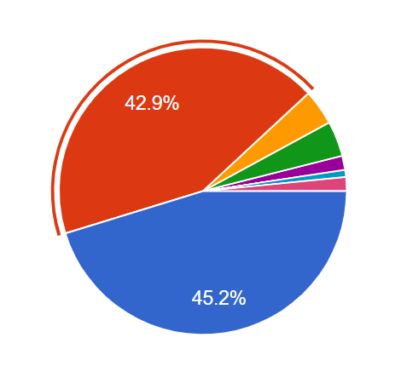
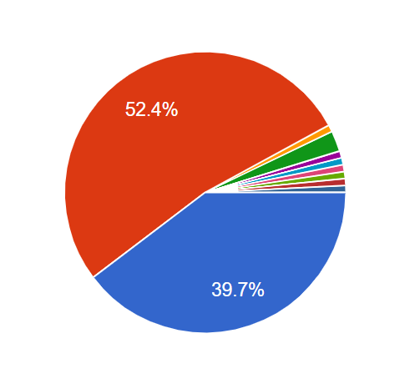
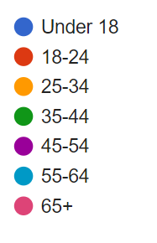
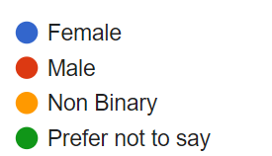
Age Group
Gender

Slide 11
Gender+Age demographic
Overview
Password Specific
MythBusters: Password Edition
Miscellaneous and Conclusion

Slide 12
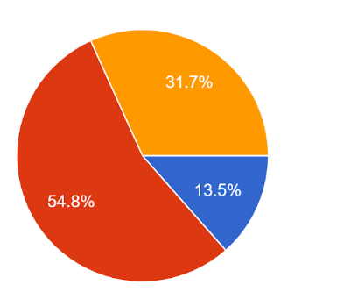
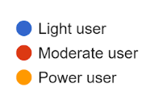
What kind of user do you consider yourself to be?
Analysis
It is quite obvious in the modern age that people around us have started to spend more time on electronic devices, and more than ever now with the onset of the pandemic.

Slide 13
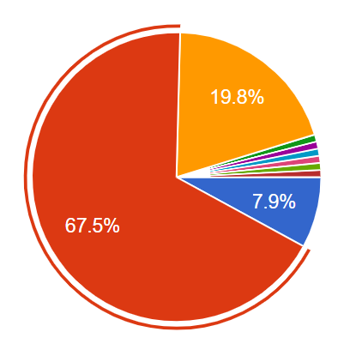
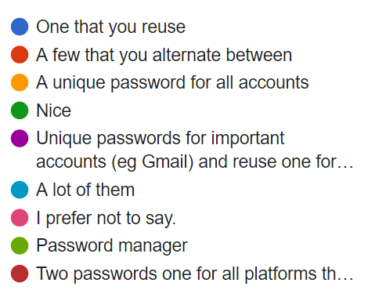
How many different passwords do you have?

Slide 14
Analysis
A bit above 2/3rds of the user pool alternate between a few passwords they use on a daily basis, usually ones which are easy to remember and are convenient. In some cases, the passwords may have been well crafted.
Almost one-fifth of the users actually use different passwords for different accounts and platforms, which while providing the best security also becomes slightly tedious to manage.
The third most significant data visible is the minute chunk of users that keep reusing a single password and as such face maximum security risks.

Slide 15
Issues
Password managers have once again proved to be highly underrated and underused, sometimes contributed to by the complexity it poses or the general laziness of the user.
The users that keep reusing the same password everywhere or alternate between a few are on the frontlines of the risk factor, as their security can be easily compromised in comparison to users who use a more diverse palette of passwords/ keep a unique one for each account they make.

Slide 16
Solutions
As mentioned, password managers play a great role in helping users set up a large number of highly secure passwords that are convenient and easy to manage. Providing users with simple-to-use and cheap managers is the ideal solution to tackle this issue.
Also, more alternatives such as keeping personal managers for different passwords is also beneficial, alongside using easy tricks to diversify and bolster your password structure.
If users choose to continue with the same password on various platforms, they could easily incorporate the initials or a portion of the platform’s name into the password itself.

Slide 17
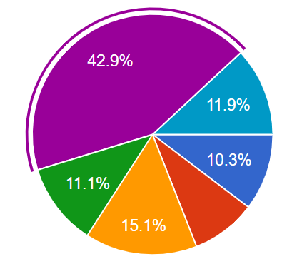
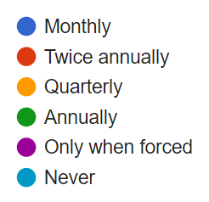
How often do you change your passwords?
Analysis
As expected, most of the users only change passwords when forced to by the platform hosting their accounts, usually in the aftermath of data breaches or as regular precautionary checks. This is followed up by a significant number of users who change it quarterly, followed up by minor portions of users in the other time ranges. A surprising number of users also don’t change their passwords at all.

Slide 18
Issue
In some cases, it already gets too late to change the passwords if a data breach has occurred, leading to the compromise of sensitive information. Users who don’t change passwords too frequently, or don’t change them at all, are the most prone.
Solutions
Encouraging users to change passwords on a frequent basis is key. Using methods such as slight alterations to your current password without changing the entire thing has proved to be effective.

Slide 19
Gender+Age demographic
Overview
Password Specific
MythBusters: Password Edition
Miscellaneous and Conclusion

Slide 20
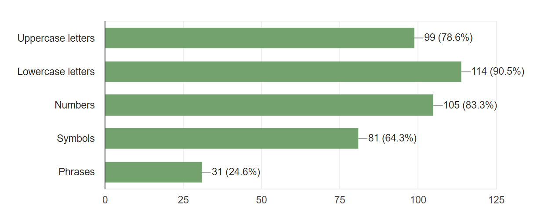
Which of the following do your passwords utilize?

Slide 21
Analysis
While lowercase letters take the obvious lead in the composition of passwords, a satisfactory % of users also utilize a good mixture of numbers and uppercase letters. Symbol usage is something that is highly underrated but provides more scope on the account of password security.
Phrases are highly underused, but prove to be the most effective in terms of taking your password and account to new heights of safety. This leads to the establishment of an inverse relationship between increased security and the actual number of users that put in the efforts to make it happen.

Slide 22
Issues
Accounts with linear passwords containing characters from only 1-2 fields/types carry a high risk of being breached.
The lack of effort that goes into creating passwords or diversifying them is the major attributing factor here, and easier methods need to be devised to encourage and motivate users to explore better password compositions.

Slide 23
Solutions
Platforms now have started to mandate the creation of passwords that are to contain characters from more than one field or type, but this needs to be reinforced everywhere else on a uniform basis.
Also, getting deeper into specifics, the usage of phrases can also be made easy.
Users could take a memorable phase and incorporate the initials of the line within their password. This inadvertently becomes easier for the user to remember, while hackers will find such passwords as incomprehensible gibberish.

Slide 24
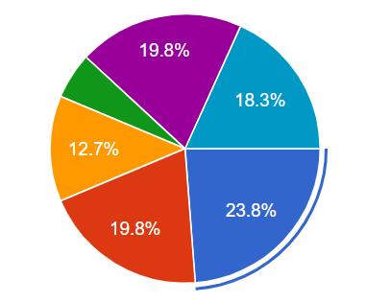
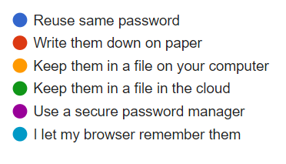
How do you remember your passwords?
Analysis
As noticed from earlier, users prefer reusing the same password over and over again, which becomes more convenient for them to remember.
People also prefer writing down passwords on a piece of paper, which has its own pros and cons.
A large chunk of the users surprisingly use secure password managers, more than keeping files on the desktop or storing them in the cloud.

Slide 25
Issue
The reuse of passwords once again proves to be the major issue, increasing the chances of account breaches.
Organisation and storage of passwords has also proved to be a hefty task for many involved, as they scourge around for easier methods which can potentially get their accounts compromised.
Solutions
Introduction of user-friendly password managers, motivating users to alter their passwords with minor modifications with respect to the platform being used, and keeping backups of the passwords in the case that the user has forgotten them are some easy solutions to tackle this.

Slide 26
Gender+Age demographic
Overview
Password Specific
MythBusters: Password Edition
Miscellaneous and Conclusion

Slide 27
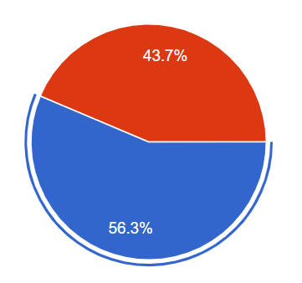

When choosing a password, do you favour security or convenience more?

Slide 28
Issues
The personal interpretation of security is what comes into play here. Users often misunderstand the true meaning of security, with the common parameters that they have set for themselves lag behind the actually recommended parameters, attributed to the lack of awareness pertaining to these issues.
Analysis
The user pool is almost neck-to-neck, with users surprisingly favouring security over convenience, albeit not with a really substantial difference between the two.

Slide 29
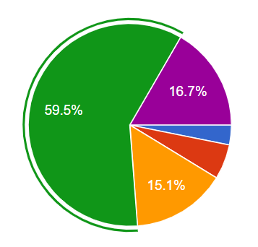
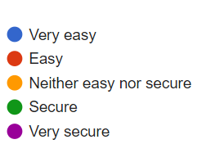
A secure password should be over 8 characters, utilize upper and lower case letters, numbers, and symbols. Are your passwords easy or secure?

Slide 30
Analysis
A stupendous 60% of the user pool has already fallen for the misconception. Calling the password which has been based on the given condition ‘safe’, has exposed the common belief that such passwords reach satisfactory safety levels when in reality they actually don’t.
Issues
The casual attitude of netizens over the internet and the minute prevalence of laziness attributes to the fact that they have chosen to craft passwords that meet sub-standard levels instead of opting for more secure ones.

Slide 31
Solution
Once again, such issues and beliefs can only be tackled by spreading awareness on a widespread basis among different age-groups of internet users is key to tackling this issue, and busting such ever-growing myths and misconceptions once and for all.

Slide 32
Gender+Age demographic
Overview
Password Specific
MythBusters: Password Edition
Miscellaneous and Conclusion

Slide 33
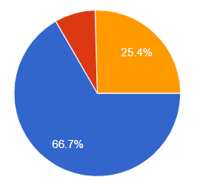

Do you use 2FA (Two-factor Authentication) on your accounts when available?
Analysis
A bit over 2/3rds of the user pool choose to opt for 2FA services, while about 1/4th use them irregularly in some form or the other. Surprisingly, only about 1/10th choose not to opt for 2FA, in stark contrast to the ones who do.

Slide 34
Solutions
2FA services need to be made more flexible and accessible in order to encourage all users to opt for this. It is an excellent, fool-proof method and carries a lot of potential
Issue
The complexity of the authentication system can pose issues.

Slide 35
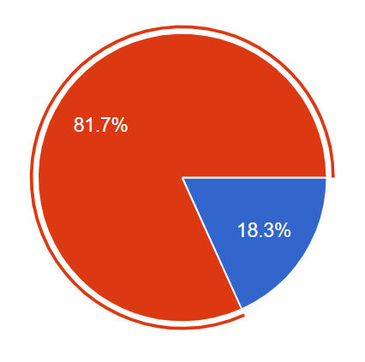
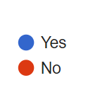
Have any of your accounts been breached in the last 3 years?
Analysis
4:1. The ratio between people who haven’t experienced an account breach in the past 3 years, to the people who have. The numbers look positive, but methods need to be devised to increase the overall security and negate the threats of breaches.

Slide 36
Solutions
Netizens need to act smart, follow protocols and rules they think are best for them and their account safety - by fortifying passwords, managing them efficiently, keeping a good safe conduct online and on reporting any bugs or threats that could potentially compromise their safety.
Issue
The accumulated misconceptions and errors we have covered so far play major roles in decreased security of accounts and lead to the creation of susceptible and weak passwords.

Slide 37
Tool Demonstration

Slide 38

SNOWFLAKE

Slide 39
What is Snowflake?
Snowflake is an innovative and organized password generator/manager multi-browser extension that enables users to maintain their passwords, find out descriptive details and statistics going into the password, as well as provide state of the art encrypted suggestions.
How has it been made?
JavaScript has been primarily used for building the web application, and for other backend processes.
We have also used HTML5 + CSS3 as the formatting language, for interaction designs and the manager layouts and interfaces.

Slide 40
Features
The PassStat Model
The manager comes with a descriptive, interactive floating overlay that provides critical statistics and information relevant to the passwords, such as the time it’ll take for it to get cracked, along with the commonness of the password.
Flakerator 1.0
The sophisticated, state of the art password generator provides users with encrypted and random suggested passwords that greatly enhance their security.

Slide 41
The inspiration.
The need for an easy-to-use, interactive and lightweight model that manages passwords of netizens hailing from different backgrounds coupled with the level of experience they possess on the account of internet usage was the main source of our inspiration.
A minimalistic, modernistic take on the overall layout of the manager inspired by current UI/UX trends also helps us to identify the interfaces users prefer to work with, usually, the ones that look the most appealing and are comfortable in its general nature.
Hence combining both reliable sophisticated programming along with a multitudinous understandable design layout, we aim to provide users with the best password security and management services out there, to make the internet a safer and more enjoyable platform.

Slide 42
A mini demonstration of the tool + our website.
https://snowflake-project.github.io/

Slide 43
Thank you.
a research+survey+tool based project
Shubhro Gupta | Indrajith Gopinathan | Aniket Mathur

