Slide 1

[at]-internal Training
16.08.2023 | Dr. Jahed Naghipoor, Nicholas Kappel, Sebastian Blum

Slide 2

Agenda
Introduction Round
Mlflow Overview
Mlflow Tracking
Mlflow Models & Model Registry
Lunch Break
Mlflow Projects
Final project / exercise

Slide 3
Introduction round
Who are you?
What is your background? Engineer or Scientist?
Why Mlflow and what do you know about it?
What do you expect from the training?

Slide 4
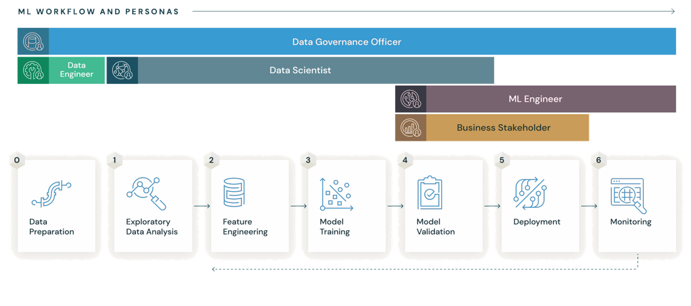
What is Mlflow and why do we need it?
...versatile, expandable, open-source platform for managing workflows and artifacts across the machine learning lifecycle.
https://mlflow.org/docs/latest/what-is-mlflow.html
Notes:
Machine learning requires experimenting with a wide range of datasets, data preparation steps, and algorithms to build a model that maximizes some target metric. Once you have built a model, you also need to deploy it to a production system, monitor its performance, and continuously retrain it on new data and compare with alternative models.
Being productive with machine learning can therefore be challenging for several reasons:
It’s difficult to keep track of experiments. When you are just working with files on your laptop, or with an interactive notebook, how do you tell which data, code and parameters went into getting a particular result?
It’s difficult to reproduce code. Even if you have meticulously tracked the code versions and parameters, you need to capture the whole environment (for example, library dependencies) to get the same result again. This is especially challenging if you want another data scientist to use your code, or if you want to run the same code at scale on another platform (for example, in the cloud).
There’s no standard way to package and deploy models. Every data science team comes up with its own approach for each ML library that it uses, and the link between a model and the code and parameters that produced it is often lost.
There’s no central store to manage models (their versions and stage transitions). A data science team creates many models. In absence of a central place to collaborate and manage model lifecycle, data science teams face challenges in how they manage models stages: from development to staging, and finally, to archiving or production, with respective versions, annotations, and history.

Slide 5
What is Mlflow and why do we need it?
Is it awesome or is it awesome?
Allows reproducibility in experimentation and deployment
Introduces a standardized and streamlined process which can be applied to already existing models
Keep track of your ML training and already existing models collaboratively
Comes with a Python, R, Java API already integrated
Exhibits a web user interface to conveniently compare models and metrics

Slide 6
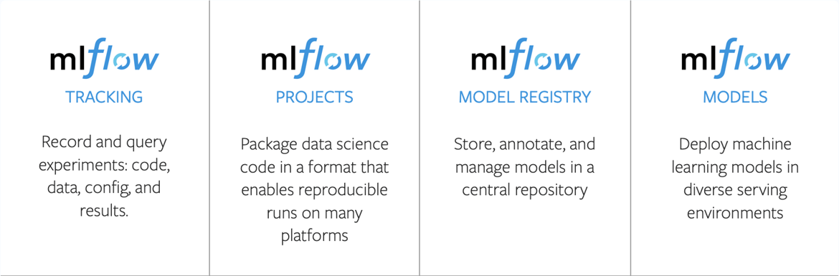
What does Mlflow do and what are its components?
Source: https://medium.com/pytorch
Notes:
Tracking: used to log and compare model parameters, code versions, metrics, and artifacts of an ML code. This can be easily done by minimal changes to your code using the MLflow Tracking API. MLflow Tracking provides a centralized place to log and organize machine learning experiments, which makes it easier to compare and reproduce results. Collaboration
Projects: packages data science code in a standard format for a reusable, and reproducible form to share your code with other data scientists or transfer it to production. Reproducibility
Model Registry: provides a central model store to collaboratively manage the full lifecycle of a MLflow Model, including model versioning, stage transitions, and annotations.
Models: enables to manage and deploy machine learning models from multiple libraries. It allows to package your own ML model for later use in downstream tasks, e.g. real-time serving through a REST API. Deployment: MLflow Models provide a standardized format for packaging and deploying machine learning models to different environments.

Slide 7
What are we going to learn?
How to log model parameters and metrics in a distributable way
How to save and load models so they are reproducible
Run machine learning code within a reusable standard format
Extend our already existing model code with all of that
Notes:
Tracking: used to log and compare model parameters, code versions, metrics, and artifacts of an ML code. This can be easily done by minimal changes to your code using the MLflow Tracking API. MLflow Tracking provides a centralized place to log and organize machine learning experiments, which makes it easier to compare and reproduce results. Collaboration
Projects: packages data science code in a standard format for a reusable, and reproducible form to share your code with other data scientists or transfer it to production. Reproducibility
Model Registry: provides a central model store to collaboratively manage the full lifecycle of a MLflow Model, including model versioning, stage transitions, and annotations.
Models: enables to manage and deploy machine learning models from multiple libraries. It allows to package your own ML model for later use in downstream tasks, e.g. real-time serving through a REST API. Deployment: MLflow Models provide a standardized format for packaging and deploying machine learning models to different environments.

Slide 8
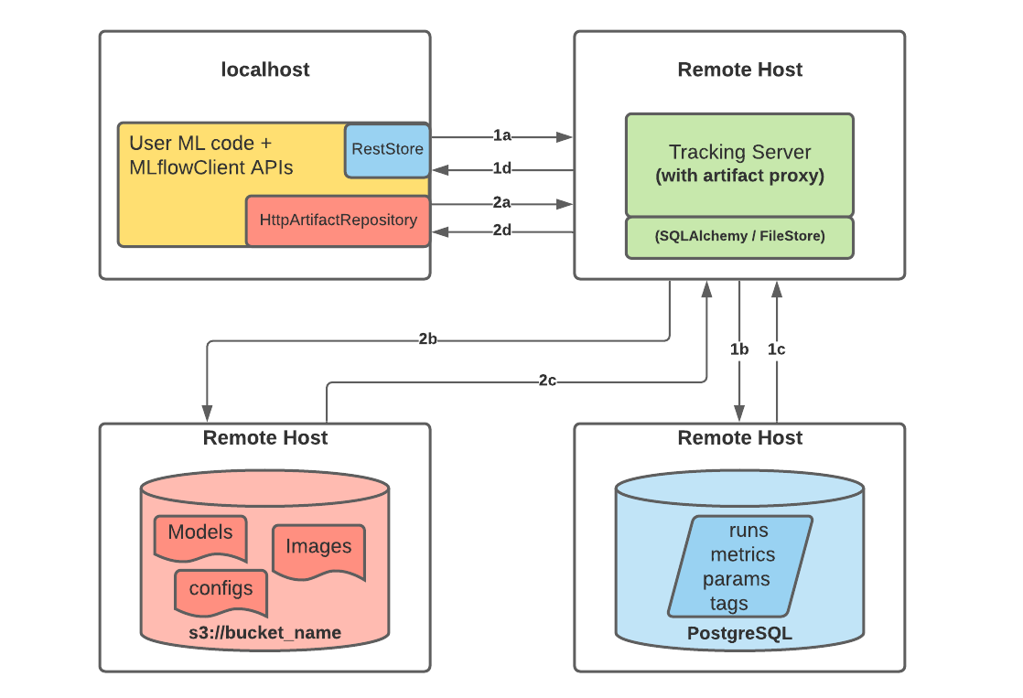
...and what about the Engineers?
The MLflow architecture consists of three main components
Webserver: handles communication between the REST API to log parameter, models, etc.. The server uses the both, backend and artifact store to read and write data.
Artifact Store: location to store large data, like artifacts, images, or data outputs,
that are not suitable for a relational database
Backend Store: stores experiments and run metadata in a relational database, and thus no large data files.
Source: https://mlflow.org/docs/latest/tracking.html
Notes:
main component that handles the communication between the REST API to log parameters, metrics, experiments and metadata to a storage solution. The server uses both, the backend store and the artifact store to store and read data from.
location to store large data of an ML run that are not suitable for the Backend Store or a relational database respectively. This is where MLflow users log their artifact outputs, or data and image files to.
stores experiment and run data like parameters, and metrics. It is usually a relational database which means that all metadata will be stored, but no large data files.

