Slide 1

ORGAN DONATION MANAGEMENT SYSTEM
Submitted by:
Ananya Prakash (RA1611003030147)
Aman Agarwal (RA1611003030160)
Aditya Tiwari (RA1611003030164)

Slide 2

Abstract
Organ donation is an ultimate humanitarian act of charity
Aim of project – simplifies maintenance and access of database of organs at different banks

Slide 3
Introduction
This is a management system used to simplify and automate the process of searching the donor organs in case of emergency
It maintains the records of organ stocks in the bank across all the branches
The purpose of this system:
Simple UI
Less paperwork
Easy maintenance of data
Faster operation
Requirements – Java, MySQL

Slide 4
Use Case Diagram
It is a set of use cases, actors, and their relationships
It models the functionality of a system using actors and use cases

Slide 5
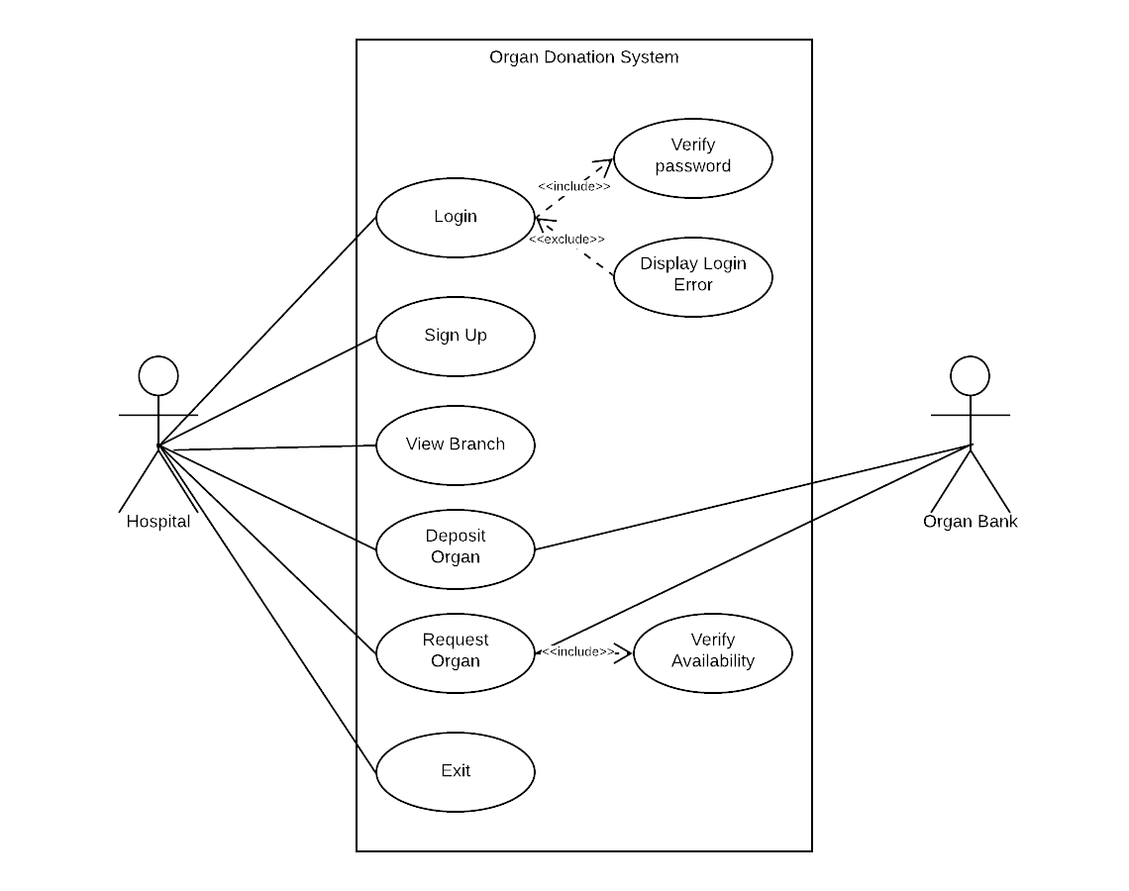

Slide 6
Class Diagram
It consists of classes, interfaces, associations, and collaboration
It is the backbone of almost every object-oriented program
It describes the static structure of the system

Slide 7
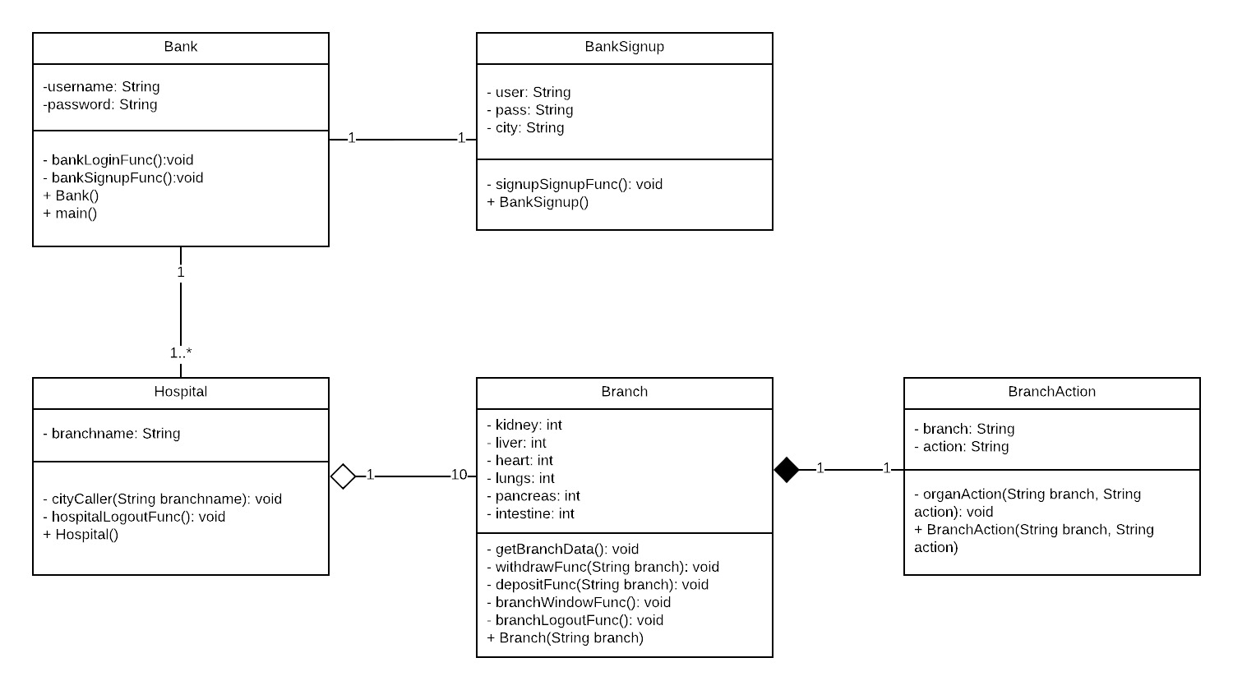

Slide 8
Sequence Diagram
It is an interaction diagram
It describes communication among classes in terms of exchange of messages over time
The communication is completed with the help of sequence of messages flowing from one object to another

Slide 9
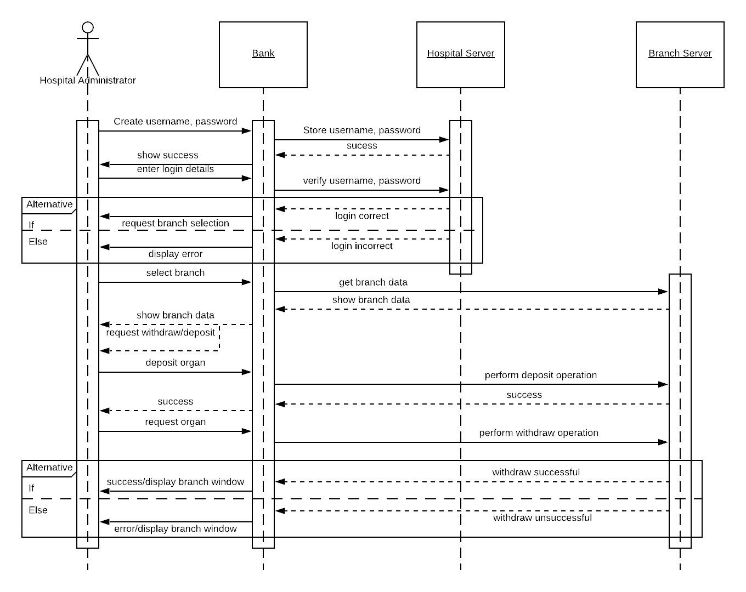

Slide 10
Collaboration Diagram
It represents the structural organization of a system and the messages sent/received.
Its purpose is to visualize the organization of objects and their interaction.

Slide 11
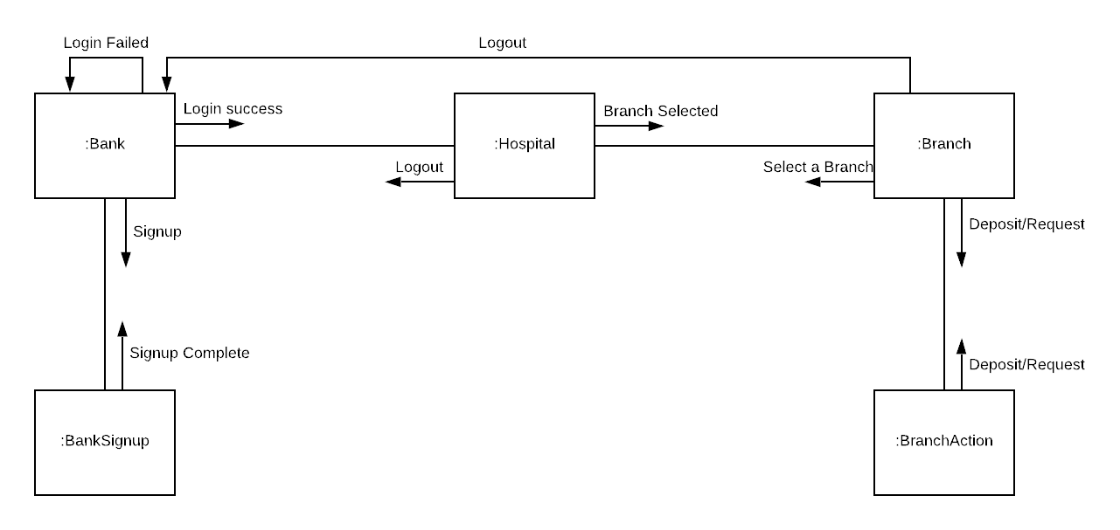

Slide 12
State Machine Diagram
Any real-time system is expected to be reacted by some kind of internal/external events. These events are responsible for state change of the system
State Machine diagram is used to represent the event driven state change of a system. It basically describes the state change of a class, interface, etc.
It diagram is used to visualize the reaction of a system by internal/external factors.

Slide 13
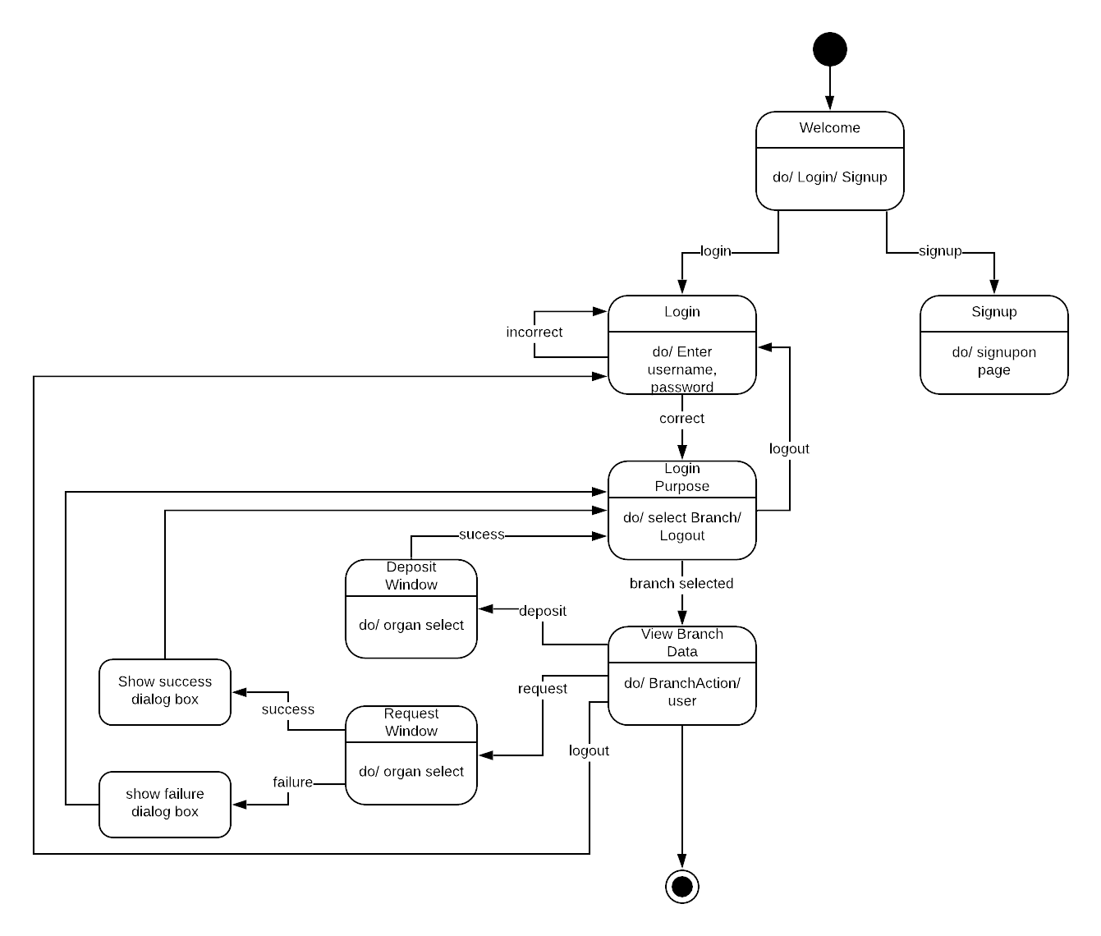

Slide 14
Activity Diagram
It describes the flow of control in a system.
It consists of activities and links. The flow can be sequential, concurrent, or branched.
It illustrates the dynamic nature of a system

Slide 15
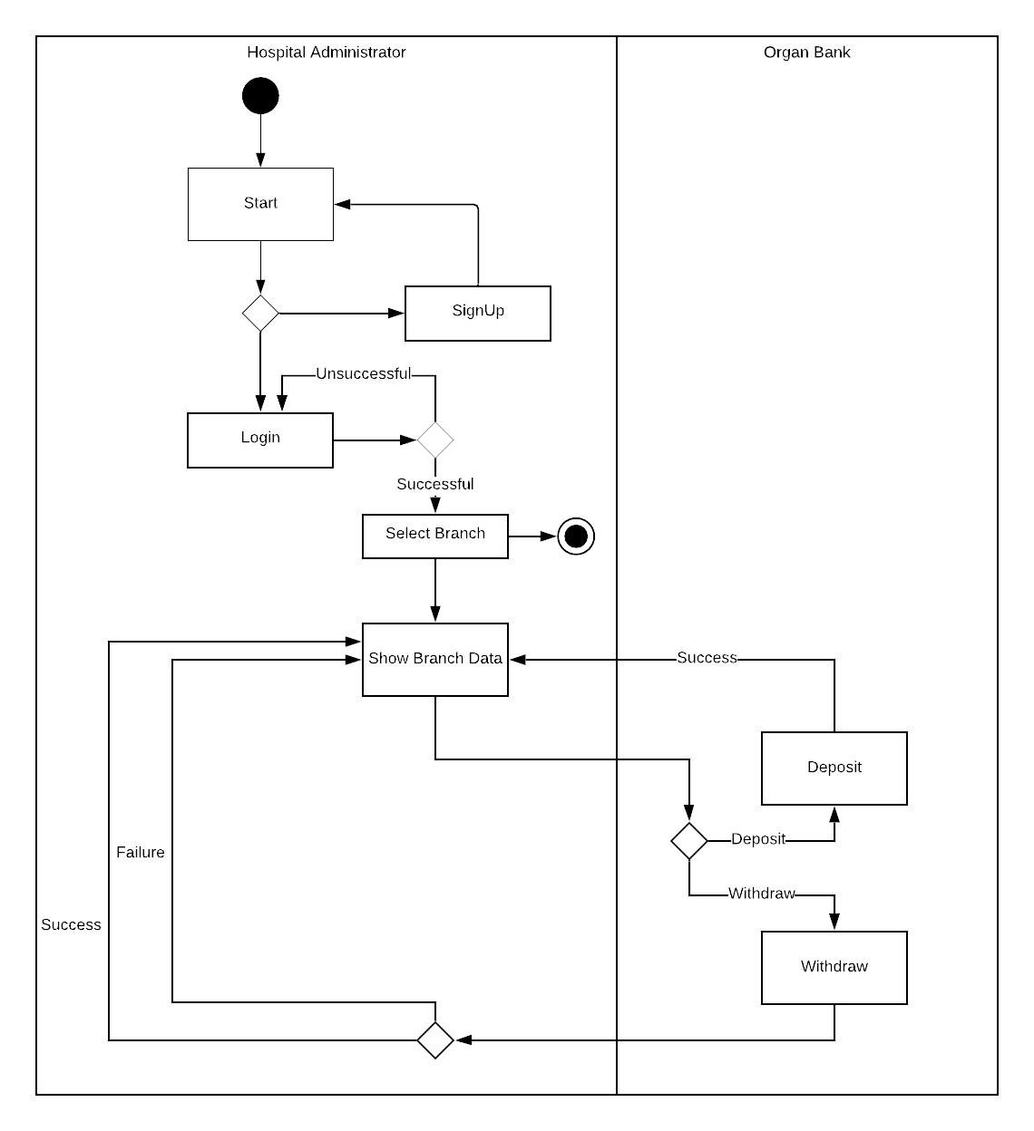

Slide 16
Component Diagram
It describes the organization of physical software components, including source code, run-time (binary) code, and executables.

Slide 17
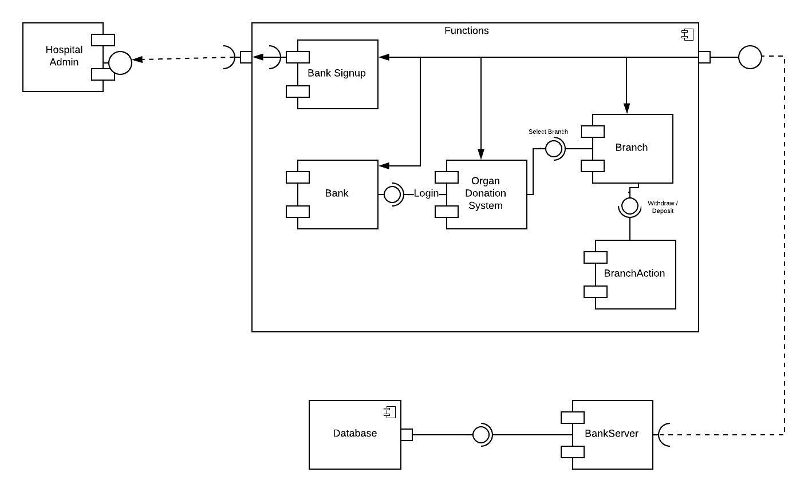

Slide 18
Deployment Diagram
Deployment diagrams are a set of nodes and their relationships. These nodes are physical entities where the components are deployed.
Deployment diagrams are used for visualizing the deployment view of a system. This is generally used by the deployment team.

Slide 19
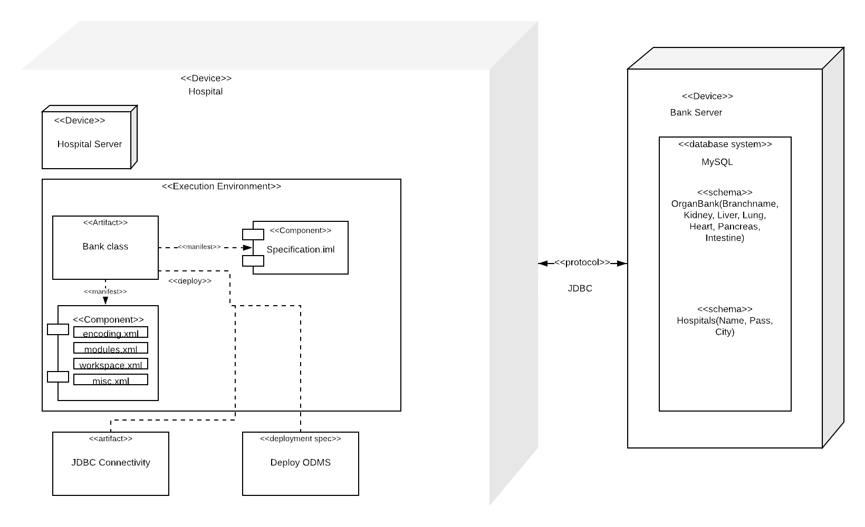

Slide 20
Skeleton Code for Class Diagram
class Bank
{
private String username;
private String password;
private void bankLoginFunc(){}
private void bankSignupFunc(){}
Bank(){}
public static void main(){}
}

Slide 21
class Hospital
{
private String branchname;
private void cityCaller(String branchname){}
Hospital(){}
}
class BranchAction
{
private String branch;
private String action;
private void organAction(String branch, String action){}
BranchAction(String branch, String action){}
}

Slide 22
class Branch
{
private int kidney;
private int liver;
private int heart;
private int lungs;
private int pancreas;
private int intestine;
private void getBranchData(){}
private void withdrawFunc(String branch){}
private void depositFunc(String branch){}
private void branchWindowFunc(){}
private void branchLogoutFunc(){}
Branch(String branch){}
}

Slide 23
class BankSignup
{
private String user;
private String pass;
private String city;
private void signupSignupFunc(){}
BankSignup(){}
}

Slide 24
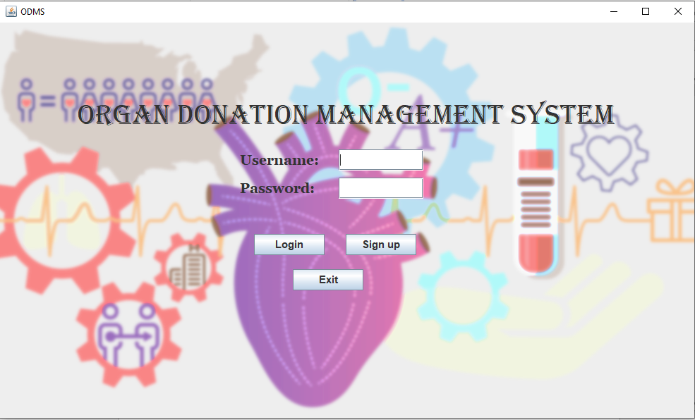
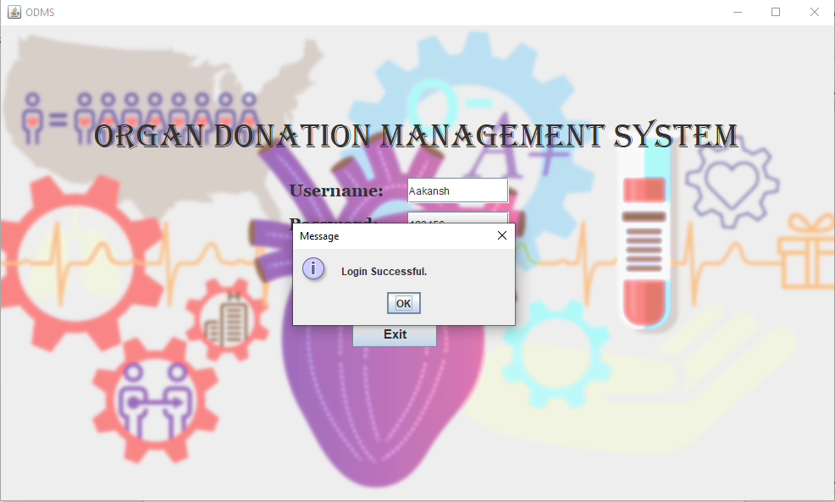
Snapshots
Login Page
Login successful

Slide 25
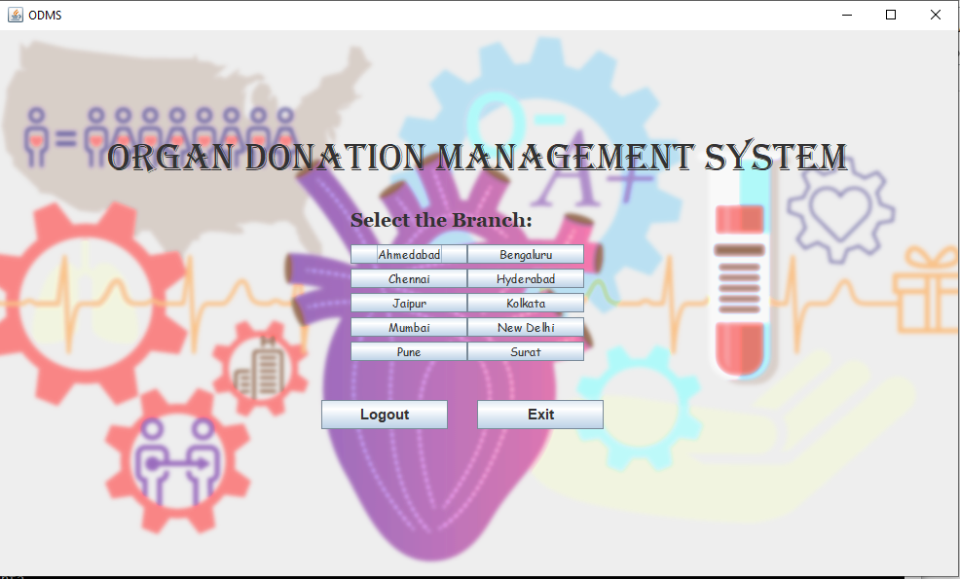
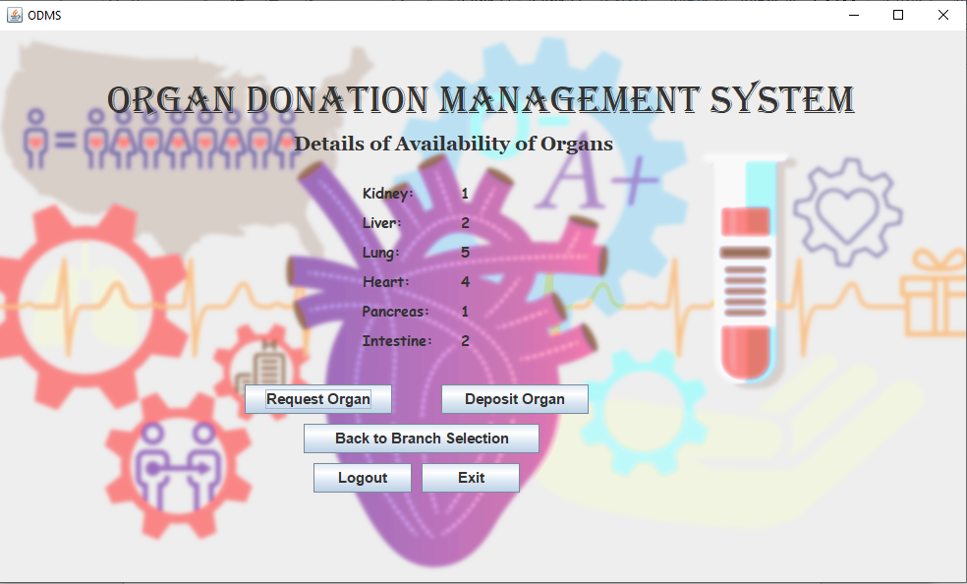
Branch Selection
Choose operation

Slide 26
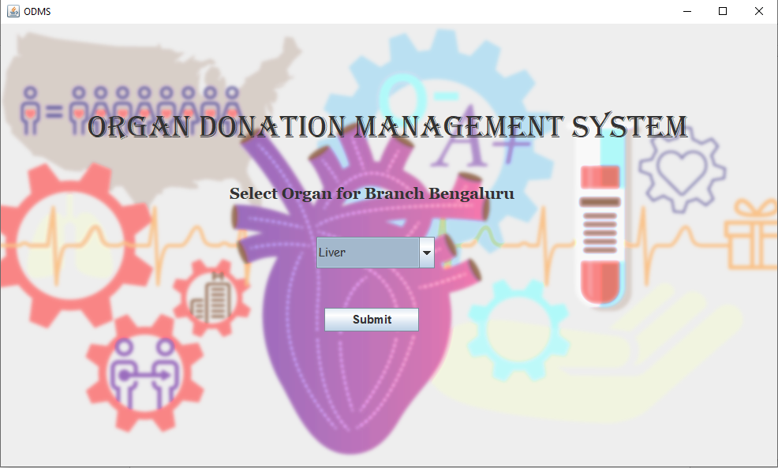
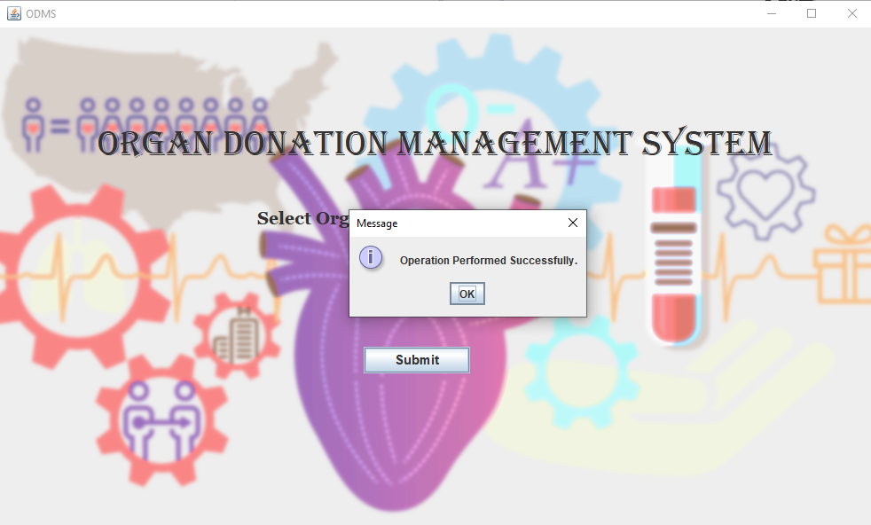
Select Organ
Operation successful

Slide 27
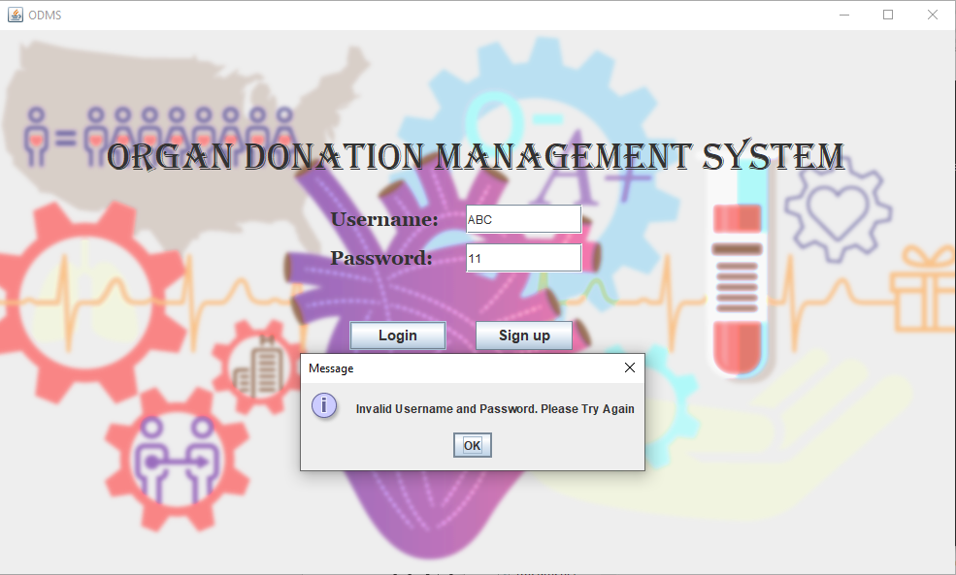
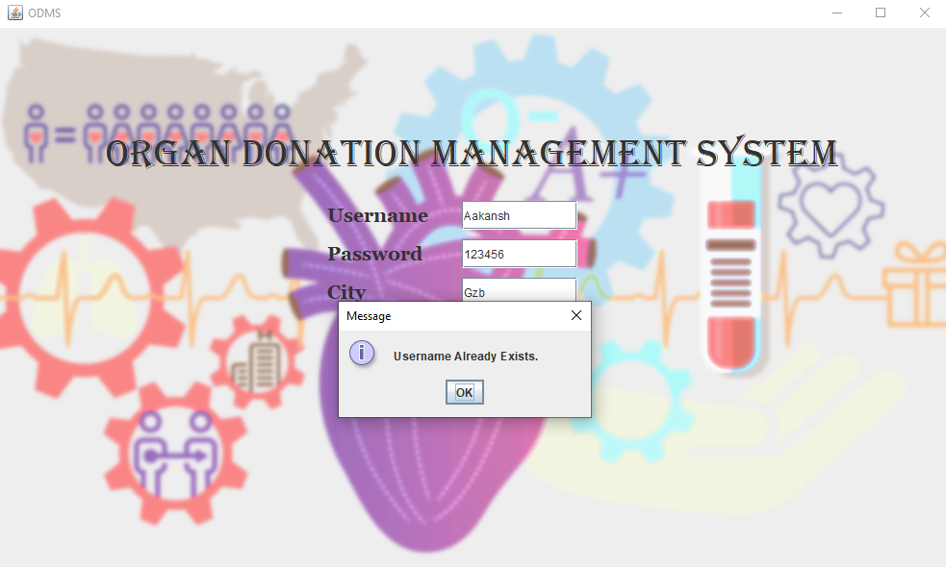
Test Cases
Invalid username/password
Username already exists

Slide 28
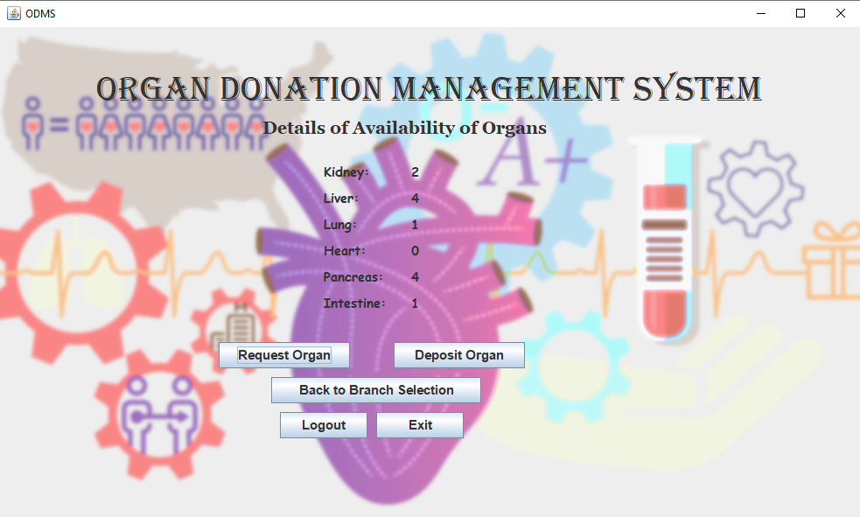
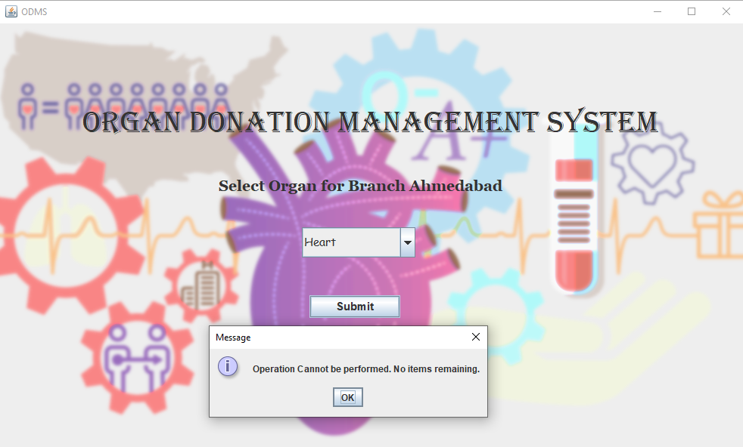
Organ Not Available
Operation cannot be performed

Slide 29
Conclusion
Organ Donation Management System provides the user with a simple and convenient way to access different organ banks to request or deposit organs. This is extremely helpful in case of emergency.
The details can be accessed quickly and efficiently. Thus, it ensures speed of operation.
This system makes it easier to maintain records and reduces paperwork.
Only the authorized users can access the system. This ensures the safety of data.

Slide 30
References
Grady Booch, Object-Oriented Analysis and Design with Applications, 3rd ed. Pearson Publication.
UML Diagram [online]. Available from: https://www.smartdraw.com/uml-diagram/
Lucidchart, UML Use Case Diagram Tutorial [Video], Available from: https://www.youtube.com/watch?v=zid-MVo7M-E&list=PLUoebdZqEHTxNC7hWPPwLsBmWI0KEhZOd&index=2
Lucidchart, UML Class Diagram Tutorial [Video], Available from: https://www.youtube.com/watch?v=UI6lqHOVHic&list=PLUoebdZqEHTxNC7hWPPwLsBmWI0KEhZOd&index=1
Lucidchart, How to Make a UML Sequence Diagram [Video], Available from: https://www.youtube.com/watch?v=pCK6prSq8aw&list=PLUoebdZqEHTxNC7hWPPwLsBmWI0KEhZOd&index=3

Slide 31
Thank You.

