Slide 1
Where and How to Increase SAT Participation Rates
By: Ata akca

Slide 2
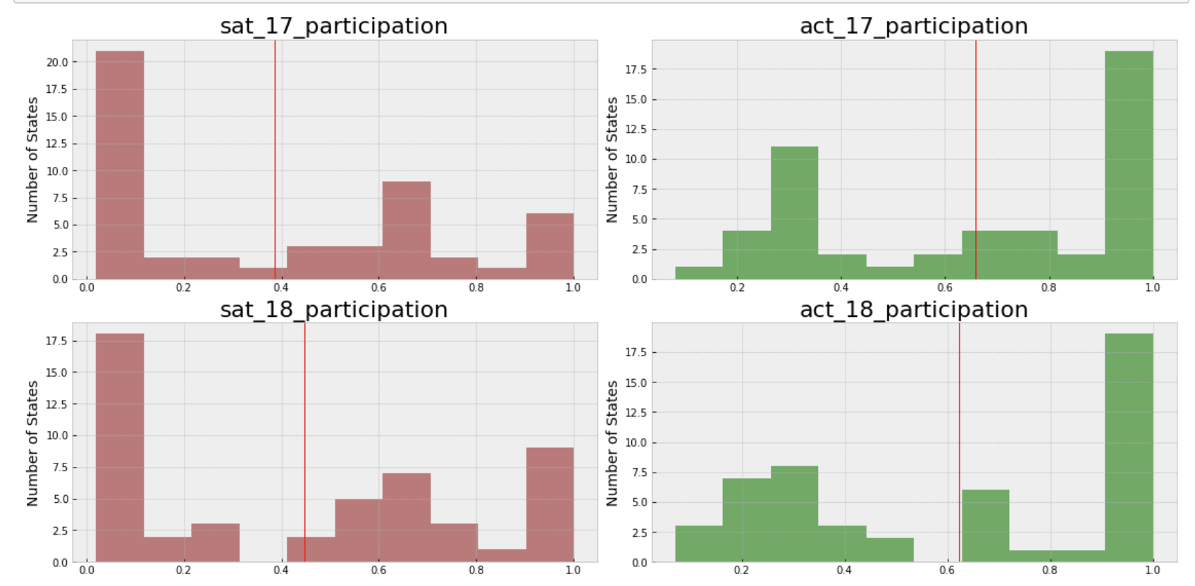
Preliminary Findings
States tend to choose ACT over SAT
SAT participation rate increases
States with lower participation rate (but positive change)

Slide 3
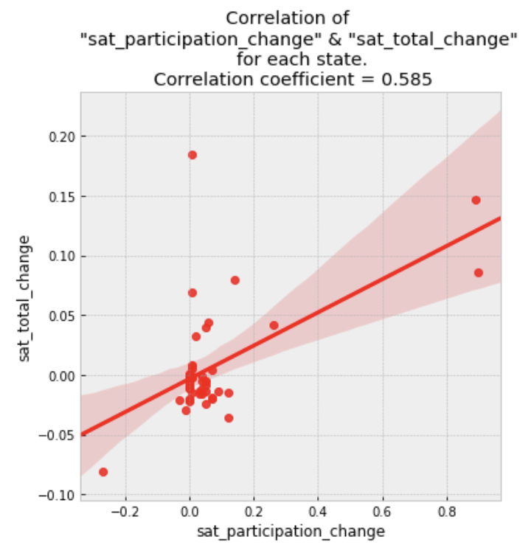
Correlation Analysis
Participation rate change is correlated to total scores changing
Highest Participation Change: Illinois and Colorado
Highest Total Change: Utah, West Virginia, Ohio
Positive change on both parameters

Slide 4
Ohio
Requires studnets to take at least one of 2 exams (funded by the state)
Positive feedback on SAT
High population on eligible students (participation volume)
Successful students

Slide 5
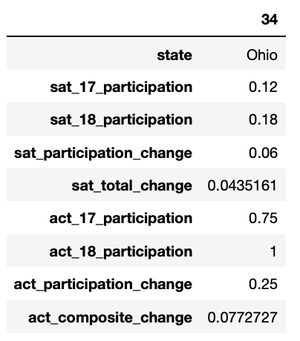
Conclusions and Recommendations
Making Reliable tests
Balanced difficulty
Creating success stories
Increasing # of resources
State-funded tests
Parent influencing

Slide 6
Thank You
References:
https://www.daytondailynews.com/news/too-much-testing-some-schools-angry-with-ohio-act-sat-mandate/5lPdirdJ68IuXs1ez7Mv7L/
https://www.cleveland.com/metro/2017/04/free_sat_or_act_exams_give_all.html
https://www.usatoday.com/story/news/nation/2019/04/23/17-students-ohio-high-school-perfect-act-score/3552583002/
http://education.ohio.gov/Topics/Testing/ACT-SAT-FAQs#FAQ2839
https://reports.collegeboard.org/pdf/2017-ohio-sat-suite-assessments-annual-report.pdf
https://www.wvgazettemail.com/news/education/wv-chooses-sat-as-new-high-school-standardized-test-for/article_b60d2618-4943-56f6-b180-4b4442172ef8.html
https://reports.collegeboard.org/pdf/2017-west-virginia-sat-suite-assessments-annual-report.pdf
https://www.sltrib.com/news/education/2019/09/18/standardized-tests-utah/
https://reports.collegeboard.org/pdf/2017-utah-sat-suite-assessments-annual-report.pdf

