Slide 1
Utilizing Bundle Adjustment technique and assessing its performance
Bundle Adjustment (BA) is almost invariably used as the last step of every feature-based multiple view reconstruction vision algorithm to obtain optimal 3D structure and motion (i.e. camera matrix)parameter estimates. Provided with initial estimates, BA simultaneously refines motion and structure by minimizing the re-projection error between the observed and predicted image points.

Slide 2
Utilizing Bundle Adjustment technique and assessing its performance
In this project I used Bundle Adjustment typical applications and run it over real data and assed its performance in terms of accuracy compared to other ordinary techniques for calibration or 3D reconstruction.
The process has 3 main steps:
1. Extracting the correspondent points between images and constructing the projection point matrices.
2. Calculating a sufficiently precise initial seed for 3D reconstructed points and camera motion.
3. Feeding the initial seed to the Bundle Adjustment (BA) code and get the optimized reconstructed points and camera motions.

Slide 3
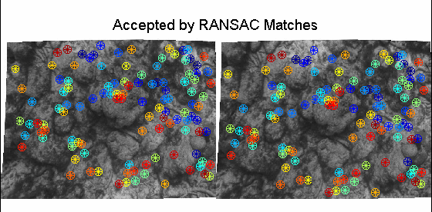
First configuration scene example

Slide 4
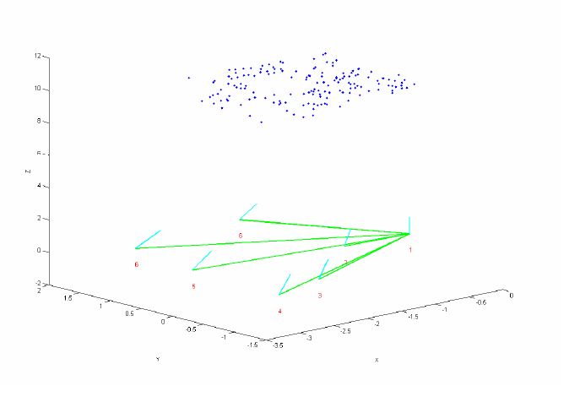
Estimated configuration

Slide 5
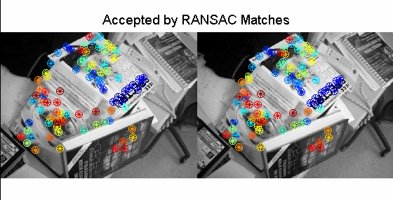
Second configuration scene example

Slide 6
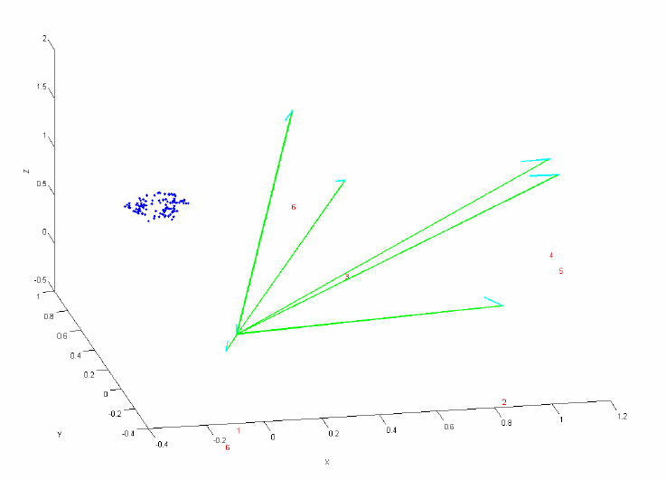
Estimated Configuration

Slide 7
Thank You!!

