Slide 1
Fingerprint Recognition using Mutual Information
Ali Taatian

Slide 2
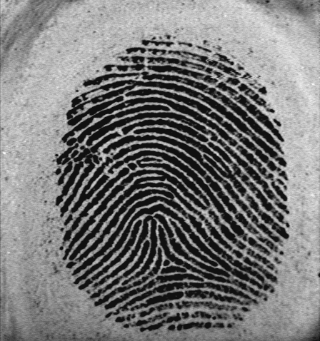
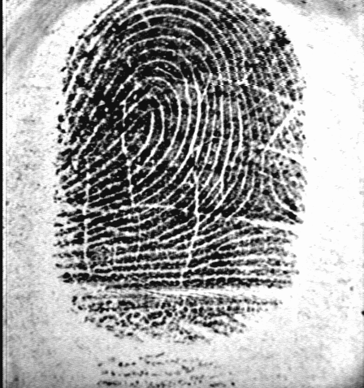
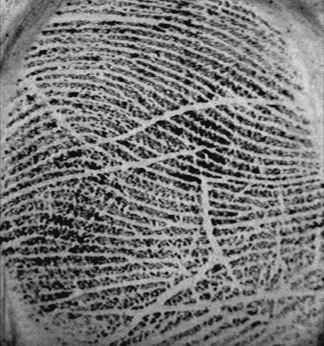

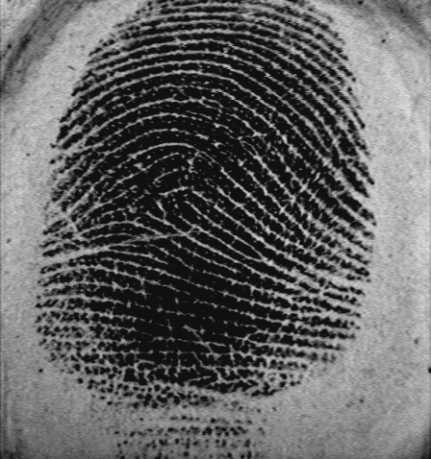
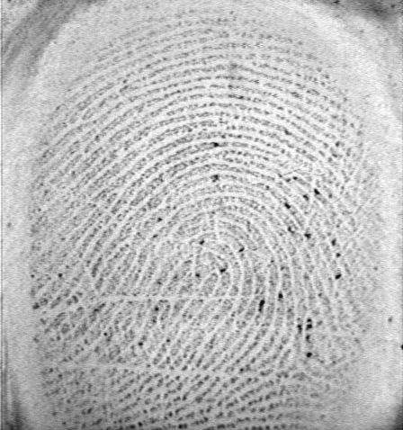
Goal: to find the best match for a template among the others in a database!

Slide 3
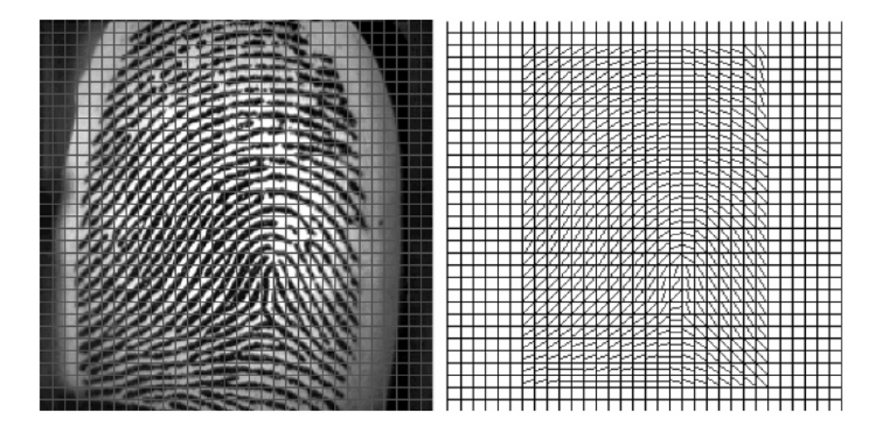
method
Defining and calculating a feature vector for each image:
  Feature vector: Direction Features

Slide 4
Method cont.
For each pair: Comparing the feature vectors of the two ( only in the common region), in terms of NMI
So NMI is the measure of “Similarity”.
Recognition based on the largest “Similarity” value

Slide 5
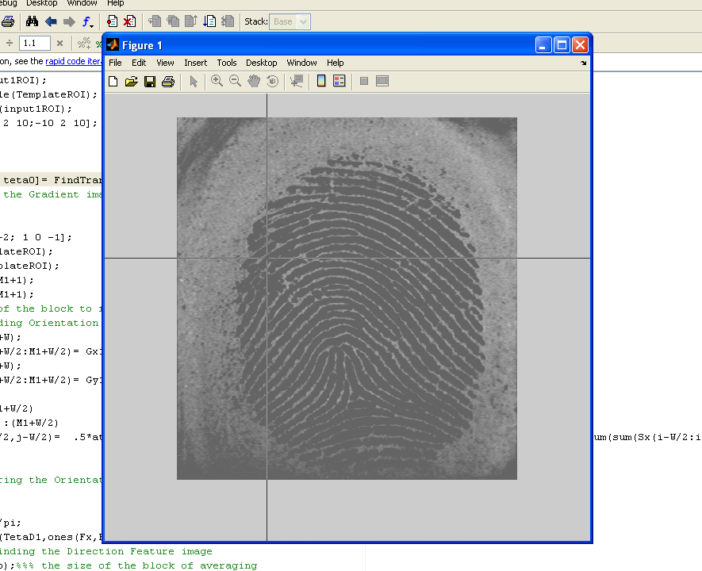
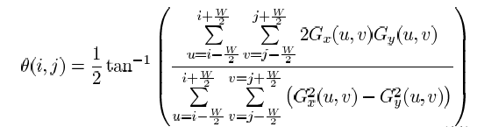
The procedure
Pre-processing
  Normalization (mean and varianc)
  Filtering
  ROI extraction (manually)
Now we have two images: Template, Input
For Template
  Orientation Field Calculation: using the bellow formula

Slide 6
The procedure cont.
Filtering the Orientation Field
Direction Features calculation: averaging the Orientation Field in each block:

Slide 7
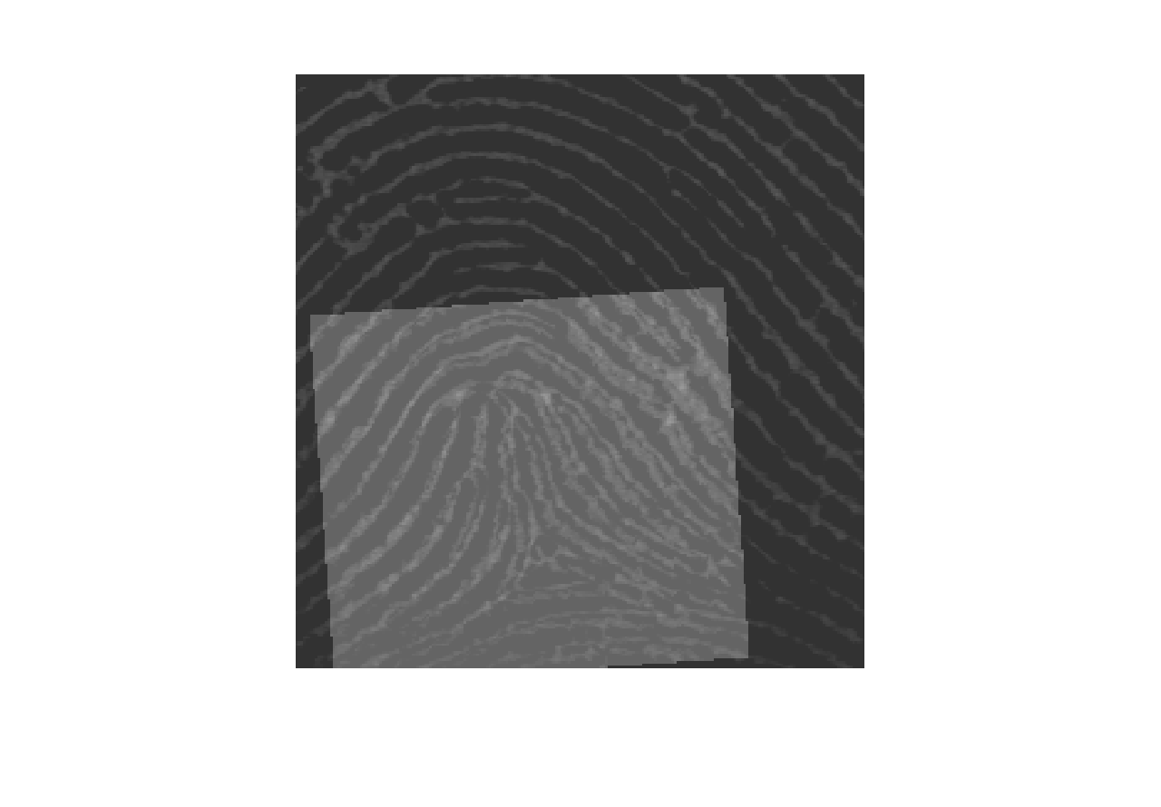
The Procedure cont.
Now searching the Transformation Space
For each transformation:
  Finding the transformed Input image: Inputxyt
  Finding the overlapped area and OverLap matrix
  Repeat the steps done for Template for Inputxyt as well.
  Finding the Direction Features and DirectionMask
    To eliminate the artifacts, it is better to thin the mask a bit, using ‘erosion’

Slide 8

Calculating the NMI over the common region
Normalized Mutual Information:

Slide 9
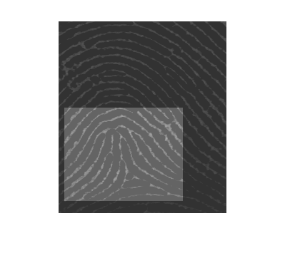
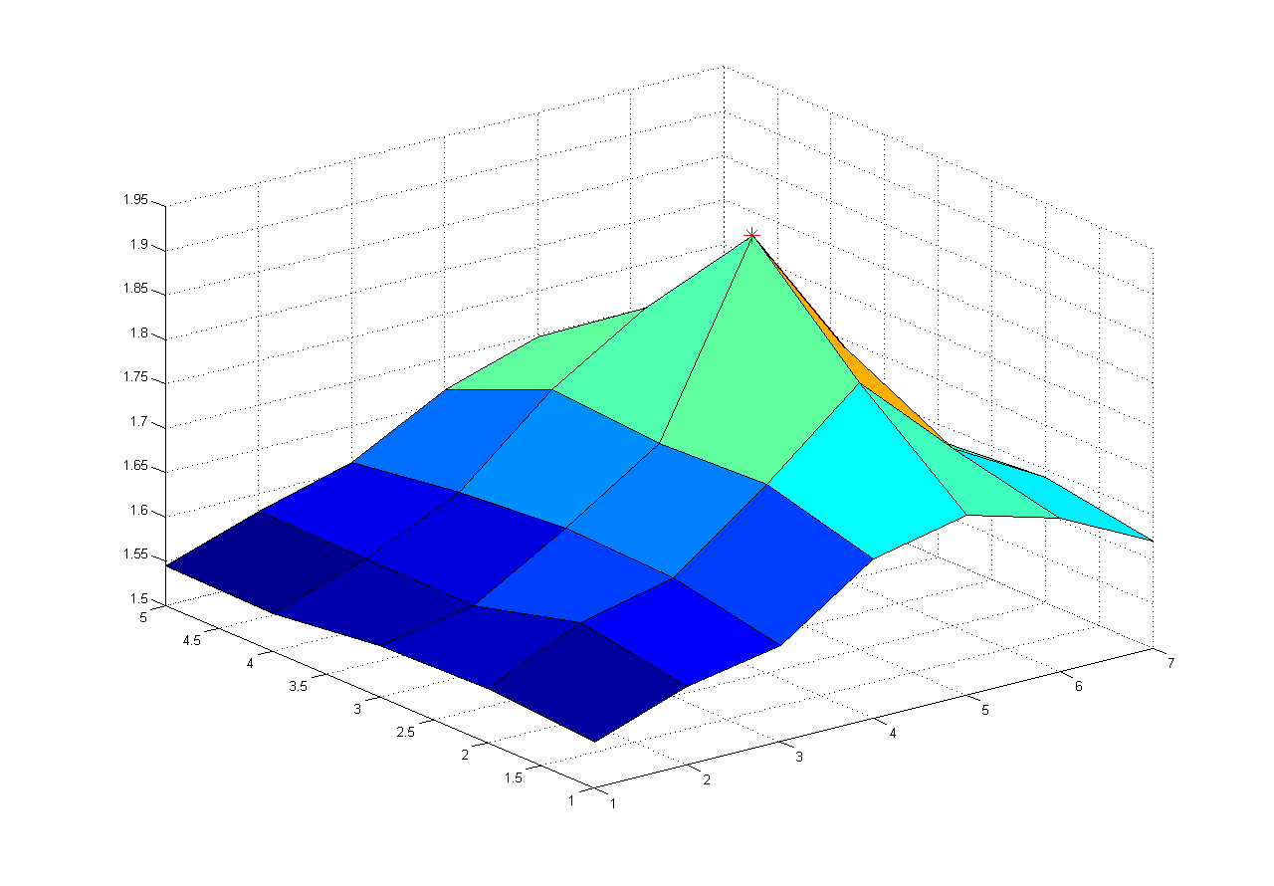
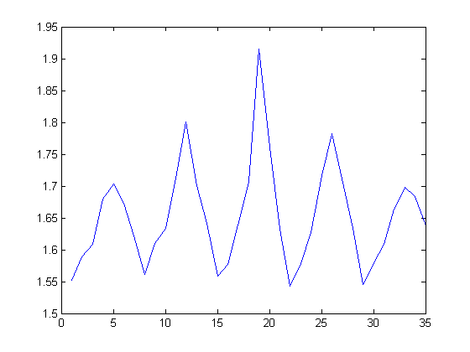
Some results:
Case 1: (only translation)
We have ‘Fine search’
Search space:
  x= 24:28
  y= -50:-56
  The result:
    NMI value:1.9152
    x=26.0000
    y=-52.0000

Slide 10

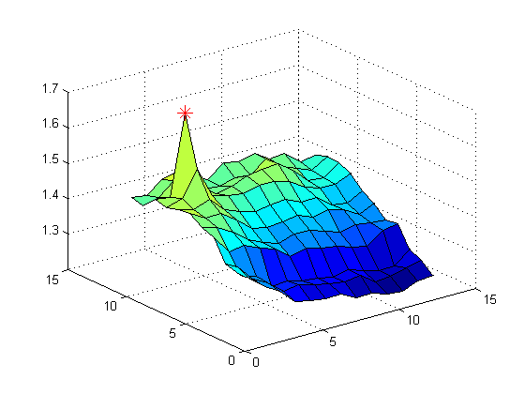
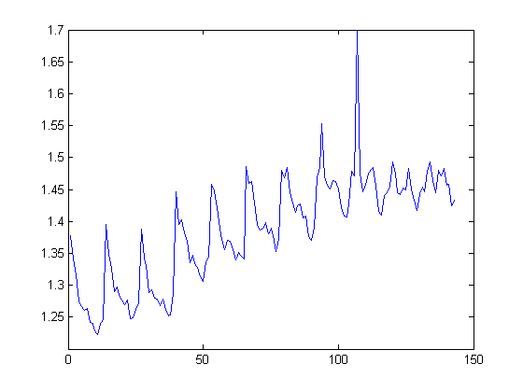
Case 1: (only translation)
Coarse search:
x= -52:10:50
y= -72:10:50
The results:
The NMI: 1.6975
x= 28.0000
y= -52.0000

Slide 11
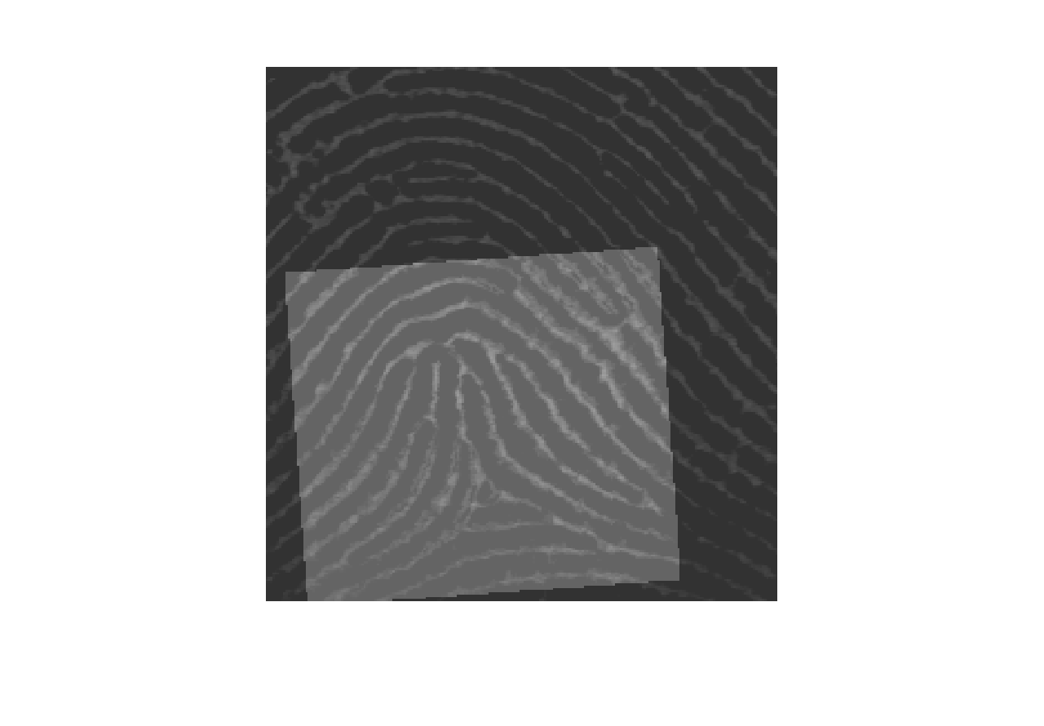
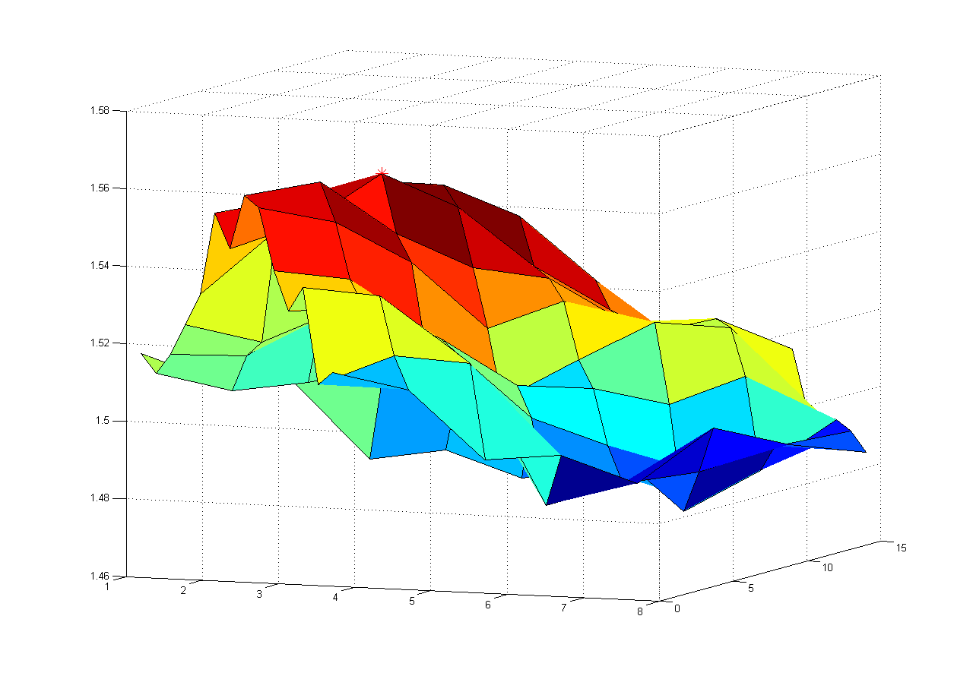
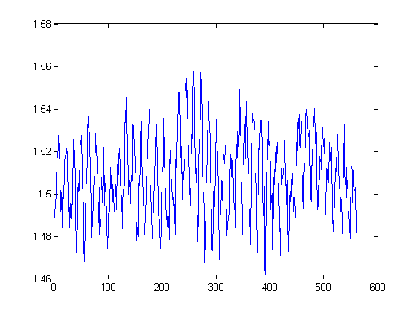
Case 2: complete transformation
I know the teta is 4 but I have no idea about x and y!
Fine search!
The search space:
  teta= 2:6
  x= 15:22
  y= -48:-35
The results
  the NMI:1.5586
  teta=4.0000
  x=17.0000
  y=-42.0000

Slide 12
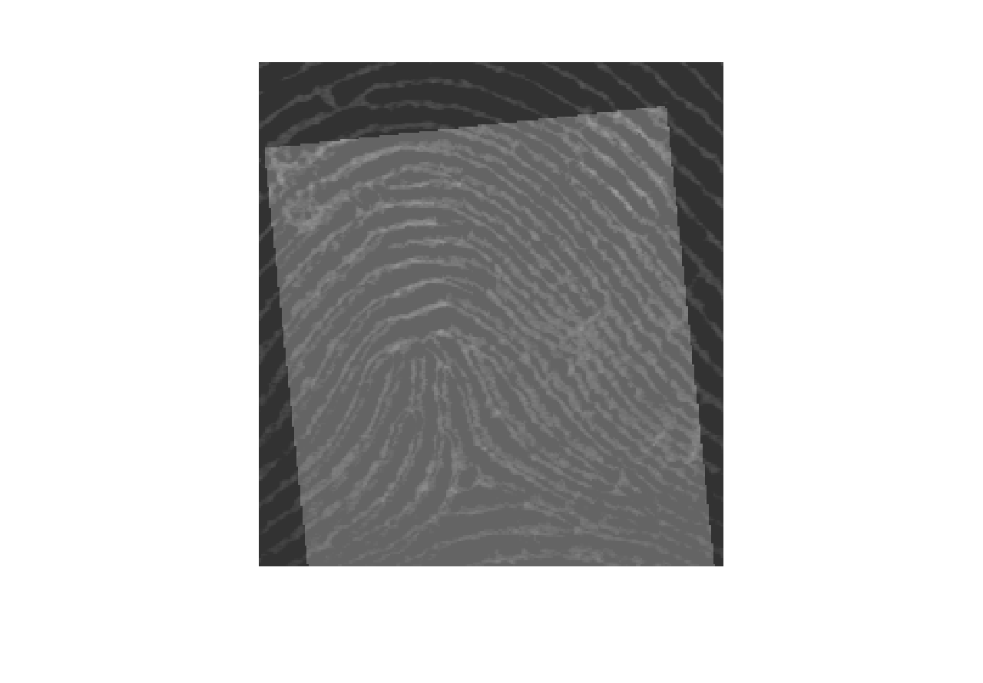
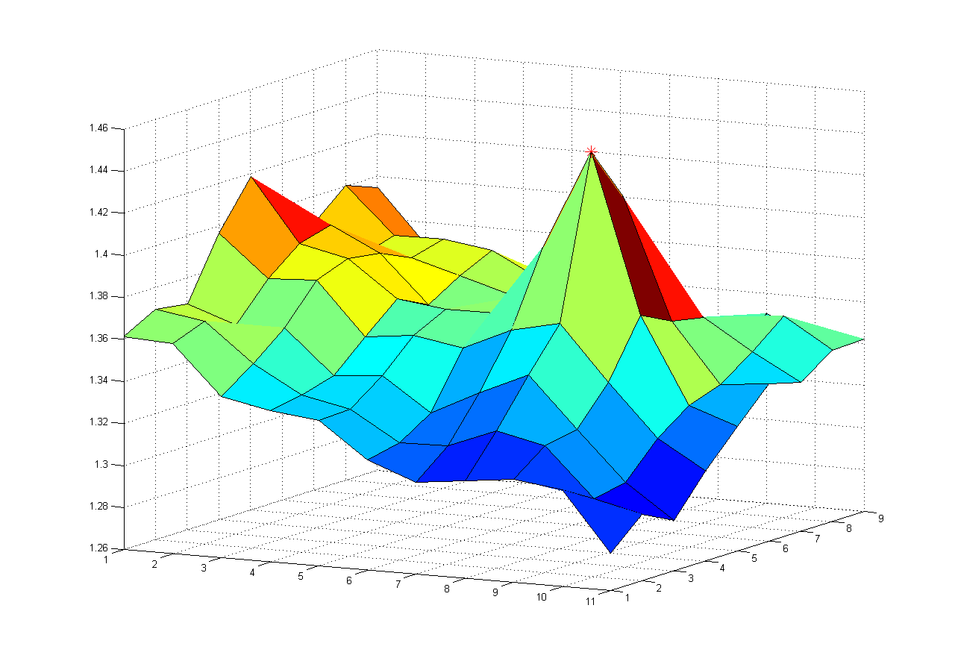
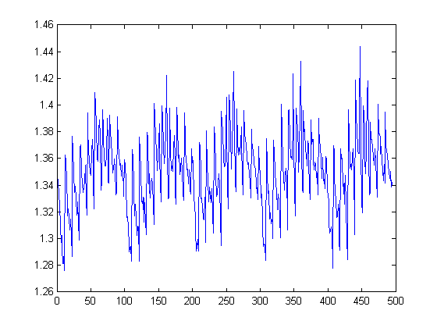
Case 2; coarse search
Search space
  teta= -6:3:6
  x= -40:10:40
  y= -100:10:0
The results:
  NMI: 1.4440
  teta=6.0000
  x= 0
  y=-30.00

Slide 13
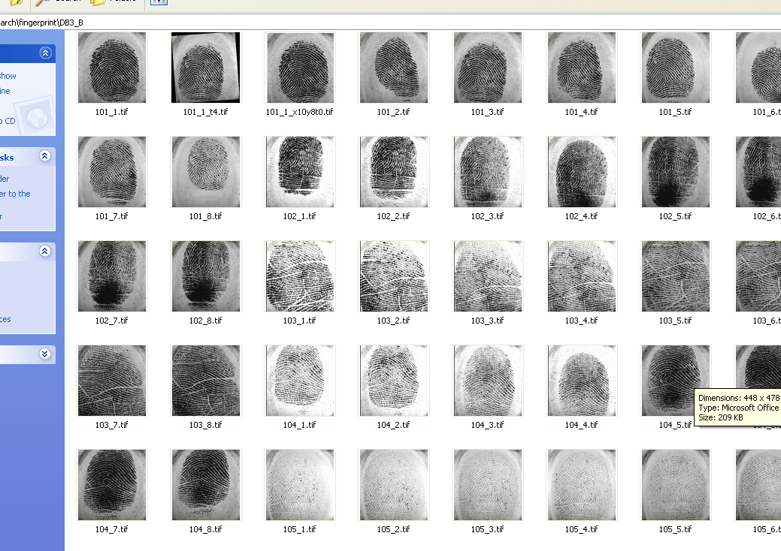
The gallery:

Slide 14
How to search : speed challenging!
Fine search: we know the neighborhood of the solution, so we have the highest resolution
Coarse search: the try to find the region of the solution
  The teta range is between -5 to 5 degrees.
  We can also have constraints on the ranges of x and y
How to become faster?
One strategy (hierarchical search)
  First have a coarse search on teta, x,y
  Again have a coarse search on x,y (fixing teta for the previous result)
  Having a fine search on x,y,teta
another strategy ( a compromise between feature quality and speed)
  Decreasing the resolution of the Feature vectors:
    The parameters are:
    Wd: the width of the block of averaging for finding Direction Features
    Reducing the number of histogram bin in NMI calculation
  Finding the Direction Features not all over the image , but on some regions
The fuction:
function [x0 y0 teta0]= FindTransform(TemplateROI,input1ROI,step,WdRatio,NumBin,RegionSelection)

Slide 15
Further study
Trying Gray level of the pixels as the features
Using correlation instead of MI

Slide 16
References:
Lifeng Liu, Tianzi Jiang,and Chaoze Zhu,”Fingerprint Registration by Maximization of Mutual Information”, IEEE transaction on Image Processing, vol. 15,No.5, May 2006.
L. Hong, Y.F. Wan, and A.K. Jain,”Fingerprint image enhancement: algorithm and performance evaluation” IEEE Trans. Pattern Anal. Mach.Intell. Vol.20, no.8, Aug 1998
A. Rao,”A taxonomy for Texture Description and Identification”, New York: Springer-Verlag, 1990
J. Yang, L. Lui, and T. Jiang,” An improved method for extraction of fingerprint features” in Proc. Int. Conf. Image Graph , Anhui, China, Aug 2002
Paul Viola, and William M. Wells, “Alignment by Maximization of Mutual Information”, International Journal of Computer Vision 24(2)
Kurt D. Bollaker and Joydeep Gosh,“Linear Features Extractors Based on Mutual Information”, University of Texas, Austin
Kary Torkkola,“Non-linear Feature Transforms Using Maximum Mutual Information”, Motorola Labs
Kari Torkkola, “Feature Extraction by Non-parametric Mutual Information Maximization “, Motorola Labs
Jiri Boldys, “Bayesian Supervised segmentation of Objects in Natural Images Using Low-Level Information”, Helsinki University of Technology

Slide 17


