Slide 1
Understanding the under pricing in adaptive markets
Ali Taatian
Stevens Institute of Technology
November 2015

Slide 2
Firms financing decision
Paying off
Firms
Investors
Selling securities

Slide 3
Some definitions:
Primary market: The primary market is the part of the capital market that deals with issuing of new securities. Companies, governments or public sector institutions can obtain funds through the sale of a new stock or bond issues through primary market.
Intrinsic value: In finance, intrinsic value refers to the value of a company, stock, currency or product determined through fundamental analysis without reference to its market value. It is also frequently called fundamental value.
Under pricing: The pricing of an initial public offering (IPO) below its market value. When the offer price is lower than the price of the first trade, the stock is considered to be underpriced. A stock is usually only underpriced temporarily because the laws of supply and demand will eventually drive it toward its intrinsic value.

Slide 4
Some definitions
Bounded Rationality: Bounded rationality is the idea that in decision-making, rationality of individuals is limited by the information they have, the cognitive limitations of their minds, and the finite amount of time they have to make a decision.
Underwriting: The process by which investment bankers raise investment capital from investors on behalf of corporations and governments that are issuing securities (both equity and debt). IBs guarantee the selling of all capital required by the corporation.

Slide 5
My question: How is under pricing affected in a market with adaptive agents?
Dependent Variable:
Under pricing of securities issued in primary market
Independent Variable:
Security Type (endogenous variable)
Learning Mode switch (GA to Bayesian Learning or vice versa); Type of most realistic Learning mode
Incorporating prior knowledge to investors about the project payoff
Heterogeneity in investors, in terms of Bounded rationality and Decision Biases
Effect of rational (inefficient) underwriter (e.g. an investment bank)

Slide 6
Why under pricing matters?
Initial public offerings (IPOs) have historically had very large initial first day gains compared to the performance of the rest of the market.
The fact is that the IPO issuing price agreed upon by the underwriter and the firm making the offer is under the actual value of the firm.
Historically, IPOs were underpriced by roughly 16% according to Loughran and Ritter (2004) . However, in recent months, some IPOs have seen first day run ups of as much as 200 to 400 percent, and the trend for the future is likely to increase.
Loughran and Ritter (2004) studied IPO issues from 1990 through 1998. With more than three thousand initial public offerings during that period, the average gain in the first day of trading was 14.1%, though returns varied somewhat with the performance of the market.

Slide 7
Literature on “ipo under pricing”
William A. Reese Jr. (1998), “IPO Underpricing, Trading Volume, and Investor Interest”
Peter-Jan Engelen (2010), ‘Underpricing of IPOs: Firm-, issue- and country-specific characteristics”, Journal of banking and Finance
Z. Jun Lin, “Accounting conservatism and IPO underpricing: China evidence”, Journal of International Accounting, Auditing and Taxation
Cynthia J. Campbell et al., “Market Sentiment, IPO Underpricing, and Valuation”
Cynthia J. Campbell (1996), “Ownership dispersion, costly information, and IPO underpricing, “ Journal of Financial Economics
…..
Evolution and Under Pricing
Chou, Shi-Hao; Yen-Sen Ni; William T. Lin (2010). "Forecasting IPO price using GA and ANN simulation". In Proceedings of the 10th WSEAS international conference on Signal processing, computational geometry and artificial vision (ISCGAV'10):145–150.
Quintana, David; Cristóbal Luque; Pedro Isasi (2005). "Evolutionary rule-based system for IPO underpricing prediction". In Proceedings of the 2005 conference on Genetic and evolutionary computation (GECCO '05): 983–989.
Luque, Cristóbal; David Quintana; J. M. Valls; Pedro Isasi (2009). "Two-layered evolutionary forecasting for IPO underpricing". In Proceedings of the Eleventh conference on Congress on Evolutionary Computation (CEC'09) (Piscatawy, NJ, USA: IEEE Press): 2384–2378.
…..

Slide 8
The relevant papers:
Arifovic, J (1996), ‘The Behavior of Exchange Rate in the Genetic Algorithm and Experimental Economies’, Journal of Political Economy
Noe, T H., Rebello, M. J. & Wang, J (2003), ‘Corporate Financing: an Artificial Agent-based Analysis’, The Journal of Finance

Slide 9
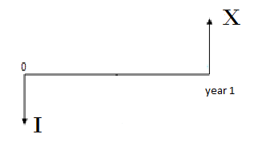
How the financing decisions are made in a market with adaptive agents?
My model:
Agent1: Firms
Agent2 and Agent3: investors
The Firms have multiple projects to invest in.
Each project needs I dollars to start.
Each project takes 1 year
Each project has a payoff of X, where X in a random variable.

Slide 10
model
Firms have different choices. Each security type has a pay off function, S(X), which could be dependent or independent of X.
The firms commits to pay the investors the S(X), if they buy the security.
The market determines the price, P, for the security.
The profit of investor who bought the security is S(X)-P (assuming no discounting over time)
The Profit of the firm is: X+P-[S(X)+I]

Slide 11
model
Firms decision:
Which security should they issue?
Investors decision:
How much to pay for each type of security?
Assume that the expected value of all securities are similar, say V. Therefore their expected profit is: E(S(X))-P= V-P
The expected profit of the firms is: E(X)+P-I-V
As far as V>P and E(X)-I>V-P both are willing to launch the project and are indifferent in choosing the security.

Slide 12
model
For each project:
The firms choose a security and issues it.
Each investor chooses his price and all place their bids to buy the security.
The firms sell the security to the highest price and receive the proceeds and launch the project.
After 1 year:
The firms announce the project pay off and pay the investor her share, S(X), and keep the rest for themselves.
The firms look for another project!

Slide 13
Firm: a representative of all firms
With no learning, the firms randomly choose a security, with equal intrinsic values, from a pool of securities and issues it. On the other hand, each investor picks a random price within an appropriate range and places her bid.
Since this process occurs multiple times, the learning exists for both sides.
For firms: in the primary market, for simplicity, we can assume no competition among firms. All could share their experiences and decide as one body
For investors: they are competing; therefore each individual has its own experiences, memory and decision making capabilities.
So my model has one firm and multiple investors

Slide 14
Using GA for learning of both firm and investors
For Firms: security choice decision
Selection
Mutation
For Investors: price choice decision
Selection
Crossover
Mutation
election

Slide 15
Evidence for Underpricing
Level of Under pricing for each security:
=WinnerPrice – IntrinsicValue
See the plots!

Slide 16
Six securities: the pay off functions
Junk: S(X)=0
Debt: S(X)= min(x,50)
Equity: S(X)= 0.75*x
Do-or-Die: S(X)= x if x<86.6 else 0
Convertible debt: S(X)= min(x,30)+0.96*max(x-50,0)
Subordinated convertible debt: S(X)= min(max(x-10,0),60)+0.75*max(x-80,0)

Slide 17
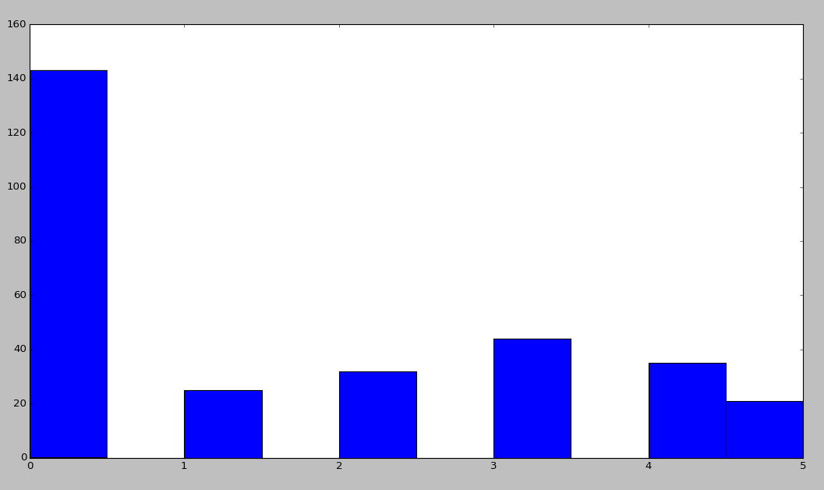
300 simulations (Runs) 100 Rounds in each

Slide 18
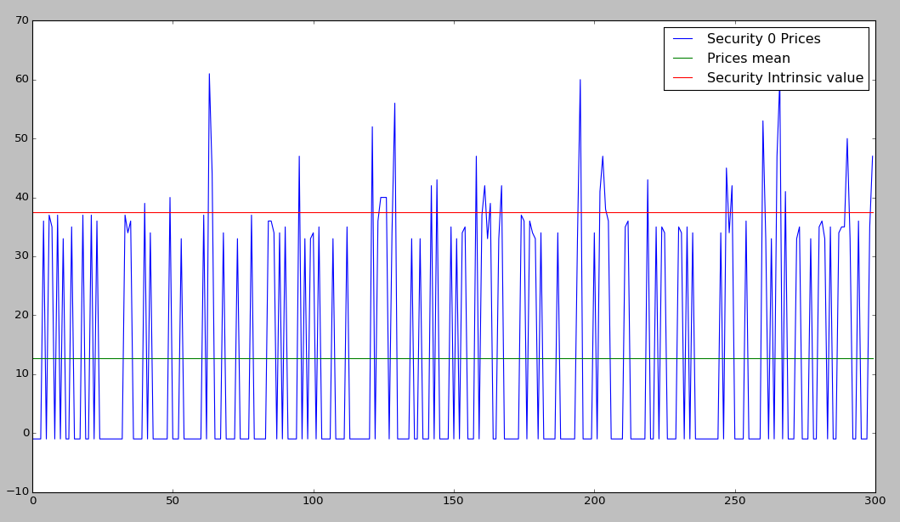
300 simulations (Runs) 100 Rounds in each

Slide 19
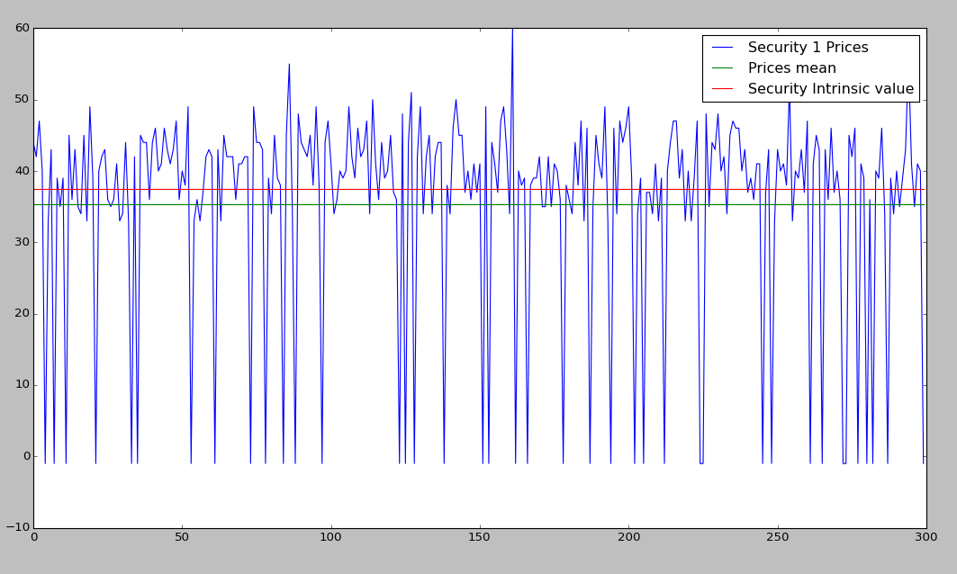
300 simulations (Runs) 100 Rounds in each

Slide 20


