Slide 1
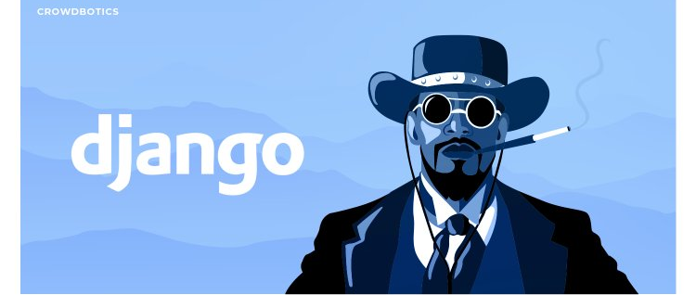

Slide 2
Tools:
To Do list app with User Registration, Login, Search and full Create Read Update and DELETE functionality.
integrated development environment Python programming languages-Pycharm.
Python library
Stages:
Develop Basic Application

Slide 3
Part 1
Getting started with django.
Models & Admin
Testing -> Model
Url's, Views
Templates
Testing -> Vews
Python Style Conventions

Slide 4
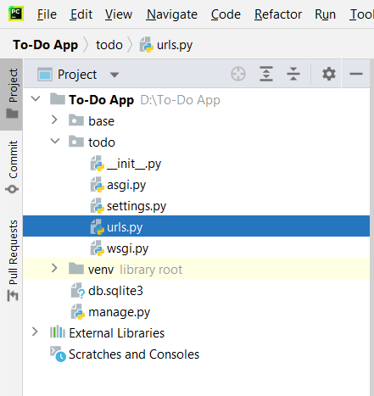
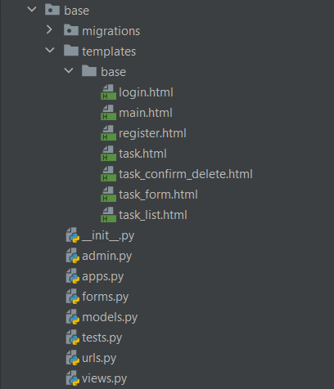

Slide 5
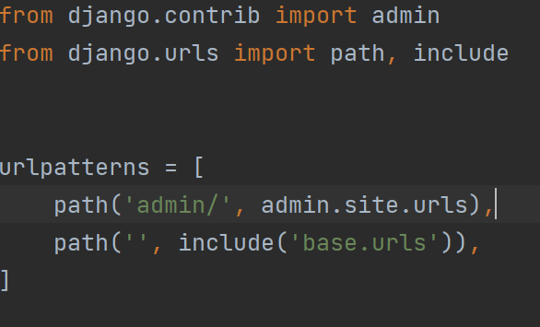
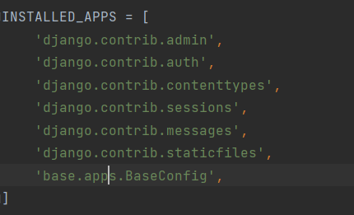
First of all, we work with the settings and urls:
In the configuration file, we connect our application in the line "Instolled_apps". As picture shown
Open the urls.py file add the include function and connect to the urls file in the base folder
#2
#1

Slide 6
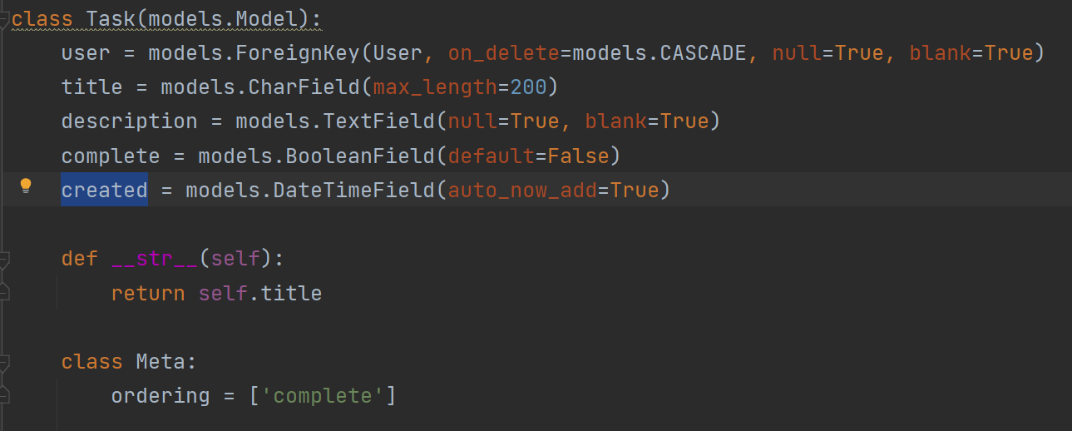
Create a Model:
Теin the task model we will create attributes:
User, Title, Description, Complete, Created

Slide 7
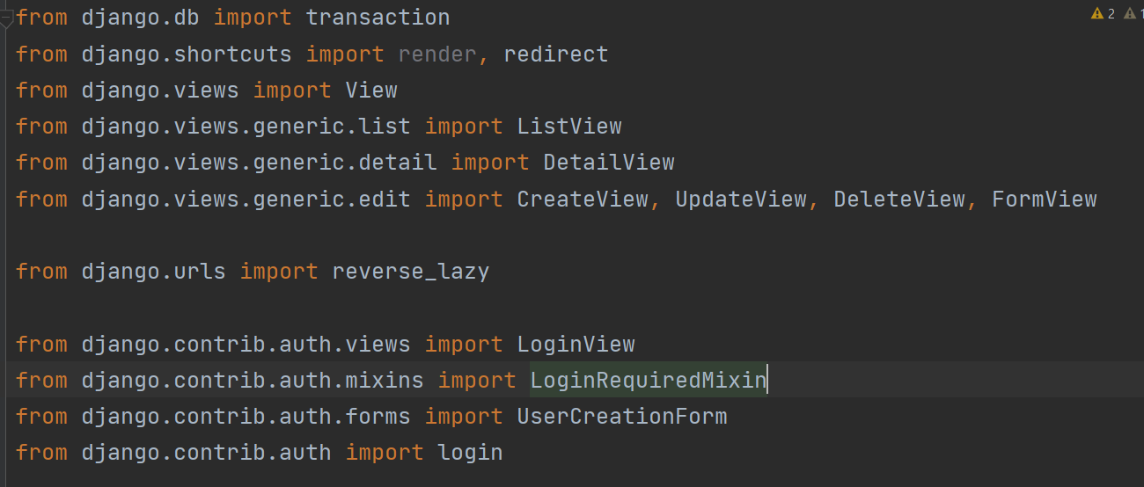
View:
import all the functions we need from the django library

Slide 8
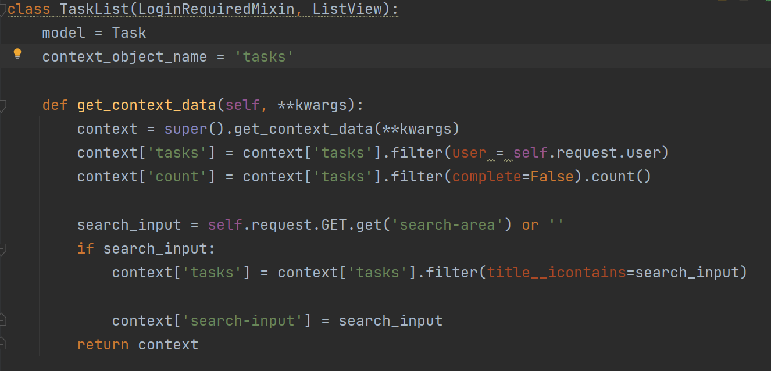
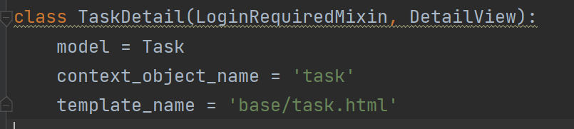
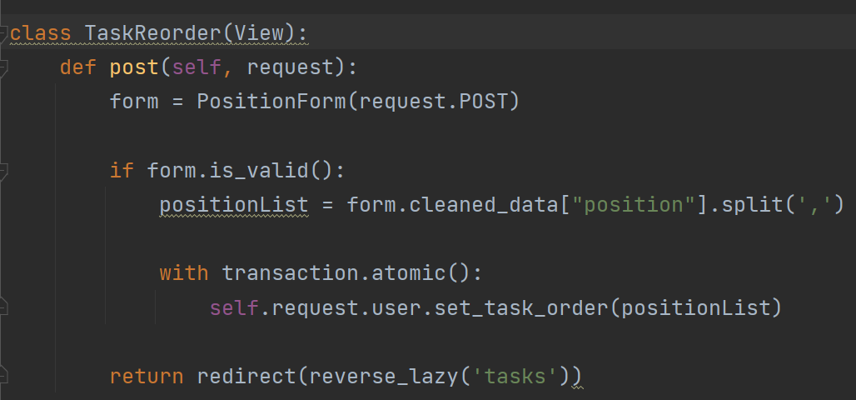
Create Class based view:
#1 class TaskList:
#2 class TaskDetail:
#9 class TaskReorder

Slide 9
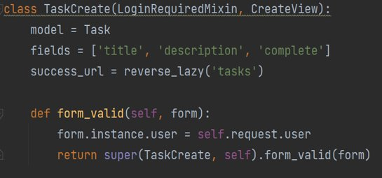
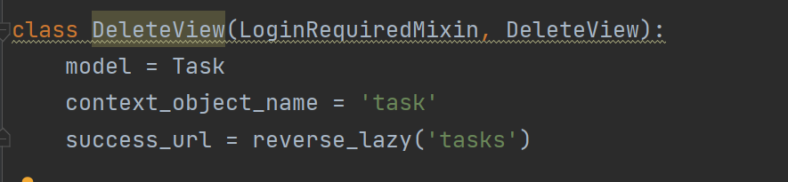
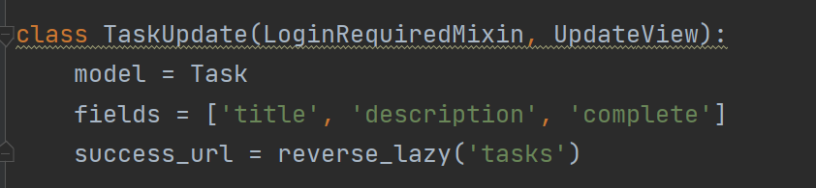
CRUD
#3 class TaskCreated:
#4 class TaskUpdate
#5 class TaskDelete

Slide 10
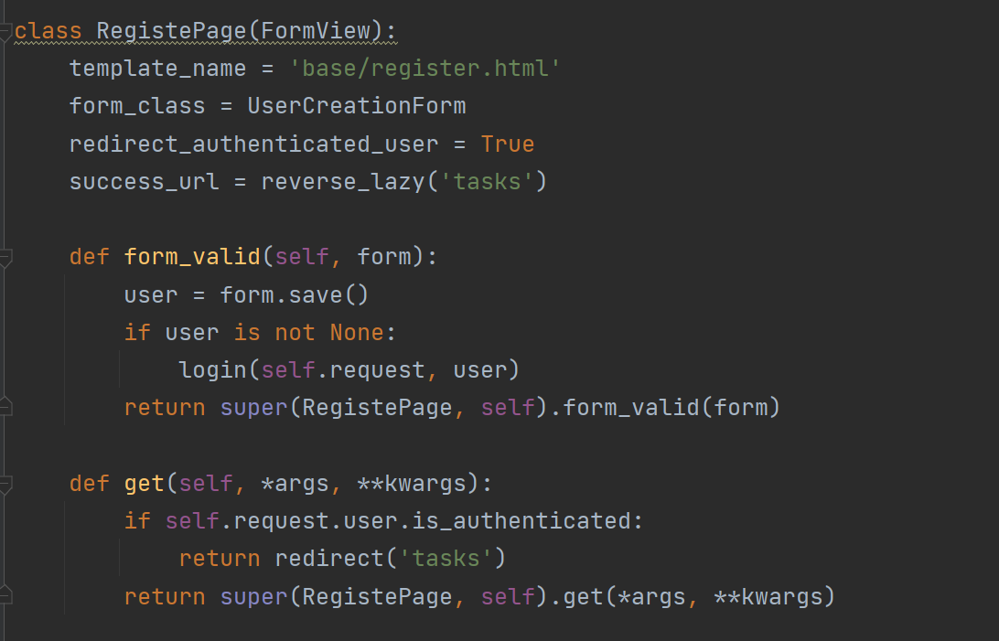
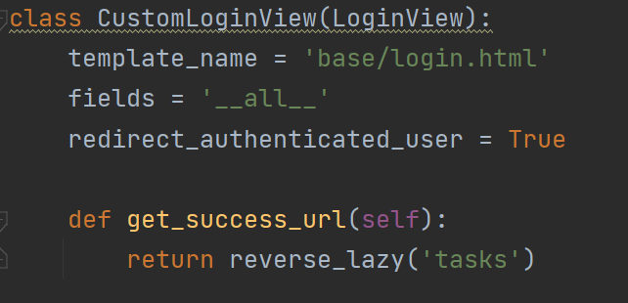
#8 Register page
#7 class Login

Slide 11
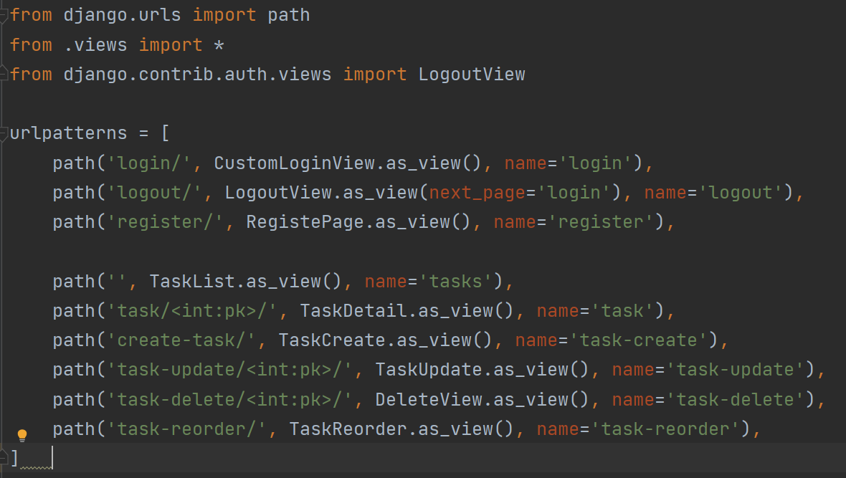
Urls.py:
After we have created all the classes we need, we import them into the url file.
The as_view() method
Because we are using a class based view, we need to add the “as_view” method for our url resolver. This is because the django url resolver cannot process a class but instead needs a function. To resolve this, we trigger the “as view” method from our “View” class which we inherited from and the “as view” method will call the correct view function depending on the method sent, therefore giving the url resolver a function.

Slide 12
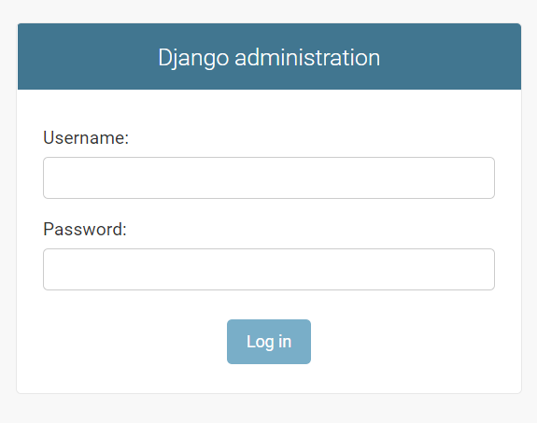
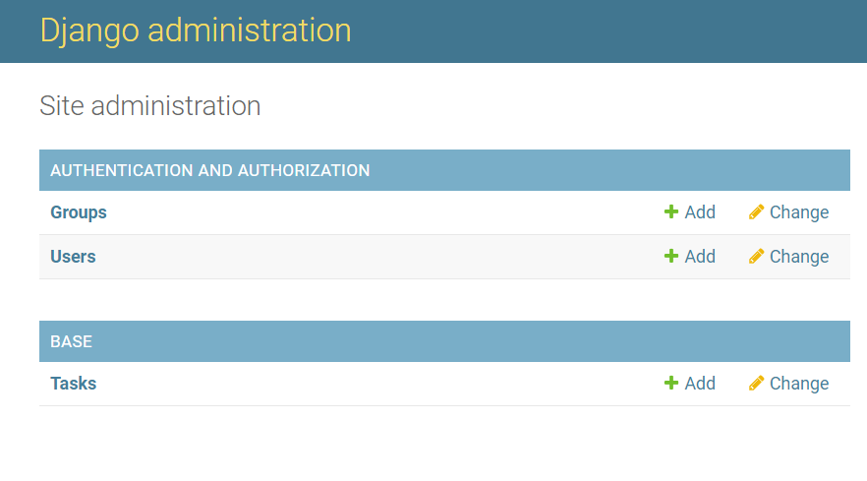
Administration:
Enter the login that you created in createsuperuser

Slide 13
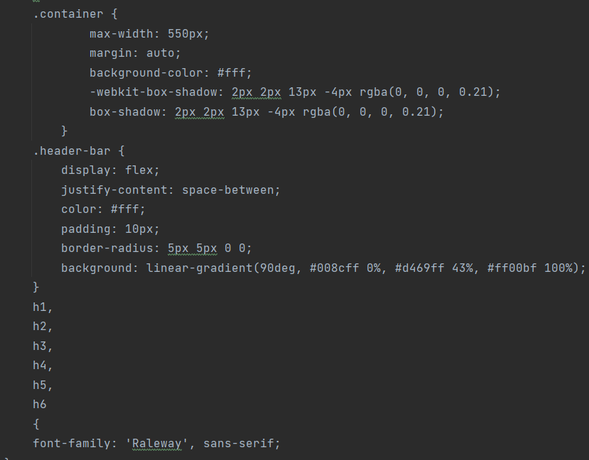
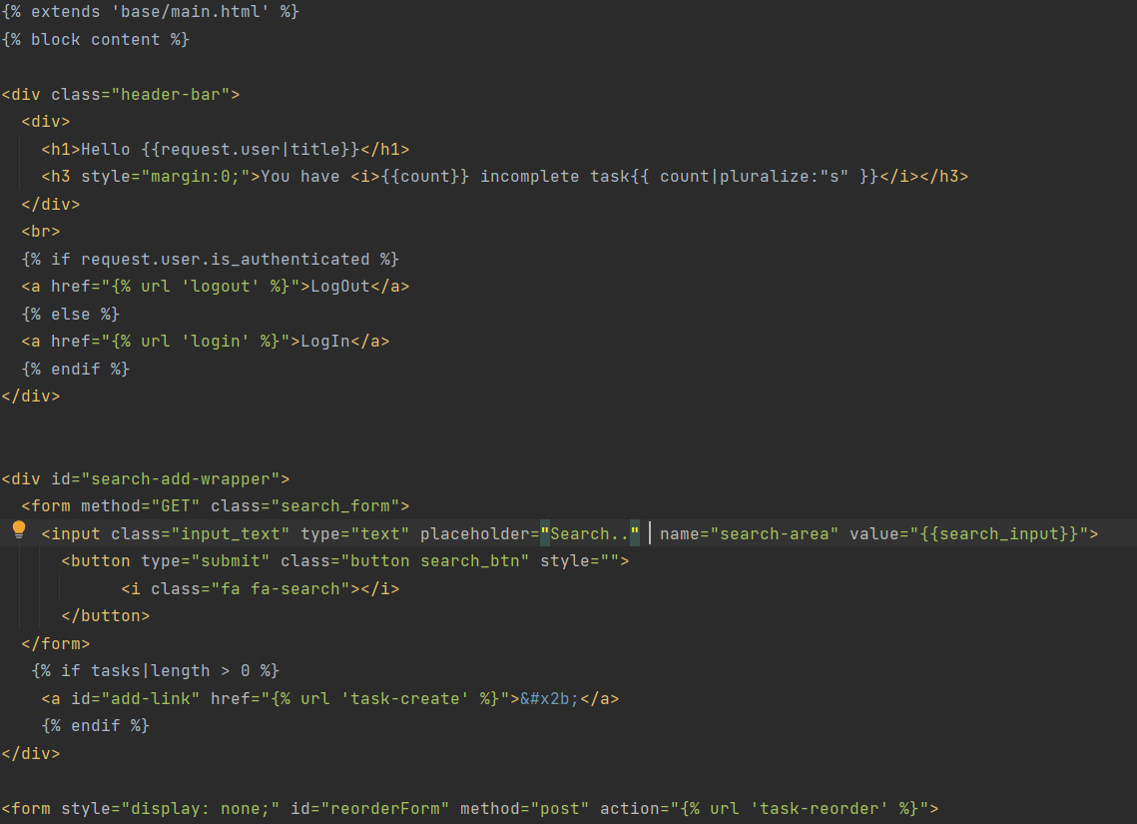
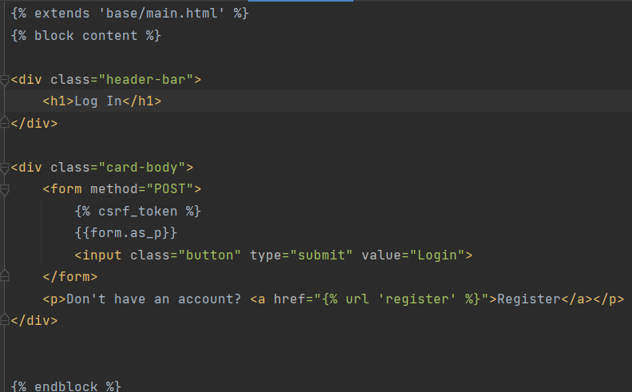
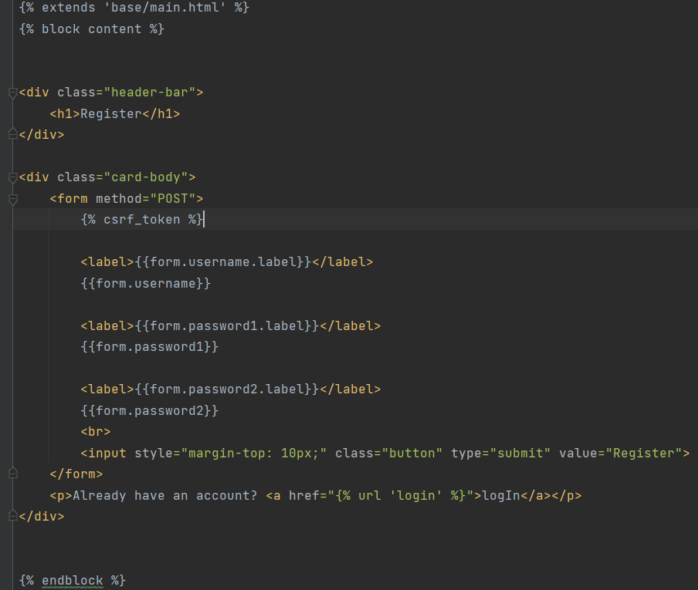
Start Work Front End:
In the base folder create a templates folder and again a base folder. And inside we create html files

Slide 14
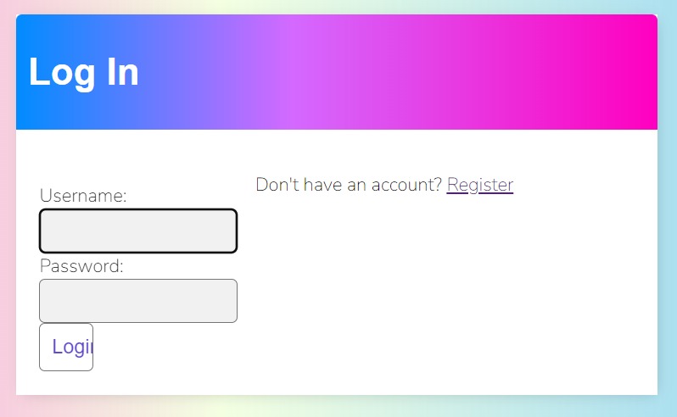
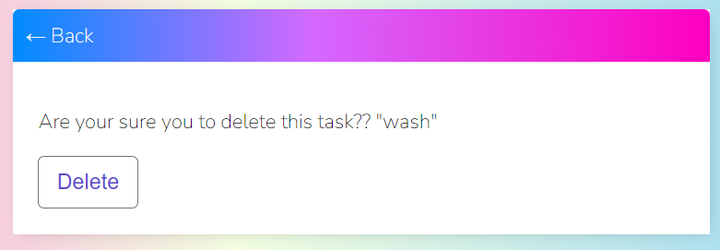
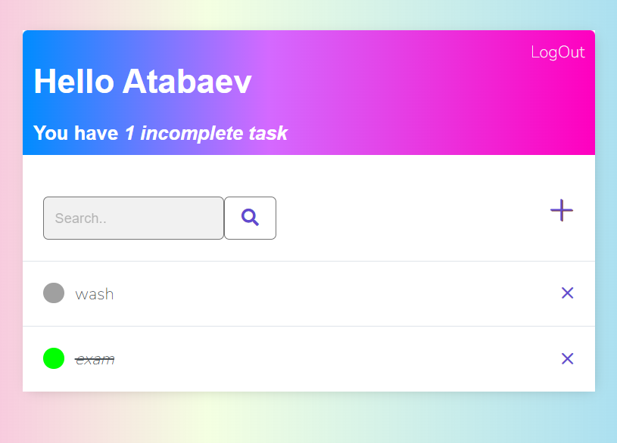
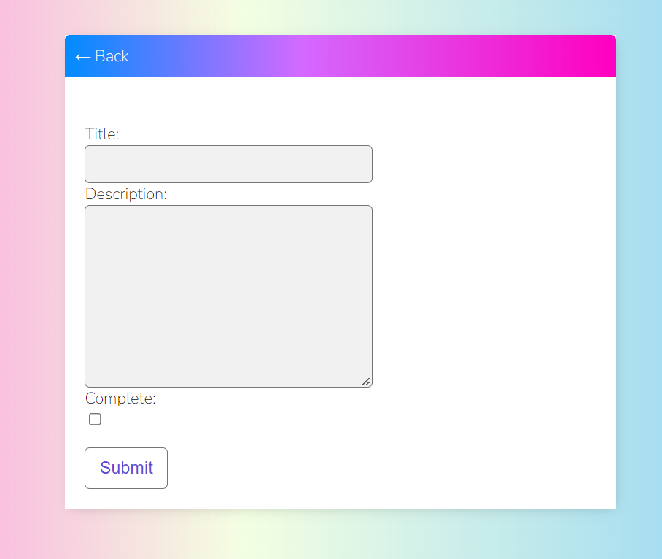
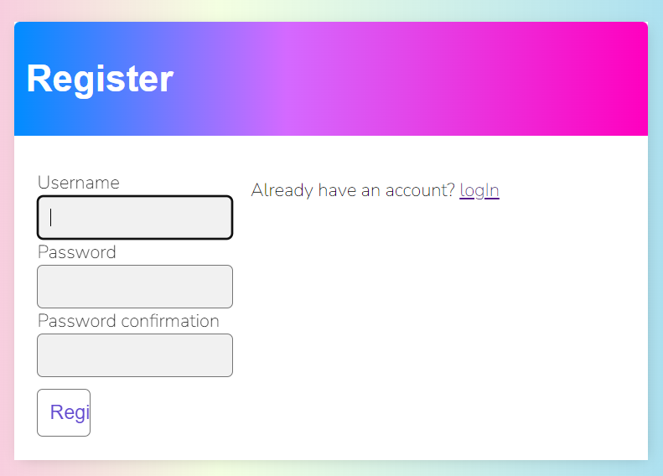

Slide 15
The main backend work was done by Atabaev Zaman
Frontend was prepared by Elmurat Imarali uulu
The End

