Slide 1
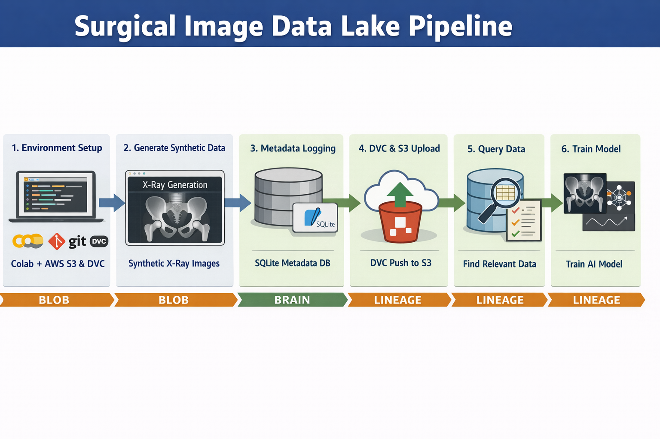
Surgical Image Data Lake Pipeline
Colab + AWS S3 + SQLite + DVC (end-to-end demo)
Tip: Present this as “Blob (S3) + Brain (SQLite) + Lineage (DVC)”
Notes:
[Sources] - Pipeline graphic: generated for this project (no external source). [/Sources]

Slide 2
Step 1 — Environment setup (Colab + AWS + DVC)
Goal: a reproducible runtime that can push/pull data from S3 with one click.
Step 1
Setup
What you do (in Colab)
Why it matters
Add AWS secrets in Colab (AWS_ACCESS_KEY_ID / AWS_SECRET_ACCESS_KEY).
Install toolchain: dvc[s3], boto3, pillow, numpy, torch.
Initialize git + dvc in the notebook workspace.
Create or choose an S3 bucket and set it as the DVC remote.
Colab is ephemeral; S3 keeps artifacts after the runtime resets.
DVC remote config makes data retrieval repeatable for anyone on the team.
Separates “compute session” from “source of truth”.
Key snippet
# DVC remote (S3)
BUCKET = "<your-bucket>"
REMOTE = "s3remote"
!dvc remote add -d $REMOTE s3://$BUCKET/dvcstore
!dvc remote modify $REMOTE version_aware true
What to demo live
Show that DVC can talk to S3 (run `dvc remote list`, then a tiny `dvc push`).
Notes:
[Sources] - No external visuals used on this slide. [/Sources]

Slide 3
Step 2 — Generate synthetic X‑ray images (Hip, AP view)
Goal: create a realistic-enough dummy dataset + ground-truth label (pelvic_tilt).
Step 2
Generate
What you do (in Colab)
Why it matters
Create a small generator that draws a pelvis “phantom”.
Randomize pelvic_tilt per sample (e.g., N(12°, 5°)).
Add simple noise to mimic imaging variability.
Write PNGs to a local staging directory (data/raw).
Shows domain-awareness: images + labels are causally linked.
Staging locally keeps generation fast; upload happens in a separate step.
The same pattern works for real DICOM/DRR generation later.
Key snippet
meta = generator.create_dataset_entry()
# meta = {image_id, pelvic_tilt, file_path, s3_key}
print(meta["pelvic_tilt"], meta["file_path"])
What to demo live
Display a sample image + its pelvic_tilt label in the notebook.
Notes:
[Sources] - No external visuals used on this slide. [/Sources]

Slide 4
Step 3 — Log metadata to SQLite (the “Brain”)
Goal: query by clinical parameters without scanning S3 or file paths.
Step 3
Index
What you do (in Colab)
Why it matters
Create a SQLite DB and a surgical_index table.
Insert one row per image (image_id, s3_uri, pelvic_tilt, view_type, …).
Keep file storage and query logic separate (URI lives in DB).
Optionally upload the DB file to S3 as a backed-up artifact.
SQL gives instant cohort selection (edge cases, balancing, QA).
Avoids brittle folder conventions like data_v1_final_final.
Makes downstream training pipelines deterministic and auditable.
Key snippet
q = """
SELECT s3_uri FROM surgical_index
WHERE pelvic_tilt > 15 AND anatomy='Hip'
"""
rows = conn.execute(q).fetchall()
print(len(rows))
What to demo live
Run a query (e.g., pelvic_tilt > 15°) and print the S3 URIs returned.
Notes:
[Sources] - No external visuals used on this slide. [/Sources]

Slide 5
Step 4 — Version + upload (DVC push to S3)
Goal: store large files in S3 while keeping lightweight pointers in git.
Step 4
Persist
What you do (in Colab)
Why it matters
Track the dataset directory with DVC: `dvc add data/raw`.
Commit only the pointer file (data/raw.dvc) and .gitignore changes.
Push binaries to S3: `dvc push`.
Back up the SQLite DB to S3 (boto3 upload).
Gives “time travel”: checkout a git commit → restore exact data state.
S3 holds the heavy artifacts; git stays fast and clean.
Enables reproducible experiments across machines/runtimes.
Key snippet
!dvc add data/raw
!git add data/raw.dvc .gitignore
!git commit -m "Ingest batch 1"
!dvc push
What to demo live
Show that `dvc push` uploads, then delete local data and `dvc pull` restores it.
Notes:
[Sources] - No external visuals used on this slide. [/Sources]

Slide 6
Step 5 — Build cohorts via SQL (and pull data on demand)
Goal: slice the dataset by conditions (tilt, view, anatomy) for training/QA.
Step 5
Select
What you do (in Colab)
Why it matters
Use SQL to define a cohort (e.g., high tilt).
Create a “manifest” list of image_ids/S3 URIs.
On a fresh runtime: run `dvc pull` to populate files locally.
Load only the cohort in your dataloader/training job.
Turns a clinical question into a deterministic dataset slice.
Keeps training repeatable and debuggable (same query = same cohort).
Scales: the query pattern is constant even as data grows.
Key snippet
cohort = conn.execute(
"SELECT image_id FROM surgical_index WHERE pelvic_tilt > 15"
).fetchall()
ids = [r[0] for r in cohort]
What to demo live
Print cohort size + show 3 sample IDs and their labels.
Notes:
[Sources] - No external visuals used on this slide. [/Sources]

Slide 7
Step 6 — Train a small model (PyTorch) on the selected cohort
Goal: prove end-to-end usability: DB → files → tensors → training loop.
Step 6
Train
What you do (in Colab)
Why it matters
Implement a Dataset that uses the DB as the index.
Load PNGs from data/raw and return (image_tensor, pelvic_tilt).
Train a tiny baseline model (e.g., a small CNN or linear head).
Save metrics + (optional) model weights back to S3.
Demonstrates the whole loop: ingestion → curation → training.
Makes it easy to debug edge cases by slicing the cohort.
This pattern extends to real training infra (SageMaker / K8s jobs).
Key snippet
for x, y in loader:
pred = model(x)
loss = loss_fn(pred.squeeze(), y)
loss.backward(); opt.step(); opt.zero_grad()
What to demo live
Run 1–2 epochs, show loss decreasing, and save a checkpoint to S3.
Notes:
[Sources] - No external visuals used on this slide. [/Sources]

