Slide 1
Text Data Processing and Analysis in Recommender Systems
MOD002726 Postgraduate Major Project
Master of Science
Artificial Intelligence and Big Data
Atabek Murtazaev
2288841

Slide 2
Introduction
Project Aim: The goal of the project is to develop a recommender system that takes text data as input for generating recommendation in various domains such as, e-commerce, media and social networks.
Scope: The system uses machine learning techniques such as collaborative filtering, content-based filtering, and a hybrid approach to generate recommendations.
Methodology: The system is built using a full-stack approach, with a Django backend and a Vue.js frontend, integrating AI models for real-time product recommendations.
Key Features:
Real-time AI-driven recommendations.
Full-stack implementation using Django and Vue.js.

Slide 3
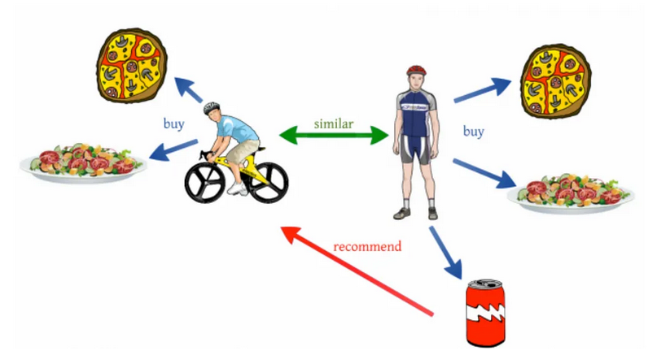
Collaborative Filtering
Collaborative filtering works by analysing user interactions to identify similarities between users and their preferences.
Users who rate the same movies highly will get similar movie recommendations.
Suffers from the cold start problem when there isn't enough data for new users or items.
Fig 1: Collaborative Filtering Process (Source)

Slide 4
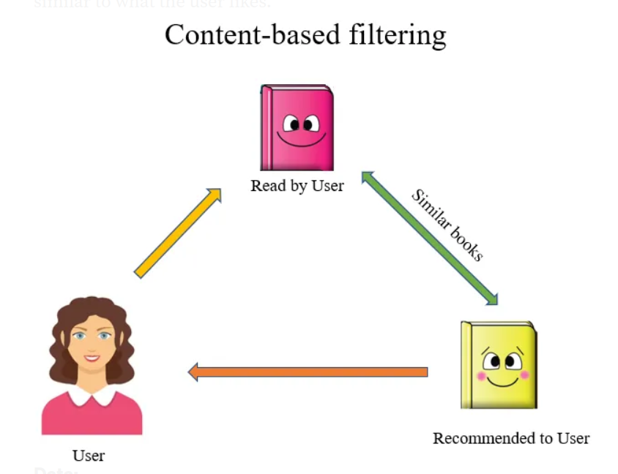
Content-Based Filtering
Content-Based Filtering focuses on item attributes (e.g., genre, actors, or keywords) to suggest similar items based on the user’s previous preferences.
If a user likes action movies, the system recommends more action movies based on genre, actors, etc.
Works well for new users or items, avoiding the cold start issue.
May lead to overspecialization where recommendations become too similar to previous content.
Fig 2: Content-Based Filtering Process (Source)

Slide 5
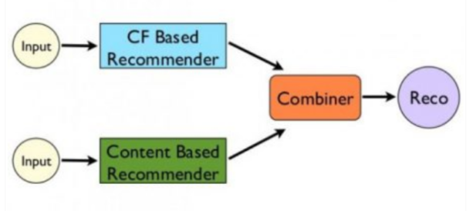
Hybrid Filtering
Hybrid recommendation systems combine multiple recommendation strategies to improve accuracy and effectiveness.
Merges content-based and collaborative filtering methods.
Combines the strengths of both approaches while minimizing their weaknesses.
Netflix uses a hybrid model to recommend shows based on both user behaviour and item attributes like genres and ratings.
Fig 3: Hybrid Filtering Process (Source)

Slide 6
Text Mining
Text mining, also referred to as text mining, is the practice of taking large amounts of text data and converting them into useful data forms. Text mining is a crucial component of recommender systems as users’ preferences can be derived directly from unstructured text such as review or comment text, or more generally descriptions of items.
Tokenization
Dividing text into smaller units called tokens (e.g., words or phrases).
Example: Splitting "I love movies" into tokens: [‘I’, ‘love’, ‘movies’].
Stop-word Removal
Eliminating common words (like "the", "and") that don't add much value to the analysis.
Lemmatization
Reducing words to their base form (e.g., "running" → "run").
Example: "Playing", "played", and "plays" all become "play".
TF-IDF Vectorization
A statistical measure that evaluates how important a word is to a document relative to a corpus.
Example: "Artificial Intelligence" might have a high TF-IDF score in a report about AI.

Slide 7
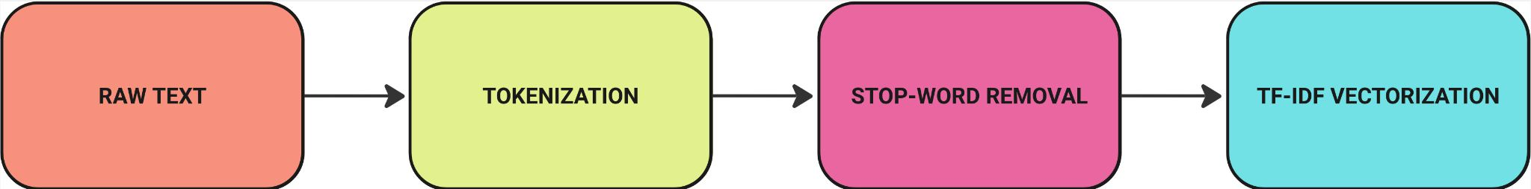
Text Mining
A flowchart that represents the Text Preprocessing Pipeline:
Fig 4: Text mining Process

Slide 8
NLP in Recommender Systems
Natural Language Processing (NLP)
NLP techniques work on raw text format and therefore is applied on large amounts of text such as the reviews and comments of a product or service, and the descriptions of products. This enables the recommender system to easily capture user preferences, context and even sentiment of the users.

Slide 9
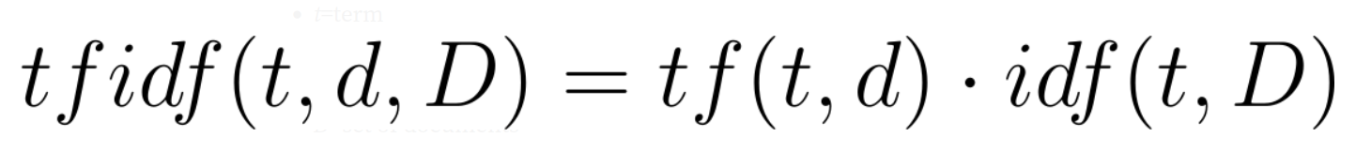
NLP TECHNIQUES
TF-IDF (Term Frequency-Inverse Document Frequency)
Converts text data into numerical vectors based on the importance of words in a document.
Used to find similarities between user reviews and products.
Example: Identifying important words in a product review to recommend similar items.
t=term
d=document
D=set of documents
Fig 5:TF-IDF Formula

Slide 10

NLP TECHNIQUES
Sentiment Analysis
Analyses the tone or emotion in user reviews (positive, neutral, negative).
Improves recommendations by favouring products with positive reviews.
Example: Recommending products that have positive sentiment in user feedback.
Fig 6: Sentiment Analysis

Slide 11
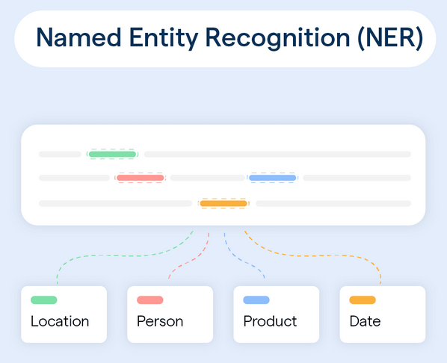
NLP TECHNIQUES
Named Entity Recognition (NER):
Identifies specific entities such as people, organizations, and locations in text.
Helps categorize and enhance recommendations based on these entities.
Example: A movie recommendation system that suggests movies starring "Tom Hanks."
Fig 7: Named Entity Recognition (Source)

Slide 12
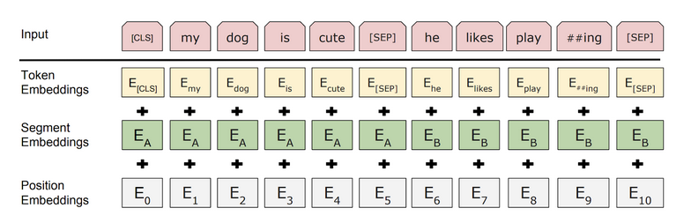
NLP TECHNIQUES
Transformer Models (e.g., BERT):
Modern NLP models that capture context at a deeper level, understanding word relationships in sentences.
Useful for improving search queries and generating better recommendations.
Example: Understanding complex user queries like "movies directed by Christopher Nolan and starring Leonardo DiCaprio."
Fig 8: Bert Training process (Source)

Slide 13
NLP TECHNIQUES
A flowchart that represents the NLP Techniques
Fig 9: NLP Improvements

Slide 14


Model Training
TF-IDF Vectorization: Converts text data into feature vectors to represent product reviews.
SMOTE: Used to balance the dataset by resampling the minority class for improved model training.
Logistic Regression: Applied for classifying product reviews based on their ratings.

Slide 15
Evaluation Metrics
Precision: Measures the accuracy of positive predictions.
Recall: Evaluates the ability of the model to identify relevant items.
F1-Score: Harmonic mean of precision and recall, providing a balanced measure.
RMSE: Root Mean Squared Error, measures how well predicted ratings match actual ratings.
MAE: Mean Absolute Error, measures the average magnitude of the prediction errors.
Full code and implementation details are available in the report or project repository.

Slide 16
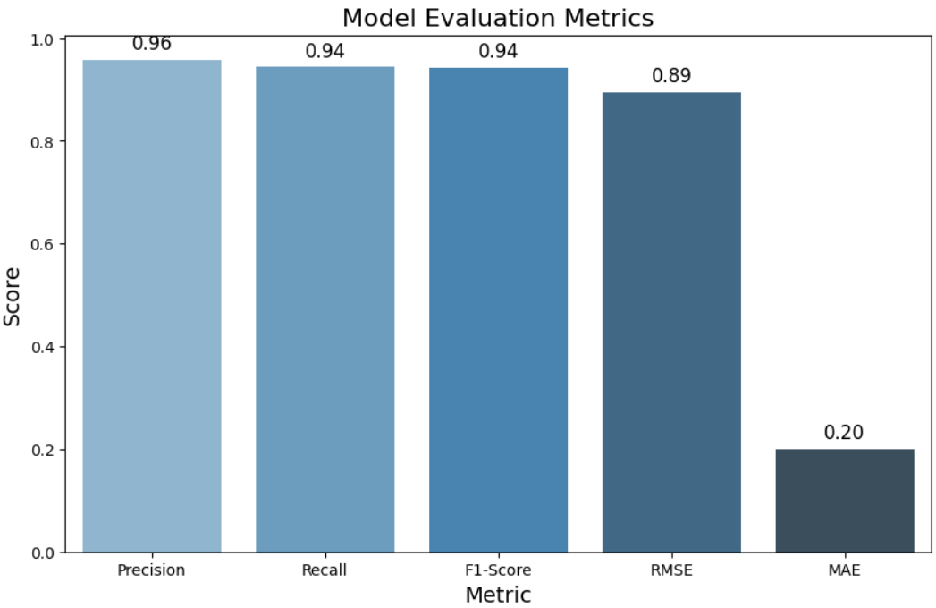
Evaluation Metrics

Slide 17
Implementation
Backend (Django):
REST API: Created using Django REST framework.
Database: PostgreSQL used for handling structured data.
Authentication: JWT-based authentication for secure user sessions.
Machine Learning Models: Integrated TF-IDF and Logistic Regression for text-based recommendations.
Full code and implementation details are available in the report or project repository.

Slide 18
Implementation
Frontend (Vue.js):
User Interface: Dynamic and responsive design for interacting with the recommender system.
Real-time Product Recommendations: Displays suggestions based on user preferences and interactions.
API Integration: Vue.js frontend communicates with Django backend through REST API for data fetching and processing.
Full code and implementation details are available in the report or project repository.

Slide 19
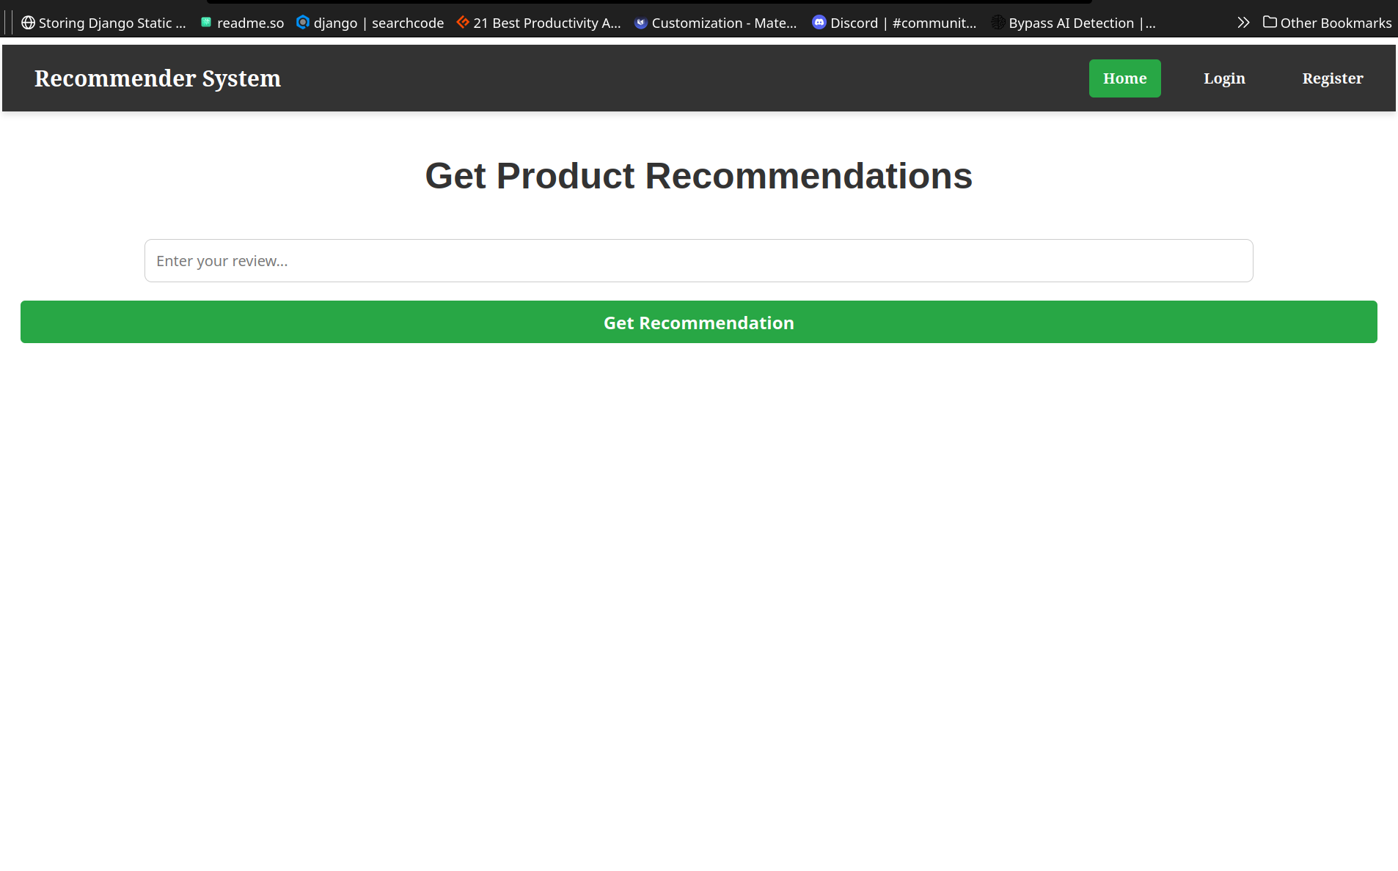
Implementation

Slide 20
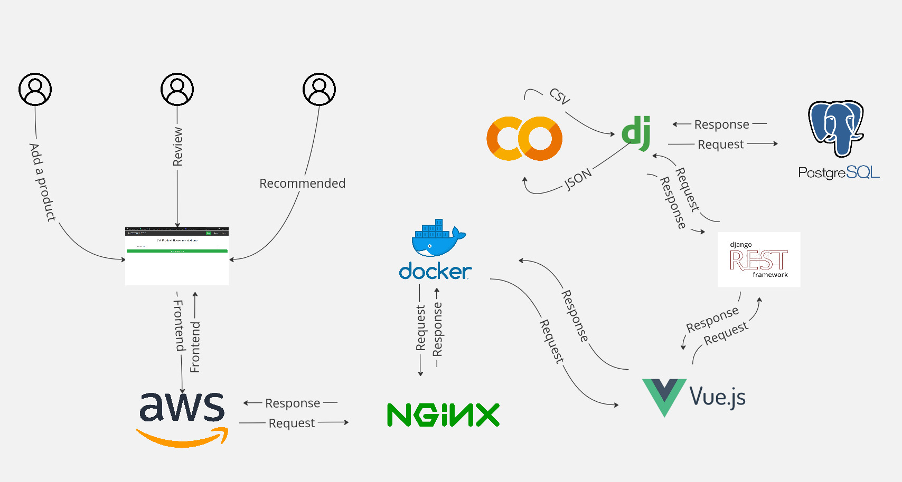
Implementation

Slide 21
Conclusion and Future Works
Conclusion:
Developed a robust recommender system using machine learning techniques such as TF-IDF, logistic regression, and cosine similarity.
Integrated Django REST API with a Vue.js frontend for real-time product recommendations.
Achieved high evaluation metrics such as Precision, Recall, F1-Score, showcasing the system's effectiveness.
Successfully built a full-stack system that can recommend products based on user input and review data.

Slide 22
Conclusion and Future Works
Future Work:
Deploy in production: Implementing the system on a cloud platform (e.g., AWS or Heroku) for real-world use.
Further optimization: Improve the recommendation engine with advanced techniques such as neural networks (RNN/CNN) for better predictions.
Personalization: Incorporate additional features like user-specific recommendations based on browsing history and preferences.
Scalability: Focus on improving the system to handle large datasets more efficiently, optimizing performance.

Slide 23
Thank you

