Slide 1

BHUK
A single-chain food delivery system
From menu discovery to order fulfilment — one connected workflow.
Mini Project Presentation | G13
51 – Tanuja Vishe
52 – Abhishek Vishwakarma
53 – Pranav Vishwakarma
54 – Sanchita Warkad
Notes:
Good morning, respected faculty members.
Today, I am going to present our mini project, Bhuk, a Single-Chain Food Delivery System.
Bhuk is a web-based application designed to simplify online food ordering and restaurant operations. It provides a common platform where customers can explore food items, add products to their cart, place orders and track order progress.
On the operational side, restaurant staff and administrators can manage menu items and monitor customer orders.
The main objective of Bhuk is to provide a convenient ordering experience while making restaurant operations more structured and manageable.
In this presentation, I will explain the problem, our proposed solution, system architecture, database design, implementation, testing and future scope.

Slide 2
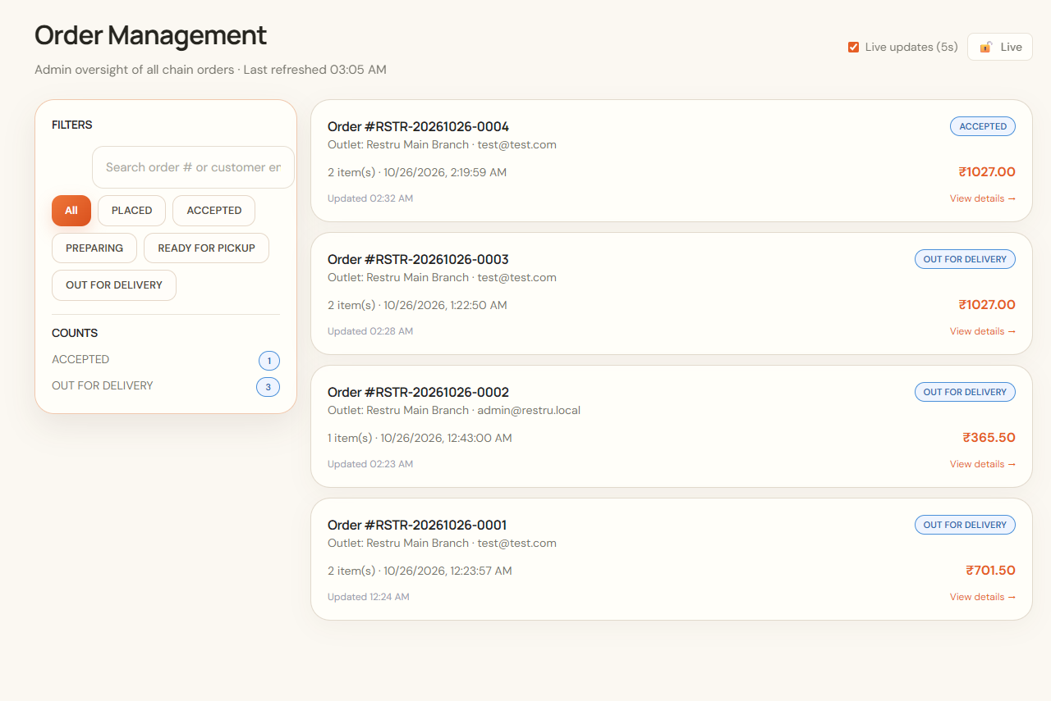
01 • CONTEXT
Problem and motivation
Disconnected ordering and fulfilment creates friction.
• Customers need a clear menu and predictable checkout.
• Restaurant teams need a shared order queue and state history.
• Delivery assignments require accountable status updates.
• Admins need chain-wide visibility over orders and menu data.
Notes:
Food ordering involves several activities, such as browsing a menu, selecting items, calculating the bill, confirming an order, preparing the food and arranging delivery.
When these activities are handled through disconnected processes, it can become difficult to maintain accurate order information, track progress and coordinate restaurant operations.
Customers also need a simple interface to find food, understand prices and view their orders.
Our motivation was to bring these activities together in a single application.
Bhuk addresses this need by connecting customer ordering with restaurant-side order and menu management.
The focus of our project is to demonstrate how software engineering principles can be used to organize a real-world food ordering workflow.

Slide 3
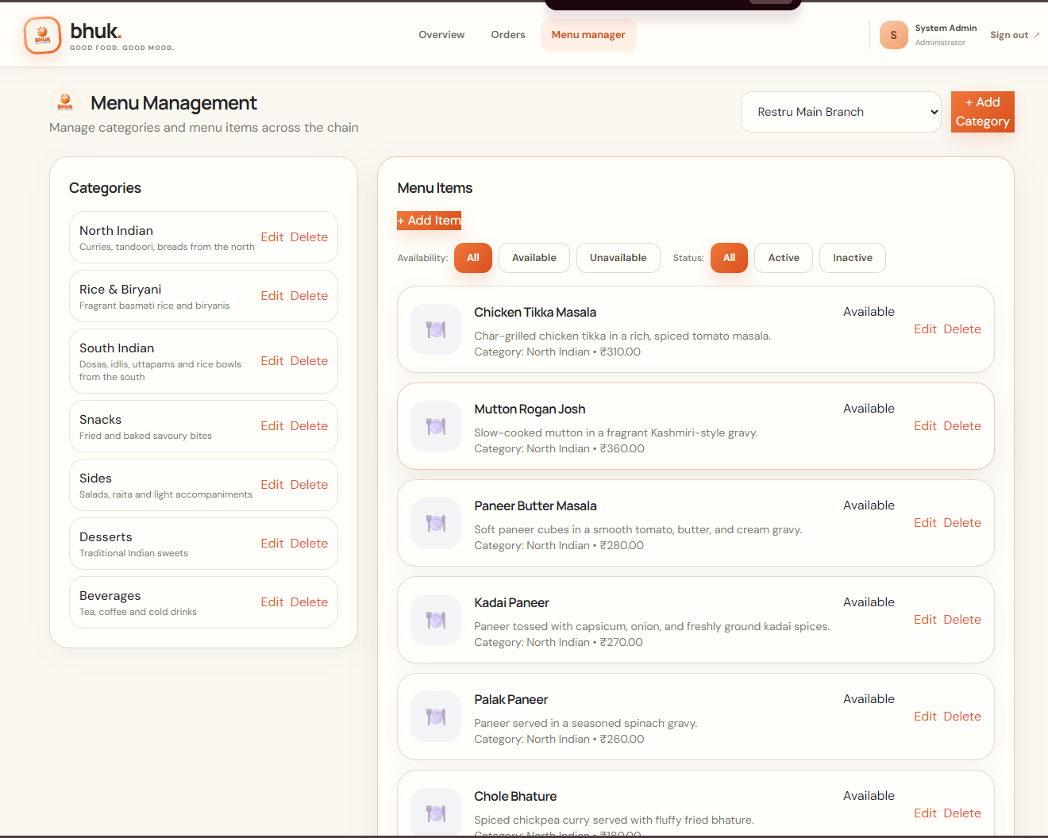
02 • BHUK
Proposed solution
A role-based workflow for a single restaurant chain.
Customer
Browse → Cart → Checkout → Track
Restaurant
Review → Accept / Reject → Prepare → Ready
Delivery
Assign → Pickup → Deliver
Administrator
Monitor orders → Manage menu → Review operations
Notes:
Our proposed solution is Bhuk, a web application with customer-facing and administrative functionality.
The customer module allows users to browse menu categories, search for food items, view prices, add products to the cart and proceed through the ordering workflow.
The order management module supports viewing orders and managing their status.
The menu management module allows authorized administrators to maintain categories, menu items and their availability.
The system also includes authentication and role-based access concepts so that users can access the functions appropriate to their roles.
Together, these modules form the foundation of the application.
Instead of treating each function as an isolated feature, the system connects them through backend business logic and database operations.

Slide 4
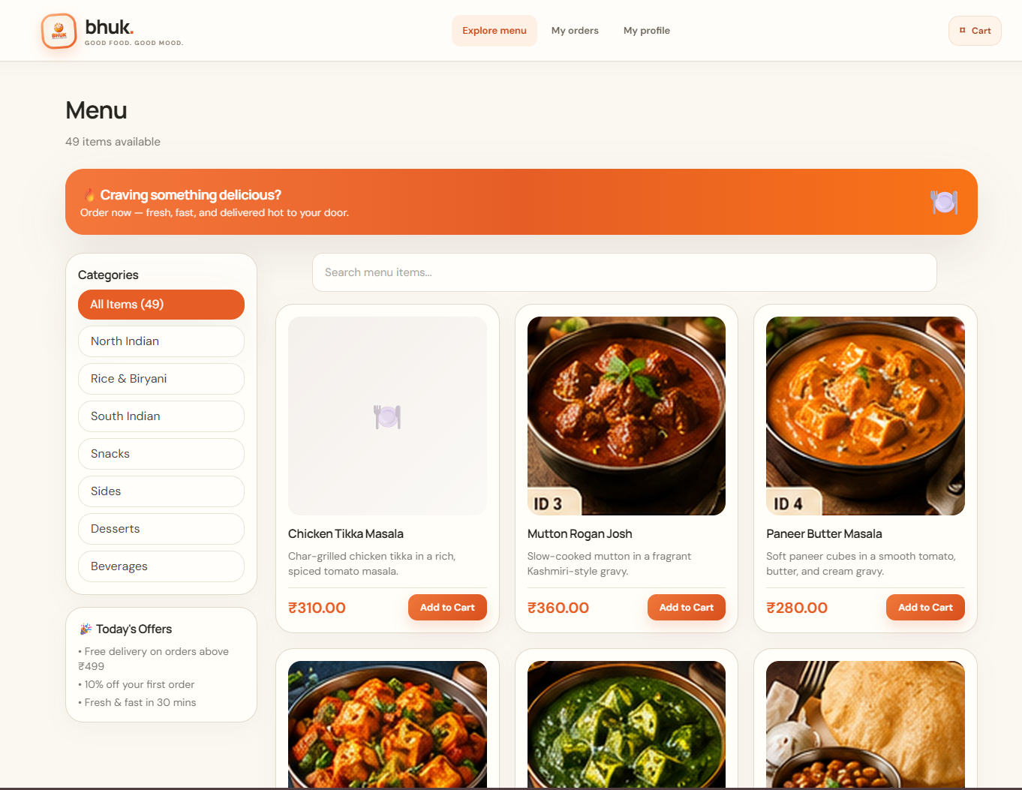
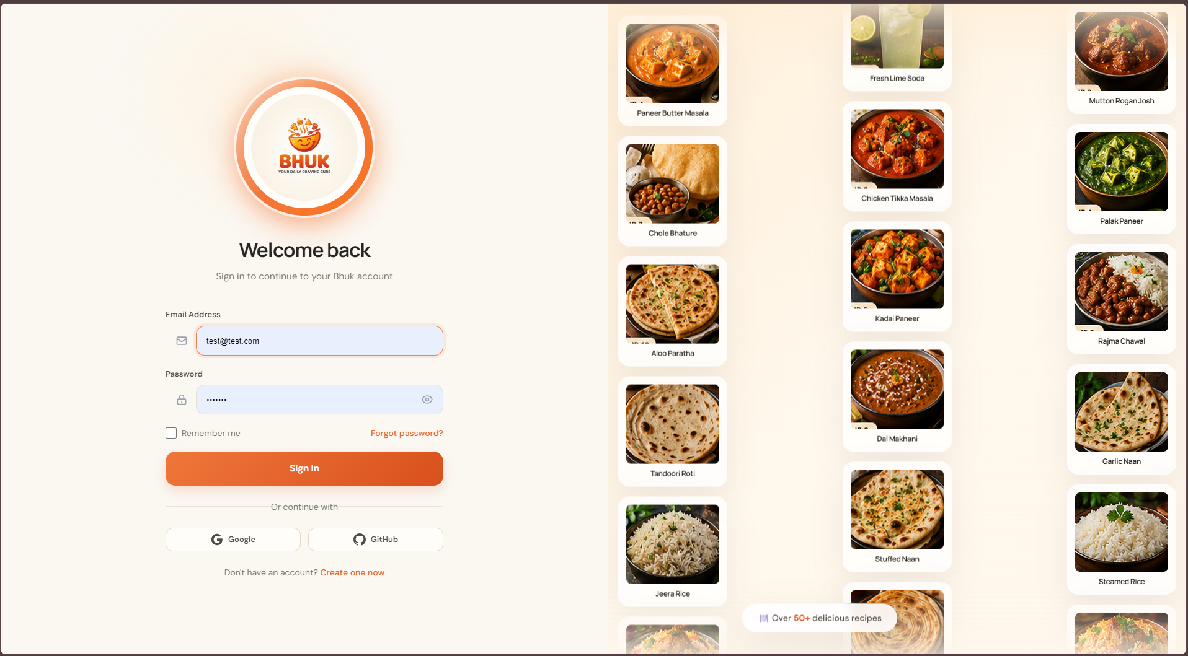
03 • UI
Customer experience
Menu discovery, dish cards, search and cart actions
Branded authentication
Notes:
This slide demonstrates the customer-facing interface of Bhuk.
The menu page displays the available food items through individual cards. Each card can present the item name, description, image, price and an option to add the item to the cart.
The category navigation helps customers explore different types of food, while the search field makes it easier to find specific items.
The login page provides the interface for users to sign in to their accounts.
We have used a consistent visual design with a warm cream background, orange accents, rounded cards and clear navigation. These choices help establish a recognizable identity for the application.
The objective is to make the interface visually appealing while keeping important actions easy to locate.
The frontend is responsible for presenting information and collecting user input, while the backend is responsible for validating and processing important operations.

Slide 5
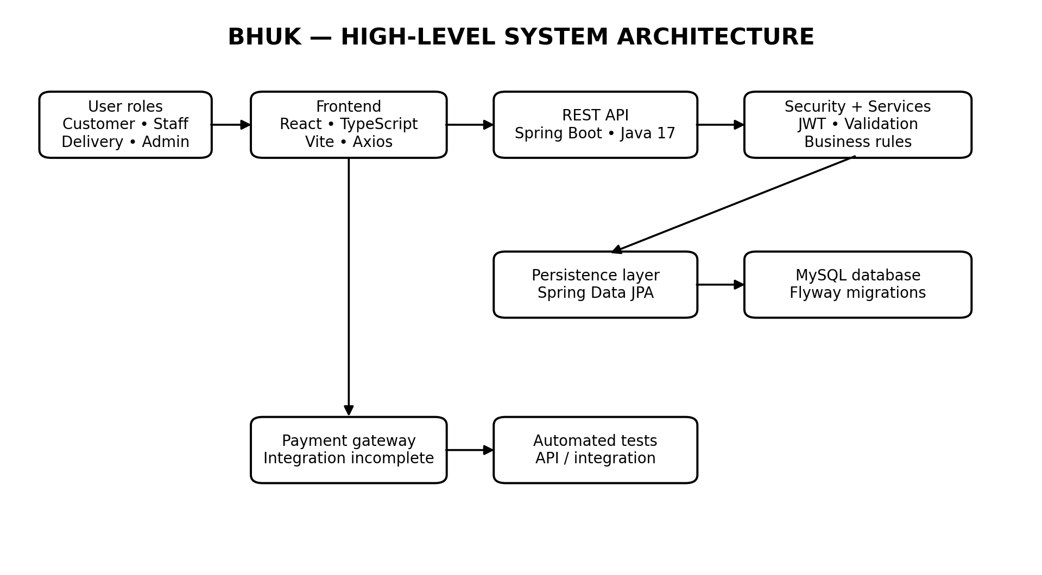
04 • DESIGN
System architecture
Frontend
React • TypeScript • Vite
Backend
Java 17 • Spring Boot • REST API
Data & security
MySQL • JPA • Flyway • JWT
Notes:
Bhuk uses a layered full-stack architecture.
The frontend is built using React, TypeScript and Vite. React helps us build reusable interface components, TypeScript provides static type checking, and Vite supports the frontend development and build process.
The frontend communicates with the backend through REST APIs.
The backend uses Java and Spring Boot to implement application logic, process requests, validate data and manage order operations.
Spring Data JPA supports interaction with the relational database, while MySQL stores persistent information such as users, menu items and orders. Flyway is used to manage database schema migrations.
JWT-based authentication supports authenticated API requests, with authorization controls needed for protected operations.
The main advantage of this architecture is separation of responsibilities. The frontend manages presentation, the backend enforces business rules, and the database stores persistent data.

Slide 6
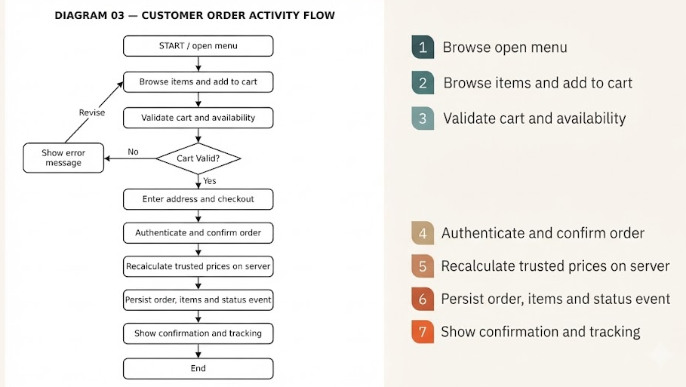
05 • WORKFLOW
Core ordering workflow
Notes:
This slide explains how an order moves through the application.
First, the customer browses the menu and selects food items. The selected items are added to the cart, where quantities can be managed and pricing can be calculated.
When the customer proceeds to checkout, the backend validates the request and checks the relevant item information and availability.
The backend recalculates the amount using trusted menu prices rather than accepting a total supplied by the browser. This is important because client-side values can be modified.
If the request is valid, the system creates the order and stores its associated order items in the database.
The order can then progress through the supported status lifecycle, such as placed, accepted, preparing, ready for pickup, out for delivery and delivered.
The system may also record cancellation or rejection when those transitions are supported by the business rules.
This workflow connects the customer interface, backend logic and persistent storage into one process.

Slide 7
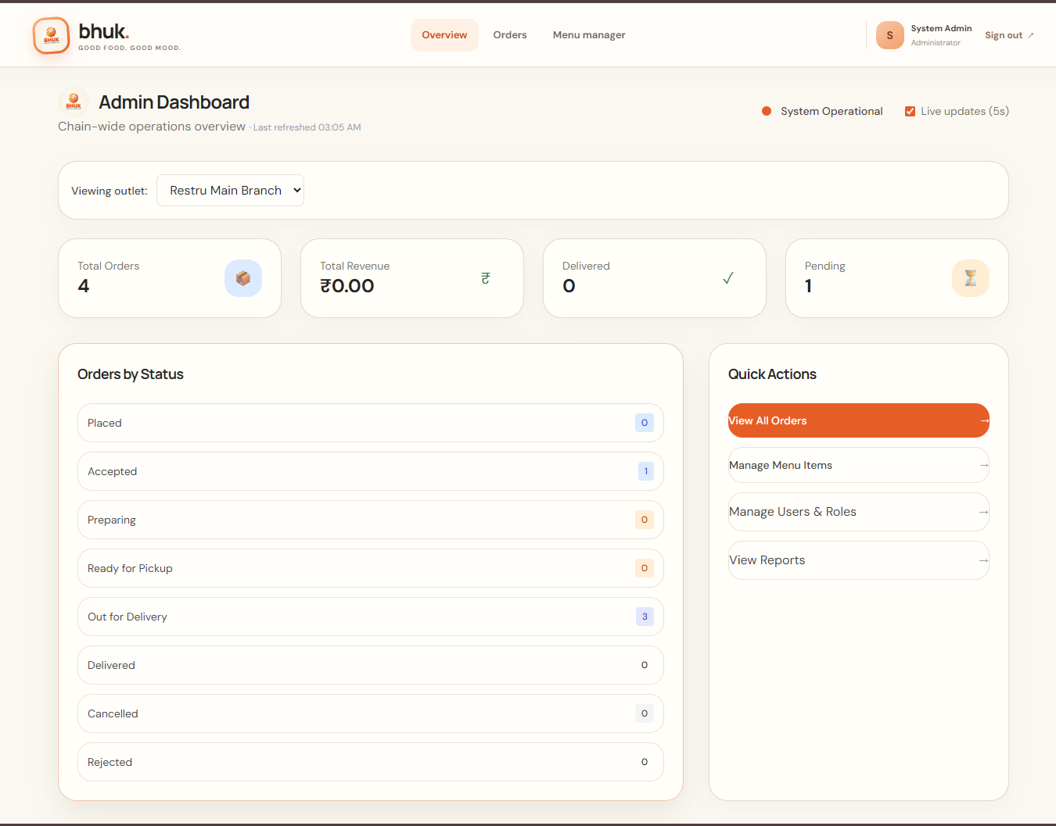
06 • OPERATIONS
Operations and administration
Chain overview, order filters, status and operational shortcuts
Notes:
This slide demonstrates the administrative side of Bhuk.
The admin dashboard provides an overview of order activity and offers quick access to important management functions.
The order management interface allows administrators to search for orders, filter them by status and open individual order details.
The order detail view provides information such as the order identifier, customer information, item quantities, pricing and order status history.
The menu management interface allows authorized users to manage menu categories and items, including availability.
These functions help organize restaurant operations and make order information easier to access.
Administrative operations should be protected by backend authorization. Hiding a button in the frontend alone is not sufficient to secure an operation.

Slide 8
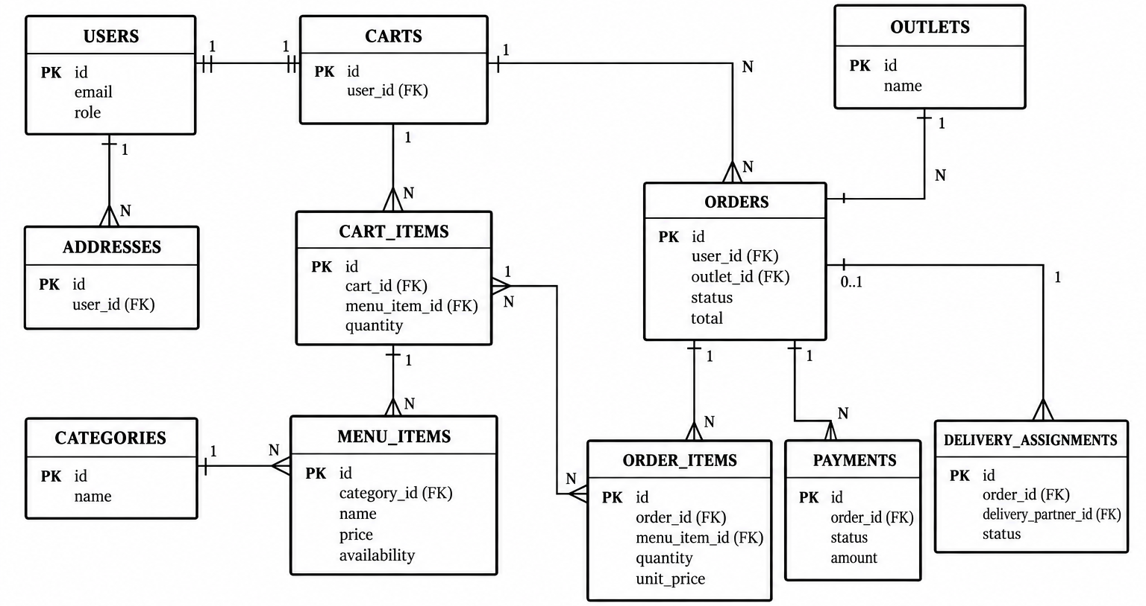
07 • ENGINEERING
Data model and object-oriented design
Notes:
The Entity Relationship diagram represents the main data entities used in the Bhuk system and the relationships between them.
The Users entity represents people who interact with the application. Addresses are associated with users, while carts and cart items represent the products a customer is preparing to order.
Categories organize menu items. Orders represent confirmed ordering records, while order items store the individual food items and their purchase details.
Payments and delivery assignments represent the payment and delivery parts of the order workflow. Outlets represent restaurant locations where applicable.
Primary keys uniquely identify records, while foreign keys connect related records.
For example, an order can be associated with a customer, and its order items can reference the corresponding order. This structure helps maintain consistency and avoids storing all information in one large table.
The diagram is a conceptual view, so its relationships and cardinalities must be verified against the actual database migrations.

Slide 9
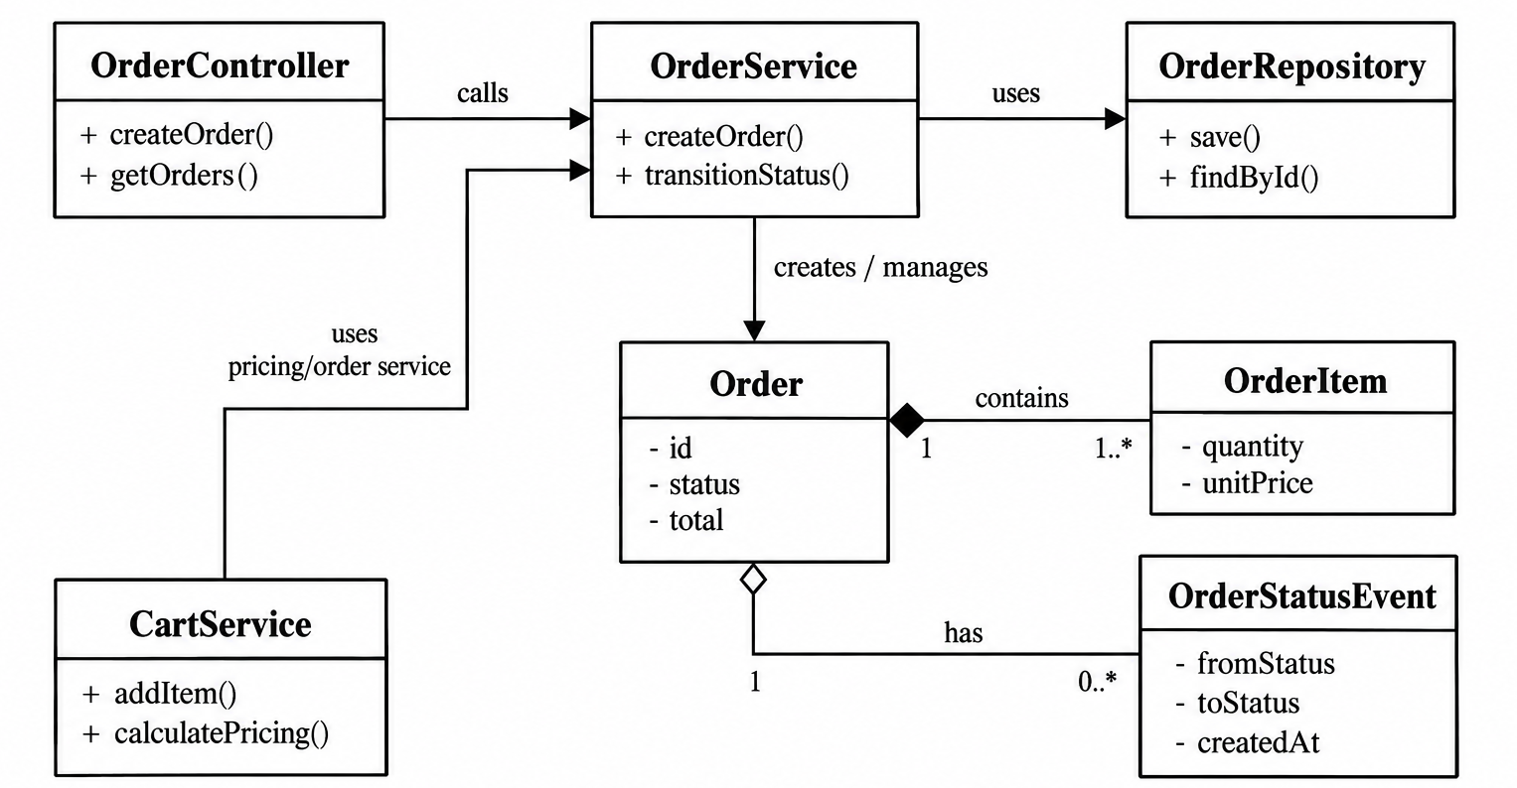
07 • ENGINEERING
Data model and object-oriented design
Core entities support orders, menu, carts, payments and delivery. Layered classes separate HTTP, business rules and persistence.
Notes:
The class diagram explains how the application is divided into classes and how they interact.
Starting from the top left, OrderController handles incoming requests, such as creating or retrieving orders.
It calls OrderService, which contains the main business logic. The service coordinates order creation and permitted status transitions.
OrderService uses OrderRepository to save and retrieve order information.
CartService supports cart operations, including adding items and calculating pricing.
The Order class represents the complete order and stores attributes such as its ID, status and total.
An Order contains OrderItem objects, each representing an item purchased, its quantity and its unit price.
OrderStatusEvent represents status-history records, allowing the system to record transitions and their timestamps.
The arrows indicate dependencies and relationships. The filled diamond represents composition, while the unfilled diamond represents aggregation in this diagram.
Overall, the class diagram illustrates separation of responsibilities between request handling, business logic, persistence and order data.

Slide 10
09 • ROADMAP
Conclusion and next steps
Bhuk establishes the core menu, ordering and admin workflow.
Priority next steps
1. Complete payment gateway integration and reconciliation
2. Add end-to-end tests for customer-to-delivery lifecycle
3. Reconcile schema counts and attach final test logs
4. Harden deployment, monitoring and accessibility
Repository: github.com/atabhishekx/bhuk
Notes:
To conclude, Bhuk demonstrates the design and development of a single-chain food delivery application that connects customer ordering with restaurant-side management.
The project brings together menu browsing, cart operations, order processing, order monitoring and menu administration through a layered full-stack architecture.
FA1 establishes the requirements, design and initial implementation, while FA2 focuses on core functionality, integration, validation and testing.
The project has helped us understand practical software engineering concepts, including API design, relational database modelling, object-oriented design, authentication and testing.
Future improvements include completing payment gateway integration, strengthening end-to-end testing, improving delivery tracking and notifications, and enhancing deployment monitoring and operational reliability.
With these improvements, Bhuk can evolve into a more complete and production-ready food ordering platform.
Thank you for your time. I am happy to answer any questions.

