Slide 1
A Gentle Introduction to Git
Andy Ackerman

Slide 2
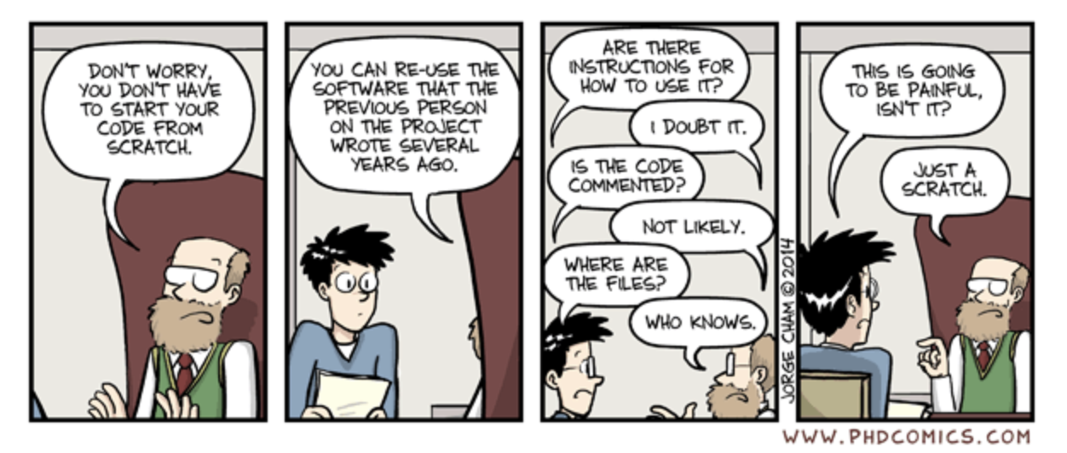
Reproducibility: Why does it matter?
Validating methods and conclusions
More generalizable contribution to knowledge base
Helps prevent misinterpretations arising from spurious artifacts
Ensuring accountability

Slide 3
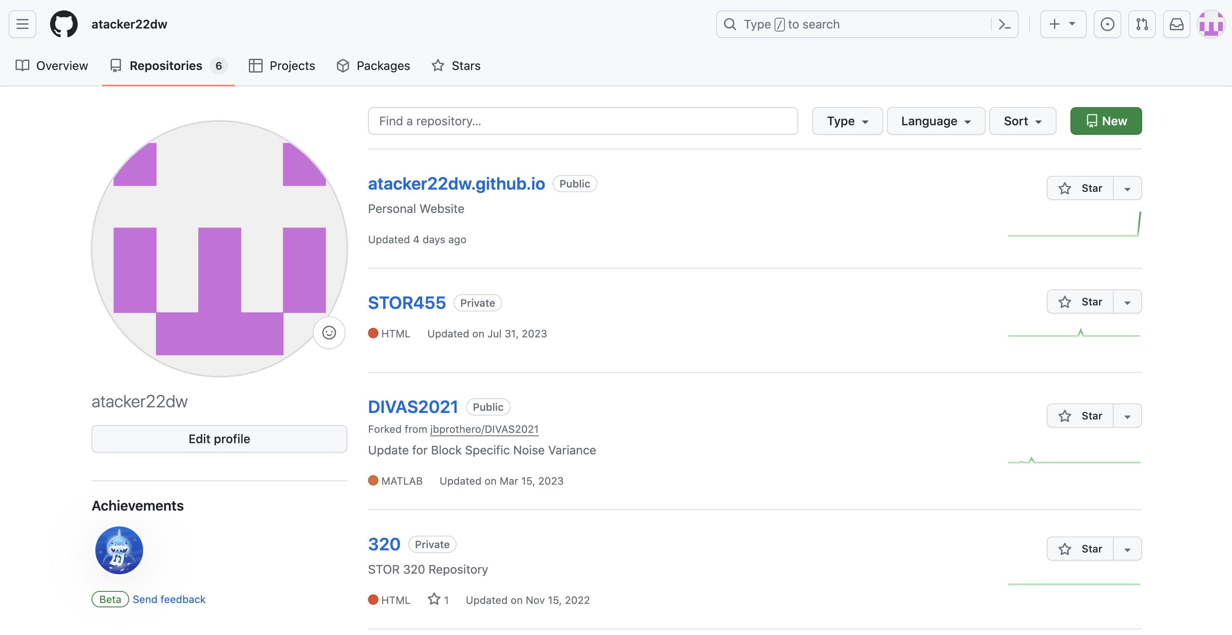
Creating a New Repository
Public (for our purposes)
Choose an informative title
Add a ReadMe
”Parent Folder to all subfolders”
Git Tutorial Repo

Slide 4
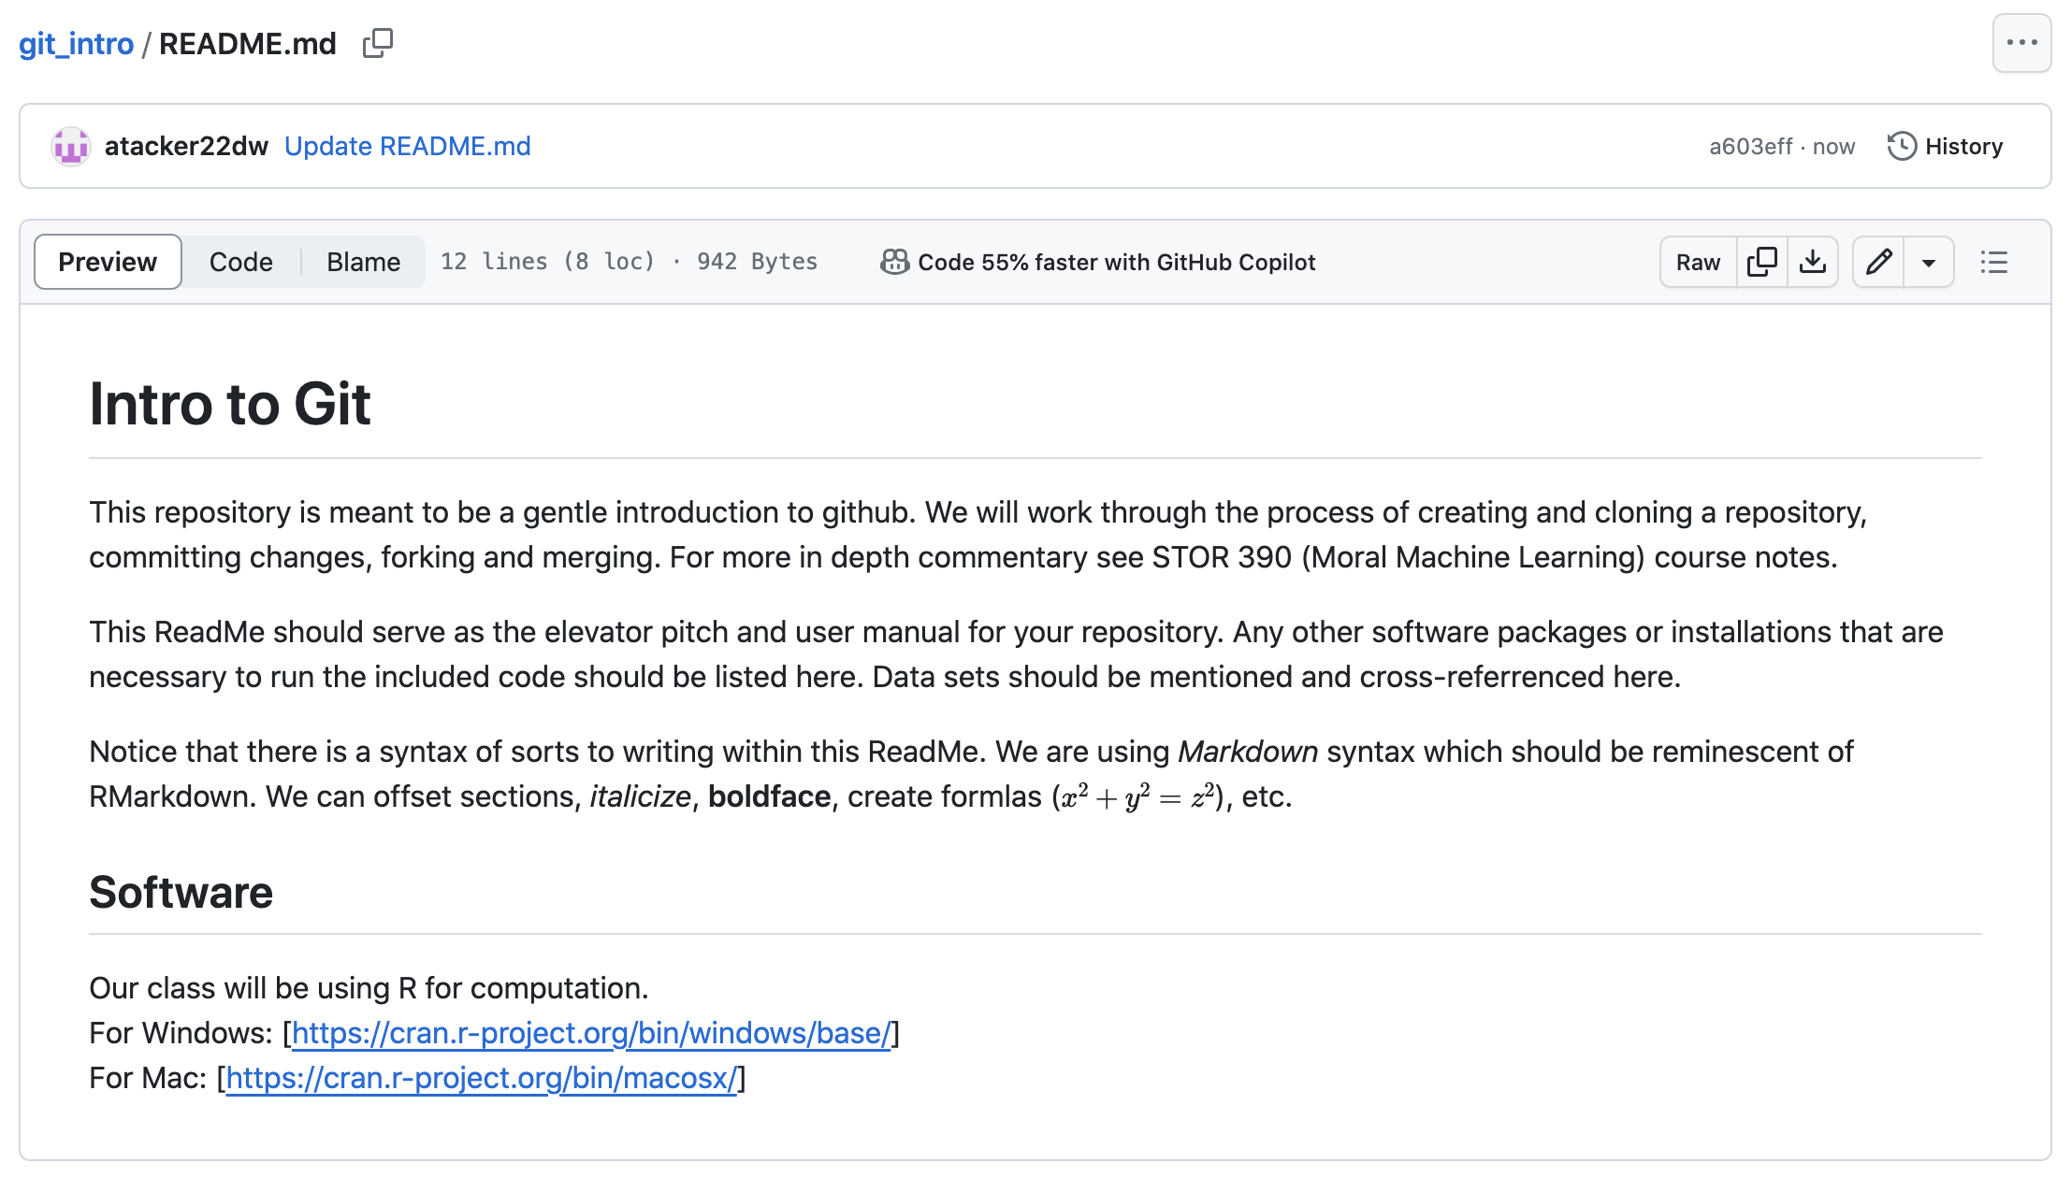
Creating a ReadMe
Informative
Concise
Makes repo fully self-contained

Slide 5
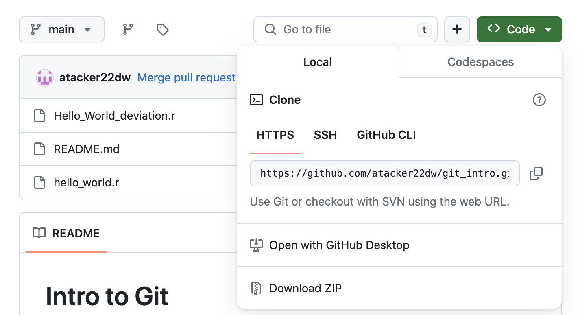
Collaborative Coding-Cloning
Cloning a repo
Locally via zip file
Terminal window
git clone https://github.com/YOUR-USERNAME/YOUR-REPOSITORY

Slide 6
Collaborative Coding: Multiple Model Guidelines
Fork/Pull
Independent users create their own “fork”
No permissions required
Best for large open-source projects
Shared Repository with Branching
Collaborators may work on subject-specific branches
These are discussed via pull request and ultimately pushed to the “main”
Ideal for small organizations working on private projects

Slide 7
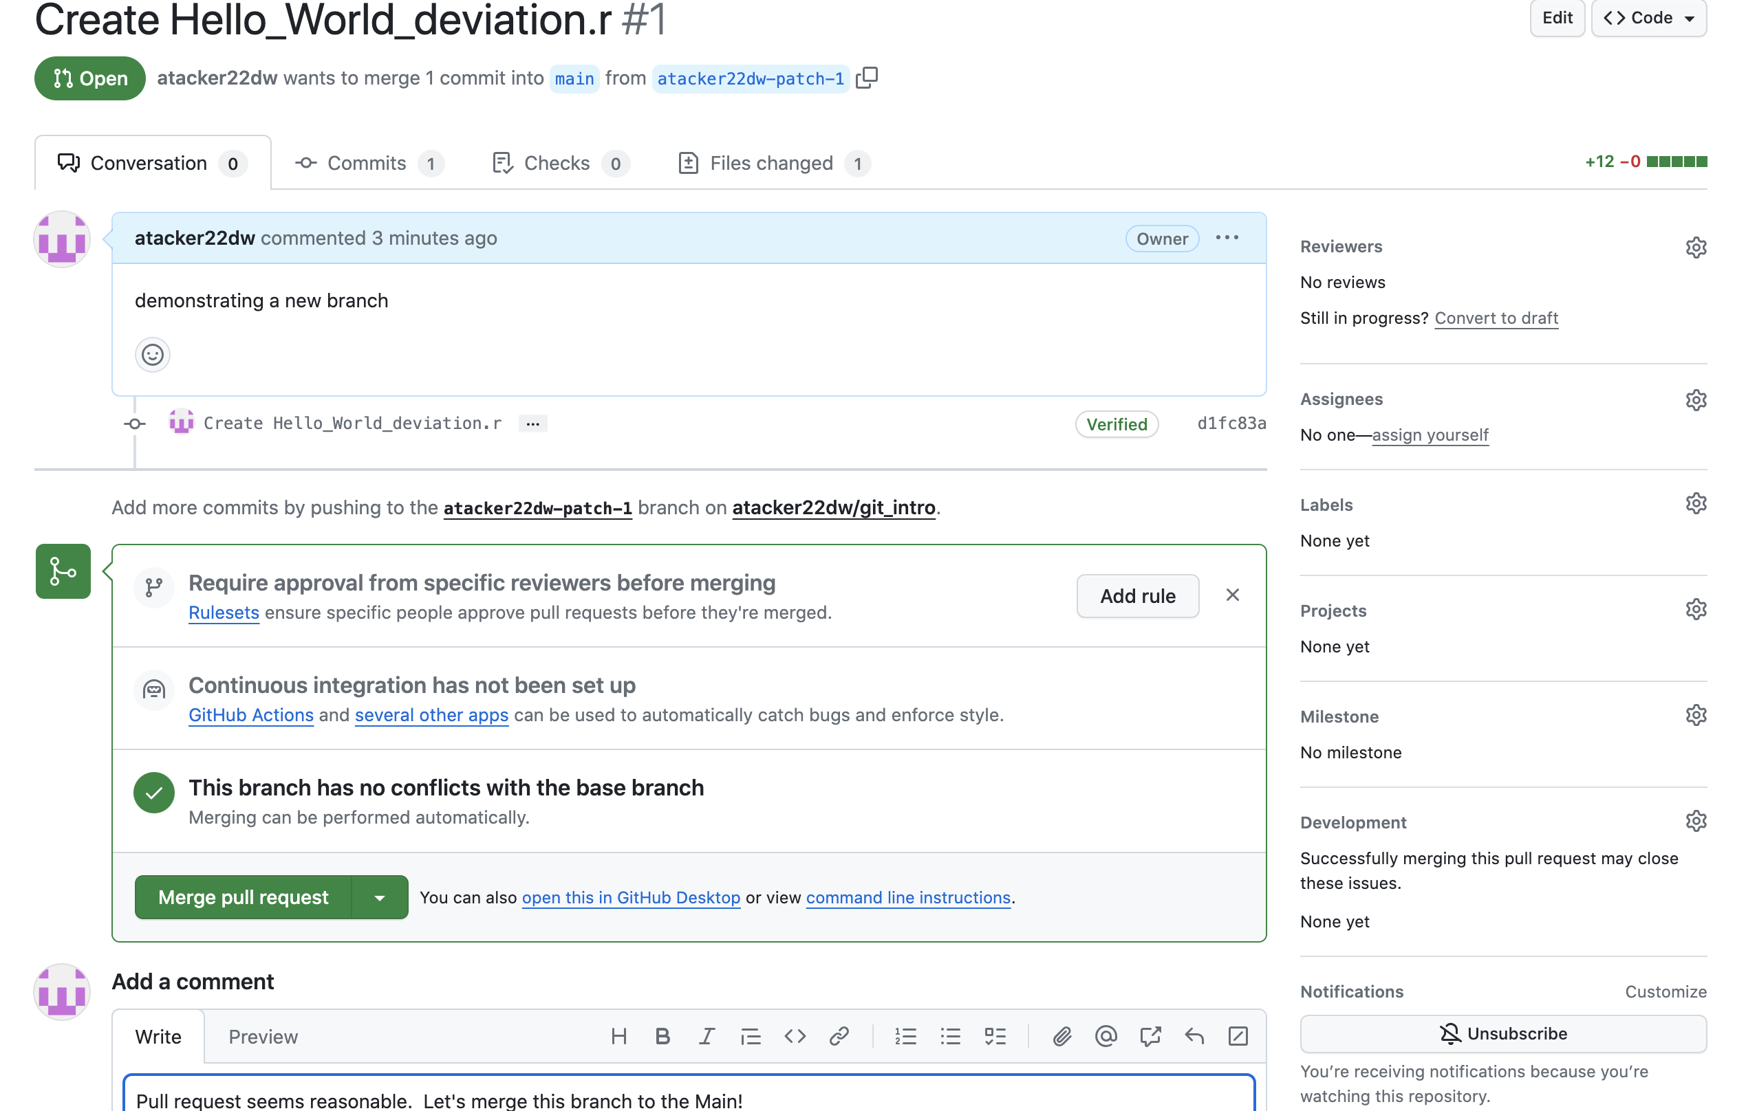
Collaborative Coding-Branching
Creating a new (protected) branch
Pull requests
Merging new branches into the main (commenting)

Slide 8
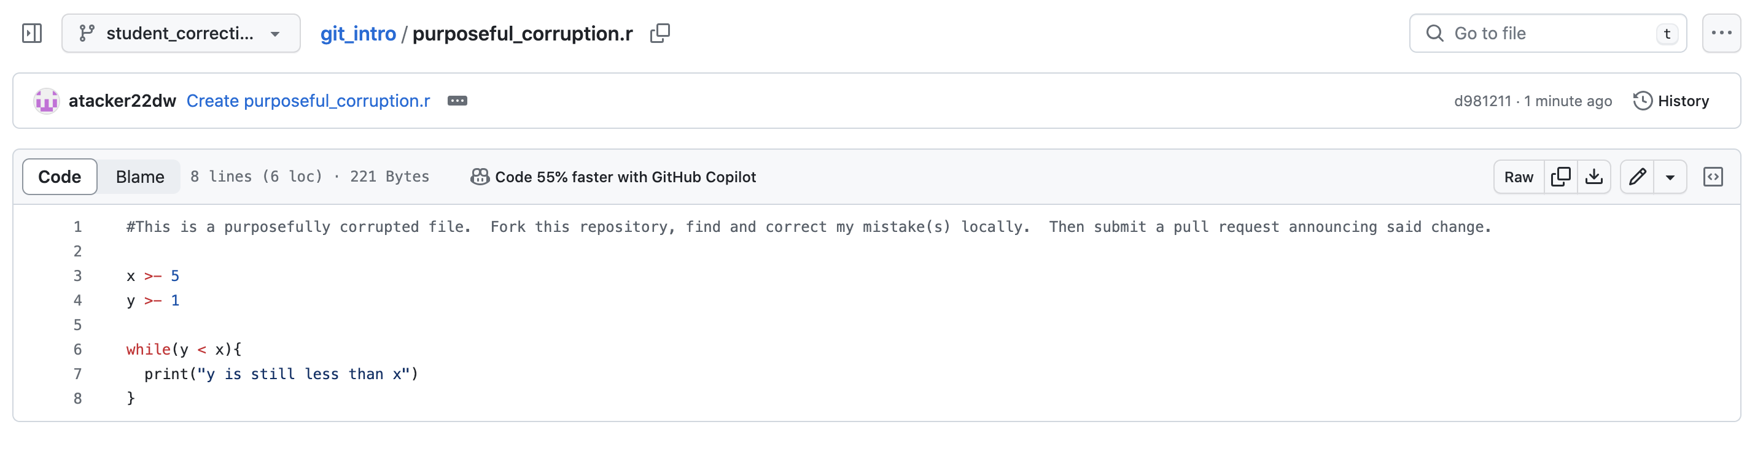
Collaborative Coding-Forking
Class Exercise

Slide 9
Best Practices
Comment thoroughly
Both in line (via proposed files) and in the comment box accompanying pull requests
Create protected branches (such as the main)
Test and apply your pull requests locally first
Encourage code owners and linear timelines to mitigate merge conflicts

Slide 10
Quote of the Day
“The power of Open Source is the power of the people. People rule.” – Philippe Kahn

