Slide 1
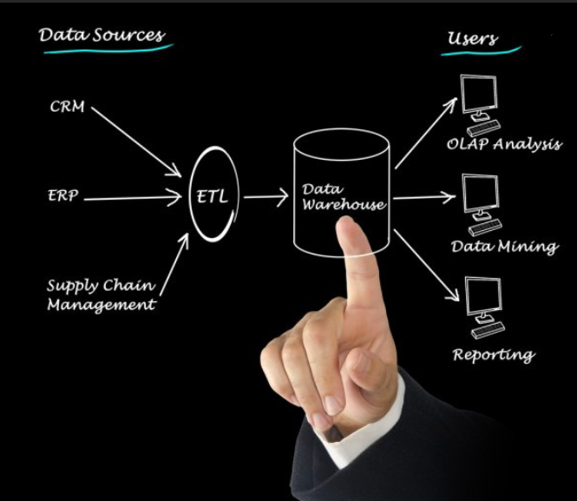
Data Warehouse and
Business Intelligence
ETL Workflow Scheduler: JobHoncho
March 2020

Slide 2
Objective
JobHoncho is an automated job control system for scheduling & monitoring ETL jobs for BI solutions. This can create a dependency between a job with full flexibility to add/remove any job(s) from ETL flow.
Focus Areas
Key Outcomes
1
Creation of Batch for daily/weekly/Monthly DW load
JobHoncho can create batch on specific day of a week (or daily) and schedule ETL jobs to load data in DW.
2
Dependency between jobs.
Creating dependency between jobs is just a matter of few row insertion in control tables.
Adding/Removing any job from flow is also easy.
3
Skipping job in ongoing DW load
JobHoncho provides basic scheduler options like skipping a job, hung the flow etc.

Slide 3
Problems JobHoncho can solve:
Job dependency
DS scheduler doesn’t allow to set dependency between jobs. With JobHoncho, it’s easy to create dependency.
Add or remove job
To add/remove job in workflow, DS wrapper sequence needs to be changed which is time consuming and involves risk.
Skipping a job on failure
If a job aborts, there is no way to skip the job in DS scheduler. JobHoncho provide the flexibility to skip a job just by updating the status to ‘Complete’ in CTRL_BATCH_JOBS table.
Hung the process
DS scheduler doesn’t provide options to wait for files or another process to complete beyond a pre-defined time. JobHoncho wait for a specific job until it’s complete or abort.

Slide 4
JobHoncho Architecture:
Control tables: The Batch Control Tables contain all the metadata about jobs that have been and are to be run.
Stored Procedure: This SP identify the run ability status of a job by checking dependent job status.
Unix Scripts: The Unix Scheduler script is continually running, checking for new jobs to run and reporting back the status of jobs that have been run.
DS Jobs: ETL code to load DW.
DB2 server
DS Server
Log files
Log files
DS Job
Control Tables & Stored Procedure
Daemon Script
JobHocho
Unix Script to trigger DS Job

Slide 5
JobHoncho Process Flow:

Slide 6

Why JobHoncho?
1
GPS Data security
JobHoncho is inhouse code residing in the internal server. Hence give full control & security of data.
2
Easy to configure & use
JobHoncho is exclusively built for internal scheduling purposes. That gives the ability to configure a job with a minimum understanding of the system.

Slide 7
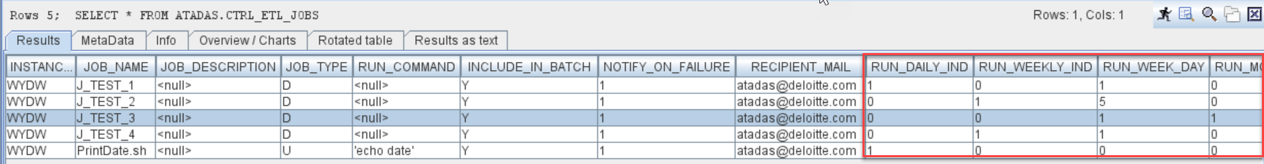
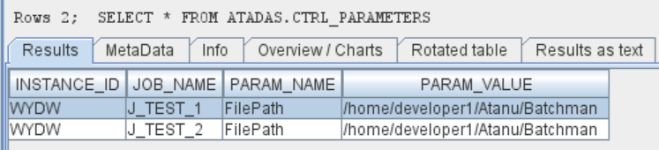
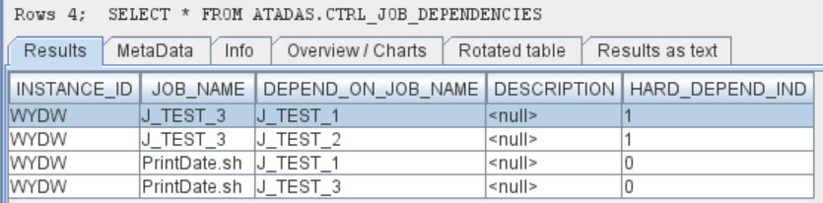
JobHoncho Control tables:
Below are the details about control tables. To configure JobHoncho for new ETL jobs, entries need to be created in the tables.
CTRL_ETL_JOBS: This table holds details of all ETL jobs that need to be triggered.
CTRL_JOB_DEPENDENCIES: Dependency between ETL jobs are maintained here.
CTRL_PARAMETERS: Details about job parameters are stored here.
CTRL_BATCH_JOBS: After new batch creation, all jobs that need to be triggered are inserted into this table.
CTRL_ETL_JOBS :
CTRL_PARAMETERS:
CTRL_JOB_DEPENDENCIES :

Slide 8
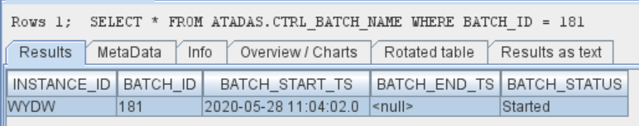
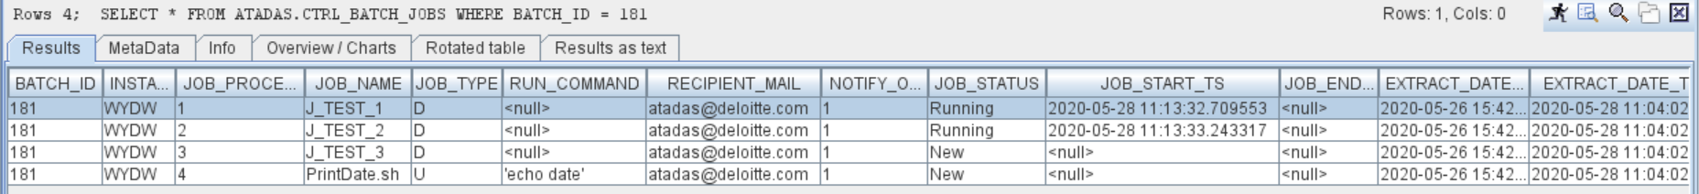
Process Output:
Creating new batch: Every week/day, new batch will be created on a specific time. Also, add hoc batch can be created through JobHonchoDaemon.
[atadas@USSLTC7496v JobHoncho]$ sh JobHonchoDaemon.sh CreateBatch
New batch 181 created.......
Start the daemon........
[atadas@USSLTC7496v JobHoncho]$ nohup sh JobHonchoDaemon.sh Start &
[1] 24603
CTRL_BATCH_NAME:
CTRL_BATCH_JOBS:

Slide 9
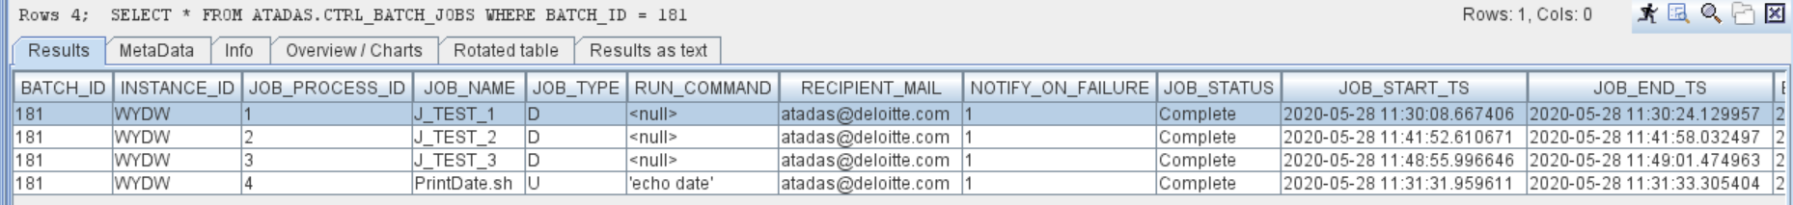
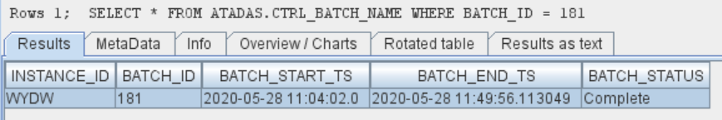
Process Output: Continue……..
Stop/Start JobHoncho:
[atadas@USSLTC7496v JobHoncho]$ sh JobHonchoDaemon.sh Stop
Script has been stopped...
[atadas@USSLTC7496v JobHoncho]$ nohup sh JobHonchoDaemon.sh Start &
[1] 15881
Completion of Batch:
Once all the ETL job completed successfully, JobHoncho will complete the batch & stop running.
CTRL_BATCH_JOBS:
CTRL_BATCH_NAME:

Slide 10
JobHoncho Language:
Access last job run datetime() :
$LastRunDate
2. Access current job run datetime() :
$RunDate
3. Insert shell command with in single quote (‘’):
e.g. 'echo date','sh <path>/<script.sh> <param1> <param2> <param3>'

Slide 11
Thank You

