Slide 1
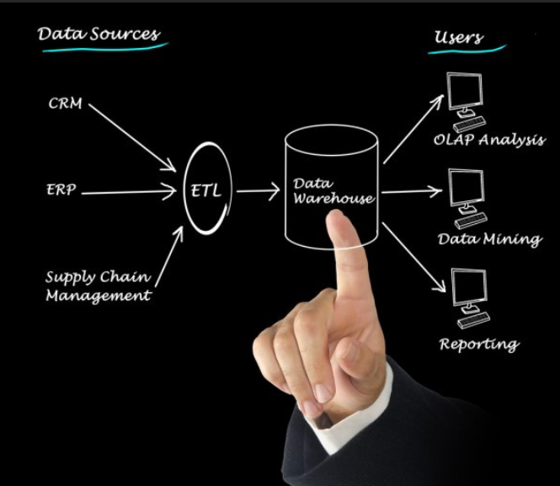
Data Warehouse and
Business Intelligence
ETL Workflow Scheduler : JobHoncho
Deloitte Consulting LLP
March, 2020

Slide 2
Objective
JobHoncho is an automated job control system for scheduling & monitoring ETL jobs for BI solution. This can create dependency between job with full flexibility to add/remove any job(s) from ETL flow.
Focus Areas
Key Outcomes
1
Creation of Batch for daily/weekly DW load
JobHoncho can create batch on specific day of a week (or daily) and schedule ETL jobs to load data in DW.
2
Dependency between jobs.
Creating dependency between jobs is just a matter of few row insertion in control tables.
Adding/Removing any job from flow is also easy.
3
Skipping job in ongoing DW load
JobHoncho provides basic scheduler options like skipping a job, hung the flow etc.

Slide 3
Problems we are solving:
Below are the shortcomings of the DataStage inbuild scheduler.
Job dependency
DS scheduler doesn’t allow to set dependency between jobs. With JobHoncho, it’s easy to create dependency.
Difficult to add new job
To add/remove job in workflow, wrapper sequence needs to be changed which is time consuming and involves risk.
Skipping a job on failure
If a job aborts [with 0 dependency], there is no way to skip the job in DS scheduler. JobHoncho provide the flexibility to skip a job just by updating the status to ‘Complete’ in CTRL_BATCH_JOBS table.
Hung the process
DS scheduler doesn’t provide options to wait for files or another process to complete beyond a pre defined time. JobHoncho wait for a specific job until it’s complete or abort.

Slide 4
JobHoncho Architecture:
Control tables: The Batch Control Tables contain all the metadata about jobs that have been and are to be run.
Stored Procedure: This SP identify the run ability status of a job by checking dependent job status.
Unix Scripts: The Unix Scheduler script is continually running, checking for new jobs to run and reporting back the status of jobs that have been run.
DS Jobs: ETL code to load DW.
DB2 server
DS Server
Log files
Log files
DS Job
Control Tables & Stored Procedure
Daemon Script
JobHocho
Unix Script to trigger DS Job

Slide 5
JobHoncho Process Flow:

Slide 6
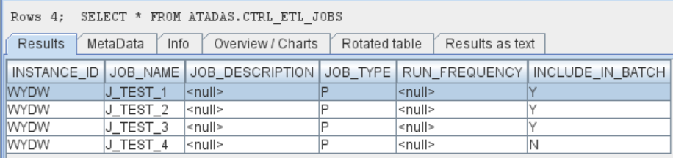
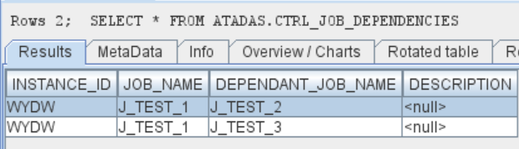
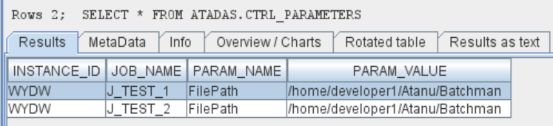
JobHoncho Control tables:
Below are the details about control tables. To configure JobHoncho for new ETL jobs, entries need to be created in the tables.
CTRL_ETL_JOBS: This table holds details of all ETL jobs that need to be triggered.
CTRL_JOB_DEPENDENCIES: Dependency between ETL jobs are maintained here.
CTRL_PARAMETERS: Details about job parameters are stored here.
CTRL_BATCH_JOBS: After new batch creation, all jobs that need to be triggered are inserted into this table.
CTRL_ETL_JOBS :
CTRL_JOB_DEPENDENCIES :
CTRL_PARAMETERS:

Slide 7
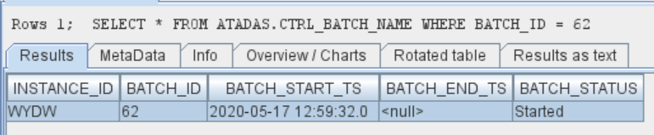
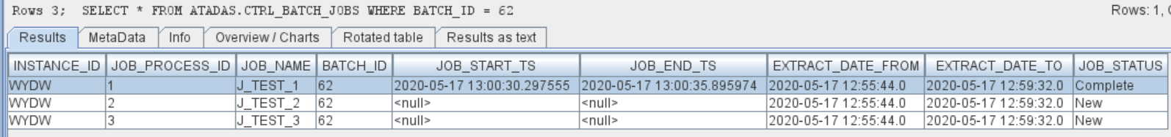
Process Output:
Creating new batch: Every week/day, new batch will be created on a specific time. Also, add hoc batch can be created through JobHonchoDaemon.
[atadas@USSLTC7496v JobHoncho]$ sh JobHonchoDaemon.sh CreateBatch
New batch 62 created.......
Start the daemon........
[atadas@USSLTC7496v JobHoncho]$ nohup sh JobHonchoDaemon.sh Start &
[1] 24603
CTRL_BATCH_NAME:
CTRL_BATCH_JOBS:

Slide 8
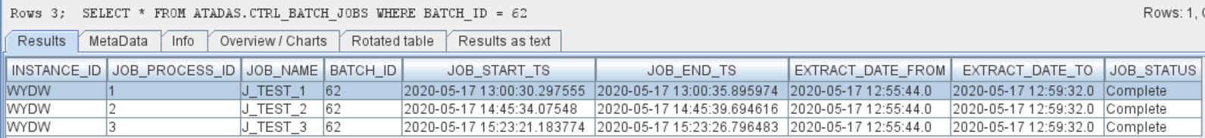
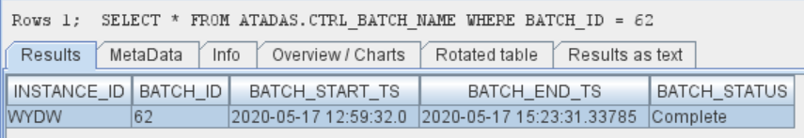
Process Output: Continue……..
Stop/Start JobHoncho:
[atadas@USSLTC7496v JobHoncho]$ sh JobHonchoDaemon.sh Stop
Script has been stopped...
[atadas@USSLTC7496v JobHoncho]$ nohup sh JobHonchoDaemon.sh Start &
[1] 15881
Completion of Batch:
Once all the ETL job completed successfully, JobHoncho will complete the batch & stop running.
CTRL_BATCH_JOBS:
CTRL_BATCH_NAME:

Slide 9
About Deloitte Deloitte refers to one or more of Deloitte Touche Tohmatsu Limited, a UK private company limited by guarantee (“DTTL”), its network of member firms, and their related entities. DTTL and each of its member firms are legally separate and independent entities. DTTL (also referred to as “Deloitte Global”) does not provide services to clients. In the United States, Deloitte refers to one or more of the US member firms of DTTL, their related entities that operate using the “Deloitte” name in the United States and their respective affiliates. Certain services may not be available to attest clients under the rules and regulations of public accounting. Please see www.deloitte.com/about to learn more about our global network of member firms.
Copyright © 2017 Deloitte Development LLC. All rights reserved.

