Slide 1

full thesis
Artificial intelligence in the air
25/09/2020 (sep)
- Introduce the network slicing in 5g and 6g also neural methods
- Introduce the nokia wireless suite
Meeting one

Slide 2
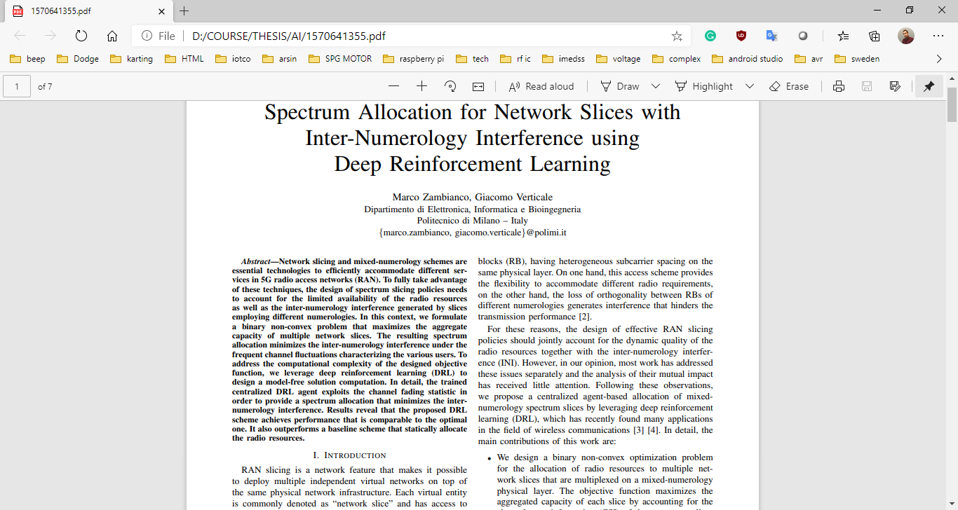
Considering INI
Network slicing
https://ieeexplore.ieee.org/abstract/document/8476595

Slide 3
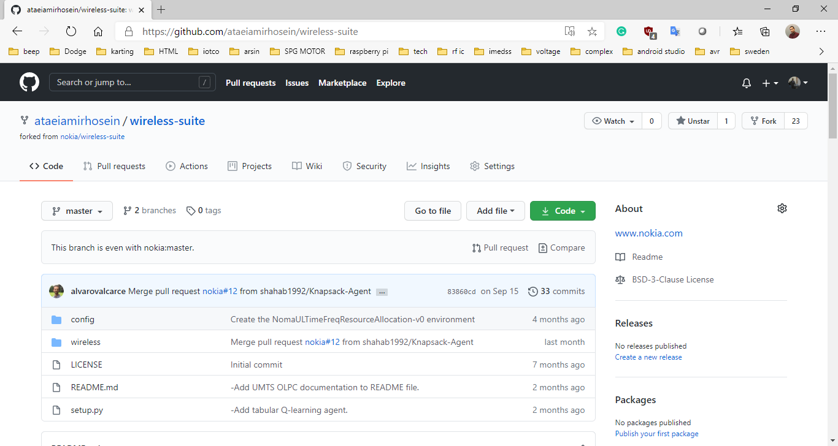
Nokia
github

Slide 4
full thesis
Artificial intelligence in the air
09/19/2020 (oct)
- Read the gym and sacred documentation also deep learning
- Run the nokia wireless suite with observer
Meeting two

Slide 5
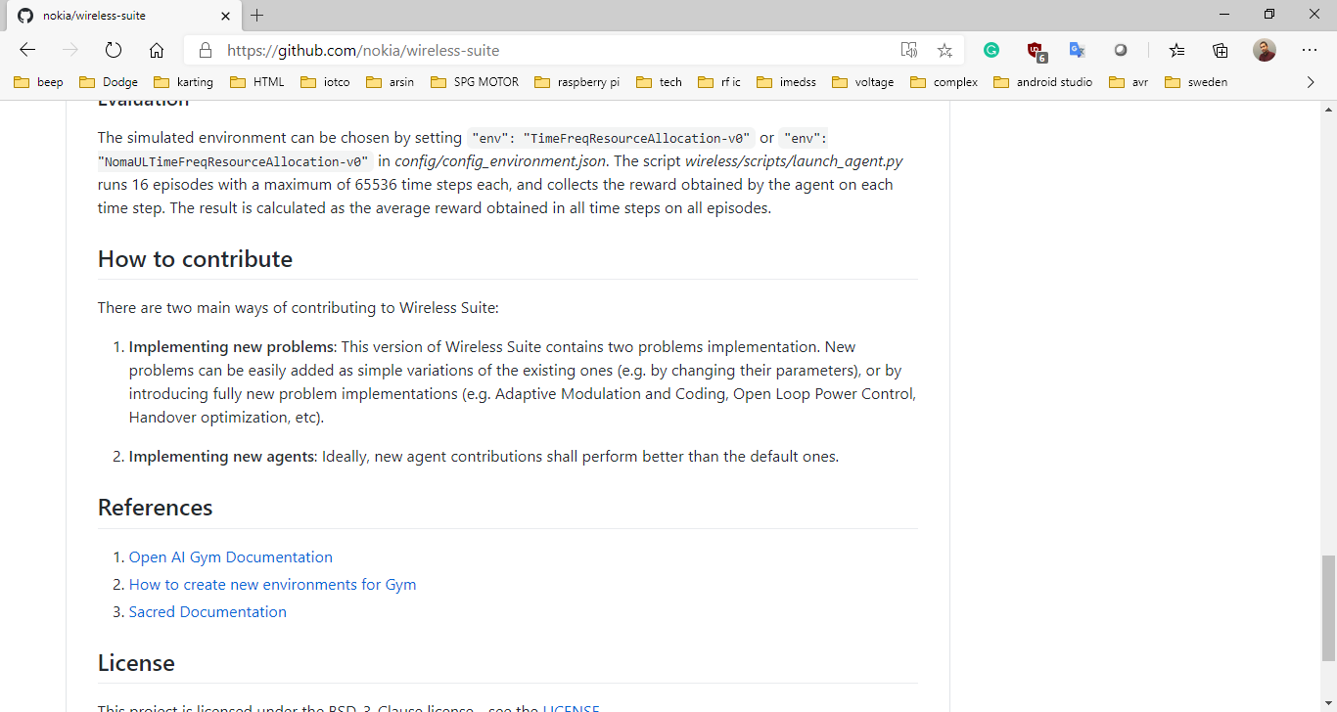
Wireless-suite develop
GYM ENVIRONMENT
SACRED CONFIGURATION

Slide 6
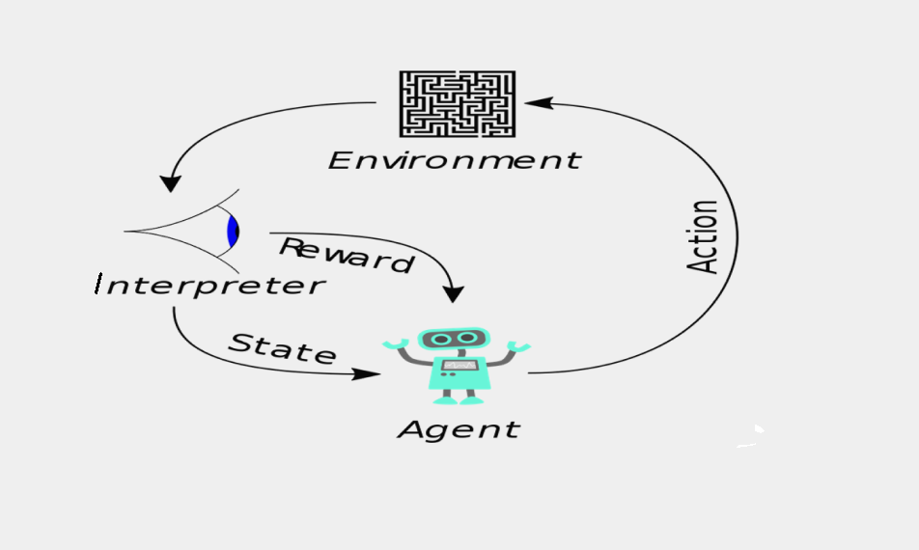
Machine learning
REINFORCEMENT LEARNING
https://youtu.be/kopoLzvh5jY

Slide 7
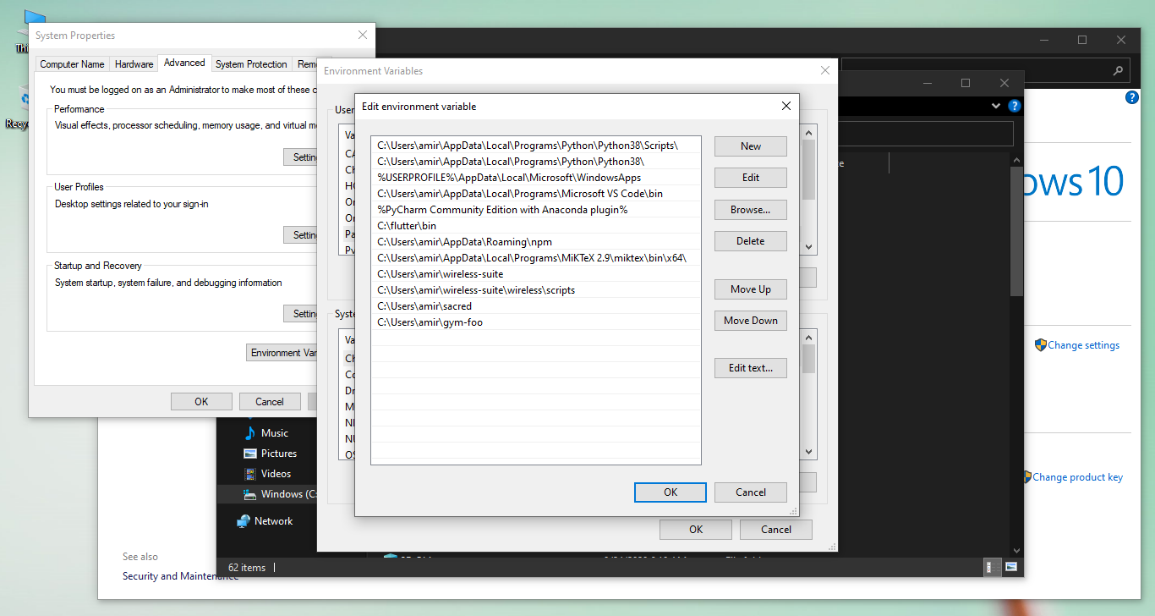
Package should be add to path list
ADD TO PATH

Slide 8
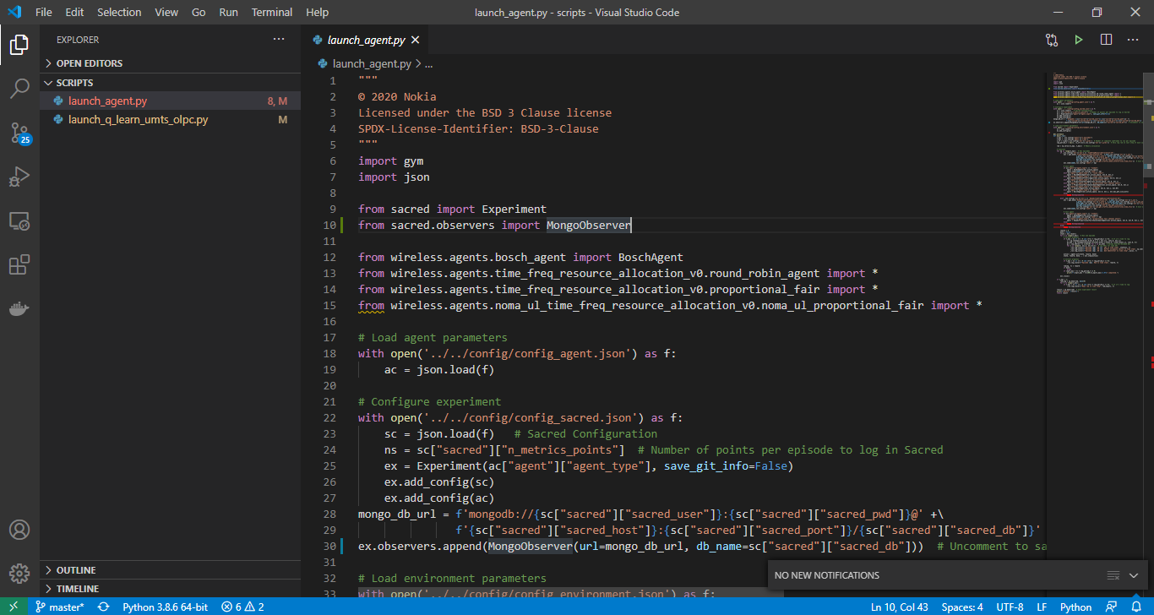
Should be import mongo observer
IMPORT MONGODB AS OBSERVER

Slide 9
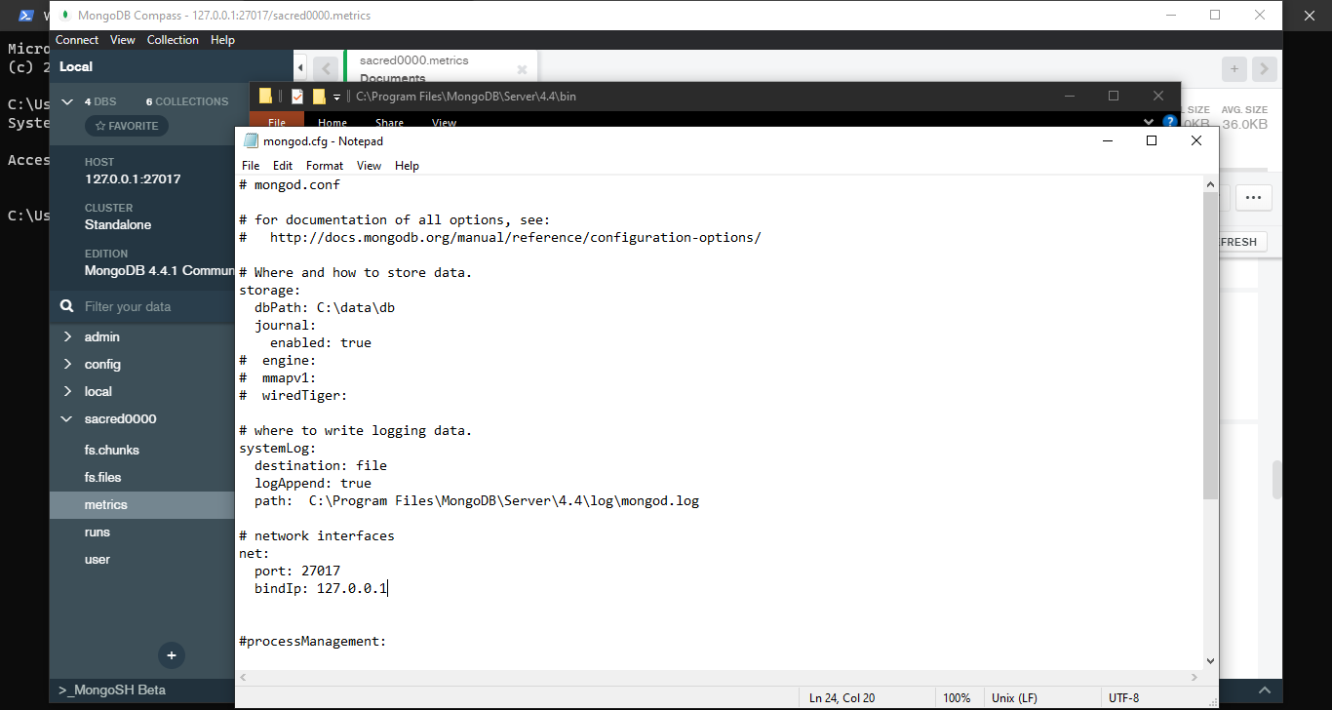
Configuration of mongodb
DATA BASE PATH
PORT AND HOST

Slide 10
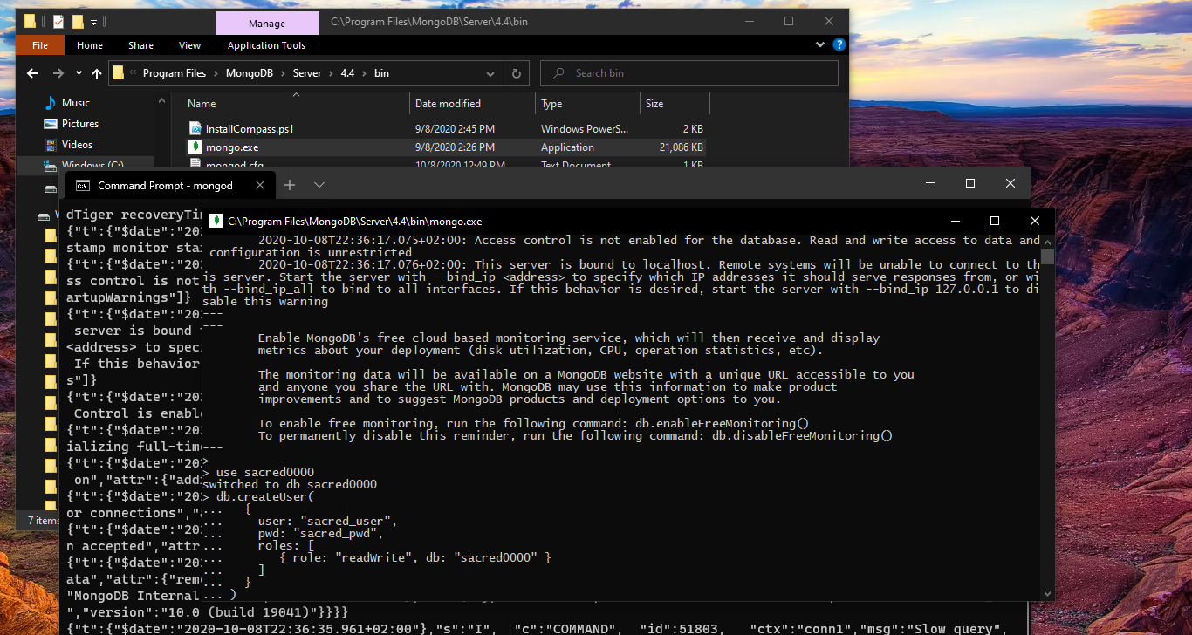
Running mongodb and it’s shell
RUN MONGO SHELL
CREATE DB AND USER TO ACCESS

Slide 11
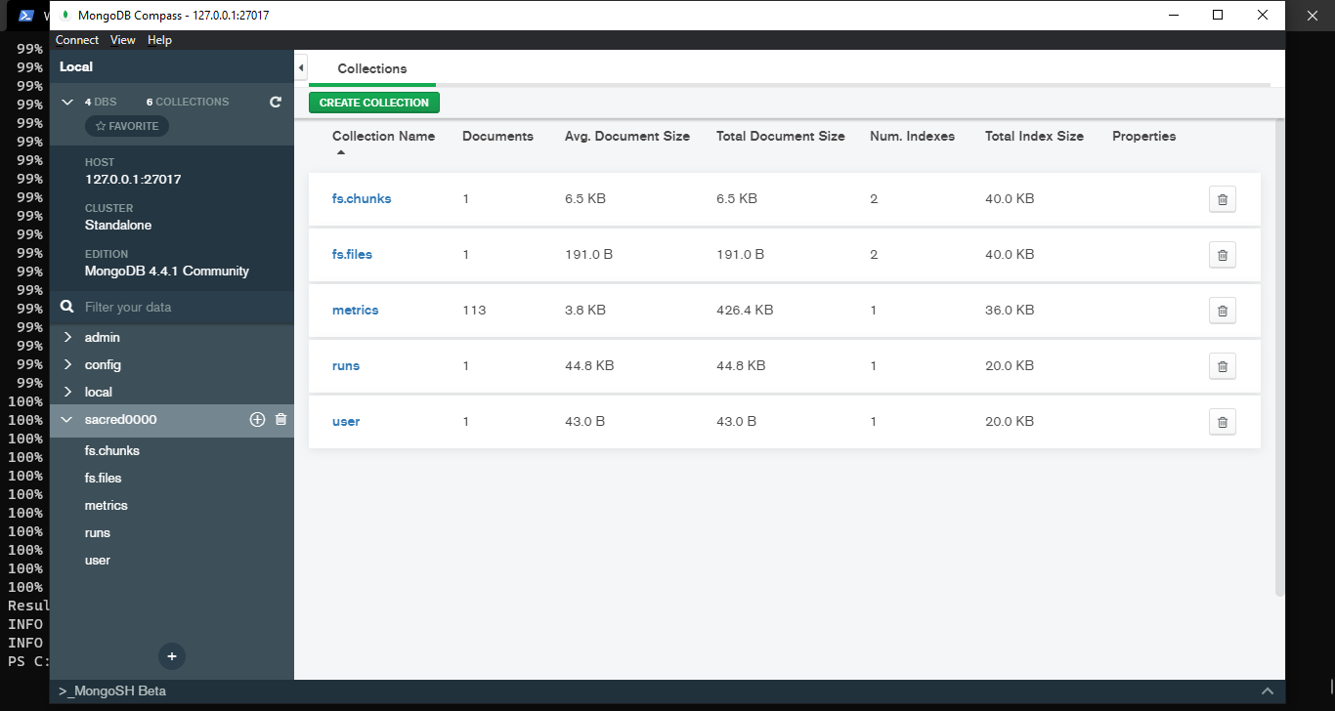
See the data in GUI mongodb compass
COMPASS GUI

Slide 12
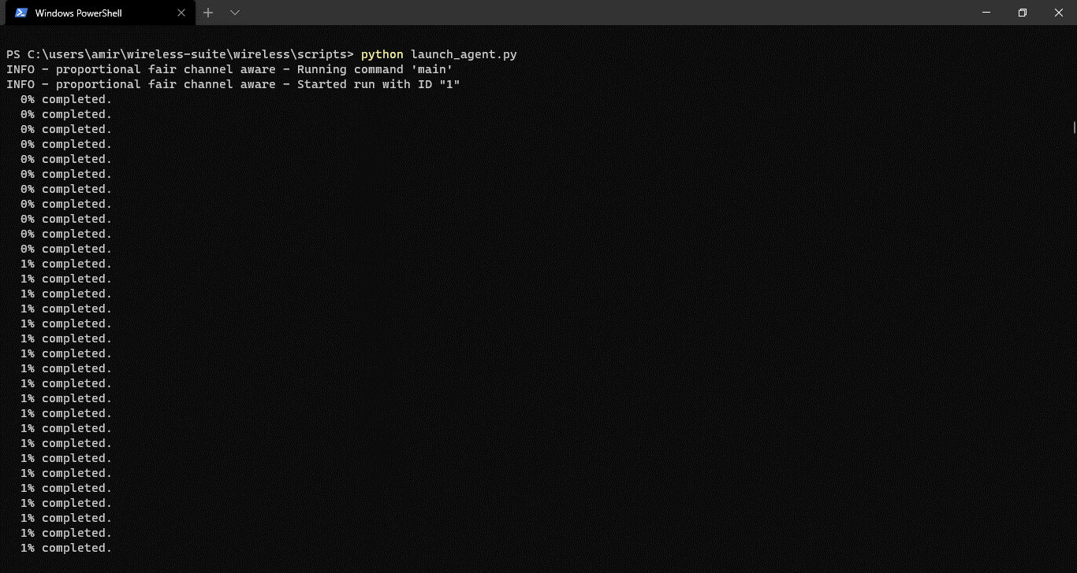
Run the simulation
RUN LAUNCH AGENT ACCORDING CONFIG FILES

Slide 13
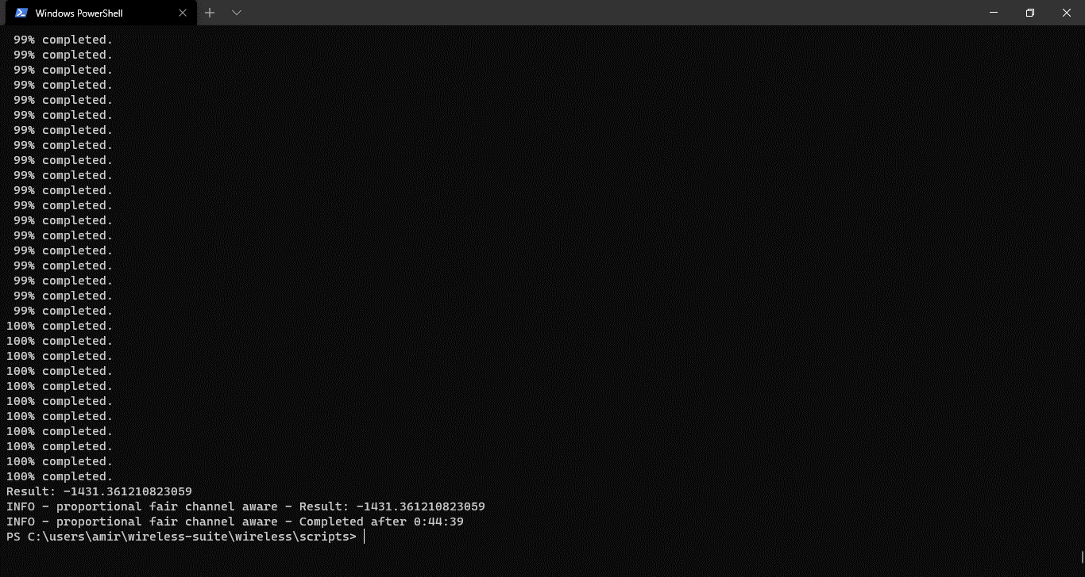
Get the reward number
REWARD VALUE AS RESULT

Slide 14
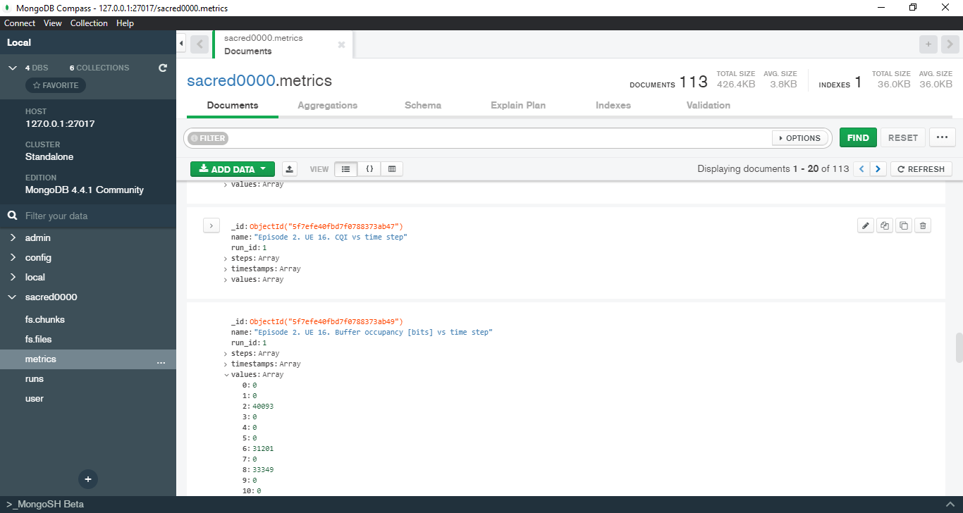
Evaluate all the datas that are saved
STORED DATA

Slide 15
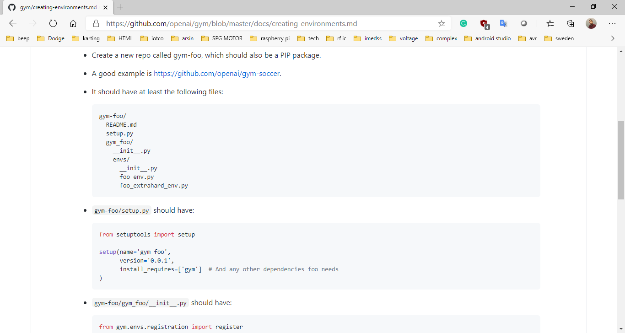
Gym environment
MAKE ENVIRONMENT

Slide 16
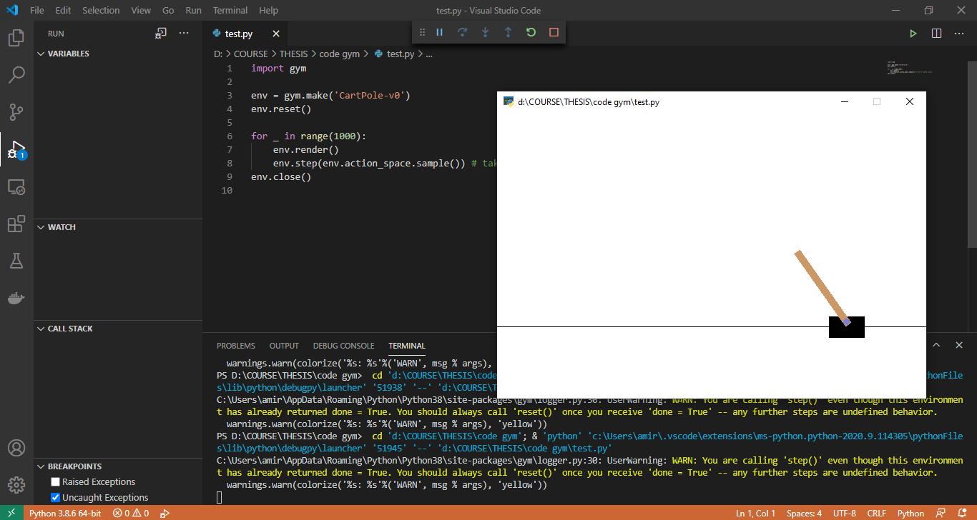
Test open ai gym
GYM ENVIRONMENT EXAMPLE

Slide 17
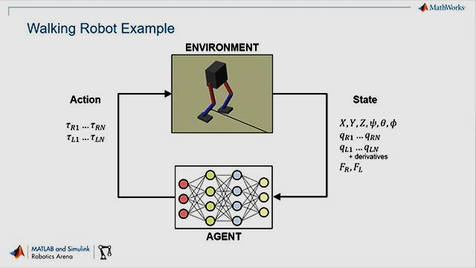
Matlab
reinforcement learning
https://it.mathworks.com/products/reinforcement-learning.html

Slide 18
full thesis
Artificial intelligence in the air
26/10/2020 (oct)
- Exploit all the specification of q-learning python program - improve the time efficiency
Meeting three

Slide 19
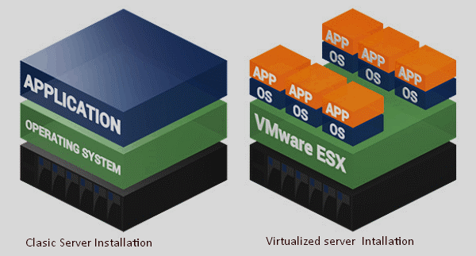
Virtualy run on top of powerful HW
Powerful resource

Slide 20
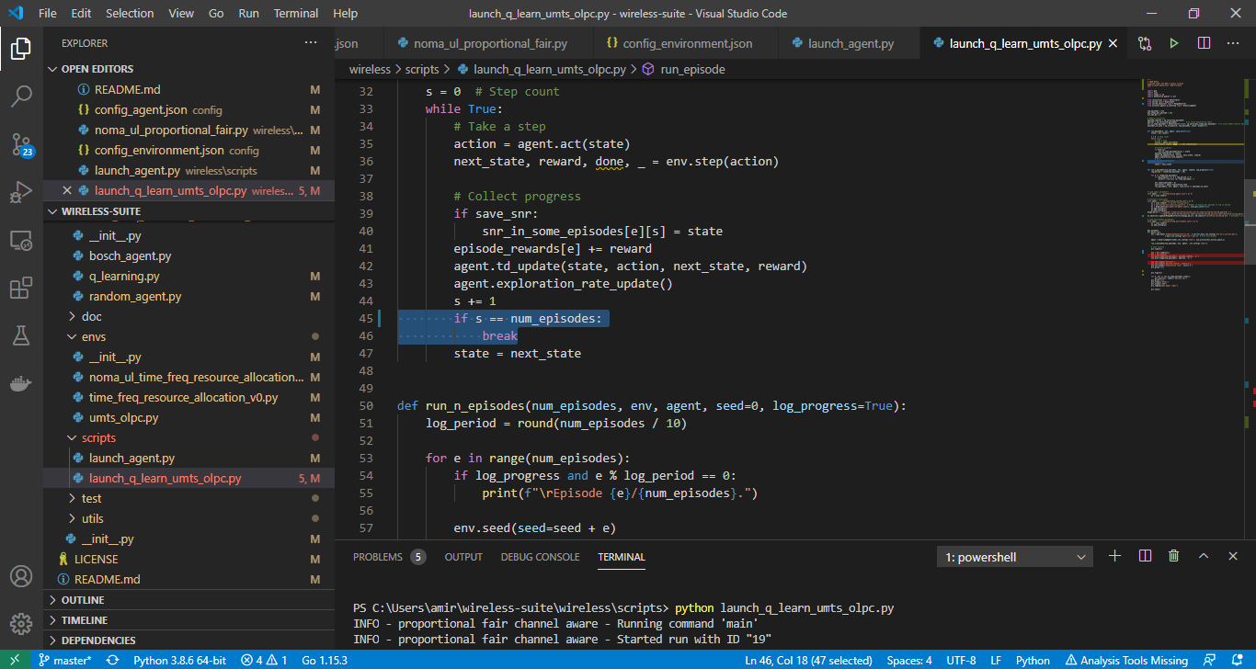
Q-learn
Find and solve the problem of UMTS-OLPC code Related to number of episodes
https://www.youtube.com/watch?v=e3L4VocZnnQ

Slide 21
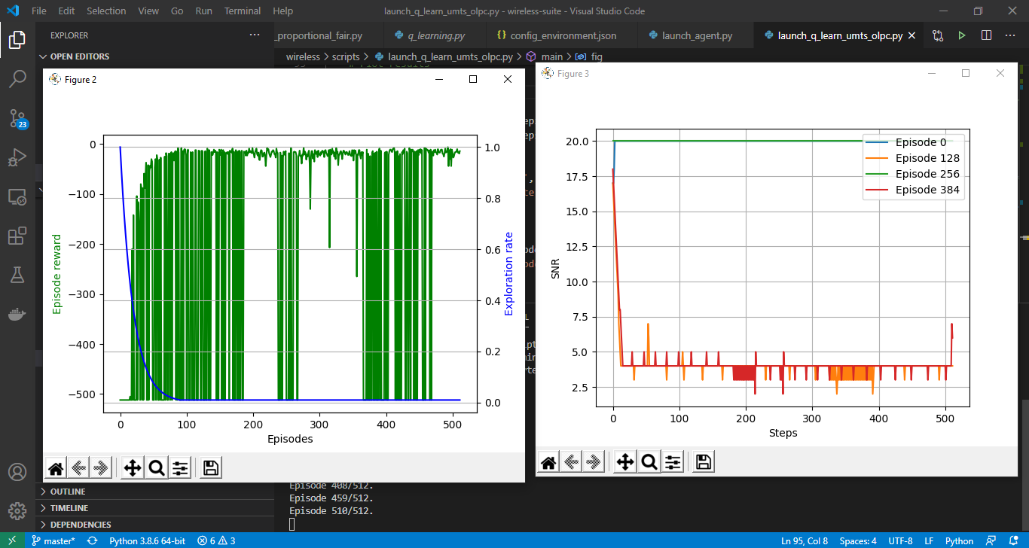
Output plots
Run the episodes

Slide 22
full thesis
Artificial intelligence in the air
10/11/2020 (nov)
- Solve the problems of q-learning python program - change the configuration and compare result
Meeting four

Slide 23
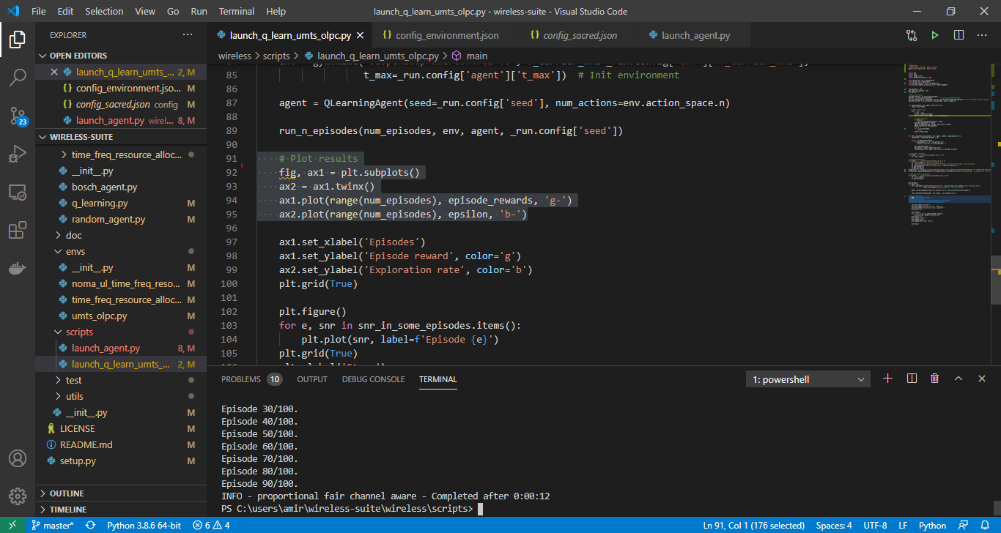
Fix the problem of plots
Solve the problem and now We have two plot with different scale in figure one

Slide 24
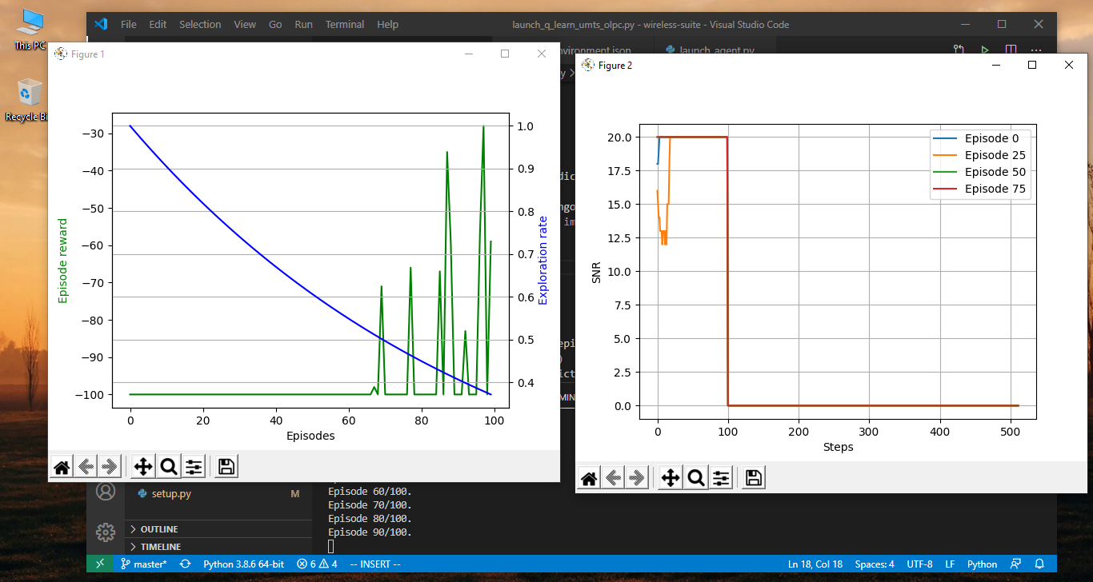
Comparing results with change config file
Change the result with different parameter

Slide 25
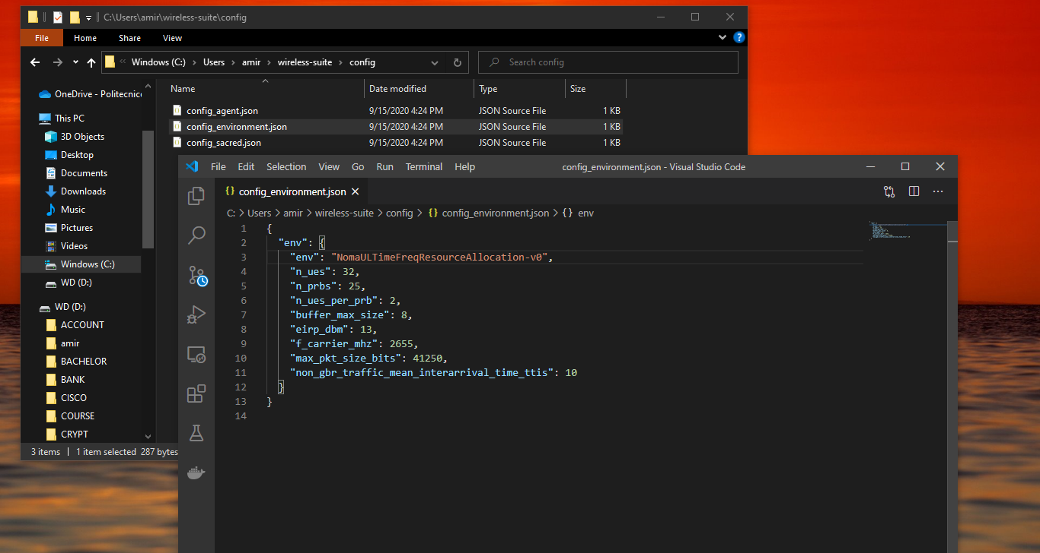
Parameters that we can change
CONFIG parameters like carrier frequency

Slide 26
full thesis
Artificial intelligence in the air
23/11/2020 (nov)
Meeting five

