Slide 1

اصول طراحی پایگاه داده
By Dr. Taghinezhad
Mail:
a0taghinezhad@gmail.com
Notes:
Hello everyone,
I'm Dr. Taghinezhad, and I'm thrilled to be your guide through the exciting world of advanced databases this semester.
With a background in Computer Engineering and a focus on distributed systems, I've spent years diving into the intricacies of how data powers our digital world.
Throughout this course, we'll explore everything from the basics of data modeling to the complex database and distributed databases.
I believe in creating an environment where questions are encouraged, discussions are lively, and learning is a collaborative effort. So, I invite each of you to actively engage and share.
I want to introduce you to one of the major resources for this course: "Database System Concepts" by Abraham Silberschatz, Henry F. Korth, and S. Sudarshan.
This textbook is like our trusty map as we navigate the complex terrain of database systems. It's not just any map, though—it's a detailed, comprehensive guide that will help us understand the landscape, identify key landmarks, and chart our course to mastery.
If you are not going to attend in this calls. Please talk to before hand. Also select a representative among yourself.

Slide 2
Chapter 7: Normalization

Slide 3
Outline
Features of Good Relational Design
Functional Dependencies
Decomposition Using Functional Dependencies
Normal Forms
Functional Dependency Theory
Algorithms for Decomposition using Functional Dependencies
Decomposition Using Multivalued Dependencies
More Normal Form
Atomic Domains and First Normal Form
Database-Design Process
Modeling Temporal Data

Slide 4
Overview of Normalization

Slide 5
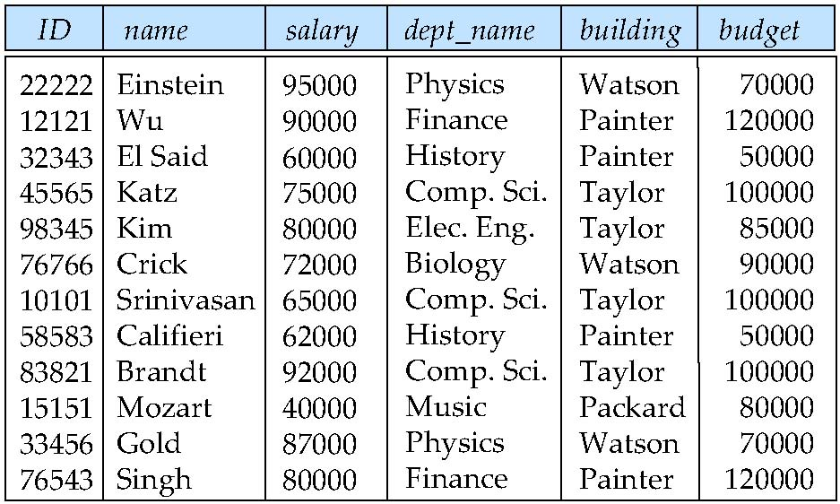
Features of Good Relational Designs
Suppose we combine instructor and department into in_dep, which represents the natural join on the relations instructor and department
There is repetition of information
Need to use null values (if we add a new department with no instructors)

Slide 6
A Combined Schema Without Repetition
Not all combined schemas result in repetition of information
Consider combining relations
sec_class(sec_id, building, room_number) and
section(course_id, sec_id, semester, year)
into one relation
section(course_id, sec_id, semester, year, building, room_number)
No repetition in this case

Slide 7
Decomposition
The only way to avoid the repetition-of-information problem in the (instructor and department) in_dep schema is to decompose it into two schemas – instructor and department schemas.
Not all decompositions are good. Suppose we decompose
employee(ID, name, street, city, salary)
into
employee1 (ID, name)
employee2 (name, street, city, salary)
The problem arises when we have two employees with the same name
The next slide shows how we lose information -- we cannot reconstruct the original employee relation -- and so, this is a lossy decomposition.
Notes:
Decomposition:تجزیه

Slide 8
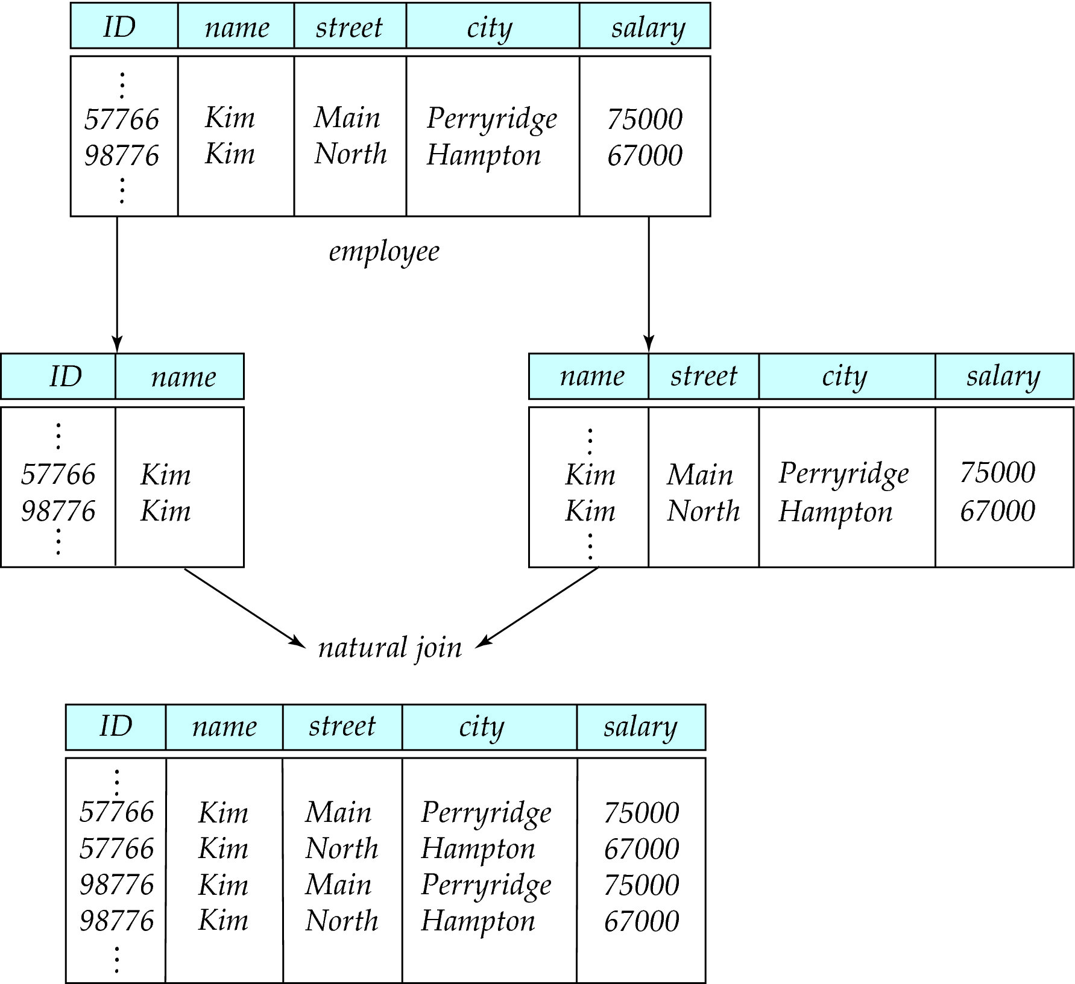
A Lossy Decomposition
Notes:
تفکیک پر اتلاف (Lossy Decomposition)

Slide 9
Lossless Decomposition
Let R be a relation schema and let R₁ and R₂ form a decomposition of R . That is R = R₁ U R₂
We say that the decomposition is a lossless decomposition if there is no loss of information by replacing R with the two relation schemas R₁ U R₂
Formally,
∏ _{R1} (r) ∏ _{R2} (r) = r
And, conversely a decomposition is lossy if
r ⊂ ∏ _{R1} (r) ∏ _{R2} (r) = r
Notes:
بگذارید RRR یک طرح‌واره رابطه باشد و R1R1R1 و R2R2R2 یک تفکیک از RRR را تشکیل دهند. یعنی R=R1∪R2R = R1 \cup R2R=R1∪R2. می‌گوییم که این تفکیک یک تفکیک بدون ضایعه (Lossless Decomposition) است اگر هیچ‌گونه از دست رفتن اطلاعاتی در هنگام جایگزینی RRR با دو طرح‌واره رابطه R1R1R1 و R2R2R2 وجود نداشته باشد. به‌طور رسمی،
∏ _{R1} (r) ∏ _{R2} (r) = r
و به‌عکس، یک تفکیک ضایعاتی است اگر
r⊆ΠR1(r)∪ΠR2(r)=rr \subseteq \Pi_{R1}(r) \cup \Pi_{R2}(r) = rr⊆ΠR1​(r)∪ΠR2​(r)=r

Slide 10
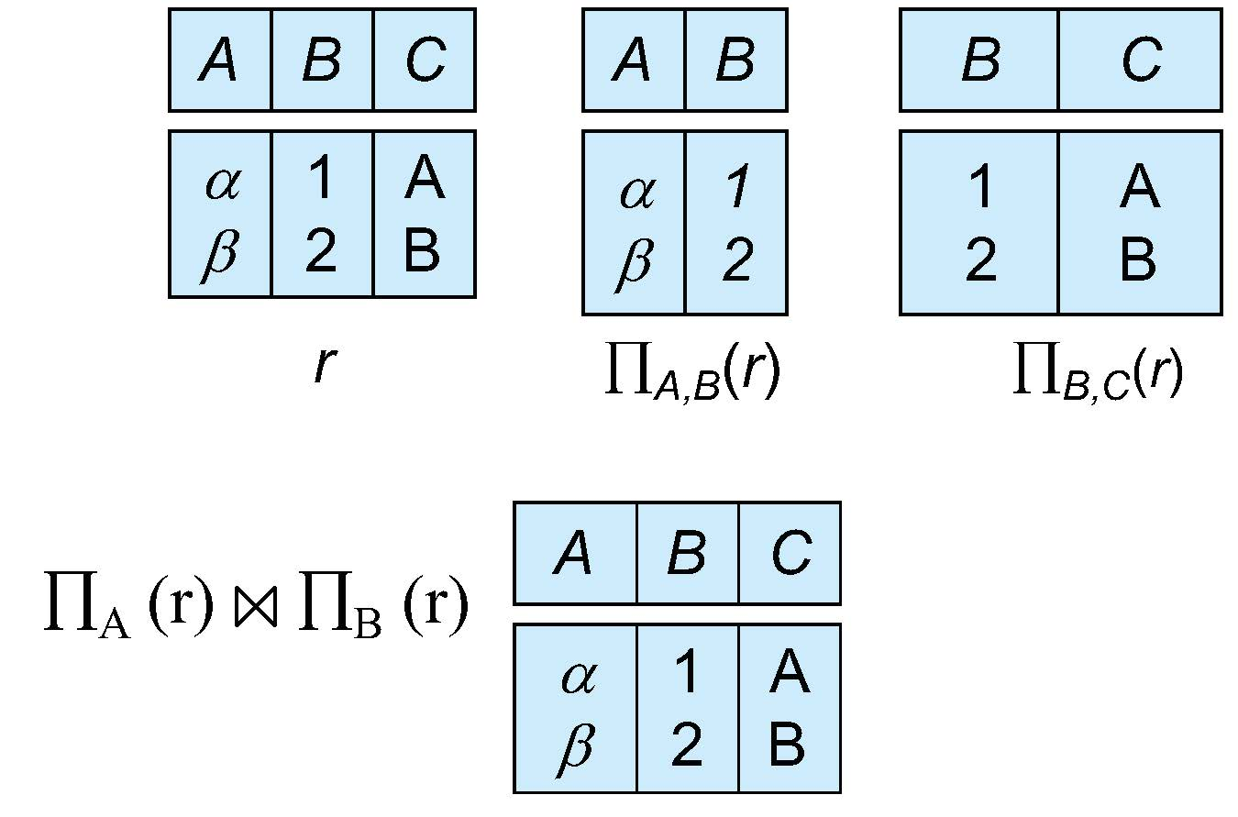
Example of Lossless Decomposition
Decomposition of R = (A, B, C) R₁ = (A, B) R₂ = (B, C)

Slide 11
Normalization Theory
Decide whether a particular relation R is in “good” form.
In the case that a relation R is not in “good” form, decompose it into set of relations {R₁, R₂, ..., R_{n}} such that
Each relation is in good form
The decomposition is a lossless decomposition
Our theory is based on:
Functional dependencies
Multivalued dependencies
Notes:
تصمیم بگیرید که آیا یک رابطه خاص RRR در فرم "خوب" قرار دارد یا نه. در صورتی که رابطه RRR در فرم "خوب" نباشد، آن را به مجموعه‌ای از روابط { R1,R2,…,RnR1, R2, \dots, RnR1,R2,…,Rn } تفکیک کنید به‌طوری‌که:
هر رابطه در فرم خوب باشد.
تفکیک یک تفکیک بدون ضایعه باشد.
نظریه‌ی ما بر اساس موارد زیر است:
وابستگی‌های تابعی (Functional dependencies)
وابستگی‌های چند ارزشی (Multivalued dependencies)

Slide 12
Functional Dependencies
There are usually a variety of constraints (rules) on the data in the real world.
For example, some of the constraints that are expected to hold in a university database are:
Students and instructors are uniquely identified by their ID.
Each student and instructor has only one name.
Each instructor and student is (primarily) associated with only one department.
Each department has only one value for its budget, and only one associated building.
Notes:
در دنیای واقعی معمولاً انواع مختلفی از محدودیت‌ها (قوانین) بر روی داده‌ها وجود دارد. برای مثال، برخی از محدودیت‌هایی که انتظار می‌رود در یک پایگاه داده دانشگاهی برقرار باشند عبارتند از:
دانشجویان و اساتید به‌طور منحصر به فرد با شناسه (ID) خود شناسایی می‌شوند.
هر دانشجو و استاد تنها یک نام دارد.
هر استاد و دانشجو (عمدتاً) تنها با یک دپارتمان مرتبط است.
هر دپارتمان تنها یک مقدار برای بودجه خود دارد و تنها یک ساختمان مرتبط با آن وجود دارد.

Slide 13
Functional Dependencies (Cont.)
An instance of a relation that satisfies all such real-world constraints is called a legal instance of the relation;
A legal instance of a database is one where all the relation instances are legal instances
Constraints on the set of legal relations.
Require that the value for a certain set of attributes determines uniquely the value for another set of attributes.
A functional dependency is a generalization of the notion of a key.
Notes:
نمونه‌ای از یک رابطه که تمامی محدودیت‌های دنیای واقعی را رعایت می‌کند، به‌عنوان یک نمونه قانونی از آن رابطه شناخته می‌شود. یک نمونه قانونی از پایگاه داده، نمونه‌ای است که در آن تمامی نمونه‌های روابط، نمونه‌های قانونی هستند. محدودیت‌ها روی مجموعه روابط قانونی، نیاز دارند که مقدار یک مجموعه خاص از صفات، مقدار مجموعه دیگری از صفات را به‌طور منحصر به فرد تعیین کند. وابستگی تابعی (Functional Dependency) تعمیمی از مفهوم کلید است.

Slide 14
Functional Dependencies Definition
Let R be a relation schema
α ⊆ R and β ⊆ R
The functional dependency
α → β
holds on R if and only if for any legal relations r(R), whenever any two tuples t₁ and t₂ of r agree on the attributes α, they also agree on the attributes β. That is,
t₁[α] = t₂ [α] ⇒ t₁[β ] = t₂ [β ]
Example: Consider r(A,B ) with the following instance of r.
On this instance, B → A hold; A → B does NOT hold,
4
1 5
3 7

Slide 15
Closure of a Set of Functional Dependencies
Given a set F set of functional dependencies, there are certain other functional dependencies that are logically implied by F.
If A → B and B → C, then we can infer that A → C
etc.
The set of all functional dependencies logically implied by F is the closure of F.
We denote the closure of F by F⁺.
Notes:
بستار یک مجموعه از وابستگی‌های تابعی
فرض کنید یک مجموعه F از وابستگی‌های تابعی داده شده است. در این صورت، وابستگی‌های تابعی دیگری وجود دارند که به‌طور منطقی از Fنتیجه می‌شوند.
برای مثال، اگر A→BA \to BA→B و B→CB \to CB→C، می‌توانیم نتیجه بگیریم که A→CA \to CA→C
و همینطور برای سایر وابستگی‌ها.
مجموعه‌ای از تمامی وابستگی‌های تابعی که به‌طور منطقی از F نتیجه می‌شوند، اختتام FFF نامیده می‌شود.
اختتام FFF را با F+F^+F+ نمایش می‌دهیم.

Slide 16
Keys and Functional Dependencies
K is a superkey for relation schema R if and only if K → R
K is a candidate key for R if and only if
K → R, and
for no α ⊂ K, α → R
Functional dependencies allow us to express constraints that cannot be expressed using superkeys. Consider the schema:
in_dep (ID, name, salary, dept_name, building, budget ).
We expect these functional dependencies to hold:
dept_name→ building
ID → building
but would not expect the following to hold:
dept_name → salary
Notes:
KKK یک ابرکلید برای طرح رابطه RRR است اگر و تنها اگر K→RK \rightarrow RK→R. KKK یک کلید کاندیدا برای RRR است اگر و تنها اگر:
K→RK \rightarrow RK→R، و
برای هیچ زیرمجموعه α⊂K\alpha \subset Kα⊂K، α→R\alpha \rightarrow Rα→R.
وابستگی‌های تابعی به ما اجازه می‌دهند محدودیت‌هایی را بیان کنیم که نمی‌توان آن‌ها را با استفاده از ابرکلیدها بیان کرد. طرح زیر را در نظر بگیرید:
\text{in_dep (ID, name, salary, dept_name, building, budget).}
انتظار می‌رود این وابستگی‌های تابعی برقرار باشند:
\text{dept_name} \rightarrow \text{building} ID→building\text{ID} \rightarrow \text{building}ID→building
اما انتظار نمی‌رود وابستگی زیر برقرار باشد:

Slide 17
Use of Functional Dependencies
We use functional dependencies to:
To test relations to see if they are legal under a given set of functional dependencies.
If a relation r is legal under a set F of functional dependencies, we say that r satisfies F.
To specify constraints on the set of legal relations
We say that F holds on R if all legal relations on R satisfy the set of functional dependencies F.
Note: A specific instance of a relation schema may satisfy a functional dependency even if the functional dependency does not hold on all legal instances.
For example, a specific instance of instructor may, by chance, satisfy name → ID.
Notes:
ما از وابستگی‌های تابعی برای موارد زیر استفاده می‌کنیم:
آزمایش روابط برای بررسی اینکه آیا آن‌ها تحت یک مجموعه مشخص از وابستگی‌های تابعی معتبر هستند یا خیر. اگر یک رابطه rrr تحت یک مجموعه FFF از وابستگی‌های تابعی معتبر باشد، می‌گوییم که rrr FFF را ارضا می‌کند.
مشخص کردن محدودیت‌ها بر مجموعه روابط معتبر. می‌گوییم FFF بر RRR برقرار است اگر تمام روابط معتبر بر RRR مجموعه وابستگی‌های تابعی FFF را ارضا کنند.
نکته: ممکن است یک نمونه خاص از یک طرح رابطه‌ای وابستگی تابعی را ارضا کند، حتی اگر آن وابستگی تابعی برای همه نمونه‌های معتبر برقرار نباشد.
برای مثال، ممکن است یک نمونه خاص از رابطه instructorinstructorinstructor، به‌طور اتفاقی، وابستگی تابعی زیر را ارضا کند:
name→ID.\text{name} \rightarrow \text{ID}.name→ID.

Slide 18
Trivial Functional Dependencies
A functional dependency is trivial if it is satisfied by all instances of a relation
Example:
ID, name → ID
name → name
In general, α → β is trivial if β ⊆ α

Slide 19
Lossless Decomposition
We can use functional dependencies to show when certain decomposition are lossless.
For the case of R = (R₁, R₂), we require that for all possible relations r on schema R
r = ∏_{R1} (r ) ∏_{R2} (r )
A decomposition of R into R₁ and R₂ is lossless decomposition if at least one of the following dependencies is in F⁺:
R₁ ∩ R₂ → R₁
R₁ ∩ R₂ → R₂
The above functional dependencies are a sufficient condition for lossless join decomposition; the dependencies are a necessary condition only if all constraints are functional dependencies

Slide 20
Example
R = (A, B, C) F = {A → B, B → C)
R₁ = (A, B), R₂ = (B, C)
Lossless decomposition:
R₁ ∩ R₂ = {B} and B → BC
R₁ = (A, B), R₂ = (A, C)
Lossless decomposition:
R₁ ∩ R₂ = {A} and A → AB
Note:
B → BC
is a shorthand notation for
B → {B, C}

Slide 21
Dependency Preservation
Testing functional dependency constraints each time the database is updated can be costly
It is useful to design the database in a way that constraints can be tested efficiently.
If testing a functional dependency can be done by considering just one relation, then the cost of testing this constraint is low
When decomposing a relation it is possible that it is no longer possible to do the testing without having to perform a Cartesian Produced.
A decomposition that makes it computationally hard to enforce functional dependency is said to be NOT dependency preserving.
Notes:
آزمایش محدودیت‌های وابستگی تابعی هر بار که پایگاه داده به‌روزرسانی می‌شود، می‌تواند هزینه‌بر باشد. بنابراین طراحی پایگاه داده به گونه‌ای که این محدودیت‌ها به‌صورت کارآمد آزمایش شوند، مفید است.
اگر آزمایش یک وابستگی تابعی تنها با در نظر گرفتن یک رابطه قابل انجام باشد، هزینه آزمایش این محدودیت پایین خواهد بود.
هنگام تجزیه یک رابطه، ممکن است شرایطی به وجود آید که آزمایش وابستگی تابعی بدون انجام عمل ضرب دکارتی امکان‌پذیر نباشد.
یک تجزیه که اجرای وابستگی تابعی را از نظر محاسباتی دشوار می‌سازد، به عنوان "حفظ‌کننده وابستگی نیست" شناخته می‌شود.

Slide 22
Dependency Preservation Example
Consider a schema:
dept_advisor(s_ID, i_ID, department_name)
With function dependencies:
i_ID → dept_name
s_ID, dept_name → i_ID
In the above design we are forced to repeat the department name once for each time an instructor participates in a dept_advisor relationship.
To fix this, we need to decompose dept_advisor
Any decomposition will not include all the attributes in
s_ID, dept_name → i_ID
Thus, the composition NOT be dependency preserving

Slide 23
Normal Forms

Slide 24
Boyce-Codd Normal Form
A relation schema R is in BCNF with respect to a set F of functional dependencies if for all functional dependencies in F⁺ of the form
α → β
where α ⊆ R and β ⊆ R, at least one of the following holds:
α → β is trivial (i.e., β ⊆ α)
α is a superkey for R

Slide 25
Boyce-Codd Normal Form (Cont.)
Example schema that is not in BCNF:
in_dep (ID, name, salary, dept_name, building, budget )
because :
dept_name→ building, budget
holds on in_dep
but
dept_name is not a superkey
When decompose in_dept into instructor and department
instructor is in BCNF
department is in BCNF

Slide 26
Decomposing a Schema into BCNF
Let R be a schema R that is not in BCNF. Let α →β be the FD that causes a violation of BCNF.
We decompose R into:
(α U β )
( R - ( β - α ) )
In our example of in_dep,
α = dept_name
β = building, budget
and in_dep is replaced by
(α U β ) = ( dept_name, building, budget )
( R - ( β - α ) ) = ( ID, name, dept_name, salary )

Slide 27
Example
R = (A, B, C) F = {A → B, B → C)
R₁ = (A, B), R₂ = (B, C)
Lossless-join decomposition:
R₁ ∩ R₂ = {B} and B → BC
Dependency preserving
R₁ = (A, B), R₂ = (A, C)
Lossless-join decomposition:
R₁ ∩ R₂ = {A} and A → AB
Not dependency preserving (cannot check B → C without computing R₁ R₂)

Slide 28
BCNF and Dependency Preservation
It is not always possible to achieve both BCNF and dependency preservation
Consider a schema:
dept_advisor(s_ID, i_ID, department_name)
With function dependencies:
i_ID → dept_name
s_ID, dept_name → i_ID
dept_advisor is not in BCNF
i_ID is not a superkey.
Any decomposition of dept_advisor will not include all the attributes in
s_ID, dept_name → i_ID
Thus, the composition is NOT be dependency preserving

Slide 29
Third Normal Form
A relation schema R is in third normal form (3NF) if for all:
α → β in F⁺
at least one of the following holds:
α → β is trivial (i.e., β ∈ α)
α is a superkey for R
Each attribute A in β – α is contained in a candidate key for R.
(NOTE: each attribute may be in a different candidate key)
If a relation is in BCNF it is in 3NF (since in BCNF one of the first two conditions above must hold).
Third condition is a minimal relaxation of BCNF to ensure dependency preservation (will see why later).

Slide 30
3NF Example
Consider a schema:
dept_advisor(s_ID, i_ID, dept_name)
With function dependencies:
i_ID → dept_name
s_ID, dept_name → i_ID
Two candidate keys = {s_ID, dept_name}, {s_ID, i_ID }
We have seen before that dept_advisor is not in BCNF
R, however, is in 3NF
s_ID, dept_name is a superkey
i_ID → dept_name and i_ID is NOT a superkey, but:
{ dept_name} – {i_ID } = {dept_name } and
dept_name is contained in a candidate key

Slide 31

Redundancy in 3NF
Consider the schema R below, which is in 3NF
What is wrong with the table?
R = (J, K, L )
F = {JK → L, L → K }
And an instance table:
Repetition of information
Need to use null values (e.g., to represent the relationship l₂, k₂
where there is no corresponding value for J)

Slide 32
Comparison of BCNF and 3NF
Advantages to 3NF over BCNF. It is always possible to obtain a 3NF design without sacrificing losslessness or dependency preservation.
Disadvantages to 3NF.
We may have to use null values to represent some of the possible meaningful relationships among data items.
There is the problem of repetition of information.

Slide 33
Goals of Normalization
Let R be a relation scheme with a set F of functional dependencies.
Decide whether a relation scheme R is in “good” form.
In the case that a relation scheme R is not in “good” form, need to decompose it into a set of relation scheme {R₁, R₂, ..., R_{n}} such that:
Each relation scheme is in good form
The decomposition is a lossless decomposition
Preferably, the decomposition should be dependency preserving.

Slide 34
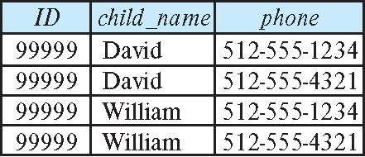
How good is BCNF?
There are database schemas in BCNF that do not seem to be sufficiently normalized
Consider a relation
inst_info (ID, child_name, phone)
where an instructor may have more than one phone and can have multiple children
Instance of inst_info

Slide 35
How good is BCNF? (Cont.)
There are no non-trivial functional dependencies and therefore the relation is in BCNF
Insertion anomalies – i.e., if we add a phone 981-992-3443 to 99999, we need to add two tuples
(99999, David, 981-992-3443) (99999, William, 981-992-3443)

Slide 36
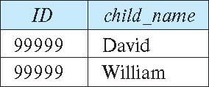
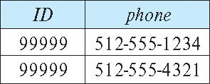
Higher Normal Forms
It is better to decompose inst_info into:
inst_child:
inst_phone:
This suggests the need for higher normal forms, such as Fourth Normal Form (4NF), which we shall see later

Slide 37
Functional-Dependency Theory

Slide 38
Functional-Dependency Theory Roadmap
We now consider the formal theory that tells us which functional dependencies are implied logically by a given set of functional dependencies.
We then develop algorithms to generate lossless decompositions into BCNF and 3NF
We then develop algorithms to test if a decomposition is dependency-preserving

Slide 39
Closure of a Set of Functional Dependencies
Given a set F set of functional dependencies, there are certain other functional dependencies that are logically implied by F.
If A → B and B → C, then we can infer that A → C
etc.
The set of all functional dependencies logically implied by F is the closure of F.
We denote the closure of F by F⁺.

Slide 40
Closure of a Set of Functional Dependencies
We can compute F⁺, the closure of F, by repeatedly applying Armstrong’s Axioms:
Reflexive rule: if β ⊆ α, then α → β
Augmentation rule: if α → β, then γ α → γ β
Transitivity rule: if α → β, and β → γ, then α → γ
These rules are
Sound -- generate only functional dependencies that actually hold, and
Complete -- generate all functional dependencies that hold.

Slide 41
Example of F⁺
R = (A, B, C, G, H, I) F = { A → B A → C CG → H CG → I B → H}
Some members of F⁺
A → H
by transitivity from A → B and B → H
AG → I
by augmenting A → C with G, to get AG → CG and then transitivity with CG → I
CG → HI
by augmenting CG → I to infer CG → CGI,
and augmenting of CG → H to infer CGI → HI,
and then transitivity

Slide 42
Closure of Functional Dependencies (Cont.)
Additional rules:
Union rule: If α → β holds and α → γ holds, then α → β γ holds.
Decomposition rule: If α → β γ holds, then α → β holds and α → γ holds.
Pseudotransitivity rule:If α → β holds and γ β → δ holds, then α γ → δ holds.
The above rules can be inferred from Armstrong’s axioms.

Slide 43
Procedure for Computing F⁺
To compute the closure of a set of functional dependencies F:
F ⁺ = F repeat for each functional dependency f in F⁺ apply reflexivity and augmentation rules on f add the resulting functional dependencies to F ⁺ for each pair of functional dependencies f₁and f₂ in F ⁺ if f₁ and f₂ can be combined using transitivity then add the resulting functional dependency to F ⁺ until F ⁺ does not change any further
NOTE: We shall see an alternative procedure for this task later

Slide 44
Closure of Attribute Sets
Given a set of attributes α, define the closure of α under F (denoted by α⁺) as the set of attributes that are functionally determined by α under F
Algorithm to compute α⁺, the closure of α under F
result := α; while (changes to result) do for each β → γ in F do begin if β ⊆ result then result := result ∪ γ end

Slide 45
Example of Attribute Set Closure
R = (A, B, C, G, H, I)
F = {A → B A → C CG → H CG → I B → H}
(AG)⁺
1. result = AG
2. result = ABCG (A → C and A → B)
3. result = ABCGH (CG → H and CG ⊆ AGBC)
4. result = ABCGHI (CG → I and CG ⊆ AGBCH)
Is AG a candidate key?
Is AG a super key?
Does AG → R? == Is R ⊇ (AG)⁺
Is any subset of AG a superkey?
Does A → R? == Is R ⊇ (A)⁺
Does G → R? == Is R ⊇ (G)⁺
In general: check for each subset of size n-1

Slide 46
Uses of Attribute Closure
There are several uses of the attribute closure algorithm:
Testing for superkey:
To test if α is a superkey, we compute α^{+,} and check if α⁺ contains all attributes of R.
Testing functional dependencies
To check if a functional dependency α → β holds (or, in other words, is in F⁺), just check if β ⊆ α⁺.
That is, we compute α⁺ by using attribute closure, and then check if it contains β.
Is a simple and cheap test, and very useful
Computing closure of F
For each γ ⊆ R, we find the closure γ⁺, and for each S ⊆ γ⁺, we output a functional dependency γ → S.

Slide 47
Canonical Cover
Suppose that we have a set of functional dependencies F on a relation schema. Whenever a user performs an update on the relation, the database system must ensure that the update does not violate any functional dependencies; that is, all the functional dependencies in F are satisfied in the new database state.
If an update violates any functional dependencies in the set F, the system must roll back the update.
We can reduce the effort spent in checking for violations by testing a simplified set of functional dependencies that has the same closure as the given set.
This simplified set is termed the canonical cover
To define canonical cover we must first define extraneous attributes.
An attribute of a functional dependency in F is extraneous if we can remove it without changing F ⁺

Slide 48
Extraneous Attributes
Removing an attribute from the left side of a functional dependency could make it a stronger constraint.
For example, if we have AB → C and remove B, we get the possibly stronger result A → C. It may be stronger because A → C logically implies AB → C, but AB → C does not, on its own, logically imply A → C
But, depending on what our set F of functional dependencies happens to be, we may be able to remove B from AB → C safely.
For example, suppose that
F = {AB → C, A → D, D → C}
Then we can show that F logically implies A → C, making extraneous in AB → C.

Slide 49
Extraneous Attributes (Cont.)
Removing an attribute from the right side of a functional dependency could make it a weaker constraint.
For example, if we have AB → CD and remove C, we get the possibly weaker result AB → D. It may be weaker because using just AB → D, we can no longer infer AB → C.
But, depending on what our set F of functional dependencies happens to be, we may be able to remove C from AB → CD safely.
For example, suppose that
F = { AB → CD, A → C.
Then we can show that even after replacing AB → CD by AB → D, we can still infer $AB → C and thus AB → CD.

Slide 50
Extraneous Attributes
An attribute of a functional dependency in F is extraneous if we can remove it without changing F ⁺
Consider a set F of functional dependencies and the functional dependency α → β in F.
Remove from the left side: Attribute A is extraneous in α if
A ∈ α and
F logically implies (F – {α → β}) ∪ {(α – A) → β}.
Remove from the right side: Attribute A is extraneous in β if
A ∈ β and
The set of functional dependencies
(F – {α → β}) ∪ {α →(β – A)} logically implies F.
Note: implication in the opposite direction is trivial in each of the cases above, since a “stronger” functional dependency always implies a weaker one

Slide 51
Testing if an Attribute is Extraneous
Let R be a relation schema and let F be a set of functional dependencies that hold on R . Consider an attribute in the functional dependency α → β.
To test if attribute A ∈ β is extraneous in β
Consider the set: F' = (F – {α → β}) ∪ {α →(β – A)},
check that α⁺ contains A; if it does, A is extraneous in β
To test if attribute A ∈ α is extraneous in α
Let γ = α – {A}. Check if γ → β can be inferred from F.
Compute γ⁺ using the dependencies in F
If γ⁺ includes all attributes in β then , A is extraneous in α

Slide 52
Examples of Extraneous Attributes
Let F = {AB → CD, A → E, E → C }
To check if C is extraneous in AB → CD, we:
Compute the attribute closure of AB under F' = {AB → D, A → E, E → C}
The closure is ABCDE, which includes CD
This implies that C is extraneous

Slide 53
Canonical Cover
A canonical cover for F is a set of dependencies F_{c} such that
F logically implies all dependencies in F_{c} , and
F_{c} logically implies all dependencies in F, and
No functional dependency in F_{c} contains an extraneous attribute, and
Each left side of functional dependency in F_{c} is unique. That is, there are no two dependencies in F_{c}
α₁ → β₁ and α₂ → β₂ such that
α₁ = α₂

Slide 54
Canonical Cover
To compute a canonical cover for F:
repeat
Use the union rule to replace any dependencies in F of the form
α₁ → β₁ and α₁ → β₂ with α₁ → β₁ β₂
Find a functional dependency α → β in F_{c} with an extraneous
attribute either in α or in β
/* Note: test for extraneous attributes done using F_{c,} not F*/
If an extraneous attribute is found, delete it from α → β
until (F_{c} not change
Note: Union rule may become applicable after some extraneous attributes have been deleted, so it has to be re-applied

Slide 55
Example: Computing a Canonical Cover
R = (A, B, C) F = {A → BC B → C A → B AB → C}
Combine A → BC and A → B into A → BC
Set is now {A → BC, B → C, AB → C}
A is extraneous in AB → C
Check if the result of deleting A from AB → C is implied by the other dependencies
Yes: in fact, B → C is already present!
Set is now {A → BC, B → C}
C is extraneous in A → BC
Check if A → C is logically implied by A → B and the other dependencies
Yes: using transitivity on A → B and B → C.
Can use attribute closure of A in more complex cases
The canonical cover is: A → B B → C

Slide 56
Dependency Preservation
Let F_{i} be the set of dependencies F ⁺ that include only attributes in R_{i}.
A decomposition is dependency preserving, if
(F₁ ∪ F₂ ∪ … ∪ F_{n} )⁺ = F ⁺
Using the above definition, testing for dependency preservation take exponential time.
Not that if a decomposition is NOT dependency preserving then checking updates for violation of functional dependencies may require computing joins, which is expensive.

Slide 57
Dependency Preservation (Cont.)
Let F be the set of dependencies on schema R and let R₁, R₂ , .., R_{n} be a decomposition of R.
The restriction of F to R_{i} is the set F_{i} of all functional dependencies in F ⁺ that include only attributes of R_{i} .
Since all functional dependencies in a restriction involve attributes of only one relation schema, it is possible to test such a dependency for satisfaction by checking only one relation.
Note that the definition of restriction uses all dependencies in in F ⁺, not just those in F.
The set of restrictions F₁, F₂ , .. , F_{n} is the set of functional dependencies that can be checked efficiently.

Slide 58
Testing for Dependency Preservation
To check if a dependency α → β is preserved in a decomposition of R into R₁, R₂, …, R_{n} , we apply the following test (with attribute closure done with respect to F)
result = α repeat for each R_{i} in the decomposition t = (result ∩ R_{i})⁺ ∩ R_{i} result = result ∪ t
until (result does not change)
If result contains all attributes in β, then the functional dependency α → β is preserved.
We apply the test on all dependencies in F to check if a decomposition is dependency preserving
This procedure takes polynomial time, instead of the exponential time required to compute F⁺ and (F₁ ∪ F₂ ∪ … ∪ F_{n})⁺

Slide 59
Example
R = (A, B, C ) F = {A → B B → C} Key = {A}
R is not in BCNF
Decomposition R₁ = (A, B), R₂ = (B, C)
R₁ and R₂ in BCNF
Lossless-join decomposition
Dependency preserving

Slide 60
Algorithm for Decomposition Using
Functional Dependencies

Slide 61
Testing for BCNF
To check if a non-trivial dependency α →β causes a violation of BCNF
1. compute α⁺ (the attribute closure of α), and
2. verify that it includes all attributes of R, that is, it is a superkey of R.
Simplified test: To check if a relation schema R is in BCNF, it suffices to check only the dependencies in the given set F for violation of BCNF, rather than checking all dependencies in F⁺.
If none of the dependencies in F causes a violation of BCNF, then none of the dependencies in F⁺ will cause a violation of BCNF either.
However, simplified test using only F is incorrect when testing a relation in a decomposition of R
Consider R = (A, B, C, D, E), with F = { A → B, BC → D}
Decompose R into R₁ = (A,B) and R₂ = (A,C,D, E)
Neither of the dependencies in F contain only attributes from (A,C,D,E) so we might be mislead into thinking R₂ satisfies BCNF.
In fact, dependency AC → D in F⁺ shows R₂ is not in BCNF.

Slide 62
Testing Decomposition for BCNF
To check if a relation R_{i} in a decomposition of R is in BCNF
Either test R_{i} for BCNF with respect to the restriction of F⁺ to R_{i} (that is, all FDs in F⁺ that contain only attributes from R_{i})
Or use the original set of dependencies F that hold on R, but with the following test:
for every set of attributes α ⊆ R_{i}, check that α⁺ (the attribute closure of α) either includes no attribute of R_{i}- α, or includes all attributes of R_{i}.
If the condition is violated by some α → β in F⁺, the dependency α → (α⁺ - α) ∩ R_{i} can be shown to hold on R_{i}, and R_{i} violates BCNF.
We use above dependency to decompose R_{i}

Slide 63
BCNF Decomposition Algorithm
result := {R }; done := false; compute F ⁺; while (not done) do if (there is a schema R_{i} in result that is not in BCNF) then begin let α → β be a nontrivial functional dependency that holds on R_{i} such that α → R_{i} is not in F ⁺, and α ∩ β = ∅; result := (result – R_{i} ) ∪ (R_{i} – β) ∪ (α, β ); end else done := true;
Note: each R_{i} is in BCNF, and decomposition is lossless-join.

Slide 64
Example of BCNF Decomposition
class (course_id, title, dept_name, credits, sec_id, semester, year, building, room_number, capacity, time_slot_id)
Functional dependencies:
course_id→ title, dept_name, credits
building, room_number→capacity
course_id, sec_id, semester, year→building, room_number, time_slot_id
A candidate key {course_id, sec_id, semester, year}.
BCNF Decomposition:
course_id→ title, dept_name, credits holds
but course_id is not a superkey.
We replace class by:
course(course_id, title, dept_name, credits)
class-1 (course_id, sec_id, semester, year, building, room_number, capacity, time_slot_id)

Slide 65
BCNF Decomposition (Cont.)
course is in BCNF
How do we know this?
building, room_number→capacity holds on class-1
but {building, room_number} is not a superkey for class-1.
We replace class-1 by:
classroom (building, room_number, capacity)
section (course_id, sec_id, semester, year, building, room_number, time_slot_id)
classroom and section are in BCNF.

Slide 66
Third Normal Form
There are some situations where
BCNF is not dependency preserving, and
efficient checking for FD violation on updates is important
Solution: define a weaker normal form, called Third Normal Form (3NF)
Allows some redundancy (with resultant problems; we will see examples later)
But functional dependencies can be checked on individual relations without computing a join.
There is always a lossless-join, dependency-preserving decomposition into 3NF.

Slide 67
3NF Example -- Relation dept_advisor
dept_advisor (s_ID, i_ID, dept_name) F = {s_ID, dept_name → i_ID, i_ID → dept_name}
Two candidate keys: s_ID, dept_name, and i_ID, s_ID
R is in 3NF
s_ID, dept_name → i_ID s_ID
dept_name is a superkey
i_ID → dept_name
dept_name is contained in a candidate key

Slide 68
Testing for 3NF
Need to check only FDs in F, need not check all FDs in F⁺.
Use attribute closure to check for each dependency α → β, if α is a superkey.
If α is not a superkey, we have to verify if each attribute in β is contained in a candidate key of R
This test is rather more expensive, since it involve finding candidate keys
Testing for 3NF has been shown to be NP-hard
Interestingly, decomposition into third normal form (described shortly) can be done in polynomial time

Slide 69
3NF Decomposition Algorithm
Let F_{c} be a canonical cover for F; i := 0; for each functional dependency α → β in F_{c} do if none of the schemas R_{j}, 1 ≤ j ≤ i contains α β then begin i := i + 1; R_{i} := α β end if none of the schemas R_{j}, 1 ≤ j ≤ i contains a candidate key for R then begin i := i + 1; R_{i} := any candidate key for R; end /* Optionally, remove redundant relations */
repeat if any schema R_{j} is contained in another schema R_{k} then /* delete R_{j} */ R_{j} = R;; i=i-1; return (R₁, R₂, ..., R_{i})

Slide 70
3NF Decomposition Algorithm (Cont.)
Above algorithm ensures
Each relation schema R_{i} is in 3NF
Decomposition is dependency preserving and lossless-join
Proof of correctness is at end of this presentation (click here)

Slide 71
3NF Decomposition: An Example
Relation schema:
cust_banker_branch = (customer_id, employee_id, branch_name, type )
The functional dependencies for this relation schema are:
customer_id, employee_id → branch_name, type
employee_id → branch_name
customer_id, branch_name → employee_id
We first compute a canonical cover
branch_name is extraneous in the r.h.s. of the 1st dependency
No other attribute is extraneous, so we get F_{C} =
customer_id, employee_id → type employee_id → branch_name customer_id, branch_name → employee_id

Slide 72
3NF Decompsition Example (Cont.)
The for loop generates following 3NF schema:
(customer_id, employee_id, type )
(employee_id, branch_name)
(customer_id, branch_name, employee_id)
Observe that (customer_id, employee_id, type ) contains a candidate key of the original schema, so no further relation schema needs be added
At end of for loop, detect and delete schemas, such as (employee_id, branch_name), which are subsets of other schemas
result will not depend on the order in which FDs are considered
The resultant simplified 3NF schema is:
(customer_id, employee_id, type)
(customer_id, branch_name, employee_id)

Slide 73
Comparison of BCNF and 3NF
It is always possible to decompose a relation into a set of relations that are in 3NF such that:
The decomposition is lossless
The dependencies are preserved
It is always possible to decompose a relation into a set of relations that are in BCNF such that:
The decomposition is lossless
It may not be possible to preserve dependencies.

Slide 74
Design Goals
Goal for a relational database design is:
BCNF.
Lossless join.
Dependency preservation.
If we cannot achieve this, we accept one of
Lack of dependency preservation
Redundancy due to use of 3NF
Interestingly, SQL does not provide a direct way of specifying functional dependencies other than superkeys.
Can specify FDs using assertions, but they are expensive to test, (and currently not supported by any of the widely used databases!)
Even if we had a dependency preserving decomposition, using SQL we would not be able to efficiently test a functional dependency whose left hand side is not a key.

Slide 75
Multivalued Dependencies

Slide 76
Multivalued Dependencies (MVDs)
Suppose we record names of children, and phone numbers for instructors:
inst_child(ID, child_name)
inst_phone(ID, phone_number)
If we were to combine these schemas to get
inst_info(ID, child_name, phone_number)
Example data: (99999, David, 512-555-1234) (99999, David, 512-555-4321) (99999, William, 512-555-1234) (99999, William, 512-555-4321)
This relation is in BCNF
Why?

Slide 77
Multivalued Dependencies
Let R be a relation schema and let α ⊆ R and β ⊆ R. The multivalued dependency
α →→ β
holds on R if in any legal relation r(R), for all pairs for tuples t₁ and t₂ in r such that t₁[α] = t₂ [α], there exist tuples t₃ and t₄ in r such that:
t₁[α] = t₂ [α] = t₃ [α] = t₄ [α] t₃[β] = t₁ [β] t₃[R – β] = t₂[R – β] t₄ [β] = t₂[β] t₄[R – β] = t₁[R – β]

Slide 78
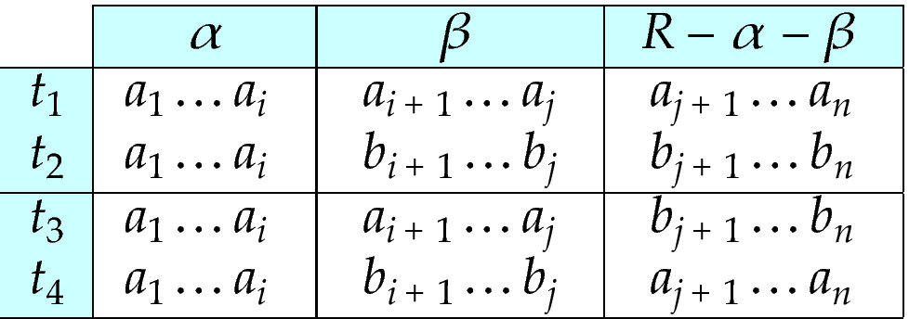
MVD -- Tabular representation
Tabular representation of α →→ β

Slide 79
MVD (Cont.)
Let R be a relation schema with a set of attributes that are partitioned into 3 nonempty subsets.
Y, Z, W
We say that Y →→ Z (Y multidetermines Z ) if and only if for all possible relations r (R )
< y₁, z₁, w₁ > ∈ r and < y₁, z₂, w₂ > ∈ r
then
< y₁, z₁, w₂ > ∈ r and < y₁, z₂, w₁ > ∈ r
Note that since the behavior of Z and W are identical it follows that
Y →→ Z if Y →→ W

Slide 80
Example
In our example:
ID →→ child_name ID →→ phone_number
The above formal definition is supposed to formalize the notion that given a particular value of Y (ID) it has associated with it a set of values of Z (child_name) and a set of values of W (phone_number), and these two sets are in some sense independent of each other.
Note:
If Y → Z then Y →→ Z
Indeed we have (in above notation) Z₁ = Z₂ The claim follows.

Slide 81
Use of Multivalued Dependencies
We use multivalued dependencies in two ways:
1. To test relations to determine whether they are legal under a given set of functional and multivalued dependencies
2. To specify constraints on the set of legal relations. We shall concern ourselves only with relations that satisfy a given set of functional and multivalued dependencies.
If a relation r fails to satisfy a given multivalued dependency, we can construct a relations r′ that does satisfy the multivalued dependency by adding tuples to r.

Slide 82
Theory of MVDs
From the definition of multivalued dependency, we can derive the following rule:
If α → β, then α →→ β
That is, every functional dependency is also a multivalued dependency
The closure D⁺ of D is the set of all functional and multivalued dependencies logically implied by D.
We can compute D⁺ from D, using the formal definitions of functional dependencies and multivalued dependencies.
We can manage with such reasoning for very simple multivalued dependencies, which seem to be most common in practice
For complex dependencies, it is better to reason about sets of dependencies using a system of inference rules (Appendix C).

Slide 83
Fourth Normal Form
A relation schema R is in 4NF with respect to a set D of functional and multivalued dependencies if for all multivalued dependencies in D⁺ of the form α →→ β, where α ⊆ R and β ⊆ R, at least one of the following hold:
α →→ β is trivial (i.e., β ⊆ α or α ∪ β = R)
α is a superkey for schema R
If a relation is in 4NF it is in BCNF

Slide 84
Restriction of Multivalued Dependencies
The restriction of D to R_{i} is the set D_{i} consisting of
All functional dependencies in D⁺ that include only attributes of R_{i}
All multivalued dependencies of the form
α →→ (β ∩ R_{i})
where α ⊆ R_{i} and α →→ β is in D⁺

Slide 85
4NF Decomposition Algorithm
result: = {R}; done := false; compute D⁺; Let D_{i} denote the restriction of D⁺ to R_{i}
while (not done) if (there is a schema R_{i} in result that is not in 4NF) then begin
let α →→ β be a nontrivial multivalued dependency that holds on R_{i} such that α → R_{i} is not in D_{i}, and α∩β=φ; result := (result - R_{i}) ∪ (R_{i} - β) ∪ (α, β); end else done:= true;
Note: each R_{i} is in 4NF, and decomposition is lossless-join

Slide 86
Example
R =(A, B, C, G, H, I)
F ={ A →→ B
B →→ HI
CG →→ H }
R is not in 4NF since A →→ B and A is not a superkey for R
Decomposition
a) R₁ = (A, B) (R₁ is in 4NF)
b) R₂ = (A, C, G, H, I) (R₂ is not in 4NF, decompose into R₃ and R₄)
c) R₃ = (C, G, H) (R₃ is in 4NF)
d) R₄ = (A, C, G, I) (R₄ is not in 4NF, decompose into R₅ and R₆)
A →→ B and B →→ HI ➔ A →→ HI, (MVD transitivity), and
and hence A →→ I (MVD restriction to R₄)
e) R₅ = (A, I) (R₅ is in 4NF)
f)R₆ = (A, C, G) (R₆ is in 4NF)

Slide 87
Additional issues

Slide 88
Further Normal Forms
Join dependencies generalize multivalued dependencies
lead to project-join normal form (PJNF) (also called fifth normal form)
A class of even more general constraints, leads to a normal form called domain-key normal form.
Problem with these generalized constraints: are hard to reason with, and no set of sound and complete set of inference rules exists.
Hence rarely used

Slide 89
Overall Database Design Process
We have assumed schema R is given
R could have been generated when converting E-R diagram to a set of tables.
R could have been a single relation containing all attributes that are of interest (called universal relation).
Normalization breaks R into smaller relations.
R could have been the result of some ad hoc design of relations, which we then test/convert to normal form.

Slide 90
ER Model and Normalization
When an E-R diagram is carefully designed, identifying all entities correctly, the tables generated from the E-R diagram should not need further normalization.
However, in a real (imperfect) design, there can be functional dependencies from non-key attributes of an entity to other attributes of the entity
Example: an employee entity with
attributes department_name and building,
functional dependency department_name→ building
Good design would have made department an entity
Functional dependencies from non-key attributes of a relationship set possible, but rare --- most relationships are binary

Slide 91
Denormalization for Performance
May want to use non-normalized schema for performance
For example, displaying prereqs along with course_id, and title requires join of course with prereq
Alternative 1: Use denormalized relation containing attributes of course as well as prereq with all above attributes
faster lookup
extra space and extra execution time for updates
extra coding work for programmer and possibility of error in extra code
Alternative 2: use a materialized view defined a course prereq
Benefits and drawbacks same as above, except no extra coding work for programmer and avoids possible errors

Slide 92
Other Design Issues
Some aspects of database design are not caught by normalization
Examples of bad database design, to be avoided:
Instead of earnings (company_id, year, amount ), use
earnings_2004, earnings_2005, earnings_2006, etc., all on the schema (company_id, earnings).
Above are in BCNF, but make querying across years difficult and needs new table each year
company_year (company_id, earnings_2004, earnings_2005, earnings_2006)
Also in BCNF, but also makes querying across years difficult and requires new attribute each year.
Is an example of a crosstab, where values for one attribute become column names
Used in spreadsheets, and in data analysis tools

Slide 93
Modeling Temporal Data
Temporal data have an association time interval during which the data are valid.
A snapshot is the value of the data at a particular point in time
Several proposals to extend ER model by adding valid time to
attributes, e.g., address of an instructor at different points in time
entities, e.g., time duration when a student entity exists
relationships, e.g., time during which an instructor was associated with a student as an advisor.
But no accepted standard
Adding a temporal component results in functional dependencies like
ID → street, city
not holding, because the address varies over time
A temporal functional dependency X → Y holds on schema R if the functional dependency X → Y holds on all snapshots for all legal instances r (R).

Slide 94
Modeling Temporal Data (Cont.)
In practice, database designers may add start and end time attributes to relations
E.g., course(course_id, course_title) is replaced by
course(course_id, course_title, start, end)
Constraint: no two tuples can have overlapping valid times
Hard to enforce efficiently
Foreign key references may be to current version of data, or to data at a point in time
E.g., student transcript should refer to course information at the time the course was taken

Slide 95
End of Chapter 7

Slide 96
Proof of Correctness of 3NF Decomposition Algorithm

Slide 97
Correctness of 3NF Decomposition Algorithm
3NF decomposition algorithm is dependency preserving (since there is a relation for every FD in F_{c})
Decomposition is lossless
A candidate key (C ) is in one of the relations R_{i} in decomposition
Closure of candidate key under F_{c} must contain all attributes in R.
Follow the steps of attribute closure algorithm to show there is only one tuple in the join result for each tuple in R_{i}

Slide 98
Correctness of 3NF Decomposition Algorithm (Cont.)
Claim: if a relation R_{i} is in the decomposition generated by the above algorithm, then R_{i} satisfies 3NF.
Proof:
Let R_{i} be generated from the dependency α → β
Let γ → B be any non-trivial functional dependency on R_{i}. (We need only consider FDs whose right-hand side is a single attribute.)
Now, B can be in either β or α but not in both. Consider each case separately.

Slide 99
Correctness of 3NF Decomposition (Cont.)
Case 1: If B in β:
If γ is a superkey, the 2nd condition of 3NF is satisfied
Otherwise α must contain some attribute not in γ
Since γ → B is in F⁺ it must be derivable from F_{c}, by using attribute closure on γ.
Attribute closure not have used α →β. If it had been used, α must be contained in the attribute closure of γ, which is not possible, since we assumed γ is not a superkey.
Now, using α→ (β- {B}) and γ → B, we can derive α →B
(since γ ⊆ α β, and B ∉ γ since γ → B is non-trivial)
Then, B is extraneous in the right-hand side of α →β; which is not possible since α →β is in F_{c}.
Thus, if B is in β then γ must be a superkey, and the second condition of 3NF must be satisfied.

Slide 100
Correctness of 3NF Decomposition (Cont.)
Case 2: B is in α.
Since α is a candidate key, the third alternative in the definition of 3NF is trivially satisfied.
In fact, we cannot show that γ is a superkey.
This shows exactly why the third alternative is present in the definition of 3NF.
Q.E.D.

Slide 101
First Normal Form
Domain is atomic if its elements are considered to be indivisible units
Examples of non-atomic domains:
Set of names, composite attributes
Identification numbers like CS101 that can be broken up into parts
A relational schema R is in first normal form if the domains of all attributes of R are atomic
Non-atomic values complicate storage and encourage redundant (repeated) storage of data
Example: Set of accounts stored with each customer, and set of owners stored with each account
We assume all relations are in first normal form (and revisit this in Chapter 22: Object Based Databases)

Slide 102
First Normal Form (Cont.)
Atomicity is actually a property of how the elements of the domain are used.
Example: Strings would normally be considered indivisible
Suppose that students are given roll numbers which are strings of the form CS0012 or EE1127
If the first two characters are extracted to find the department, the domain of roll numbers is not atomic.
Doing so is a bad idea: leads to encoding of information in application program rather than in the database.

