Slide 1

اصول طراحی پایگاه داده
By Dr. Taghinezhad
Mail:
a0taghinezhad@gmail.com
Notes:
Hello everyone,
I'm Dr. Taghinezhad, and I'm thrilled to be your guide through the exciting world of advanced databases this semester.
With a background in Computer Engineering and a focus on distributed systems, I've spent years diving into the intricacies of how data powers our digital world.
Throughout this course, we'll explore everything from the basics of data modeling to the complex database and distributed databases.
I believe in creating an environment where questions are encouraged, discussions are lively, and learning is a collaborative effort. So, I invite each of you to actively engage and share.
I want to introduce you to one of the major resources for this course: "Database System Concepts" by Abraham Silberschatz, Henry F. Korth, and S. Sudarshan.
This textbook is like our trusty map as we navigate the complex terrain of database systems. It's not just any map, though—it's a detailed, comprehensive guide that will help us understand the landscape, identify key landmarks, and chart our course to mastery.
If you are not going to attend in this calls. Please talk to before hand. Also select a representative among yourself.

Slide 2
Chapter 4 : Intermediate SQL

Slide 3
Outline
Join Expressions
Views
Transactions
Integrity Constraints
SQL Data Types and Schemas
Index Definition in SQL
Authorization
Notes:
1

Slide 4
Joined Relations
Join operations take two relations and return as a result another relation.
A join operation is a Cartesian product which requires that tuples in the two relations match (under some condition). It also specifies the attributes that are present in the result of the join
The join operations are typically used as subquery expressions in the from clause
Three types of joins:
Natural join
Inner join
Outer join

Slide 5
Natural Join in SQL
Natural join matches tuples with the same values for all common attributes, and retains only one copy of each common column.
List the names of instructors along with the course ID of the courses that they taught
select name, course_id from students, takes where student.ID = takes.ID;
Same query in SQL with “natural join” construct
select name, course_id from student natural join takes;

Slide 6
Natural Join in SQL (Cont.)
The from clause can have multiple relations combined using natural join:
select A₁, A₂, … A_{n} from r₁ natural join r₂ natural join .. natural join r_{n} where P ;

Slide 7
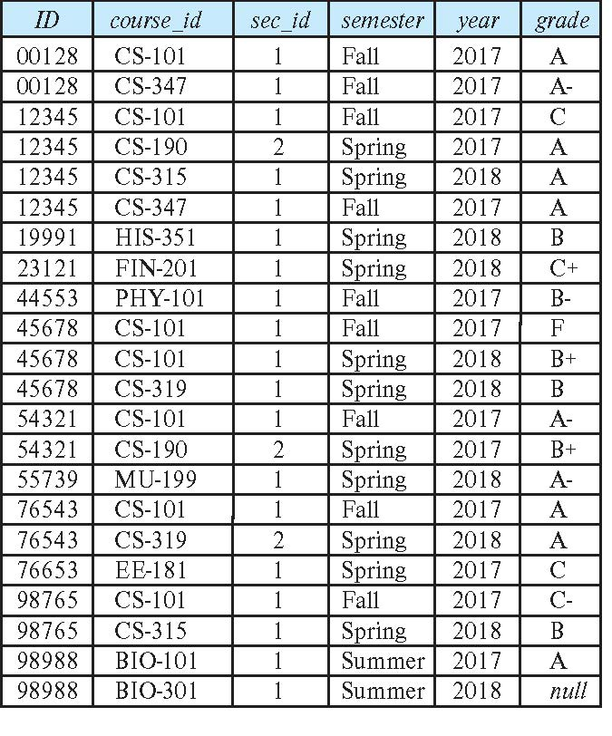
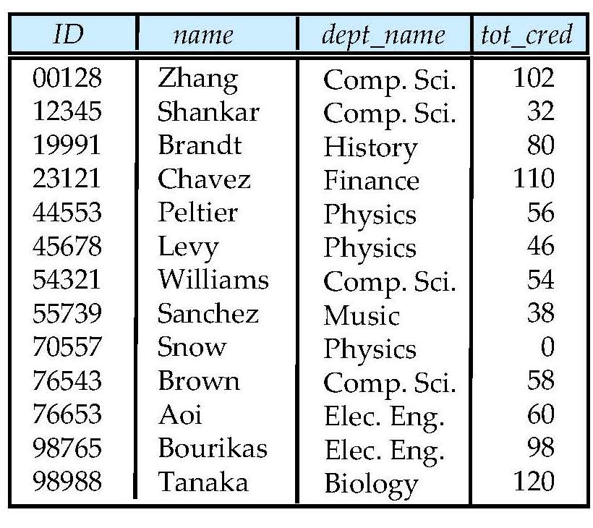
Student and Takes Relation Relation

Slide 8
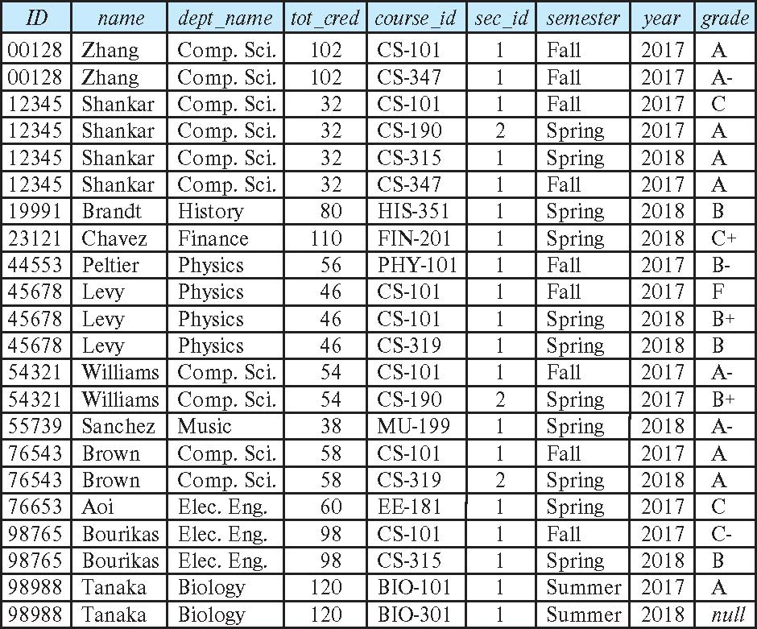
student natural join takes

Slide 9
Dangerous in Natural Join
Beware of unrelated attributes with same name which get equated incorrectly
Example -- List the names of students instructors along with the titles of courses that they have taken
Correct version
select name, title from student natural join takes, course where takes.course_id = course.course_id;
Incorrect version
select name, title from student natural join takes natural join course;
This query omits all (student name, course title) pairs where the student takes a course in a department other than the student's own department.
The correct version (above), correctly outputs such pairs.
Notes:
course(course_id, title, dept_name, credits)
student(ID, name, dept_name, tot_cred)
takes(ID, course_id, sec_id, semester, year, grade)
select name, title from student natural join takes natural join course; -> SELECT student.name, course.title FROM student, takes, course WHERE student.ID = takes.ID AND takes.course_id = course.course_id; and student.dept_name=course.dempt_name

Slide 10
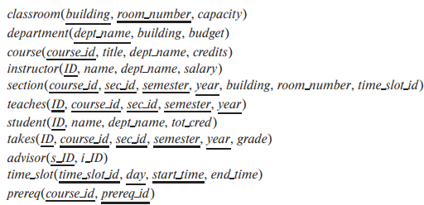
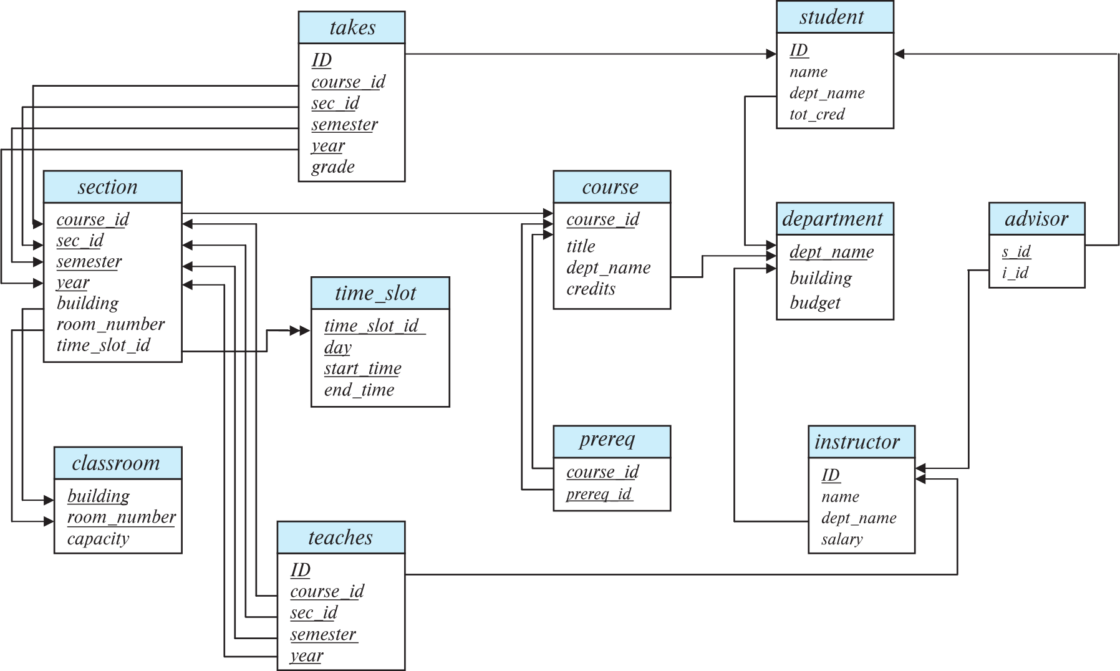
Schema Diagram for University Database
Notes:
classroom(building, room_number, capacity)
department(dept_name, building, budget)
course(course_id, title, dept name, credits)
instructor(ID, name, dept name, salary)
section(course_id, sec id, semester, year, building, room_number, time_slot_id
teaches(ID, course_id, sec id, semester, year)
student(ID, name, dept_name, tot_cred)
takes(ID, course_id, sec_id, semester, year, grade)
advisor(s_ID, i_ID)
time_slot(time_slot_id, day, start time, end_time)
prereq(course_id, prereq_id)

Slide 11
Natural Join with Using Clause
To avoid the danger of equating attributes erroneously, we can use the “using” construct that allows us to specify exactly which columns should be equated.
Query example
select name, title from (student natural join takes) join course using (course_id)
Notes:
Explanation:
NATURAL JOIN (student NATURAL JOIN takes): This part combines the student and takes tables based on their common columns, which is typically ID since both tables have that column.
JOIN course USING (course_id): This part then joins the result of the natural join with the course table, specifically using the course_id column.

Slide 12
Join Condition
The on condition allows a general predicate over the relations being joined
This predicate is written like a where clause predicate except for the use of the keyword on
Query example
select * from student join takes on student_ID = takes_ID
The on condition above specifies that a tuple from student matches a tuple from takes if their ID values are equal.
Equivalent to:
select * from student , takes where student_ID = takes_ID
Notes:
The USING clause is used to specify a column or set of columns that should be used for the join. It is more concise and easier to read when you have columns with the same name in both tables.
Automatically ensures that the joined columns have the same name in the resulting dataset. ‘
SELECT name, title FROM (student NATURAL JOIN takes) JOIN course USING (course_id);
The ON clause is more flexible and powerful, allowing you to specify complex join conditions.
SELECT student.name, course.title FROM student JOIN takes ON student.ID = takes.ID JOIN course ON takes.course_id = course.course_id;

Slide 13
Outer Join
An extension of the join operation that avoids loss of information.
Computes the join and then adds tuples form one relation that does not match tuples in the other relation to the result of the join.
Uses null values.
Three forms of outer join:
left outer join
right outer join
full outer join

Slide 14
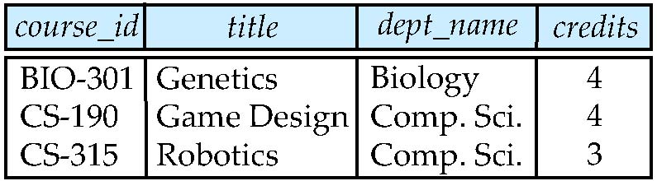
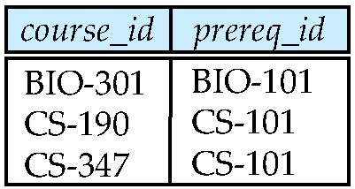
Outer Join Examples
Relation course
Relation prereq
Observe that
course information is missing CS-347
prereq information is missing CS-315

Slide 15
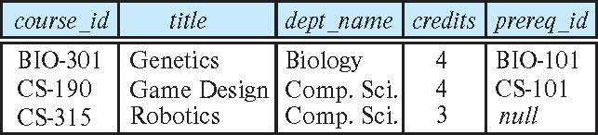
Left Outer Join
course natural left outer join prereq
In relational algebra: course ⟕ prereq

Slide 16
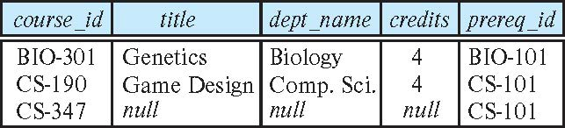
Right Outer Join
course natural right outer join prereq
In relational algebra: course ⟖ prereq

Slide 17
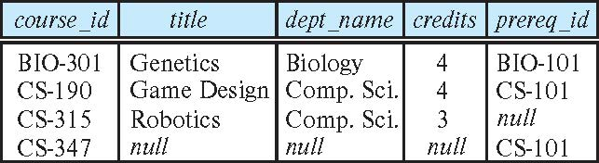
Full Outer Join
course natural full outer join prereq
In relational algebra: course ⟗ prereq

Slide 18
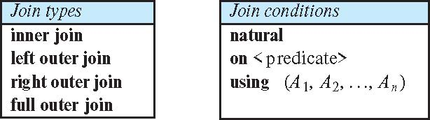
Joined Types and Conditions
Join operations take two relations and return as a result another relation.
These additional operations are typically used as subquery expressions in the from clause
Join condition – defines which tuples in the two relations match.
Join type – defines how tuples in each relation that do not match any tuple in the other relation (based on the join condition) are treated.

Slide 19
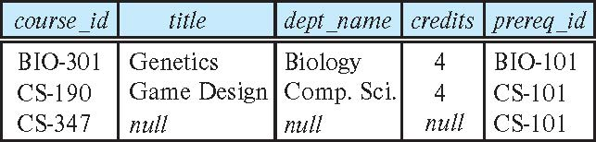
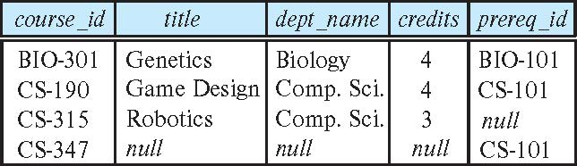
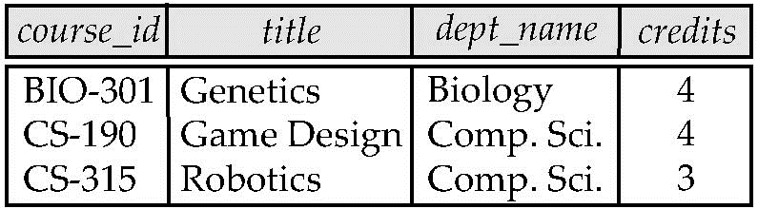
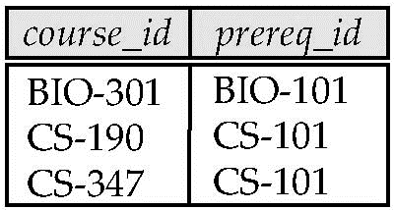
Joined Relations – Examples
course natural right outer join prereq
course full outer join prereq using (course_id)
Notes:
classroom(building, room_number, capacity)
department(dept_name, building, budget)
course(course_id, title, dept name, credits)
instructor(ID, name, dept name, salary)
section(course_id, sec id, semester, year, building, room_number, time_slot_id
teaches(ID, course_id, sec id, semester, year)
student(ID, name, dept_name, tot_cred)
takes(ID, course_id, sec_id, semester, year, grade)
advisor(s_ID, i_ID)
time_slot(time_slot_id, day, start time, end_time)
prereq(course_id, prereq_id)

Slide 20
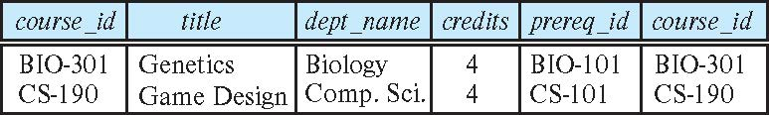
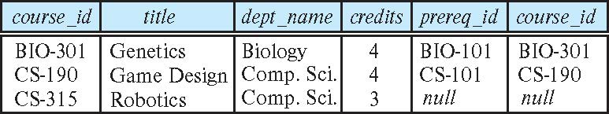
Joined Relations – Examples
course inner join prereq on course.course_id = prereq.course_id
What is the difference between the above, and a natural join?
course left outer join prereq on course.course_id = prereq.course_id

Slide 21
Joined Relations – Examples
course natural right outer join prereq
course full outer join prereq using (course_id)

Slide 22
Views
In some cases, it is not desirable for all users to see the entire logical model (that is, all the actual relations stored in the database.)
Consider a person who needs to know an instructors name and department, but not the salary. This person should see a relation described, in SQL, by select ID, name, dept_name from instructor
A view provides a mechanism to hide certain data from the view of certain users.
Any relation that is not of the conceptual model but is made visible to a user as a “virtual relation” is called a view.

Slide 23
View Definition
A view is defined using the create view statement which has the form
create view v as < query expression >
where <query expression> is any legal SQL expression. The view name is represented by v.
Once a view is defined, the view name can be used to refer to the virtual relation that the view generates.
View definition is not the same as creating a new relation by evaluating the query expression
Rather, a view definition causes the saving of an expression; the expression is substituted into queries using the view.

Slide 24
View Definition and Use
A view of instructors without their salary
create view faculty as select ID, name, dept_name from instructor
Find all instructors in the Biology department
select name from faculty where dept_name = 'Biology'
Create a view of department salary totals
create view departments_total_salary(dept_name, total_salary) as select dept_name, sum (salary) from instructor group by dept_name;

Slide 25
Views Defined Using Other Views
One view may be used in the expression defining another view
A view relation v₁ is said to depend directly on a view relation v₂ if v₂ is used in the expression defining v₁
A view relation v₁ is said to depend on view relation v₂ if either v₁ depends directly to v₂ or there is a path of dependencies from v₁ to v₂
A view relation v is said to be recursive if it depends on itself.

Slide 26
Views Defined Using Other Views
create view physics_fall_2017 as select course.course_id, sec_id, building, room_number from course, section where course.course_id = section.course_id and course.dept_name = 'Physics' and section.semester = 'Fall' and section.year = '2017’;
create view physics_fall_2017_watson as select course_id, room_number from physics_fall_2017 where building= 'Watson';

Slide 27
View Expansion
Expand the view :
create view physics_fall_2017_watson as select course_id, room_number from physics_fall_2017 where building= 'Watson'
To:
create view physics_fall_2017_watson as
select course_id, room_number
from (select course.course_id, building, room_number
from course, section
where course.course_id = section.course_id
and course.dept_name = 'Physics'
and section.semester = 'Fall'
and section.year = '2017')
where building= 'Watson';

Slide 28
View Expansion (Cont.)
A way to define the meaning of views defined in terms of other views.
Let view v₁ be defined by an expression e₁ that may itself contain uses of view relations.
View expansion of an expression repeats the following replacement step:
repeat Find any view relation v_{i} in e₁ Replace the view relation v_{i} by the expression defining v_{i} until no more view relations are present in e₁
As long as the view definitions are not recursive, this loop will terminate
Notes:
Understanding View Expansion in SQL
Views in SQL are virtual tables created by querying one or more tables. They simplify complex queries and improve readability. When a view references other views, it can create a chain of dependencies. Understanding and expanding these dependencies is crucial to correctly interpreting and optimizing SQL queries.
Concept:
Imagine you have a view v1 defined by an expression e1. This expression might use other views, creating a nested structure. View expansion involves replacing these nested views with their underlying definitions until you get a final expression that no longer contains any view relations.
Steps for View Expansion:
Identify View Relation: Find any view relation vi used in e1.
Replace View Relation: Replace vi with the expression defining vi.
Repeat: Continue this process until no more view relations are present in e1.
Example:
Let's take a practical example to illustrate this:
View Definitions:
sql
CREATE VIEW v1 AS SELECT a, b FROM t1; CREATE VIEW v2 AS SELECT v1.a, t2.c FROM v1, t2 WHERE v1.b = t2.b;
View Expansion Process:
Initial Expression (e1):
sql
SELECT v1.a, t2.c FROM v1, t2 WHERE v1.b = t2.b;
Identify: v1 is a view relation.
Replace v1 with its definition:
sql
SELECT t1.a, t2.c FROM (SELECT a, b FROM t1) AS v1, t2 WHERE v1.b = t2.b;
Replace: Substitute v1 with (SELECT a, b FROM t1) AS v1.
Simplify Expression:
sql
SELECT t1.a, t2.c FROM t1, t2 WHERE t1.b = t2.b;
Simplify: The intermediate step simplifies to remove the AS v1.
Final Expression:
The expanded view expression no longer contains any view relations.
Key Points:
Non-recursive Definitions: The process works as long as the view definitions are not recursive. Recursive definitions would create an infinite loop.
Efficiency: This expansion helps understand and optimize queries, ensuring correct and efficient execution.
By using view expansion, you break down complex nested view definitions into their fundamental components, making the overall query more transparent and manageable. Any questions about view expansion or SQL in general?

Slide 29
View Expansion (Cont.)
Example: View Definitions:
CREATE VIEW v1 AS SELECT a, b FROM t1;
CREATE VIEW v2 AS SELECT v1.a, t2.c FROM v1, t2 WHERE v1.b = t2.b;
View Expansion Process:
Identify: v1 is a view relation.
Replace v1 with its definition:
SELECT t1.a, t2.c FROM (SELECT a, b FROM t1) AS v1, t2 WHERE v1.b = t2.b;
Final Expression:
The expanded view expression no longer contains any view relations.
Key Points:
Non-recursive Definitions: The process works as long as the view definitions are not recursive. Recursive definitions would create an infinite loop.
Efficiency: This expansion helps understand and optimize queries, ensuring correct and efficient execution.
By using view expansion, you break down complex nested view definitions into their fundamental components, making the overall query more transparent and manageable. Any questions about view expansion or SQL in general?
Notes:
Understanding View Expansion in SQL
Views in SQL are virtual tables created by querying one or more tables. They simplify complex queries and improve readability. When a view references other views, it can create a chain of dependencies. Understanding and expanding these dependencies is crucial to correctly interpreting and optimizing SQL queries.
Concept:
Imagine you have a view v1 defined by an expression e1. This expression might use other views, creating a nested structure. View expansion involves replacing these nested views with their underlying definitions until you get a final expression that no longer contains any view relations.
Steps for View Expansion:
Identify View Relation: Find any view relation vi used in e1.
Replace View Relation: Replace vi with the expression defining vi.
Repeat: Continue this process until no more view relations are present in e1.
Example:
Let's take a practical example to illustrate this:
View Definitions:
sql
CREATE VIEW v1 AS SELECT a, b FROM t1; CREATE VIEW v2 AS SELECT v1.a, t2.c FROM v1, t2 WHERE v1.b = t2.b;
View Expansion Process:
Initial Expression (e1):
sql
SELECT v1.a, t2.c FROM v1, t2 WHERE v1.b = t2.b;
Identify: v1 is a view relation.
Replace v1 with its definition:
sql
SELECT t1.a, t2.c FROM (SELECT a, b FROM t1) AS v1, t2 WHERE v1.b = t2.b;
Replace: Substitute v1 with (SELECT a, b FROM t1) AS v1.
Simplify Expression:
sql
SELECT t1.a, t2.c FROM t1, t2 WHERE t1.b = t2.b;
Simplify: The intermediate step simplifies to remove the AS v1.
Final Expression:
The expanded view expression no longer contains any view relations.
Key Points:
Non-recursive Definitions: The process works as long as the view definitions are not recursive. Recursive definitions would create an infinite loop.
Efficiency: This expansion helps understand and optimize queries, ensuring correct and efficient execution.
By using view expansion, you break down complex nested view definitions into their fundamental components, making the overall query more transparent and manageable. Any questions about view expansion or SQL in general?

Slide 30
Materialized Views
Certain database systems allow view relations to be physically stored.
Physical copy created when the view is defined.
Such views are called Materialized view:
Challenge: If relations used in the query are updated, the materialized view result becomes out of date
Need to maintain the view, by updating the view whenever the underlying relations are updated.
Notes:
Materialized Views نمای مادی:
A materialized view is a database object that contains the results of a query.
Unlike regular views, which are virtual tables calculated on-the-fly when queried, a materialized view stores the query results physically in the database.
This can significantly improve query performance, especially for complex queries that are expensive to compute each time.
Since the data in materialized views is physically stored, it can become outdated if the underlying data changes.
To keep the materialized view up to date, it needs to be refreshed periodically. This can be done manually or automatically.

Slide 31
Update of a View
Add a new tuple to faculty view which we defined earlier
insert into faculty
values ('30765', 'Green', 'Music');
This insertion must be represented by the insertion into the instructor relation
Must have a value for salary attribute in the table.
Two approaches
Reject the insert
Insert the tuple
('30765', 'Green', 'Music', null)
into the instructor relation

Slide 32
Some Updates Cannot be Translated Uniquely
create view instructor_info as select ID, name, building from instructor, department where instructor.dept_name = department.dept_name;
insert into instructor_info
values ('69987', 'White', 'Taylor');
Issues
Which department, if multiple departments in Taylor?
What if no department is in Taylor?
Notes:
department(dept_name, building, budget)
instructor(ID, name, dept name, salary)

Slide 33
And Some Not at All
create view history_instructors as select * from instructor where dept_name= 'History';
What happens if we insert
('25566', 'Brown', 'Biology', 100000)
into history_instructors?
Notes:
department(dept_name, building, budget)
instructor(ID, name, dept name, salary)

Slide 34
View Updates in SQL
Most SQL implementations allow updates only on simple views
The from clause has only one database relation.
The select clause contains only attribute names of the relation, and does not have any expressions, aggregates, or distinct specification.
Any attribute not listed in the select clause can be set to null
The query does not have a group by or having clause.

Slide 35
Transactions
A transaction consists of a sequence of query and/or update statements and is a “unit” of work
The SQL standard specifies that a transaction begins implicitly when an SQL statement is executed.
The transaction must end with one of the following statements:
Commit work. The updates performed by the transaction become permanent in the database.
Rollback work. All the updates performed by the SQL statements in the transaction are undone.
Atomic transaction
either fully executed or rolled back as if it never occurred
Isolation from concurrent transactions
Notes:
استاندارد SQL مشخص می‌کند که یک تراکنش به‌طور ضمنی زمانی که یک دستور SQL اجرا می‌شود، آغاز می‌شود.
تراکنش باید با یکی از دستورات زیر پایان یابد:
Commit work. به‌روزرسانی‌های انجام‌شده توسط تراکنش به‌طور دائمی در پایگاه داده ثبت می‌شوند.
Rollback work. تمام به‌روزرسانی‌های انجام‌شده توسط دستورات SQL در تراکنش لغو می‌شوند.
تراکنش اتمی
یا به‌طور کامل اجرا می‌شود یا به‌طور کامل لغو می‌شود به‌طوری که انگار هرگز رخ نداده است.
جداسازی از تراکنش‌های همزمان
امیدوارم این ترجمه کمک کند! اگر سوال دیگری دارید، بفرمایید.

Slide 36
Integrity Constraints
Integrity constraints guard against accidental damage to the database, by ensuring that authorized changes to the database do not result in a loss of data consistency.
A checking account must have a balance greater than $10,000.00
A salary of a bank employee must be at least $4.00 an hour
A customer must have a (non-null) phone number

Slide 37
Constraints on a Single Relation
not null
primary key
unique
check (P), where P is a predicate

Slide 38
Not Null Constraints
not null
Declare name and budget to be not null
name varchar(20) not null budget numeric(12,2) not null

Slide 39
Unique Constraints
unique ( A₁, A₂, …, A_{m})
The unique specification states that the attributes A₁, A₂, …, A_{m} form a candidate key.
Candidate keys are permitted to be null (in contrast to primary keys).

Slide 40
The check clause
The check (P) clause specifies a predicate P that must be satisfied by every tuple in a relation.
Example: ensure that semester is one of fall, winter, spring or summer
create table section
(course_id varchar (8),
sec_id varchar (8),
semester varchar (6),
year numeric (4,0),
building varchar (15),
room_number varchar (7),
time slot id varchar (4),
primary key (course_id, sec_id, semester, year),
check (semester in ('Fall', 'Winter', 'Spring', 'Summer')))

Slide 41
Referential Integrity
Ensures that a value that appears in one relation for a given set of attributes also appears for a certain set of attributes in another relation.
Example: If “Biology” is a department name appearing in one of the tuples in the instructor relation, then there exists a tuple in the department relation for “Biology”.
Let A be a set of attributes. Let R and S be two relations that contain attributes A and where A is the primary key of S. A is said to be a foreign key of R if for any values of A appearing in R these values also appear in S.

Slide 42
Referential Integrity (Cont.)
Foreign keys can be specified as part of the SQL create table statement
foreign key (dept_name) references department
By default, a foreign key references the primary-key attributes of the referenced table.
SQL allows a list of attributes of the referenced relation to be specified explicitly.
foreign key (dept_name) references department (dept_name)

Slide 43
Cascading Actions in Referential Integrity
When a referential-integrity constraint is violated, the normal procedure is to reject the action that caused the violation.
An alternative, in case of delete or update is to cascade
create table course ( (… dept_name varchar(20), foreign key (dept_name) references department on delete cascade on update cascade, . . .)
Instead of cascade we can use :
set null,
set default

Slide 44
Integrity Constraint Violation During Transactions
Consider:
create table person ( ID char(10), name char(40), mother char(10), father char(10), primary key ID, foreign key father references person, foreign key mother references person)
How to insert a tuple without causing constraint violation?
Insert father and mother of a person before inserting person
OR, set father and mother to null initially, update after inserting all persons (not possible if father and mother attributes declared to be not null)
OR defer constraint checking

Slide 45
Complex Check Conditions
The predicate in the check clause can be an arbitrary predicate that can include a subquery.
check (time_slot_id in (select time_slot_id from time_slot))
The check condition states that the time_slot_id in each tuple in the section relation is actually the identifier of a time slot in the time_slot relation.
The condition has to be checked not only when a tuple is inserted or modified in section , but also when the relation time_slot changes

Slide 46
Assertions
An assertion is a predicate expressing a condition that we wish the database always to satisfy.
The following constraints, can be expressed using assertions:
For each tuple in the student relation, the value of the attribute tot_cred must equal the sum of credits of courses that the student has completed successfully.
An instructor cannot teach in two different classrooms in a semester in the same time slot
An assertion in SQL takes the form:
create assertion <assertion-name> check (<predicate>);
Notes:
یک ادعا (Assertion) گزاره‌ای است که شرطی را بیان می‌کند که می‌خواهیم پایگاه داده همیشه آن را برآورده کند. محدودیت‌های زیر را می‌توان با استفاده از ادعاها بیان کرد:
برای هر ردیف در رابطه دانشجو (student)، مقدار ویژگی tot_cred باید برابر با مجموع واحدهای درسی باشد که دانشجو با موفقیت گذرانده است.
یک استاد نمی‌تواند در یک نیم‌سال در دو کلاس مختلف و در یک بازه زمانی مشابه تدریس کند.
یک ادعا در SQL به صورت زیر نوشته می‌شود:

Slide 47
Built-in Data Types in SQL
date: Dates, containing a (4 digit) year, month and date
Example: date '2005-7-27'
time: Time of day, in hours, minutes and seconds.
Example: time '09:00:30' time '09:00:30.75'
timestamp: date plus time of day
Example: timestamp '2005-7-27 09:00:30.75'
interval: period of time
Example: interval '1' day
Subtracting a date/time/timestamp value from another gives an interval value
Interval values can be added to date/time/timestamp values

Slide 48
Large-Object Types
Large objects (photos, videos, CAD files, etc.) are stored as a large object:
blob: binary large object -- object is a large collection of uninterpreted binary data (whose interpretation is left to an application outside of the database system)
clob: character large object -- object is a large collection of character data
When a query returns a large object, a pointer is returned rather than the large object itself.
Notes:
اشیاء بزرگ (عکس‌ها، ویدئوها، فایل‌های CAD و غیره) به عنوان یک شیء بزرگ ذخیره می‌شوند:
- blob: شیء بزرگ باینری -- شیء یک مجموعه بزرگ از داده‌های باینری تفسیر نشده است (که تفسیر آن به یک برنامه خارج از سیستم پایگاه داده واگذار شده است)
- clob: شیء بزرگ کاراکتری -- شیء یک مجموعه بزرگ از داده‌های کاراکتری است
هنگامی که یک پرس و جو یک شیء بزرگ را برمی‌گرداند، به جای خود شیء بزرگ، یک اشاره‌گر برگردانده می‌شود.
Types of Large Objects
BLOB (Binary Large Object):
A BLOB is a large collection of binary data that the database does not interpret.
Commonly used for storing files such as:
Images (e.g., .png, .jpg)
Videos (e.g., .mp4, .mov)
Executables
Any other type of binary data.
The data is treated as raw bytes, and its interpretation is left entirely to the application or user interacting with the database.
CLOB (Character Large Object):
A CLOB is a large collection of character data, typically textual content.
Commonly used for storing:
Documents (e.g., .txt, .docx)
Articles
Logs or extensive descriptions.
Unlike a BLOB, the database can handle the content as character data (e.g., encoding, searching).
Storage:
Large objects are usually stored outside the main table where other structured data resides. Instead of placing the entire content within a table's row:
A pointer/reference to the large object's location in storage is kept in the table.
The actual object is stored in a specialized storage area optimized for handling large files.
Why Use a Pointer?
Efficiency: Large objects can be extremely resource-intensive to handle, transfer, and process. Returning the actual object with a query could slow down performance significantly.
Memory Usage: Storing and transferring pointers (small references) instead of the actual data reduces memory consumption and network load.
Flexibility: Applications can fetch the large object when needed, avoiding unnecessary data transfer.
Query Behavior:
When a query involving a large object is executed:
The query retrieves and returns a pointer (or reference) to the large object rather than the object itself.
The application accessing the database uses this pointer to fetch the object only when required.

Slide 49
User-Defined Types
create type construct in SQL creates user-defined type
create type Dollars as numeric (12,2) final
Example:
create table department (dept_name varchar (20), building varchar (15), budget Dollars);

Slide 50
Domains
create domain construct in SQL-92 creates user-defined domain types
create domain person_name char(20) not null
Types and domains are similar. Domains can have constraints, such as not null, specified on them.
Example:
create domain degree_level varchar(10) constraint degree_level_test check (value in ('Bachelors', 'Masters', 'Doctorate'));

Slide 51
Index Creation
Many queries reference only a small proportion of the records in a table.
It is inefficient for the system to read every record to find a record with particular value
An index on an attribute of a relation is a data structure that allows the database system to find those tuples in the relation that have a specified value for that attribute efficiently, without scanning through all the tuples of the relation.
We create an index with the create index command
create index <name> on <relation-name> (attribute);
Notes:
شاخص‌ها در پایگاه داده از الگوریتم‌های مختلفی برای یافتن مقادیر خاص به صورت کارآمد استفاده می‌کنند. رایج‌ترین الگوریتم‌ها شامل موارد زیر می‌شوند:
1. شاخص‌های B-Tree (درخت متوازن):
نحوه کار: B-Tree یک ساختار داده‌ای درختی خود متوازن است که داده‌ها را مرتب نگه می‌دارد و جستجوها، دسترسی ترتیبی، درج‌ها و حذف‌ها را در زمان لگاریتمی امکان‌پذیر می‌کند.
استفاده: بیشتر پایگاه‌های داده رابطه‌ای (مانند MySQL، PostgreSQL) از B-Tree یا تغییرات آن مانند B+ Tree استفاده می‌کنند.
مزایا: کارآمد برای دامنه گسترده‌ای از پرس و جوها، شامل پرس و جوهای برابری و دامنه.
2. شاخص‌های Hash:
نحوه کار: شاخص‌های Hash از یک تابع Hash برای تبدیل کلید جستجو به یک مکان در شاخص استفاده می‌کنند. تابع Hash تضمین می‌کند که داده‌ها به طور یکنواخت در سراسر شاخص توزیع شوند.
استفاده: بهترین برای مقایسه‌های برابری اما مناسب برای پرس و جوهای دامنه نیست.
مزایا: جستجوی بسیار سریع برای تطابقات دقیق.
3. شاخص‌های Bitmap:
نحوه کار: شاخص‌های Bitmap از Bitmapها (آرایه‌های بیت) برای نشان دادن وجود یک مقدار در مجموعه‌ای از رکوردها استفاده می‌کنند. هر بیت به یک سطر در جدول اشاره دارد.
استفاده: معمول در انبارهای داده برای ستون‌هایی با تعداد کم مقادیر منحصربه‌فرد (کم کاردینالی).
مزایا: کارآمد برای عملیات منطقی پیچیده و پرس و جوهای تجمیعی.
4. GiST (درخت جستجوی عمومی):
نحوه کار: GiST یک ساختار درختی متوازن است که می‌تواند برای انواع مختلفی از پرس و جوها، شامل پرس و جوهای فضایی و دامنه، استفاده شود.
استفاده: به طور گسترده در پایگاه‌های داده مانند PostgreSQL برای شاخص‌گذاری تخصصی، مانند داده‌های جغرافیایی، استفاده می‌شود.
مزایا: انعطاف‌پذیر و پشتیبانی از دامنه گسترده‌ای از پرس و جوها.
5. R-Tree:
نحوه کار: R-Tree برای شاخص‌گذاری اطلاعات چند بعدی مانند مختصات جغرافیایی، مستطیل‌ها و غیره استفاده می‌شود.
استفاده: اغلب در پایگاه‌های داده فضایی استفاده می‌شود.
مزایا: کارآمد برای پرس و جوهای فضایی مانند یافتن تمام اشیاء در یک منطقه معین.
خلاصه:
Indexes in databases use various search algorithms to efficiently locate specific values. The most common algorithms include:
1. B-Tree (Balanced Tree) Indexes:
How it works: A B-Tree is a self-balancing tree data structure that maintains sorted data and allows searches, sequential access, insertions, and deletions in logarithmic time.
Usage: Most relational databases (like MySQL, PostgreSQL) use B-Trees or variations like B+ Trees.
Advantages: Efficient for a wide range of queries, including equality and range queries.
2. Hash Indexes:
How it works: Hash indexes use a hash function to convert the search key into a location in the index. The hash function ensures that data is evenly distributed across the index.
Usage: Best for equality comparisons but not suitable for range queries.
Advantages: Very fast lookup for exact matches.
3. Bitmap Indexes:
How it works: Bitmap indexes use bitmaps (arrays of bits) to represent the existence of a value in a set of records. Each bit corresponds to a row in the table.
Usage: Common in data warehousing for columns with low cardinality (few unique values).
Advantages: Efficient for complex logical operations and aggregate queries.
4. GiST (Generalized Search Tree):
How it works: GiST is a balanced tree structure that can be used for various types of queries, including spatial and range queries.
Usage: Widely used in databases like PostgreSQL for specialized indexing, such as geographic data.
Advantages: Flexible and supports a wide range of queries.
5. R-Tree:
How it works: R-Tree is used for indexing multi-dimensional information such as geographical coordinates, rectangles, etc.
Usage: Often used in spatial databases.
Advantages: Efficient for spatial queries like finding all objects within a given area.
Summary

Slide 52
Index Creation Example
create table student (ID varchar (5), name varchar (20) not null, dept_name varchar (20), tot_cred numeric (3,0) default 0, primary key (ID))
create index studentID_index on student(ID)
The query:
select * from student where ID = '12345'
can be executed by using the index to find the required record, without looking at all records of student

Slide 53
Authorization
We may assign a user several forms of authorizations on parts of the database.
Read - allows reading, but not modification of data.
Insert - allows insertion of new data, but not modification of existing data.
Update - allows modification, but not deletion of data.
Delete - allows deletion of data.
Each of these types of authorizations is called a privilege. We may authorize the user all, none, or a combination of these types of privileges on specified parts of a database, such as a relation or a view.

Slide 54
Authorization (Cont.)
Forms of authorization to modify the database schema
Index - allows creation and deletion of indices.
Resources - allows creation of new relations.
Alteration - allows addition or deletion of attributes in a relation.
Drop - allows deletion of relations.

Slide 55
Authorization Specification in SQL
The grant statement is used to give authorization
grant <privilege list> on <relation or view > to <user list>
<user list> is:
a user-id
public, which allows all valid users the privilege granted
A role (more on this later)
Example:
grant select on department to Akbar, Asghar
Granting a privilege on a view does not imply granting any privileges on the underlying relations.
The grantor of the privilege must already hold the privilege on the specified item (or be the database administrator).
Notes:
بیانیه grant برای اعطای مجوز استفاده می‌شود
```sql
GRANT <لیست امتیازات> ON <رابطه یا نما> TO <لیست کاربران>
```
**لیست کاربران** شامل:
- یک user-id
- `public`، که به همه کاربران معتبر امتیاز اعطا شده را می‌دهد
- یک نقش (بیشتر در مورد این بعداً)
**مثال**:
```sql
GRANT SELECT ON department TO Amit, Satoshi;
```
اعطای امتیاز بر روی یک نما به معنی اعطای هرگونه امتیاز بر روی روابط زیری نیست.
اعطا کننده امتیاز باید قبلاً امتیاز را بر روی آیتم مشخص شده داشته باشد (یا مدیر پایگاه داده باشد).
امیدوارم این ترجمه برای شما مفید باشد! اگر سوال دیگری دارید، بفرمایید.

Slide 56
Privileges in SQL
select: allows read access to relation, or the ability to query using the view
Example: grant users U₁, U₂, and U₃ select authorization on the instructor relation:
grant select on instructor to U₁, U₂, U₃
insert: the ability to insert tuples
update: the ability to update using the SQL update statement
delete: the ability to delete tuples.
all privileges: used as a short form for all the allowable privileges

Slide 57
Revoking Authorization in SQL
The revoke statement is used to revoke authorization.
revoke <privilege list> on <relation or view> from <user list>
Example:
revoke select on student from U₁, U₂, U₃
<privilege-list> may be all to revoke all privileges the revokee may hold.
If <revokee-list> includes public, all users lose the privilege except those granted it explicitly.
If the same privilege was granted twice to the same user by different grantees, the user may retain the privilege after the revocation.
All privileges that depend on the privilege being revoked are also revoked.
Notes:
بیانیه REVOKE برای لغو مجوز استفاده می‌شود.
sql
REVOKE <فهرست امتیازات> ON <رابطه یا نما> FROM <فهرست کاربران>
مثال:
sql
REVOKE SELECT ON student FROM U1, U2, U3;
توضیحات:
فهرست امتیازات می‌تواند شامل ALL باشد تا تمام امتیازاتی که کاربر لغوشونده ممکن است داشته باشد، لغو شوند.
اگر فهرست لغوشونده شامل PUBLIC باشد، همه کاربران امتیاز را از دست می‌دهند به جز کسانی که به طور صریح آن را دریافت کرده‌اند.
اگر همان امتیاز دو بار به همان کاربر توسط اعطاکنندگان مختلف اعطا شده باشد، کاربر ممکن است پس از لغو امتیاز را حفظ کند.
همه امتیازاتی که به امتیاز لغوشده وابسته هستند نیز لغو می‌شوند.
اگر سوال یا موضوع دیگری در ذهن دارید، بفرمایید!

Slide 58
Roles
A role is a way to distinguish among various users as far as what these users can access/update in the database.
To create a role we use:
create a role <name>
Example:
create role instructor
Once a role is created we can assign “users” to the role using:
grant <role> to <users>

Slide 59
Roles Example
create role instructor;
grant instructor to Amit;
Privileges can be granted to roles:
grant select on takes to instructor;
Roles can be granted to users, as well as to other roles
create role teaching_assistant
grant teaching_assistant to instructor;
Instructor inherits all privileges of teaching_assistant
Chain of roles
create role dean;
grant instructor to dean;
grant dean to Satoshi;

Slide 60
Authorization on Views
create view geo_instructor as (select * from instructor where dept_name = 'Geology');
grant select on geo_instructor to geo_staff
Suppose that a geo_staff member issues
select * from geo_instructor;
What if
geo_staff does not have permissions on instructor?
Creator of view did not have some permissions on instructor?
Notes:
geo_staff Does Not Have Permissions on instructor
When geo_staff queries geo_instructor, the database checks the permissions of the view’s creator, not the geo_staff user, to access the instructor table.
If the creator of the view has SELECT permissions on instructor: The query will succeed. The geo_staff member will see the rows of the view (geo_instructor) without requiring direct access to the instructor table.
If the creator of the view does not have SELECT permissions on instructor: The query will fail, even if geo_staff has access to the view, because the underlying data access is blocked

Slide 61
Other Authorization Features
references privilege to create foreign key
grant reference (dept_name) on department to Mariano;
Why is this required?
transfer of privileges
grant select on department to Amit with grant option;
revoke select on department from Amit, Satoshi cascade;
revoke select on department from Amit, Satoshi restrict;
And more!
Notes:
GRANT REFERENCES (dept_name) ON department TO Mariano;
Purpose:
The REFERENCES privilege allows a user (in this case, Mariano) to create a foreign key that references the specified column (dept_name) in the department table.
Without this privilege, Mariano cannot define a foreign key constraint referencing the dept_name column.
REVOKE SELECT ON department FROM Amit, Satoshi CASCADE;
Revokes the SELECT privilege from Amit and Satoshi and any users who received the privilege from them.
CASCADE ensures that the revocation propagates, removing permissions for all indirect recipients of the privilege.
REVOKE SELECT ON department FROM Amit, Satoshi RESTRICT;
Attempts to revoke the SELECT privilege from Amit and Satoshi.
RESTRICT prevents the revocation if there are users who have received the privilege from Amit or Satoshi. This maintains the hierarchy of granted privileges.
grant select on department to Amit with grant option;
Means that Amit can transfer his grant to other users

Slide 62
Other Authorization Features
GRANT REFERENCES (dept_name) ON department TO Mariano;
The REFERENCES privilege allows a user (in this case, Mariano) to create a foreign key that references the specified column (dept_name) in the department table.
REVOKE SELECT ON department FROM Amit, Satoshi CASCADE;
CASCADE ensures that the revocation propagates, removing permissions for all indirect recipients of the privilege.
REVOKE SELECT ON department FROM Amit, Satoshi RESTRICT;
RESTRICT prevents the revocation if there are users who have received the privilege from Amit or Satoshi. This maintains the hierarchy of granted privileges.
grant select on department to Amit with grant option;
Means that Amit can transfer his grant to other users

Slide 63
CASCADE/ RESTRICT GRANT FEATURES
Aspect | CASCADE | RESTRICT
Behavior | Revokes the privilege from the specified users and all those who were granted the privilege by them. | Revokes the privilege only if no dependent users exist. Otherwise, it raises an error.
Use Case | Use when you want to remove all dependencies. | Use when you want to ensure no other users are affected.
Example Result | If Amit granted SELECT to Bob, Bob loses the privilege when Amit's privilege is revoked. | Amit’s privilege cannot be revoked if Bob received the privilege from Amit.

Slide 64
End of Chapter 4

