Slide 1
Global View Consensus
Topological View Consensus
N₉
…
N_{v}
…
…
N_{y}
…
…
N_{w}
…
N₁
N_{n}
N_{u}
N_{x}
N_{z}
Shared Observation (O)
Local Observation O₁
Local Observation O₂
…
O_{m}

Slide 2
Global View Consensus
Topological View Consensus
N₁
…
N₉
…
N_{n}
N₁
…
N_{j}
…
N_{k}
N_{x}
…
N_{j’}
…
N_{n}
Shared Observation (O)
Local Observation O₁
Local Observation O₂
…
O_{m}

Slide 3
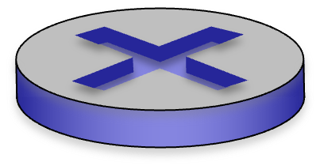
RPKI
RPKI
RPKI

Slide 4

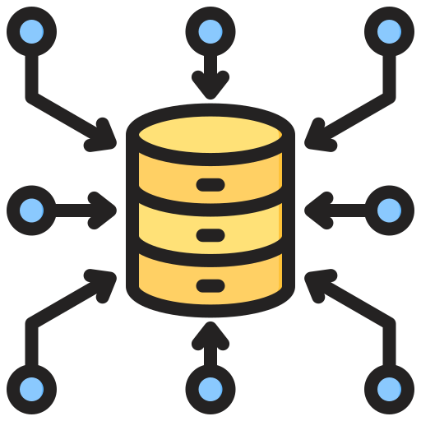
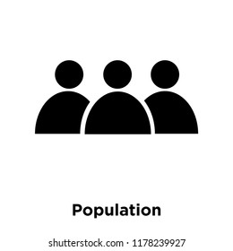
2
3
4
Central RPKI Repository
RPKI-only
ROA validation
PoP Ledger Commit
Forensic
Audit Trail
Trust Quantification
RPKI
RPKI
RPKI
RPKI Trust Proxies
RPKI Trust Proxies
1
…
…
…
…
Isolated world of non-RPKIs
Unified observability of BGP-Sentry
.
.
B_{x}
.
.
.
.
.
RPKI Trust Proxies
B₁
B₂
.
B₃
.
.
.
.
B_{n}

Slide 5
Central RPKI Repository
(ROA records, etc.)
PoP Ledger Commit
3
Forensic
Audit Trail
Trust Quantification
2
4
RPKI-only
ROA validation
BGP-Sentry
Trust Expansion
Trust-based
ROA validation
RPKI-enabled
AS
RPKI
RPKI
1
RPKI trust proxies
RPKI trust proxies
…
…
Prefix Observation
…
Isolated world of non-RPKI ASes
Unified observability of BGP-Sentry

Slide 6
PoP Ledger Commit
3
Forensic
Audit Trail
Trust Quantification
2
4
Central RPKI Repository
(ROA records, etc.)
RPKI-only
ROA validation
BGP-Sentry
Trust Expansion
Trust-based
ROA validation
RPKI-enabled ASes
1
RPKI trust proxies
Prefix Observation
Non-RPKI ASes
Unified observability of BGP-Sentry

