Slide 1

Car Rental Service Software or CRSS
Ali Tahami Kanwaljeet Ahluwalia CPSC 362 – Software Engineering Professor MeHdi Peiravi

Slide 2
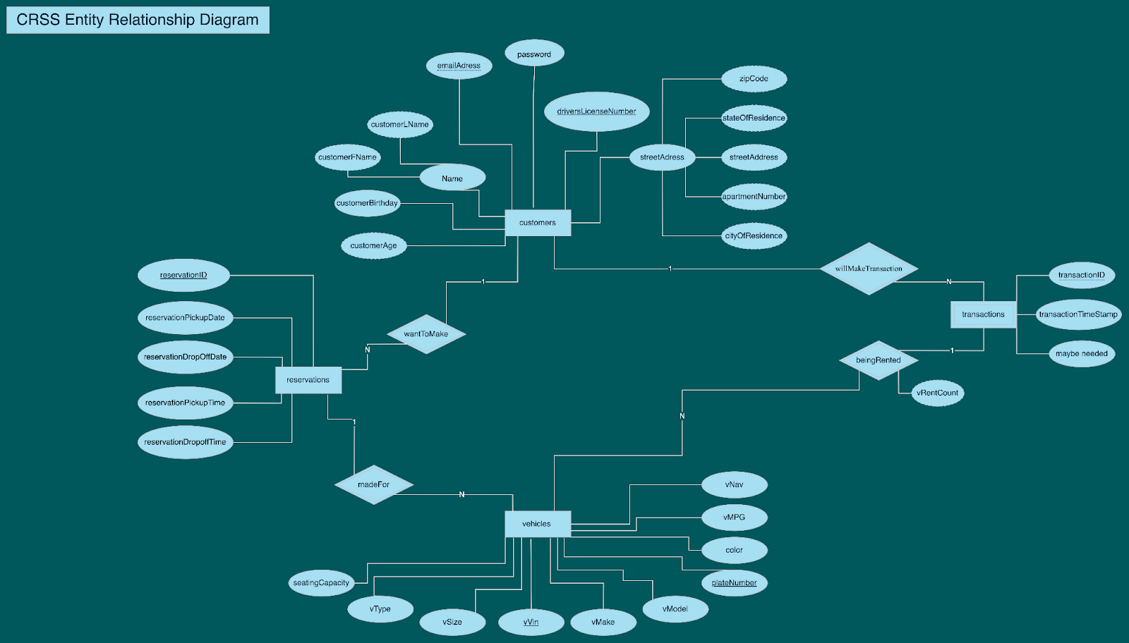

Slide 3
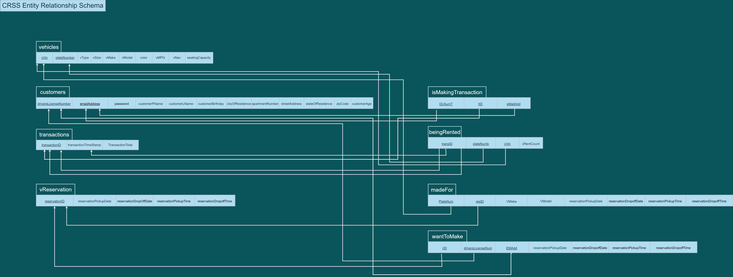

Slide 5
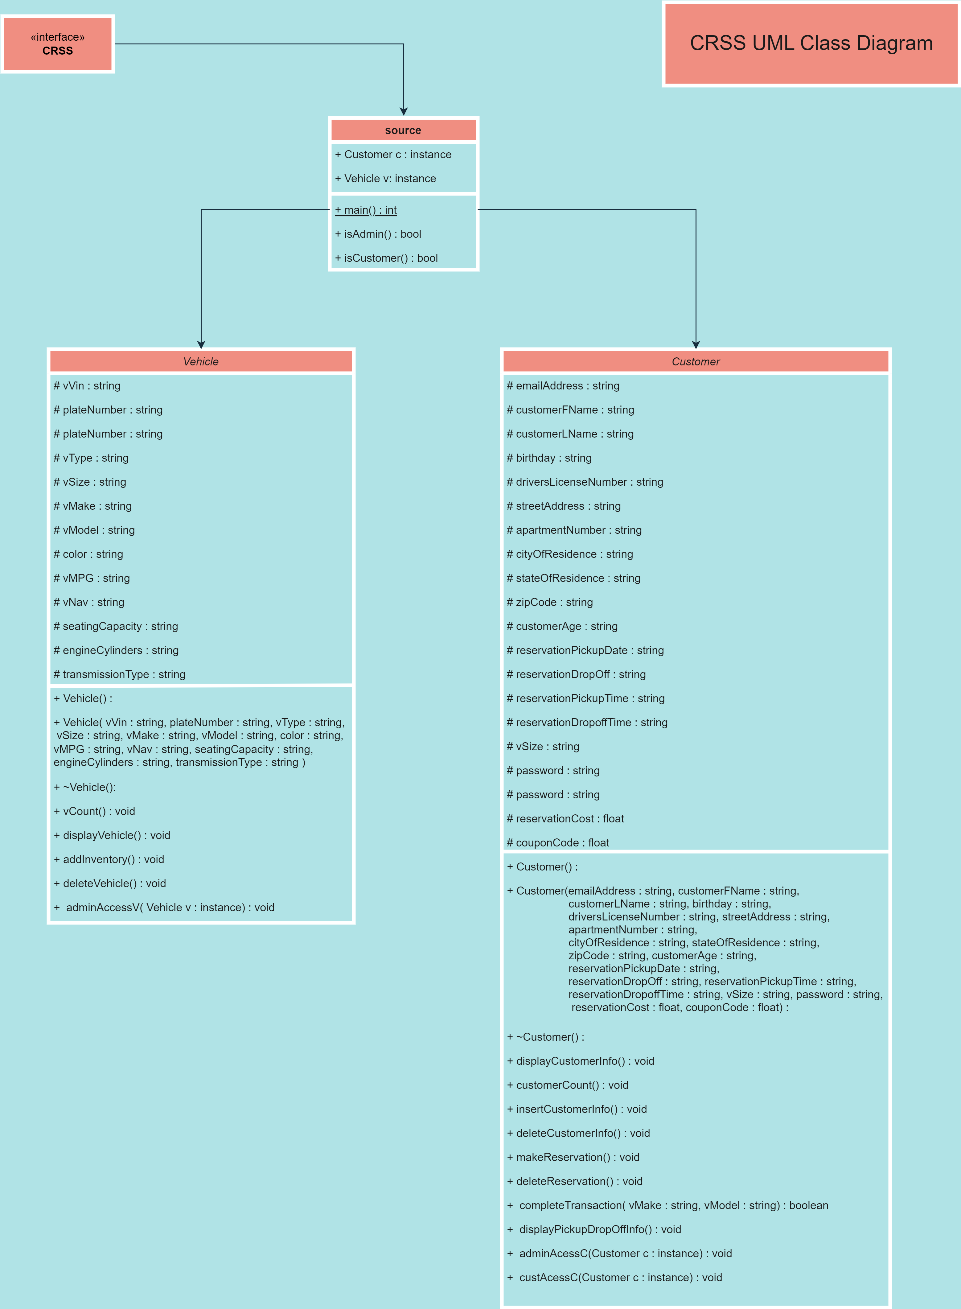

Slide 6
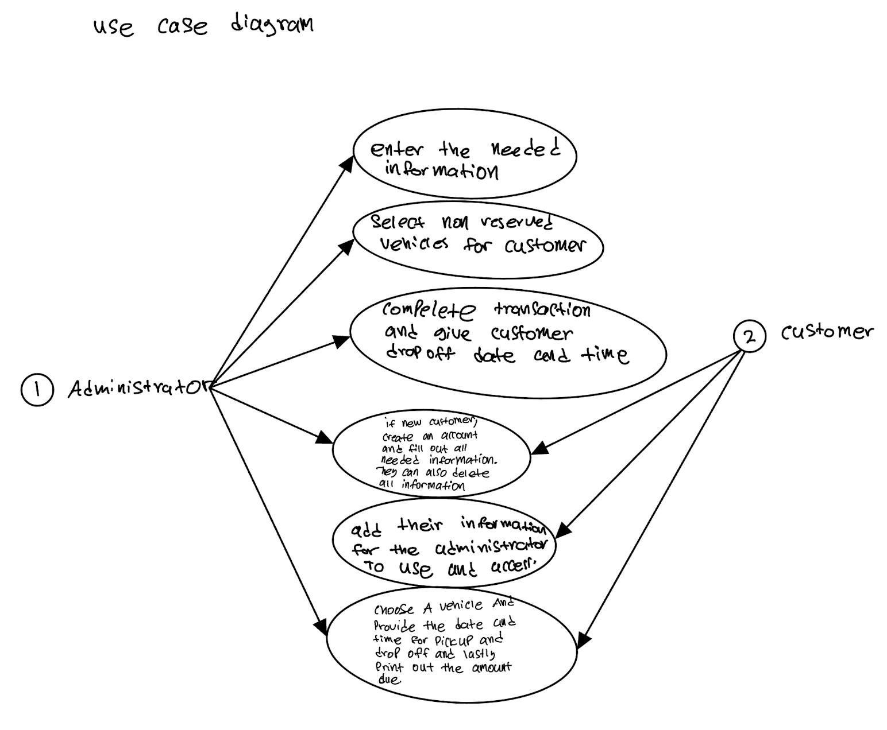

Slide 7
Test Cases

Slide 8
Presenters: Ali Tahami Kanwaljeet Ahluwalia
Thank You
Email:
Atahami3@csu.Fullerton.edu
Kanahluwalia@csu.Fullerton.edu

