Slide 1

Brain Tumor Classification With Autoencoder
Atahan Çaldır, Musa Berkay Kocabaşoğlu, Kerem Ersan
CS 454 – Final Project

Slide 2
Problem
Classifying brain MRI images by tumor types
Delayed diagnosis of brain tumors
Lack of additional support tool for doctors to diagnose brain tumors

Slide 3
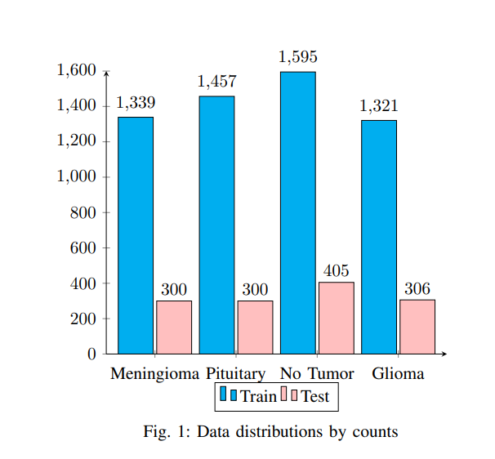
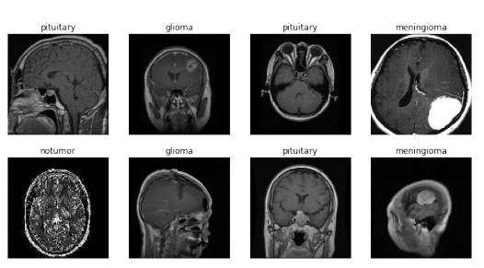
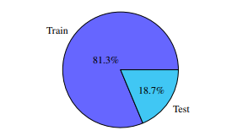
Data
Brain Tumor MRI Dataset (Kaggle, 2020)
7022 images of shape 128x128x3, 4 class labels

Slide 4
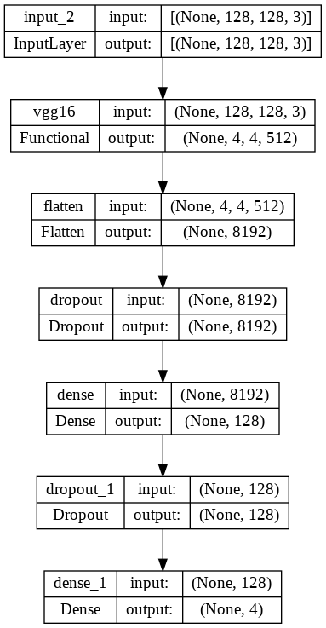
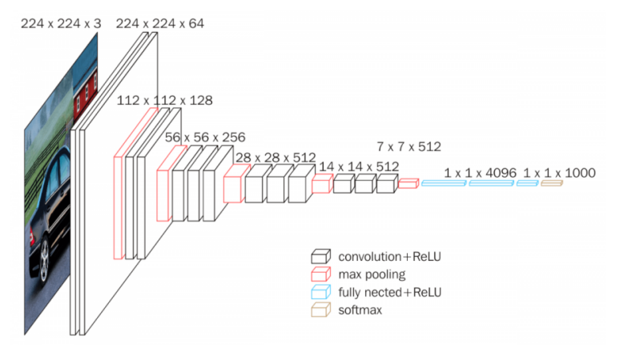
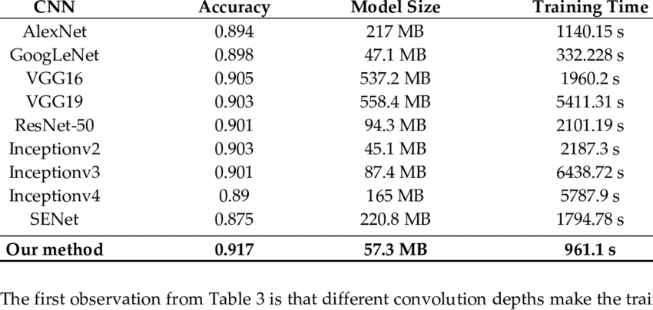
VGG16 Model
Convolutional Neural Network (CNN) with 16 layers
Implemented with Keras library

Slide 5
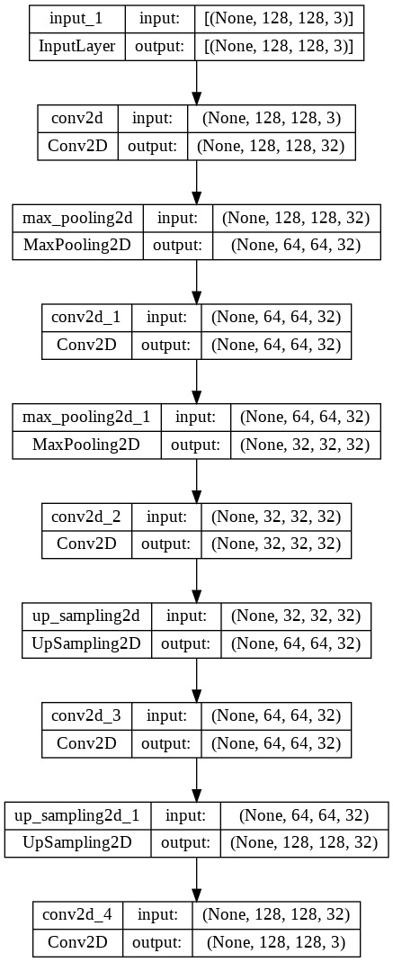
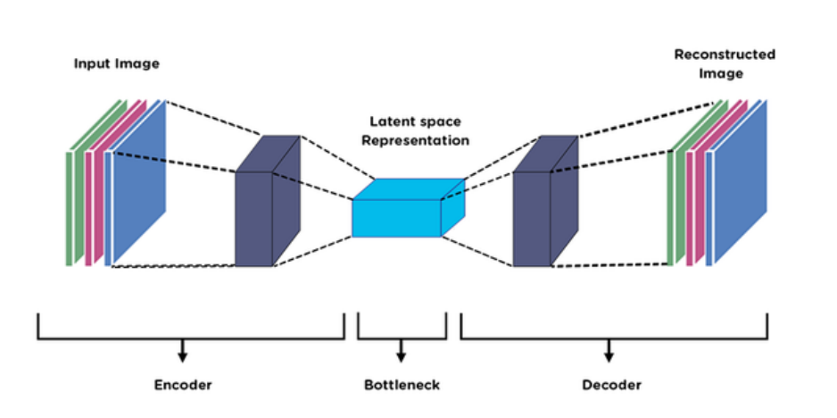
Autoencoder
Autoencoder, by design, reduces data dimensions by learning how to ignore the noise in the data.

Slide 6
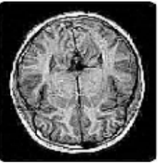

Solution Approach
Case 1
Normal image data
VGG16 Model
Case 2
Normal image data
Autoencoded image data (blurry)
Autoencoder

Slide 7
Results
 | Normal Image Inputs |  |  | Autoencoded Image Inputs
Label | Precision | Recall | F1-Score | Precision | Recall | F1-Score
Glioma | 1.00 | 0.83 | 0.91 | 0.91 | 0.98 | 0.95
Meningioma | 0.82 | 0.99 | 0.90 | 0.98 | 0.91 | 0.94
No Tumor | 1.00 | 1.00 | 1.00 | 1.00 | 1.00 | 1.00
Pituitary | 1.00 | 0.94 | 0.97 | 0.99 | 0.98 | 0.99
Macro Avg. | 0.95 | 0.94 | 0.94 | 0.97 | 0.97 | 0.97
Accuracy | 0.95 |  |  | 0.97
Training Time | 142.8 s |  |  | 90.4 s

Slide 8
Thank you for listening!

