Slide 1
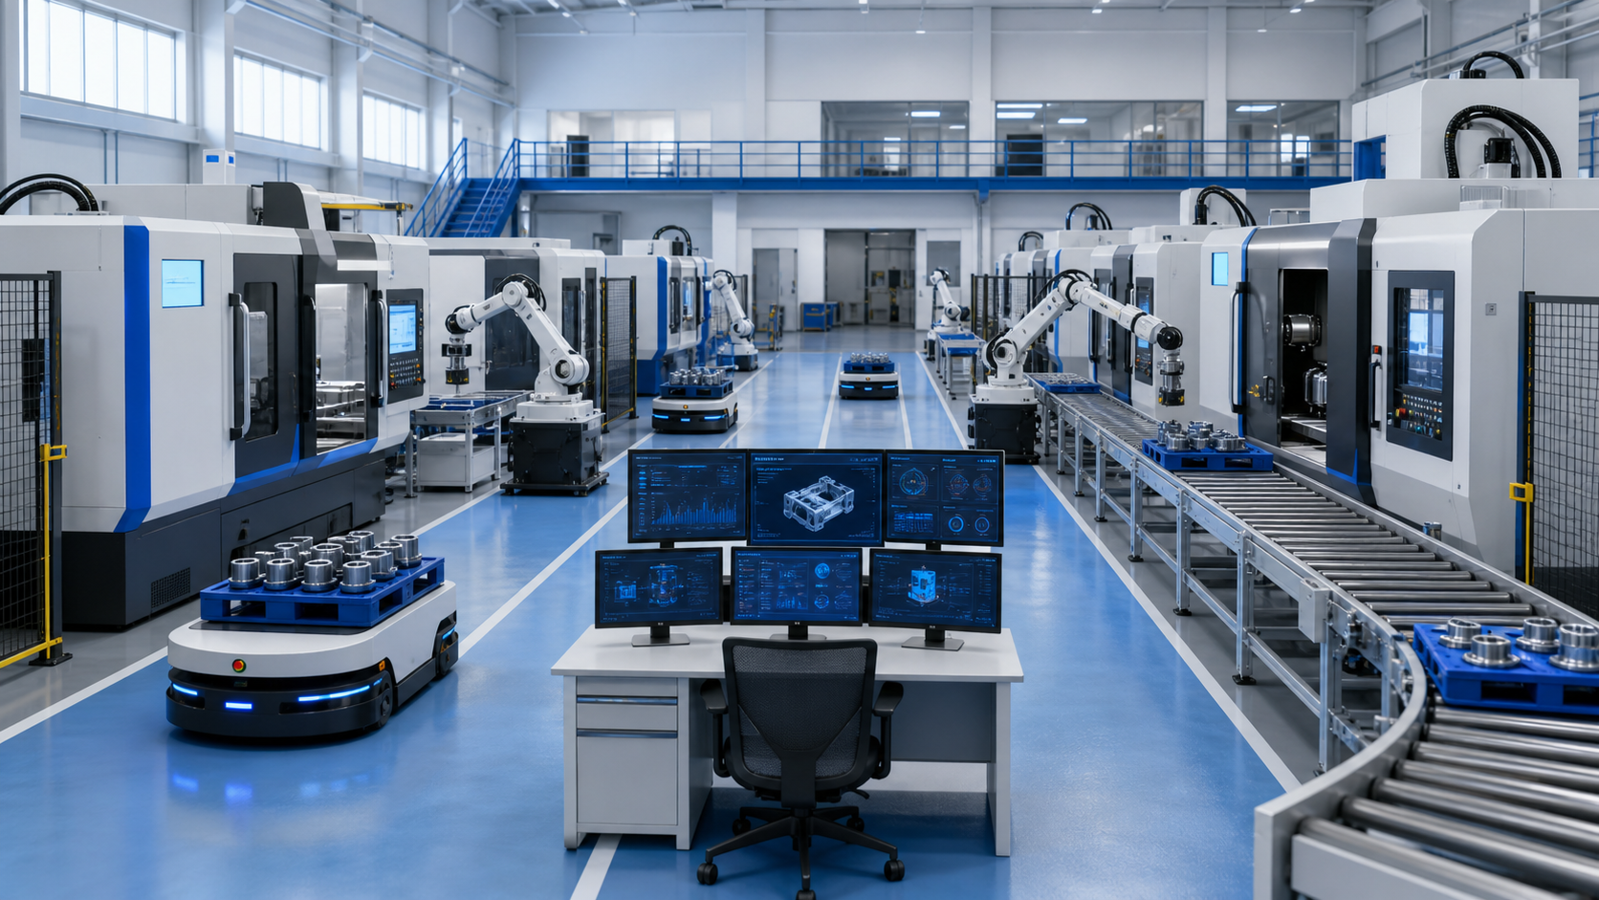
Industrial Applications of
Flexible Manufacturing Systems
Production Management Class
FMS = efficiency + versatility
Notes:
Open with the idea that FMS is not just a machine. It is a connected factory ecosystem designed to balance efficiency with versatility.

Slide 2
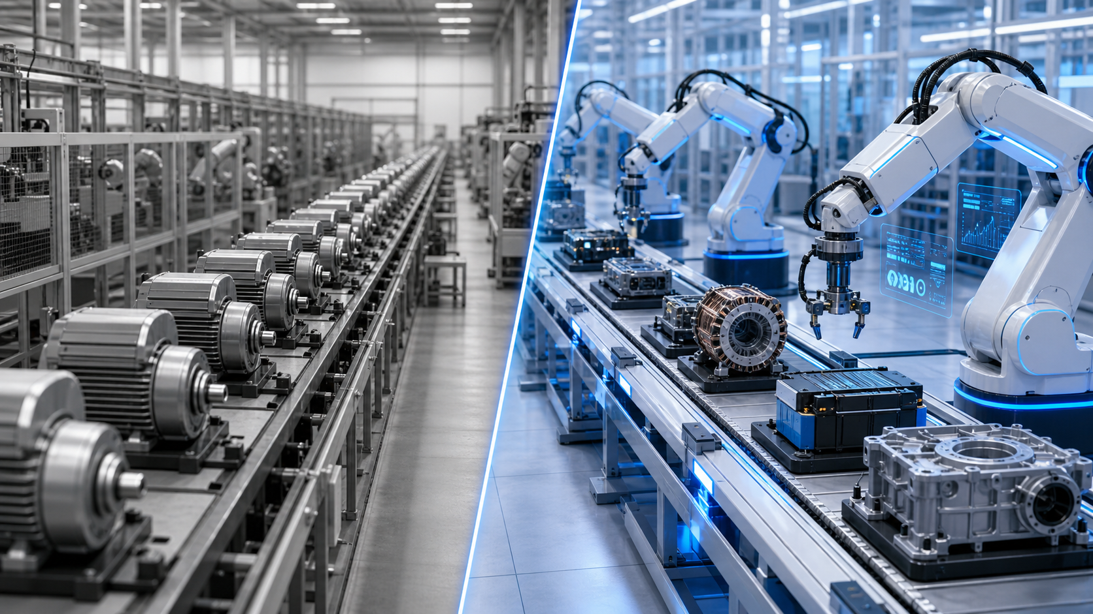
Why Do We Need Flexibility?
In the past...
• To be efficient, companies made 100,000 identical items. • If a customer wanted a slight change, the factory had to stop for weeks to retool.
The Definition
Flexible Manufacturing Systems (FMS) is a production method that uses a central computer to coordinate various machines, allowing the system to react almost instantly to changes in product design or production volume.
The Vibe
Think of FMS as the “Swiss Army Knife” of factories: an ecosystem that balances efficiency with versatility.
Notes:
Start by addressing the “Why.” In the past, if a company wanted to be efficient, they had to make 100,000 identical items. If the customer wanted a slight change, the factory had to stop for weeks to retool.,Definition: Flexible Manufacturing Systems is a production method that uses a central computer to coordinate various machines, allowing the system to react almost instantly to changes in product design or production volume.,The vibe: FMS is like the Swiss Army Knife of factories. It is not just a tool; it is an ecosystem that balances efficiency with versatility.

Slide 3
The Core Problem: Rigidity vs. Flexibility
Mass production is efficient but rigid; FMS is adaptive.
Feature
Traditional Mass Production
Flexible Manufacturing (FMS)
Goal
High volume, lowest cost per unit.
Mass customization and variety.
Changeover
Slow and expensive
(manual setup).
Fast and automated
(software-driven).
Life Cycle
Best for products that stay
the same for years.
Best for products that
change frequently.
Risk
High risk if the market
trend shifts.
Low risk; system adapts
to new trends.
Notes:
To help the audience understand, compare the old way with the new way. Traditional mass production focuses on high volume and lowest cost per unit, but changeover is slow and expensive. FMS focuses on mass customization and variety, with fast, software-driven changeover.,Talking point: in today’s world, product life cycles are shorter. People want the newest phone or a custom-colored car every year. Rigid systems cannot keep up; FMS is the solution to this market volatility.

Slide 4
Key Components: The Anatomy of FMS
FMS is not one machine; it is three parts working as one.
A
The Processing Stations
The “Muscles”
CNC machines switch from drilling to milling to cutting by downloading a new instruction set.
B
Automated Material Handling
The “Circulatory System”
AGVs and AS/RS move parts between machines without human hands.
C
The Central Control Computer
The “Brain”
Monitors machine status, tool wear, order priority, and reroutes work if needed.
Notes:
Briefly explain that FMS is not just one machine; it is three parts working as one: processing stations, automated material handling, and the central control computer.

Slide 5
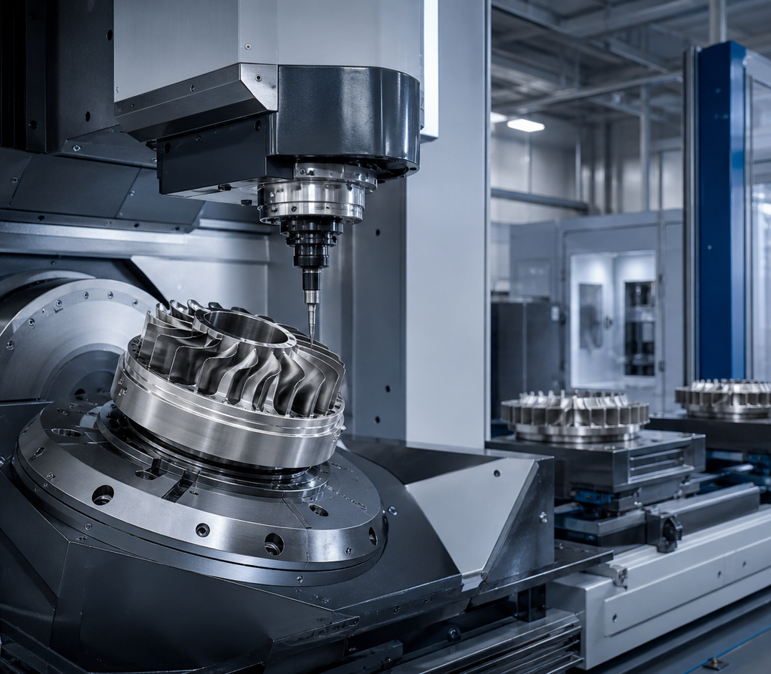
Processing Stations: The “Muscles”
Versatile CNC machines turn instructions into physical work.
• Usually CNC (Computer Numerical Control) machines. • Versatile robots can switch from drilling to milling to cutting. • They change tasks by downloading a new instruction set. • They reduce manual setup and make fast product changes possible.
Notes:
Processing stations are usually CNC machines. They are versatile robots that can switch from drilling to milling to cutting just by downloading a new instruction set.

Slide 6
Automated Material Handling: The “Circulatory System”
How parts move between machines without human hands.
AGVs
AS/RS
Key Idea
Automated Guided Vehicles
Automated Storage and Retrieval Systems
FMS material handling acts like the factory’s “delivery service.” It connects workstations and keeps production flowing without human hands.
Small, driverless robots that navigate the factory floor.
High-tech warehouses that “hand” the right part to the robot at exactly the right time.
They move the right part to the right machine.
This reduces waiting and manual carrying.
It knows which machine is busy, free, or next in line.
Notes:
Automated material handling is how parts move between machines without human hands. AGVs are small driverless robots that navigate the floor. AS/RS are high-tech warehouses that hand the right part to the robot at exactly the right time.

Slide 7
The Central Control Computer: The “Brain”
This is where the information systems side comes in.
The brain monitors:
• Which machines are busy. • Which tools are getting dull and need replacing. • The priority of incoming orders.
If one machine fails, the whole factory does not stop — the computer reroutes the work.
Notes:
The central control computer is the brain. It monitors which machines are busy, which tools are getting dull and need replacing, and the priority of incoming orders. It ensures that if one machine fails, the whole factory does not stop; it reroutes the work.

Slide 8
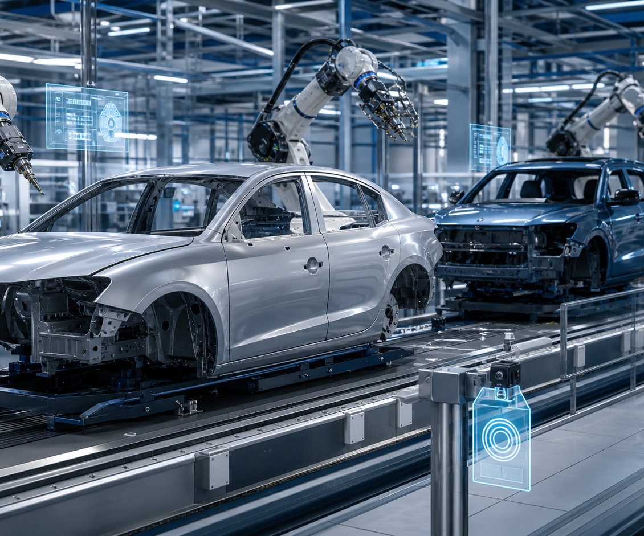
Automotive Industry: Mixed-Model Assembly
Automotive is about speed and variety.
The Concept
In the past, a car factory had one line for a sedan and a different line for an SUV. If nobody bought the sedan, that line sat idle.
How FMS makes it happen
• A car chassis carries a digital tag, like an RFID chip. • The central computer reads the tag at each workstation. • Robots swap tools to weld an SUV roof, then switch again for a sedan.
Notes:
Automotive industry: mastering mixed-model assembly. In the past, a car factory had one assembly line for a sedan and a completely different line for an SUV. If nobody bought the sedan, that entire line sat idle, losing money. Today, auto manufacturers use mixed-model assembly.,As a car chassis moves down the conveyor, it carries a digital tag like an RFID chip. When it enters a workstation, the central computer reads the tag and tells the robotic arms exactly what to do. The robots can instantly swap tools to weld an SUV roof, and 60 seconds later swap tools again to weld a compact sedan.

Slide 9
Real-Life Example: BMW Group
A flexible assembly line can adjust the product mix.
The Story
BMW manufacturing plants, such as Munich, integrated FMS so deeply that they can build an internal combustion engine car, a plug-in hybrid, and a fully electric vehicle such as the BMW i4 on the exact same assembly line.
The Impact
When consumer demand shifted toward electric vehicles, BMW did not need to build a brand-new factory. The flexible system adjusted the ratio, sending more EV parts down the line without missing a beat.
Automotive = speed + variety
Notes:
BMW Group example. BMW’s manufacturing plants, like their plant in Munich, integrated FMS so deeply that they can build an internal combustion engine car, a plug-in hybrid, and a fully electric vehicle like the BMW i4 on the exact same assembly line.,The impact: when consumer demand shifted toward electric vehicles, BMW did not have to build a brand-new factory. Their flexible system adjusted the ratio, sending more EV parts down the line without missing a beat.

Slide 10
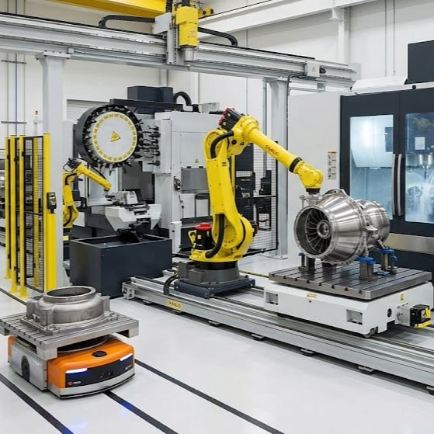
Aerospace Industry: High-Precision, Low-Volume
Aerospace is about extreme precision and avoiding costly mistakes.
The Concept
Aerospace has the opposite problem of cars. It is low-volume, but the parts are complex, highly regulated, and made from expensive materials like titanium.
How FMS makes it happen
• Used in machining centers. • A turbine blade may need milling, drilling, grinding, and laser inspection. • The raw block can be clamped once while the automated system cycles through hundreds of tools.
Notes:
Aerospace has the opposite problem of the car industry. They do not make 1,000 planes a day; they might make 50 a year. It is low-volume, but parts are incredibly complex, highly regulated, and made from expensive materials like titanium.,In aerospace, FMS is used in machining centers. A single jet engine turbine blade might need milling, drilling, grinding, and laser inspection. Instead of a human moving the expensive metal from machine to machine, an FMS clamps the raw metal block once and cycles through hundreds of different tools, shaping the part to microscopic precision.

Slide 11
Real-Life Example: GE Aerospace / Aviation
Flexible systems can run “lights out” and switch parts by file.
The Story
GE Aerospace uses FMS to produce complex jet engine components using massive multi-axis CNC machines connected by automated pallets. The system can be loaded on Friday afternoon and run “lights out” over the weekend.
“So, whether it is building a custom car every 60 seconds or carving a perfect jet engine part overnight, FMS is the engine behind modern industry. But how do these machines actually know what to do without crashing into each other?”
The Impact
To switch from Boeing 737 parts to larger Boeing 777 parts, the central computer loads a new digital file and robots fetch the new drill bits.
Notes:
GE Aerospace / Aviation example. GE Aerospace uses FMS to produce complex jet engine components. They use massive, multi-axis CNC machines connected by automated pallets. The system can be loaded with raw materials on a Friday afternoon and run entirely lights out over the weekend.,If GE needs to switch from making parts for a Boeing 737 to a larger Boeing 777, the central computer loads a new digital file. Robots fetch the required drill bits, and production switches smoothly. This reduces human error, which matters when one mistake on a titanium block can cost tens of thousands of dollars.,Hand-off: So, whether it is building a custom car every 60 seconds or carving a perfect jet engine part overnight, FMS is the engine behind modern industry. But how do these machines actually know what to do without crashing into each other? To explain the technology and software that makes this possible, I’ll pass it over to Speaker 3.,Speaking tips: The contrast between the two industries is the strongest point. Emphasize that Automotive is about speed and variety, while Aerospace is about extreme precision and avoiding expensive mistakes. When talking about robots changing tools for the sedan versus the SUV, use your hands to demonstrate the swift mechanical swap.

Slide 12
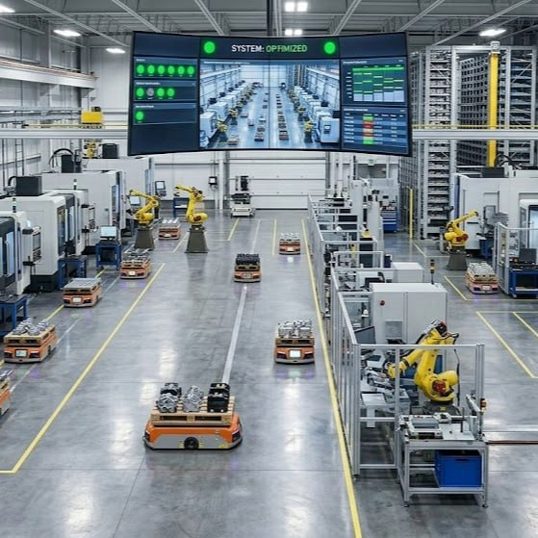
Implementation: Hardware
Multi-axis CNC and robotics make the physical system flexible.
• Beyond X, Y, and Z: FMS often uses 5-axis or even 7-axis CNC machines. • Benefit: the machine reaches every side of a part without manual flipping. • Tool magazine: a library of drills, sanders, and polishers allows automatic tool changes. • One-and-Done: turn raw material into a finished product in one setup.
Notes:
Start by explaining how physical machines evolved to become flexible.,Traditional machines move in three directions, but an FMS typically uses 5-axis or even 7-axis CNC machines. This allows the machine to reach every side of a part without a human having to stop and manually flip the part over.,These robots have a library of tools, such as drills, sanders, and polishers. When the code changes, the robot automatically swaps its own hand in seconds.,Key concept: One-and-Done. The goal of FMS hardware is to take a raw piece of material and turn it into a finished product in a single setup, eliminating time wasted moving parts between specialized machines.

Slide 13
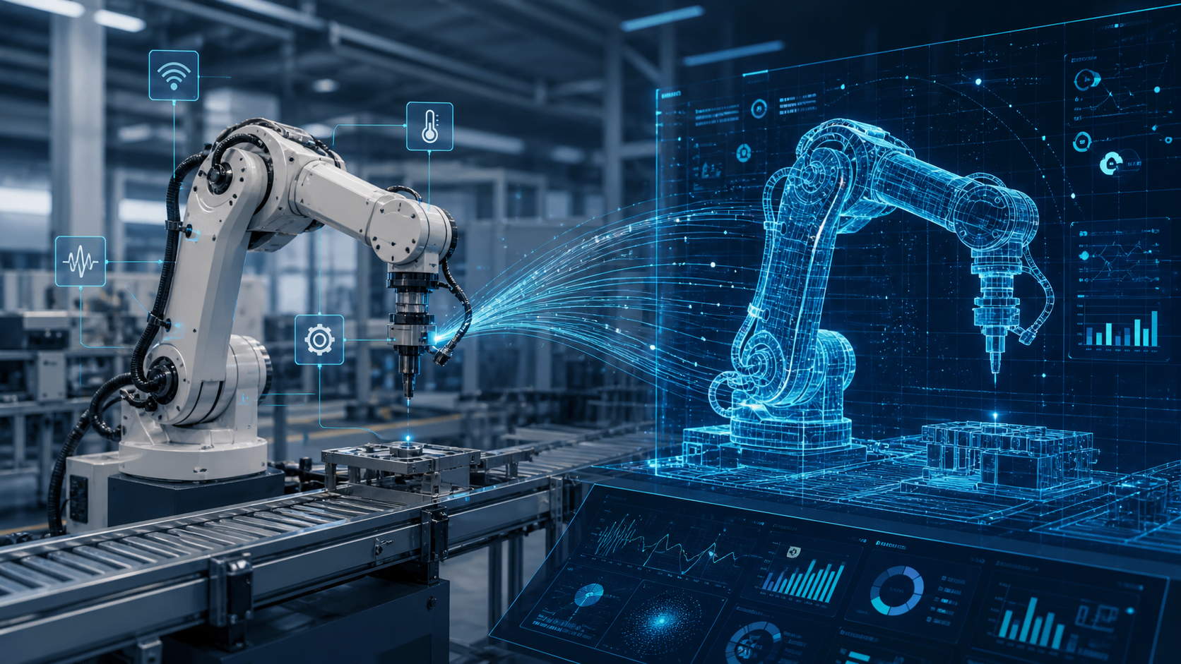
The Virtual Layer: Digital Twins and IoT
The information systems side of FMS.
Digital Twin
A perfect virtual 3D replica of the physical factory floor. Engineers simulate the full production before cutting metal.
Minimizing Downtime
• Collision detection: checks if robot arms hit walls or machines. • Optimization: runs 1,000 scenarios to find the fastest flow.
IoT Sensors
Sensors act as nerve endings, feeding real-time data such as vibration, temperature, and speed back to the Digital Twin.
Notes:
This is where the information systems side of the project shines.,A Digital Twin is a perfect virtual 3D replica of the physical factory floor. Before a single piece of metal is cut, engineers run the entire production in a simulation.,Minimizing downtime: collision detection checks if a robot arm will accidentally hit a wall or another machine. Optimization allows the computer to run 1,000 different scenarios to find the fastest way to move parts through the factory.,The role of IoT: sensors are the nerve endings of the factory. They are attached to every motor and belt, feeding real-time data such as vibration, temperature, and speed back to the Digital Twin. This allows the system to see what is happening in the physical world and reflect it in the virtual world instantly.

Slide 14
Data Integration & Real-Time Response
An FMS is only as good as its ability to communicate.
Dynamic Scheduling
Predictive Maintenance
A high-priority rush order arrives. The central computer recalculates the schedule, tells AGVs to move rush parts forward, and updates delivery estimates.
IoT sensors let the system “hear” when a tool is about to break before it actually does.
Real-Time Adjustment
The Nervous System
If a drill bit is getting dull, the system schedules a tool change or reroutes the part to a machine with a fresh tool.
Full-stack integration connects the customer order software directly to the robot movements in hardware.
Notes:
Now explain how the system thinks when things go wrong. An FMS is only as good as its ability to communicate.,Dynamic scheduling: if a high-priority rush order comes in, the central computer does not need a manager to come down to the floor. It automatically recalculates the schedule, tells the AGVs to move the rush parts to the front of the line, and updates the delivery estimate.,Predictive maintenance: because of IoT sensors, the system can hear if a tool is about to break before it actually does.,Real-time adjustment: if a drill bit is getting dull, the system automatically schedules a tool change during a natural break in production, or reroutes the part to a different machine with a fresh tool.,The nervous system: this requires full-stack integration, where the customer order software is directly connected to the robot movements in the hardware.

Slide 15
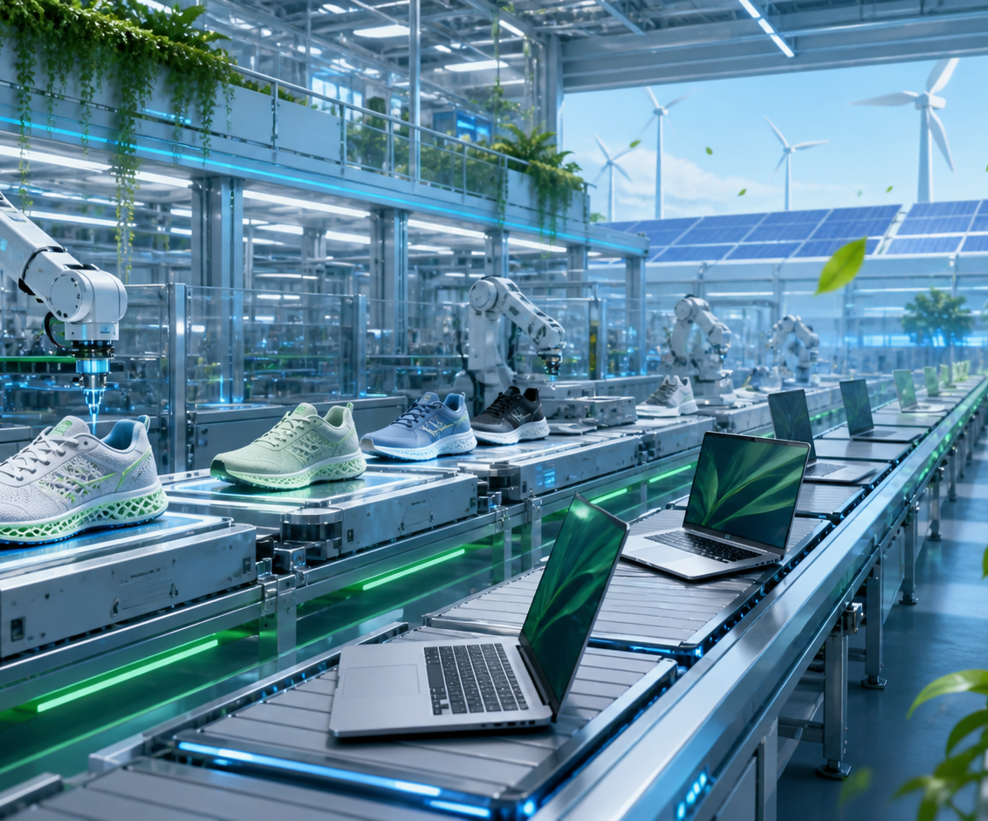
Economics and Future Trends
The “buy once, cry once” strategy.
The Economics
• High barrier: robotics, software, and specialized staff are expensive. • Long-term win: shift from labor-intensive to capital-intensive production. • Savings: labor costs and setup time drop. • Inventory: Just-In-Time production reduces giant warehouses.
Future Trends
• Mass customization: “Lot Size One” makes personalized products profitable at scale. • Green manufacturing: less waste and smarter energy use.
Notes:
Address the elephant in the room: FMS is incredibly expensive. Building an FMS requires a massive initial investment: high-end robotics, complex software, and specialized staff training.,The long-term win: this is a shift from labor-intensive to capital-intensive production. Companies save on labor costs and setup time. In a traditional factory, time spent retooling is money lost. In FMS, that cost drops to nearly zero.,Inventory: because you can make parts Just-In-Time, you do not need giant expensive warehouses to store unsold products. You only make what you have already sold.,Future trends: mass customization means moving away from the era of everyone getting the same blue shirt. FMS allows Lot Size One, so a factory can produce a custom-fitted sneaker or personalized laptop as cheaply as a generic one. FMS makes the personal touch profitable at scale.,Sustainability: because the central computer is precise, there is less scrap metal or wasted plastic. Smart systems can power down sections of the factory when not in use, reducing the carbon footprint.

Slide 16
Summary:
• We started by looking at manufacturing evolving from rigid assembly lines to fluid systems. • We saw how giants like BMW and Lockheed Martin use this to build cars and planes with zero errors. • We explored Digital Twins and AI guiding every movement.
Closing Thought
Flexible Manufacturing Systems are the bridge between the industrial past and a customized, sustainable future. It is not just about making things better — it is about making things smarter.
Notes:
Grand finale: summarize the points made by the group and end strongly.,Summary: We started by looking at how manufacturing evolved from rigid assembly lines to fluid systems. We saw how giants like BMW and Lockheed Martin use this to build our cars and planes with zero errors. We explored the Digital Twins and AI that act as the invisible hands guiding every movement.,Closing thought: In conclusion, Flexible Manufacturing Systems are not just a fancy way to move robots. They are the bridge between the industrial past and a customized, sustainable future. It is not just about making things better; it is about making things smarter. Thank you, and we are now open for any questions.

Slide 17
Thank you for listening !

