Slide 1
Zero-Shot REBOOT-State Detection across Android Malware Families
Inspired by the research paper: “Detecting New Obfuscated Malware Variants: A Lightweight and Interpretable Machine Learning Approach”
Abdullah Atahan TÜRK
N24120222

Slide 2
Motıvatıon of the related work: Detecting New Obfuscated Malware Variants
Evaluate how well ML-based detectors can spot entirely new, obfuscated malware families that were never seen during training.
Design a lightweight, high-accuracy system that remains interpretable and automatically adapts to emerging malware variants.

Slide 3
METHODOLOGY AND RESULTS OF THE RELATED WORK: Detecting New Obfuscated Malware Variants
Detection of previously unseen (zero-day) malware using memory analysis from the CIC-MalMem-2022 dataset.
Evaluated various algorithms (Random Forest, Naive Bayes, Logistic Regression, K-Nearest Neighbors, Decision Trees) with binary classification at first.
RF was chosen for subtype classification because it gave the best results with binary classification.
Each malware subtype was trained exclusively on its own samples.
The model trained only on Transponder spyware achieved excellent detection accuracy against 14 completely different, previously unseen malware subtypes.

Slide 4
My Contributions and Improvements over the Published Study
Various algorithms, including XGBoost and LightGBM, were used in addition to Random Forest, Logistic Regression, and Decision Tree, initially for binary classification.
XGBoost and LightGBM achieved perfect results in binary classification, similar to the Random Forest results reported in the original paper.
XGBoost and LightGBM were chosen for subtype classification, as it achieved 100% accuracy, matching the performance of RF.
By training exclusively on a single malware subtype (Coolwebsearch spyware), slightly better results were achieved compared to those reported in the original paper.

Slide 5
Comparison of Accuracy: Random Forest (Paper) vs. XGBoost and LightGBM (This Study)
Malware Subtype | Random Forest (Paper’s Work) | XGBoost (My Work ) | LightGBM (My Work)
Pysa | 0.9974 | 0.9956 | 0.9982
Conti | 0.9962 | 0.9973 | 0.9978
MAZE | 0.9953 | 0.9983 | 0.9980
Shade | 0.9905 | 0.9986 | 0.9983
Ako | 0.9844 | 0.9973 | 0.9980
Transponder | 0.9984 | 0.9980 | 0.9976
Gator | 0.9977 | 0.9982 | 0.99880
180Solutions | 0.9972 | 0. 9980 | 0.9983
TIBS | 0.9955 | 0.9962 | 0.9959
CoolWebSearch | 0.9904 | 0.9975 | 0.99884
Reconyc | 0.9967 | 0.9977 | 0.9956
Emotet | 0.9901 | 0.9969 | 0.9987
Refroso | 0.9810 | 0.9966 | 0.9978
Scar | 0.9800 | 0.9974 | 0.9983
Zeus | 0.9800 | 0.9973 | 0.9985

Slide 6
Results of my ımprovements
XGBoost and LightGBM outperformed Random Forest in 14 out of 15 malware subtype categories. Only in “Transponder” subtype RF achieved better result.
LightGBM achieved the highest accuracy in 10 out of 15 malware subtypes, while XGBoost had the best results in 4 subtypes.
LightGBM achieved the highest accuracy, with a score of 99.88% on the Coolwebsearch subtype, narrowly surpassing the highest accuracy reported in the paper %99.84, which was obtained using Random Forest on the Transponder subtype.
These results motivated me to apply XGBoost and LightGBM in my work inspired by this paper.

Slide 7
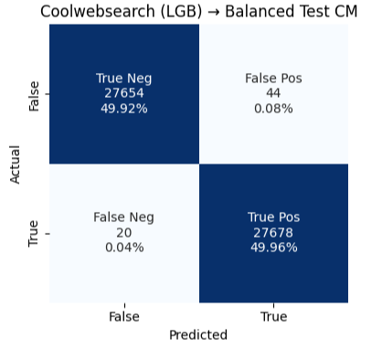
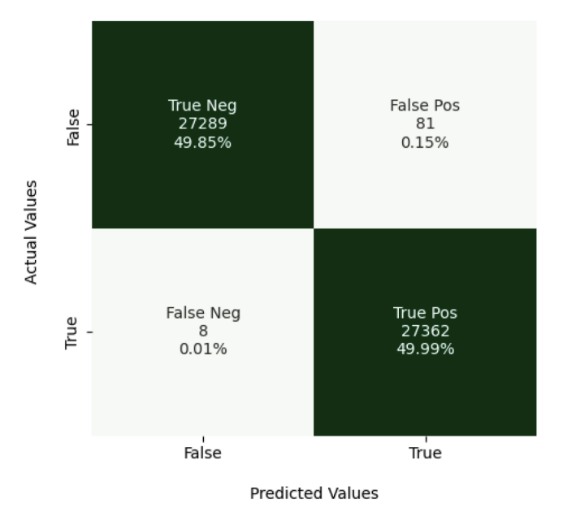
Comparıson of confusıon matrices
Coolwebsearch (Lightgbm)
Transponder (RF)

Slide 8
Problem STATE
Every day, tens of thousands of new Android apps appear, many of them malicious, targeting sensitive data, abusing device resources, or extorting users.
Many variants only reveal their persistence or payload after a device reboot behaviors that standard, single-session sandboxes never see.

Slide 9
MOTIVATION
Many Android malware hide or change behavior across device reboots. Making dynamic analysis of these behavior can guide dynamic defense strategies.
Examining which dynamic metrics (memory, API calls, logcat, etc.) are universally important across android malware families.
New malware families crop up every day; continuously retraining for each is not efficient. A model that generalizes persistence-signatures across families can help catch never-seen-before threats.

Slide 10
DATASET AND DATA PREPARATION
CCCS-CIC-AndMal-2020 dataset’s dynamic analysis part.
Contains 14 android malware families (category column in the dataset) and their behavioral feature changes before and after system reboots. (53439 rows)
Six categories of features are extracted after executing the malware in an emulated environment: Memory, API, Network, Battery, Logcat, Process.
The features for each of the malware families were in separate csv files, they were merged into a single csv file, and a new column was added indicating their reboot status.

Slide 11
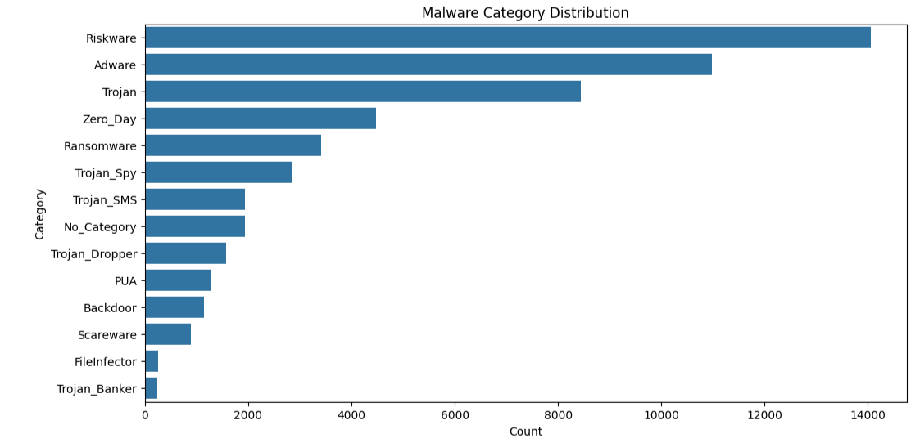
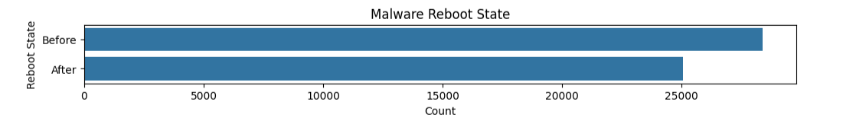
Malware category and reboot state distribution

Slide 12
Bınary classıfıcatıon
Used SMOTE to oversample the minority class so both Before/After have equal representation.
Stratified 80/20 split on the balanced, scaled data.
To determine which algorithms can reliably distinguish between pre-execution and post-execution behaviors, binary classification with 5 different ML algorithms have been done:
Logistic Regression
Random Forest
Decision Tree
XGBoost
LightGBM

Slide 13
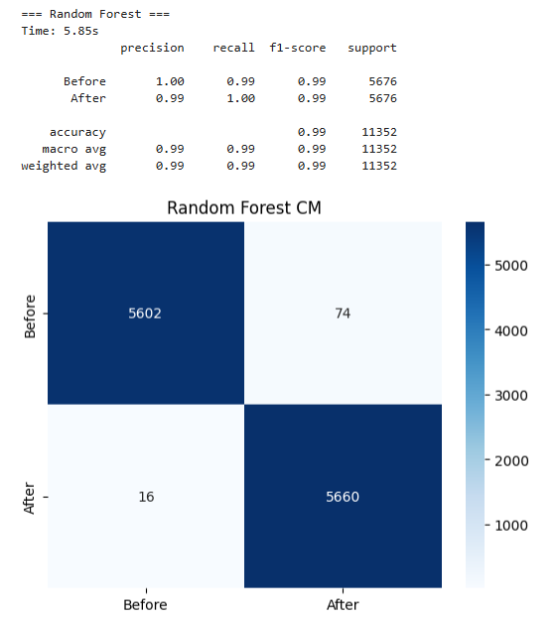
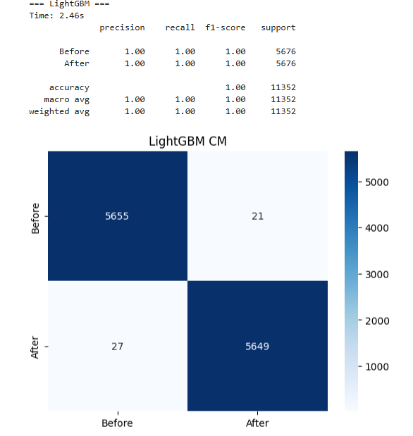
RESULTS ACHIEVED BY RF AND LIGHTGBM

Slide 14

Best results achıeved by xgboost

Slide 15
Feature extractıon
In order to find the most effective reboot-predictive features, the 5 most important features were found in all malware categories one by one and their total frequency was examined.
This may be helpful to identify a few metrics that consistently distinguish between pre-execution and post-execution across all malware families.
XGBoost was used because it achieved the best results in binary classification.

Slide 16
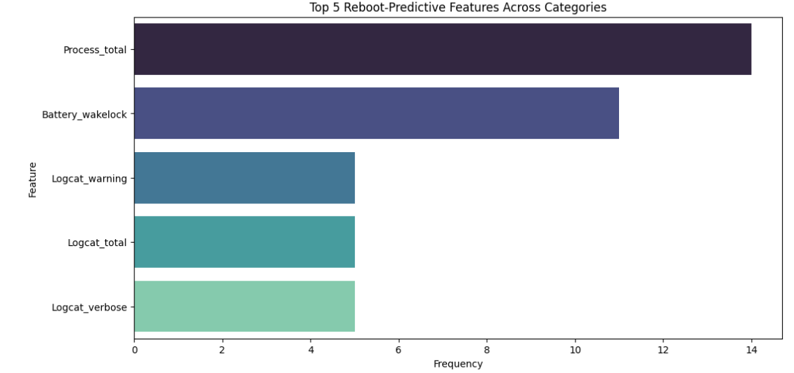
most effective reboot-predictive 5 features

Slide 17
ZERO-SHOT REBOOT STATE DETECTION
Collected the top-5 most important features per category from previous feature extraction process.
To enforce zero-shot learning, I trained each model on %80 of a single malware category’s samples and then tested it on the remaining %20 of that category plus all samples from every other category.
The model trained with XGBoost.
The model trained with Trojan malwares achieved the highest zero-shot reboot-state accuracy on average (pre and post-reboot).

Slide 18
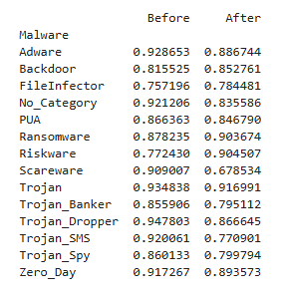
Zero-Shot Reboot Accuracy by Category

Slide 19
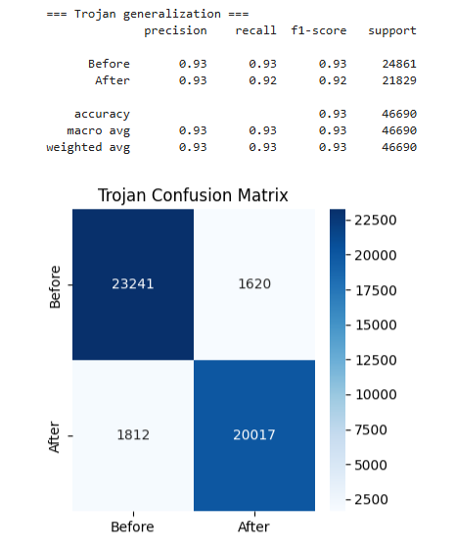
Trojan-traıned model statıstıcs and confusıon matrıx

Slide 20
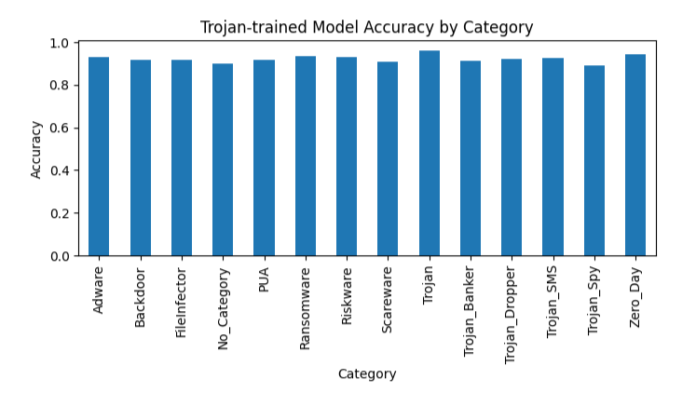
Trojan-traıned model accuracy by category

Slide 21
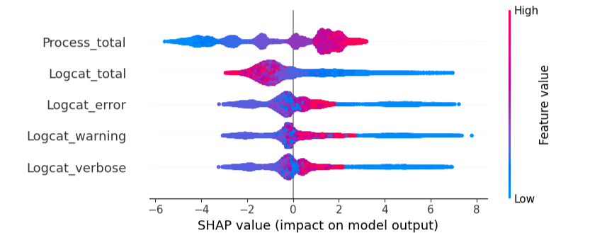
Shap Analysis of top 5 features of Trojan-TRAINED MODEL
The total number of processes and the volume of logcat messages are the strongest, most consistent indicators of whether an Android malware sample runs “Before” vs. “After” reboot when the model was trained only on Trojan behavior.

Slide 22
CONCLUSION
Demonstrated that a model trained on just one Android family (e.g. Trojans) can predict pre- vs post-execution (“reboot”) with high accuracy (> 91 %) on 13 completely unseen families.
Discovered five dynamic metrics that generalize across all malware categories.
XGBoost models using only five features run in microseconds per sample, suitable for real-time sandbox integration.
SHAP analysis confirmed that higher process activity and log output reliably indicate “After” execution, making the detection interpretable for security analysts.

Slide 23
GitHub reposıtory
https://github.com/atahanturk/CMP656/

