Slide 1
Inheritance
Tapestry Chp. 13
Horton Chp. 9
Extended lecture Notes (extended version of these slides, including C++ code you can take and play with), which are inherited ☺ from Berrin Yanıkoğlu, will be available at the website.
CAUTION! some parts may mismatch with the slides.
As usual, take the slides and what I said in the class as the main reference

Slide 2
Overview
In this topic, we will see an important concept of Object Oriented Programming (OOP), namely inheritance.
Inheritance in OOP refers to deriving new classes from existing classes. Imagine a case where you have already written a general matrix class, but now you want to specialize it to a square matrix class. Similarly you can think that you have written a shape class with few functionality and data members, but now you want to derive rectangle, circle, triangle classes from it.
In these cases, re-using your (or someone else's) code written for the base class is a great way to start, eliminating the need for code development and testing for the functions that will be inherited and used from the base class.
When you design your new (derived) class, you can certainly add new functionality, new data members, and modify functionality (called overriding). But you cannot remove data parts and cannot reduce functionality.
Think of it as an IS-A relationship. A circle is a shape, so it has all of its data and functionality inherited, but with more special behavior and/or data parts.

Slide 3
Summary
In these slides, we will see how to:
Derive new classes from the base: e.g. class circle: public shape
  How each data member (public, protected, private) is inherited in the derived class
How to add new functionality: just adding a new function
How to modify existing functionality: overriding an existing function by reimplementing it.
How to use the base class constructor and destructors:
  They are not inherited
  Constructors of the derived class should explicitly call the most suitable base class constructor. Otherwise, the default base class constructor is called automatically.
  Cat(int weight, string name, short toes): Pet(weight,name),
  numberToes(toes) {};
The use of the keyword virtual
  It is in some cases necessary (so you are advised to always use it) to use the keyword virtual before functions that are intended to be modified – both in the base class and in the derived class.
Polymorphism
  technique that allows assigning a derived object to a base object and still behaving properly
Pure Virtual Functions and Abstract Classes
  Mechanisms to have a class just for serving as the base class for the derived ones
    No objects can be defined for the base one

Slide 4
Overview and Terminology
Classes in C++ can be derived from existing classes:
  For example, 'circle', 'rectangle' classes can be derived from 'shape' class
  terminology:
    derived class of a base class
    subclass of a superclass
The derived class inherits data and functionality from the base class
  circle, rectangle classes have an 'area' just as any shape subclass would
  all shape subclasses can be Drawn(), Scaled(),…

Slide 5
Overview and Terminology
We will see how to derive new subclasses with an example:
  superclass (base class): Pet
  subclass (derived class): Rat, Cat
Learn the vocabulary!

Slide 6
Deriving Subclasses from a Base class
//base class
class Pet{
public:
// Constructors, Destructors
Pet(): weight(1), food("Pet Chow") {}
~Pet() {}
void setWeight (int w)
{weight = w;}
int getWeight() const
{return weight;}
void setfood (string f)
{food = f;}
string getFood () const
{return food;}
void eat ();
void speak ();
protected: //only subclasses can inherit protected variables
int weight;
string food;
};
void Pet::eat()
{
cout << "Eating " << food << endl;
}
void Pet ::speak()
{
cout << "Growl" << endl;
}

Slide 7
Declaring a new subclass
class Rat: public Pet
{
public:
Rat() {} //Pet class' default constructor is automatically called
~Rat() {} //Pet class' default destrcutor is automatically called
…
};

Slide 8
Adding new functionality and data members
class Rat: public Pet //Other methods can be added
{
public:
Rat() {}
~Rat() {}
void sicken () {cout << "Spreading Plague" << endl;}
};
class Cat: public Pet //Other accessors can be added
{
public:
Cat() : numberToes(5) {}
~Cat() {}
void setNumberToes(int toes) {numberToes = toes;}
int getNumberToes() {return numberToes;}
private: //Additional data members can be added
int numberToes;
};

Slide 9
Usage:
int main()
{
Rat charles;
Cat fluffy;
charles.setWeight(25); //base class member function
cout << "Charles weighs " << charles.getWeight() << " kilos. " << endl;
charles.speak(); //base class member function
charles.eat(); //base class member function
charles.sicken(); //new subclass function
fluffy.speak(); //base class member function
fluffy.eat(); //base class member function
//new subclass function
cout << "Fluffy has " << fluffy.getNumberToes() << " toes " << endl;
return 0;
}
Output??
See Pet_Basic.cpp

Slide 10
Summary so far
The Rat and Cat objects inherit the methods of the base class, Pet.
  We can call the speak method and the eat method on objects of types Rat and Cat. These methods were defined only in Pet and not in the subclasses.
Each subclass extends the base class by adding methods and data members.
  The Rat class has the "sicken" method.
  The Cat class has methods and a data member related to the number of toes an individual cat object has.

Slide 11
Access Control Under Inheritance

Slide 12
Access Control Under Inheritance
You can derive a subclass in 3 different ways:
  class Rat: private Pet
  class Rat: protected Pet
  class Rat: public Pet
This will affect how the {public, private, protected} data members of the base class will be accessed. See next 2 slides for basics of protected and private inheritance. However we will stress and use public inheritance.
In public inheritance: (e.g. class Cat: public Pet )
  public: as usual, any class/function can access these variables/methods and subclasses also inherit and access them (i.e. it is as if Cat class has declared these members inside the Cat class declaration, w/o actually doing so!)
  private: as usual, no other class/function can access these variables and subclasses inherit but CANNOT access these members
  protected: no other classes/functions can access them, but subclasses inherit and access them (so it is a relaxed form of private)

Slide 13
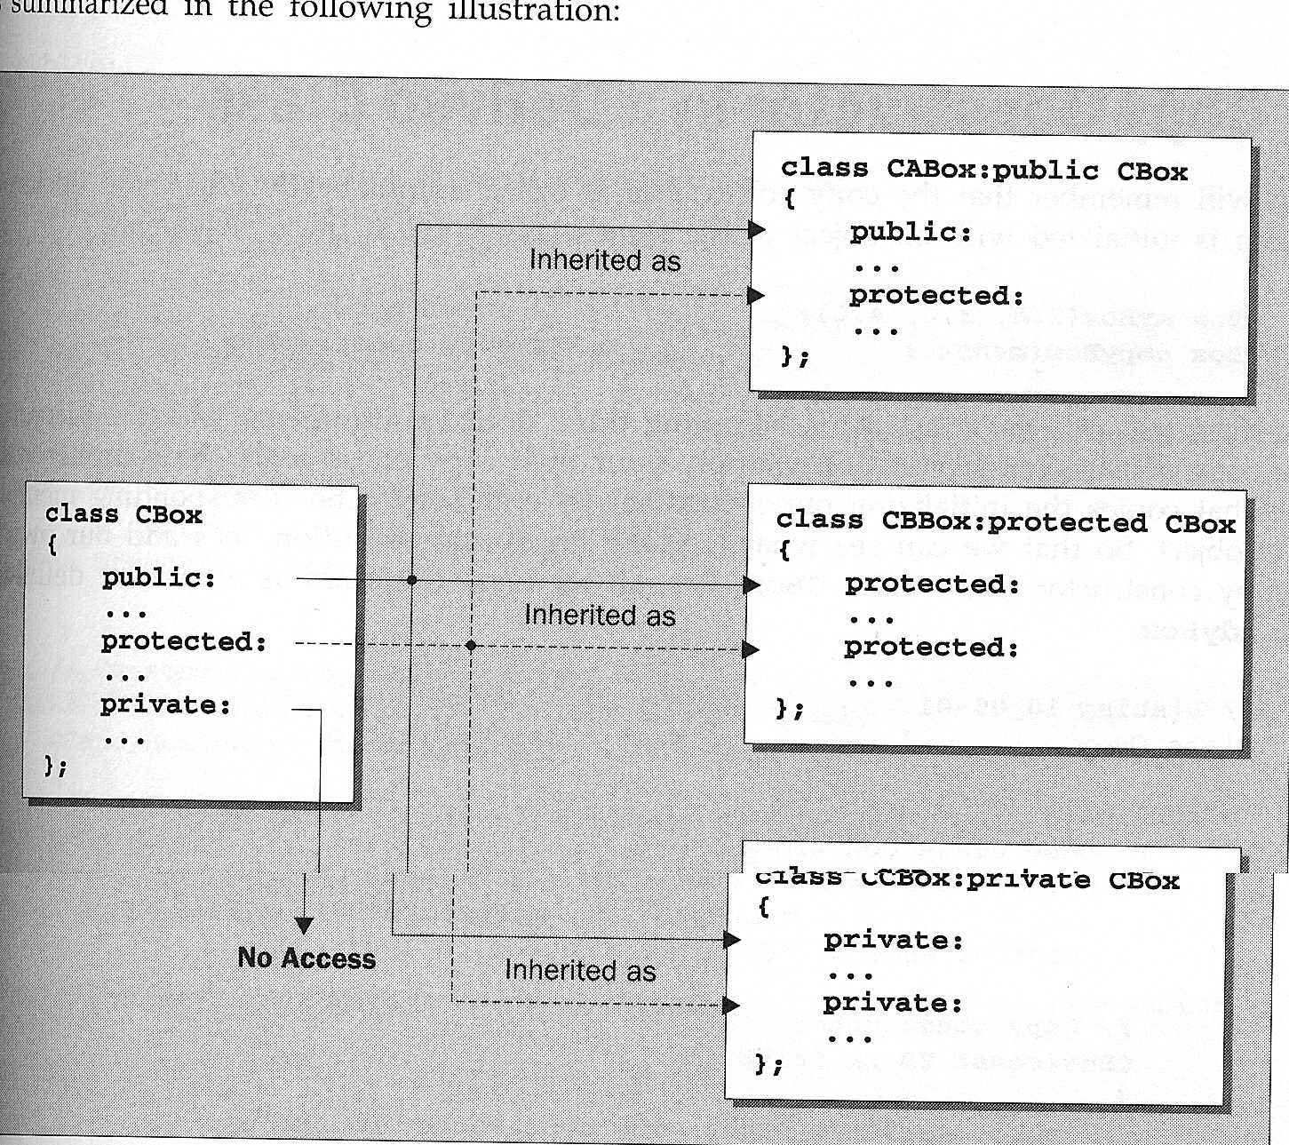
Most common inheritance is public.

Slide 14
Access Control Under Inheritance
When you {publicly, protectedly,privately} derive from
{public, protected, private} base members,
you can basically narrow down the data member type, but cannot expand:
public data inherited as public will be public in the subclass
public data inherited as protected will be protected in the subclass
public data inherited as private will be private in the subclass
protected data inherited as public will be protected in the subclass
protected data inherited as protected will be protected in the subclass
protected data inherited as private will be private in the subclass
private data is not accessible in the subclass under any inheritance method.
Usually public inheritance is used.
We can summarize these as new type being the
minimum of base type and inheritance method.

Slide 15
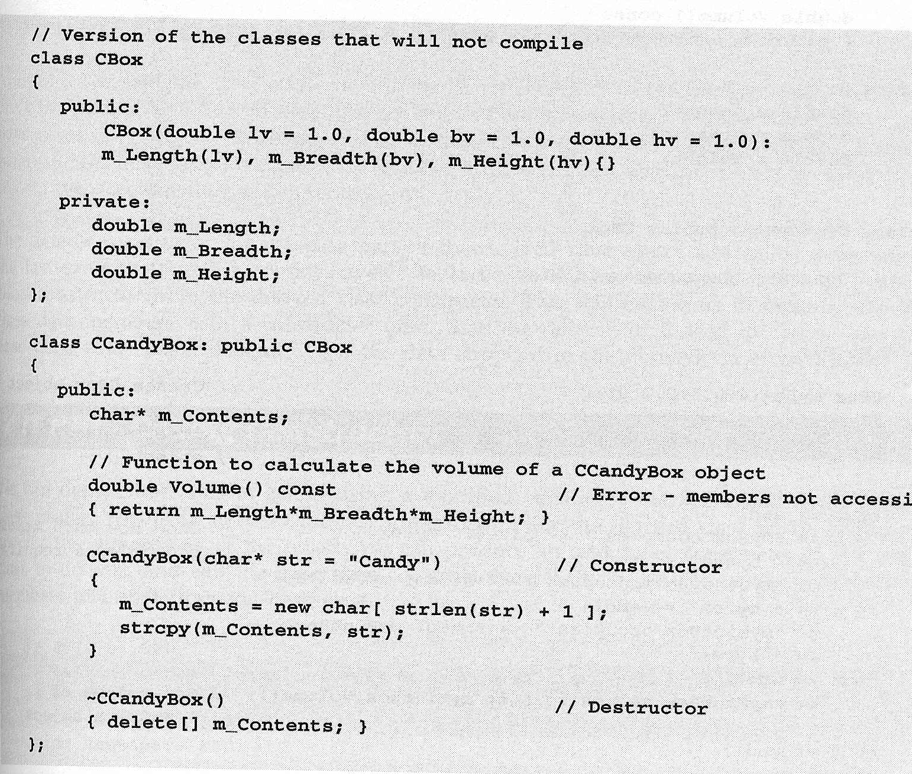
Access control example
The function Volume() in the class CCandyBox attempts to access the private members of the base class, Cbox.
  not legal
But note that they are inherited, just not directly accessible

Slide 16
How to access private of base class in derived class
You can access private variable of the base class in three ways:
  You can make them protected in the base class, so subclasses can access them but others cannot (see next slide)
    Best solution
  by using accessors/mutators of the base class
    A very general solution to serve the private data members to client functions.
    Note that even unrelated classes and free functions can access/change private variables if accessors/mutators exist.
  declaring the subclass as friend in the base class.
    Syntactically OK, but not so practical for general purpose
      You may not know the names of the derived classes while writing the base class

Slide 17
Using the keyword Protected
You can make the base class members protected (this is the typical solution):
Class CBox {
public:
...
protected:
double m_Length, m_Breadth,m_Width;
};
Class CCandyBox: public Cbox {
public:
...
//this version is OK
double Volume()
{
return m_Length*m_Breadth*m_Width;
}
};

Slide 18
Using an accessor function of the base class
Class CBox {
public:
...
double Volume() const
{
return m_Length*m_Breadth*m_Width;
}
private:
double m_Length, m_Breadth,m_Width;
};
Class CLabelledBox: public Cbox {
public:
CLabelledBox(char * str = “Candy”)
{ m_Label = new char [strlen(str)+1];
strcpy(m_Label, str);
}
~CLabelledBox()
{
delete [] m_Label;
}
private:
char * m_Label;
};
int main() {
CBox myBox(4.0,3.0,2.0);
CLabelledBox myTeaBox;
CLabelledBox myCoffeeBox("Coffee");
cout << "My coffee box’s volume is "<< myCoffeeBox.Volume();
return 0;
}

Slide 19
Another Example of Accessing Private - Problem
class Pet{
public:
// Constructors, Destructors
Pet(): weight(1), food("Pet Chow") {}
~Pet() {}
void setWeight (int w) {weight = w;}
int getWeight() const
{return weight;}
void setfood (string f) {food = f;}
string getFood () const
{return food;}
void eat ();
void speak ();
private:
int weight;
string food;
};
void Pet::eat()
{ cout << "Eating " << food << endl;}
void Pet ::speak()
{cout << "Growl" << endl;}
class Cat: public Pet
{
public:
Cat() : numberToes(5) {}
~Cat() {}
void setNumberToes(int toes)
{numberToes = toes;}
int getNumberToes()
{return numberToes;}
void growCat() {weight++;}
private:
int numberToes;
};
Problem: cannot access private data weight

Slide 20
Another Example of Accessing Private - Solution1
class Pet{
public:
// Constructors, Destructors
Pet(): weight(1), food("Pet Chow") {}
~Pet() {}
void setWeight (int w) {weight = w;}
int getWeight() const
{return weight;}
void setfood (string f) {food = f;}
string getFood () const
{return food;}
void eat ();
void speak ();
protected:
int weight;
string food;
};
void Pet::eat()
{ cout << "Eating " << food << endl;}
void Pet ::speak()
{cout << "Growl" << endl;}
class Cat: public Pet
{
public:
Cat() : numberToes(5) {}
~Cat() {}
void setNumberToes(int toes)
{numberToes = toes;}
int getNumberToes()
{return numberToes;}
void growCat() {weight++;}
private:
int numberToes;
};
Solution1 (preferred solution): Change private: label as protected:

Slide 21
Another Example of Accessing Private - Solution2
class Pet{
public:
// Constructors, Destructors
Pet(): weight(1), food("Pet Chow") {}
~Pet() {}
void setWeight (int w) {weight = w;}
int getWeight() const
{return weight;}
void setfood (string f) {food = f;}
string getFood () const
{return food;}
void eat ();
void speak ();
private:
int weight;
string food;
friend class Cat;
};
void Pet::eat()
{ cout << "Eating " << food << endl;}
void Pet ::speak()
{cout << "Growl" << endl;}
class Cat: public Pet
{
public:
Cat() : numberToes(5) {}
~Cat() {}
void setNumberToes(int toes)
{numberToes = toes;}
int getNumberToes()
{return numberToes;}
void growCat() {weight++;}
private:
int numberToes;
};
Solution2 (not so good): Declare Cat class as friend

Slide 22
Another Example of Accessing Private - Solution3
See Pet_PrivateAccess.cpp
class Pet{
public:
// Constructors, Destructors
Pet(): weight(1), food("Pet Chow") {}
~Pet() {}
void setWeight (int w) {weight = w;}
int getWeight() const
{return weight;}
void setfood (string f) {food = f;}
string getFood () const
{return food;}
void eat ();
void speak ();
private:
int weight;
string food;
};
void Pet::eat()
{ cout << "Eating " << food << endl;}
void Pet ::speak()
{cout << "Growl" << endl;}
class Cat: public Pet
{
public:
Cat() : numberToes(5) {}
~Cat() {}
void setNumberToes(int toes)
{numberToes = toes;}
int getNumberToes()
{return numberToes;}
void growCat()
{
int current = getWeight();
setWeight(++current);
}
private:
int numberToes;
};
Solution3: Implement the function using existing accessors and mutators

Slide 23
Constructors/Destructors in Derived Classes

Slide 24
Constructors/Destructors in Derived Classes: Important
Constructors, including copy constructors, and destructors are NOT inherited.
    Each derived class has its own constructor and destructor.
Each object of a derived class consists of two parts:
    a base class part and
    a derived class part.
  The base class constructor forms the base class part.
  The derived class constructor forms the derived class part.
Derived class constructors should call the base class constructor.
  If they don’t, the default base class constructor is called automatically.
Destructors clean up their respective parts (derived class destructor and base class destructor).

Slide 25
Demonstration of Constructor Calls
You can have this to first call the default base class constructor. But it is not necessary since default base class constructor is called automatically
class Pet
{
public:
Pet()
: weight(1), food("Pet Chow")
{
cout << "Pet constructor called" << endl;
}
~Pet()
{
cout << "Pet destructor called" << endl;
}
// Rest of code unmodified from first example
// ......
};
class Rat: public Pet
{
public:
Rat() : Pet()
{
cout << "Rat constructor called" << endl;
}
~Rat()
{
cout << "Rat destructor called" << endl;
}
// Rest of code unmodified from first example
// ......
};
Do not explicitly call the base class destructor. It is called automatically after running the derived class destructor.
Even if you call the base class destructor, it is called again automatically. Thus I really mean that do not call the base class destructor here.
class Cat is defined similarly.
See Pet_ConstructorDestructor.cpp

Slide 26
Demonstration of Constructor Calls
int main()
{
Rat charles; //What happens when this line is executed?
Cat fluffy;
...
return 0;
}

Slide 27
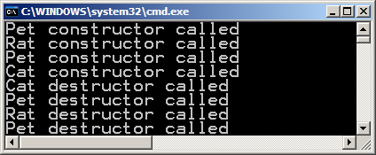
Demonstration of Constructor Calls
int main()
{
Rat charles;
//calls the default Pet constructor, and then the Rat constructor
Cat fluffy;
//calls the default Pet constructor, and then the Cat constructor
... //when they go out of scope, the destructors are called in //reverse order
return 0;
}
Run Pet_ConstructorDestructor.cpp

Slide 28
Constructors with Parameters
class Pet
{
public:
// Constructors, Destructors
Pet () : weight(1), food("Pet Chow") {}
Pet(int w) : weight(w), food("Pet Chow") {}
Pet(int w, string f) : weight(w), food(f) {}
~Pet() {}
//Accessors
void setWeight(int w) {weight = w;}
int getWeight() {return weight;}
void setfood(string f) {food = f;}
string getFood() {return food;}
//General methods
void eat();
void speak();
protected:
int weight;
string food;
};
void Pet::eat()
{
cout << "Eating " << food << endl;
}
void Pet::speak()
{
cout << "Growl" << endl;
}
class Rat: public Pet
{
public:
Rat() {}
//calls the default Pet constructor automatically
Rat(int w) : Pet(w) {}
Rat(int w, string f) : Pet(w,f) {}
~Rat() {}
//Other methods
void sicken() {cout << "Speading Plague" << endl;}
void speak();
};
void Rat::speak() {
cout << "Rat noise" << endl;
}
When there are more than one constructors with different number of parameters, recommendation is that the derived class constructors call the corresponding base class constructors.
Always, call the base class constructor at initalizer list

Slide 29
Constructors with Params.
Same as previous slide, just the full code
class Rat: public Pet
{
public:
Rat() {} //calls Pet() automatically
Rat(int w) : Pet(w) {}
Rat(int w, string f) : Pet(w,f) {}
~Rat() {}
//Other methods
void sicken() {cout << "Speading Plague" << endl;}
void speak();
};
void Rat::speak() {
cout << "Rat noise" << endl;
}
class Cat: public Pet
{
public:
Cat() : numberToes(5) {} //calls Pet() automatically
Cat(int w) : Pet(w), numberToes(5) {}
Cat(int w, string f) : Pet(w,f), numberToes(5) {}
Cat(int w, string f, int toes) : Pet(w,f), numberToes(toes) {}
~Cat() {}
//Other accessors
void setNumberToes(int toes) {numberToes = toes;}
int getNumberToes() {return numberToes;}
//Other methods
void speak();
private:
int numberToes;
};
void Cat::speak() {
cout << "Meow" << endl;
}
class Pet
{
public:
// Constructors, Destructors
Pet () : weight(1), food("Pet Chow") {}
Pet(int w) : weight(w), food("Pet Chow") {}
//Pet(int w = 4) : weight(w), food("Pet Chow") {}
//to give a default value of 4
Pet(int w, string f) : weight(w), food(f) {}
~Pet() {}
//Accessors
void setWeight(int w) {weight = w;}
int getWeight() {return weight;}
void setfood(string f) {food = f;}
string getFood() {return food;}
//General methods
void eat();
void speak();
protected:
int weight;
string food;
};
void Pet::eat()
{
cout << "Eating " << food << endl;
}
void Pet::speak()
{
cout << "Growl" << endl;
}

Slide 30
Default Constructor: A reminder
As usual, the default constructor is the constructor with no parameters.
But you may also write one constructor instead of multiple constructors by using default values for parameters. This will make the constructors more neat:
  So, instead of:
  Pet():weight(1),food("Pet food") {}; //default constructor
  Pet(int w, string f):weight(w),food(f) {};
  you can write one constructor (which may become the default constructor since it allows for no arguments as well):
  Pet(int w=1, string f = "Pet food"):weight(w),food(f) {};

Slide 31
Summary
The base class constructor is called in the initializer list of the derived class constructors.
  The Rat and Cat constructors that take arguments should call the appropriate Pet constructor
    they could call the default constructor (or one that takes less parameters), but that would be unreasonable because more initialization would be left to do in the derived class constructor.
  If they do not explicitly call a particular base class constructor (Pet class in our example), the default base class constructor will be called automatically
    this is also true for copy constructors (will see later copy constructor cases in more detail later).
  If to be called explicitly, base class (Pet in our example) constructor must be called in the initializer list, not in the body of the constructor.
  When creating a derived class object, first base class constructor is called and then the derived class constructor.
Base class destructor is automatically called after running the derived class destructor.
  So do not call the base class destructor (~Pet()) in derived class class destructor (~Rat() and ~Cat())
Destructors are called in reverse order of object creation (this is true for all classes in C++)

Slide 32
Copy constructors in derived classes

Slide 33
Copy Constructor for the base class
Class CBox {
public:
//base class constructor – w/ default values
Cbox (double lv = 1.0, double bv = 1.0, double hv = 1.0):
m_length(lv), m_breadth(bv), m_height(hv);
//copy constructor
//this is equivalent to what the compiler would provide automatically, if you did not write one
Cbox (const Cbox & rhs)
{
m_length = rhs.m_length;
m_breadth = rhs. m_breadth ;
m_height = rhs.m_height;
}
protected:
double m_length;
double m_breadth;
double m_height;
}

Slide 34
Derived class
Notice this constructor has an initializer part that calls the base class constructor, as well as a body.
class CCandyBox : public CBox
{
public:
//Constructor calls base class constructor
CCandyBox (double lv, double bv, double hv, char *label = "Candy")
: CBox(lv,bv,hv)
{
cout << "CCandyBox constructor called" << endl ;
m_label = new char [strlen(label)+1];
strcpy (m_label, label);
}
//No copy constructor
protected:
char * m_label;
};

Slide 35
Copy Constructor for the derived classes
//No copy constructor
As usual, if you have not written one, the compiler provides one that can do shallow copy
  int main()
  {
    CCandyBox cb1 (2.0, 2.0, 4.0, "Chocolate Box");
    CCandyBox cb2 (cb1);
    ...
    return 0;
  }
  A problem occurs – what is it?

Slide 36
Copy Constructor for the derived classes
//No copy constructor
As usual, if you have not written one, the compiler provides one that can do shallow copy
  int main()
  {
    CCandyBox cb1 (2.0, 2.0, 4.0, "Chocolate Box");
    CCandyBox cb2 (cb1);
    ...
    return 0;
  }
  cb2 has its own protected data members but its m_label points to cb1's name
  The compiler provided copy constructor does a shallow copy. If shallow copy is not enough for your class you need to write your own copy constructor.
      in this case, you need deep copy. Otherwise, you just have a pointer to cb1’s name, not your own label!

Slide 37
Solution
class CCandyBox : public CBox
{
public:
CCandyBox (double lv, double bv, double hv, char *label = "Candy")
: CBox(lv,bv,hv)
{
m_label = new char [strlen(label)+1];
strcpy (m_label, label);
}
CCandyBox (const CCandyBox & initCB)
{
// Since the copy constructor is a constructor,
// it will call the base class default constructor first
cout << "CCandyBox copy constructor called" << endl ;
m_label = new char [strlen(initCB.m_label)+1];
strcpy (m_label, initCB.m_label);
}
protected:
char * m_label;
}; There still is a problem!

Slide 38
Again a problem
The dimensions of the copy constructed object is not set properly
(not copied from the object it is constructed from, but set to default values).
Solution: Call the copy constructor of the base class explicitly.
class CCandyBox : public CBox
{
public:
...
CCandyBox (const CCandyBox & initCB):
CBox(initCB)
{
cout << "CCandyBox copy constructor called" << endl ;
m_label = new char [strlen(initCB.m_label)+1];
strcpy (m_label, initCB.m_label);
}
protected:
char * m_label;
};

Slide 39
Overriding Methods

Slide 40
Overriding Methods
A derived class can use the methods of its base class(es), or it can override them.
  The method in the derived class must have the same signature and same return type as the base class method to override.
      The signature is number and type of parameters and the constantness (const, non-const) of the method.
  If you do not follow this rule, you may or may not get an error or warning, but even if your program compiles and executes correctly, you may not end up overriding, but overloading/hiding the base class implementation.
  There is also a rule regarding the use keyword “virtual”; will see later
  When an object of the base class is used, the base class method is called.
  When an object of the subclass is used, subclass version of the method is used if the method is overridden.
Overriding is different than overloading.
Notes:
C++ Standard (http://www.open-std.org/jtc1/sc22/wg21/docs/papers/2014/n4296.pdf), clause 10.3.2, footnote 111, clause 10.3.7

Slide 41
Overriding
class Rat: public Pet
{
public:
...
//Other methods
void sicken() {
cout << "Spreading Plague" << endl;}
void speak();
};
void Rat::speak() {
cout << "Rat noise" << endl;
}
class Cat: public Pet
{
public:
...
//Other methods
void speak();
private:
int numberToes;
};
void Cat::speak() {
cout << "Meow" << endl;
}
class Pet
{
public:
...
//General methods
void eat();
virtual void speak();
protected:
int weight;
string food;
};
. . .
void Pet::speak(){
cout << "Growl" << endl;
}
Notice the re-declaration
– not just re-implementation

Slide 42
Overriding
Run Pet_Overriding.cpp
int main()
{
Pet peter;
Rat ralph;
Cat chris;
//Output:
peter.speak(); //Growl
ralph.speak(); //Rat noise
chris.speak(); //Meow
return 0;
}
Notice that each subclass implemented and used its own speak method, overriding the base class speak method.

Slide 43
Overriding: Special Rule
If the base class had overloaded a particular method, overriding a single one of the overloads will hide the rest.
  E.g, suppose the Pet class had defined several speak methods.
  void speak();
  void speak(string s);
  void speak(string s, int loudness);
  If the subclass, Cat, defined only
  void speak();
      Pet::speak() would be overridden.
      Pet:: speak(string s) and Pet:: speak(string s, int loudness) would be hidden.
        If we had a cat object, fluffy, we could call:
        fluffy.speak();
        But the following would cause compilation errors.
        fluffy.speak("Hello");
        fluffy.speak("Hello", 10);
Generally, if you override an overloaded base class method you should override every one of the overloaded forms; otherwise, it it will be assumed that only the new form
is needed.

Slide 44
Virtual Functions
Overridden methods should be declared as virtual
  Any base class method intended to be overridden in any subclass must be declared as virtual.
    The keyword virtual must be put before the function prototype in the class definition body, not in outside implementation (if any).
    The keyword virtual is optional, but recommended in subclasses;
If a class declares any virtual methods, the destructor of the class should be declared as virtual as well.
    If you do not use virtual, overriding seems working, but this is not real overriding; this is kind of overloading and you just hide the base class implementation. And this causes lots of problems in execution.
We will see some other uses and details of virtual later

Slide 45
Virtual Keyword
  class Pet
  {
  ...
  virtual void speak();
  ...
  }
  class Cat : public Pet
  {
  ...
  virtual void speak()
  {cout << "Meoww";}
  ...
  }
void Pet::speak(){
cout << "Growl" << endl;
}

Slide 46
Polymorphism
  many forms

Slide 47
Polymorphism
Polymorphism is a technique that allows you to assign a derived object to its base object.
CBox b; or CBox *pb;
CCandyBox c; CCandyBox * pc;
b = c; pb = pc;
After the assignment, the base acts in different ways, depending on the traits of the derived object that is currently assigned to it, hence the name "polymorphism," which translates literally to "many forms".
While the statements in the red box are correct (no warning/error), you may not get the desired behavior. Polymorphism is achieved properly through the use of pointers.
Correct Polymorphic behavior: if a base class object contain a derived class object, it should behave as if it is a derived class object.
Note that you cannot assign a Box to a CandyBox, since the subclass relationship is one way! i.e. if you do c=b; you got a compiler error since b is not a CandyBox.

Slide 48
Polymorphism using objects?
class CCandyBox: public CBox {
public:
…
virtual int Volume() const {
return 0.85*w*h*l;
};
private:
};
class CBox {
public:
…
void PrintType() const {
cout << “I am a box”; }
virtual int Volume() const {
return w*h*l;
};
protected:
int h, w, l;
};
CBox b;
CCandyBox c (4,2,2);
b = c;
b.PrintType(); //no problem because both the base and subclass share the same function
cout << b.Volume(); //problem: even though b contains a CCandyBox object, it will call the base //class Volume function – volume will be 16, as opposed to 13.6
Polymorphism can only be achieved through pointers

Slide 49
Polymorphism using pointers
get in the habit of using the keyword “virtual”
See Cbox.cpp for a demo
Using pointers with objects of a base class and of a derived class, you can achieve polymorphism.
A pointer to a base class object can be assigned the address of a derived class object, as well as that of the base.
    CBox * ptr; or CBox * p_b = new CBox();
CBox b; CCandyBox * p_c = new CCandyBox();
CCandyBox c;
    ... …
    ptr = &b ; p_b = p_c;
    …
    ptr = &c;
If you use the keyword virtual with overriden function, the assignment of derived objects to base objects through pointers will work as desired: that is, the base object pointer will pick the correct behavior of the pointed object. Here the use of virtual is a must; otherwise, you cannot have the correct behavior.
ptr = &b;
vol=ptr->Volume(); //CBox Volume vol=p_b->Volume(); //CBox Volume
ptr = &c; p_b = p_c;
vol=ptr->Volume(); //CCandyBox Volume vol=p_b->Volume(); //CCandyBox Volume

Slide 50
Pointers and Inheritance
While a pointer declared as pointing to a base class can later be used to point to an object of a derived class of that base class;
A pointer to a derived class cannot be used to point to an object of the base class or to any of the other derived classes of the base class.
  After all, a CandyBox – is a – Box, but not the other way around!

Slide 51
Polymorphism: new motivating example
#define MAXNUM 50
int main()
{
int quit = 0;
int choice;
int totalNumber;
Pet *Pets[MAXNUM];
//Array of pointers to base class
int i = 0;
while (!quit && i < MAXNUM)
{
cout << "Enter (0) to quit" << endl;
cout << "Enter (1) for Rat" << endl;
cout << "Enter (2) for Cat" << endl;
cin >> choice;
if (choice == 0) {
quit = 1;
}
else if (choice == 1) {
Pets[i++] = new Rat;
}
else if (choice == 2) {
Pets[i++] = new Cat;
}
else {
cout << "Invalid Choice, Reenter" << endl;
}
}
totalNumber = i;
for (i = 0; i < totalNumber; i++)
{
Pets[i]->speak();
}
return 0;
}
Notice that Rat and Cat types are determined at Run time.
But the array is defined previously of type Pet
Do we expect correct output?

Slide 52
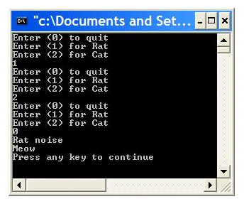
Polymorphism: pointers to base and derived classes - new motivating example
#define MAXNUM 50
int main()
{
int quit = 0;
int choice;
int totalNumber;
Pet *Pets[MAXNUM];
//Array of pointers to base class
int i = 0;
while (!quit && i < MAXNUM)
{
cout << "Enter (0) to quit" << endl;
cout << "Enter (1) for Rat" << endl;
cout << "Enter (2) for Cat" << endl;
cin >> choice;
if (choice == 0) {
quit = 1;
}
else if (choice == 1) {
Pets[i++] = new Rat;
}
else if (choice == 2) {
Pets[i++] = new Cat;
}
else {
cout << "Invalid Choice, Reenter" << endl;
}
}
totalNumber = i;
for (i = 0; i < totalNumber; i++)
{
Pets[i]->speak();
}
return 0;
}
Output is as expected if we define the speak function of Pet class virtual

Slide 53
Polymorphism: slicing
class Pet
{
public:
// Constructors, Destructors
Pet () {}
virtual ~Pet() {}
//General methods
virtual void speak();
{
cout << "Growl" << endl;
}
};
class Rat: public Pet
{
public:
Rat() {}
~Rat() {}
virtual void speak()
{
cout << "Rat noise" << endl;
}
};
void Rat::speak()
class Cat: public Pet
{
public:
Cat() {}
~Cat() {}
virtual void speak()
{
cout << "Meow" << endl;
}
}
void chorus(Pet pet, Pet *petPtr, Pet &petRef)
{
pet.speak();
petPtr->speak();
petRef.speak();
}

Slide 54
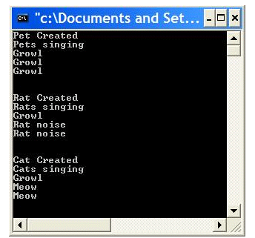
Polymorphism: pointers to base and derived classes
void chorus(Pet pet, Pet *petPtr, Pet &petRef)
{
pet.speak();
petPtr->speak();
petRef.speak();
}
int main(){
Pet *ptr; //Pointer to base class
ptr = new Pet;
cout << "Pet Created" << endl;
cout << "Pets singing" << endl;
chorus(*ptr, ptr,*ptr);
cout << endl << endl;
delete ptr;
ptr = new Rat;
cout << "Rat Created" << endl;
cout << "Rats singing" << endl;
//object, pointer to obj, ref. object
chorus(*ptr, ptr,*ptr);
cout << endl << endl;
delete ptr;
ptr = new Cat;
cout << "Cat Created" << endl;
cout << "Cats singing" << endl;
chorus(*ptr, ptr,*ptr);
cout << endl << endl;
delete ptr;
return 0;
}
Polymorphic behavior was NOT observed when the object was passed as value, as opposed to a pointer or ref. variable)

Slide 55
What is the problem?
In each object, there is a hidden pointer (vptr or vfptr) to a table that contains the Virtual Functions of that class (VTABLE). Normally there is one table for the whole class and each object points to it. You can see this pointer if you look at your variables in the debug window.
When you pass a parameter by value as Pet, you implicitly use the copy constructor of the Pet class to initialize the parameter (as in the first parameter of Chorus), and the VTABLE pointer gets the address of the Pet class VTABLE. Hence, even though a Rat object is passed, its methods are not used. Using pointers or reference variables, you don’t have the problem because the copy constructors are not called.
When you use pointers or reference variables, the VTABLES are accessed dynamically for the correct subtype.
Moral of the story:
Do not pass classes to the functions using value parameters. Use reference parameters and pointers.

Slide 56
virtual functions & static/dynamic binding
There is another reason to use the virtual keyword: to obtain dynamic binding (dynamically selecting functions depending on the object type, even when the function actually called is not overriden)

Slide 57
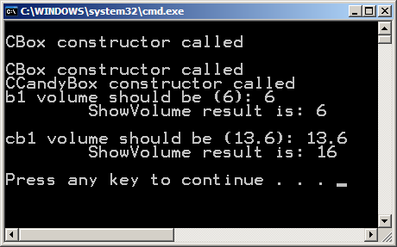
Virtual Funtions: example that needs a virtual function
class CCandyBox : public CBox {
public:
...
double Volume() const {
return 0.85*m_length*m_breadth*m_height;
}
private: …
};
class CBox {
public:
...
double Volume() const
{ return m_length*m_breadth*m_height; }
void ShowVolume() const
{ cout << "\tShowVolume result is: " << Volume(); }
private: …
};
int main()
{
CBox b1(2,3);
CCandyBox cb1 (2.0, 2.0, 4.0, "Choc.");
cout << "b1 volume should be (6): " << b1.Volume() << endl;
b1.ShowVolume();
cout << "cb1 volume should be (13.6): " << cb1.Volume() << endl;
cb1.ShowVolume(); //problem
return 0;
}

Slide 58
Static resolution – Early binding
The call to the function Volume() in ShowVolume() is set once and for all by the compiler as the version defined in the base class.
  This is an example of static resolution of the function call or "early binding" (done during the compilation)
We want the object type to determine which Volume() function will be called
  dynamic linkage
  late binding
  dynamic binding
  ALL SAME MEANING
  => Solution: virtual functions

Slide 59
Virtual Functions for Dynamic Binding
If you want the right function to be selected based on the kind of the object on which it is called (dynamic binding):
  you should declare the function as "virtual" in the base class (and in the derived classes, though that is not strictly necessary).
  class CBox
  {
  ...
  virtual double Volume() const
  { return m_length*m_breadth*m_height; }
  ...
  }
  class CCandyBox : public CBox
  {
  ...
  virtual double Volume() const
  { return 0.85*m_length*m_breadth*m_height;}
  ...
  }
  //now ShowVolume() will pick the right Volume()
See Cbox_earlybinding.cpp for a demo

Slide 60
Pure Virtual Functions and Abstract Classes

Slide 61
Pure Virtual Functions and Abstract Classes
Sometimes you may want to include a function in the base class to enforce the derived classes to override it, but that function does not have a meaning in the base class => pure virtual function
  E.g. shape class does not have a suitable default implementation for Area() function
  E.g. container class can be the base class of the Box class or Can class, but itself may have only a pure virtual volume method.
You indicate a pure virtual function by adding “ = 0” to the definition.
  virtual void Area() const = 0;
  virtual void Foo() = 0;

Slide 62
Pure Virtual Functions and Abstract Classes
A pure virtual function in declared in C++ by initializing a virtual function to zero.
  virtual return_type function_name (parameters) = 0;
  virtual void accelerate() const = 0;
accelerate and decelerate functions in Vehicle class are pure virtual functions.
  The Car class overrides both of these pure virtual methods
  See next slide for this example

Slide 63
Pure Virtual Functions and Abstract Classes: example
class Vehicle { //abstract class
public:
Vehicle() {}
virtual ~Vehicle() {}
virtual void accelerate() const = 0; //pure virtual function defined
virtual void decelerate() const = 0; //pure virtual function defined
void setAcceleration(double a)
{acceleration = a;}
double getAcceleration() const
{return acceleration;}
protected:
double acceleration;
};
class Car: public Vehicle {
public:
Car() {}
virtual ~Car() {}
virtual void accelerate() const {cout << "Car Accelerating" << endl;}
virtual void decelerate() const {cout << "Car Decelerating" << endl;}
virtual void drive() const {cout << "Car Driving" << endl;}
};

Slide 64
Pure Virtual Functions andAbstract Classes
Any class containing at least one pure virtual function is an abstract class
  E.g. The Pet class should really be an abstract class (well, actually it was not abstract in our previous examples). It should provide an interface and perhaps a partial implementation, but it would not be instantiated: You can have a cat, dog or rat but cannot have a "pet" in general terms (you can have a pet, but the point is that it is too abstract, people would ask you what you have, a cat or a dog…?)
Any class containing any pure virtual function (an abstract class) cannot be instantiated
  the compiler will give you an error when you attempt to instantiate the class.
  if every pure virtual function is not overridden, a subclass of an abstract class will also be abstract (it cannot be instantiated)
    it is possible to create an inheritance hierarchy of abstract data types. That is, abstract classes may be derived from other abstract classes. But, at the bottom of such a hierarchy, there will be non-abstract classes that can be instantiated.

Slide 65
Pure Virtual Functions: Why???
By declaring the function as pure virtual in the base class, the class designer forces the client code to implement/override the function in subclasses (and provide specialized behavior), so that they are not forgotten.
But it is possible to provide an implementation for a pure virtual function. This implementation can provide support for methods in derived classes.
  The subclass function can chain up the pure virtual function to perform part of its work.

Slide 66
Pure Virtual Functions: Example
  class Vehicle {
  public:
  Vehicle() {}
  virtual ~Vehicle() {}
  virtual void accelerate() const = 0;
  virtual void decelerate() const = 0;
  void setAcceleration(double a) {acceleration = a;}
  double getAcceleration() const {return acceleration;}
  protected:
  double acceleration;
  };
  }
  void Vehicle::decelerate() const {
  //do not put “= 0” in implementation, put it only in declaration!
  cout << "Friction decelerates all vehicles" << endl;
  }

Slide 67
Implementations for Pure Virtual Functions
class Car: public Vehicle {
public:
Car() {}
virtual ~Car() {}
virtual void accelerate() const {cout << "Car Accelerating" << endl;}
virtual void decelerate() const
{ //can call the base class version - anywhere in this code
cout << "Car Decelerating" << endl;
Vehicle::decelerate(); //Chaining Up
}
virtual void drive() const
{
cout << "Car Driving" << endl;}
};
}
//If implemented outside the class definition:
void Car::decelerate() const {
cout << "Car Decelerating" << endl;
Vehicle::decelerate(); //Chaining Up
}

Slide 68
Multiple Inheritance

Slide 69
Multiple Inheritance
In C++, a class may have multiple base classes. That is, it may inherit the members and methods of multiple base classes.
  Class JetCar: public Car, public Jet
  {
  //...
  }
Some complications may arise as to the which member function is intended (Car’s or Jet’s), but it can be solved by specifically indicating the intended:
Ex:
class Package: public Box, public Contents
{
//...
}
Package myPackage;
myPackage.Show(); //which Show function? Box’s or Content’s?
myPackage.Contents::Show();

Slide 70
Example
  MathQuiz from Tapestry
  Program that asks you different levels of math questions and verifies your answers
  Saved for the lab

Slide 71
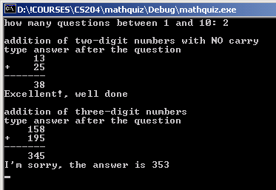
Example: MathQuiz

Slide 72
MathQuestion
Ask()
IsCorrect()
Answer()
Create()
Description()
myNum1
myNum2
myAnswer
HardMathQuestion
Create()
Description()
CarryMathQuestion
Create()
Description()

Slide 73
inheritquiz.cpp
#include <iostream>
#include <string>
using namespace std;
#include "tvector.h"
#include "prompt.h"
#include "randgen.h"
#include "mathquestface.h“ // prototype quiz program for demonstrating inheritance
void GiveQuestion ( MathQuestion & quest)
// post: quest is asked once, correct response is given
{
string answer;
cout << endl << quest.Description() << endl;
cout << "type answer after the question" << endl;
quest.Create();
quest.Ask();
cin >> answer;
if (quest.IsCorrect(answer))
{ cout << "Excellent!, well done" << endl;
}
else
{ cout << "I'm sorry, the answer is " << quest.Answer() << endl;
}
}

Slide 74
inheritquiz.cpp
MathQuestion
CarryMathQuestion
HardMathQuestion
void GiveQuestion (MathQuestion & quest)
// post: quest is asked once, correct response is given
{
string answer;
cout << endl << quest.Description() << endl;
cout << "type answer after the question" << endl;
quest.Create();
quest.Ask();
cin >> answer;
if (quest.IsCorrect(answer))
{ cout << "Excellent!, well done" << endl;
}
else
{ cout << "I'm sorry, the answer is " << quest.Answer() << endl;
}
}
You can pass subclass objects to where a superclass object is expected
Afterall, a CarryMathQuestion - IS A- MathQuestion

Slide 75
inheritquiz.cpp cont.
int main()
{
tvector<MathQuestion *> questions; // fill with questions
questions.push_back(new MathQuestion()); //2digit-no carry
questions.push_back(new CarryMathQuestion()); //2digit- carry
questions.push_back(new HardMathQuestion()); //3digit- carry
int qCount = PromptRange("how many questions",1,10);
RandGen gen;
int k;
for(k=0; k < qCount; k++)
{ int index = gen.RandInt(0,questions.size()-1); //randomly pick 1-3
GiveQuestion(*questions[index]); //generate and ask the question
}
for(k=0; k < questions.size(); k++)
delete questions[k];
return 0;
}
13
26
39
103
89
192
534
288
822

Slide 76
inheritquiz.cpp
void GiveQuestion (MathQuestion& quest)
// post: quest is asked once, correct response is given
{
string answer;
cout << endl << quest.Description() << endl;
cout << "type answer after the question" << endl;
quest.Create();
quest.Ask();
cin >> answer;
if (quest.IsCorrect(answer))
{ cout << "Excellent!, well done" << endl;
}
else
{ cout << "I'm sorry, the answer is " << quest.Answer() << endl;
}
}
Each subclass calls its own Create() function since this aspect is specialized
MathQuestion.Create()
CarryMathQuestion.Create()
HardMathQuestion.Create()

Slide 77
mathquestface.cpp
void MathQuestion::Create() //2digit summation
{ RandGen gen;
// generate random numbers until there is no carry
do
{
myNum1 = gen.RandInt(10,49);
myNum2 = gen.RandInt(10,49);
} while ( (myNum1 % 10) + (myNum2 % 10) >= 10);
myAnswer = tostring(myNum1 + myNum2);
}
string MathQuestion::Description() const
{
return "addition of two-digit numbers with NO carry";
}
MathQuestion::MathQuestion()
: myAnswer("*** error ***"),
myNum1(0),
myNum2(0)
{
// nothing to initialize
}

Slide 78
CarryMathQuestion::CarryMathQuestion()
: MathQuestion()
{
// all done in base class constructor
}
void CarryMathQuestion::Create()
{
RandGen gen;
// generate random numbers until there IS a carry
do
{
myNum1 = gen.RandInt(10,49);
myNum2 = gen.RandInt(10,49);
} while ( (myNum1 % 10) + (myNum2 % 10) < 10);
myAnswer = tostring(myNum1 + myNum2);
}
string CarryMathQuestion::Description() const
{
return "addition of two-digit numbers with a carry";
}

Slide 79
Note that MathQuestion here is used in fact for an easy math question (2 digit and no carry),
in that sense the is-a relationship does not hold, semantically.However this is not a problem in
terms of implementation.
If we really wanted to be strict, we could make an abstract class for a generic math question, and derive easy math question (2 digits no carry), hard math question (3 digits) and carry math question (2 digits carry) from that.

