Slide 1
CS 204 Advance Programming
Exception Handling in C++
Horton, pp. 239 – 247 (the contents in the slides may be different than the book)

Slide 2
Exceptions
A good program is stable and fault tolerant one.
In a good program, exceptional (“error”) situations must be handled.
  Exceptions are unusual/unexpected events
  They may require special processing
  Exception handler is part of the code that processes an exception
Some examples for exceptions:
  EOF is reached while trying to read from a file
  Division by 0 is attempted (result is meaningless)
  Array index is out of range
  Bad input
  …

Slide 3
Exception Handling
In traditional code, the following may be done in error-prone situations:
  error values are returned from a function
    new or malloc() returns null if out of memory
    fopen() returns NULL when the file cannot be opened
The programmer is then responsible for checking these returned values
Example.
if ((p = malloc(sizeof(float)) == NULL)
//handle error
if ((f = fopen("file.txt", "r")) == NULL)
//handle error

Slide 4
Exception Handling
This kind of error detection and handling
  makes the program logic unclear since the normal operational code and error handling parts mix up.
  cannot be used to handle errors in constructors (because they don’t return a value).
Because of these drawbacks, a new method to handle error situations (exceptions) is developed in C++.
With exception handling, it is possible to separate the code needed for "normal" operation and the code for handling "exception" situations.

Slide 5
The Basics
try identifies a code block where exception might occur
throw causes an exception to be raised (thrown)
catch identifies a code block where the exception will be handled (caught)
try
{
…
throw an exception
…
}
catch the exception

Slide 6
Exception Handling: Sample Code (ExceptionSample1.cpp)
Simple program to collect the height of people:
cin >> height;
try
{
if (height > 300)
throw "height exceeds maximum";
if (height < 30)
throw "height below minimum";
cout << "Person is " << ToInches(height) << "inches tall" << endl;
}
catch (const char msg[])
{
cout << "Exception occured: " << msg << endl;
}

Slide 7
The fundamentals of exception handling
The "normal" code is put in try block.
  It means that we "try to execute code" in the try block.
If the system succeeds to run the code, everything is fine (execution goes in order from top to down; catch blocks are skipped).
If something goes wrong when code of try block is executed, code throws an exception object and stops executing the code of try block further.
Another part of the code (the error handling part; the catch part) catches the exception (which is an object) and takes necessary actions needed in that error situation. After that, execution continues with the next statement following the catch blocks
The exception object (thrown object) can contain information about the exception, so that the error handling part of the program can examine the reason and take appropriate actions.

Slide 8
How it works?
int main()
{
int height;
cin >> height;
try
{
if (height > 300)
throw "height exceeds maximum";
if (height < 30)
throw "height below minimum";
cout << "Person is " <<ToInches(height)
<< "inches tall" << endl;
}
catch(const char msg[])
{
cout << "Exception occured: "<<
msg << endl;
}
cout << "Program Stops " << endl;
return 0;
}
When an exception is thrown, the remaining code in the try block is skipped, just as in the case of the return statement in a function, and every auto object created after the try block is entered, is destroyed automatically
The thrown object is caught by the catch block where the execution continues
Then, the execution continues with the next statement after the catch block

Slide 9
How it works?
When no exception is raised in the try block, then catch block(s) is/are skipped.
You can throw exceptions anywhere in the try block several times
The operand following the throw keyword can be any expression and the type of the result of the expression determines the type of the exception thrown (can be any type - basic type or user defined class type)
The input type of the catch statement (the type of the exception object) is defined as in function declaration (like parameters)
There must be a match between the types of the thrown exception object and the parameter of catch
int main()
{
int height;
cin >> height;
try
{
if (height > 300)
throw "height exceeds maximum";
if (height < 30)
throw "height below minimum";
cout << "Person is " <<ToInches(height)
<< "inches tall" << endl;
}
catch (const char msg[])
{
cout << "Exception occured: "<<
msg << endl;
}
cout << "Program Stops " << endl;
return 0;
}

Slide 10
Catching Exceptions
You must supply at least one catch block for a try block
Otherwise compiler error (let's see it in ExceptionSample1.cpp).
int main()
{
int height;
cin >> height;
try
{
if (height > 300)
throw "height exceeds maximum";
if (height < 30)
throw "height below minimum";
cout << "Person is " <<ToInches(height)
<< "inches tall" << endl;
}
//NO CATCH HERE – NOT ALLOWED
return 0;
}

Slide 11
Catching Exceptions
Catch blocks must immediately follow the try block without any program code between them.
  Otherwise, compiler error (let's see it in ExceptionSample1.cpp).
int main()
{
int height;
cin >> height;
try
{
if (height > 300)
throw "height exceeds maximum";
if (height < 30)
throw "height below minimum";
cout << "Person is " <<ToInches(height) << "inches tall" << endl;
}
cout << "Wassup"; //no statements are allowed between try and catch
catch(const char msg[])
{
cout << "Exception occured: "<< msg << endl;
}
cout << "Program Stops " << endl;
return 0;
}

Slide 12
Catching Exceptions
Catch blocks will catch exceptions of the correct type that occur in the code in the immediately preceding try block, including the ones thrown by functions called within the try block.
Let's see it in ExceptionSample1.cpp).
int main()
{
int height;
cin >> height;
try
{
if (height > 300)
throw "height exceeds maximum";
if (height < 30)
throw "height below minimum";
cout << "Person is " <<ToInches(height)
<< "inches tall" << endl;
}
catch(const char msg[])
{
cout << "Exception occured: "<<
msg << endl;
}
cout << "Program Stops " << endl;
return 0;
}
int ToInches (int cm)
{
if (cm == 100)
throw "you are a winner!";
return cm/2.54;
}
Here, if height is 100, exception is thrown in ToInches function and caught in main. Output is:
Exception occured: you are a winner!
Program Stops

Slide 13
Catching Exceptions
There can be more than one catch blocks. The one that will catch a particular exception is determined by the type of the object/value thrown (like overloaded functions).
Let's see it in ExceptionSample2.cpp).
throw 0; is caught by
catch (int i)
String literals thrown are caught by catch(const char msg[])
or by
catch(const char * msg)
In both cases, consts can be omitted
try
{
if (height <= -1)
  throw 0;
if (height > 300)
throw "height exceeds maximum";
if (height < 30)
throw "height below minimum";
cout << "Person is " <<ToInches(height)
<< "inches tall" << endl;
}
catch (int i)
{
cout << "Bad input: height cannot be less than " << i << endl;
}
catch(const char msg[])
{
cout << "Exception occured: "<< msg << endl;
}
You cannot have two catches with the same type in the same try-catch block; this would be a compiler error.

Slide 14
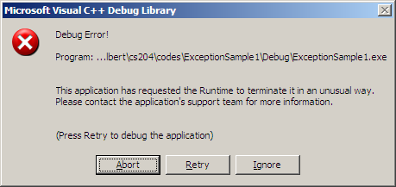
Process Terminates (Actually Your Program Crashes) If Exception is not Caught – Unhandled Exceptions
int main()
{
try
{
throw "error";
}
catch (int i)
{
cout << "Why dont I catch anything? \n";
}
}
If an exception is not caught by any catch statement because there is no catch statement with a matching type, the special function terminate will be called.
This function terminates the current process immediately showing an "Abnormal termination" or a similar error message.

Slide 15
No Typecasting between throw and catch
The type matching between the object thrown and caught is very strict. The parameter given in catch must be exactly the same as the type of the object/value thrown.
No typecasting is done implicitly (there is no typecasting even between double and int)
Let's see it in ExceptionSample3.cpp).
Having a missing catch may cause a crash.
For example, if we do not have catch (int i) and its block, and if the input is 2, catch with double parameter does not handle this case and program crashes.
String literals (e.g. "ali veli") are considered as char pointers, not C++ strings. Thus thrown string literals always have to be caught by catch with char * or
char [] parameters (catch with string parameters cannot catch them).
string s="yadda yadda";
cin >> input;
try
{
if (input == 1) throw 1.1;
if (input == 2) throw 2;
if (input == 3) throw "bla bla";
if (input == 4) throw s;
}
catch (double i)
{ cout << "Double exception handler" << endl;
}
catch (int i)
{ cout << "Integer exception handler" << endl;
}
catch(const char msg[])
{ cout<<"char array exception handler" <<endl;
}
catch(string s)
{ cout << "String exception handler" << endl;
}

Slide 16
Nested tries
Try-catch blocks can be nested.
  Each try block has its own catch blocks
In case of nested try blocks:
  If an exception is thrown within an inner try block, which is not followed by a catch block with the right type, the catch handlers for the outer try block(s) will be searched (starting with the closer try).
  When a matching catch is found, search finishes. This catch block is executed. Then the execution continues starting with the code after this catch.
  If a matching catch is not found, then the program terminates with an error (unhandled exception case).

Slide 17
Nested tries – Example (see ExceptionSample4.cpp)
The exception of type const char[ ] is caught by the catch block in the inner try block
int height;
string err="Input cannot be below 0";
try
{
cin >> height;
try
{
if (height <= -1)
throw err;
if (height > 300)
throw "height exceeds maximum";
if (height < 30)
throw height;
cout << "Person is " << ToInches(height) << " inches tall" << endl;
}
catch(const char msg[])
{
cout << "Exception occured: " << msg << endl;
}
cout << "I am in the middle.\n" << endl;
}
catch (int i)
{
cout << "Exception occured: Height must be greater than "<<i<< endl;
}
The exception of type int has no catch handler for exceptions of that type, so the the catch handler in the outer try block is executed
The exception of type string has no catch iny any of the try blocks, so the program crashes if height is less than zero.
This statement is executed if no exceptions are thrown or the thrown exception is caught before that

Slide 18
Catching exceptions
If you want to catch any exception that is thrown in a try block, no matter the type of thrown object is,
  you specify this as:
  catch (...)
  {
  // code to handle any exception
  }
This catch block must appear last if you have other catch blocks defined for the try block.
Note that in this catch block, you do not know what type of exception has occured and cannot use a reference to an object

Slide 19
Example (see ExceptionSample4.cpp)
int height;
string err="Input cannot be below 0";
try
{
cin >> height;
try
{
if (height <= -1)
throw err;
if (height > 300)
throw "height exceeds maximum";
if (height < 30)
throw height;
cout << "Person is " << ToInches(height) << " inches tall" << endl;
}
catch(const char msg[])
{
cout << "Exception occured: " << msg << endl;
}
cout << "I am in the middle.\n" << endl;
}
catch (int i)
{
cout << "Exception occured: Height must be greater than "<<i<< endl;
}
catch (...)
{
cout << "Houston we have a problem, but I do not know what it is :(\n";
}
Previous example but now we have catch (...) to catch any unhandled exception, which is the string exception in our example case.

Slide 20
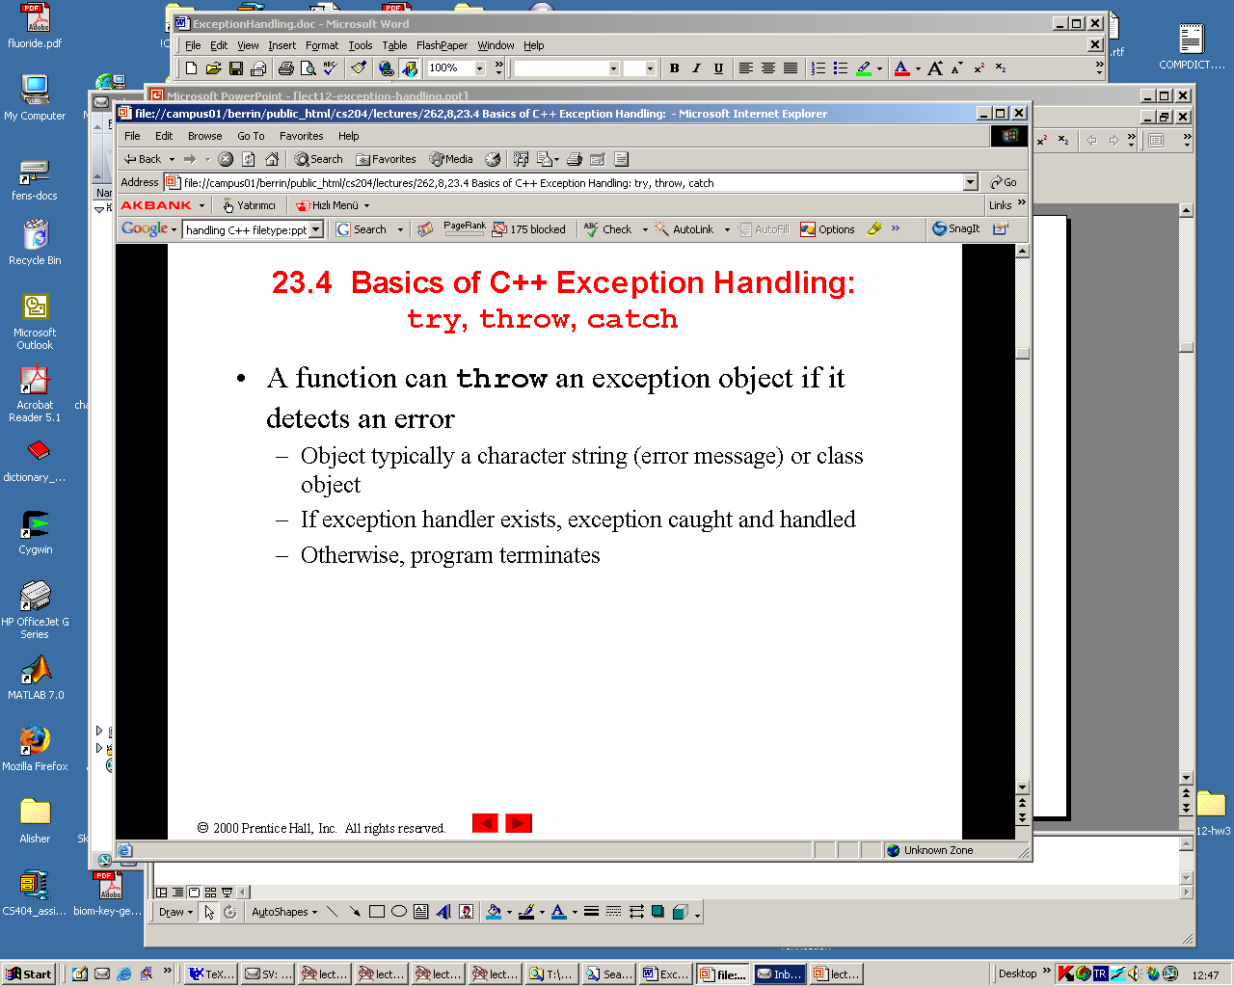
Basics of Exception Handling

Slide 21
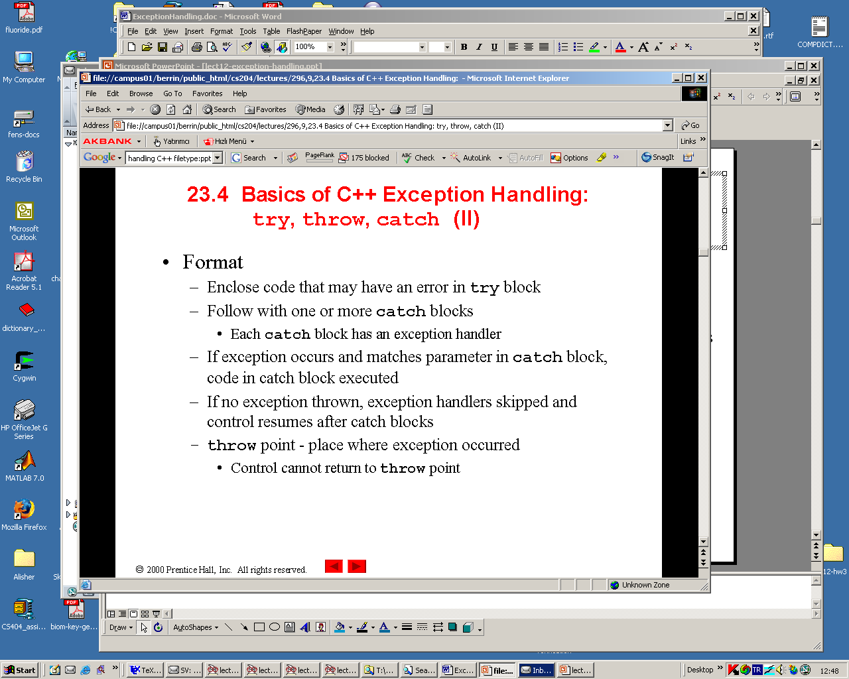

Slide 22
Stack unwinding
If exception is thrown in a try block (or in a function that is called from a try block or in a function that is called from a function that is called from a try block and so on), all local objects allocated from the runtime stack after the try block was entered are released (go out of scope) and their destructors are called. This process is called stack unwinding.
This process guarantees that when we try to recover from an error, there are no inconsistent data in the runtime stack and there is no memory leak (again within the stack; we will discuss memory leak considerations in the heap for dynamically allocated memory later).

Slide 23
Stack unwinding
Example
int main() {
//....
try {
Aclass myA;
f1();
//....
}
//catch come here
}
void f1() {
Bclass myB;
f2();
//....
}
void f2() {
Cclass myC;
//....
throw "Exception";
}
If error occurs in the function f2, the destructors for objects myA, myB and myC are called and those objects are deleted from the stack in the reverse order of creation and before the exception is caught.
Note that this would also return any dynamically allocated memory used in those objects (myA, myB, myC), through their properly implemented destructors.

Slide 24
Another example (problematic)
Sometimes stack unwinding does not suffice since it does not return the dynamic memory to heap.
try
{
int * myarr;
myarr = new int [LARGECLASS];
Process(myarr); //suppose an exception is thrown in Process function
}
catch (...)
{
//Need to free the heap memory pointed by myarr
//But there is a problem – cannot refer myarr
cout << "Exception caught" << endl;
}

Slide 25
Another example (acceptable, but questionable solution)
Move myarr definition outside the try block so that catch can refer.
But this time you cannot force myarr pointer to go out of scope by stack unwinding.
int * myarr; //moved outside of try
try
{
myarr = new int [LARGECLASS];
Process(myarr); //suppose an exception is thrown in Process function
}
catch (...)
{
delete [] myarr;
cout << "Exception caught" << endl;
}

Slide 26
Another example (best solution)
Pure object oriented approach.
Define a class for the array and let the class destructor to handle delete.
Destructor of local objects are automatically called when exception is thrown but before it is caught (this is what stack unwinding is)
CAUTION: You cannot refer to myarr in the catch block, not only due to scope rules, but also due to the fact it has been destructed when the exception is thrown.
try
{
ArrayClass myarr;
myarr.Init(); //allocates memory, etc.
myarr.Process(); //suppose an exception is thrown in Process function
}
catch (...)
{
cout << "Exception caught" << endl;
}

Slide 27
Exception Handling as an Object Oriented Mechanism
Exception handling is actually a pure object oriented mechanism
You can throw objects of classes specifically designed for exception handling.
You can also inherit subclasses from a base exception class and throw them.
Now we will see these mechanisms via some examples.

Slide 28
Example: Division by zero handled via a user defined exception class - 1
// Class DivideByZeroException definition.
// DivideByZeroException objects should be thrown by functions
// upon detecting division-by-zero exceptions
class DivideByZeroException
{
public:
// constructor specifies default error message
DivideByZeroException()
: message( "attempted to divide by zero" ) {}
//what returns the message
char * what() {return message;}
private:
char * message;
};

Slide 29
Example: Division by zero handled via a user defined exception class - 2
// perform division and throw DivideByZeroException object if
// divide-by-zero exception occurs
double quotient( int numerator, int denominator )
{
// throw DivideByZeroException if trying to divide by zero
if ( denominator == 0 )
throw DivideByZeroException(); // generate and throw exception object
// return division result
return (double) numerator / denominator;
}

Slide 30
Example: Division by zero handled via a user defined exception class - 3
int main()
{
//. . . .
try
{
result = quotient( number1, number2);
cout << "The quotient is: " << result << endl;
}
catch ( DivideByZeroException myException )
{
cout << "Exception occurred: " << myException.what() << endl;
}
//. . . .
}
See and run the full code at
DividebyZeroException.cpp

Slide 31
What happens behind the scenes - 1?
General rule: object thrown is not destructed until the end of the catch block that catches the exception. At the end of the catch, it is destructed automatically.
  But what is this object?
Normally when you throw an object, throw automatically calls the copy constructor and generated copy is thrown.
  So it is better to have a copy constructor.
  This copy is not destructed until the end of catch block that catches this exception
  Original object is destructed before the exception is caught due to stack unwinding
If you generate and throw the object at the same time as in previous example throw DivideByZeroException();
  Strange behavior in VS2010 and VS2012
    If a copy constructor is implemented by the programmer, it is not called; the generated original object is thrown
      This object will be destructed at the end of catch.
    If no copy constructor is implemented, then default copy constructor is automatically invoked and that copy is thrown.
Run these cases at
DividebyZeroExceptionExtra.cpp

Slide 32
What happens behind the scenes - 2?
When you catch an object as value parameter as in the previous example:
catch ( DivideByZeroException myException )
  Copy constructor is automatically invoked on the thrown object and that copy is used in catch routines (valid in all versions of VS)
In order to avoid invoking copy constructor here, you may prefer to pass the thrown object as reference such as:
catch ( DivideByZeroException & myException )
In anyway, thrown object is to be generated using copy constructor as explained in the previous slides.
Run these cases at
DividebyZeroExceptionExtra.cpp

Slide 33
Inheritance for Exception Classes
We can use inheritance!
Suppose MathException is the base class for several math exceptions.
  class MathException
  {
  public:
  MathException(char * m = "Unidentified Math Error")
  {
  message = new char [strlen(m)+1];
  strcpy (message, m);
  }
  char * what() {return message;}
  protected:
  char * message;
  };
Study Yourselves:
Think of destructor and copy
constructor here and consequences
of having/not having them

Slide 34
Inheritance for Exception Classes
We can use inheritance!
Suppose MathException is the base class for several math exceptions. We can inherit several subclasses from it
  class DivideByZeroException : public MathException
  {
  public:
  DivideByZeroException () :
  MathException("attempted to divide by zero") {}
  };
  class OverflowException : public MathException
  {
  public:
  OverflowException () :
  MathException("overflow detected") {}
  };
  class RootOfNegativeException : public MathException
  {
  public:
  RootOfNegativeException () :
  MathException("you cannot calculate square root of negatives") {}
  };

Slide 35
Inheritance for Exception Classes
We can use inheritance!
Suppose MathException is the base class for several math exceptions. We can inherit several subclasses from it and use to catch different type of exceptions
Example:
  try {
  // code to throw exceptions here
  }
  catch (DivideByZeroException myEx) //catches DivideByZeroException objects only
  { /* catch code here */ } //specialized handler for divide by zero
  catch (OverflowException myEx) //catches OverflowException objects only
  { /* catch code here */ } //specialized handler for oveflow
  catch (MathException &myEx)//catches all other objects derived from MathException base class
  { /* catch code here */ } //generic handler
The last catch may cause polymorphism (if the thrown object is of a derived class, e.g. RootOfNegativeException)
  To avoid slicing it is better to use reference parameter here.

Slide 36
END OF CS204
Lectures finished, but there is lab this week.
  Lab 14: Samples about inheritance, polymorphism and exception handling
  Extra Recitations for sample exam question solving are planned during final week and announced later
HW7 is due on May 26.
Final Exam is on June 8, 2021, Tuesday, 16:00 (online)
Two A4 size cheat notes (each two sided) + 3 blank pages for sketches
Expect 120 – 140 minutes exam
Comprehensive (everything included)
More details about the final exam will be sent later
Thanks for your time and effort in this course.
And many thanks to our assistants (both your and mine ☺ ) Ahmed, Amro, Arın, Artrim, Ayşegül, Berk C., Berk K., Berk S., Berke, Buket, İlker, İrem, Mohammad, Pınar, Sadi, Selim, Püren, Uğur, Utku, Vedat, Yağız and Zeynep.

Slide 37
C++ Standard Exception Classes
Some advanced topics
You are not responsible from the rest of this ppt.

Slide 38
Standard exception classes
C++ standard defines the following class hierarchy for exceptions.
It is meant to serve as a starting point so that programmers can inherit and develop their own exceptions.
The base class for this class hierarchy is exception.

Slide 39
C++ Exception Classes
#include <iostream>
#include <exception>
using namespace std;
int main()
{
try {
char *c = new char[0x7fffffff];
}
catch (exception & e)
{
cout << "Exception: " << e.what() << endl;
}
}
Output:
Exception: bad allocation
But still this is not a silver bullet. new operator throws a standard exception if memory allocation fails and we caught it.
If the used function/operator/etc. does not throw a standard exception, you can not catch it.

Slide 40
Standard exception classes
Exception class hierarchy:
exception
bad_alloc //class bad_alloc : public exception
bad_cast //class bad_cast : public exception
bad_typeid …
logic_error
domain_error
invalid_argument
length_error
out_of_range
runtime_error
range_error
overflow_error
underflow_error
ios_base::failure
bad_exception

Slide 41
Standard exception classes
Exception class hierarchy:
exception
bad_alloc
bad_cast
bad_typeid
logic_error
domain_error
invalid_argument
length_error
out_of_range
runtime_error
range_error
overflow_error
underflow_error
ios_base::failure
bad_exception
A logic error indicates an inconsistency in the internal logic of a program, or a violation of pre-conditions on the part of client software.
For example, the substr member function of the standard string class throws an out_of_range exception if you ask for a substring beginning past the end of the string.
A bad_alloc exception occurs when heap memory is exhausted. C++ will generate a bad_cast exception when a dynamic_cast to a reference type fails.
If you rethrow an exception from within an unexpected handler, it gets converted into a bad_exception. If you attempt to apply the typeid operator to a null expression, you get a bad_typeid exception.

Slide 42
Memory allocation errors
Some build-in operations (global or class operations) throw an exception when they don’t succeed to complete the asked operation; or they can be asked to do so.
There are three options how memory allocation errors can be handled:
  Option 1. Conventional way: new returns 0 when allocation fails
  Option 2. Programmer can write his/her own new_handler
  Option 3. New throws an exception (bad_alloc) if allocation fails.

Slide 43
