Slide 1
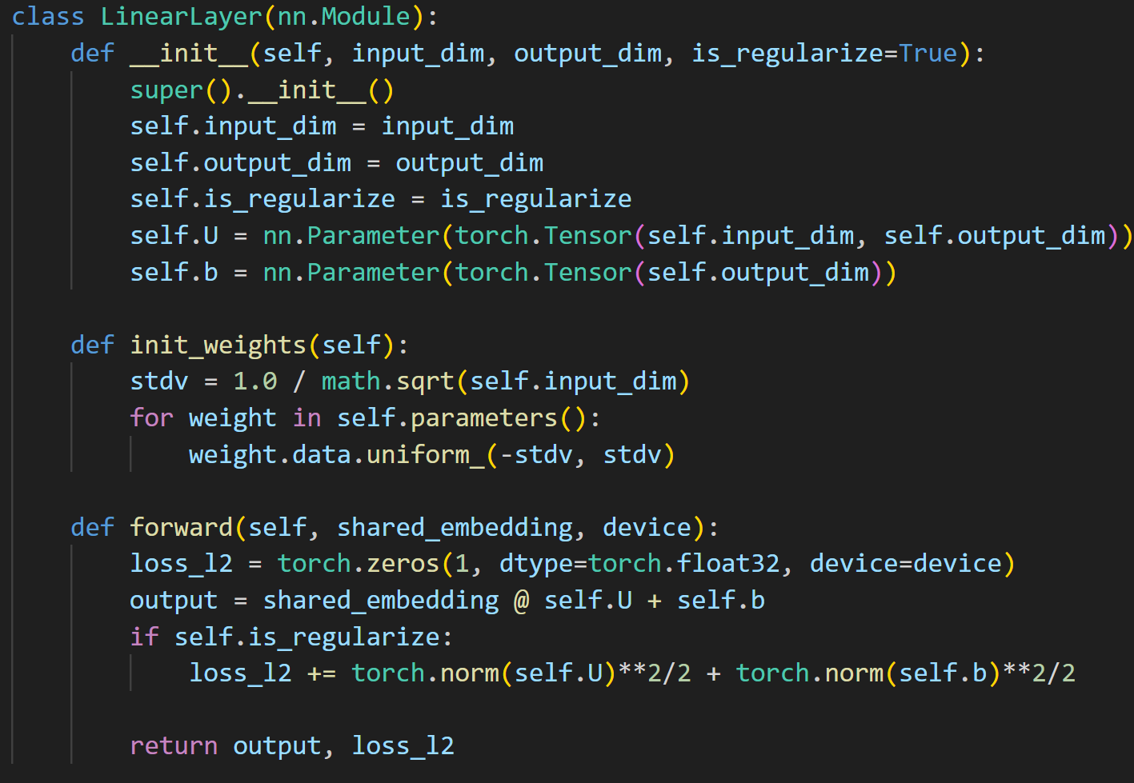
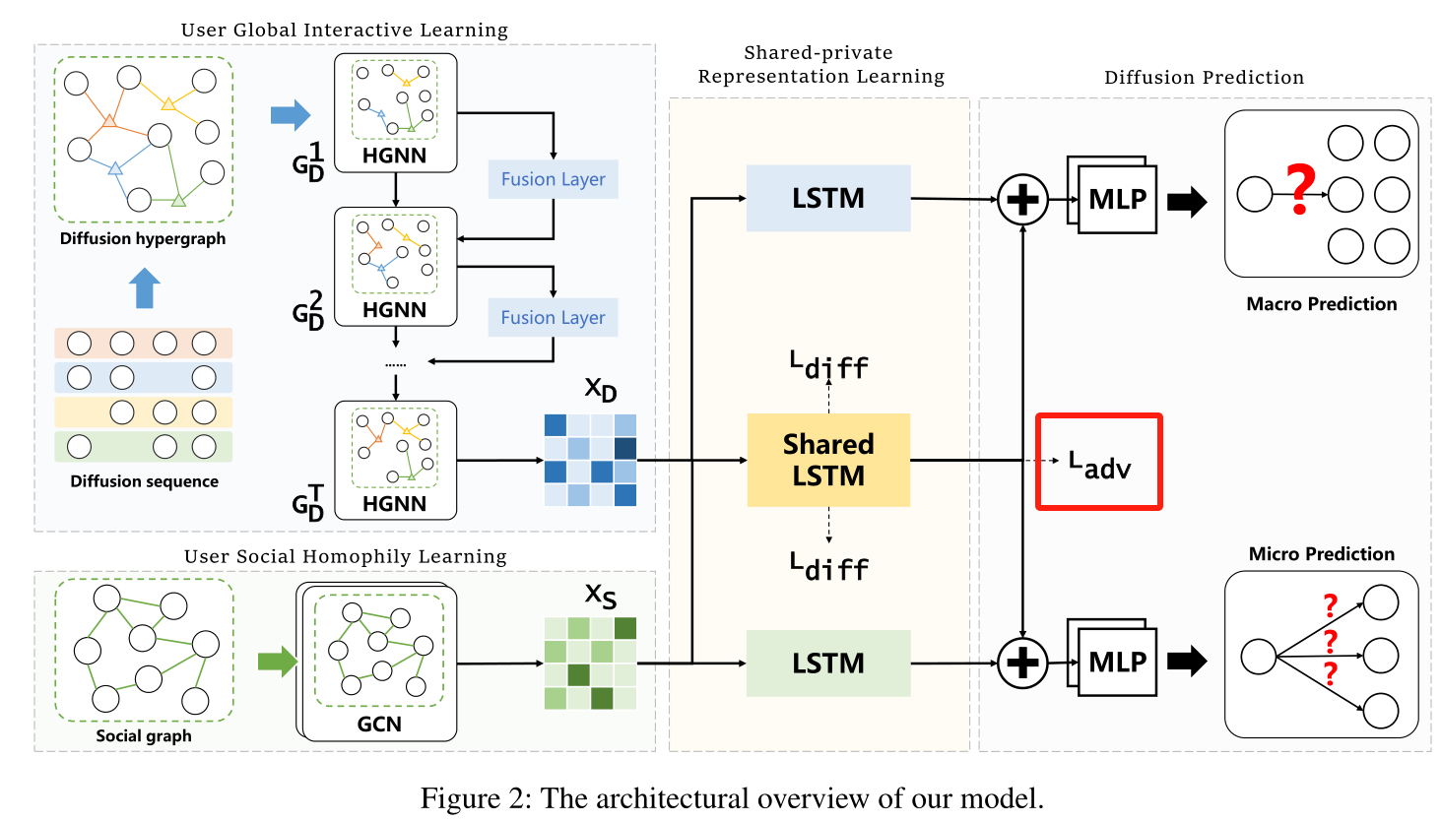
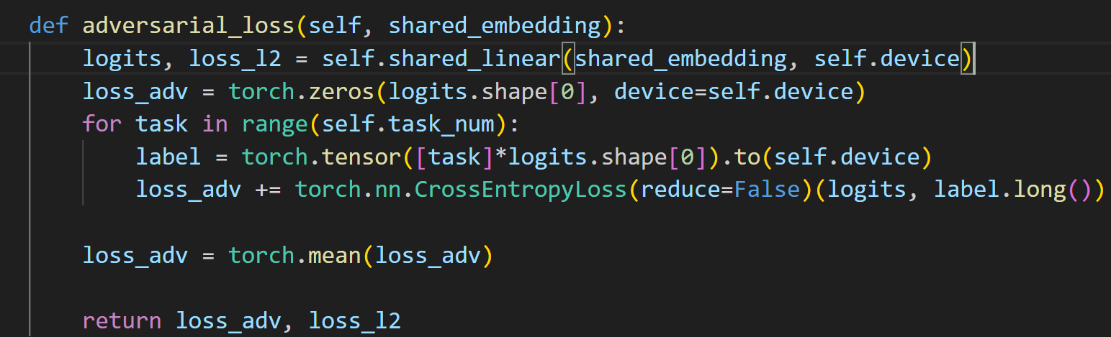
2024_AAAI_Enhancing Multi-Scale Diffusion Prediction via Sequential Hypergraphs and Adversarial Learning
对抗损失

