Slide 1
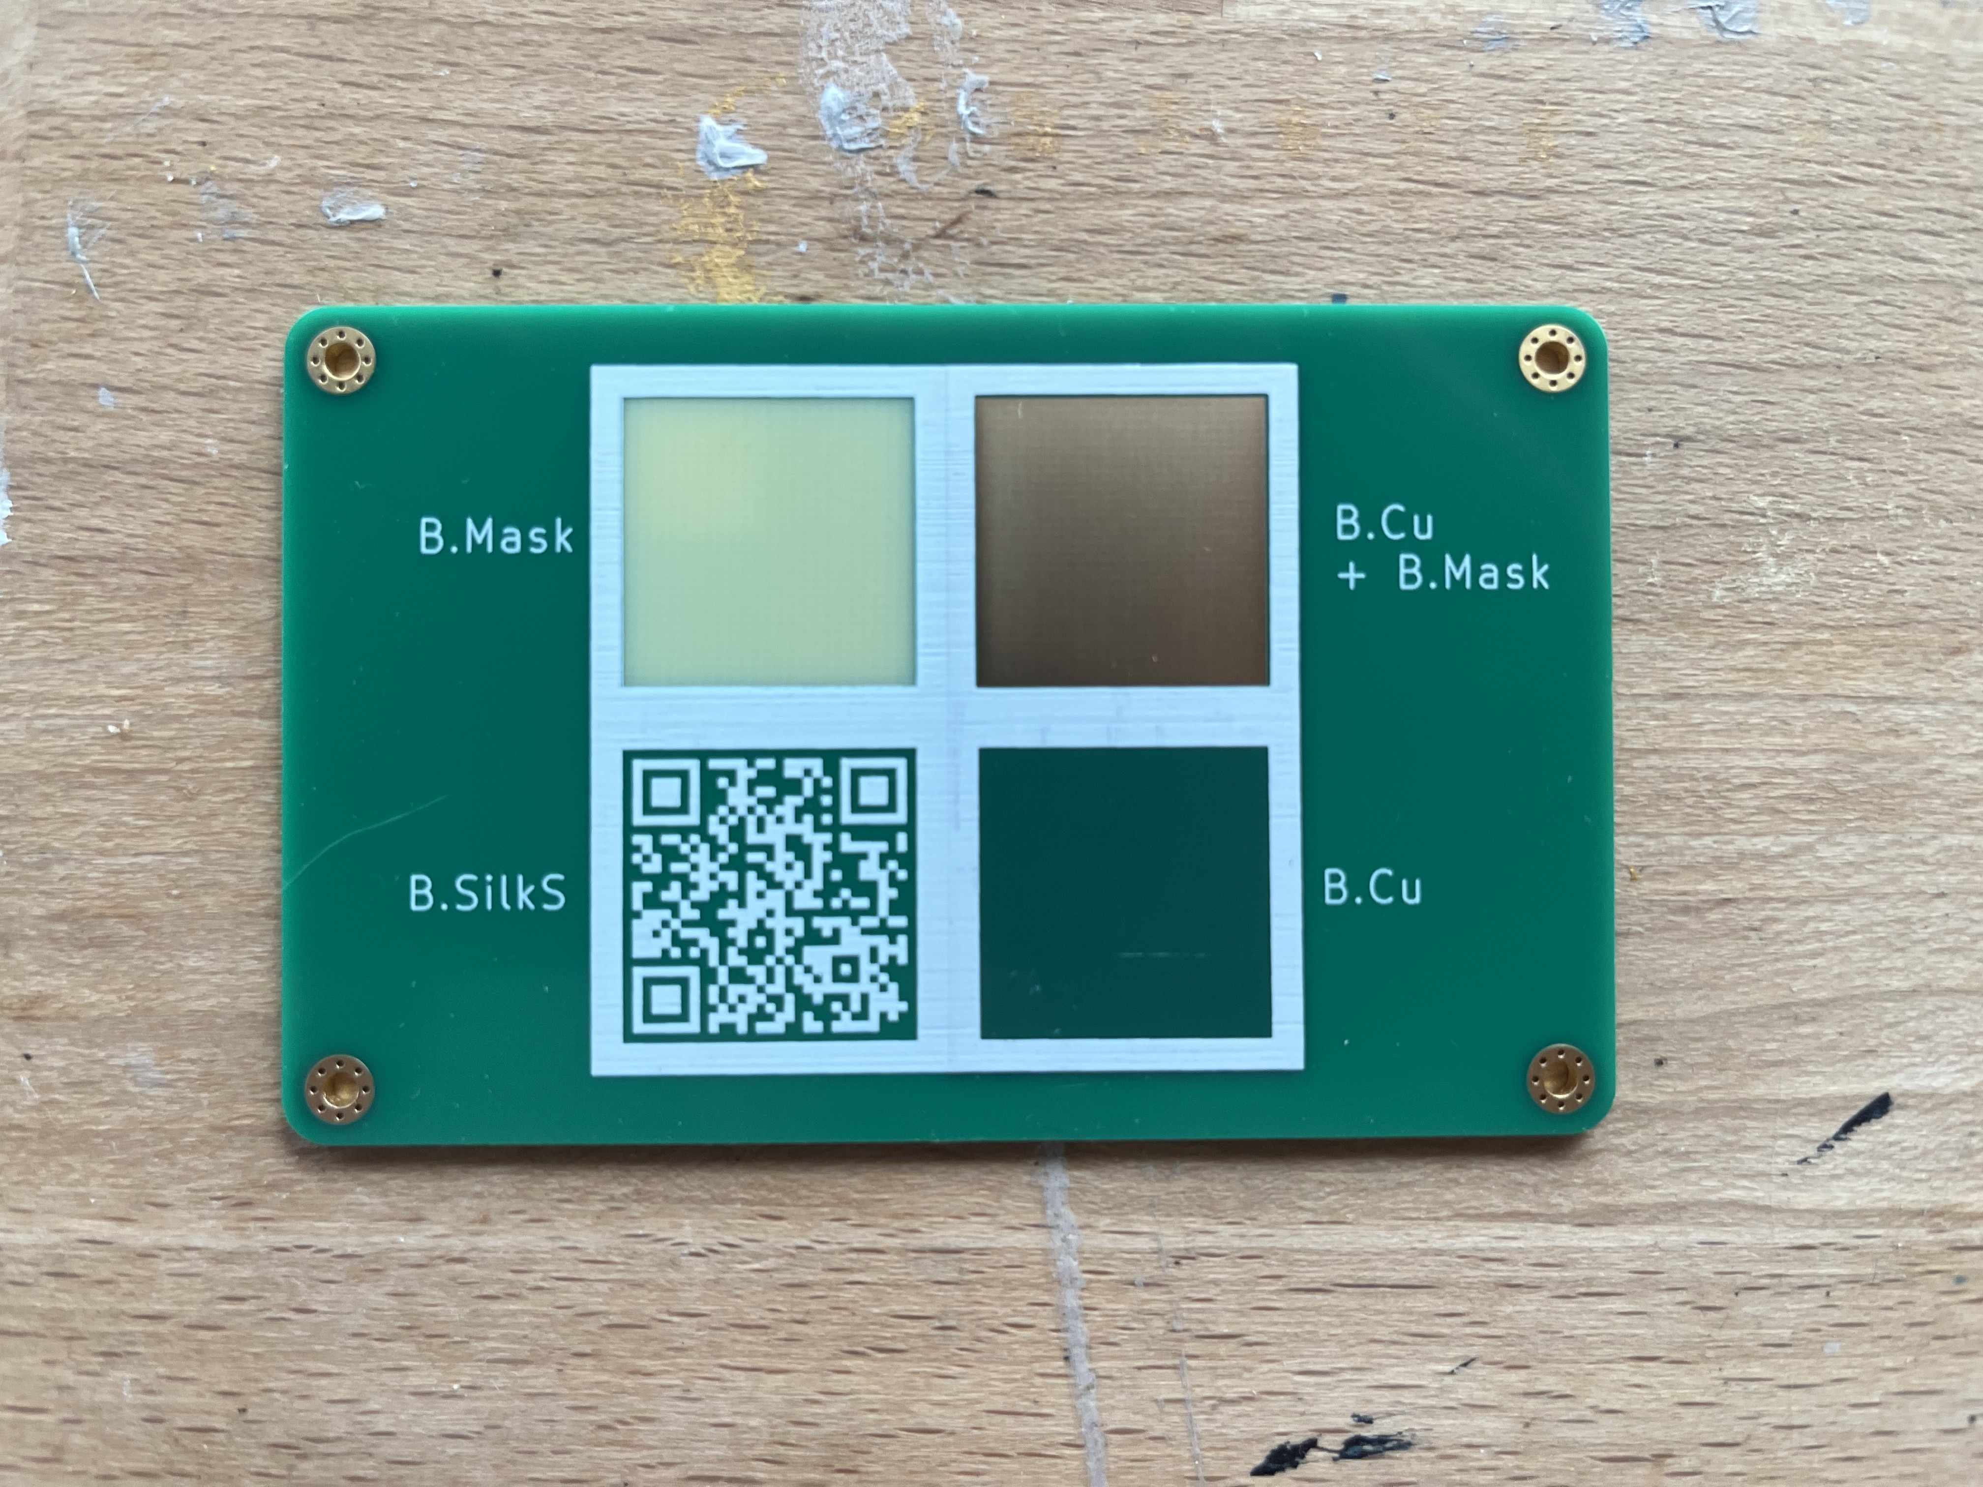
PCB artwork:
Make a business card
Alex Tait
atait@ieee.org, taitphotonlab.com
Welcome
1. Download Kicad & Inkscape
2. Get the course repo and slides:
https://github.com/atait/PCB-artwork-workshop
<-QR code
3. Look at the example PCBs
NYC Resistor, Oct 2026
Notes:
See the handout PCBs. You will get it to this point by the end of the workshop
Lenape and Haudenoshone

Slide 2
Objectives
Download KiCAD and Inkscape
Single-layer import
Multi-layer footprints (svg2mod)
Design your own graphics
Submit designs to fabrication house
Receive PCBs before the final camp show

Slide 3
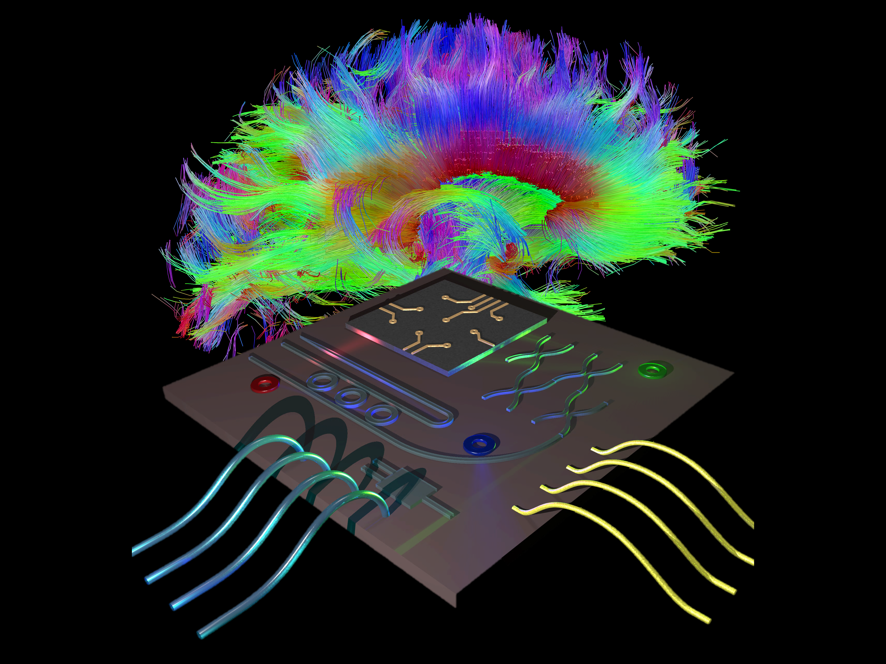
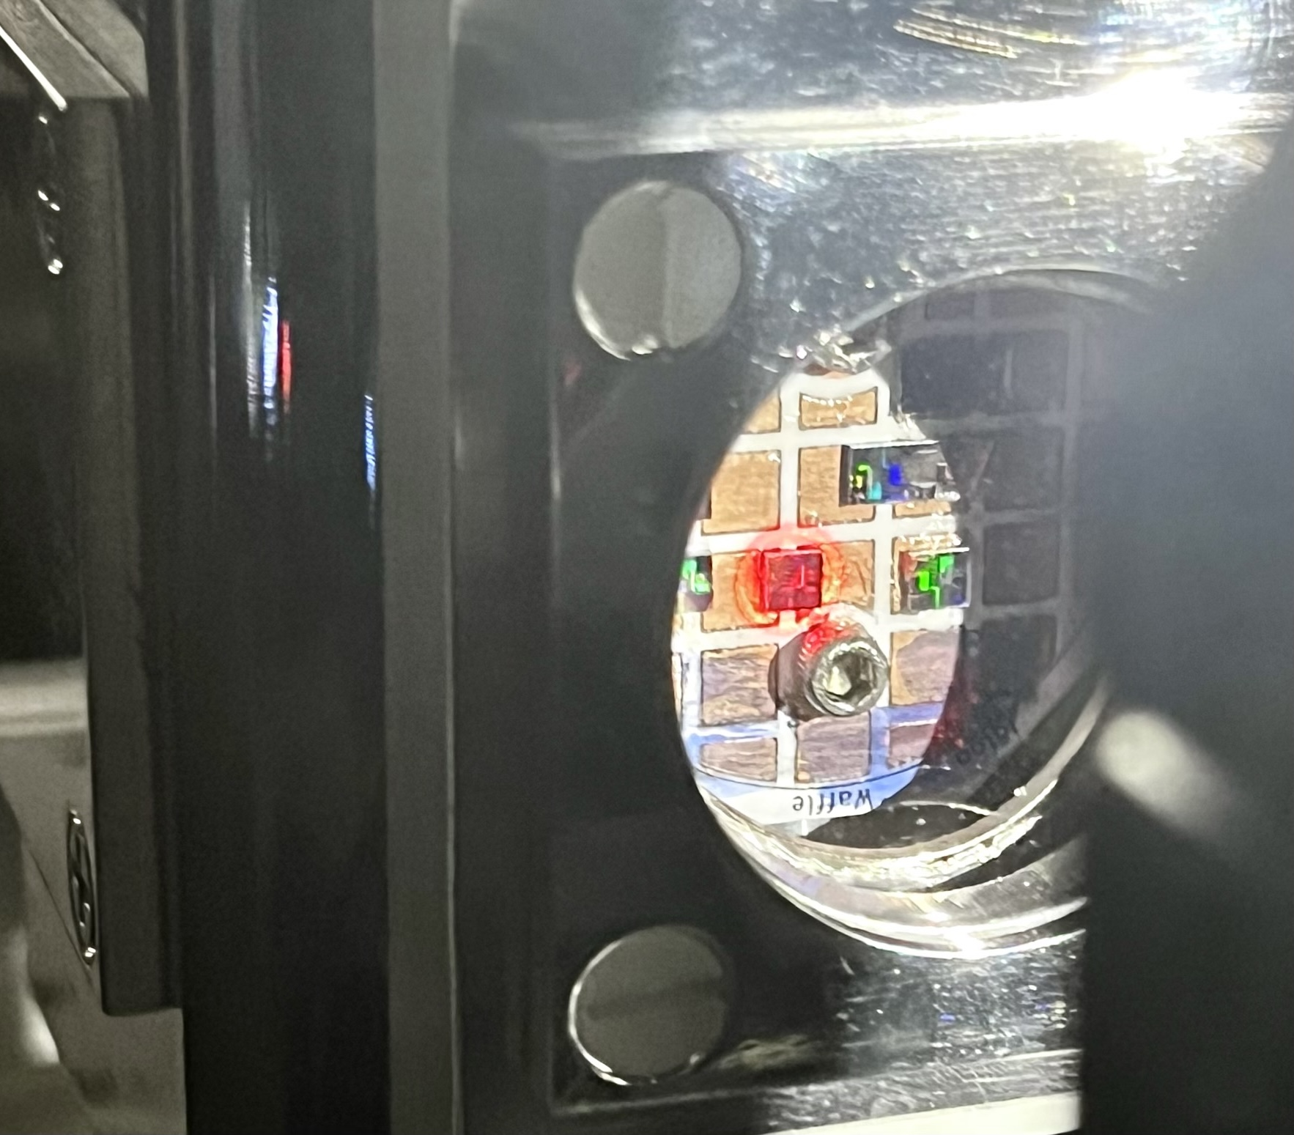
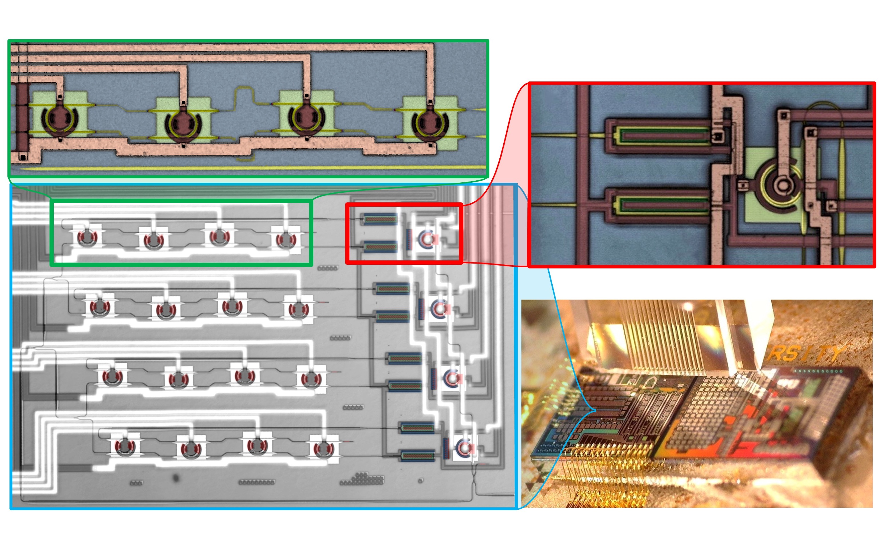
My background
Have lived in NJ, Colorado, Minneapolis, Ontario, Brooklyn
Taught for 4 years in Canada
Past Research
  Neuromorphic photonics
  Cryogenic photonics
Current research direction: open-source supply chains

Slide 4
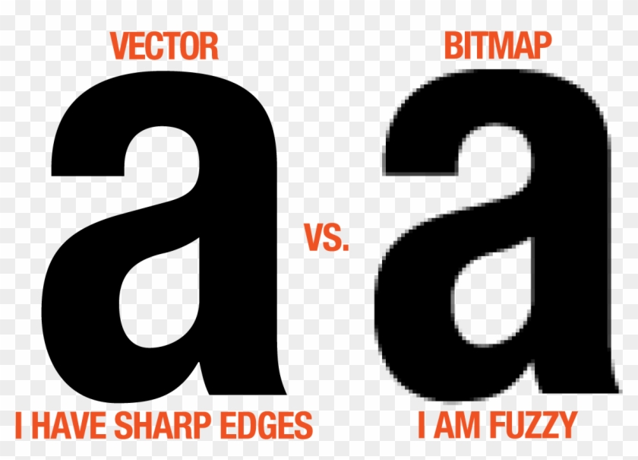
Computer Graphics: Vector vs. Raster
And anchor points
a.k.a., a picture
.svg (scalable vector graphics)
.png (portable network graphics)
.jpeg
.bmp

Slide 5
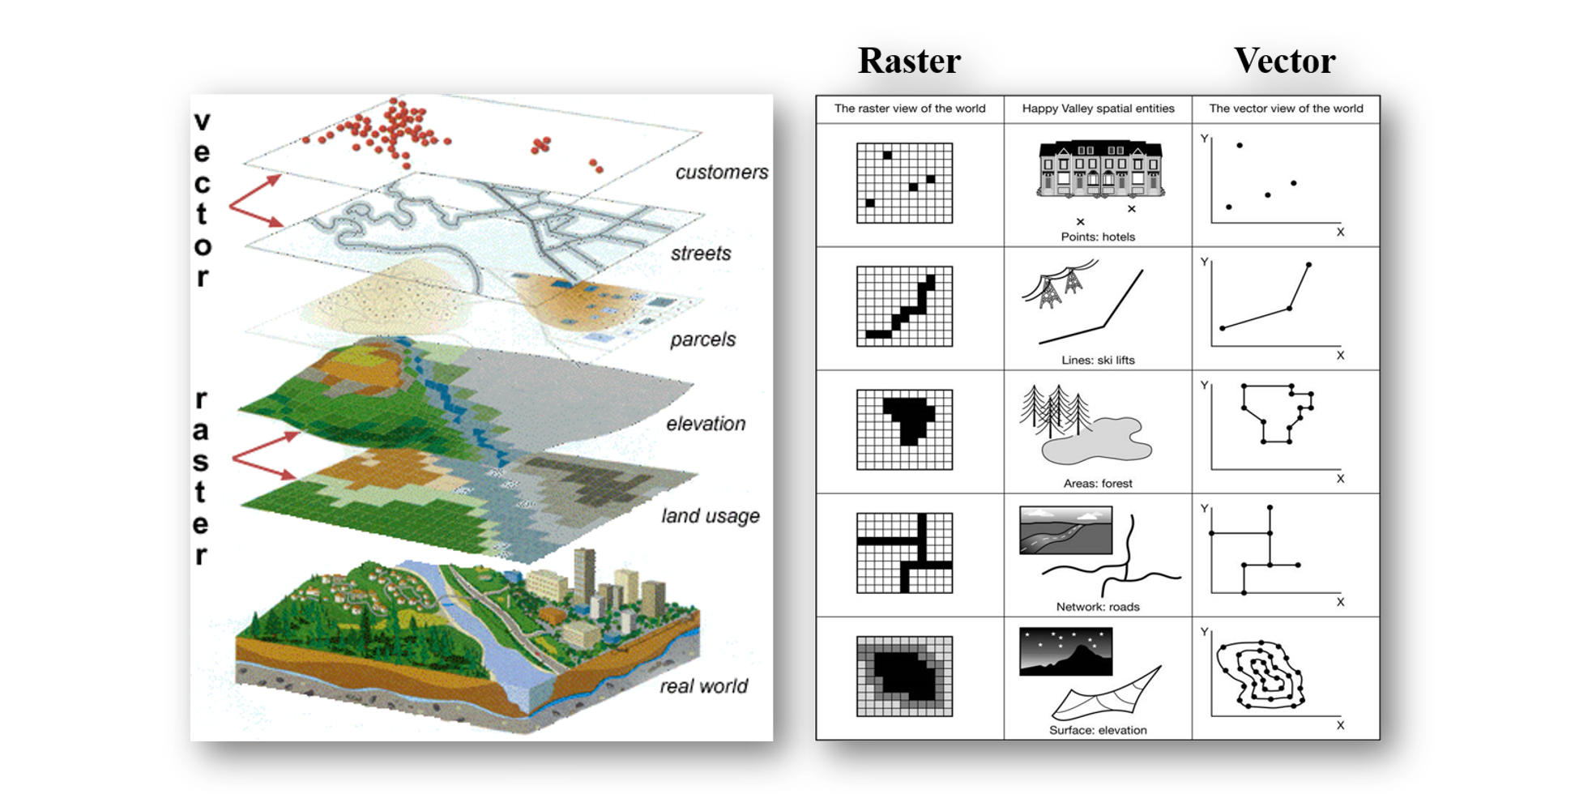
Computer Graphics: Vector vs. Raster
Most things can be visualized as vector or raster
So which way is better?
Points
Lines
Path
Network
Surface
Credit: Clemson Intro to GIS

Slide 6
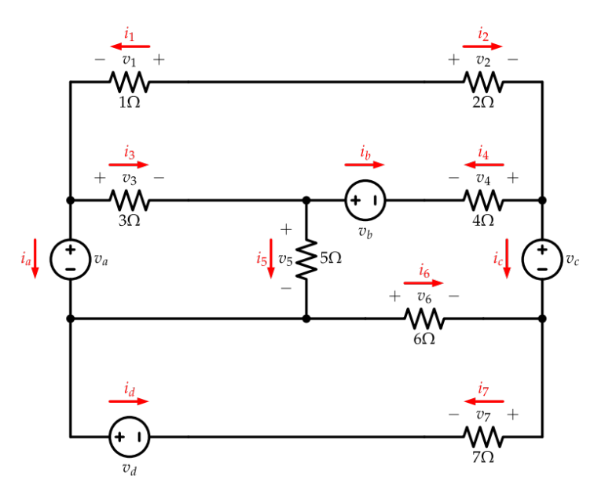
Graphic format for PCB hardware
This is an electric circuit
It looks like this one
Raster
Vector

Slide 7

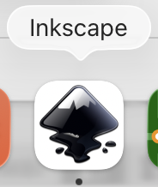
Software
KiCAD: vector graphics for PCBs, wiring, and electronics
Inkscape: vector graphics in general for art and design
These can talk to each other
Combined: PCB artwork

Slide 8

KiCanvas visualizer for PCBs on github
Navigate to a .kicad_pcb on github
Copy the github link
Navigate to kicanvas.org
Paste the link
Try it out
Copy: https://github.com/atait/PCB-artwork-workshop/tree/main/Example-Zoo
Paste: https://kicanvas.org
Or use a direct link: https://kicanvas.org/?repo=https%3A%2F%2Fgithub.com%2Fatait%2FPCB-artwork-workshop%2Ftree%2Fmain%2FExample-Zoo

Slide 9
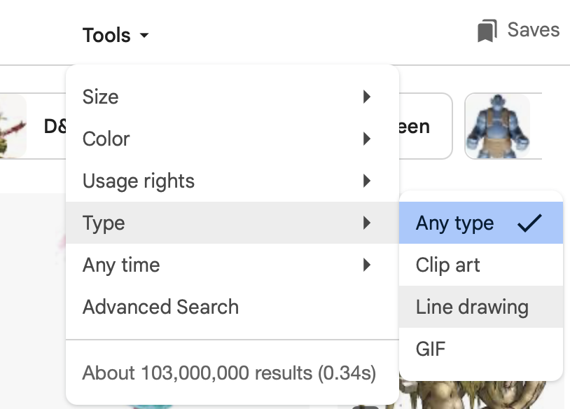
Asynchronous 0: get the software
Software
  Get the repo
  Download Inkscape
  Download KiCAD
Meet your neighbors. Ask if they know what they want to draw today.
Find vector artwork
  Search engine. Choose Type > Line drawing
  By hand.
  vecteezy.com and similar sites
Link to slides
https://github.com/atait/PCB-artwork-workshop

Slide 10
What a PCB looks like

Slide 11
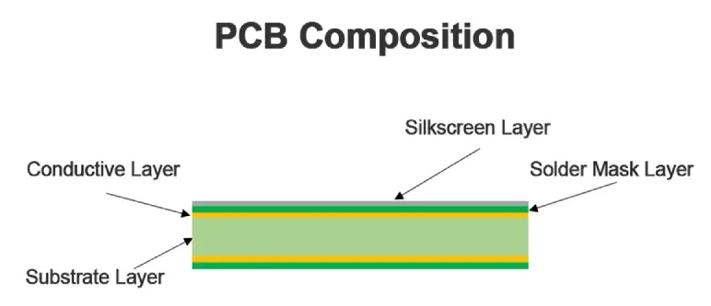
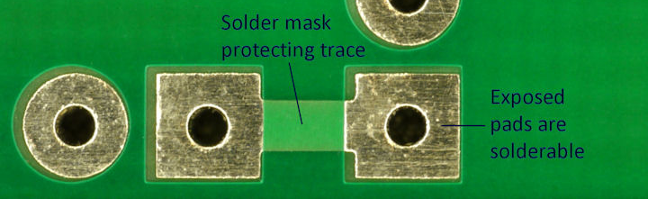
Cross section of PCB layers
Copper layer makes electrical connections between pads
  Called wires or traces
Solder mask layer insulates the traces
Solder mask is removed from exposed pads
Silkscreen for labeling and decoration

Slide 12
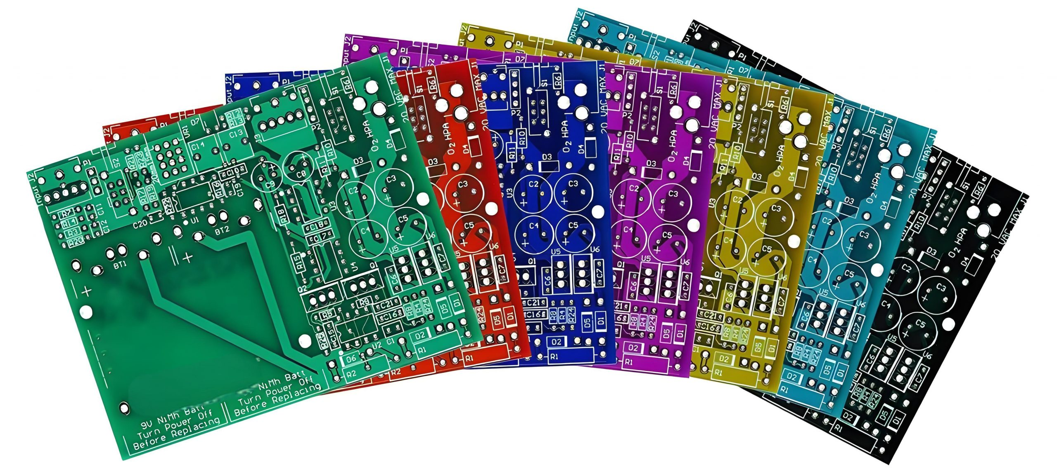
Solder mask colors
Usually green
Also: blue, black
Less common: red, white, yellow, purple, etc.

Slide 13
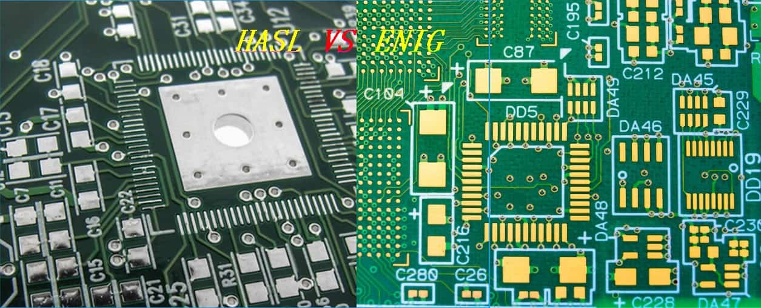
Copper finish colors
Copper is coated to look silver or gold

Slide 14
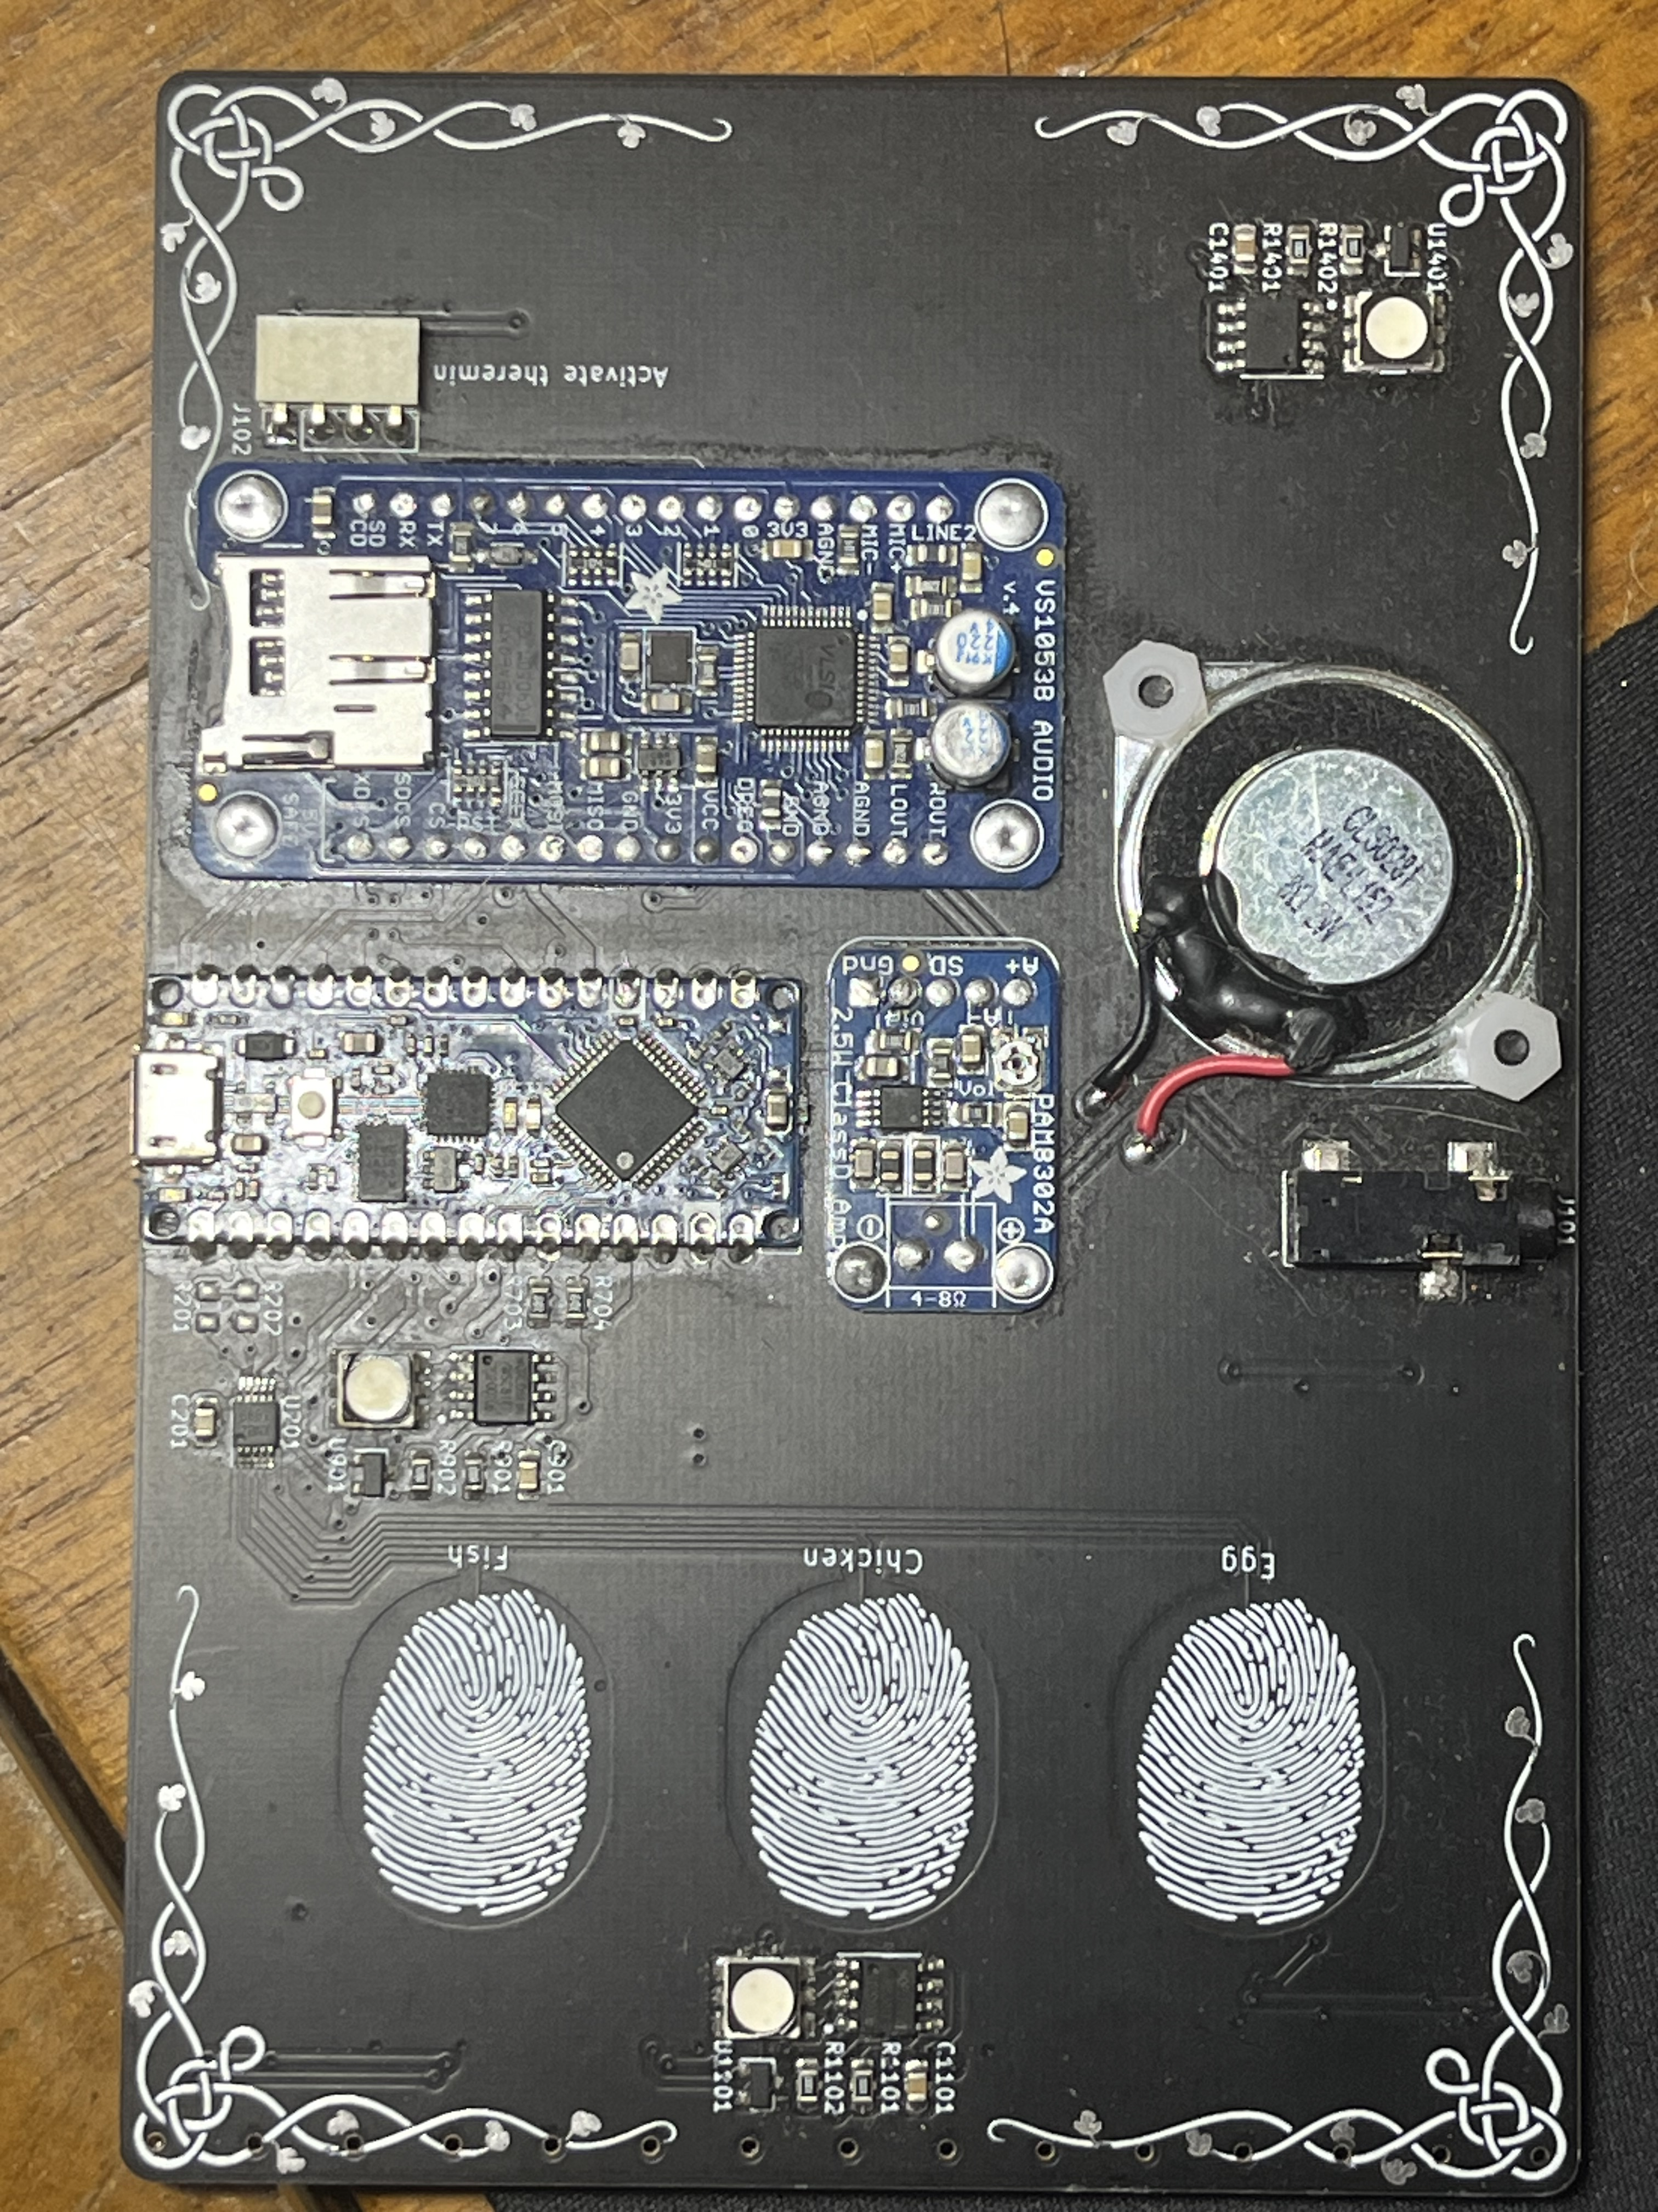
Silkscreen is white
Used for labeling components
Also used for text and graphics

Slide 15
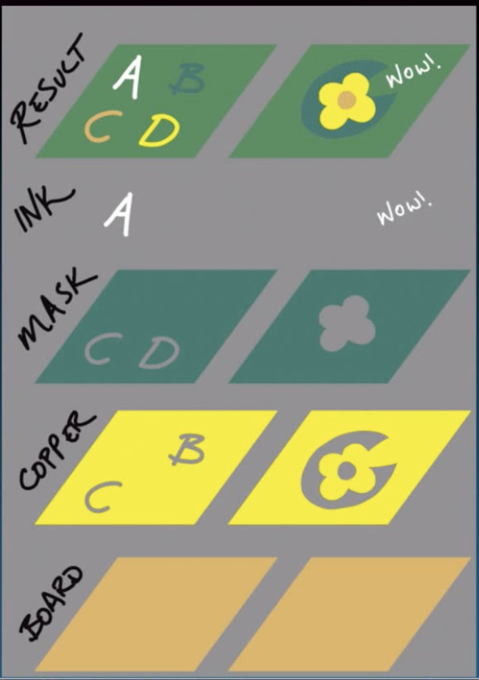
All layers together
Note, F.Mask drawing layers are inverted

Slide 16
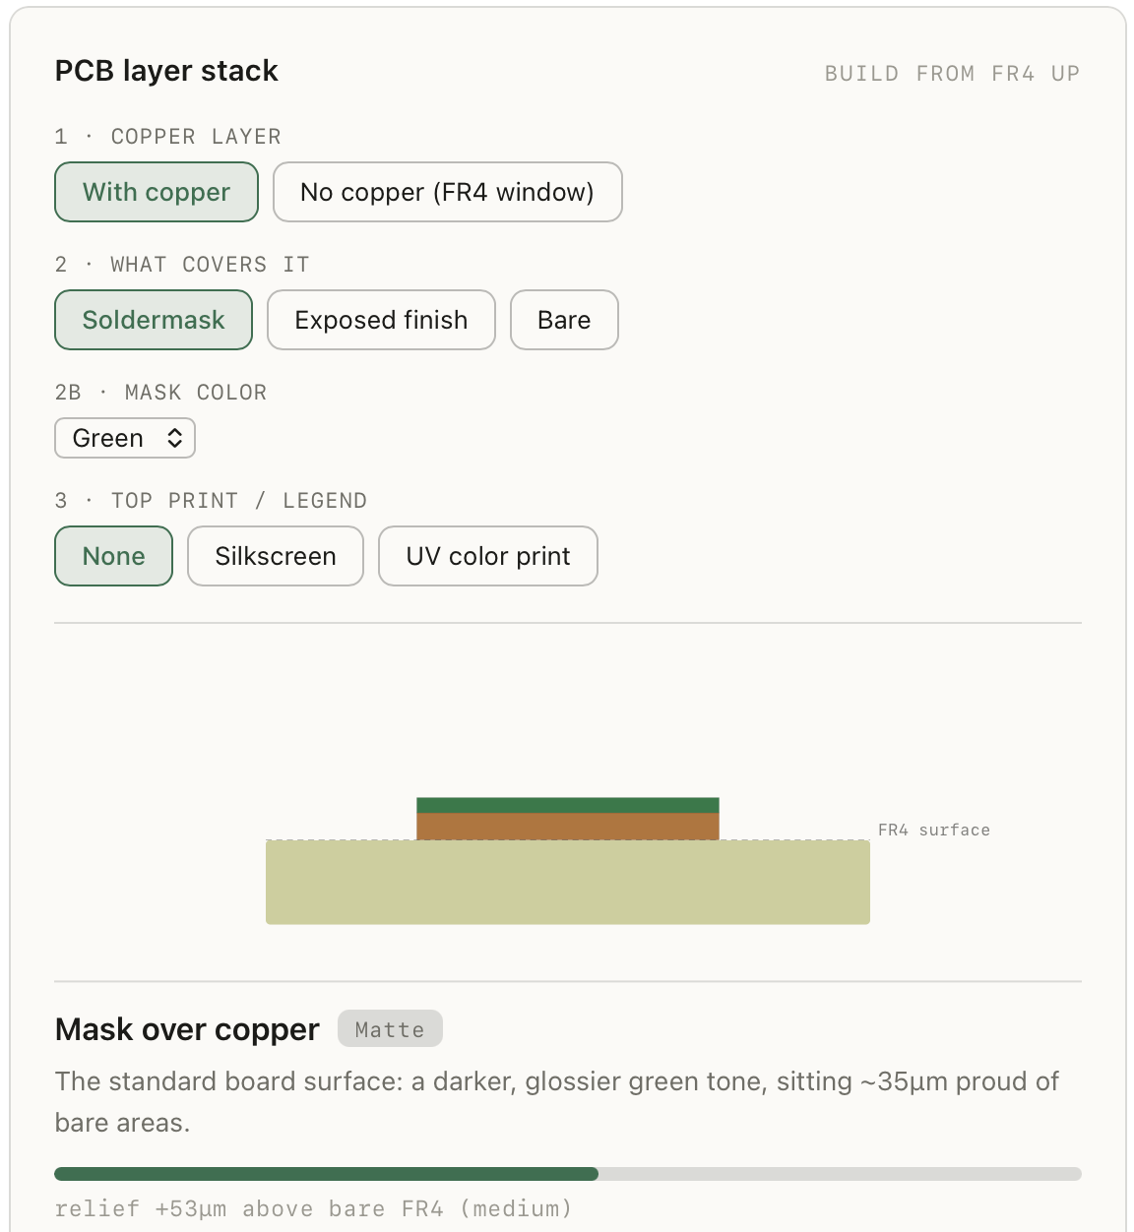

Layer cross section visualizer
https://www.kayzeng.com/pcb

Slide 17
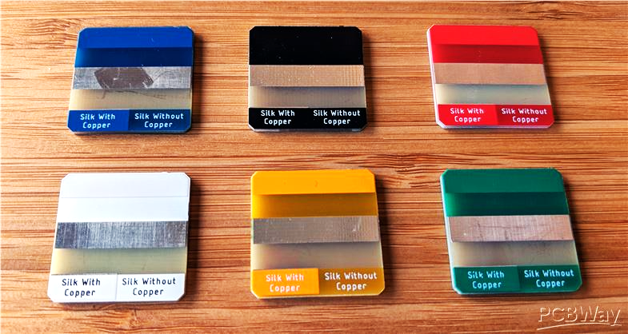
Swatches for reference
Each board has 1 soldermask color (green, blue, black, etc.) and 1 copper finish (silver or gold)
Each board has 6 valid layer combinations (soldermask+copper, soldermask, copper, fiberglass, silkscreen+copper, silkscreen)
Silkscreen is black when using white soldermask

Slide 18
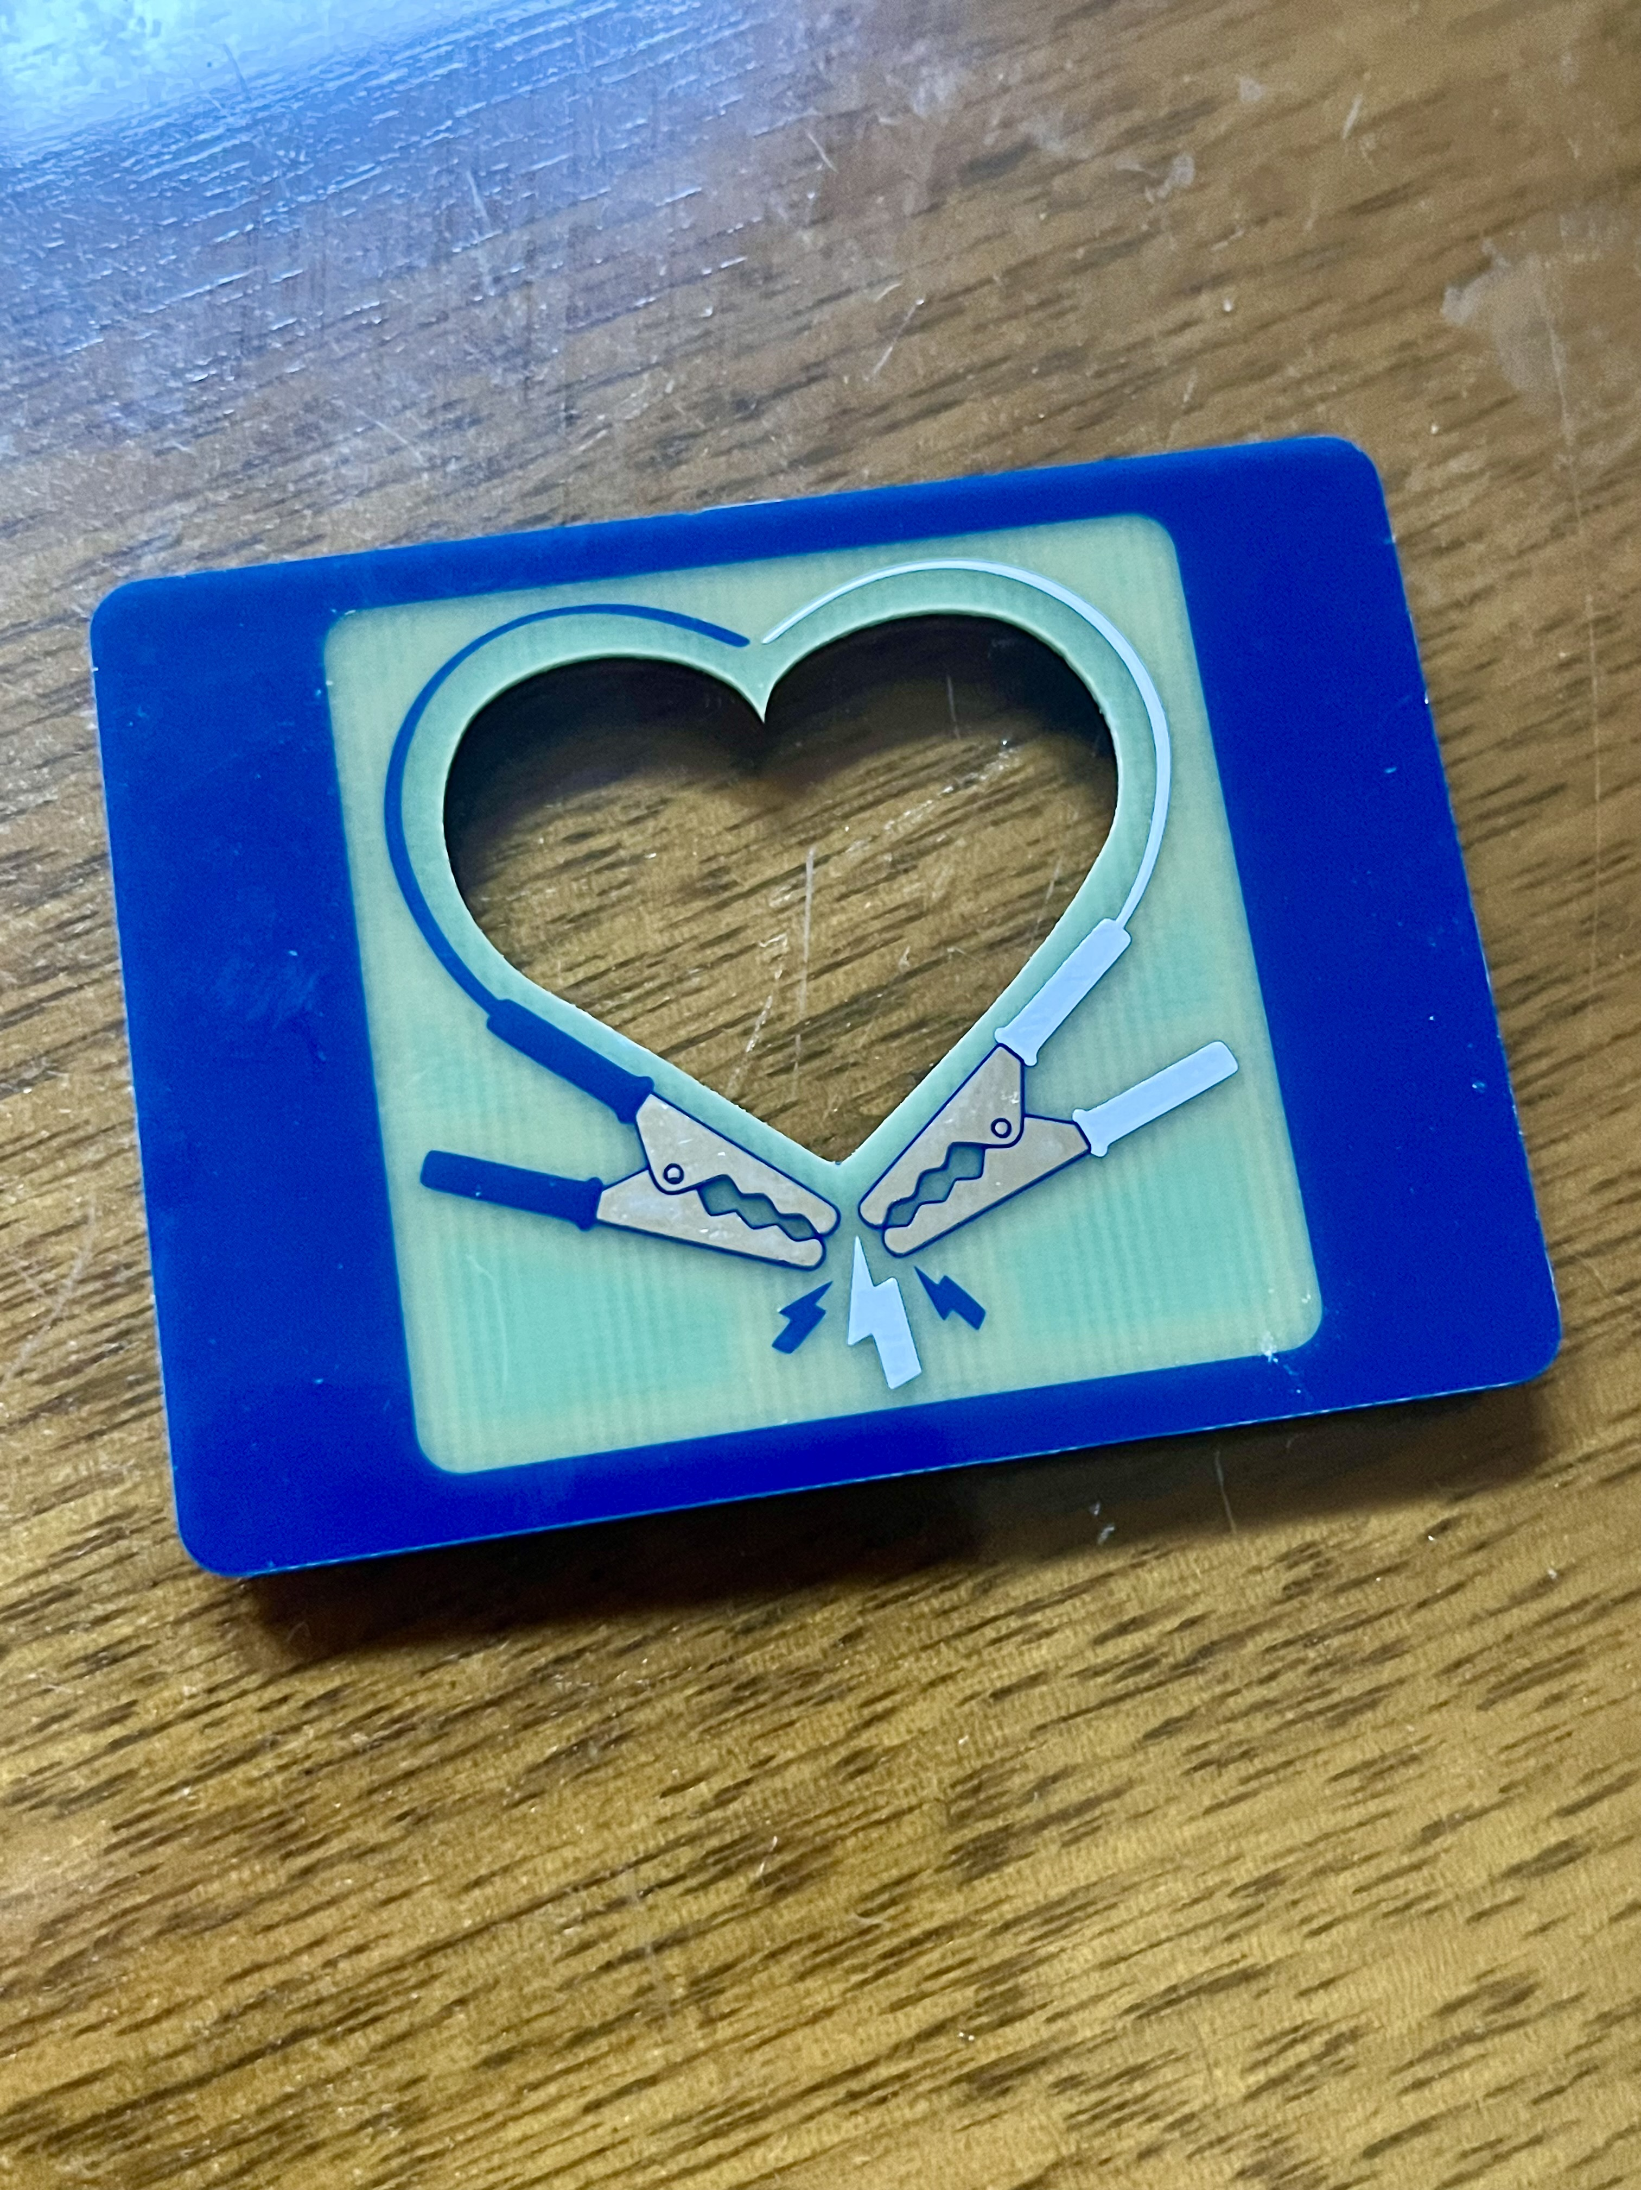
Cutouts
Edge.Cuts is like an extra design layer
Use paths with outline strokes instead of filled paths
Right: heart + bottle opener

Slide 19
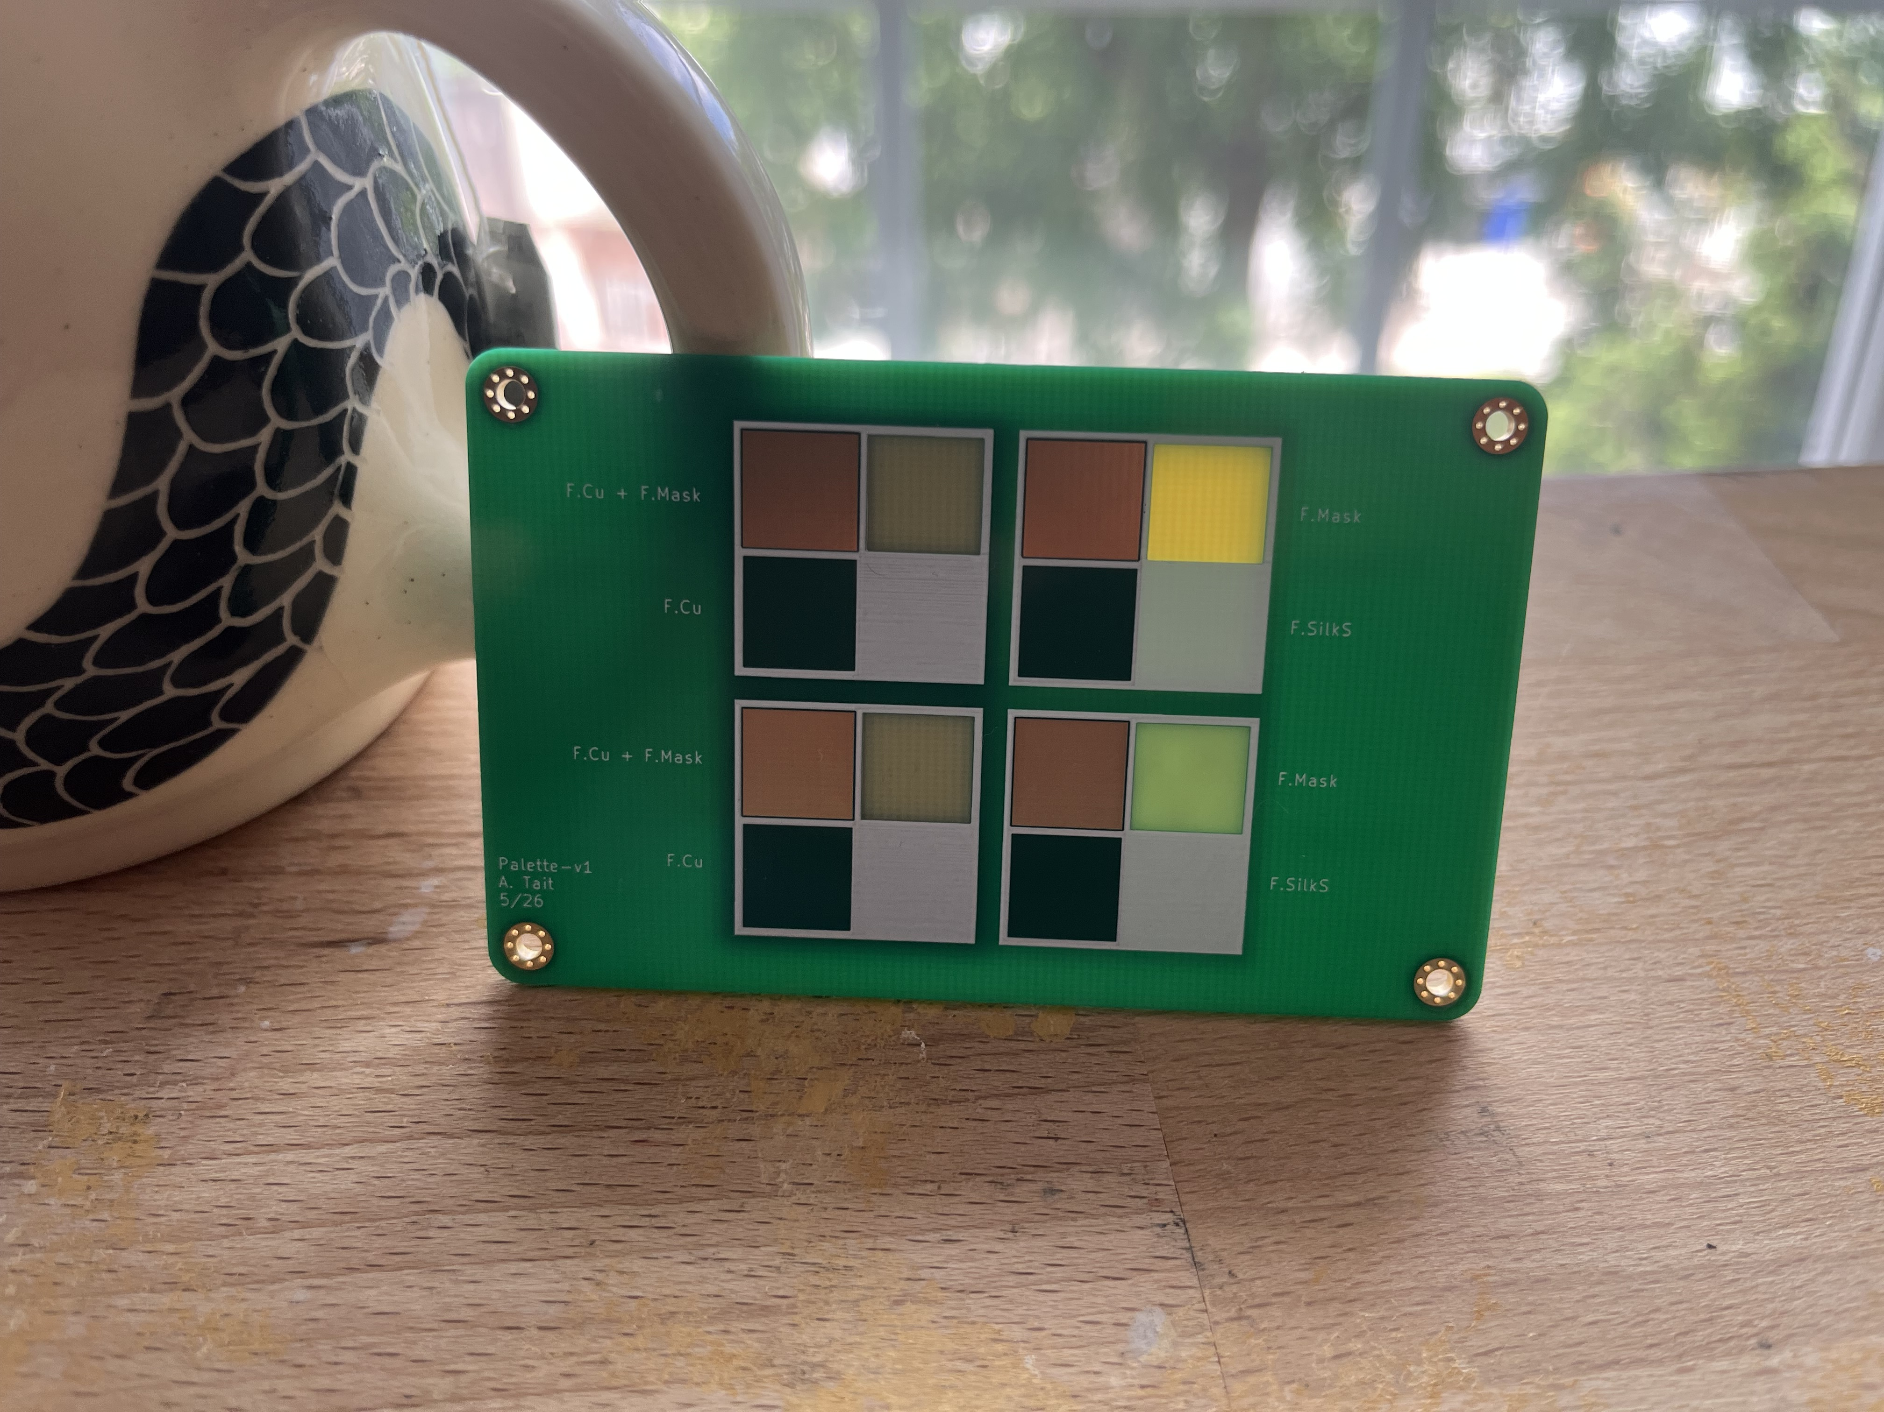
Translucency effects
You can use soldermask and copper on the back side to create different translucencies
  Single-layer: 6 design colors
  W/ translucency: effectively 8 design colors
Swatch
Fiberglass with copper backing
Fiberglass with bare back
Fiberglass with soldermask, no copper

Slide 20
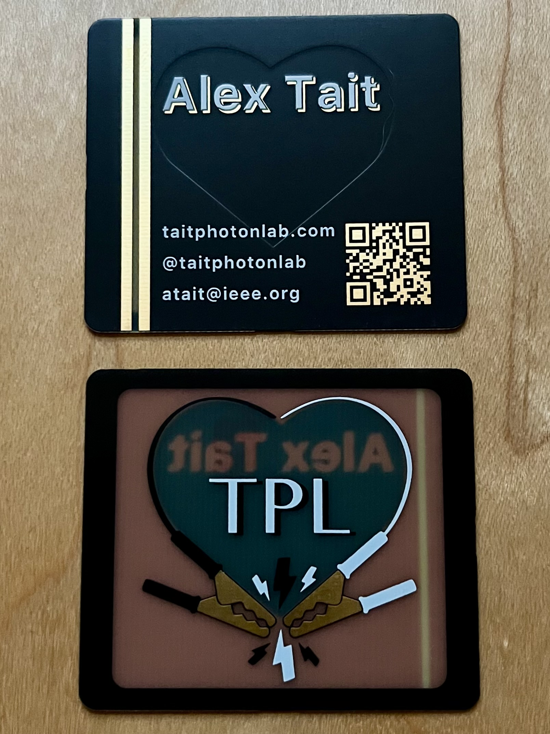
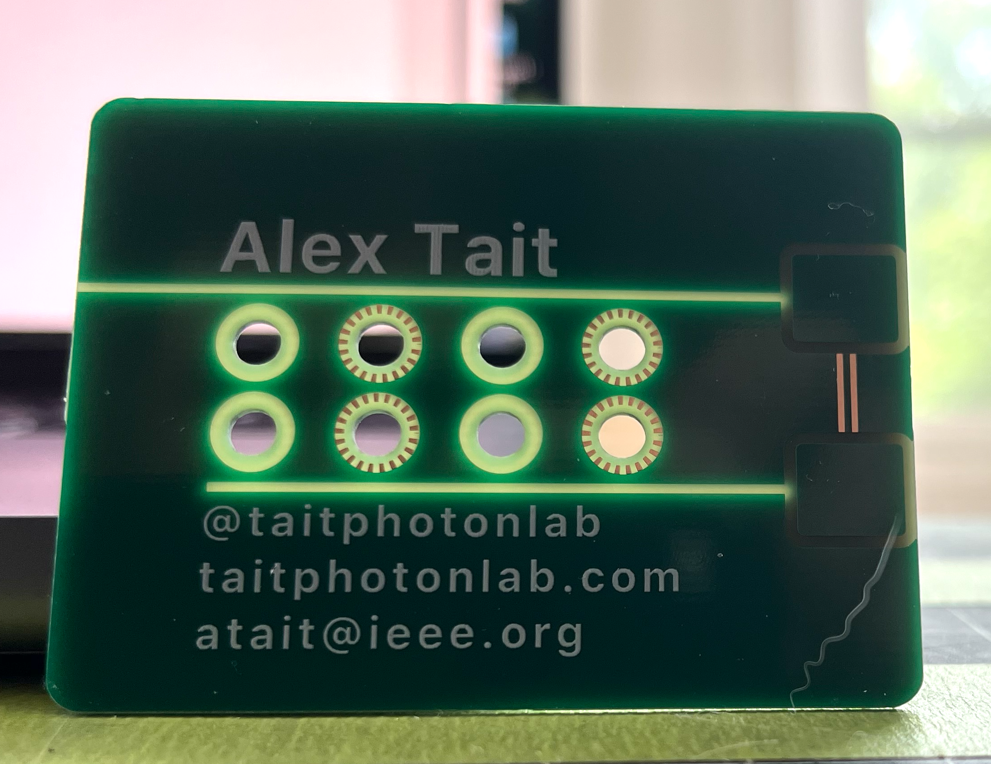
Translucency ideas

Slide 21
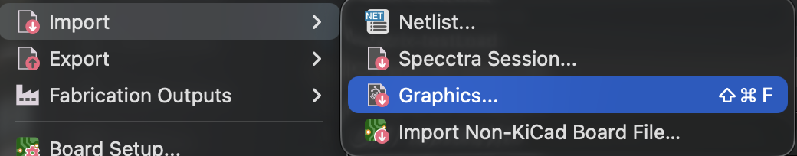
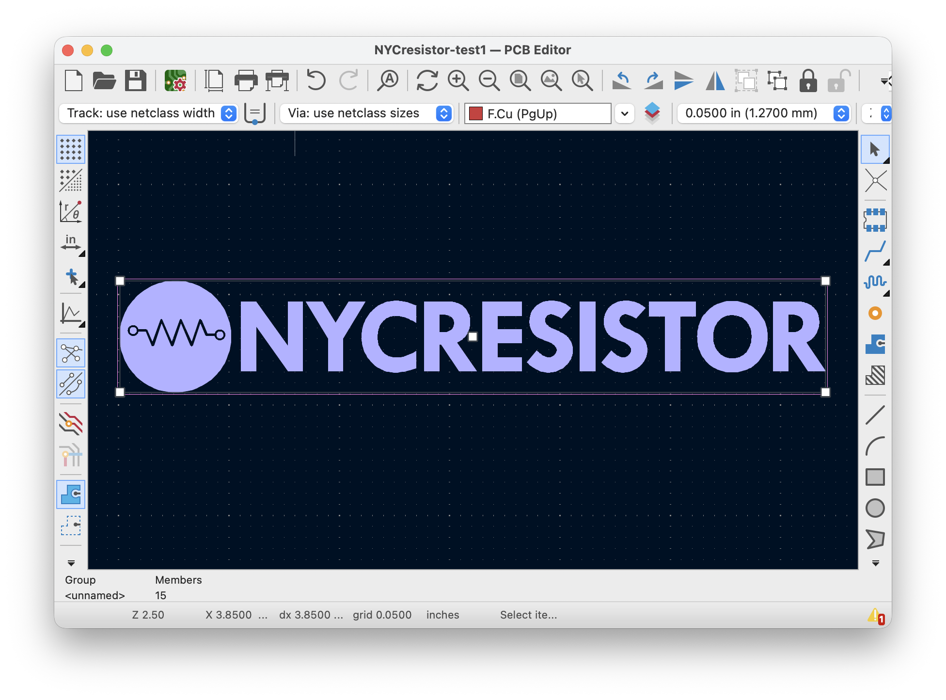
Asynchronous: Workflow 1: single-layer import into CAD
Start: NYCR-logo-phase-1.svg
End: NYCresistor-card-example1.kicad_pcb
Follow the instructions in README.md
Do the example first, then try your own
Try importing multiple copies onto different layers

Slide 22
Vector graphics concepts

Slide 23
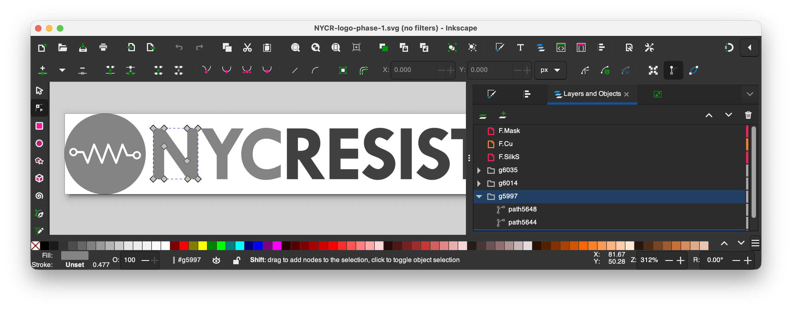
Paths and nodes
Each path is a closed shape
They are defined by anchor nodes
Anchor points

Slide 24
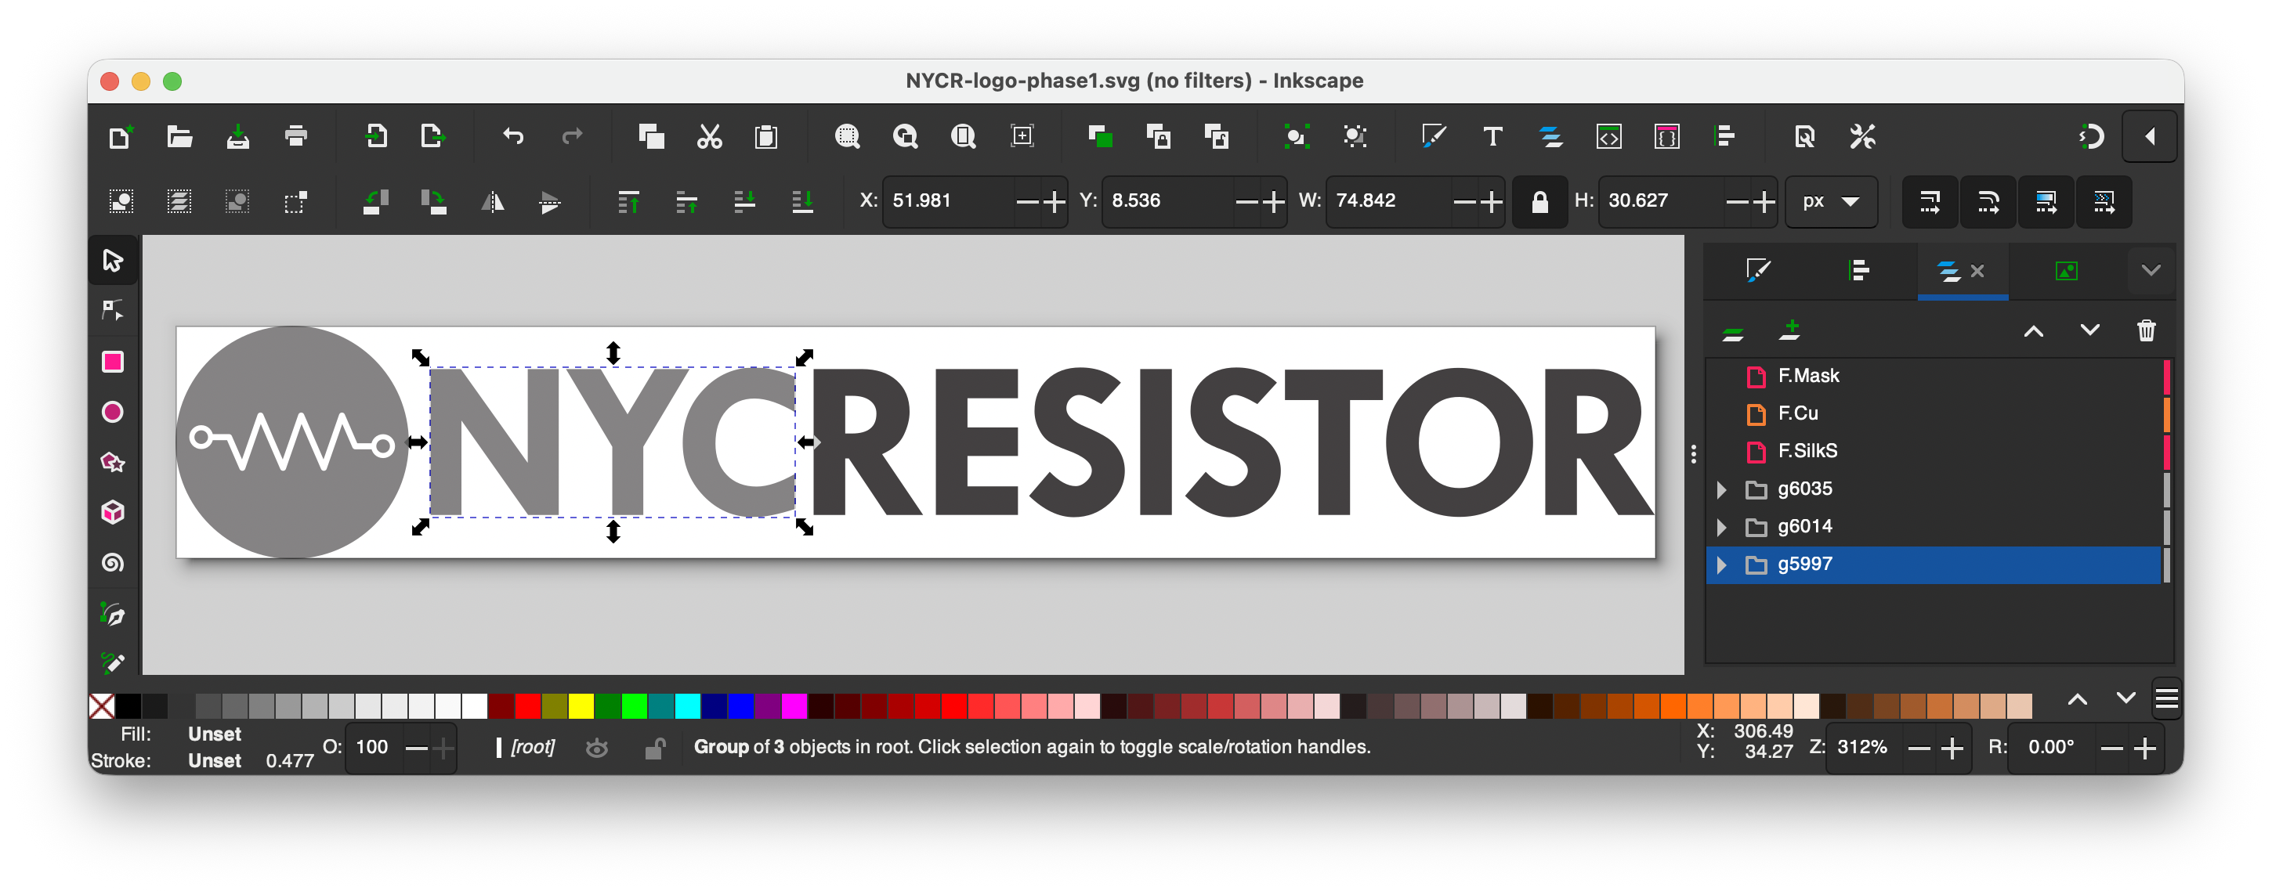
Grouping
A group is a set of multiple paths that move together

Slide 25
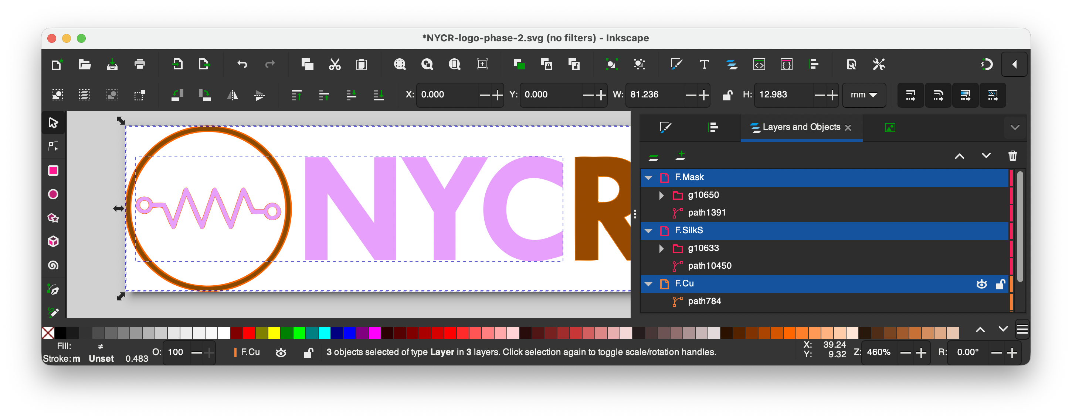
Layers in SVG
A layer is also a set of multiple paths, but different from a group
Layers typically don’t move together
Layers give control over
  Naming
  Hiding/Showing
  Ordering (what shows in front)
  Communicating with Kicad

Slide 26
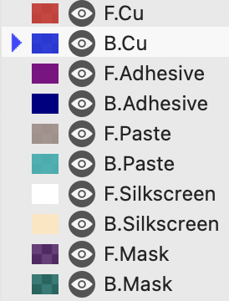
SVG Layers for PCB design
SVG layers correspond to PCB CAD layers
F.x (front) B.x (back)
x.Cu = copper
So F.Cu = front copper
x.Mask layers are inverted
  Shapes on Mask layers will be openings in the solder mask

Slide 27
Editing vector graphics

Slide 28
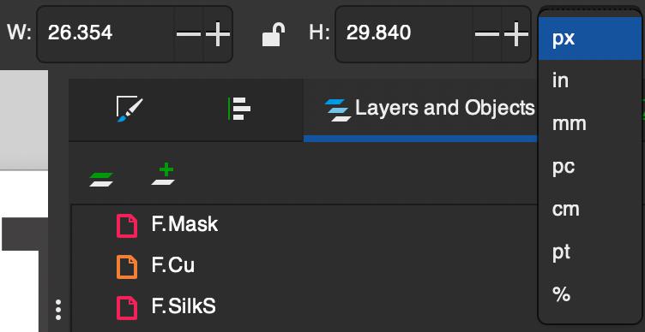
Scale operations
Make things the right size
Two techniques
  Click and drag
  Enter scale numbers
Usually you want to lock the aspect ratio
  Hold Ctrl while dragging
  or click the lock button
Turn on to lock aspect ratio
Real units
Relative units

Slide 29
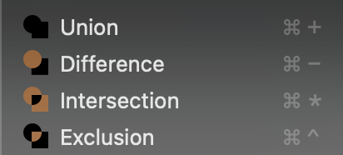
Boolean operations
Boolean is a term from logic, something True or False...
  In digital electronics: True = 5 Volts, False = 0 Volts
Operation: two things in, one thing out
  A + B = C
  A x B = D
In vector graphics: inputs and outputs are shapes
  True = inside, False = outside
A
+
C
B
+
x

Slide 30
Boolean operations
Shape A
Shape B
Point 1
Point 2
Intersection (a.k.a. AND):
”Point 2 is inside shape A and inside shape B, so Point 2 is inside the output shape”
Repeat this logic for every point
Union (a.k.a. OR):
”Point 2 is inside shape A or inside shape B, so Point 2 is inside the output shape”

Slide 31
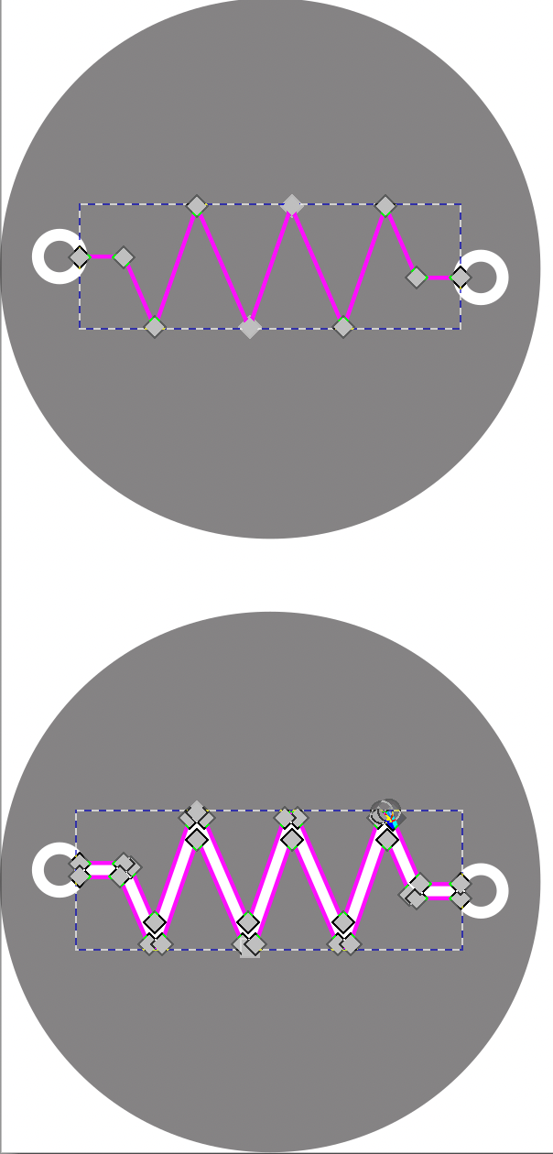
Stroke to path
Input: path with a line thickness
Output: filled path
All graphics need to be filled paths for
  Boolean operations
  PCB areas
What do we need to do to process “NYCR-logo-phase-0-downloaded.svg”?

Slide 32
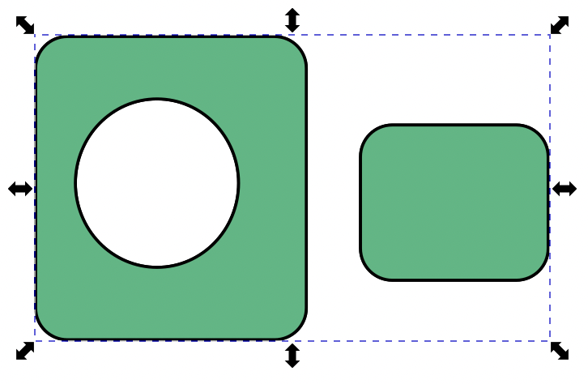
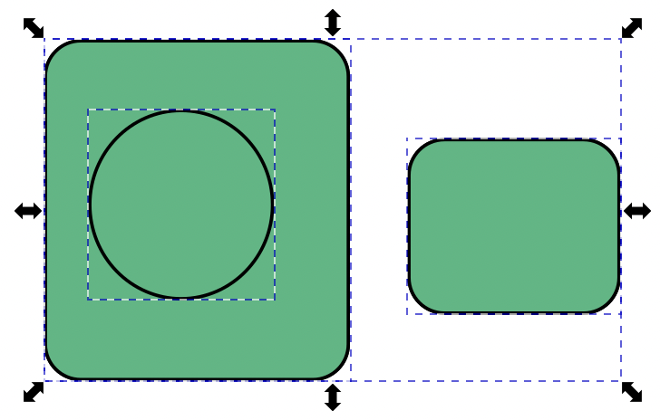
Decompose/combine paths
Paths can have multiple separate shapes and holes
Simple path is one shape with no holes
Decompose paths with Shift-Cmd-K, Recompose with Cmd-K
This is useful if you want to get the outline of a path that contains holes
This is one compound path
This is three simple paths

Slide 33

Inset/outset operations
Outset = Expand the shape outwards
This is useful for generating outlines and overlaps
Stroke to path = outset, then subtract inside to get outline
Scale
Outset
Stroke to path

Slide 34
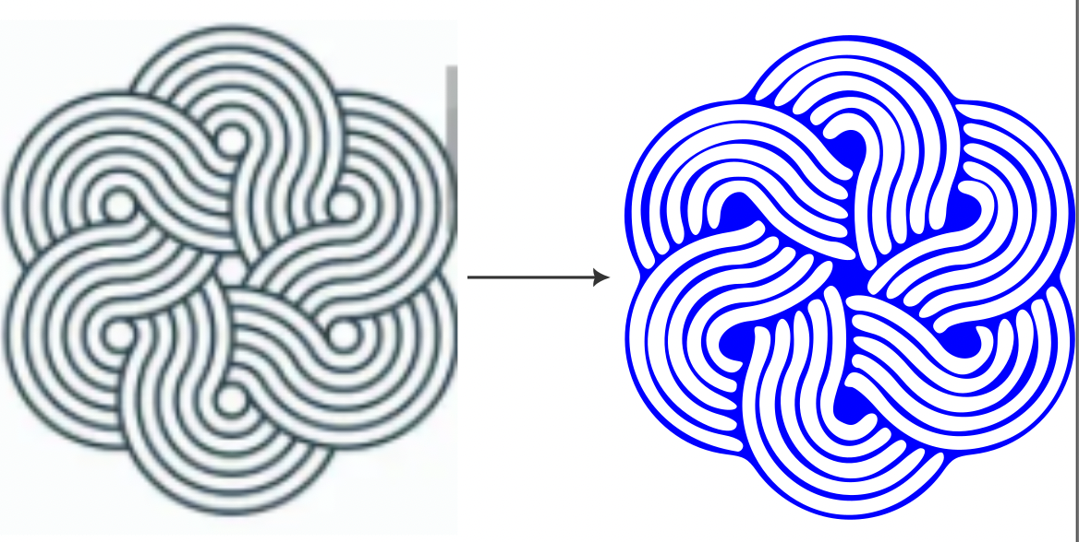
Trace bitmap
Converts raster to vector path
Based on brightness threshold
Not a perfect representation!
  Usually, you have to fine-tune nodes after converting

Slide 35

Tip: QR codes
Many free generators are available
  https://www.qr-code-generator.com
Uncheck “scan tracking”
Download SVG, PNG, or JPG or take a screenshot
Drag-and-drop into Inkscape
Use Trace Bitmap if you used a raster format

Slide 36
Recap: vector graphics editing
Concepts
  Paths
  Nodes
  Groups
  Layers
Path operations
  Scale
  Boolean (AND, OR, XOR)
  Inset/outset
  Stroke to path
  Break/combine

Slide 37
Asynchronous: Workflow 2:
SVG editing
Start: NYCR-logo-phase-0.svg
Milestone: NYCR-logo-phase-1.svg
End: NYCR-logo-phase-2.svg
Follow the instructions in README.md
Do the example first, then try your own

Slide 38
Computer aided layout design

Slide 39

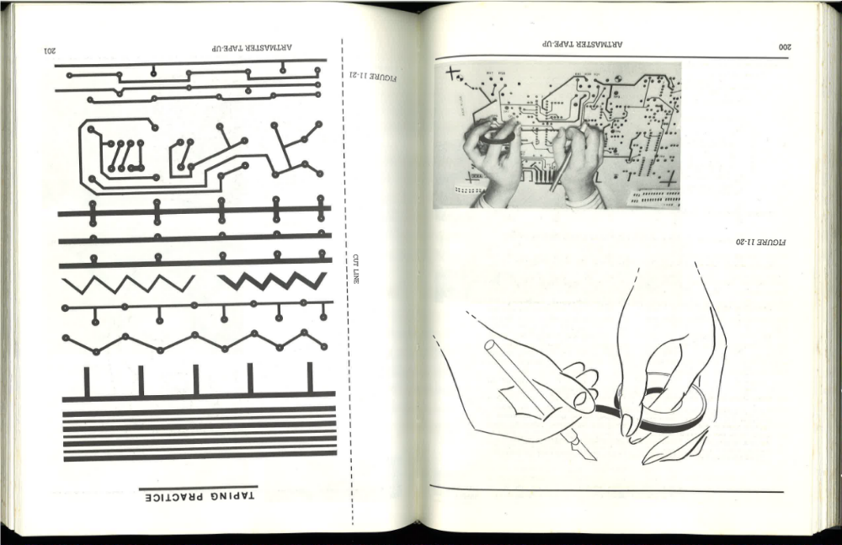
Old fashioned style

Slide 40
Rubylith period

Slide 41
Computer aided design (CAD)
Mainframe CAD system
IBM, Fairchild, 1967
Calma Dimension III
Calma Inc., 1985

Slide 42
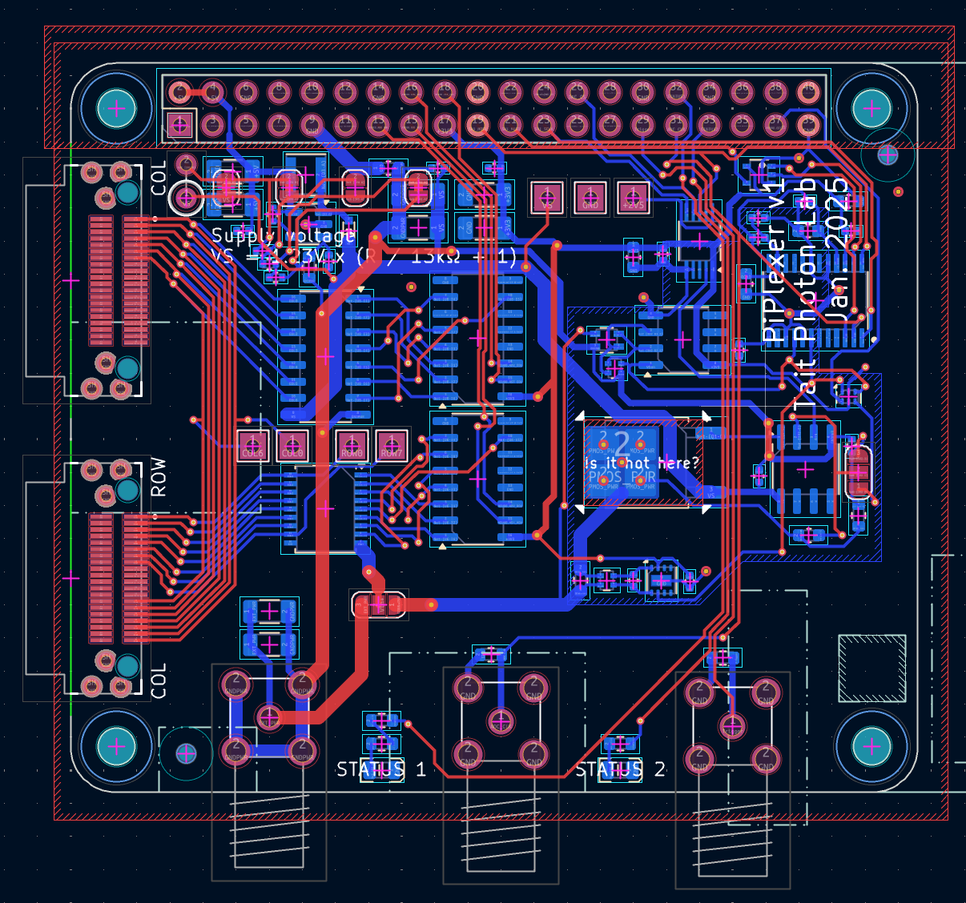
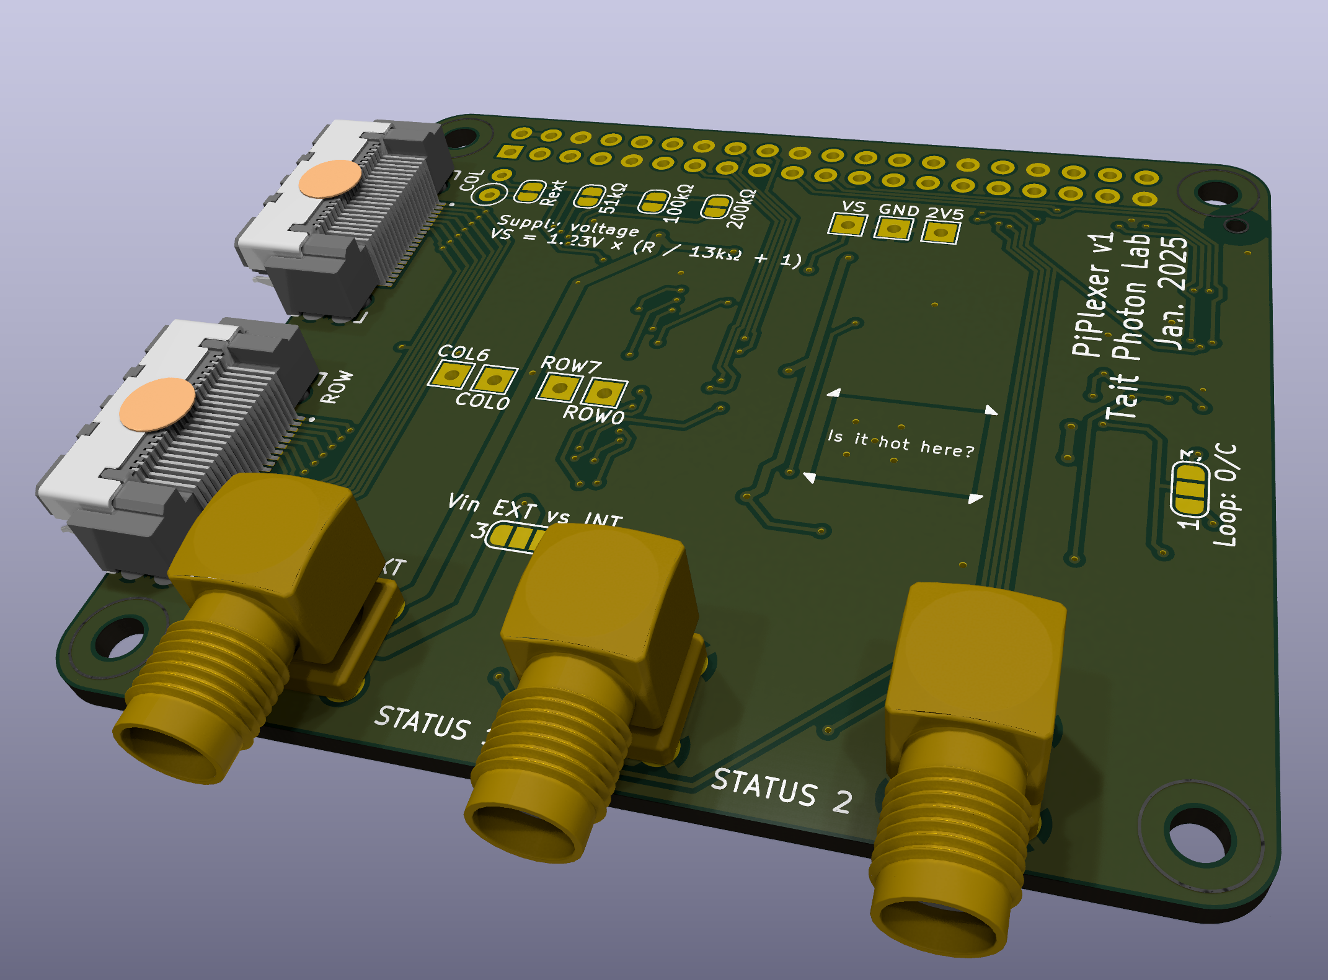


Modern computer aided design (CAD)
Modern circuit + layout design
Commercial: Altium
Open-source: Kicad

Slide 43
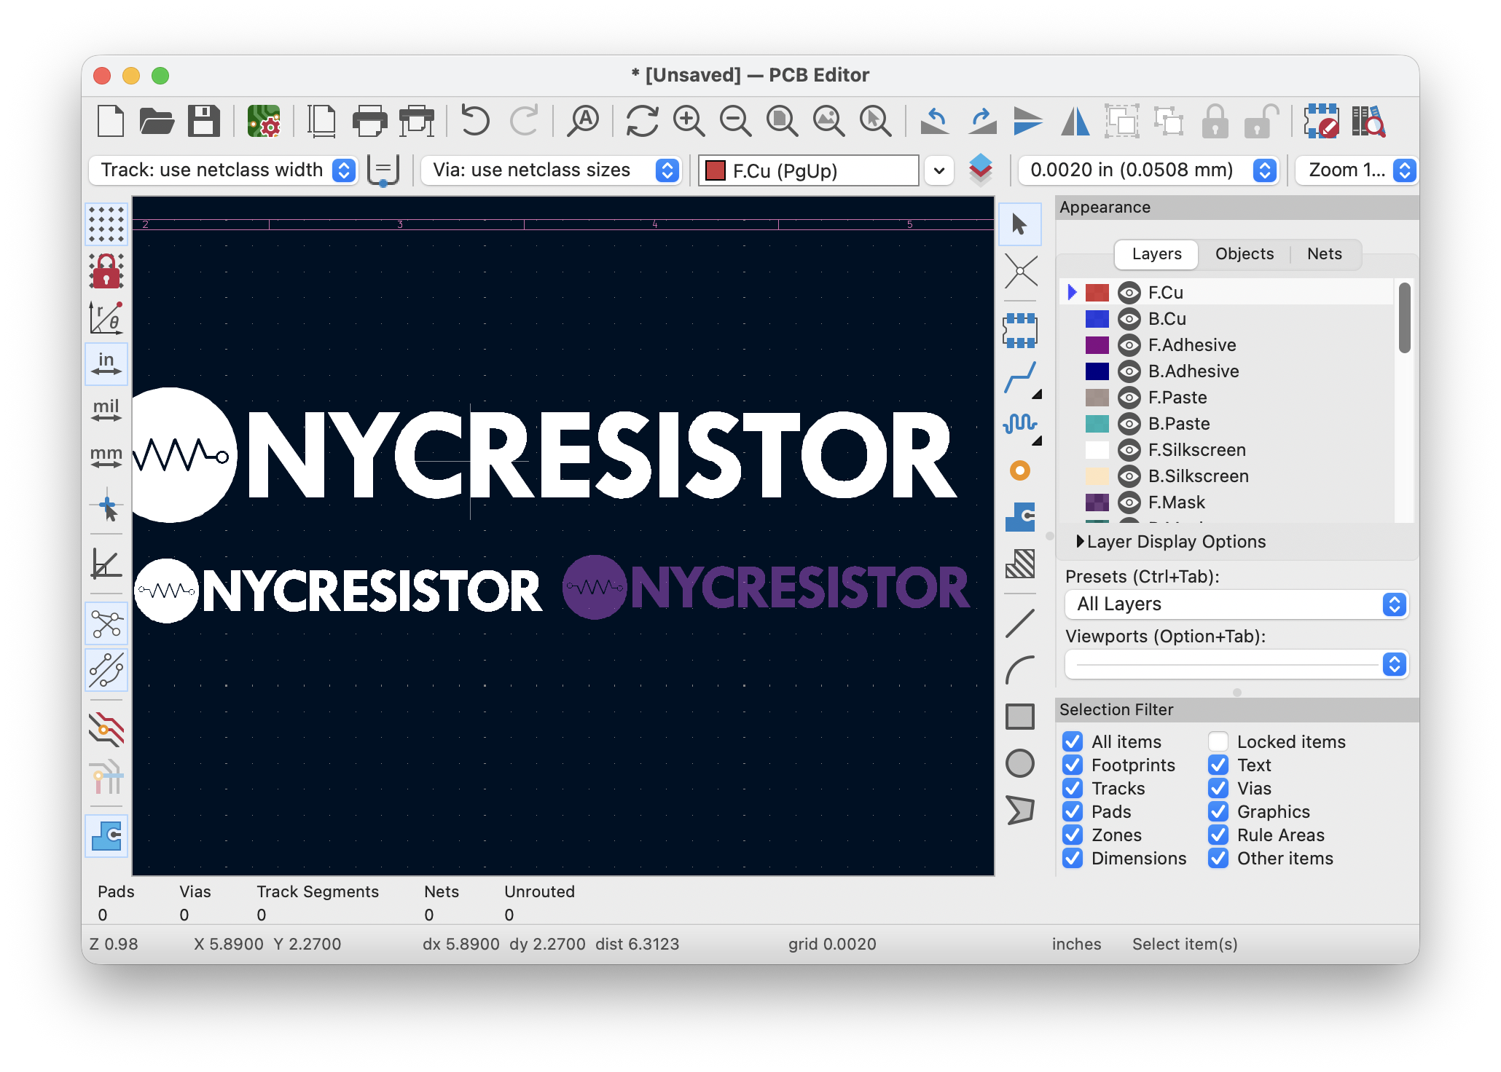
The pcbnew application
Grid controls (N)
Layer browser
Unit selector

Slide 44
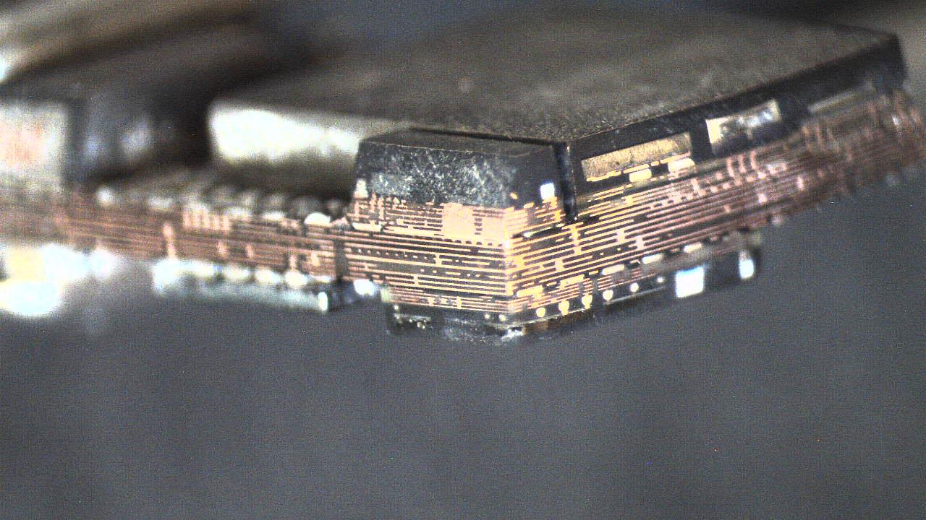
What does CAD enable
These CAD layout programs have revolutionized all of our electronic chips and boards,
They allow for more complex circuitry per square mm
iPhone dissected in 2019 (c) Alex Tait

Slide 45

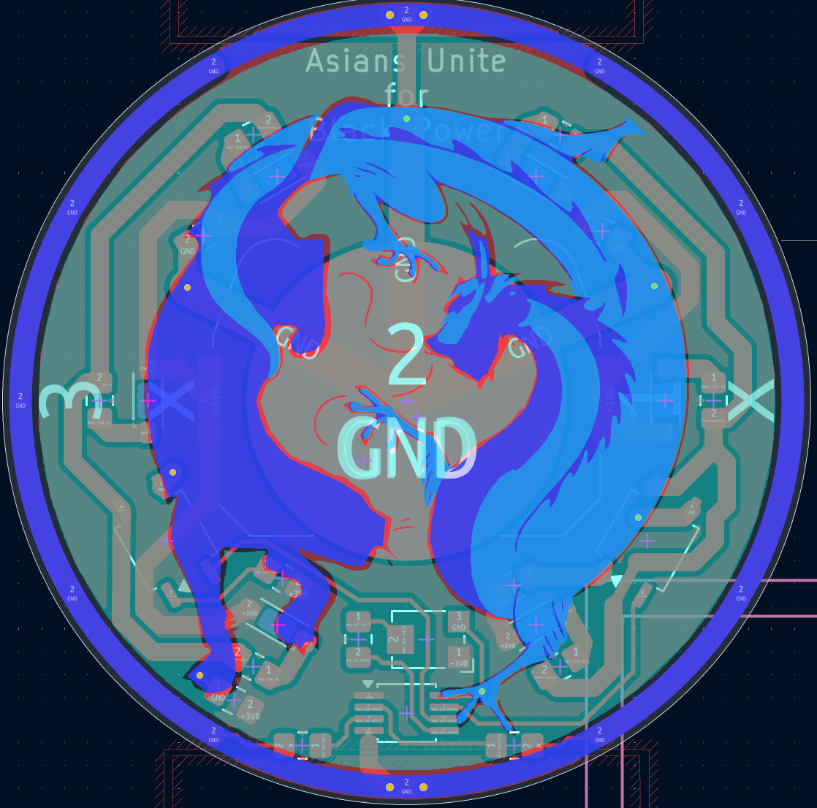
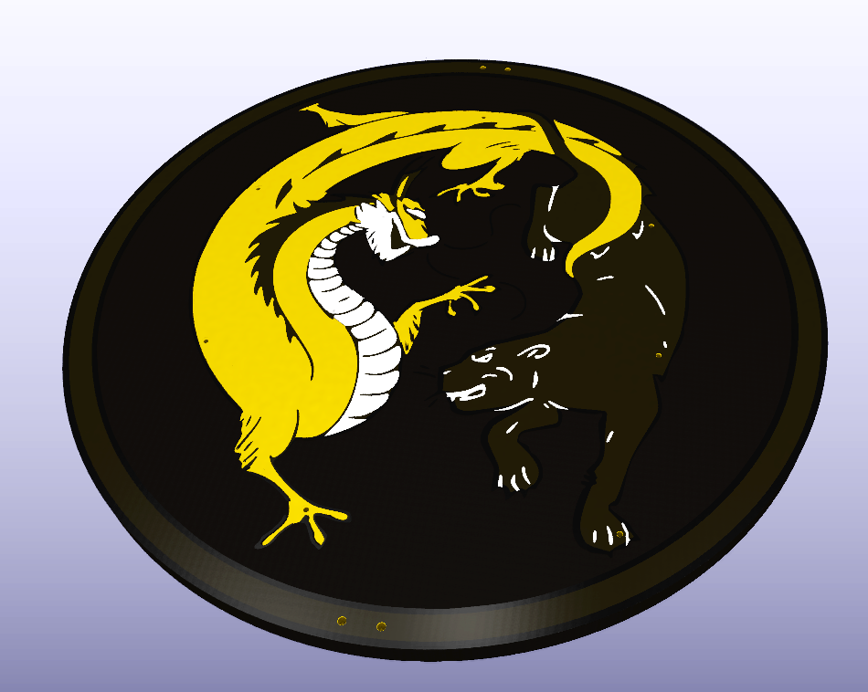
Converting multi-layer graphics

Slide 46
SVG Layers for PCB design
SVG layers correspond to PCB CAD layers
F.x (front) B.x (back)
x.Cu = copper
So F.Cu = front copper
Tips
  Shapes on Mask layers will be openings in the solder mask
  Inkscape “SilkS”, not “Silkscreen”
From Kicad
From Inkscape

Slide 47
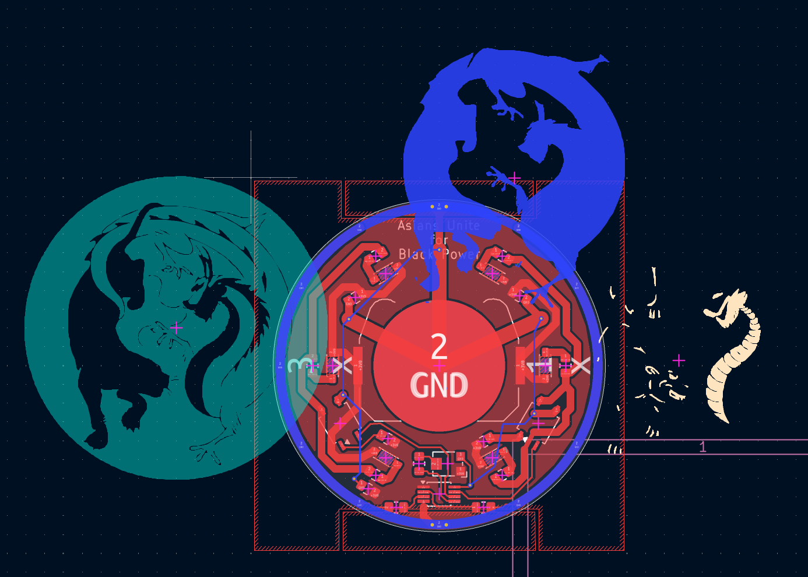
Conversion step (old way)
A group of files, each one with one Inkscape layer
Import each file to a different Kicad layer
Align the shapes on different layers

Slide 48
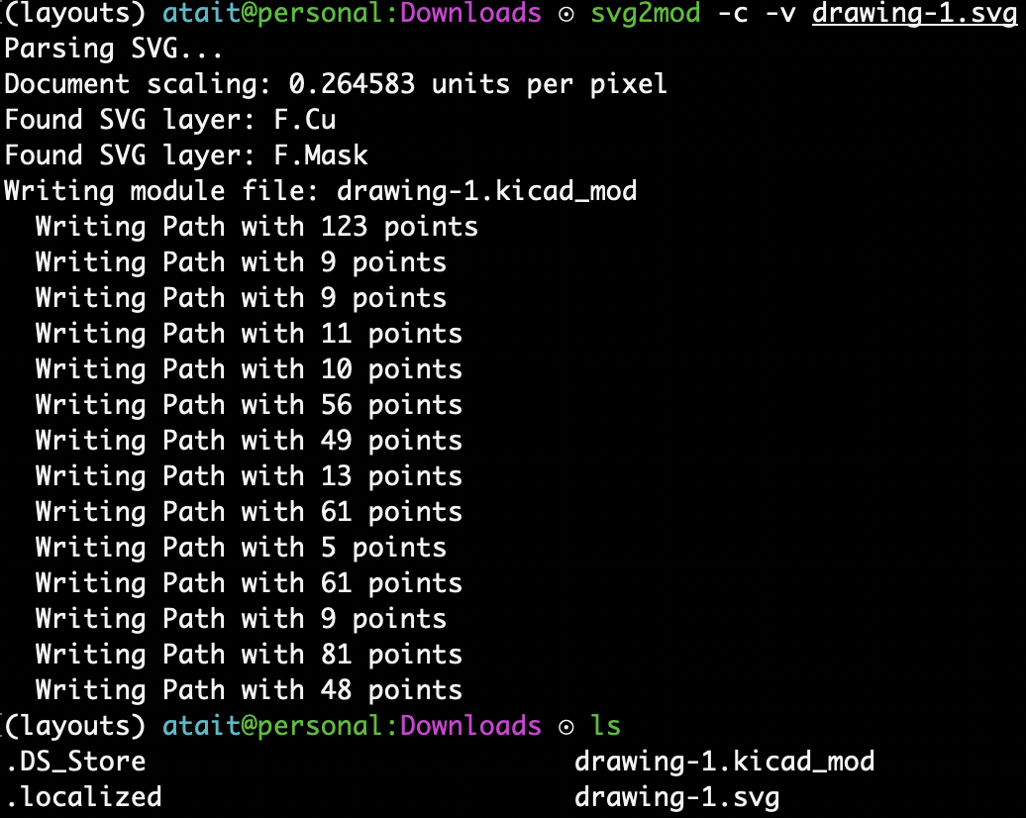
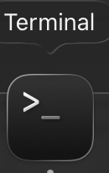
Conversion step (recent way)
Use a terminal
Configure a python environment
Install svg2mod through pip
Use –h option for help
...Figure out the rest

Slide 49
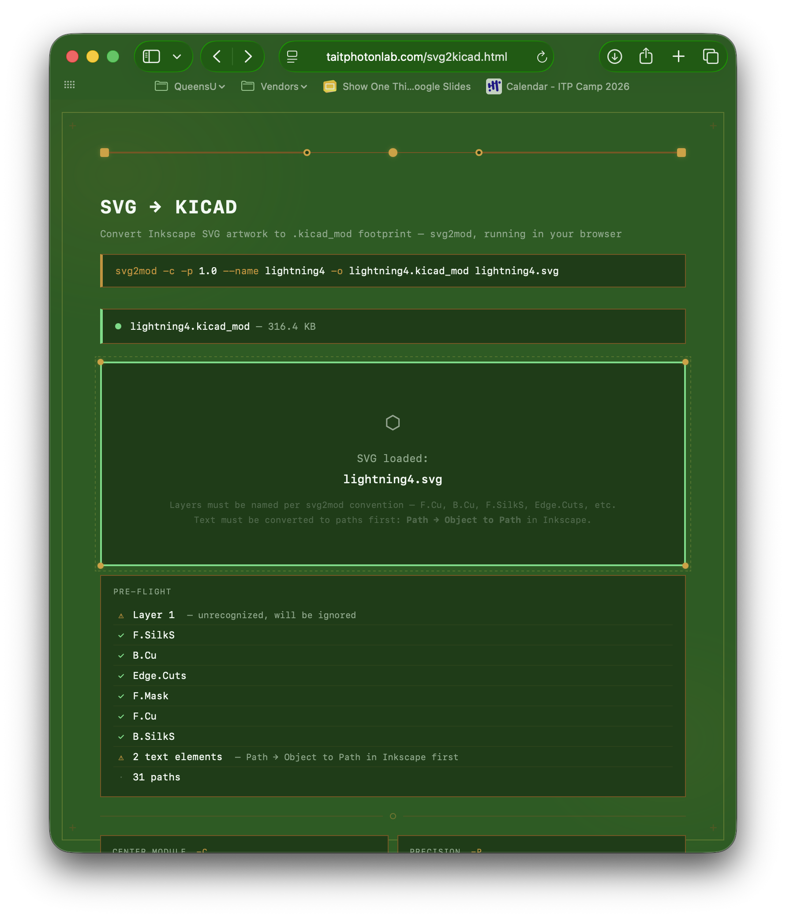

Conversion step (new way)
taitphotonlab.com/apps/svg2kicad.html
Skip the terminal. This runs it for you.
Files don’t leave your computer (Pyodide runtime)

Slide 50
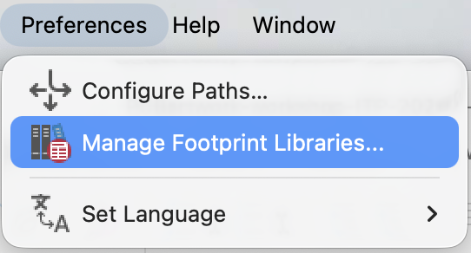
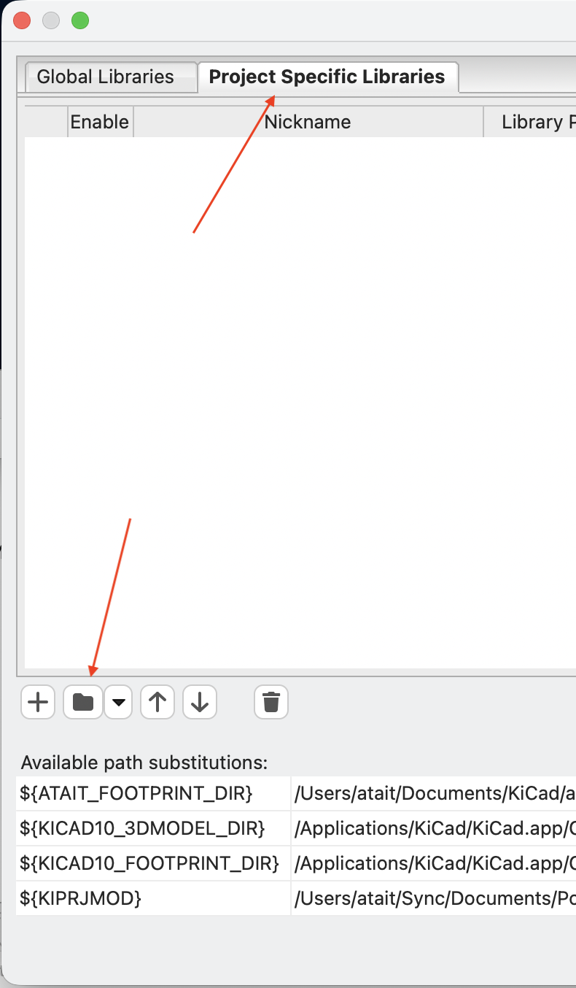
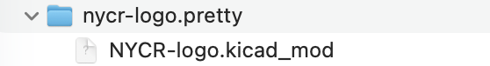
Footprint libraries
Pcbnew layouts contain references to footprints
We need to tell it where to find the files
  Make it project specific
  Use a relative path (automatic)
Our files are
  Library nycr-logo.pretty/
  Footprint NYCR-logo.kicad_mod

Slide 51
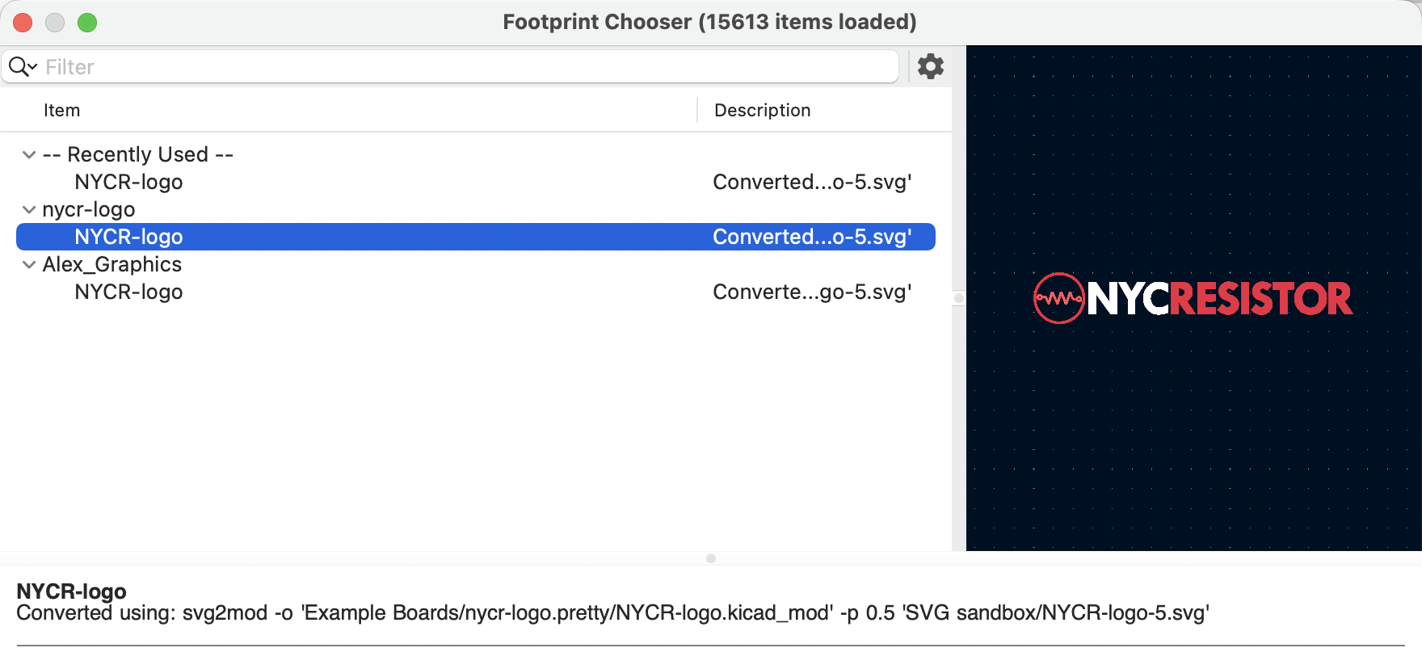
Placing the footprint
Quit and reopen pcbnew
Press “A” (add footprint)
It should show up like this in the newly added library

Slide 52
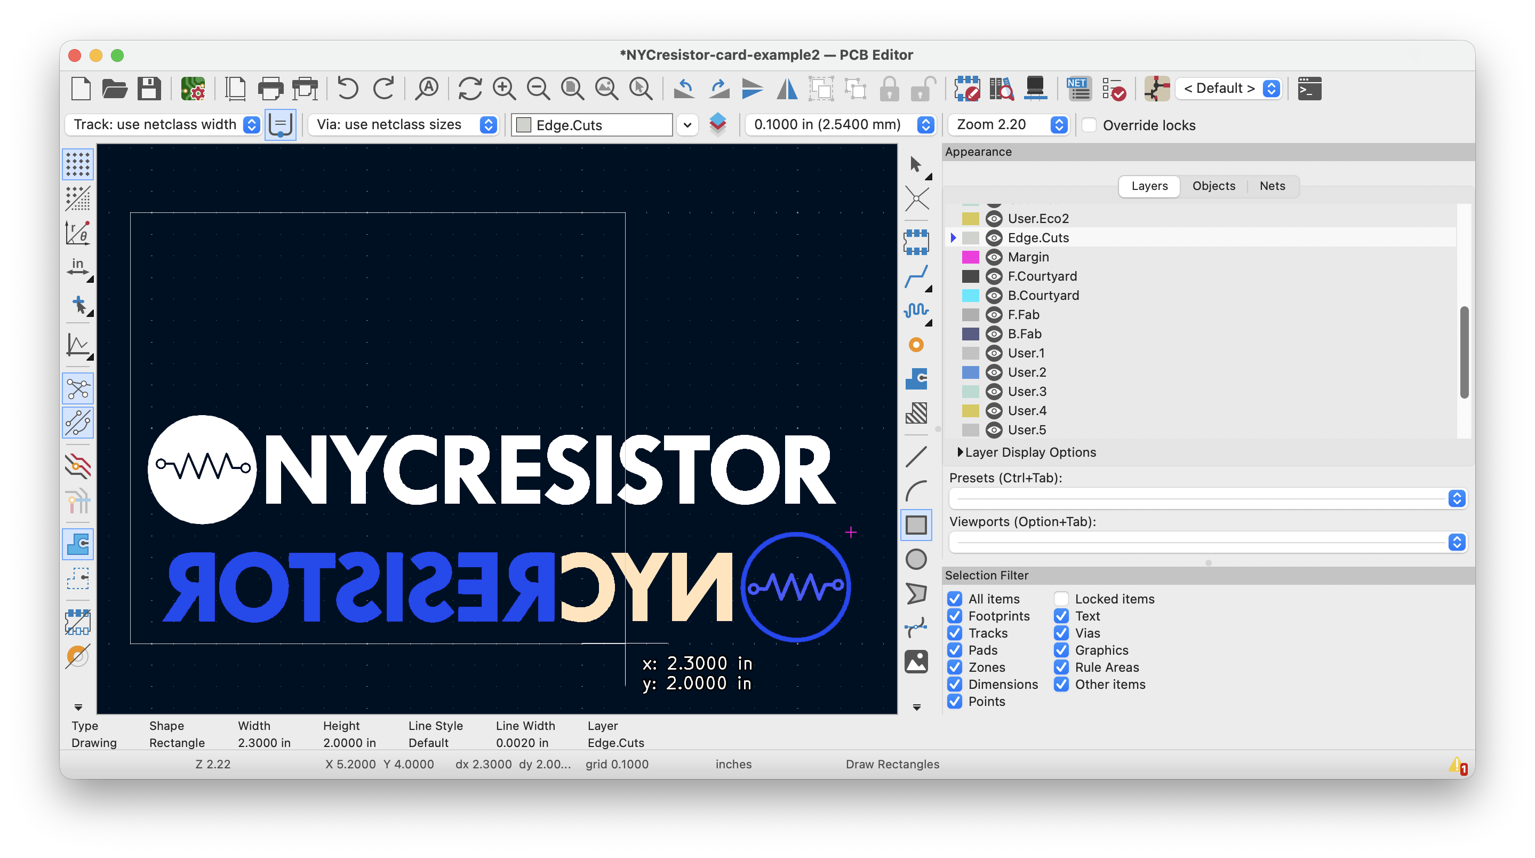

Drawing the outline
Select layer Edge.Cuts
Click the square tool
Click on the corners
Resize in the properties dialog (“E”)
Right-click > Shape Modification > Fillet Lines...

Slide 53
Iteration workflow
To iterate means going from start (SVG file) to finish (3D view), then revising
Iterate often, before perfecting
Our iteration cycle step-by-step:
  Make changes in Inkscape
  Save the SVG file
  Run svg2mod (taitphotonlab.com/apps/svg2kicad.html)
  Move file into “.pretty” folder
  Quit and reopen `pcbnew.app`
  Add component (hotkey: `A`)
  Find your component
  3D view (hotkey: `Opt-3`)
  Review the 3D model and make further adjustments in Inkscape

Slide 54
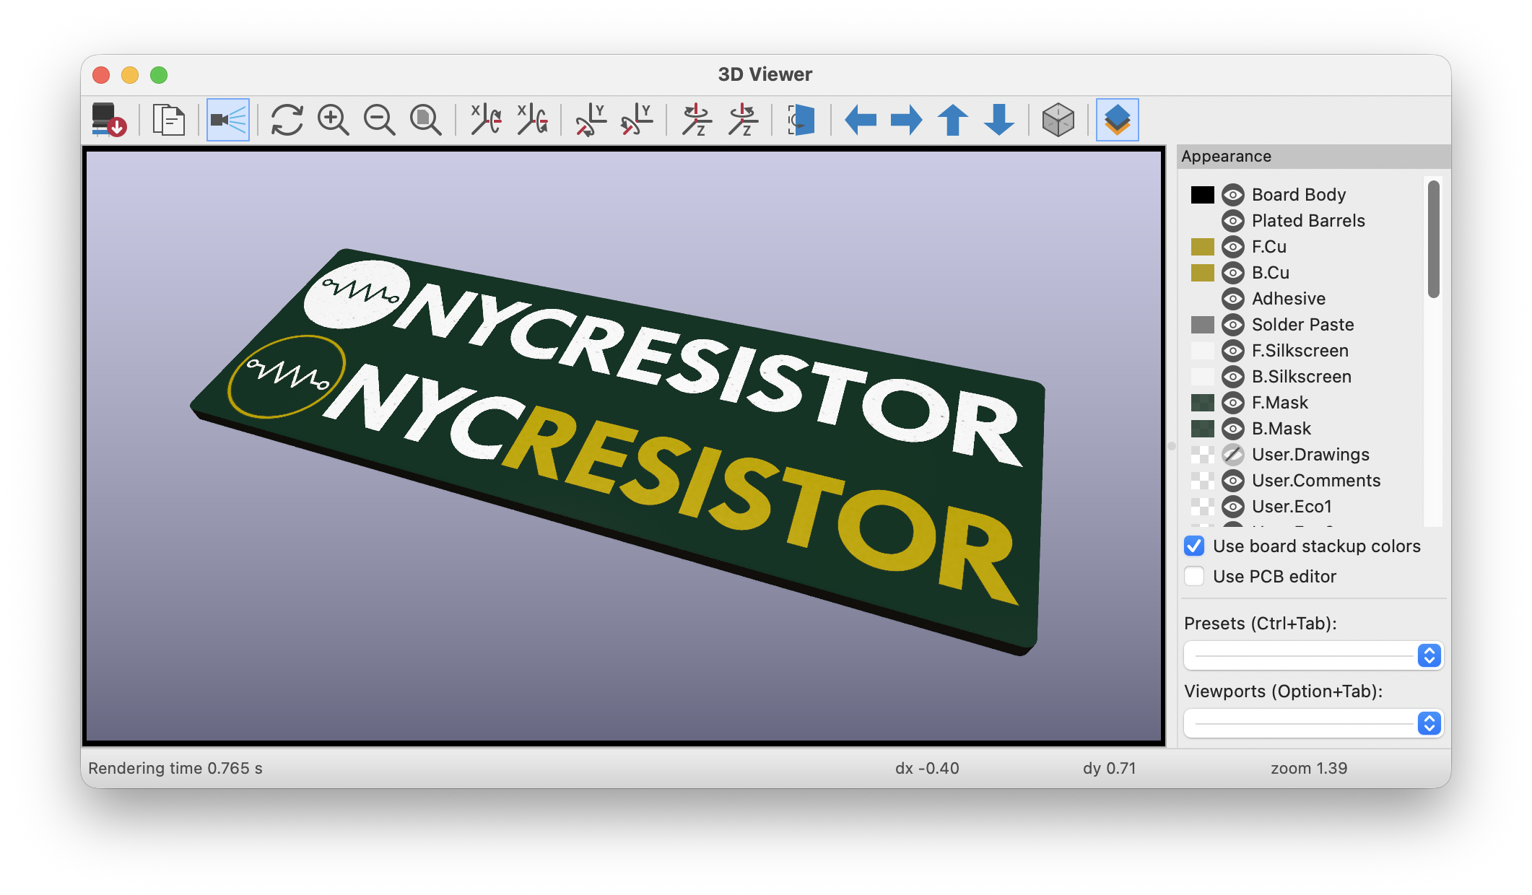

Asynchronous: Workflow 3:
Converting, placing, iterating a footprint
Start: NYCR-logo-phase-2.svg
Milestone: NYCR-logo.kicad_mod
End: NYCresistor-card-example2.kicad_pcb
Follow the instructions in README.md
Do the example first, then try your own
taitphotonlab.com/apps/svg2kicad.html
Notes:
IF YOU ARE NOT DONE with design, move forward anyways

Slide 55

Uploading a PCB for fabrication

Slide 56

Plotting gerbers
Print
Do not use this
Plot

Slide 57

Plotting gerbers
Check that these are selected
Don’t leave this field blank
Deselect these
Deselect X2 format
First click Drill Files and press OK in the new popup
Finally, press PLOT here

Slide 58

Compressing to zip archive
Right click
Windows/Linux: google how to zip a directory

Slide 59


Uploading to JLCPCB
(similar for OSHPARK)
drag,drop

Slide 60

Inspect upload

Slide 61

Configuring the physical properties

Slide 62

Properties you can change
Quantity
Core Material
PCB Thickness
Soldermask Color
Surface Finish
We will not need the rest of the properties

Slide 63
Recap: from PCB design to delivered boards
Starting in .kicad_pcb
Plot gerbers
Zip folder of gerbers
Drag-drop to JLCPCB or OSHPARK
Inspect upload

Slide 64
Uploading designs for the order

Slide 65

Instructions for the order
Fill out your info in the spreadsheet
Sign into my JLCPCB account
  Username: atait
  Password: ****************
Upload your board and select the fabrication options
Add to cart
Calculate price and put it in the spreadsheet
Calculating price
After putting your PCB(s) in the cart,
Select the checkbox next to your PCB.
Look at the subtotal.
Subtract $20 (since we share shipping)
Write the result in the spreadsheet
Spreadsheet link
https://docs.google.com/spreadsheets/d/1kogPh8-kZjdPBVyFecbTC-Yk5dQ5IPqLUJ6YryDgMXk/edit?gid=0#gid=0
Example

Slide 66
Documentation time
Let’s take some “candid” pictures
They help NYCR!
Over-the-shoulder CAD pics are great
  Ask first
Avoid getting faces or identifying markings without asking

