Slide 1
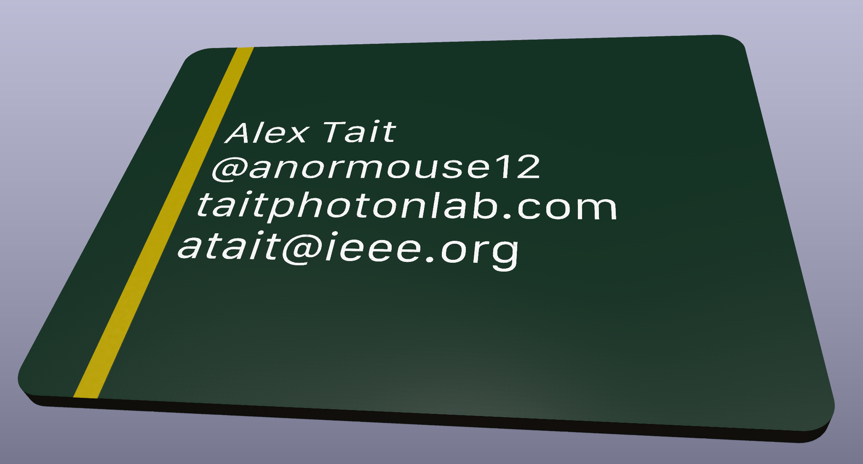
PCB artwork:
Make a business card
Alex Tait
atait@ieee.org

Slide 2
Objectives
Download KiCAD and Inkscape
Find/create/remix some vector artwork
Single layer import (KiCAD)
Multi-layer designs (inkscape)
Convert to footprints (svg2mod)
Insert a footprint into a pcbnew file
Submit PCB designs to fabrication house
Fabricate PCBs
Pick up from Resistor
Skip over kicad_pro and eeschema

Slide 3
Workshop outline
Hour 1: Importing graphics
20 min talking
Printed circuit boards
Computer aided design (CAD)
Layout primitives (lines, curves)
30 min asynchronous
Download KiCAD
Obtain template files
Edit text
Import basic Resistor logo (from SVG file)
Notice the primitive shapes
10 min break
Hour 2: Editing graphics
30 min talking
Computer graphics
SVG/PCB Layers
Path operations
20 min asynchronous
Download Inkscape
Find and download a vector image
Import, version, and begin editing
Notice colors and layers
10 min break
Hour 3: Custom footprints
10 min talking
KiCAD footprints
KiCAD local libraries
PCB fabrication + economics
50 min asynchronous
Place fancy Resistor logo (from footprint Library)
Use svg2mod to generate your own footprint
Upload to JLCPCB and play with pricing options
Continue editing your footprint until finished
Afterwards
- continue working at your own pace
- follow instructions to upload to OSHPARK
- email/discord for tech support

Slide 4
Provided assets
Business card template (bcard_template.pcbnew)
With LocalLib on the paths
Resistor logo (resistor_logo.svg)
Resistor logo footprint (resistor_logo2.kicad_mod)
Inside LocalLib/modules

Slide 5
Obtaining the repo
Git clone...

Slide 6
How asynchronous sessions will work
Learn the procedure by reproducing the NYCRESISTOR example design
Then repeat the procedure on your own design
Each session, we start from checkpoint X, try to get to checkpoint X+1
All the example checkpoint files are in the repo
If you reproduce the example early, move to your own design or help others
If not, no problem, you’ll be able to catch up at the next checkpoint
The last hour is all asynchronous work time

Slide 7
Asynchronous 1
Clone the repo
Download Inkscape
Download KiCAD
Meet your neighbors. You will be helping each other later
Name
Pronouns
Relationship to NYC Resistor
Something you are working on or want to work on

Slide 8
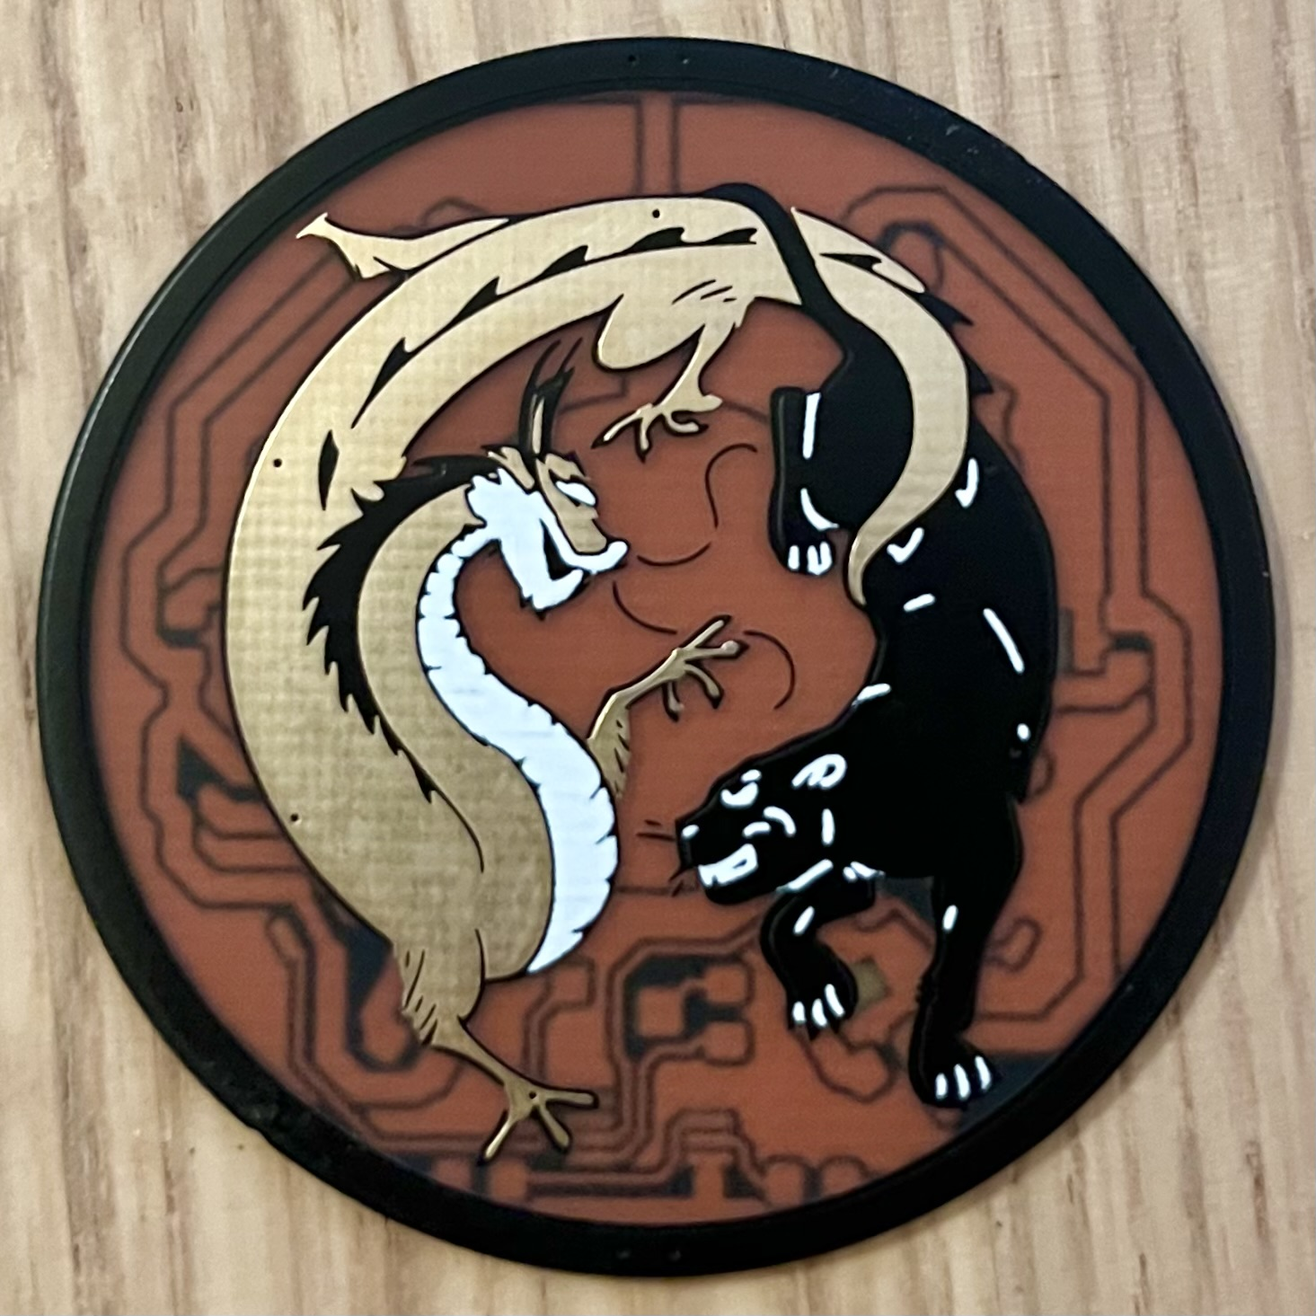

Slide 9
Computer Graphics

Slide 10
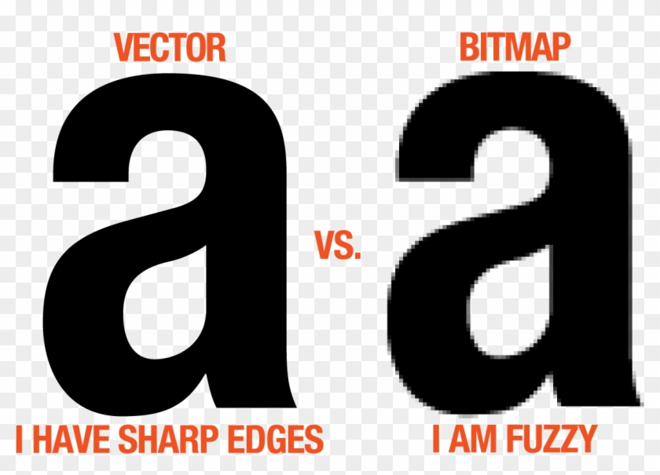
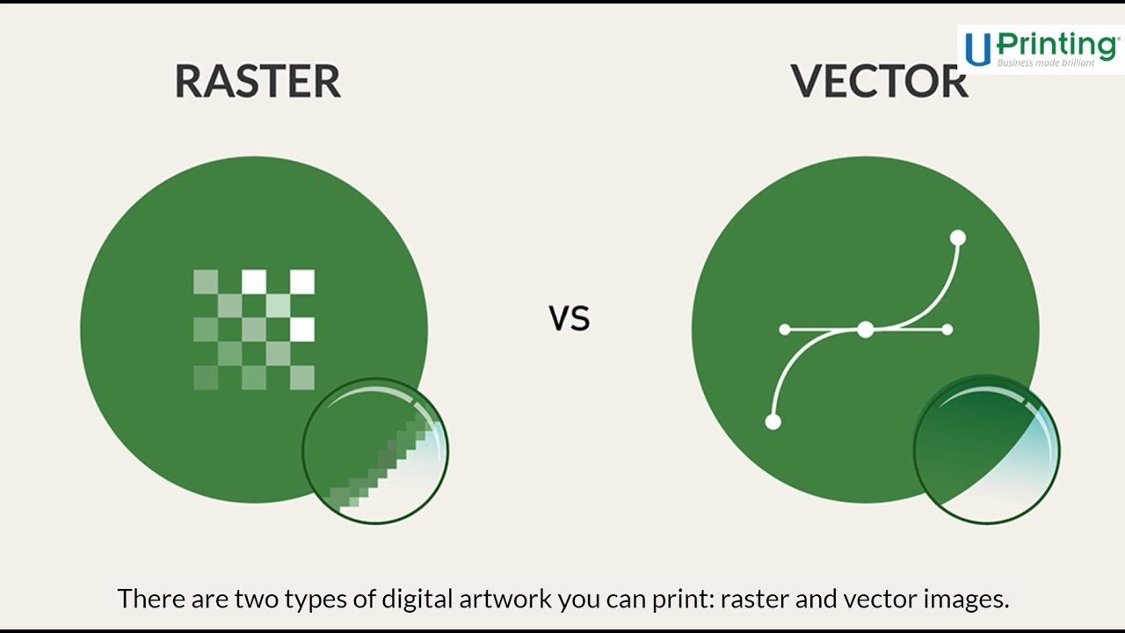
Computer Graphics: Vector vs. Raster
And anchor points
a.k.a., a picture
.svg (scalable vector graphics)
.png (portable network graphics)
.jpeg
.bmp

Slide 11
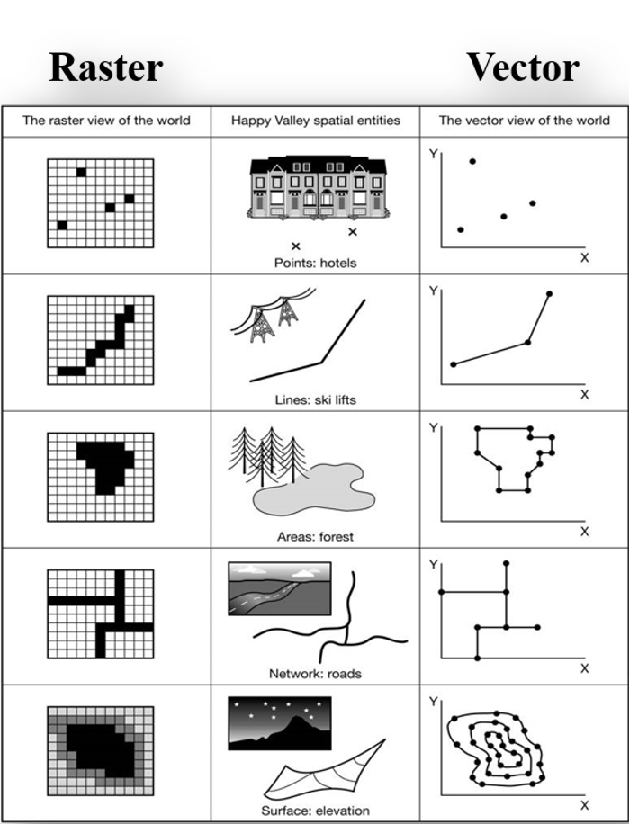
Computer Graphics: Vector vs. Raster
Most things can be visualized as vector or raster
So which way is better?
Credit: Clemson Intro to GIS

Slide 12
Graphics for PCB hardware
Electrical wires are lines
Always vectorized eventually

Slide 13
Converting: vector ↔ raster
Which is easier?

Slide 14
KiCAD-native graphics imports
SVG
Single layer
Bitmap
Single color
Asynchronous interactive time

Slide 15
What is a PCB

Slide 16
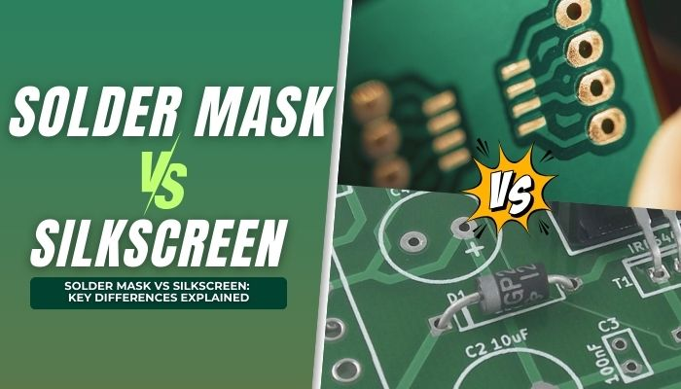
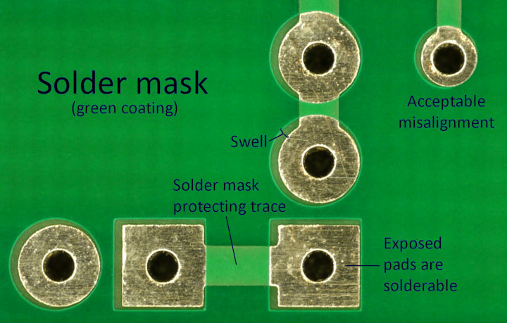
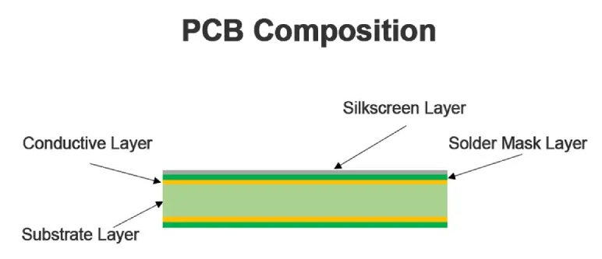
Stackup

Slide 17
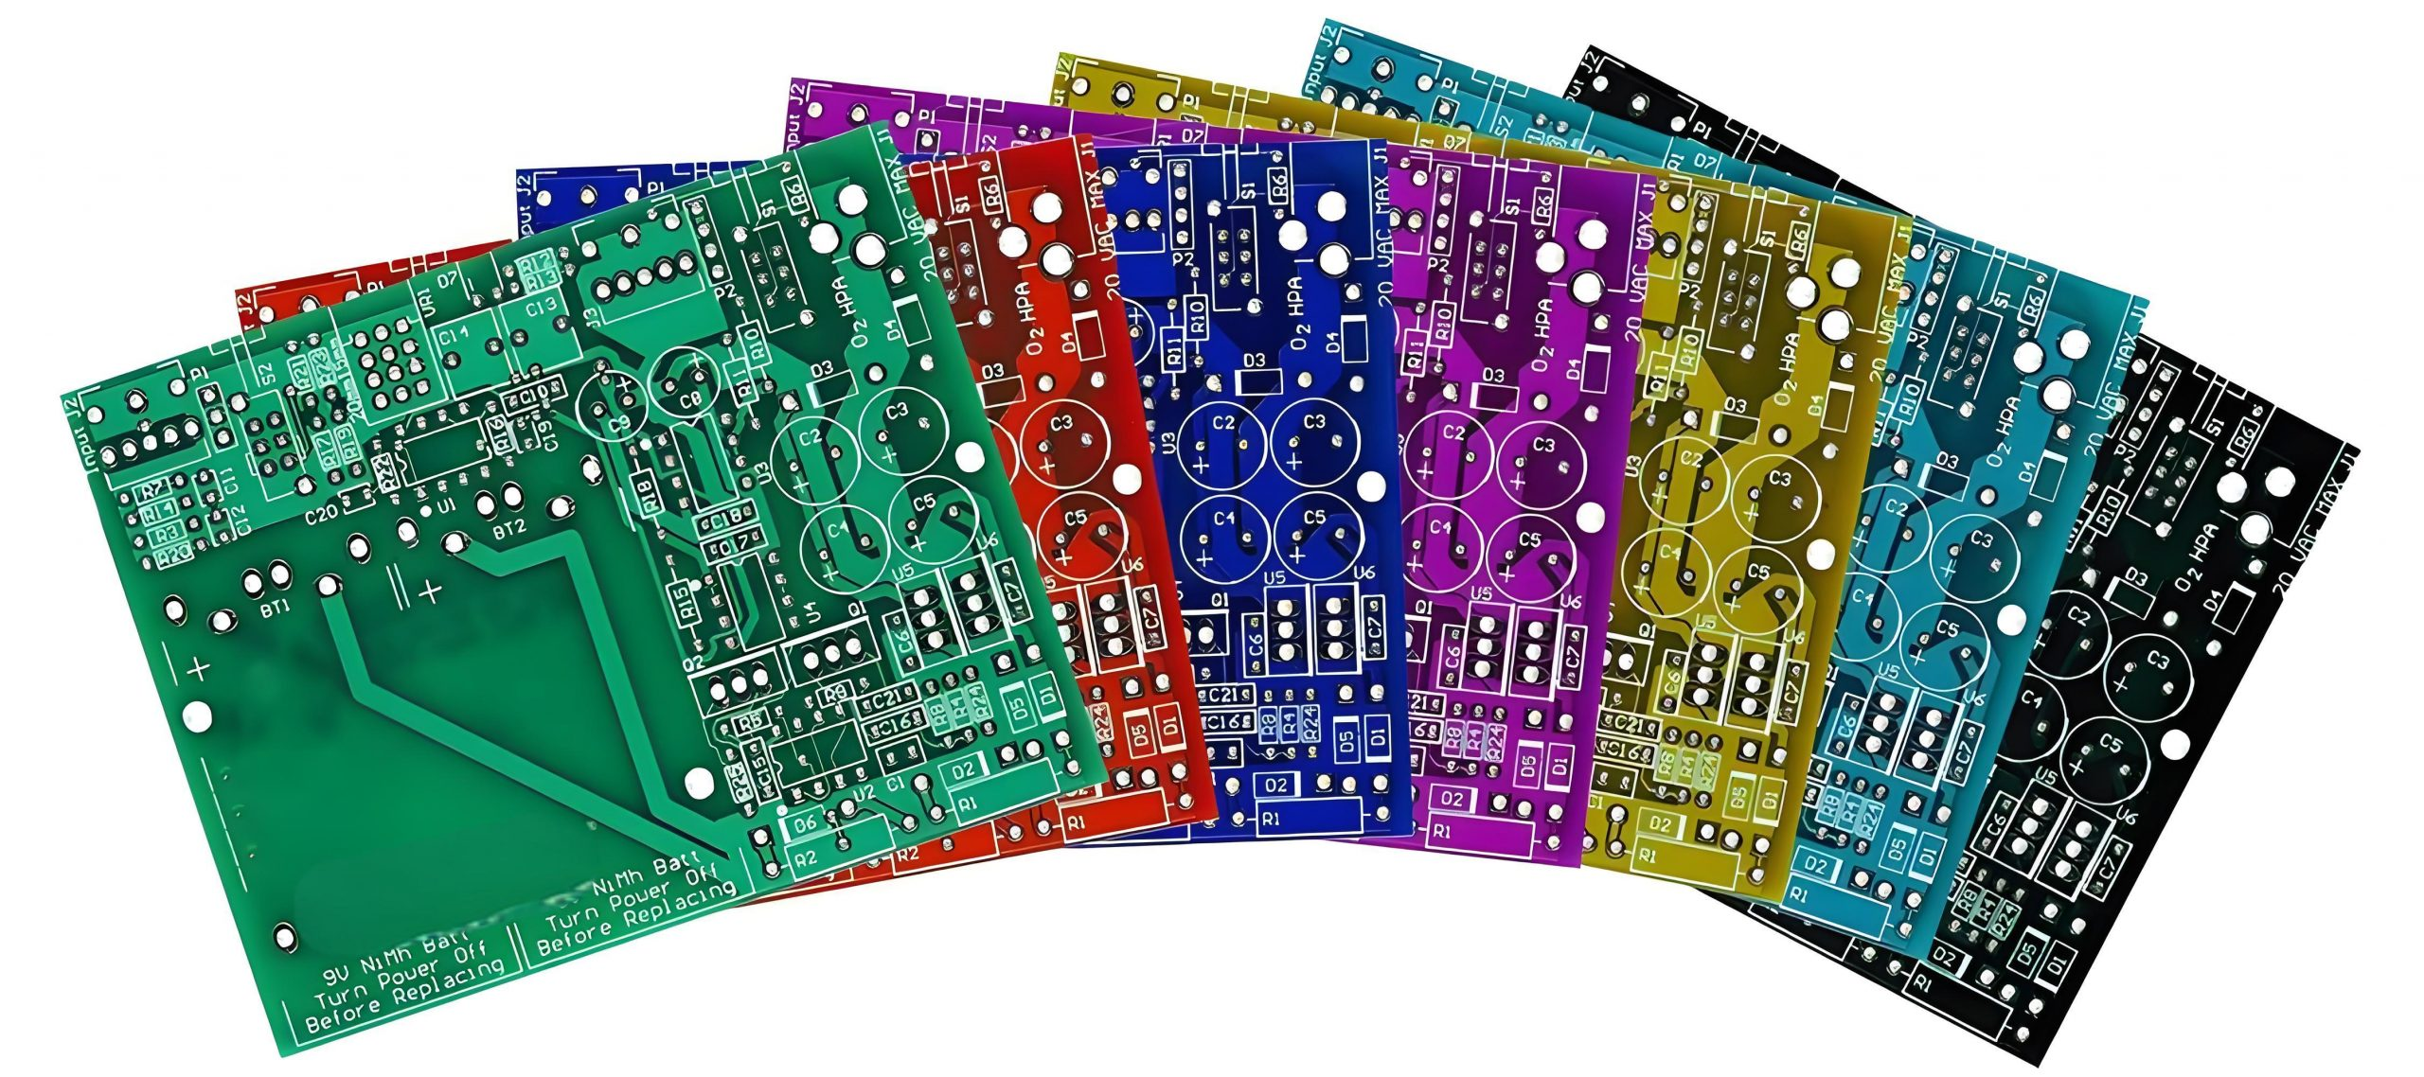
Solder mask colors
Usually green
Also: blue, black
Less common: red, white, yellow, purple, etc.

Slide 18
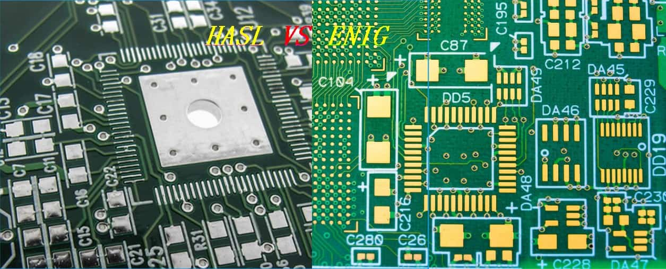
Copper finish colors
Silver or gold
That’s pretty much all we care about today

Slide 19
Layout design

Slide 20
Old fashioned style

Slide 21
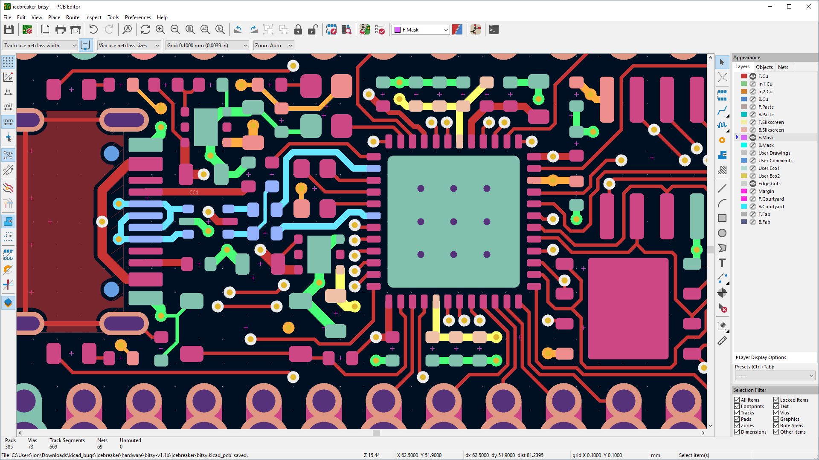
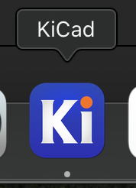
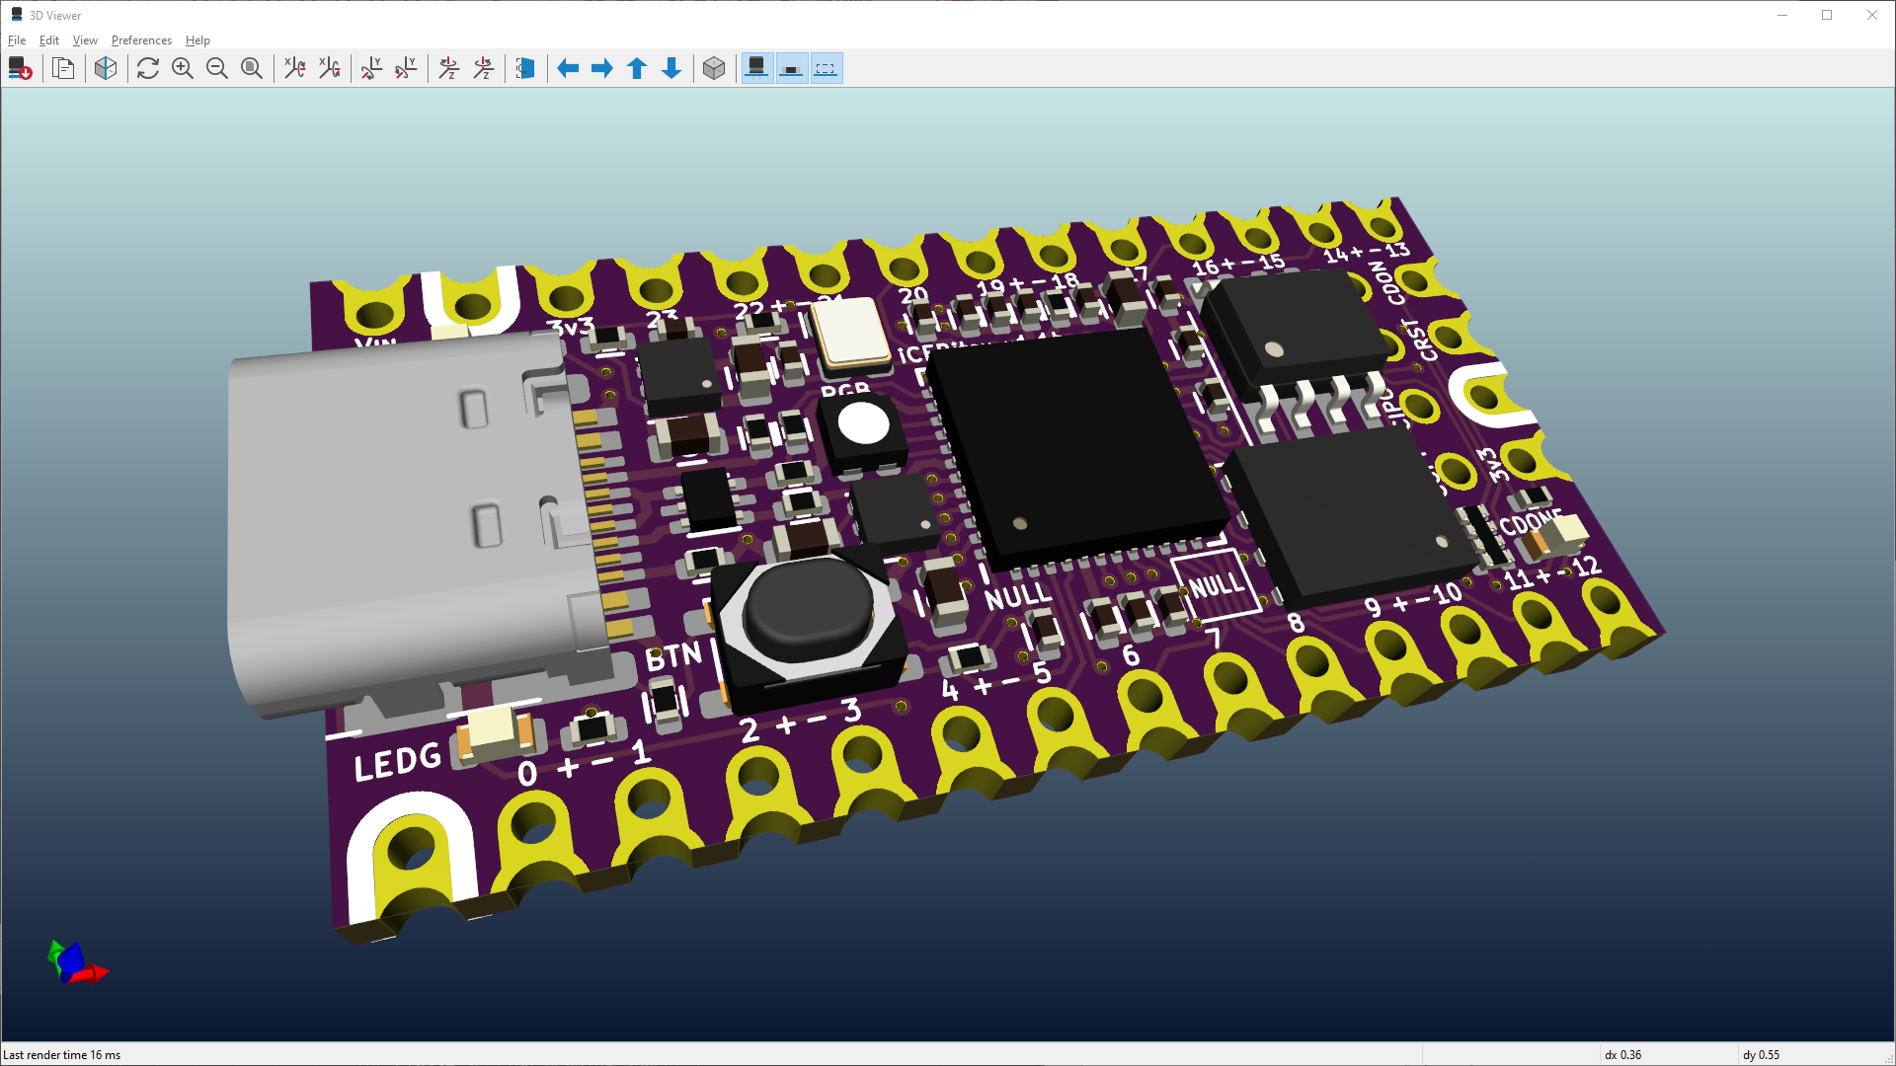
KiCAD
Modern circuit + layout design

Slide 22
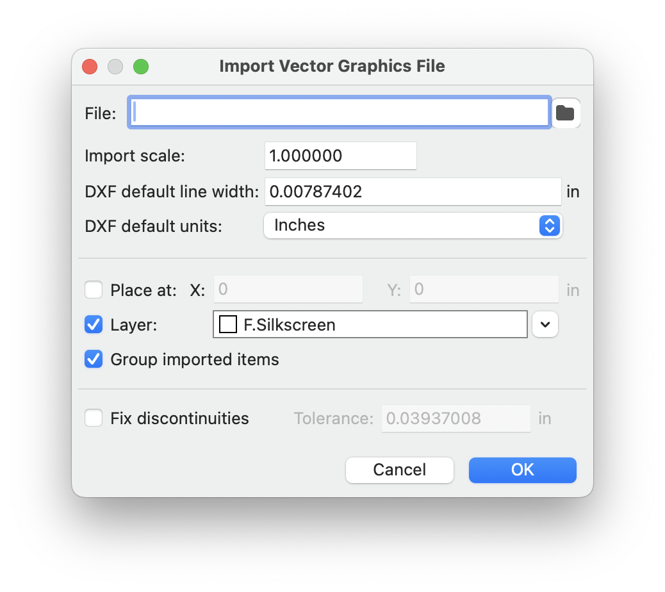
Vector import dialog

Slide 23
Editing vector graphics

Slide 24
Inkscape
Tips

Slide 25
Vocab
Point / node
Segment
Line, or Curve
Path
Polygon

Slide 26
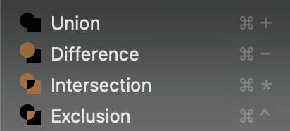
Boolean operations
Boolean is a term from logic, something True or False...
In digital electronics: True = 5 Volts, False = 0 Volts
Operation: two things in, one thing out
A + B = C
A x B = D
In vector graphics: inputs and outputs are shapes
True = inside, False = outside
A
+
C
B
+
x

Slide 27
Boolean operations
Shape A
Shape B
Point 1
Point 2
Intersection (a.k.a. AND):
”Point 2 is inside shape A and inside shape B, so Point 2 is inside the output shape”
Repeat this logic for every point
Union (a.k.a. OR):
”Point 2 is inside shape A or inside shape B, so Point 2 is inside the output shape”

Slide 28
Inset/outset operations
This is very useful for us

Slide 29
Scale operations
Make things the right size
Locking the aspect ratio

Slide 30
Layers in SVG
Naming
Hiding/Showing
Ordering
Coloring

Slide 31
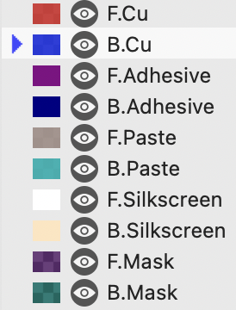
SVG Layers for PCB design
F.x (front) B.x (back)
x.Cu = copper
So F.Cu = front copper
x.Mask layers are inverted
Shapes on Mask layers will be openings in the solder mask

Slide 32
Multi-layer graphics

Slide 33
Workflow
Open Terminal
Install `svg2mod`
Move shapes to named layers
Use svg2mod to convert
Open footprint editor
Import the new footprint
Insert into board
Inspect in 3D

Slide 34
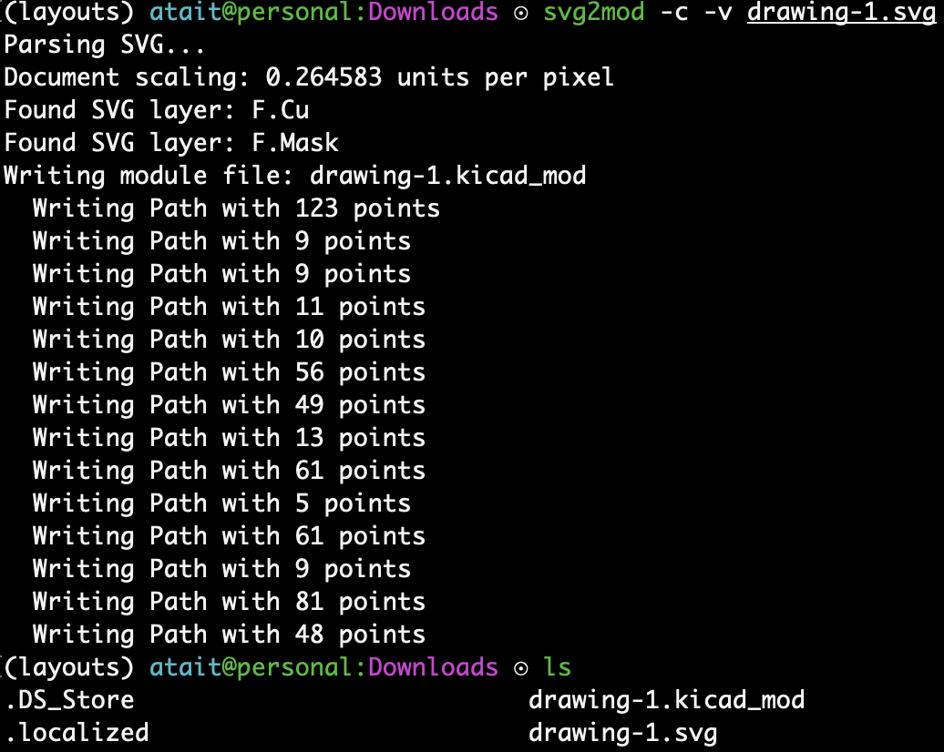
Conversion step
Edit SVG paths

Slide 35
Uploading a PCB for fabrication

Slide 36
Workflow
Starting in .kicad_pcb
Review 3D + ERC (good practice)
Plot gerbers
Zip folder of gerbers
Drag-drop to JLCPCB
Inspect upload

Slide 37
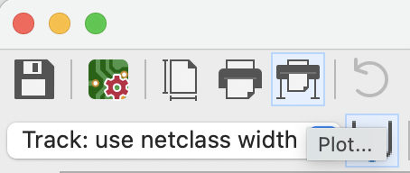
Plotting gerbers
Print
Do not use this
Plot

Slide 38
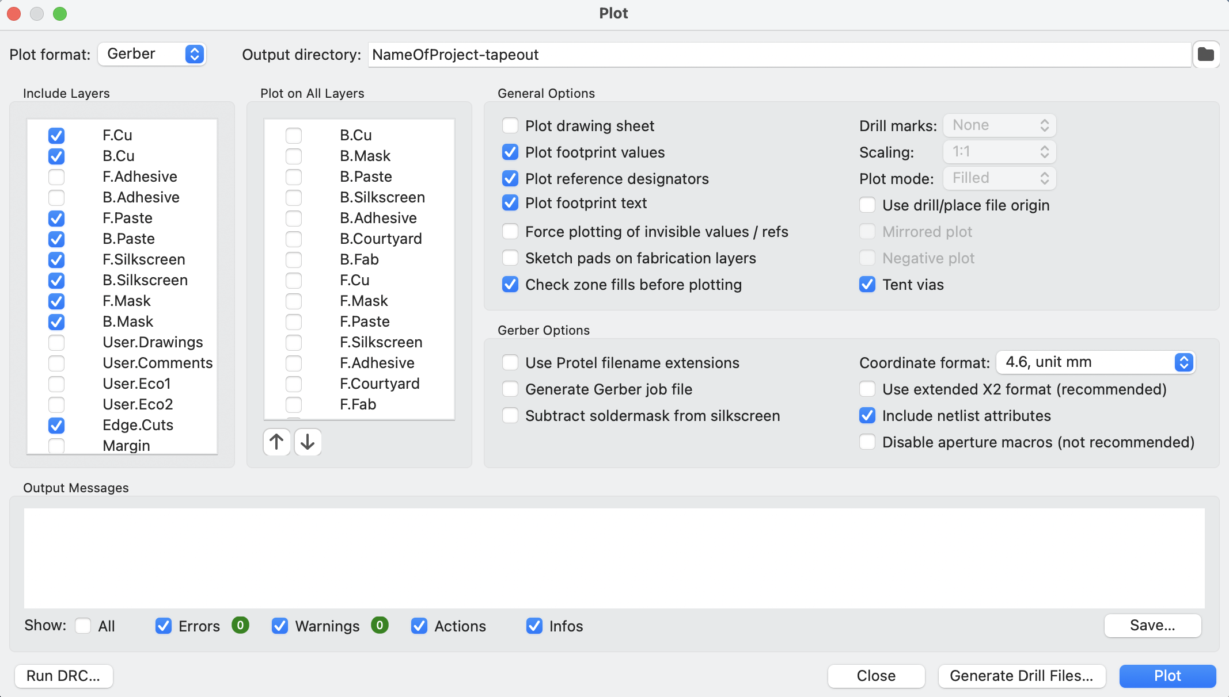
Plotting gerbers
Check that these are selected
Don’t leave this field blank
Deselect these
Deselect X2 format
First click Drill Files and press OK in the new popup
Finally, press PLOT here

Slide 39
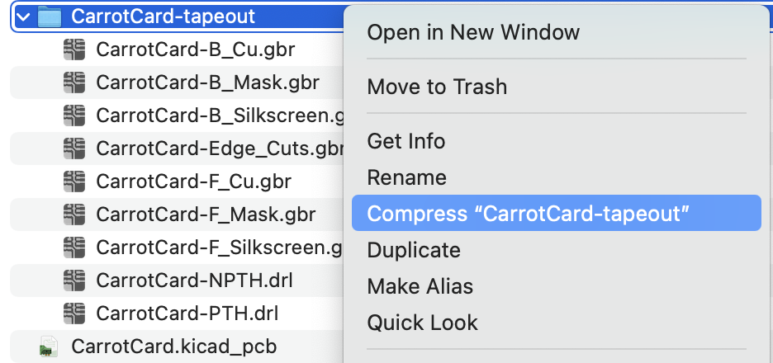
Compressing to zip archive
Right click
Windows/Linux: google how to zip a directory

Slide 40
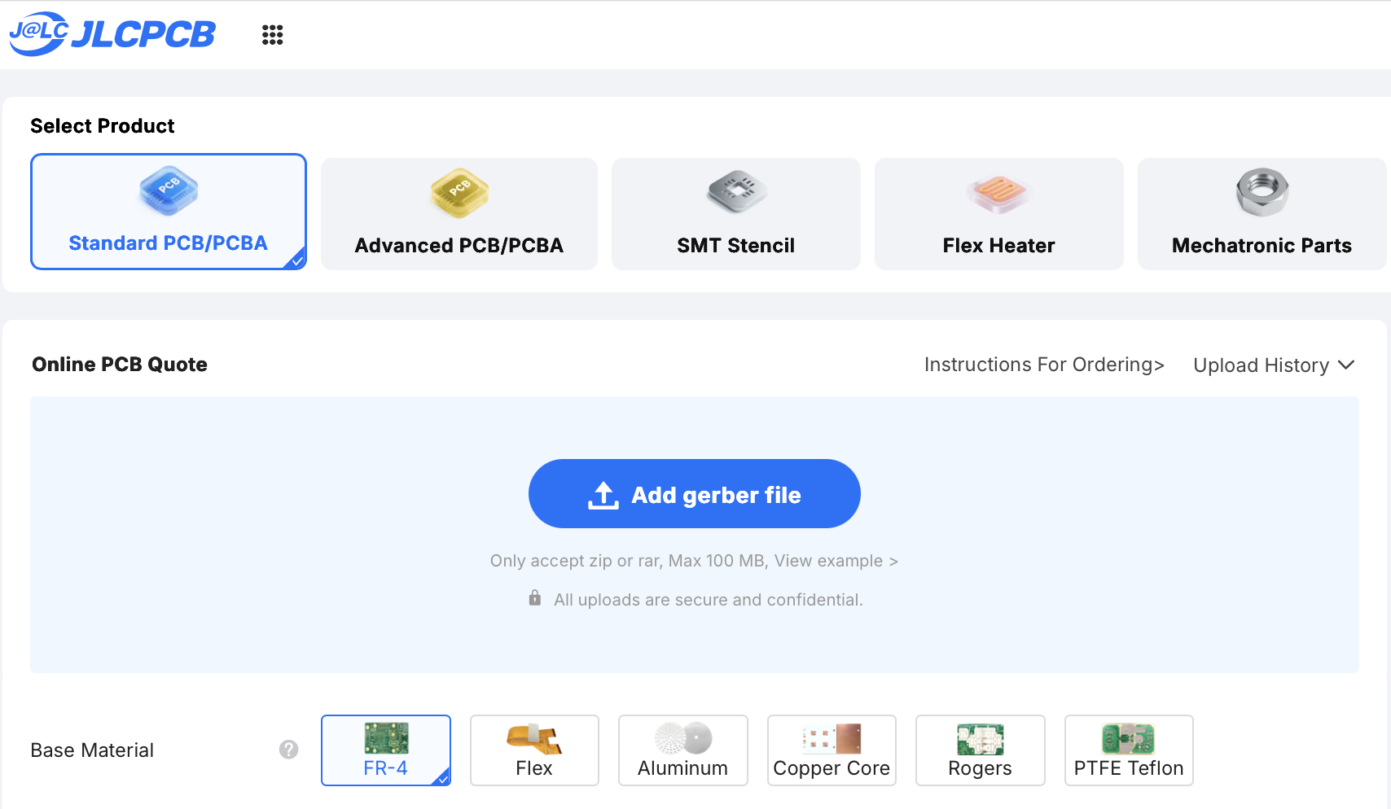
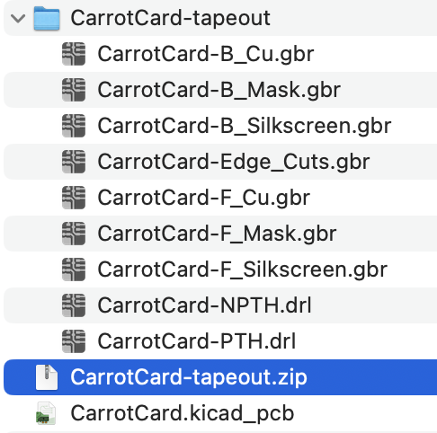
Uploading to JLCPCB
drag,drop

Slide 41
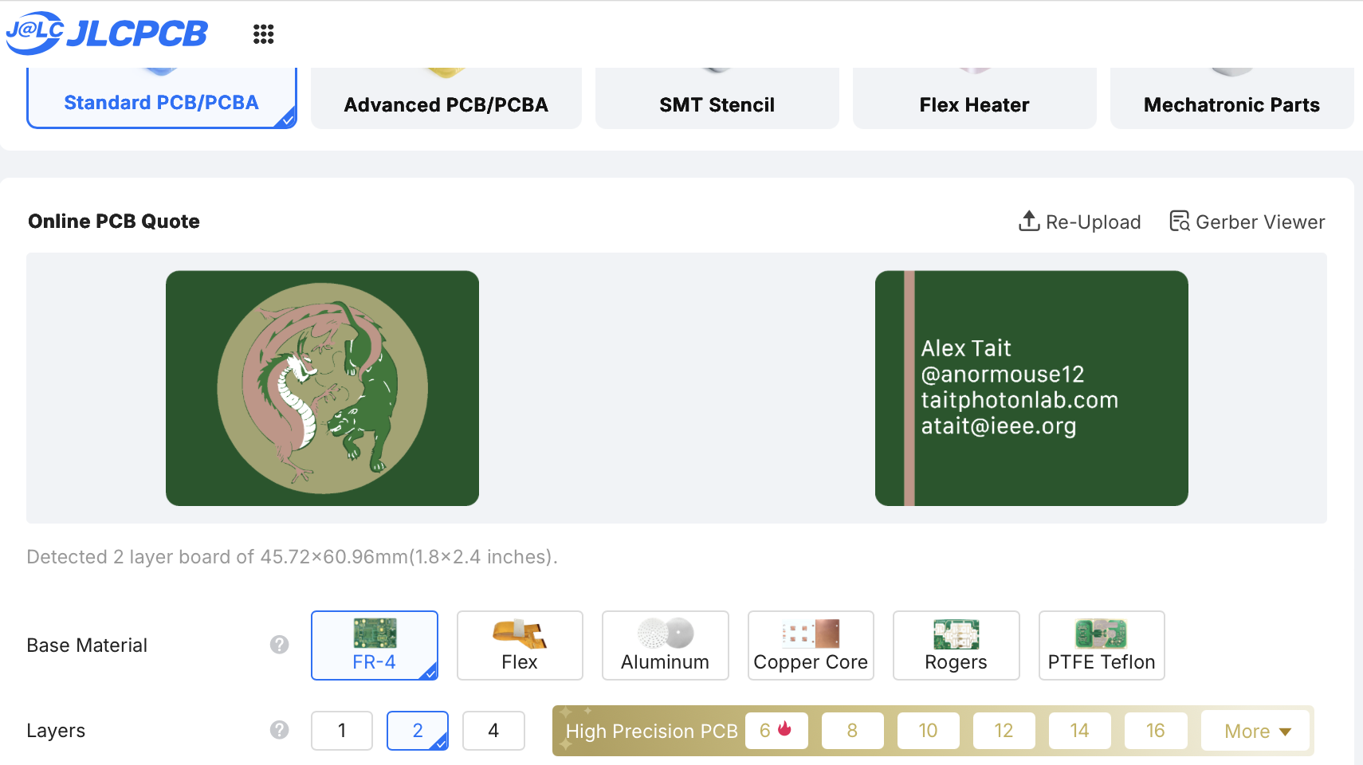
Inspect upload

Slide 42
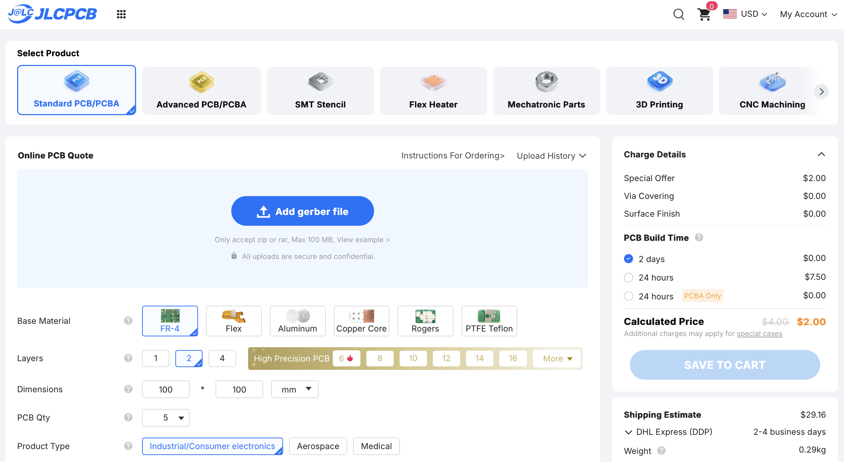
Configuring the physical properties

Slide 43
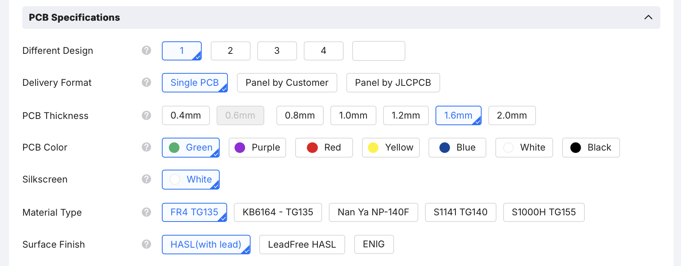
Properties you can change
Quantity
Core Material
PCB Thickness
Soldermask Color
Surface Finish
We will not need the rest of the properties

Slide 44
Offloads

Slide 45
Our group order costs
Defaults: funded by the workshop ticket price
5x qty
Any color
1.6mm thickness
Silver surface finish
Fiberglass core
Add-ons: cost extra
Greater qty
Gold surface finish
Other thicknesses
Aluminum or copper core
We’re making add-ons available individually and at-cost
Upload zip file
Select options
Calculated Price
Shipping Estimate
Subtract $2.00
Subtract $29.16
Add
Venmo Resistor this amount
Resistor pays JLCPCB

Slide 46
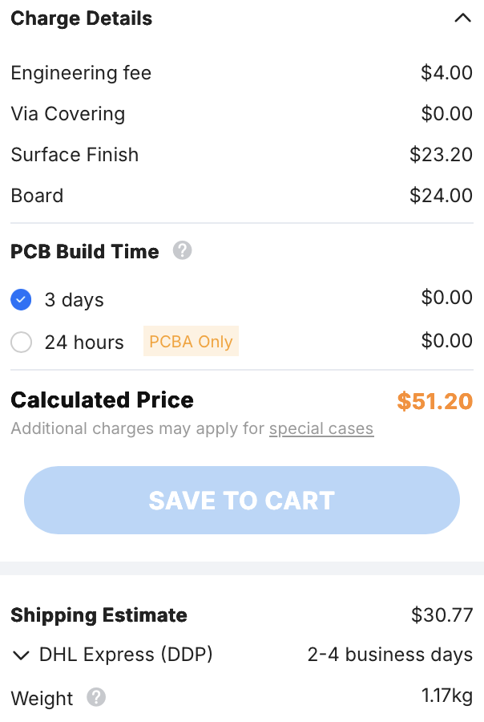
Pricing add-ons: example 1
Suppose I want
30x qty
Black mask
Gold finish
Boards: $51.20 – $2.00 = $49.20
Excess shipping: $30.77 – $29.16 = $1.61
I would Venmo Resistor $49.20 + $1.61 = $50.81 on top of the ticket price
Note: the numbers you get will differ based on size of board

Slide 47
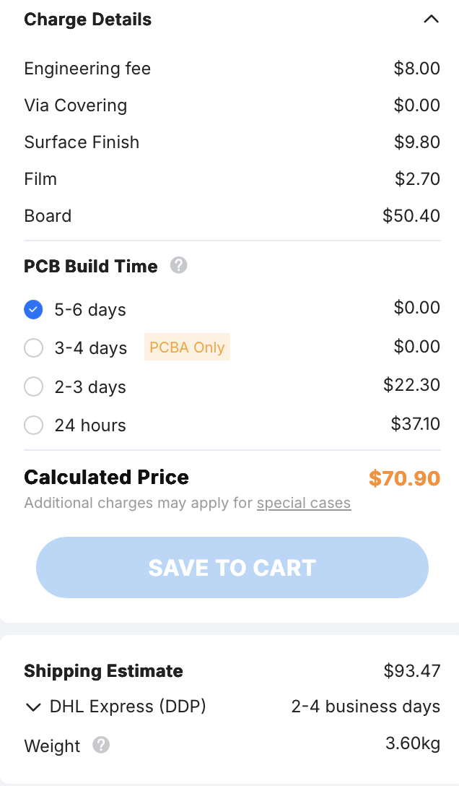
Pricing add-ons: example 2
Suppose I want
100x qty
Lead-free silver finish
Boards: $50.40 – $2.00 = $48.40
Excess shipping: $93.47 – $29.16 = $64.31
I would Venmo Resistor $48.40 + $64.31 = $112.71
Because 100x is significantly heavier than 5x
Note: the numbers you get will differ based on size of board

Slide 48
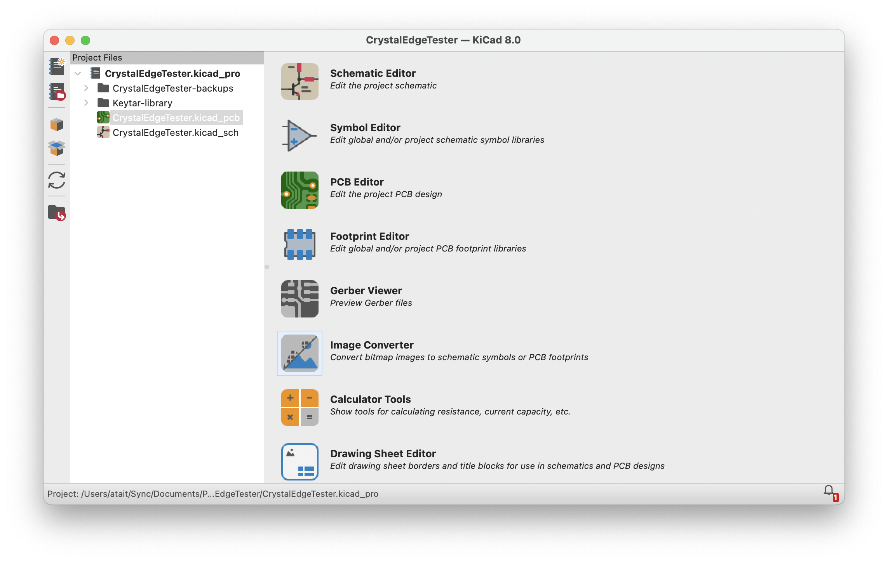
Raster import program (bitmap2component)

Slide 49
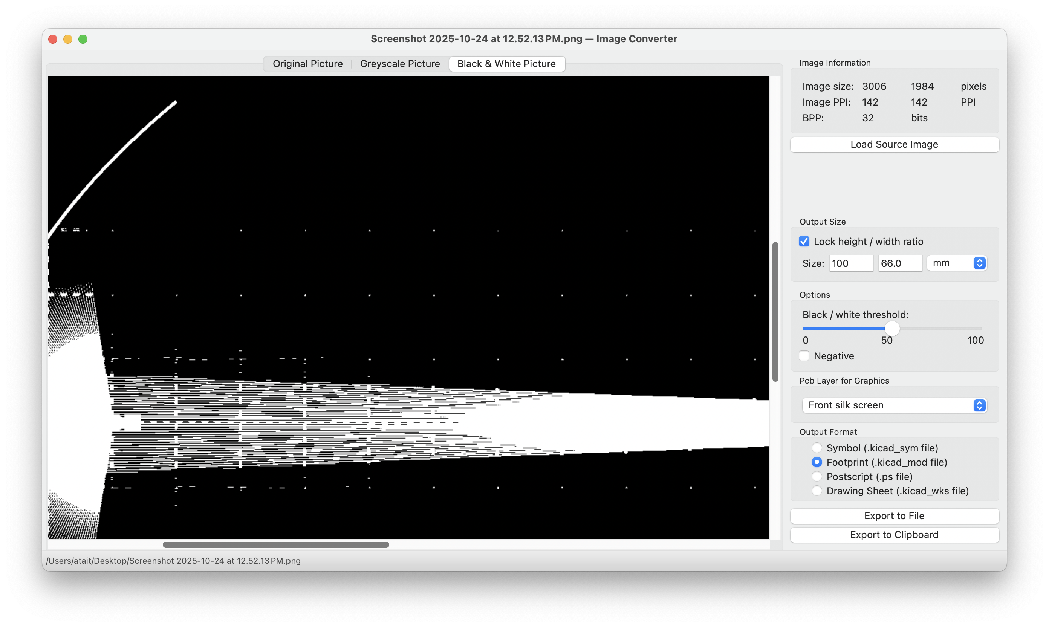
Raster import program

