Slide 1
AI Planning Annotation in Reinforcement Learning: Options and Beyond
Junkyu Lee, Michael Katz, Don Joven Agravante, Miao Liu, Tim Klinger, Murray Campbell, Shirin Sohrabi, Gerald Tesauro
IBM research AI
August 5 10:40 AM EST.
PRL Workshop at ICAPS 2021 (August 5-6)
Bridging the Gap Between AI Planning and Reinforcement Learning

Slide 2
Overview
Introduction
Background
Planning annotated Reinforcement Learning (PaRL) Task
Solving PaRL Task
Conclusion and Future Work

Slide 3
Introduction - Motivation
AI Planning
Efficient for finding goal directed sequence of actions
Scalable through compact symbolic encoding of state transition system
Plans are natively explainable
Reinforcement Learning
Easily handle low level control signals, high dimensional inputs
No need to provide symbolic models
High cost of maintaining large amount of data
Difficult to obtain symbolic models in general
Cannot handle perception-oriented high dimensional inputs, e.g. images
Most RL methods are suffering from sample inefficiency
Learned policy is not easy to understand
Integrated Method
Improve Scalability and Sample Efficiency
Tasks are handled by AI Planner
Low level perceptions are handled by RL
Obtain Easier to understand plans or policy

Slide 4

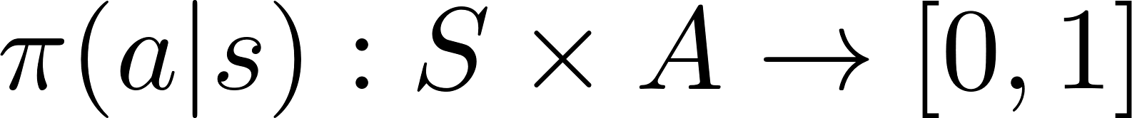

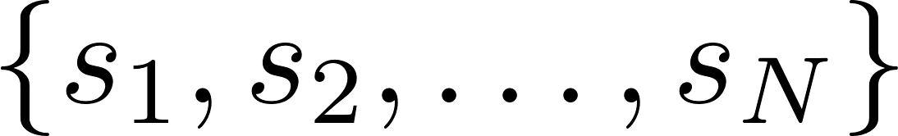

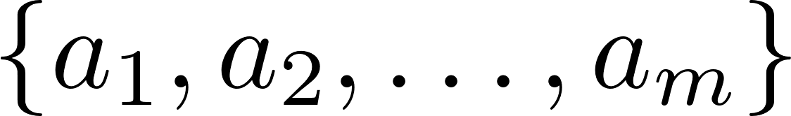


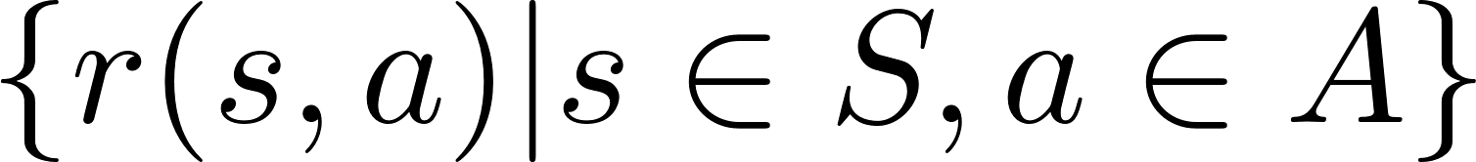


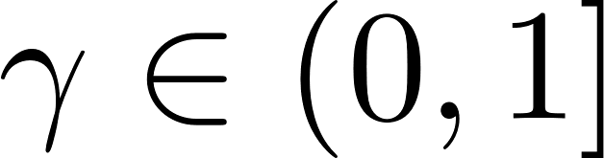
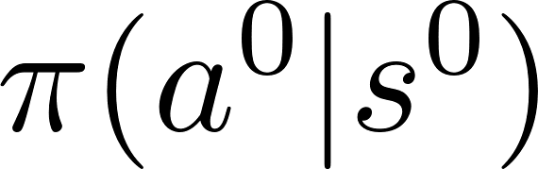
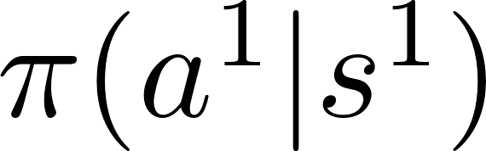
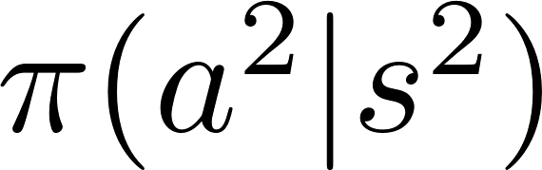
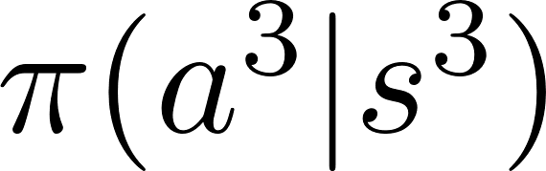
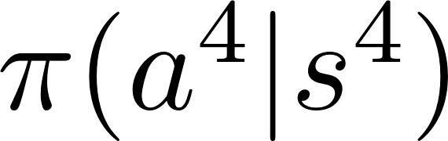
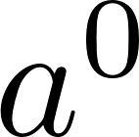
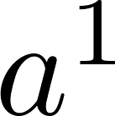
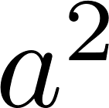
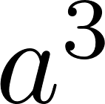
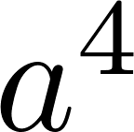


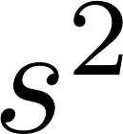

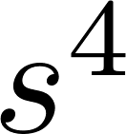
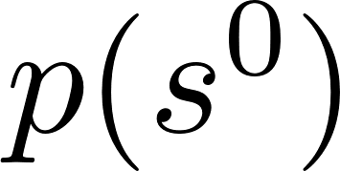
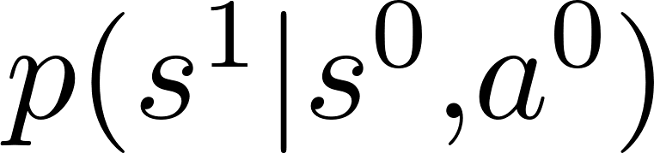
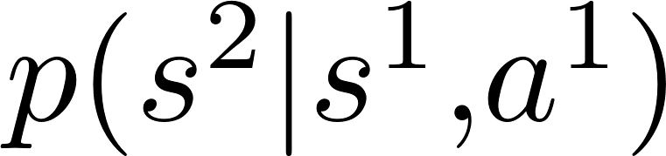
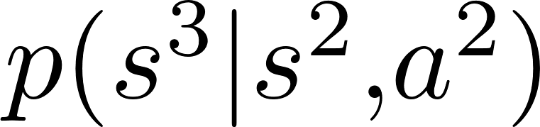
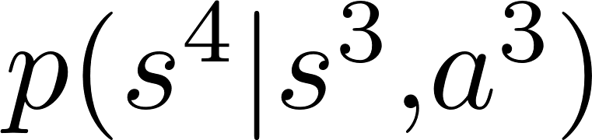

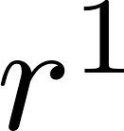
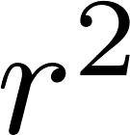

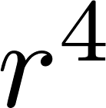
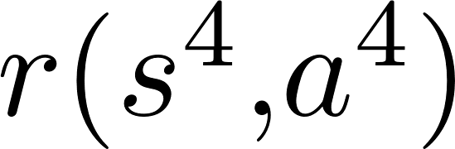
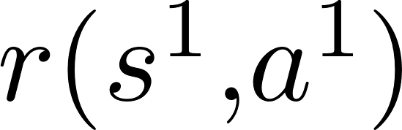
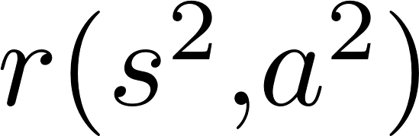
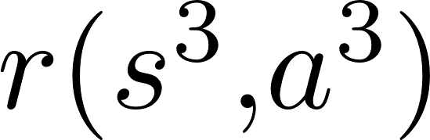
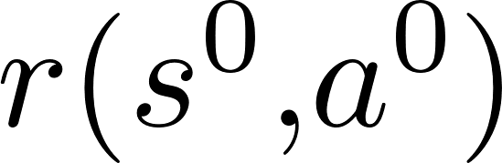
Background – RL and Options Framework
Markov Decision Process
stationary stochastic policy
states
actions
probability functions
reward functions
Discounting factor
Super script for time step

Slide 5



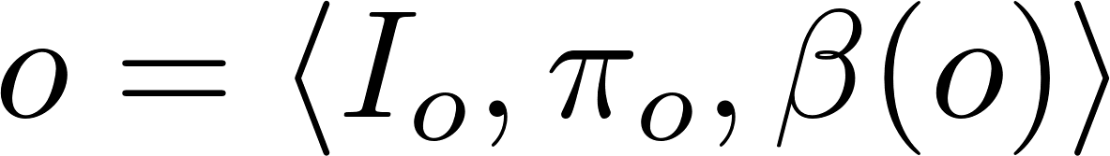






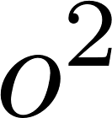


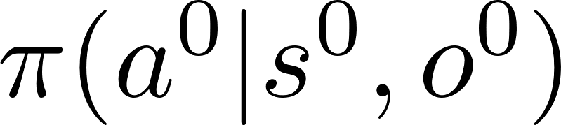
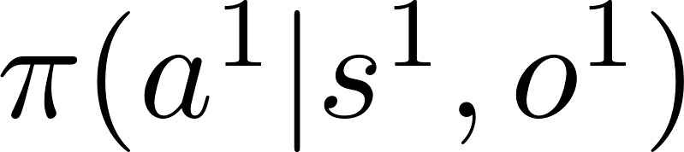
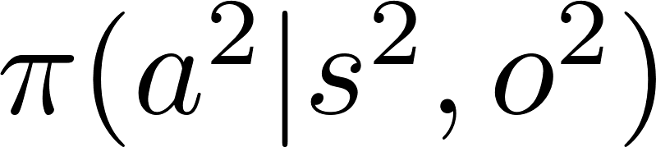
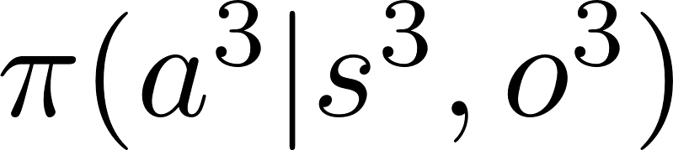
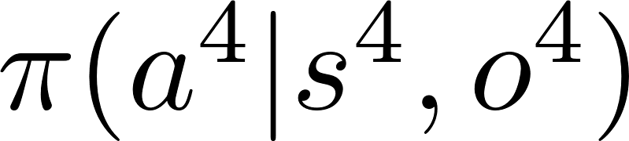
Background – RL and Options Framework
Options Framework
[Sutton, Precup, and Singh 1999]
options
Option level policy
Option Initiation set
Intra Markovian option policy
Intra option policy function
Option level MDP is semi-MDP since duration of option execution steps is random variable
Option termination set

Slide 6
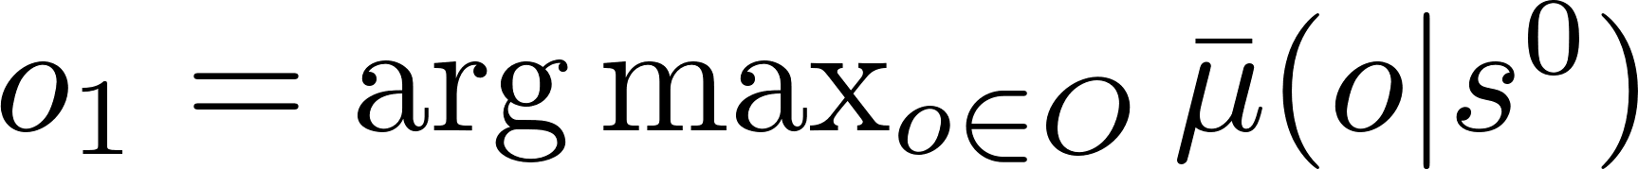
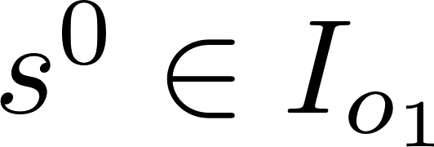
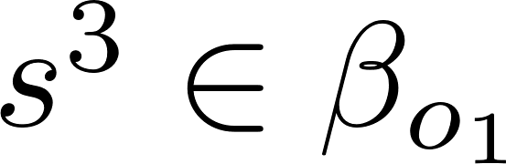
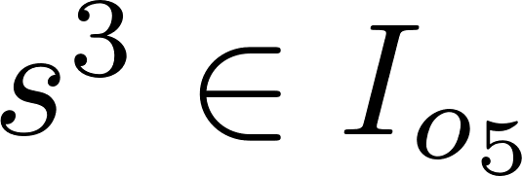
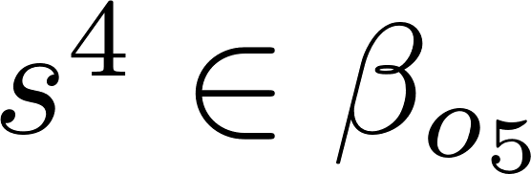
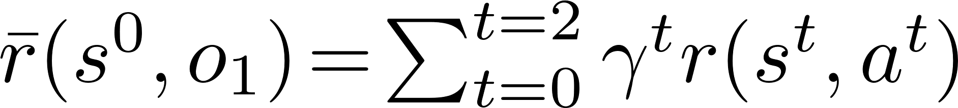
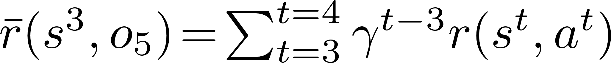
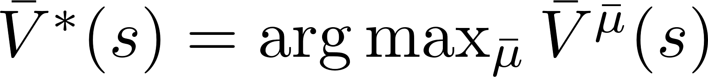
Background – RL and Options Framework
Semi-MDP
Value function for SMDP over options:
Sum of the probability over state transitions over option:
Optimal value over SMDP over options:

Slide 7
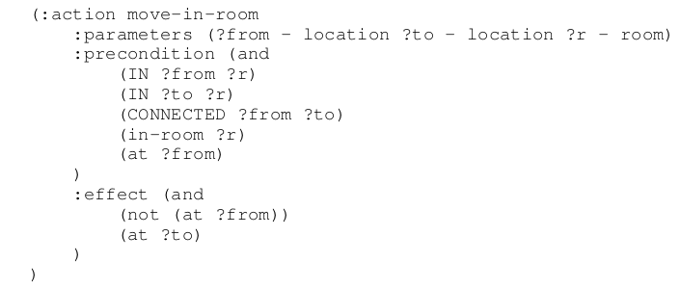
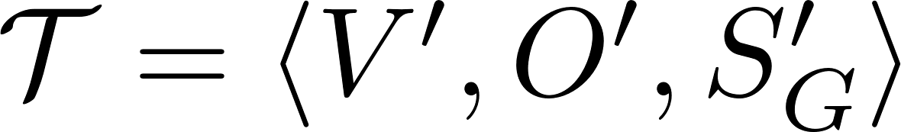






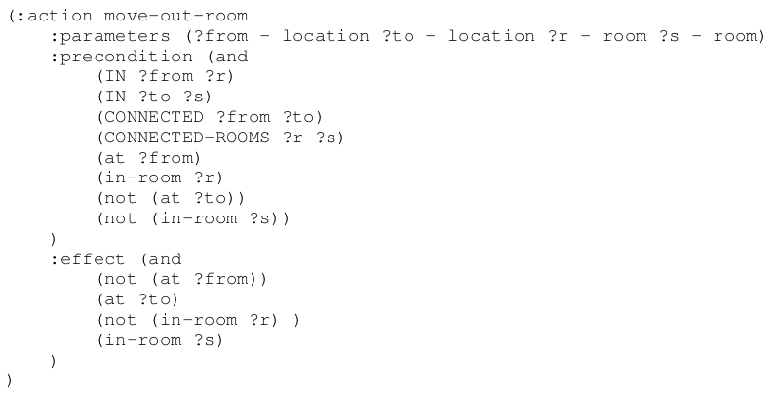

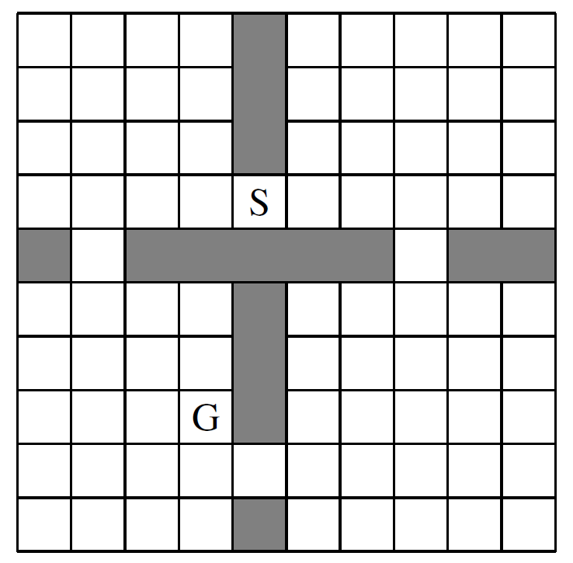
Background – AI Planning Task
AI Planning Task
variables
operators
Goal states
Planning states

Slide 8






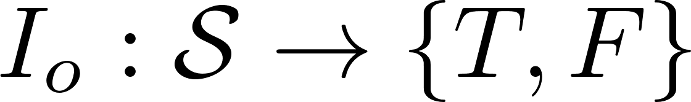




Planning Annotated RL (PaRL)
Planning Annotated RL Task (PaRL)
MDP
AI Planning Task
State mapping function
Given MDP
Define an option for each operator
Option
Initiation set
Intra-option policy
Termination set
AI Planning Task operator
Option for MDP task
(Move from r5 to c-r5-r3)
(precondition): in-room(r5)
(effect): in-room(c-r5-r3)

Slide 9


Solving PaRL
r1
r2
PaRL provides “side information” to the RL agent
Can be viewed as a model-based hierarchical RL approach
AI planner generates high-level plans at the level of options
Offline Planning: option sequence is generated before learning intra option policy functions
Online Planning: option sequence is generated while learning policy functions

Slide 10




Solving PaRL – Offline Options Training+ SMDP Learning
Problem: there are many options available to train/use.
We want to use only “useful” options for solving a problem with a fixed initial state and terminal state.
Planning Annotated RL Task (PaRL)
Option Selection by Offline planning
MDP Environment
AI Planning Task
1.
Generate PaRL Plan
2.
Option Selection
1. AI planner generates plans over options 2. Select options - Rank options with some score functions
such as frequency
Intra option training: train only selected options by any RL algorithm
SMDP learning: train option level policy function over the selected options and primitive actions

Slide 11




Solving PaRL – Experiments
SMDP Learning + Proximal Policy Optimization using pretrained options
Intra-option policy training: PPO with
Option level policy training: PPO with
[Sutton, Precup, and Singh 1999]
[Schulman, et. al 2017]

Slide 12
Related Works
[Kulkarni, et. al 2016]
Hierarchical RL
Define master/slave architecture and master policy generates subgoals for each slave
Agent policy at the lower level is similar to the options
Option Critic
End-to-End approach for training intra option and option level policy functions
Learning algorithm: policy gradients derived for option value function
PEORL/SDRL
Derive a Planning task from BC action language
Define 1 option per state transition in planning problem
Learning algorithm: R-max learning
Taskable RL
Derive a planning task from subtasks in RL problem
Manually define termination set of options from planning operators
Learning algorithm: SMDP-Q learning + Q-learning for intra option training
[Bacon and Precup 2017]
[Lyu, et. al 2019]
[Yang, et. al 2018]
[Illanes, et. al 2020]

Slide 13
Conclusion
Planning annotated RL
Annotate an RL task with a planning task and derive hierarchical RL architecture
Generate option specifications from planning operators
Option level policy learning can utilize AI planning algorithms
Solving PaRL task
Offline approach: utilize AI planner for selecting useful options for RL task
Future Work
Online approach: interleave option selection and intra-option training
Learning AI planning task from RL environment

