Slide 1
NetCDF
NetCDF: Network Common Data Form
Self-describing (includes metadata along with main main dataset of interest)
Portable (reasonably)
Access subsets of data efficiently
Widely used in atmospheric sciences community
Many tools for visualization and manipulation
More information about NetCDF: http:// www.unidata.ucar.edu/netcdf/

Slide 2
NetCDF metadata part 1 CIDA-processed DayMet precipitation
~/smwdata/source_code/swb_test_cases/common_climate $ncdump -h 2010-82_prcp.nc
netcdf \2010-82_prcp {
dimensions:
x = 5268 ;
y = 4823 ;
time = 4 ;
nv = 2 ;
variables:
short lambert_conformal_conic ;
lambert_conformal_conic:grid_mapping_name = "lambert_conformal_conic" ;
lambert_conformal_conic:longitude_of_central_meridian = -100. ;
lambert_conformal_conic:latitude_of_projection_origin = 42.5 ;
lambert_conformal_conic:false_easting = 0. ;
lambert_conformal_conic:false_northing = 0. ;
lambert_conformal_conic:standard_parallel = 25., 60. ;
short yearday(time) ;
yearday:long_name = "yearday" ;
yearday:valid_range = 1s, 365s ;
short prcp(time, y, x) ;
prcp:long_name = "daily total precipitation" ;
prcp:units = "mm/day" ;
prcp:coordinates = "lat lon" ;
prcp:grid_mapping = "lambert_conformal_conic" ;
prcp:cell_methods = "area: sum time: sum" ;
prcp:missing_value = -32768s ;
prcp:valid_range = 0s, 200s ;

Slide 3
NetCDF metadata part 2 CIDA-processed DayMet precipitation
double time_bnds(time, nv) ;
double x(x) ;
x:units = "m" ;
x:long_name = "x coordinate of projection" ;
x:standard_name = "projection_x_coordinate" ;
double y(y) ;
y:units = "m" ;
y:long_name = "y coordinate of projection" ;
y:standard_name = "projection_y_coordinate" ;
double time(time) ;
time:long_name = "time" ;
time:calendar = "standard" ;
time:units = "days since 1980-01-01 00:00:00 UTC" ;
time:bounds = "time_bnds" ;
// global attributes:
:source = "Daymet Software Version 2.0" ;
:Version_software = "Daymet Software Version 2.0" ;
:Version_data = "Daymet Data Version 2.1" ;
:Conventions = "CF-1.4" ;
:citation = "Please see http://daymet.ornl.gov/ for current Daymet data citation information" ;
:references = "Please see http://daymet.ornl.gov/ for current information on Daymet references" ;
}

Slide 4
NetCDF Climate and Forecast (CF) Conventions
Suggest a uniform set of attributes, dimension names
Suggest attributes that more or less consistently allow for preservation of geospatial data attributes
Most importantly, datasets that meet these CF conventions are more likely to work as expected in the many NetCDF-aware tools that are out in the wild
Source: http://cf-pcmdi.llnl.gov/documents/cf-conventions/1.6/cf-conventions.html

Slide 5
SWB and NetCDF
Previous versions of SWB could read and write NetCDF3 files
Current versions can read and write NetCDF4 files
NetCDF4 offers significant improvements over NetCDF3 (data compression)
New NetCDF capabilities in SWB make it possible to access data directly from the web

Slide 6
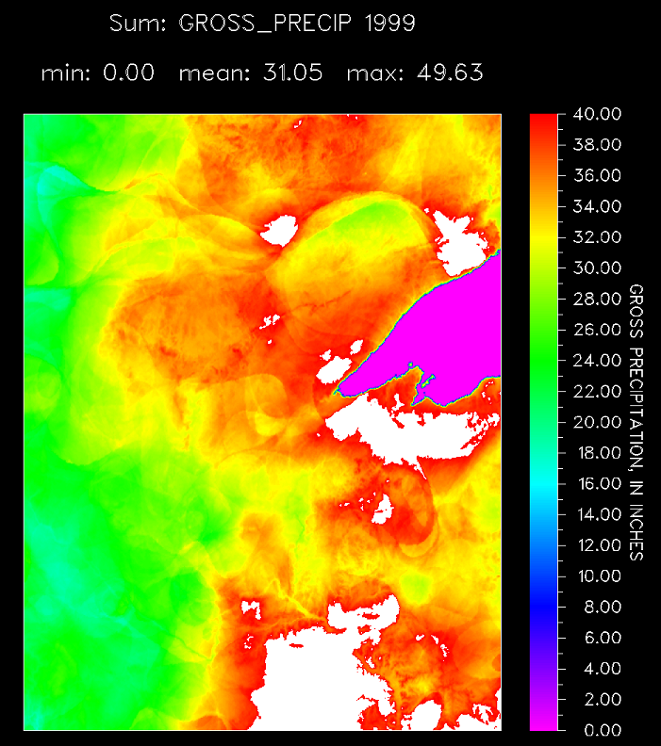
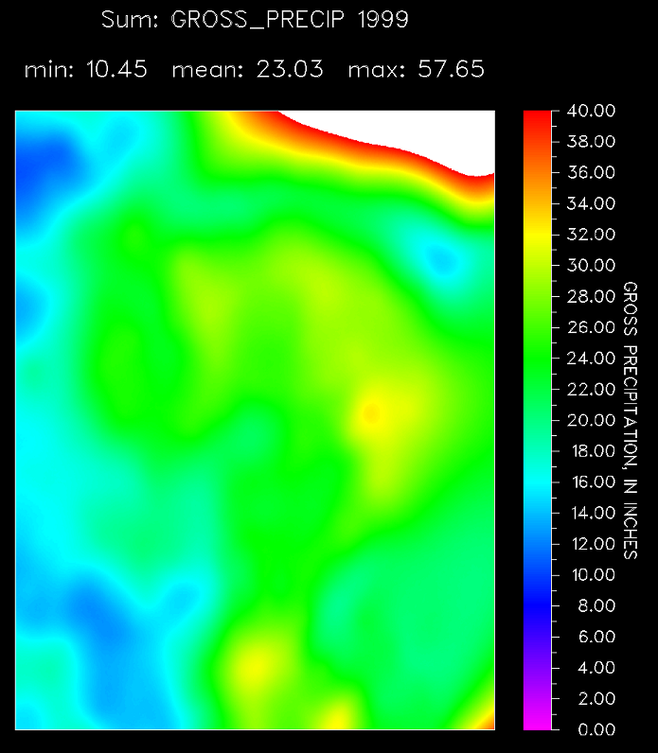
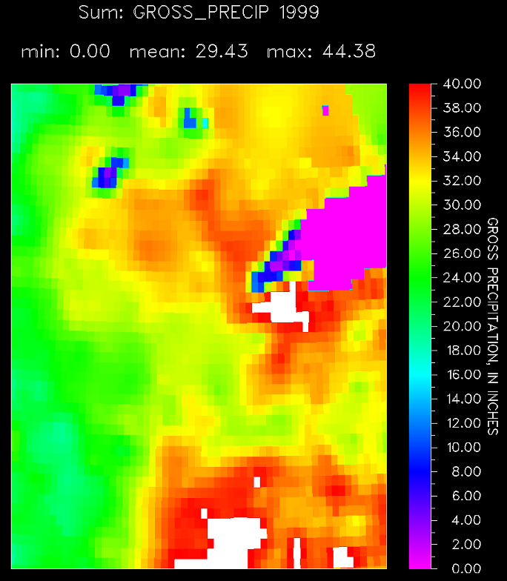
Comparison of DayMet, thin-plate spline, and Mauer precipitation, Minnesota
Ed Mauer:
1/8-degree
interpolations
TPS Interpolation:
NOAA NCDC
DayMet

Slide 7
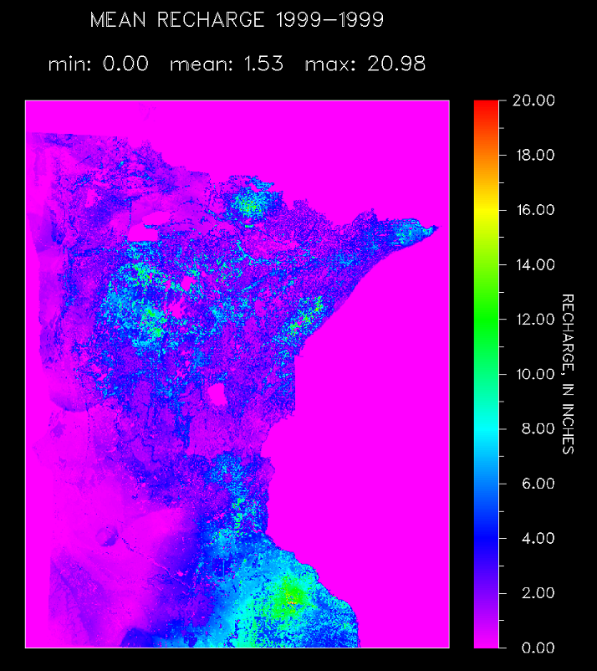
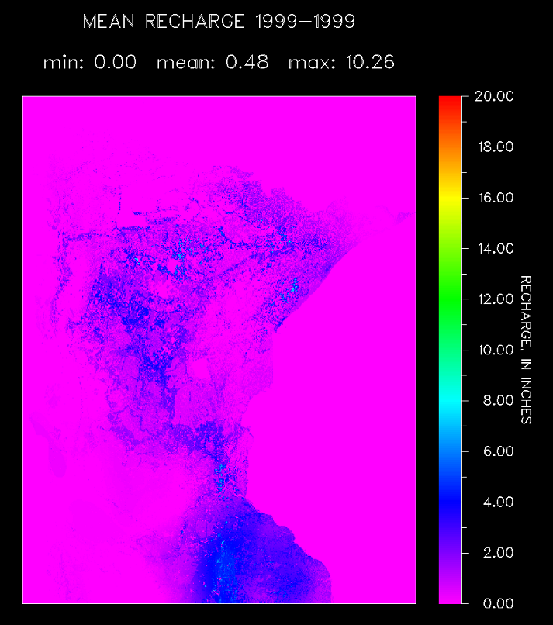
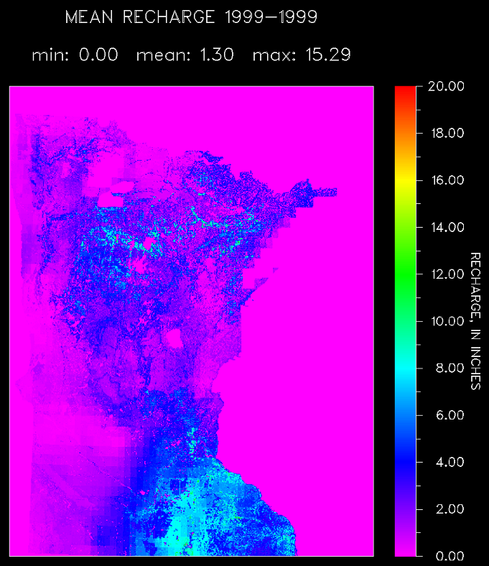
Comparison of DayMet, thin-plate spline, and Mauer potential recharge, Minnesota
Ed Mauer:
1/8-degree
interpolations
TPS Interpolation:
NOAA NCDC
DayMet

Slide 8
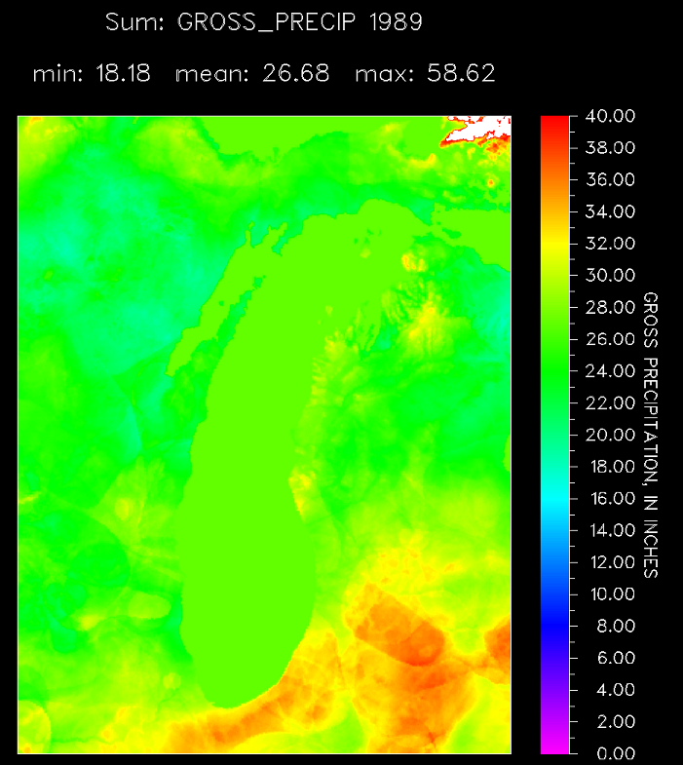
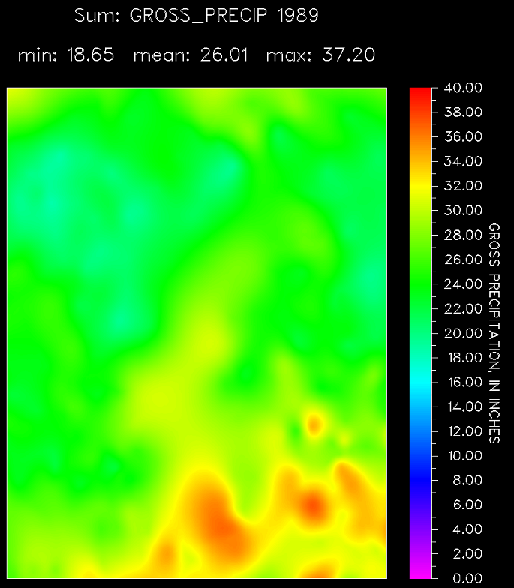
Comparison of DayMet to thin-plate spline (TPS) precipitation, Lake Michigan Basin
DayMet
TPS: NOAA NCDC

Slide 9
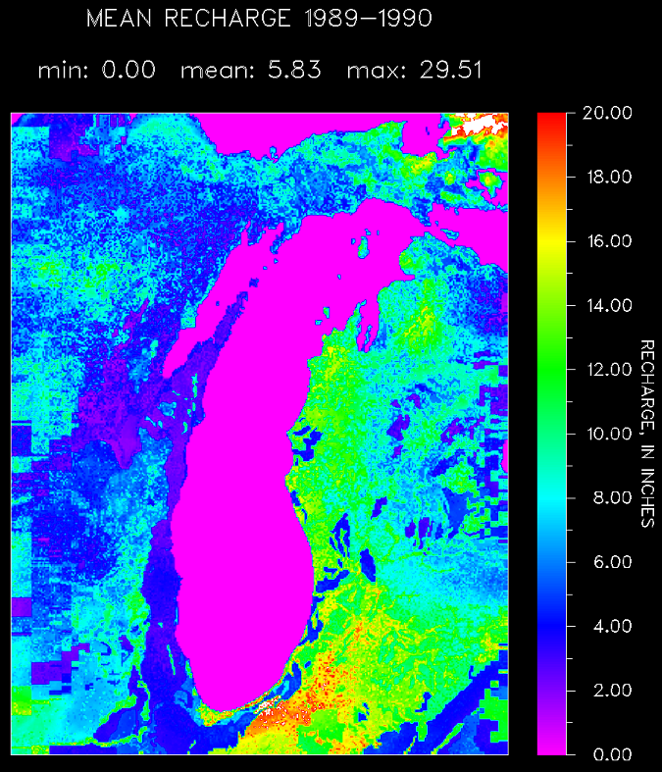
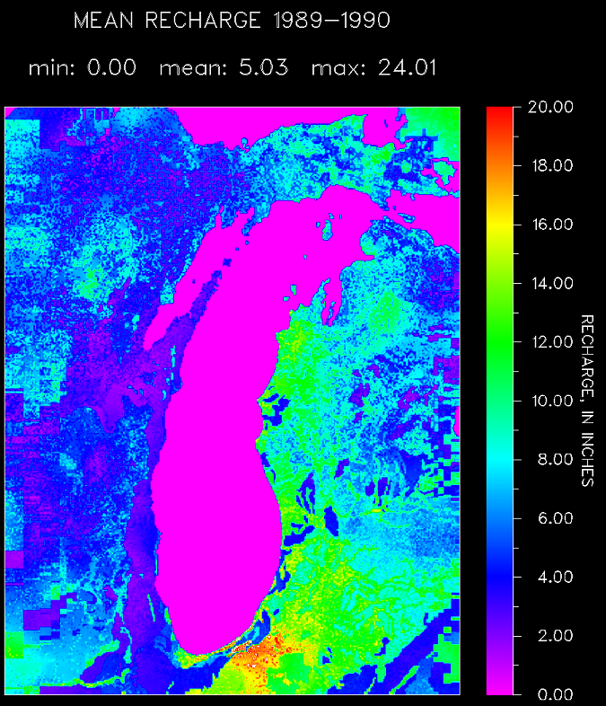
Comparison of DayMet to thin-plate spline (TPS) potential recharge, Lake Michigan Basin
Steve’s Interpolation: NOAA NCDC
DayMet
TPS: NOAA NCDC

Slide 10
Accessing data via the web Ed Mauer’s interpolated observed climate data
PRECIPITATION NETCDF http://cida.usgs.gov/thredds/dodsC/new_gmo
PRECIPITATION_GRID_PROJECTION_DEFINITION +proj=lonlat +ellps=GRS80 +datum=WGS84 +no_defs
PRECIPITATION_CONVERSION_FACTOR 3.937E-2
PRECIPITATION_MISSING_VALUES_CODE 1.0E+15
PRECIPITATION_MISSING_VALUES_OPERATOR >=
PRECIPITATION_MISSING_VALUES_ACTION MEAN
NETCDF_PRECIP_X_VAR longitude
NETCDF_PRECIP_Y_VAR latitude
NETCDF_PRECIP_Z_VAR pr
NETCDF_PRECIP_TIME_VAR time
NETCDF_PRECIP_MAKE_LOCAL_ARCHIVE
SWB control file syntax for precipitation data as served via CIDA’s geodata portal.

Slide 11
Accessing data via the web Ed Mauer’s interpolated observed climate data
TEMPERATURE NETCDF http://cida.usgs.gov/thredds/dodsC/new_gmo http://cida.usgs.gov/thredds/dodsC/new_gmo
TMAX_GRID_PROJECTION_DEFINITION +proj=lonlat +ellps=GRS80 +datum=WGS84 +no_defs
TMAX_MISSING_VALUES_CODE 1.0E+15
TMAX_MISSING_VALUES_OPERATOR >=
TMAX_MISSING_VALUES_ACTION MEAN
NETCDF_TMAX_X_VAR longitude
NETCDF_TMAX_Y_VAR latitude
NETCDF_TMAX_Z_VAR tasmax
NETCDF_TMAX_TIME_VAR time
TMAX_SCALE 1.8
TMAX_OFFSET 32
NETCDF_TMAX_MAKE_LOCAL_ARCHIVE
SWB control file syntax for maximum air temperature data as served via CIDA’s geodata portal.
For minimum air temperature, substitute TMAX with TMIN in the directives.

Slide 12
Accessing data via the web CIDA’s munged version of the DayMet interpolated observed climate data
PRECIPITATION NETCDF http://cida-eros-mows1.er.usgs.gov:8080/thredds/dodsC/daymet
PRECIPITATION_GRID_PROJECTION_DEFINITION +proj=lcc +lat_1=25.0 +lat_2=60.0 +lat_0=42.5 +lon_0=-100.0 +x_0=0.0 +y_0=0.0 +ellps=GRS80 +datum=NAD83 +units=m +no_defs
PRECIPITATION_CONVERSION_FACTOR 0.03936996
PRECIPITATION_MISSING_VALUES_CODE -32768
PRECIPITATION_MISSING_VALUES_OPERATOR <=
PRECIPITATION_MISSING_VALUES_ACTION ZERO
NETCDF_PRECIP_MAKE_LOCAL_ARCHIVE
SWB control file syntax for precipitation data as served via CIDA’s geodata portal.
This URL likely does not work outside the USGS domain.

Slide 13
Accessing data via the web CIDA’s munged version of the DayMet interpolated observed climate data
TEMPERATURE NETCDF http://cida-eros-mows1.er.usgs.gov:8080/thredds/dodsC/daymet http://cida-eros-mows1.er.usgs.gov:8080/thredds/dodsC/daymet
TMAX_GRID_PROJECTION_DEFINITION +proj=lcc +lat_1=25.0 +lat_2=60.0 +lat_0=42.5 +lon_0=-100.0 +x_0=0.0 +y_0=0.0 +ellps=GRS80 +datum=NAD83 +units=m +no_defs
TMAX_MISSING_VALUES_CODE -128
TMAX_MISSING_VALUES_OPERATOR <=
TMAX_MISSING_VALUES_ACTION MEAN
TMAX_SCALE 0.9
TMAX_OFFSET 32
NETCDF_TMAX_MAKE_LOCAL_ARCHIVE
SWB control file syntax for maximum air temperature data as served via CIDA’s geodata portal.
This URL likely does not work outside the USGS domain.

Slide 14
Accessing data locally
New data access wildcards for time series grids.
Example: CIDA DayMet; 91 files per year.
TEMPERATURE NETCDF ..\COMMON_CLIMATE\%Y-%0#_tmax.nc ..\COMMON_CLIMATE\%Y-%0#_tmin.nc
The wildcards have the following meaning:
%Y year
%d day
%m month
%0# index number, starting with zero, incremented as needed, reset at year’s end

