Slide 1
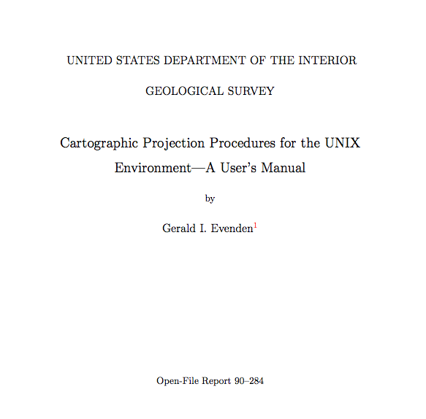
PROJ.4
Supports over 70 map projections
Originally developed by USGS
Researcher Gerald Evenden
Adopted and extended by the
Open Source Geospatial
Foundation
( http://www.osgeo.org/ )
Linked as a library to the latest
version of SWB
Sources: http://pubs.er.usgs.gov/publication/ofr90284
http://trac.osgeo.org/proj/

Slide 2
Datasets highlighted in previous SWB example note the variety of projections used
Data Type | Projection | Datum | Provider | Used for
Elevation | State Plane, Ohio North (feet) | NAD 1983 | Ohio Statewide Imagery Program | Flow direction grid
Soils | UTM Zone 17N (meters) | NAD 1983 | USDA Soil Data Mart | Available water content (AWC) and hydrologic soils group grids
Land Use / Land Cover | Albers Equal Area (meters) | NAD 1983 | USGS Seamless | Land use grid

Slide 3
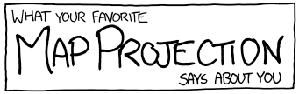
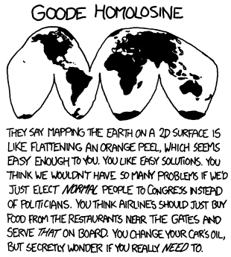
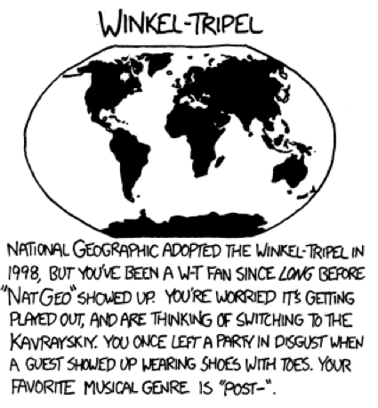
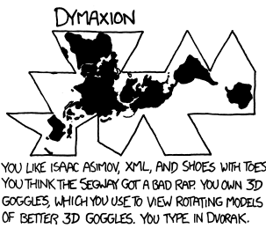
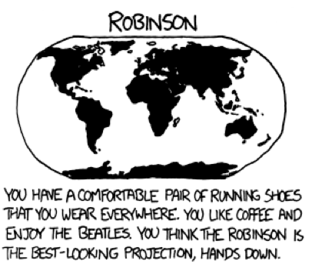
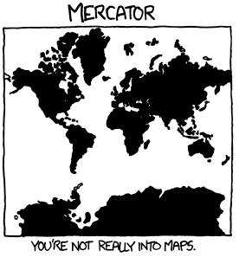
Source: http://xkcd.com/977/

Slide 4
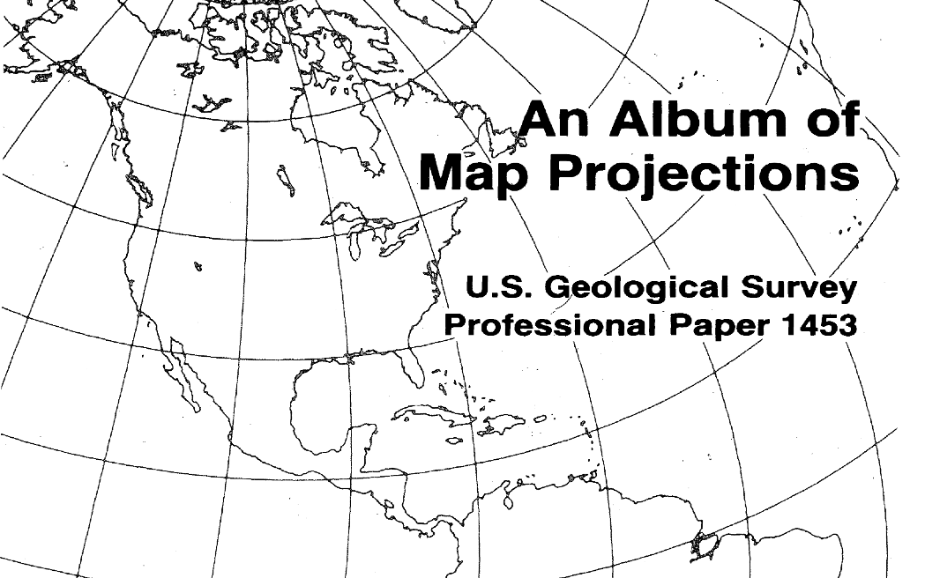
A classic USGS publication on the subject
Source: http://pubs.er.usgs.gov/publication/pp1453

Slide 5
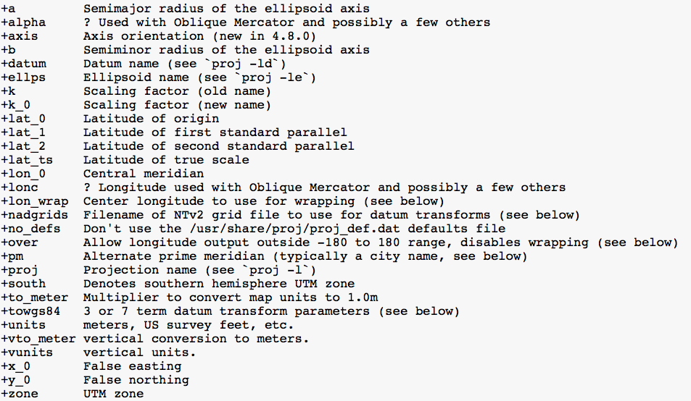
PROJ.4 Projection String Parameters
Source: https://trac.osgeo.org/proj/wiki/GenParms

Slide 6
Common PROJ.4 Strings
National Landcover Database (NLCD)
Albers Equal Area projection
+proj=aea +lat_1=29.5 +lat_2=45.5 +lat_0=23.0 + lon_0=-96 +x_0=0 +y_0=0 +ellps=GRS80 +datum=NAD83 +units=m +no_defs
DayMet (as processed by CIDA)
Lambert Conformal Conic projection
+proj=lcc +lat_1=25.0 +lat_2=60.0 +lat_0=42.5 +lon_0=-100.0 +x_0=0.0 +y_0=0.0 +ellps=GRS80 +datum=NAD83 +units=m +no_defs
Ed Mauer’s gridded climate station data
Geographic (unprojected)
+proj=lonlat +ellps=GRS80 +datum=WGS84 +no_defs

Slide 7
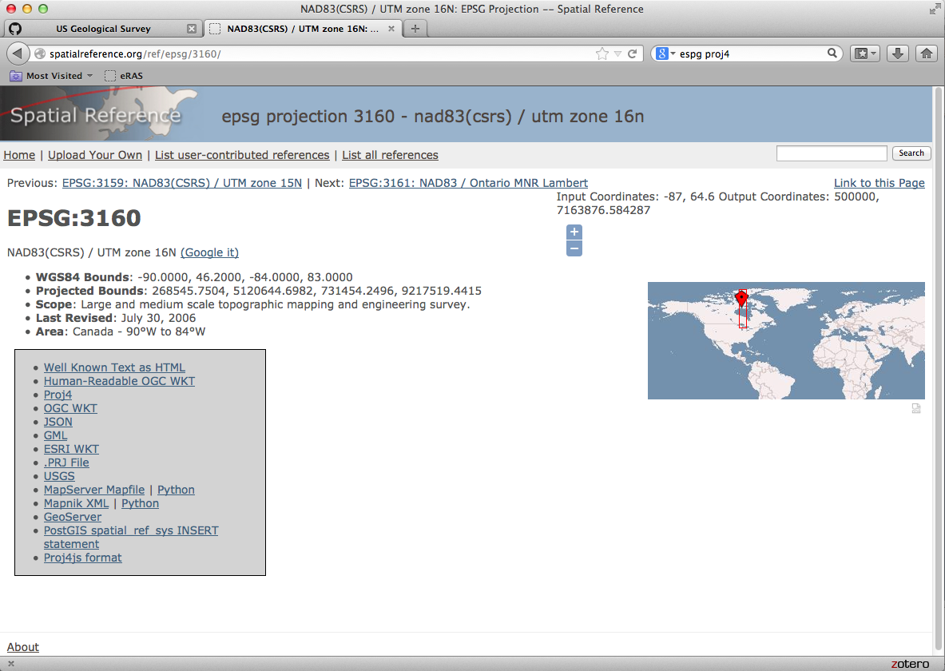
A potentially useful source for PROJ.4 strings use caution: users can upload their own PROJ.4 strings
Source: http://www.spatialreference.org

Slide 8
Using the PROJ.4 features in SWB base grid *must* have a projection defined
GRID 75 85 757000.0 539100.0 200.0
BASE_PROJECTION_DEFINITION +proj=tmerc +lat_0=0.0 +lon_0=-90.0 +k=0.9996 +x_0=520000 +y_0=-4480000 +datum=NAD83 +units=m +no_defs
In this example the SWB model domain is associated with the
Wisconsin Transverse Mercator (WTM) projection (NAD83/91)

Slide 9
Using the PROJ.4 features in SWB SWB control file directives
# climate data is unprojected (lat/lon)
PRECIPITATION_GRID_PROJECTION_DEFINITION +proj=lonlat +ellps=GRS80 +datum=WGS84 +no_defs
TMAX_GRID_PROJECTION_DEFINITION +proj=lonlat +ellps=GRS80 +datum=WGS84 +no_defs
TMIN_GRID_PROJECTION_DEFINITION +proj=lonlat +ellps=GRS80 +datum=WGS84 +no_defs
# flow direction grid is in Wisconsin Transverse Mercator (83/91)
FLOW_DIRECTION_PROJECTION_DEFINITION +proj=tmerc +lat_0=0.0 +lon_0=-90.0 +k=0.9996 +x_0=520000 +y_0=-4480000 +datum=NAD83 +units=m +no_defs
# soil hydrologic group grid is unprojected (lat/lon)
SOIL_GROUP_PROJECTION_DEFINITION +proj=lonlat +ellps=GRS80 +datum=NAD83 +no_defs
# landuse grid is in Albers Equal Area
LANDUSE_PROJECTION_DEFINITION +proj=aea +lat_1=29.5 +lat_2=45.5 +lat_0=23 +lon_0=-96 +x_0=0 +y_0=0 +ellps=GRS80 +datum=NAD83 +units=m +no_defs
# available water capacity grid is unprojected (lat/lon)
WATER_CAPACITY_PROJECTION_DEFINITION +proj=lonlat +ellps=GRS80 +datum=NAD83 +no_defs
If no projection information is specified for a particular spatial dataset,
It is assumed to share the same projection characteristics as the base grid

Slide 10
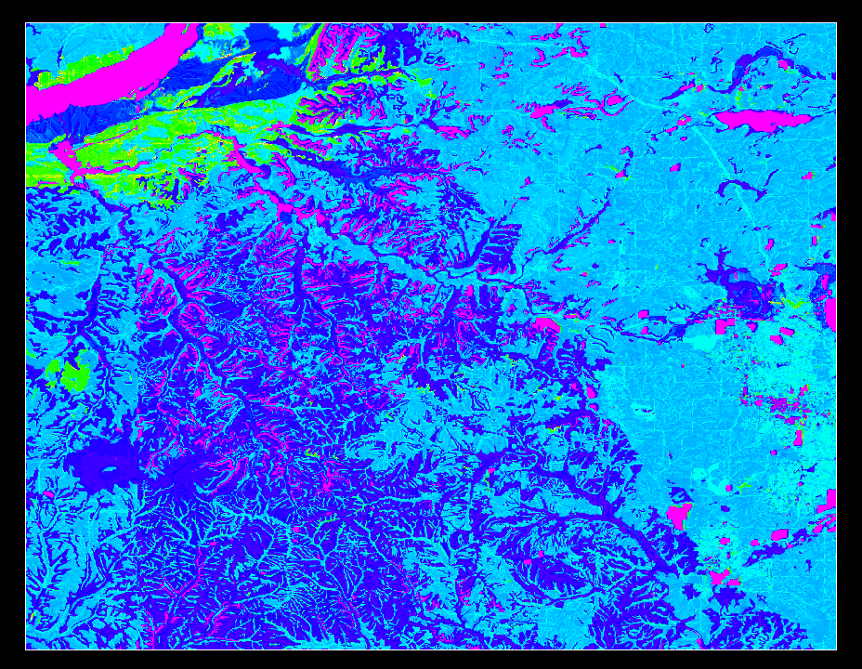
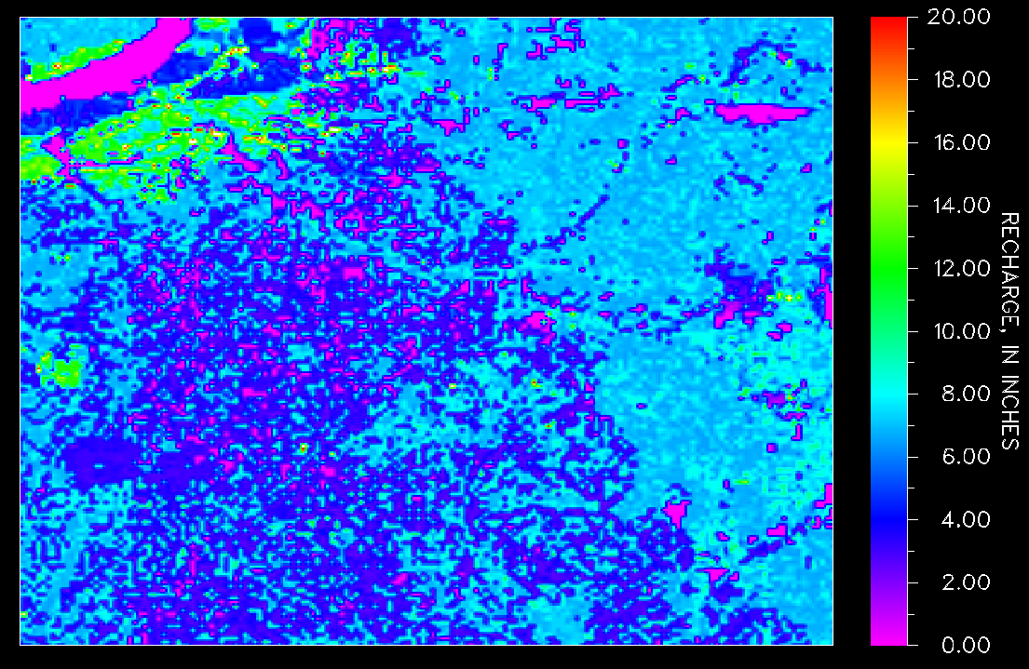
Basic regridding algorithm + PROJ.4 much easier to experiment with alternate grid cell resolutions
25-meter grid
200-meter grid
integer grids: simple majority filter; real-value grids: mean value over adjacent cells

