Slide 1

Django Async View
Atakan Doğan
19070006045

Slide 2
Presentation Outline
Overview of Django Async Views:
Definition and benefits of asynchronous programming in Django.
Basic Concepts:
Introduction to coroutine functions, async and await keywords.
Django's Asynchronous Support:
Transition from traditional synchronous views to asynchronous views in Django.
Async Views in Django:
Declaration using the async def syntax and examples.
Managing Asynchronous Operations:
Overview of asynchronous tasks in Django, integration with Django's ORM, and examples using asyncio with async views.
Real-world Use Cases:
Explore scenarios where async views are beneficial, with examples from production use cases.
Challenges and Considerations:
Discuss potential challenges of using async views and considerations for migrating existing synchronous views to async.
Demo:
I will show you an example async view code snippet that I wrote.
Conclusion:
Recap of key points and emphasizing the advantages and considerations of using async views in Django.
Sources:
List of references, articles, and resources used in the presentation and code implementation.

Slide 3
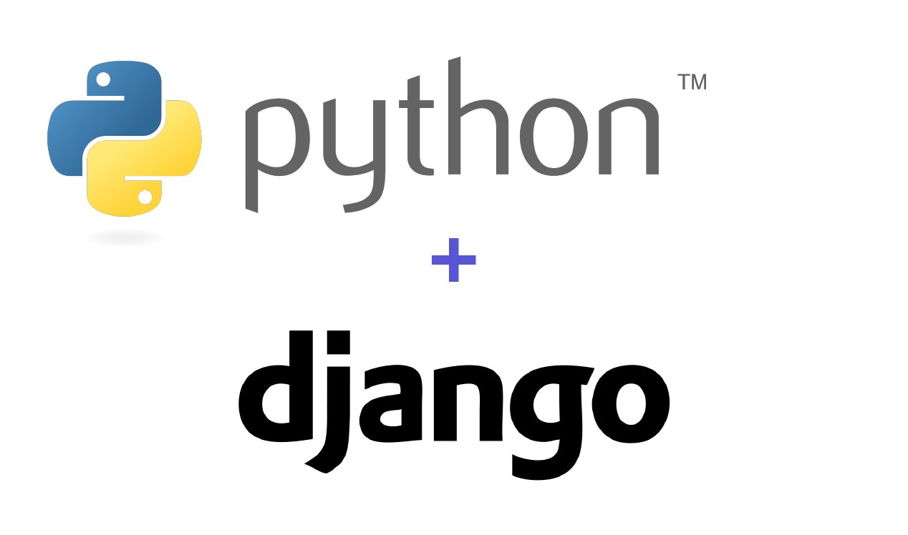
Introduction
Introduction to Django
Django is a high-level web framework for building robust web applications.
Known for its simplicity, flexibility, and adherence to the DRY (Don't Repeat Yourself) principle.

Slide 4

Django's Role in Web Development
Facilitates the rapid development of web applications.
Django's built-in Object-Relational Mapping (ORM) simplifies database interactions. Developers can work with Python objects, abstracting the complexity of database management.

Slide 5
Traditional Synchronous Nature of Django Views:
In traditional Django views, operations occur sequentially.
Each task must complete before the next one begins, potentially leading to slower response times.

Slide 6
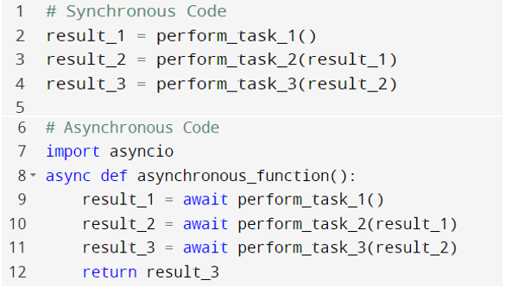
What is Asynchronous Programming?
Definition: Asynchronous programming allows tasks to run independently, boosting performance and responsiveness.
Synchronous vs. Asynchronous Execution
Synchronous: Operations wait for each other to finish.
Asynchronous: Tasks can overlap, enhancing responsiveness, and performance.

Slide 7
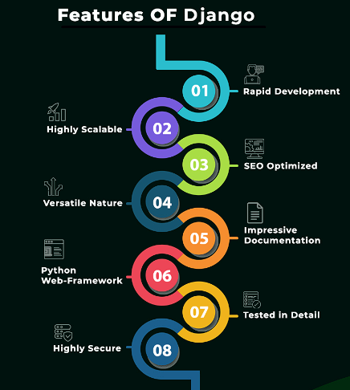
Django's Asynchronous Support
Django introduced asynchronous support in version 3.1 and later.
Benefits:
Improved scalability and responsiveness.
Efficient handling of concurrent requests.

Slide 8
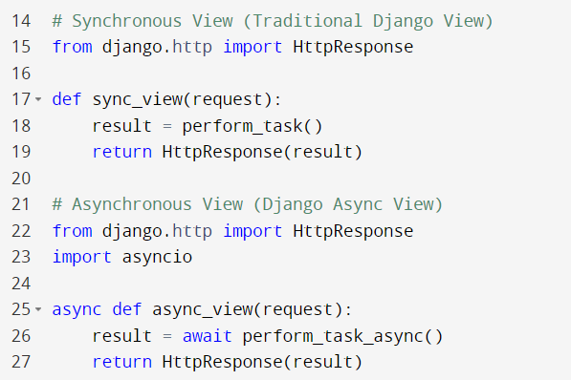
Asynchronous Operations
async def syntax and await keyword

Slide 9

Real-world Use Cases
Scenarios where Async Views are Beneficial
High Traffic Websites
Real-time Applications (chat applications - live notifications)
Long-running Operations: (like image processing or data analysis)
Performance Improvements in Handling Concurrent Requests:
Concurrency (multiple requests simultaneously)
Improved Responsiveness (responsive, better user experience)
Examples from Production Use Cases
Social Media Feeds
E-commerce Platforms
Collaborative Editing

Slide 10
Challenges and Considerations
Potential Challenges of Using Async Views
Complexity
Debugging
Compatibility
Considerations for Migrating Existing Synchronous Views to Async
Partial Adoption
Dependencies

Slide 11
Conclusion
Recap of Key Points
Async Views in Django: Introduced in Django 3.1 and later.
Basic Concepts: async def syntax, await keyword, and the benefits of asynchronous programming.
Advantages:
Improved performance in handling concurrent requests.
Enhanced responsiveness for a better user experience.
Efficient handling of long-running operations.
Considerations:
Potential complexity in asynchronous code.
Debugging challenges.
Compatibility with third-party libraries.

Slide 12
References and Resources
Django Documentation. https://docs.djangoproject.com/
Helped for the code implementation part. https://testdriven.io/blog/django-async-views/
API that i use in project : https://newsapi.org , https://www.weatherapi.com/

