Slide 1
CASINO REVENUE PREDICTION ANALYSIS
NAZIM ATAKAN ERDOGAN, Data Science Intern

Slide 2
Agenda
Introduction
EDA
ML

Slide 3
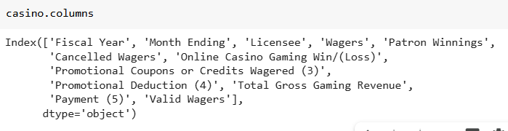
OVERVIEW
In this project it will searched for the interrelating factors of casino revenues; and machine learning algorithms will be applied for predictions.

Slide 4
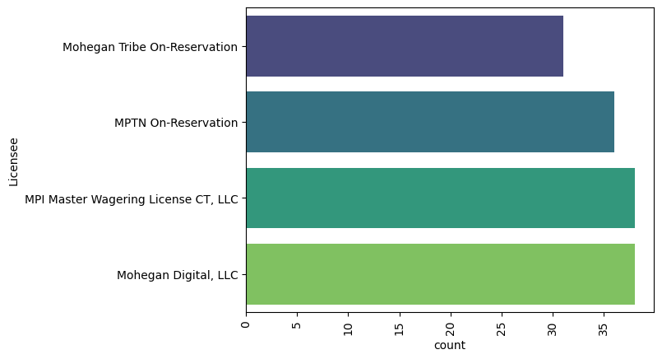
LICENSEES

Slide 5
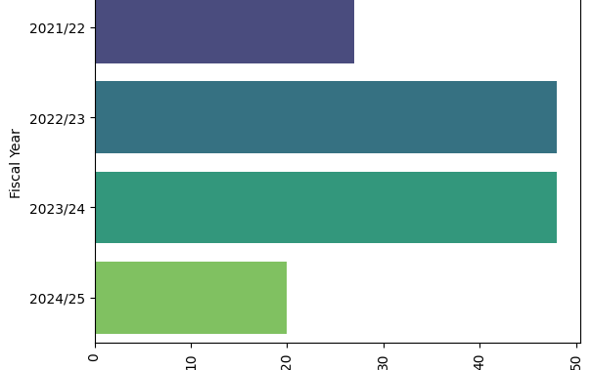
WAGERS THROUGH THE YEARS

Slide 6
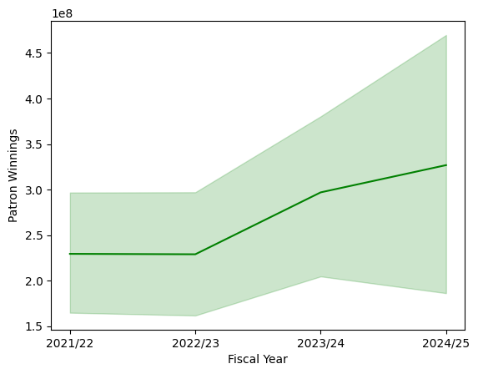
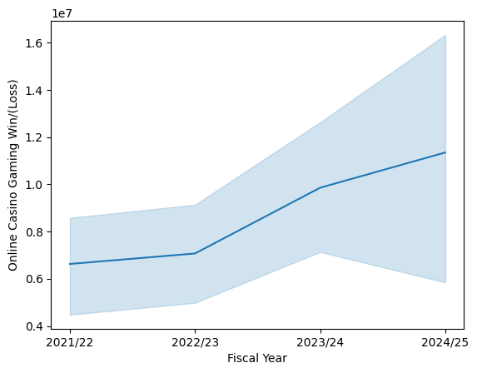
Patron winnings and Online Casino Gaming Win and Losses

Slide 7
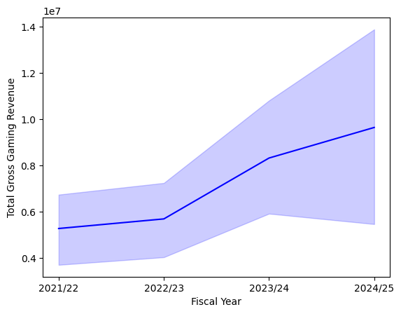
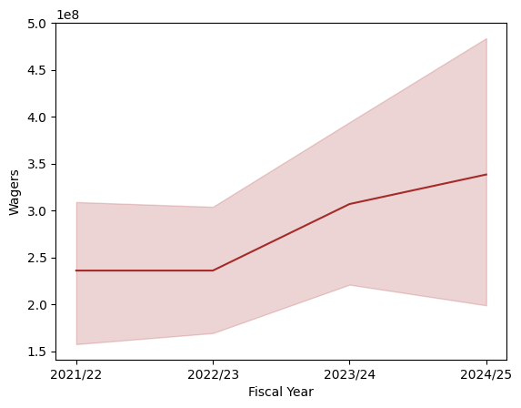
Total gross gaming revenue and wagers

Slide 8
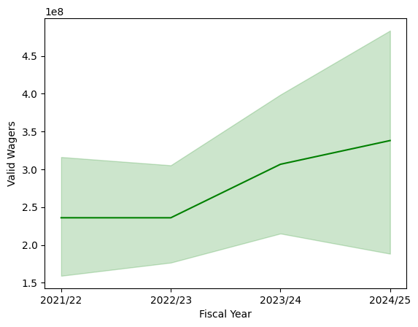
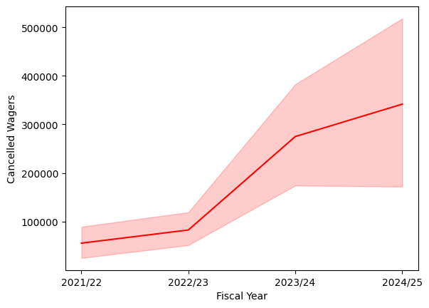
Cancelled wagers and valid wagers

Slide 9
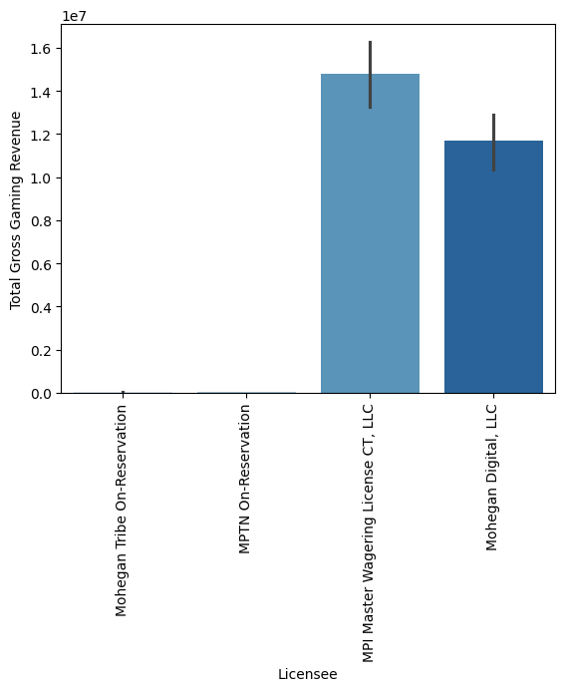
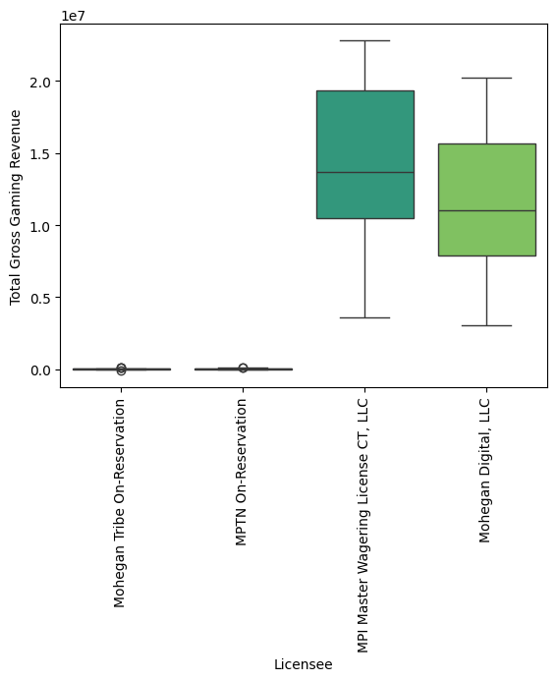

Slide 10
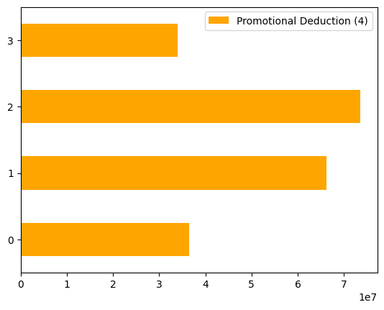
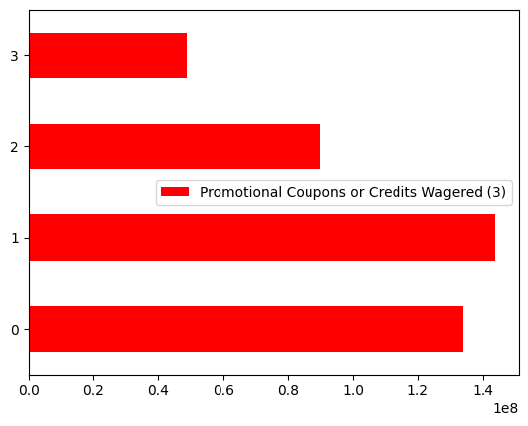
Promotions

Slide 11
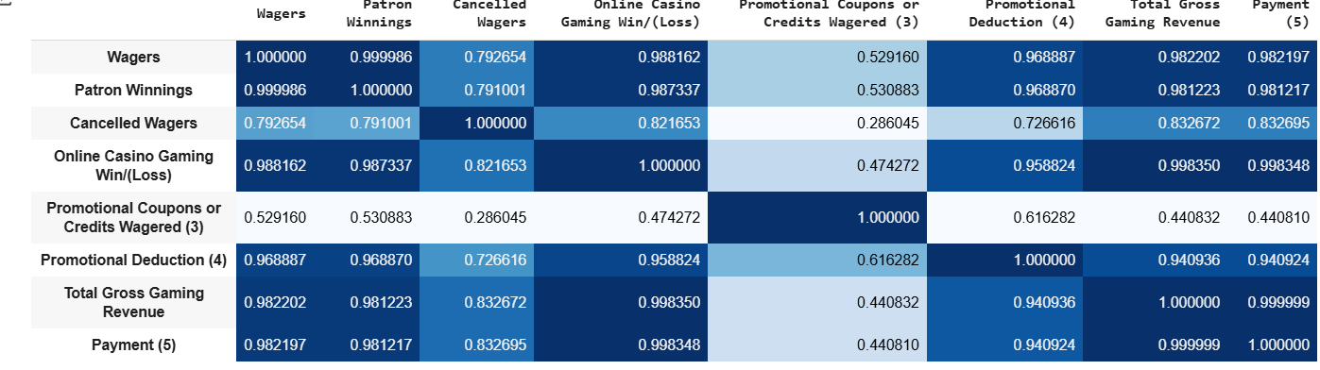

Slide 12
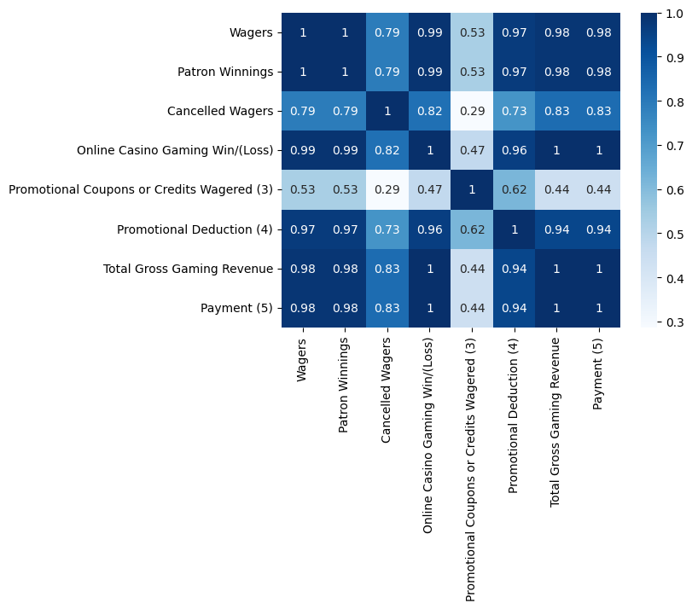

Slide 13
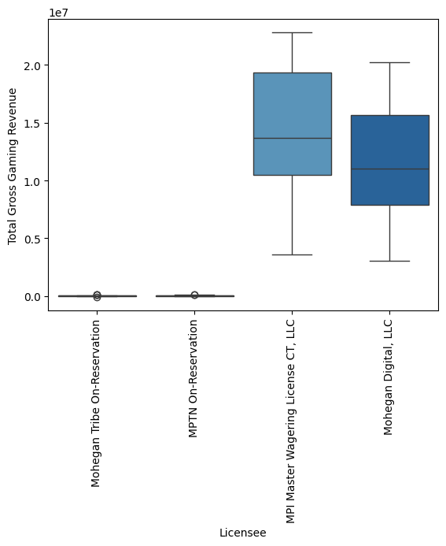
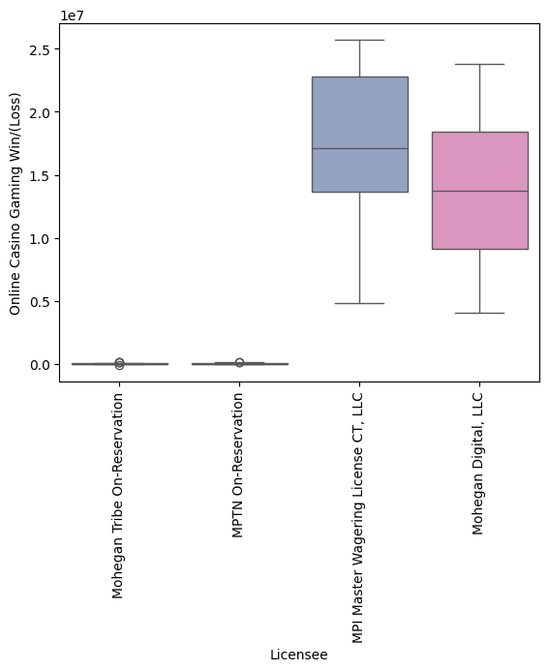

Slide 14
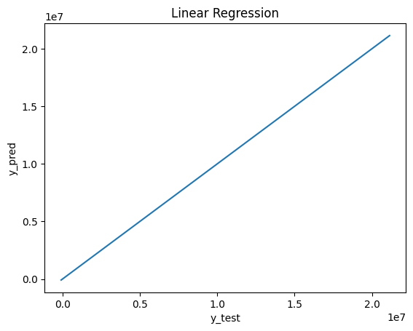
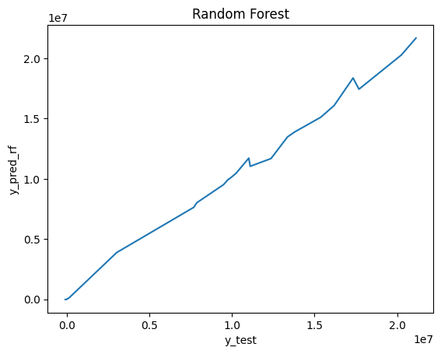
ML 1

Slide 15
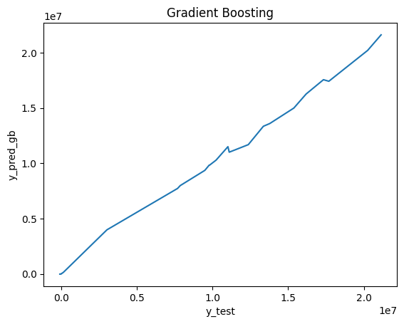
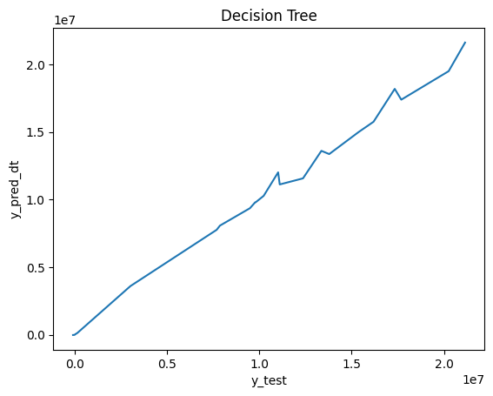
ML 2

Slide 16
Thank you
Nazim Atakan Erdogan
Data Science Intern

