Slide 1
Utilizing Parallel Workers: LLVM’s Vectorization Plan
Jonas Fritsch
School of Computation, Information, and Technology
Technical University of Munich
Munich, 29. January 2025

Slide 2
Outline
TODO

Slide 3
Background: SIMD & Vectorization
Single Instruction, Single Data (SISD)
Single Instruction, Multiple Data (SIMD)
1
2
3
4
1
2
3
4
+
+
+
+
+
5
5
5
5
5
5
5
5
=
=
=
=
=
6
7
8
9
6
7
8
9
Notes:
Compare SISD (scalar) to SIMD (vectorized)
Normal Register vs. Vector Register
Normal Add Instruction vs Vector Add Instruction

Slide 4
Background: SIMD & Vectorization
Single Instruction, Multiple Data (SIMD):
Can provide major performance speedup by multiple factors
Applies one operation to multiple vector elements at once
Needs specialized hardware and ISAs
SIMD ISAs:
Intel MMX as first widely adopted SIMD ISA in 1996
Intel & AMD: SSE, AVX (128 – 512 bit wide registers)
ARM: NEON, SVE
RISC-V: RVV
SVE & RVV provide vector length agnostic instructions!
Notes:
SIMD:
+ Can provide major Speedup (4 – 16x or more)
- Applies one operation to multiple packed vector elements (operation can be masked to allow for more complex behaviour)
- Needs specialized hardware (SIMD Registers) and ISAs
SIMD ISAs:
- First wide adoption back in 1996 with Intel MMX, but nowadays:
Intel & AMD: SSE, AVX (up to 512 bit wide registers – fits 16 x 32 bit integers at once)
ARM: NEON, SVE,
RISC-V: RVV
- SVE and RVV as variable vector length ISAs (code is vector-length agnostic)

Slide 5
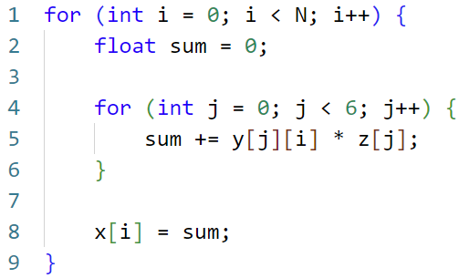
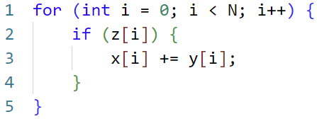
Vectorization: Strategies
Inner-Loop Vectorization
Outer-Loop Vectorization
Asdlfasdf
asdfaasdf
Asdlfasdf
asdfaasdf

Slide 6
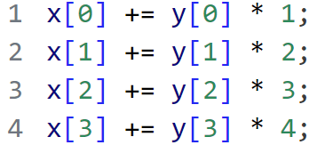
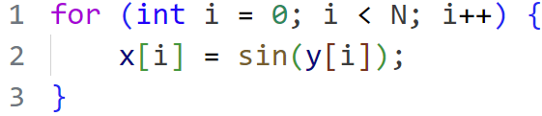
Vectorization: Strategies
Super-Word Parallelism (SLP) Vectorization
Function Vectorization
Asdlfasdf
asdfaasdf
Asdlfasdf
asdfaasdf

Slide 7
Vectorization: Legality
1. Data Dependencies
asdf

Slide 8
Vectorization: Legality
1. Data Dependencies
asdf

Slide 9
Vectorization: Legality
2. Uncountable Loops
asdf

Slide 10
Vectorization: Legality
3. Scalar Instructions without SIMD Equivalent
asdf

Slide 11
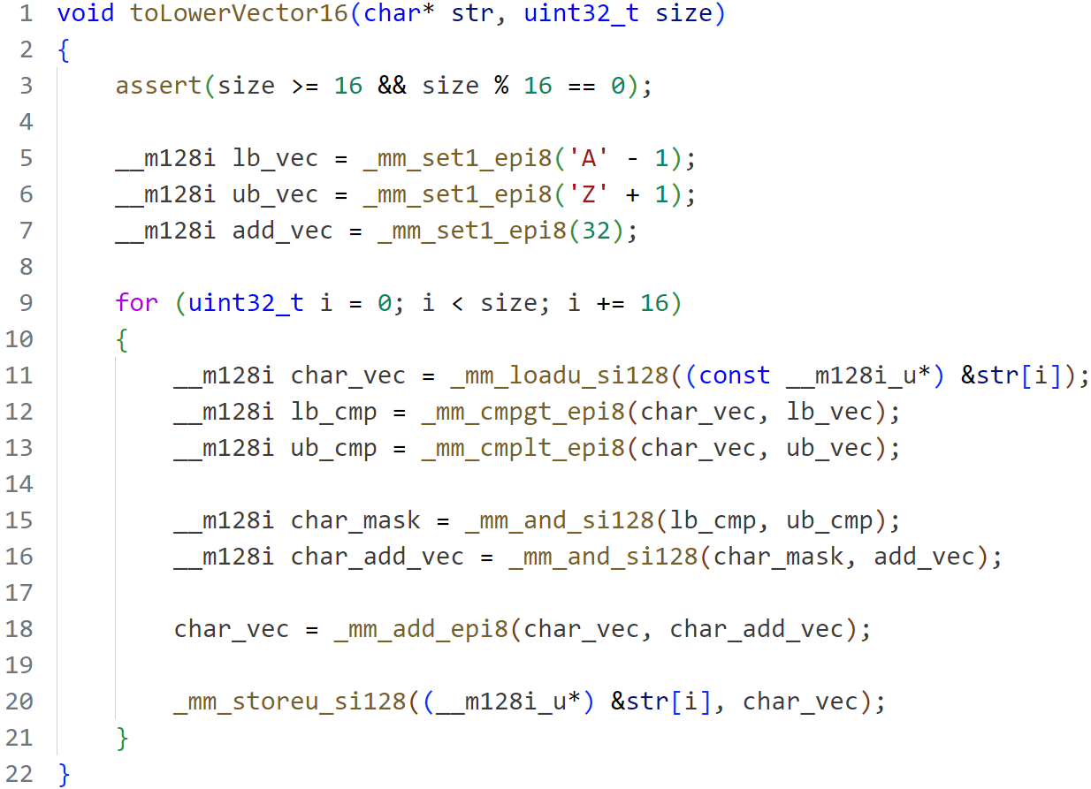
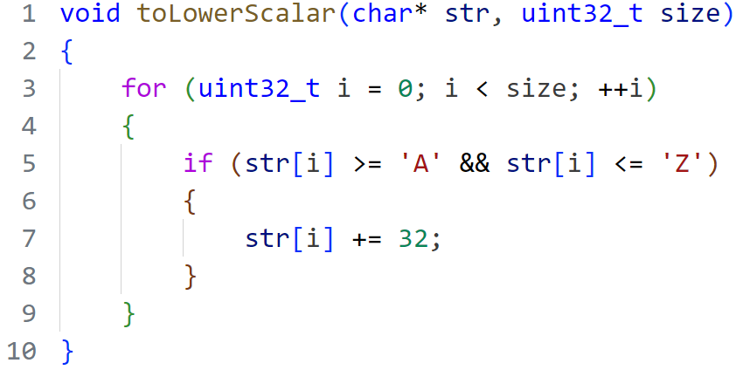
Why Auto-Vectorization?
Idea: Let the Compiler do the work!
Notes:
Function converts upper case characters to lower case
Vector version doesn’t look too bad. About double code size.
BUT: SIMD version is specialized (size % 16) and SSE architecture specific
Handling arbitrary size adds more complexity / code.
Targeting other architectures requires completely new code.
=> Manual Code Vectorization is time consuming
Idea: Let the compiler do the work
Compiler knows the target architecture

Slide 12
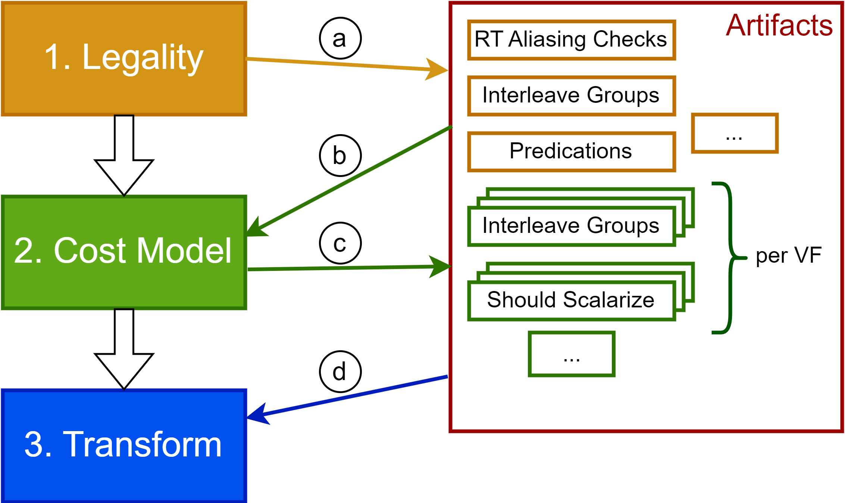
LLVM’s Auto-Vectorization (Before)
Provides two Vectorizers:
LoopVectorize (innermost loops)
SLPVectorize (straight-line code)

Slide 13
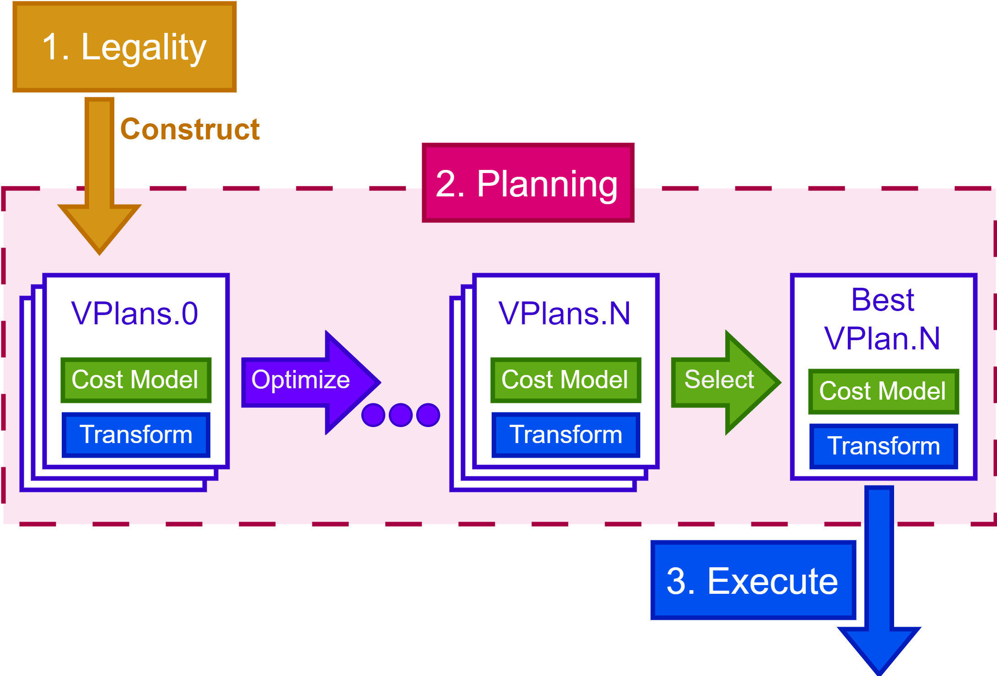
Intel’s initial VPlan Proposal
New system proposed by Intel in 2016:
Focus on modularity and extendibility
Unite SLP, Inner-/Outer-Loop, and Whole-Function Vectorization
VPlans representing different vectorization approaches

Slide 14
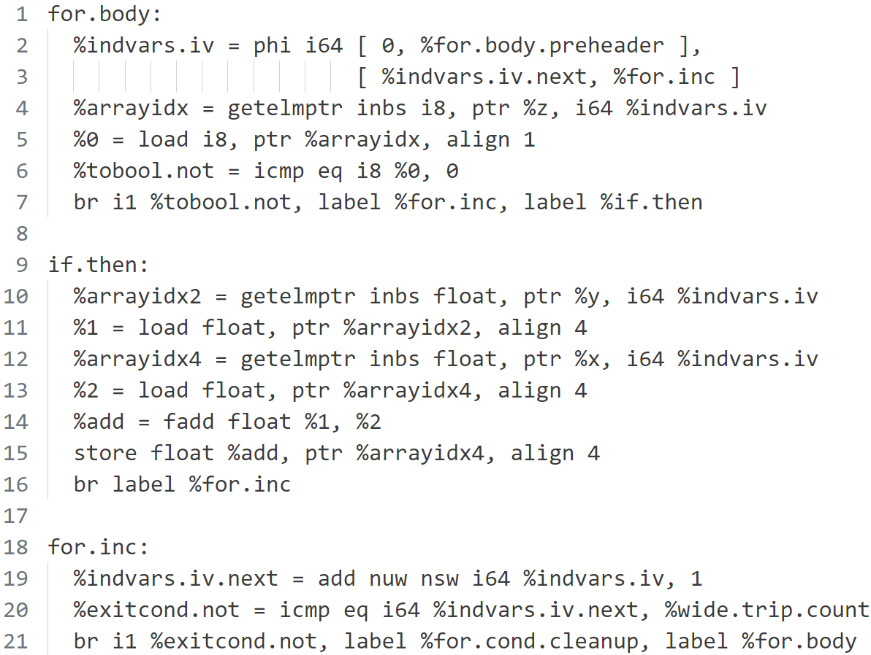
LLVM IR

Slide 15
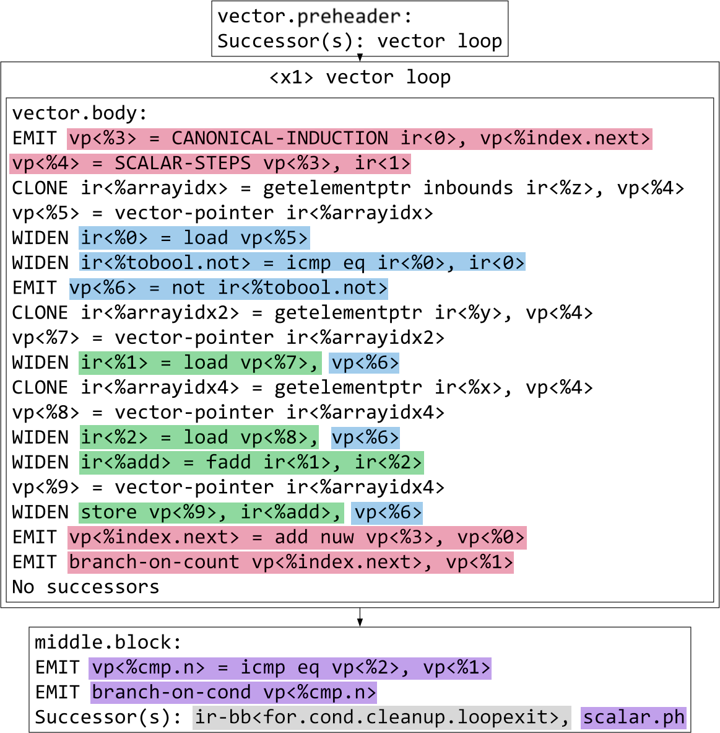
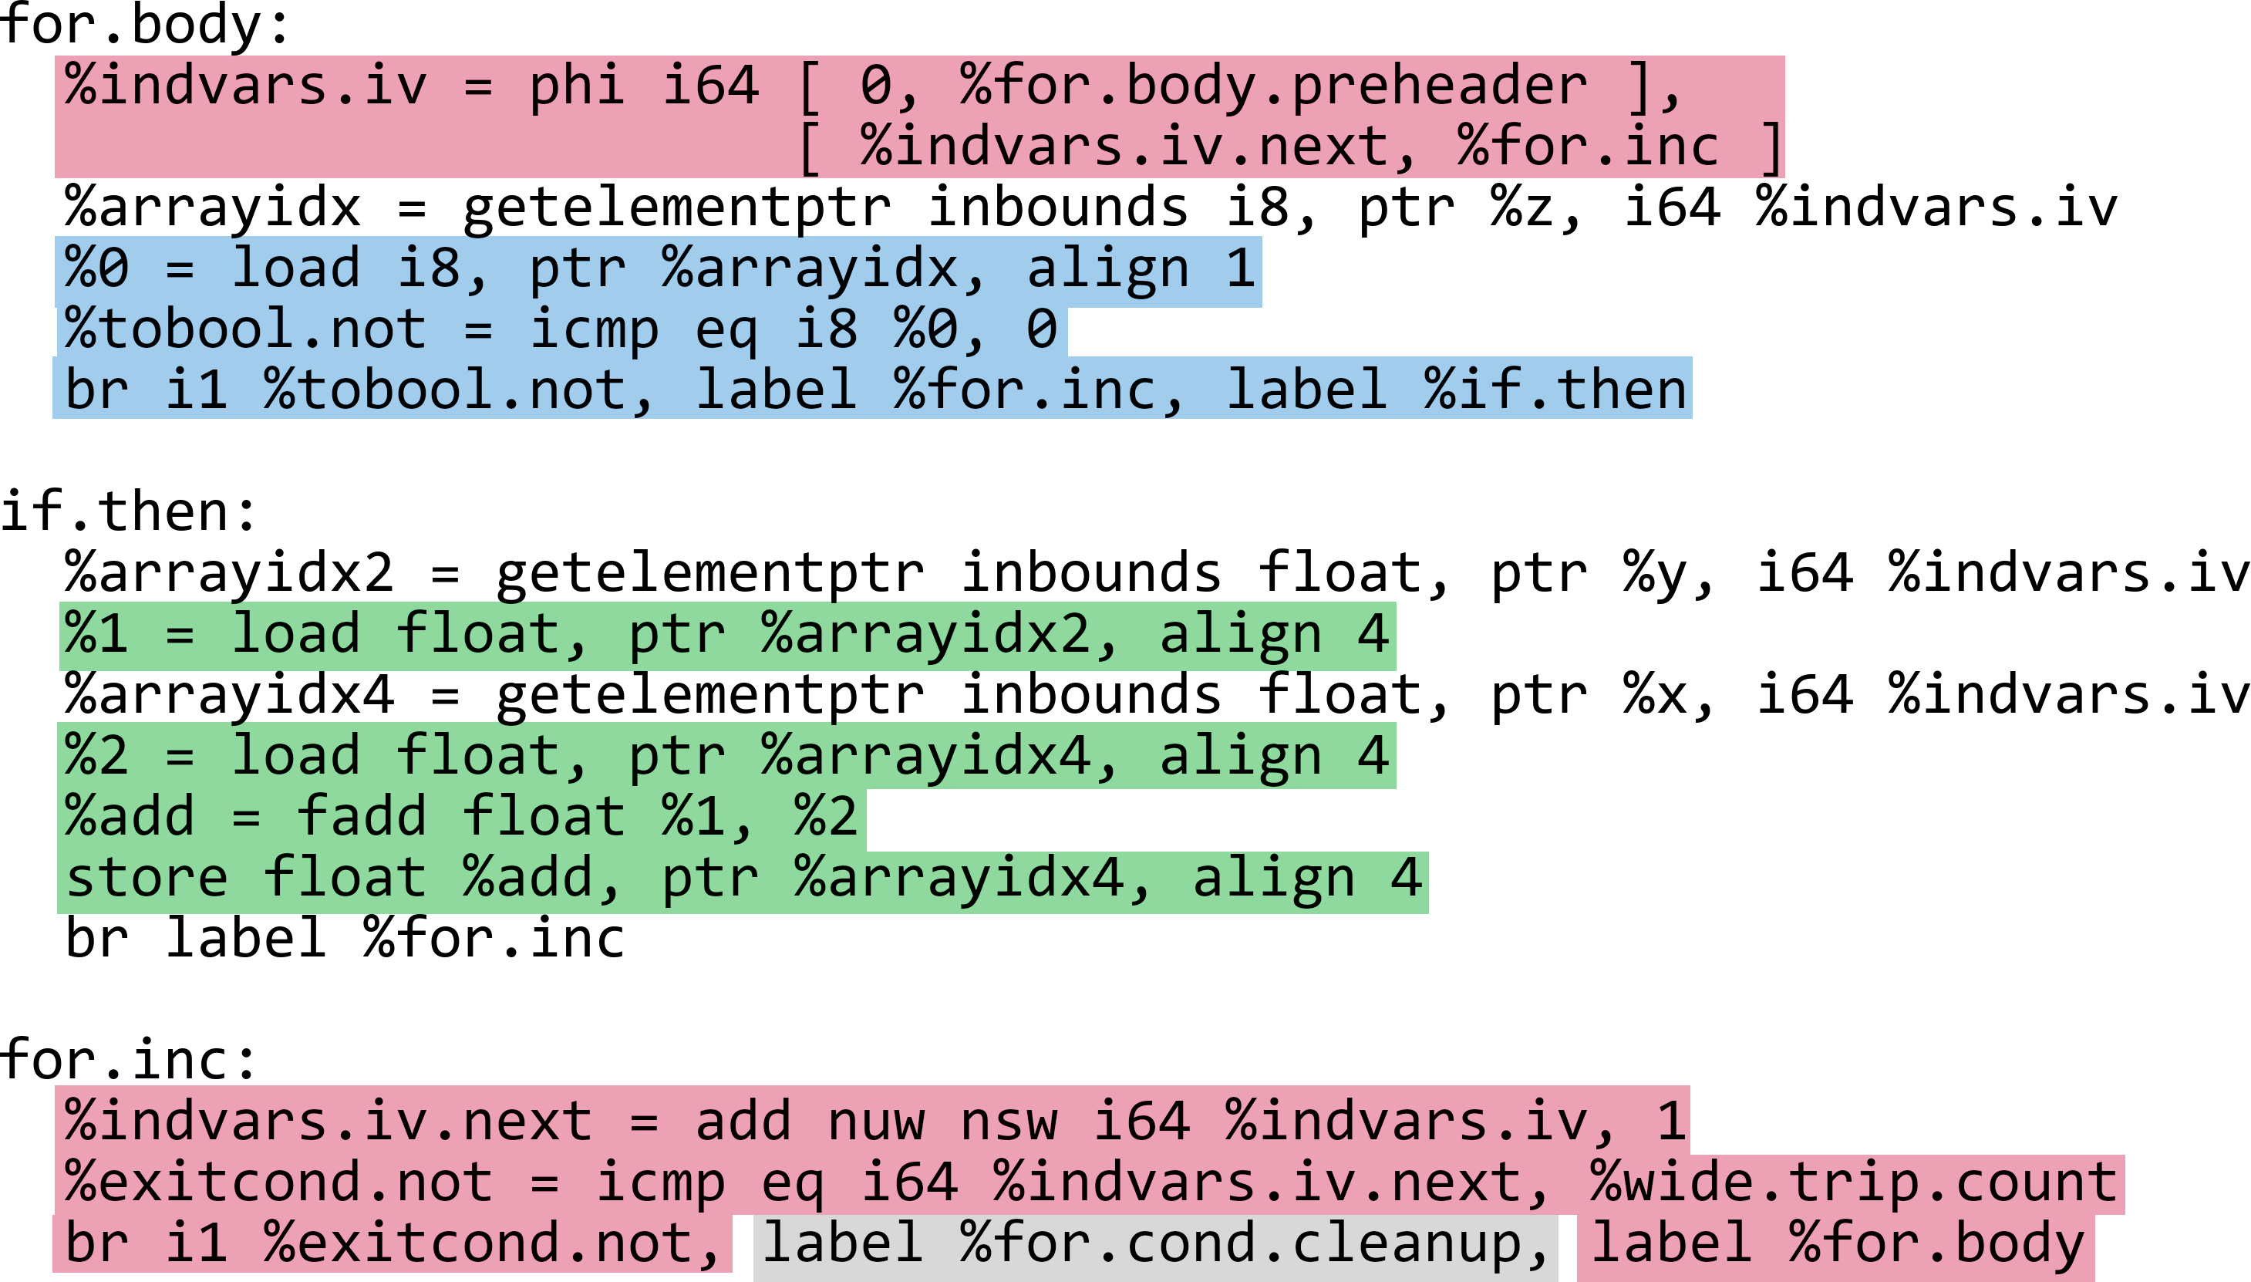
VPlan Structure

Slide 16
Conclusion
Vectorization

