Slide 1
Utilizing Parallel Workers: LLVM’s Vectorization Plan
Jonas Fritsch
School of Computation, Information, and Technology
Technical University of Munich
Munich, 29. January 2025

Slide 2
Outline
Background: SIMD & Vectorization
Auto-Vectorization in LLVM (Before)
The new VPlan system
What is a VPlan?
State of VPlan (LLVM 19.1.4)
Conclusion

Slide 3
SIMD
Single Instruction, Single Data (SISD)
Single Instruction, Multiple Data (SIMD)
1
2
3
4
1
2
3
4
+
+
+
+
+
5
5
5
5
5
5
5
5
=
=
=
=
=
6
7
8
9
6
7
8
9
Notes:
Compare SISD (scalar) to SIMD (vectorized)
Normal Register vs. Vector Register
Normal Add Instruction vs Vector Add Instruction

Slide 4
SIMD
Single Instruction, Multiple Data (SIMD):
Can provide major performance speedup by multiple factors
Applies one operation to multiple vector elements at once
Needs specialized hardware and ISAs
SIMD ISAs:
Intel & AMD: SSE, AVX (128 – 512 bit wide registers)
ARM: NEON, SVE
RISC-V: RVV
Notes:
SIMD:
+ Can provide major Speedup (4 – 16x or more)
- Applies one operation to multiple packed vector elements (operation can be masked to allow for more complex behaviour)
- Needs specialized hardware (SIMD Registers) and ISAs
SIMD ISAs:
- First wide adoption back in 1996 with Intel MMX, but nowadays:
Intel & AMD: SSE, AVX (up to 512 bit wide registers – fits 16 x 32 bit integers at once)
ARM: NEON, SVE,
RISC-V: RVV
- SVE and RVV as variable vector length ISAs (code is vector-length agnostic)

Slide 5
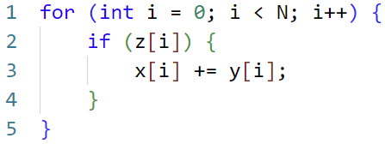
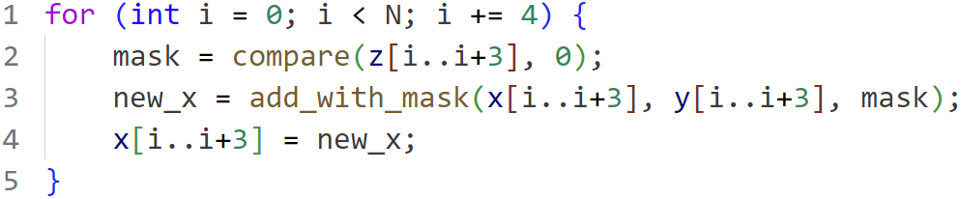
Vectorization: Strategies
Inner-Loop Vectorization

Slide 6
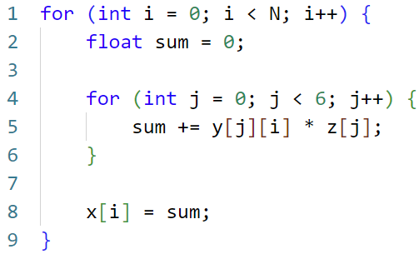
Vectorization: Strategies
Inner-Loop Vectorization
Outer-Loop Vectorization

Slide 7
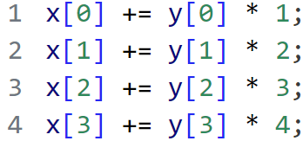
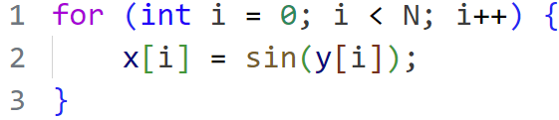
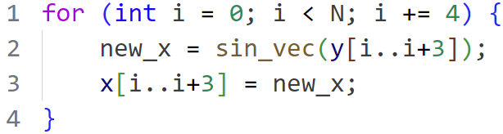
Vectorization: Strategies
Super-Word Parallelism (SLP) Vectorization
Whole-Function Vectorization
Notes:
Vectorization seems pretty cool and useful. Can we always do it?

Slide 8

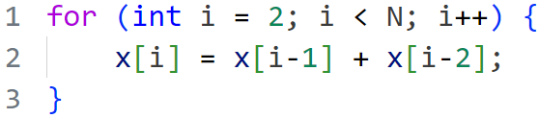
Vectorization: Legality
1. Data Dependencies
Vectorization changes order of operations
All operations must not depend on previous iterations
Notes:
Question: Is loop legal to vectorize? Why not?
Data Dependencies
Vectorization changes order of operations.
To ensure not changing semantic, all operations inside loop body must be independent from results of previous iteration

Slide 9
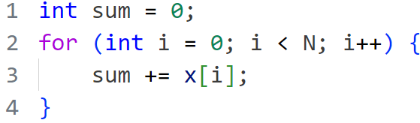

Vectorization: Legality
1. Data Dependencies
Vectorization changes order of operations
All operations must not depend on previous iterations
except for things like reductions
Notes:
Sum addition does depend on previous iteration result
but special case (reduction)
Vectorize by splitting up total sum and adding split sums together afterwards

Slide 10

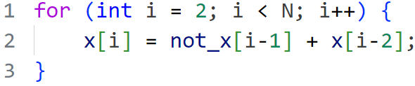
Vectorization: Legality
1. Data Dependencies
Vectorization changes order of operations
All operations must not depend on previous iterations
except for things like reductions
with regards to the Vectorization Factor (VF)
Notes:
Same as first loop but not_x instead of x.
Store does depend on “previous-previous” iteration
But 2 iterations could be processed at the same time => Vectorization Factor
Why could this potentially still not work?

Slide 11
Vectorization: Legality
1. Data Dependencies
Vectorization changes order of operations
All operations must not depend on previous iterations
except for things like reductions
with regards to the Vectorization Factor (VF)
and pointers should not overlap (alias).
Notes:
Why could VF=2 potentially still not work?
Lie: not_x = x
Pointers should not overlap (pointer alias)

Slide 12
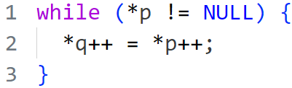
Vectorization: Legality
2. Uncountable Loops
Termination condition depends on executing loop’s body
Don’t know how many iterations can be put together

Slide 13
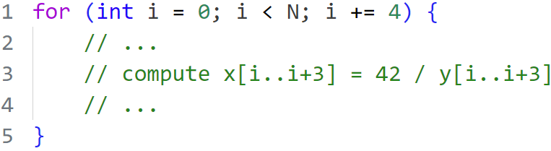
Vectorization: Legality
3. Scalar Instructions without SIMD Equivalent
Example: Integer Division
Slow and complex
Execution depends on operands
Solution:
Do it with scalar
instructions!
Notes:
Some instructions too “complicated” to vectorize in hardware (not worth it)
What to do if we really need to do something?
Do the operation with scalar instructions!

Slide 14
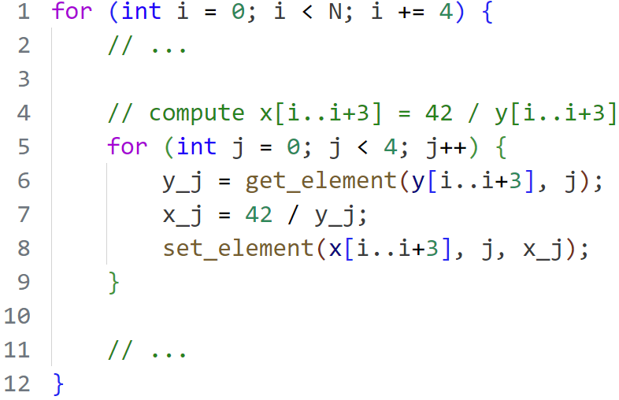
Vectorization: Legality
3. Scalar Instructions without SIMD Equivalent
(*)
Example: Integer Division
Slow and complex
Execution depends on operands
Solution:
Do it with scalar
instructions!
(*) http://0x80.pl/notesen/2024-12-21-uint8-division.html
Notes:
Some instructions too “complicated” to vectorize in hardware (not worth it)
What to do if we really need to do something?
Do the operation with scalar instructions!
This seems costly? Is this even worth it?

Slide 15
Vectorization: Cost
Vectorized Code can be slower than scalar code!
Vector code can be slower for complex control flow (e.g. Branch prediction)
Vectorized code size is larger than scalar equivalent:
More Instructions
Scalar tail loop (handle remaining iterations)
Additional legality checks at runtime (trip count, pointer aliasing)
Notes:
Question: How could vector version end up slower?

Slide 16
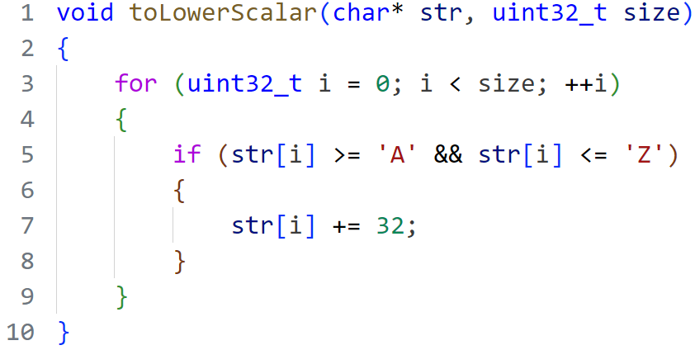
Why Auto-Vectorization?
Notes:
Function converts upper case characters to lower case
Vector version doesn’t look too bad. About double code size.
BUT: SIMD version is specialized (size % 16) and SSE architecture specific
Handling arbitrary sizes adds more complexity / code.
Targeting other architectures requires completely new code.
=> Manual Code Vectorization is time consuming
Idea: Let the compiler do the work
Compiler knows the target architecture

Slide 17
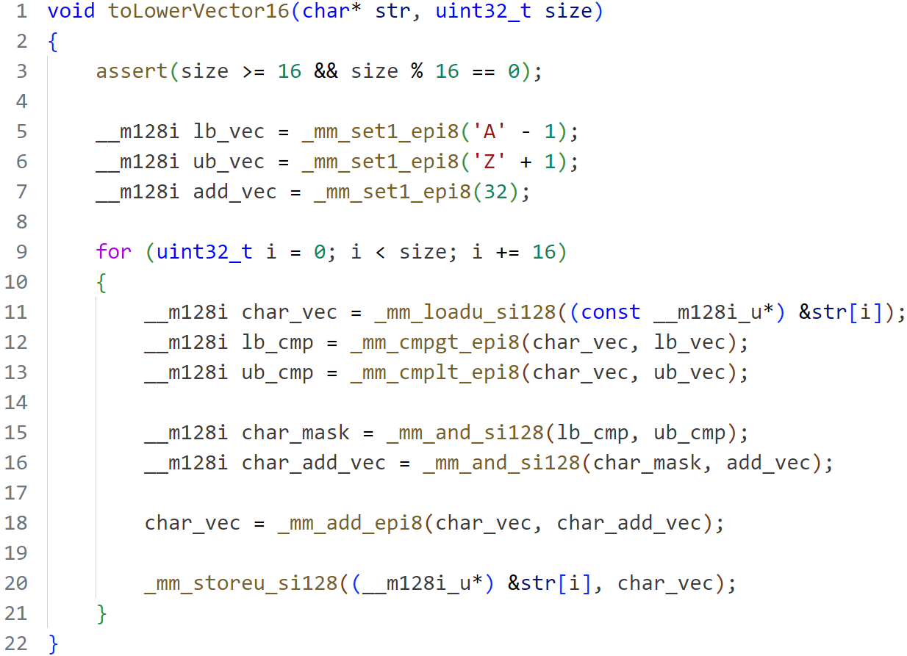
Why Auto-Vectorization?
Idea: Let the Compiler do the work!
Notes:
Function converts upper case characters to lower case
Vector version doesn’t look too bad. About double code size.
BUT: SIMD version is specialized (size % 16) and SSE architecture specific
Handling arbitrary sizes adds more complexity / code.
Targeting other architectures requires completely new code.
=> Manual Code Vectorization is time consuming
Idea: Let the compiler do the work
Compiler knows the target architecture

Slide 18
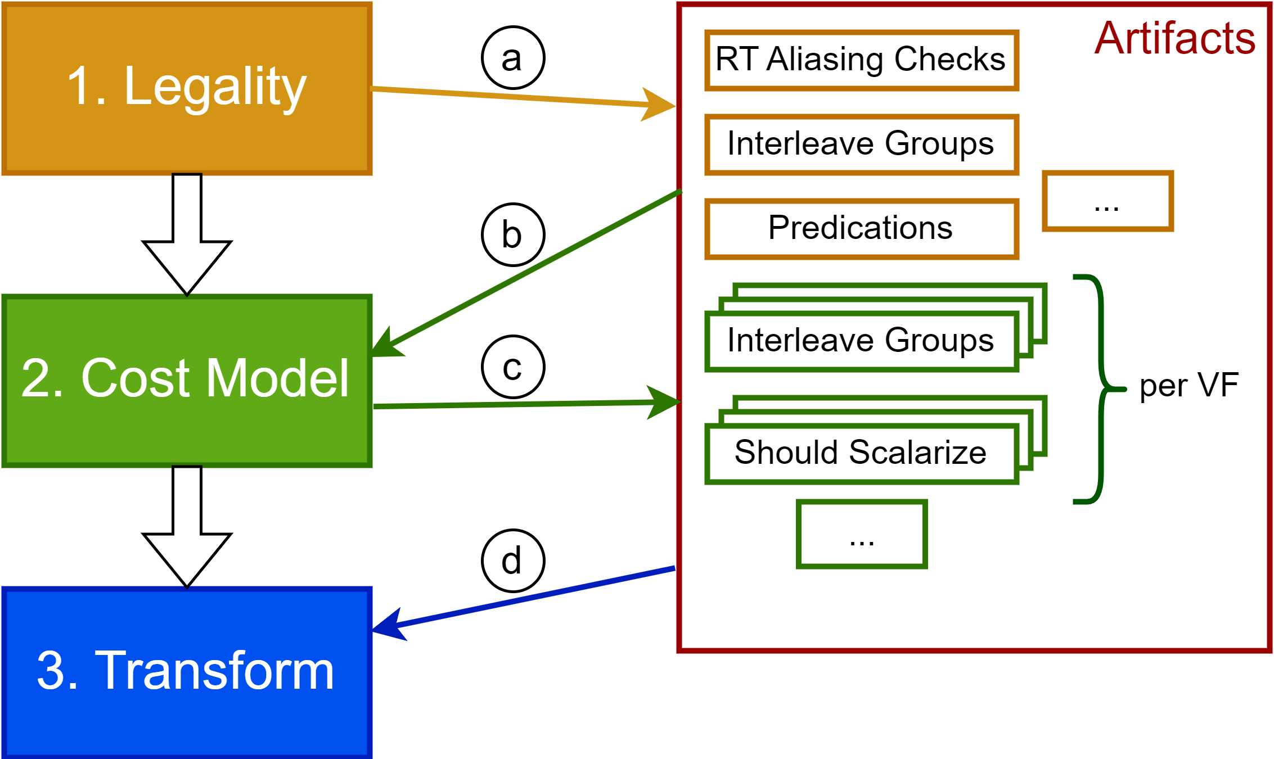
LLVM’s Auto-Vectorization (Before)
Provides two Vectorizers:
LoopVectorize (inner loops)
SLPVectorize (straight-line code)

Slide 19
LLVM’s Auto-Vectorization (Before)
Provides two Vectorizers:
LoopVectorize (inner loops)
SLPVectorize (straight-line code)
Problems:
Very rigid pipeline (e.g. no cost decisions after transformation)
Doesn’t scale well when more features added
Transformation designed to flatten loop into single basic block (no complex control flow possible)

Slide 20
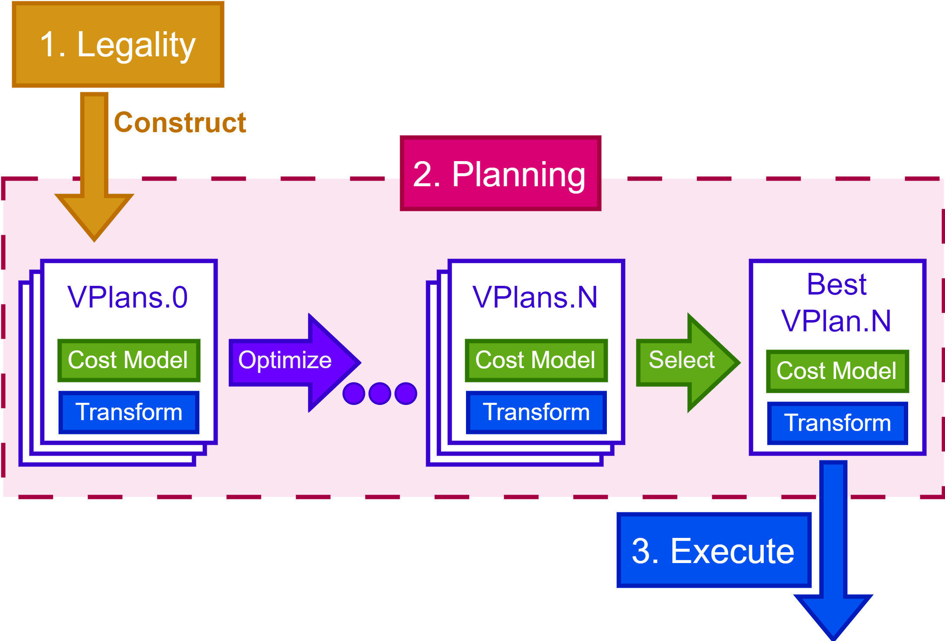
Intel’s Initial VPlan Proposal
New system proposed by Intel in 2016:
Focus on modularity and extendibility
Unite SLP, Inner-/Outer-Loop, and Whole-Function Vectorization
VPlans represent multiple vectorization approaches
Explore different vectorization approaches, compute costs, and choose best one
Use abstracted vectorization IR

Slide 21
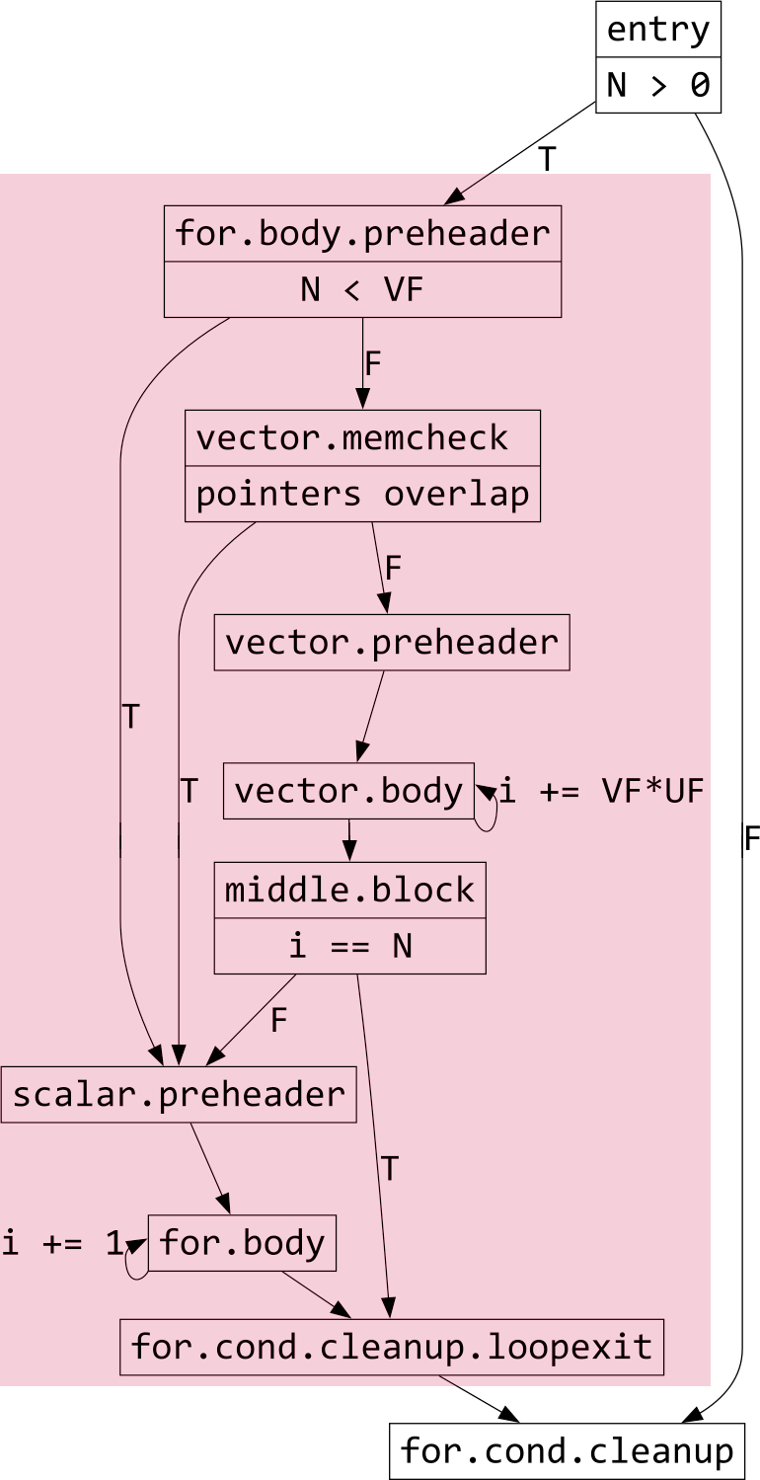
VPlan Components
Hierarchical Control-Flow Graph (H-CFG)
CFG with 3 node types:
VPBasicBlock contains VPRecipes; equivalent to LLVM IR’s BasicBlock
VPRegionBlock contains subgraph (can be replicated)
VPIRBasicBlock wraps underlying IR BasicBlock

Slide 22
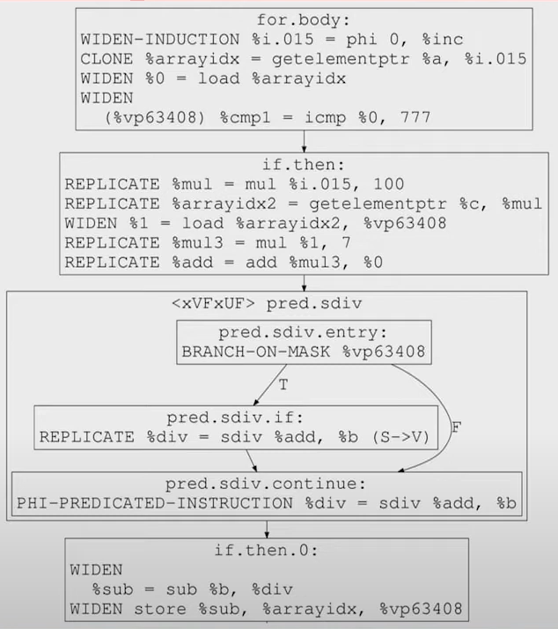
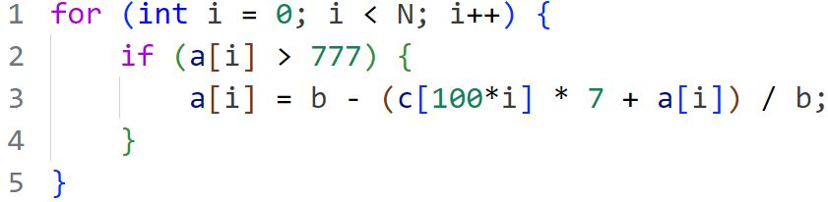
VPlan Components
Hierarchical Control-Flow Graph (H-CFG)
CFG with 3 node types:
VPBasicBlock contains VPRecipes; equivalent to LLVM IR’s BasicBlock
VPRegionBlock contains subgraph (can be replicated)
VPIRBasicBlock wraps underlying IR BasicBlock

Slide 23
VPlan Components
VPRecipes
Instructions of special vector IR:
Based on ≥ 0 scalar IR instructions
Will materialize back into ≥ 1 LLVM IR instructions when executed
Currently 40 different VPRecipe types

Slide 24
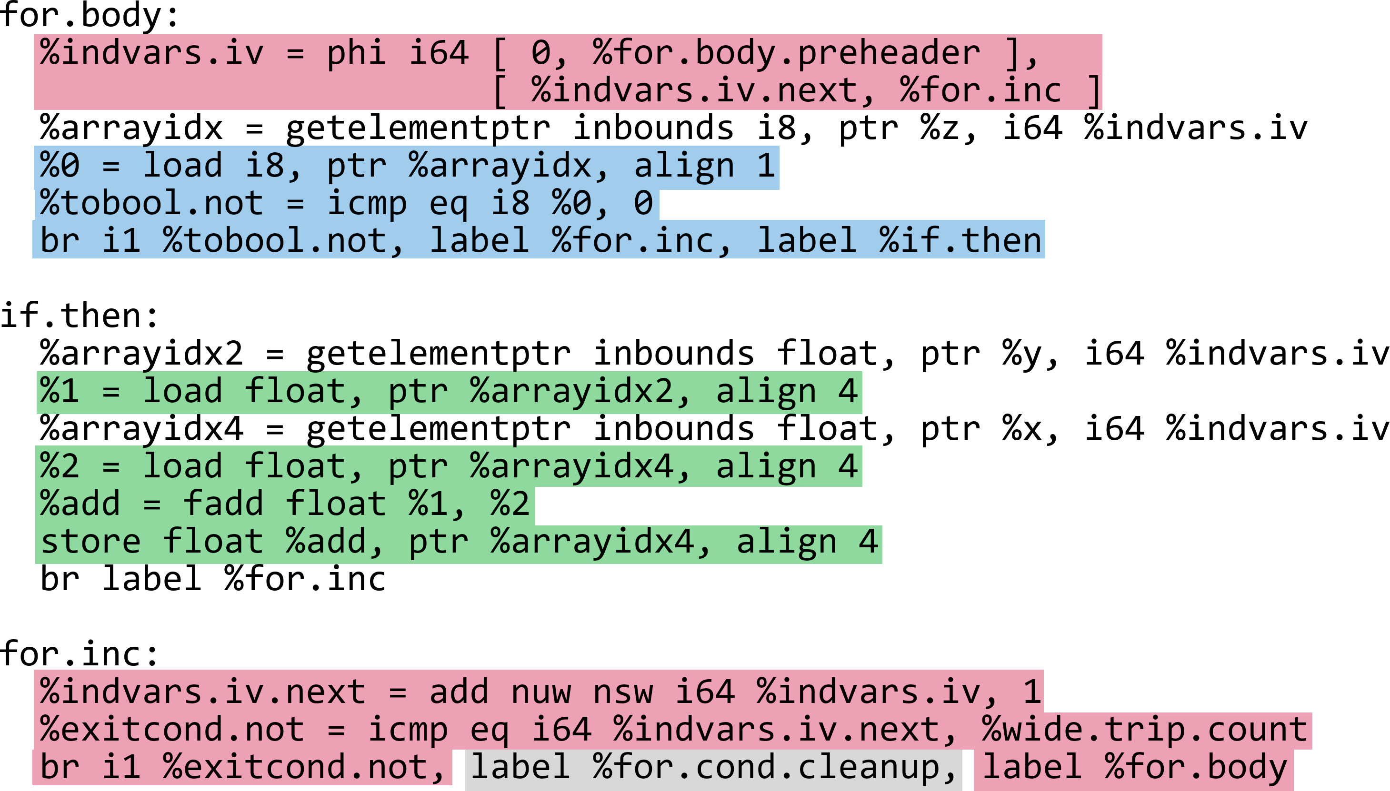
LLVM IR (scalar)

Slide 25
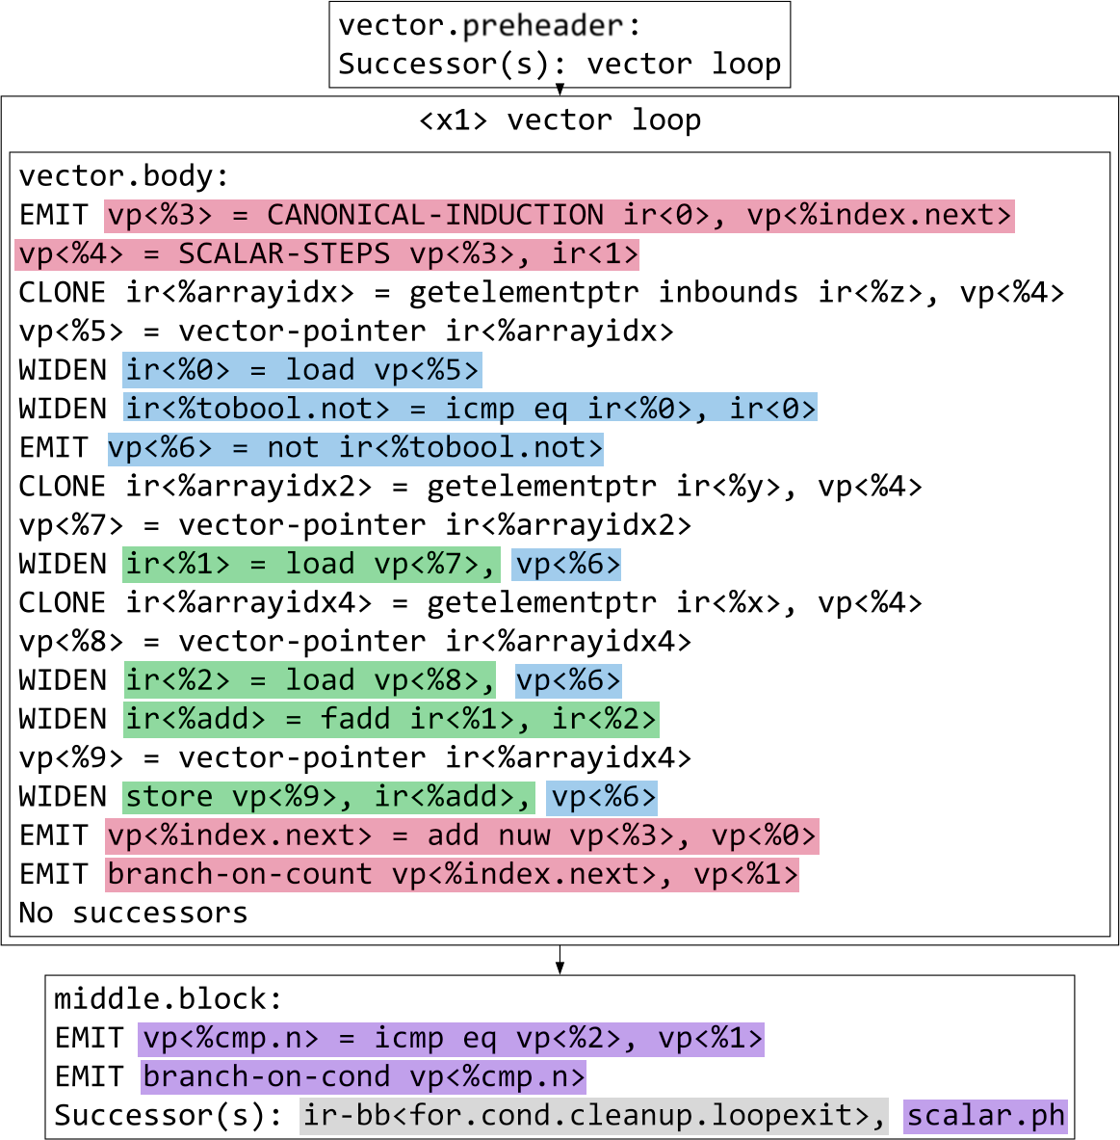
VPlan in Action
Notes:
VPReplicateRecipe (replicates one scalar IR instr. once or VF * UF times)
VPWidenRecipe (widens one scalar IR instr. into vector equivalent)
VPInstruction (not based on any scalar IR. Models newly needed instr.)

Slide 26
VPlan Components
VPlan Transformations
Idea: Make VPlan system easily extendable
Static Method that takes a VPlan object and modifies it or generates a new VPlan
Already existing transformations:
Remove redundant type casts
Simplify logical patterns: (X && Y) || (X && !Y) => X
Remove dead VPRecipes
Move loop-invariant VPRecipes out of loop

Slide 27
VPlan Components
VPlan based Cost-Model
Idea: Each VPlan can fully calculate its own cost
Each VPRecipe can calculate its own cost
Specific cost can be influenced by target architecture

Slide 28
State of VPlan (LLVM 19.1.4)
VPlans integrated into LoopVectorize (model, optimize, execute auto-vectorization for inner loops)
Outer loop vectorization support still experimental (not enabled by default)
No integration of VPlans into SLPVectorize yet
No development on Whole-Function Vectorization
Development on VPlan specific Cost-Model has “started”

Slide 29
State of VPlan (LLVM 19.1.4)
Phase 1 – Legality
Checks vectorization legality by analysing scalar IR:
Data dependencies
Uncountable loops
Control flow too complex
...
Stores some results for later use (e.g. induction variables)

Slide 30
State of VPlan (LLVM 19.1.4)
Phase 2 – Planning
Initializes VPlans for different VFs:
Create empty H-CFG structure
Iterate over scalar IR and create VPRecipes
Apply various VPlan transformations
Find the best VPlan by computing costs (still based on underlying scalar IR)
If the best VPlan has VF of 1 => Do not vectorize

Slide 31
State of VPlan (LLVM 19.1.4)
Phase 3 – Execution
Execute chosen VPlan:
Walk H-CFG and execute each VPRecipe
VPRecipe modifies LLVM IR

Slide 32
Conclusion
Compilers use auto-vectorization to aid developers
Original LLVM auto-vectorization had multiple problems making it hard to implement new features (e.g. outer loop vectorization)
Intel proposed new flexible and scalable VPlan system in 2016
Already integrated into original LoopVectorize path (inner loop vectorization)
Still a lot of features missing (SLP, outer loops, VPlan cost model)
Relatively large and active community :)
Idea: Compare LLVM VPlan to different other auto-vectorizers (GCC, ICC, others) in extensive benchmark

Slide 33
Additional Slides

Slide 34
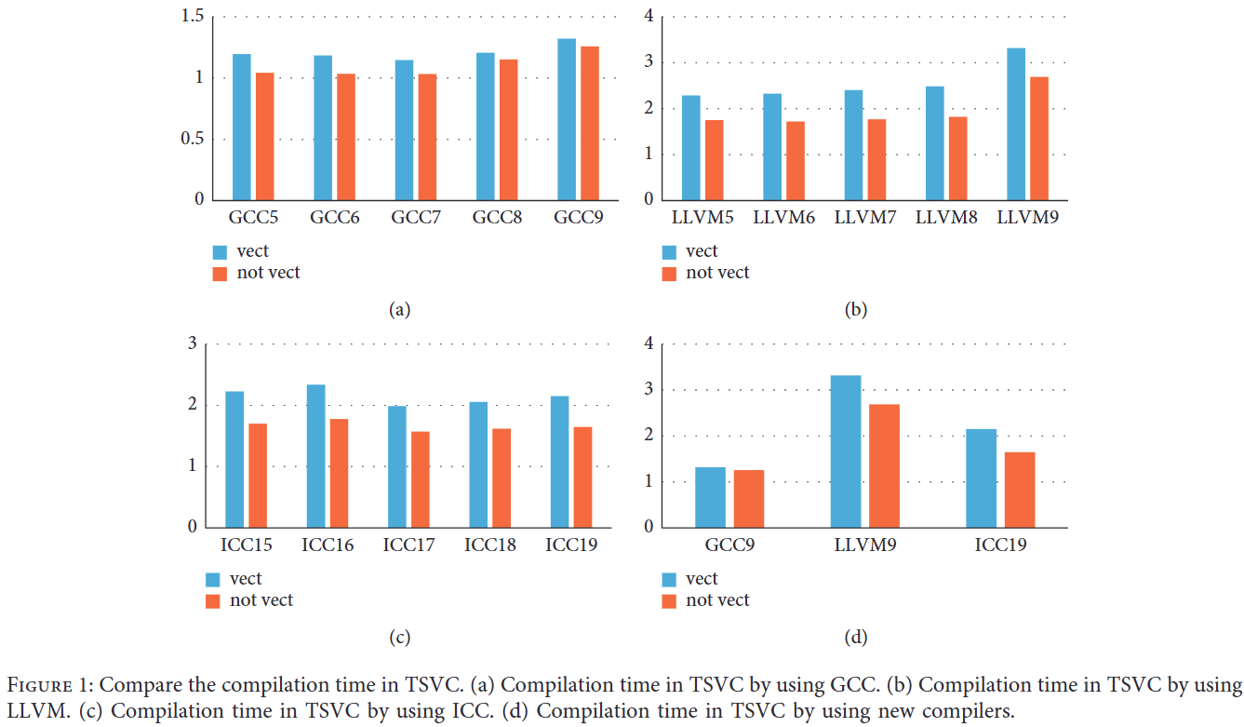
Auto-Vectorization Compiler Comparison (2019, TSVC)
Source: https://doi.org/10.1155/2021/3264624

Slide 35
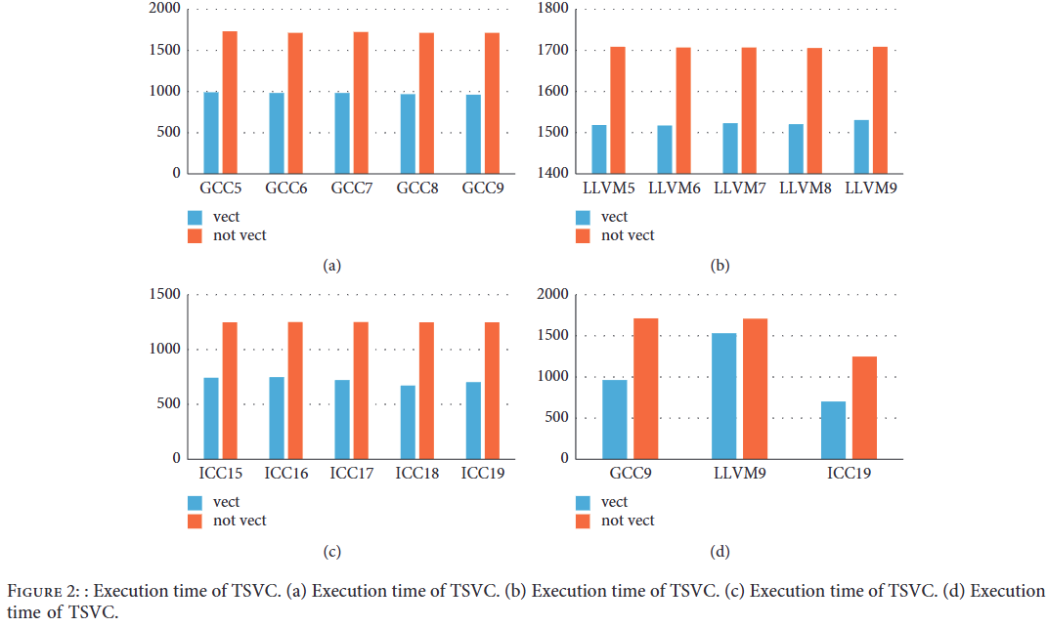
Auto-Vectorization Compiler Comparison (2019, TSVC)
Source: https://doi.org/10.1155/2021/3264624

Slide 36
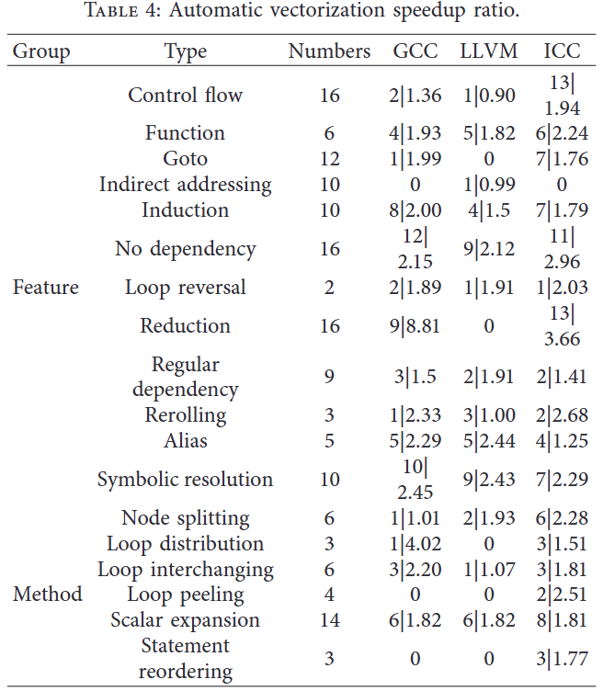
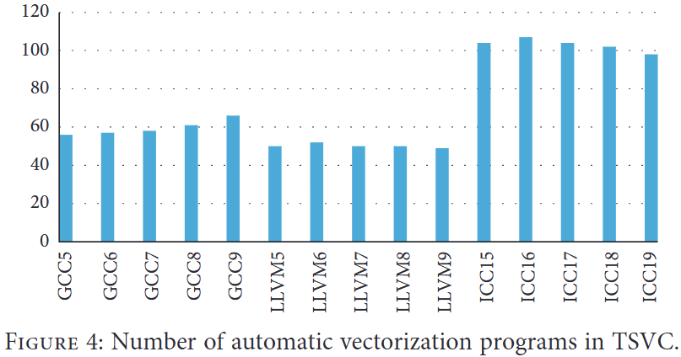
Auto-Vectorization Compiler Comparison (2019, TSVC)
Source: https://doi.org/10.1155/2021/3264624

