Slide 1


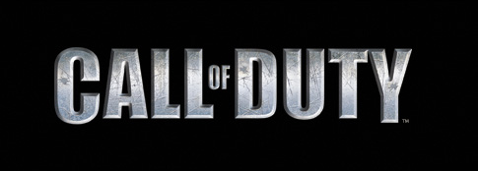
COD League tweets and fans emotions
This Photo by Unknown author is licensed under CC BY-SA.
Atalia Horenshtien,
Hult international business school

Slide 2




Agenda
Tweets among 13 teams ~27k
Focus on the top 3 teams ~5k tweets
Notes:
17.6% from the tweets are represented by the top 3 teams - Immortals, Optic Chicago, and LA Thieves
I chose the top 3 teams based on popularity – number of followers because most tweets are mostly to be related to them. Any themes and findings on the top 3 teams probably will be relevant for all the current and the upcoming teams.

Slide 3
Preprocessing and setup
Data preparation
Sentiments preparation
Re-structure
Load
Filter
Bing
NRC
Clean
Notes:
The Bing lexicon uses a binary categorization model that sorts words into positive or negative positions.
the NRC lexicon categorizes sentiment words into universal emotions: anger, anticipation, disgust, fear, joy, sadness, surprise and trust
Lets see the code

Slide 4
Vizualization

Slide 5
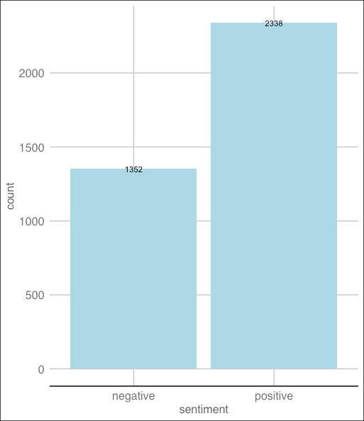
Bar chart: Number of Negative vs Positive words.
Notes:
All the tweets are either negative or positive - There is no natural
And the good news is that 63% represent positive vs. 37% negative
That means followers are more engaged by submitting positive content.

Slide 6
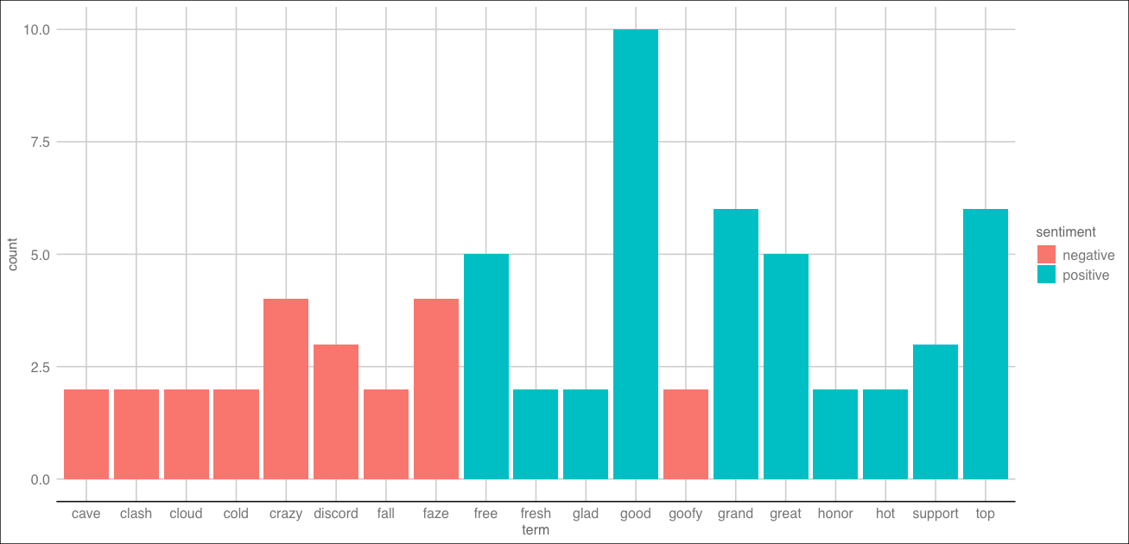
Bar chart: The highest scoring words and their sentiment
Notes:
Among the words, those with the scoring +/-2 or more, there are 19 words
9 negative
10 positive
This is where we can filter based on specific terms, see if it has negative or positive sentiment, and understand if it will make a good or bad impact

Slide 7
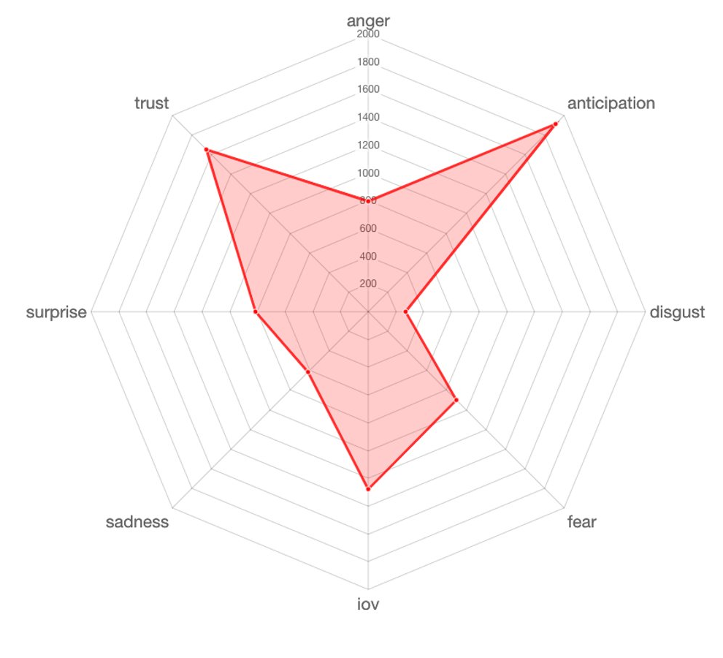
Radar Chart: The emotions distribution among the tweets
Notes:
Here we can see that most tweets related to the top 3 teams are represented by good feelings – joy, trust. Anticipation.

Slide 8
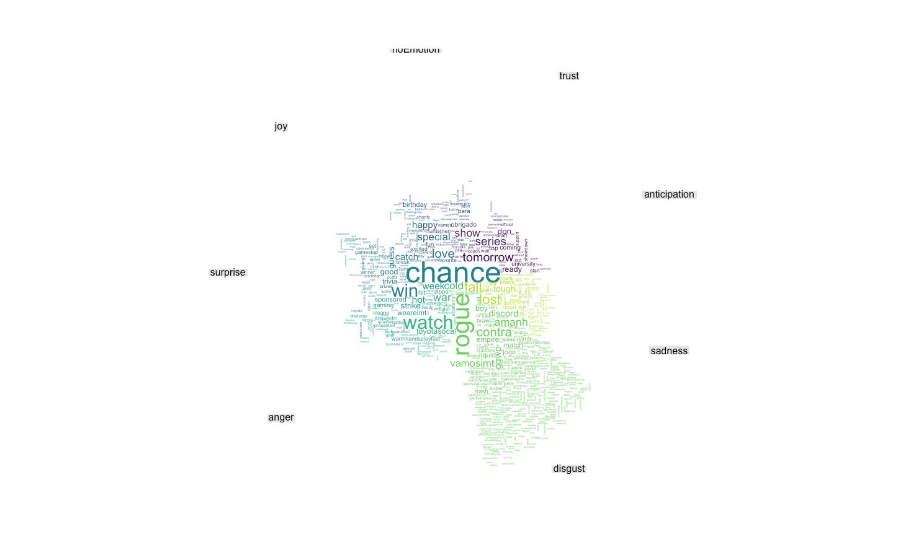
Cloud comparison: The feelings behind the tweets
Notes:
The bold ones:
Anticipation – tomorrow, series
Joy – love, special
Surprise – chance, win
Anger – watch, war
Sadness – fall, lost
Disgust – rogue, contra

Slide 9
Take away
Fans of most loved teams share mostly positive content
Fans of most loved teams have mostly positive feelings

