Slide 1
HEALTHCARE MANAGEMENT SYSTEM
Team Members:-
Atal Kumar
Shruti Singh
Divya Dwivedi
Riya Agarwal

Slide 2
OBJECTIVES
Project Understanding
Use Case Diagram For Customer
Use Case Diagram For Admin
Class Diagrams (for DTO , DAO, Service Layer)
Sequence Diagram
ER Diagram
Activity Diagram
Approach used
Best Practices
Notes:
Add instructor notes here.

Slide 3
PROJECT UNDERSTANDING
The healthcare management system consists of various diagnostic centers, with their own tests which the customers can opt for. The system should be accessible to two types of users, namely admin and customer. Admin has control over adding, removing and updating diagnostic centers and the tests under them.
Customer makes an appointment after selecting a proper date-time as well as the test and diagnostic center. The appointment will be confirmed only after the admin approves it.

Slide 4
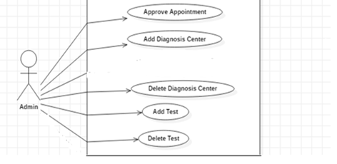
USE CASE DIAGRAM FOR ADMIN

Slide 5
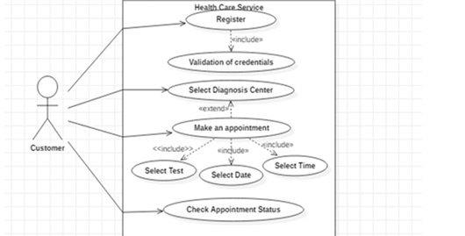
USE CASE DIAGRAM FOR CUSTOMER

Slide 6
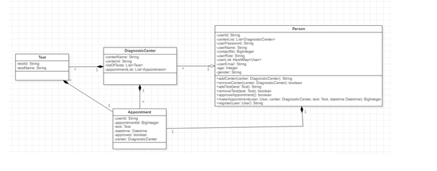
CLASS DIAGRAM (DTO LAYER)

Slide 7
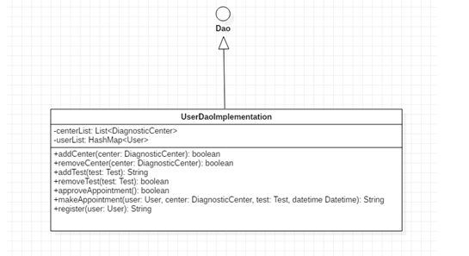
CLASS DIAGRAM (DAO LAYER)

Slide 8
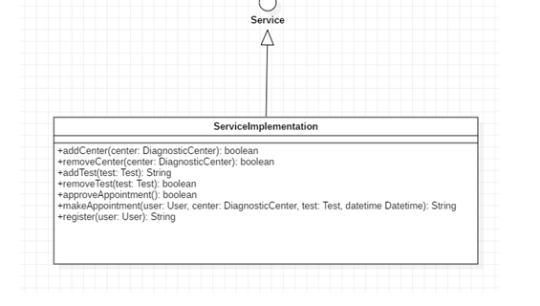
CLASS DIAGRAM (SERVICE LAYER)

Slide 9
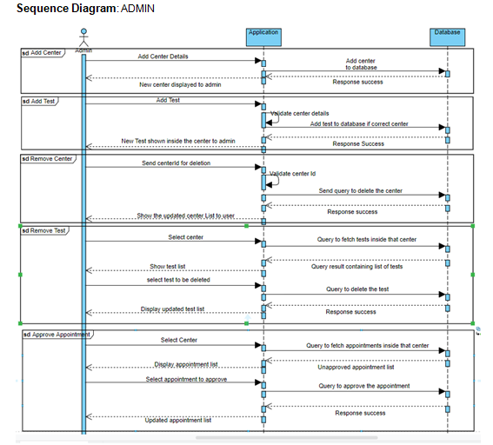
SEQUENCE DIAGRAM- ADMIN

Slide 10
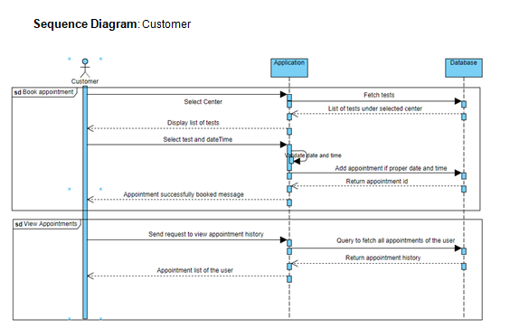
SEQUENCE DIAGRAM- CUSTOMER

Slide 11
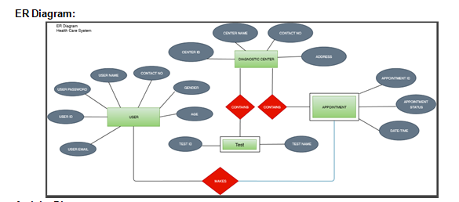
ER DIAGRAM

Slide 12
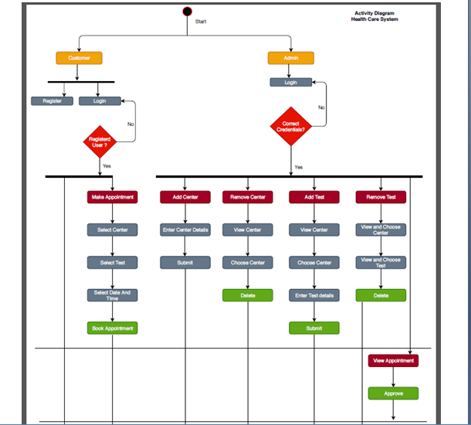
ACTIVITY DIAGRAM

Slide 13
APPROACH USED
    Front End & Web Components:–
      Angular 8
    Business Logic Components :-
      -Spring Boot
    Databases:-
      -Oracle SQL

Slide 14
BEST PRACTICES
Followed placing comments in appropriate places
Followed naming conventions.
Followed proper indentation.

Slide 15


