Slide 1
AI/ML in Sustainable Agriculture
Week 1 Submission – Crop Disease Detection

Slide 2
Problem Statement & Motivation
Crop diseases significantly reduce agricultural productivity and cause food insecurity.
Manual disease detection is slow and requires expert knowledge.
AI/ML enables automatic crop disease detection through image analysis:
- Prevents crop losses with early detection
- Reduces pesticide overuse
- Helps small farmers with affordable solutions

Slide 3
Research Background
- Mohanty et al. (2016): CNN on PlantVillage dataset, >99% accuracy
- Ferentinos (2018): Deep learning on 87,000+ images, 99.5% accuracy
- Applications: Plantix and Leaf Doctor apps use AI for farmers

Slide 4
Dataset – PlantVillage
- 54,000+ labeled leaf images
- 14 crops, 38 disease classes
- Example: Apple, Tomato, Grape, Potato, Corn
- Images: Standardized 256x256 pixels

Slide 5
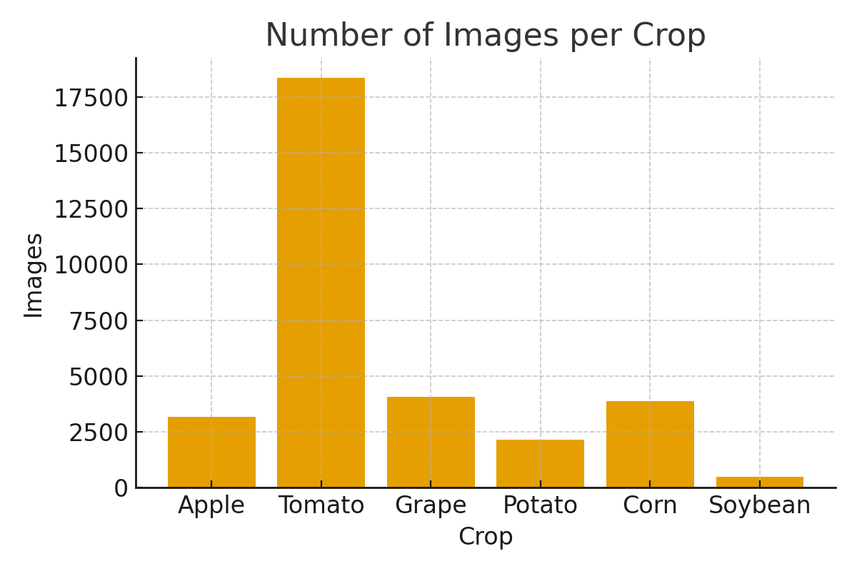
EDA – Images per Crop

Slide 6
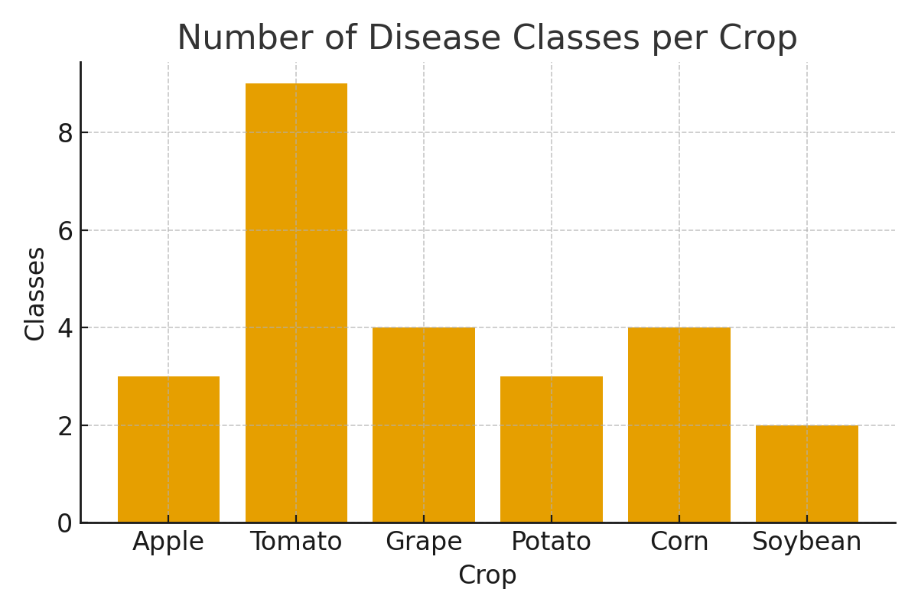
EDA – Disease Classes per Crop

Slide 7
4-Week Project Plan
Week 1: Problem definition, dataset collection, EDA ✅
Week 2: Data preprocessing, baseline CNN model
Week 3: Model tuning, transfer learning (ResNet, MobileNet)
Week 4: Evaluation, results, sustainability impact, final report

