Slide 1
Android Training for Java Developers
1. Project Structure
DMYTRO DMYTRENKO dmytrenko.d@gmail.com https://github.com/ddmytrenko

Slide 2
Sources
./app/src
Typical Android Project should have a place for:
Source Code ./app/src/main
Android Instrumented Tests ./app/src/androidTest
Unit Tests ./app/src/test

Slide 3
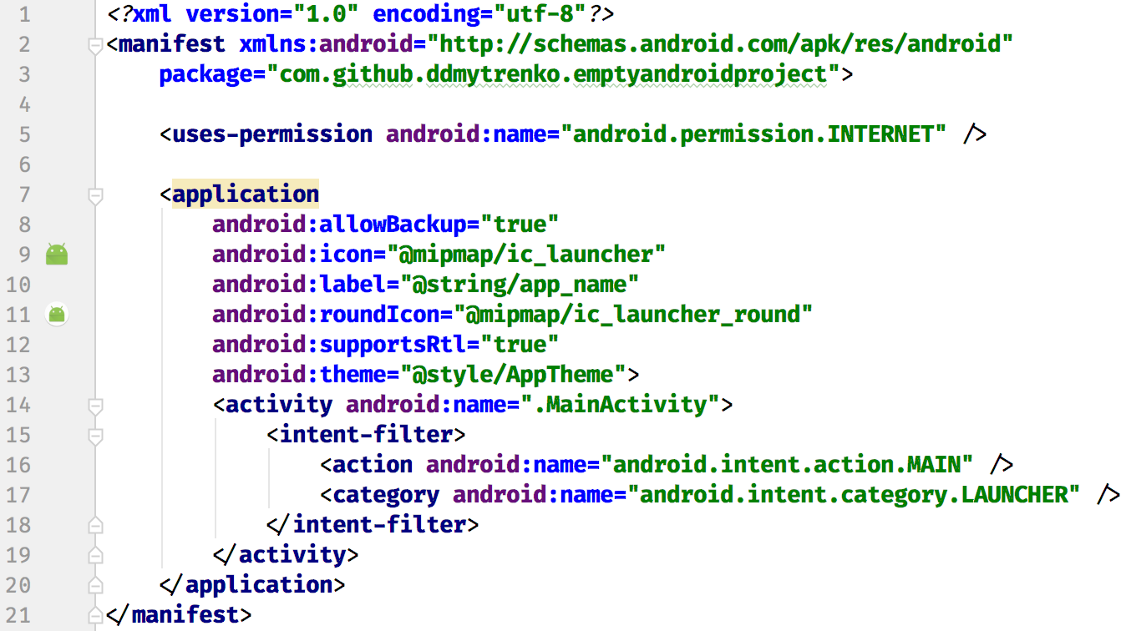
AndroidManifest.xml
./app/src/main/AndroidManifest.xml

Slide 4
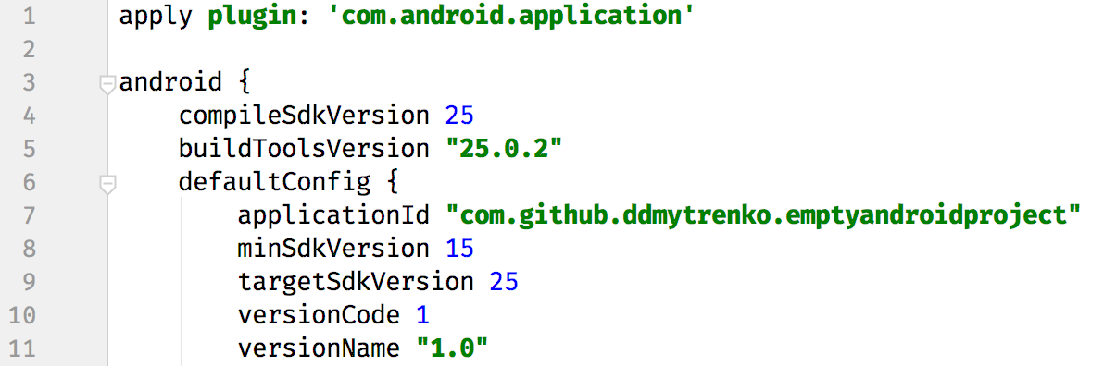
Targeting
./app/build.gradle

Slide 5
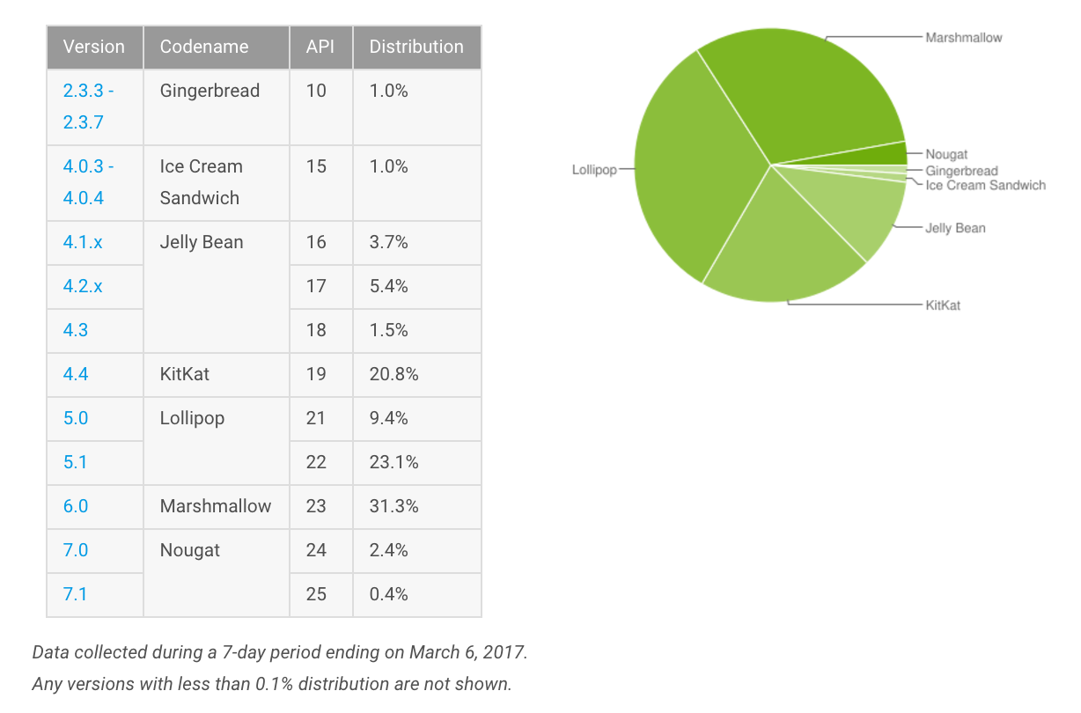
Choose a Platform to Support
https://developer.android.com/about/dashboards

Slide 6
Support Libraries
What if we want to support old devices and use a new features?
The answer is: Android Support Libraries
The most popular ones are:
appcompat-v7
cardview-v7
design
gridlayout-v7
palette-v7
recyclerview-v7
support-annotations
support-v4
All of them you can find in Google Maven Repository (the part of Android SDK).
$ANDROID_HOME/extras/android/m2repository/com/android/support

Slide 7
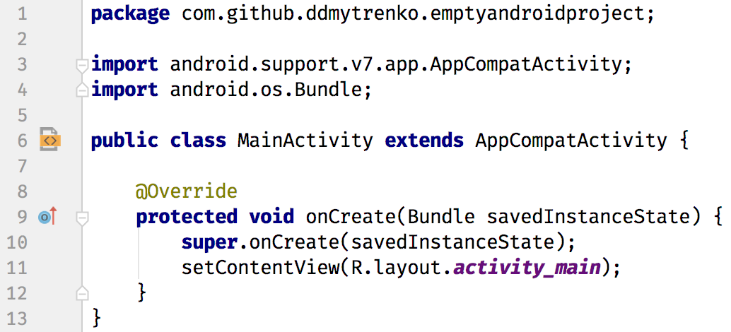
Support Libraries: in the code
./app/src/main/java/com/github/ddmytrenko/emptyandroidproject/MainActivity.java

Slide 8


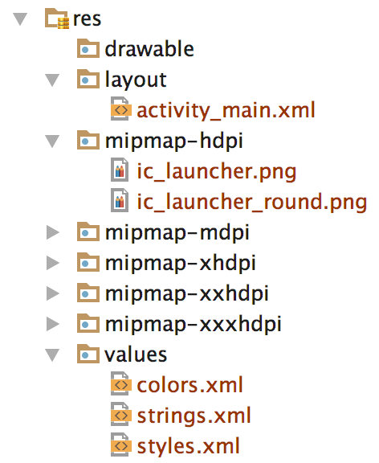
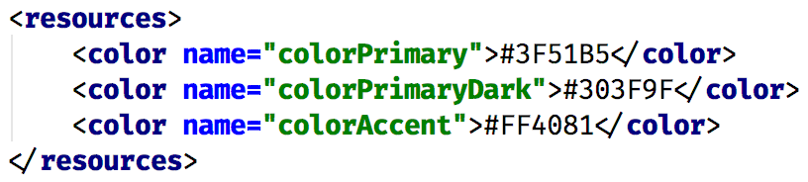
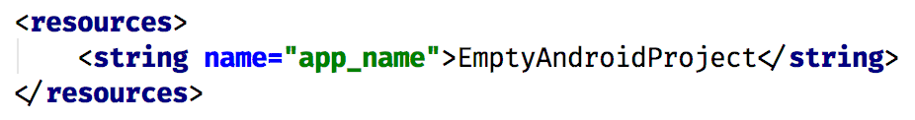
Resources
./app/src/main/res

Slide 9
Getting ready to push the code

Slide 10
What to ignore?
Your local setup
local.properties
Your IDE configuration
.idea/
*.iml
Local Gradle configuration
.gradle/
Output directories
build/
API keys, keystores, etc.

