Slide 1
Android Training for Java Developers
4. Building User Interface
DMYTRO DMYTRENKO dmytrenko.d@gmail.com https://github.com/ddmytrenko

Slide 2
View Hierarchy: components
View — occupies a rectangular area on the screen and is responsible for drawing
and event handling
https://developer.android.com/reference/android/view/View.html
ViewGroup — special view that can contain other views (called children)
https://developer.android.com/reference/android/view/ViewGroup.html

Slide 3
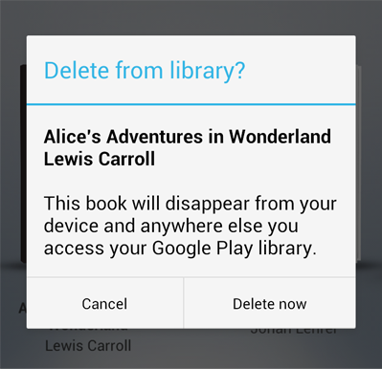
View Hierarchy: example
LinearLayout
TextView
TextView
LinearLayout
Button
Button

Slide 4
View Hierarchy: example
ViewGroup
LinearLayout
View
View
ViewGroup
TextView
TextView
LinearLayout
View
View
Button
Button

Slide 5
Measurement Units
dp
density-independent pixel — abstract measurement unit, which makes layout
looking same in different screen sizes and densities
sp
scale-independent pixel — almost the same as dp, but used only for specifying
the size of any text, which is going to be drawn on the Widget
px
pixel — highly NOT recommended, in case of using pixels your layout will look
different depends on screen size and density
mm
milimeter — physical measurement unit, depends on screen size
in
inch — physical measurement unit, depends on screen size

Slide 6
Layouting
Live DEMO/Workshop

Slide 7
Layouting
DEBUGGING

Slide 8
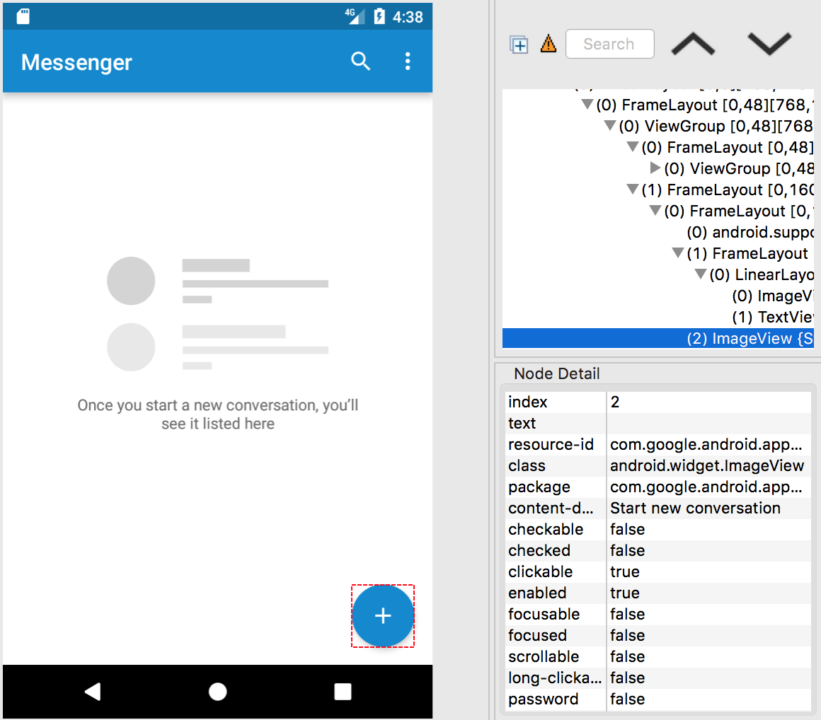

Slide 9
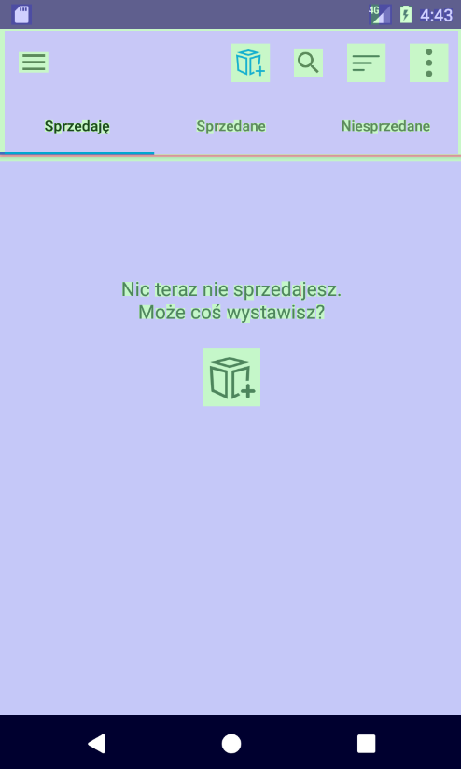
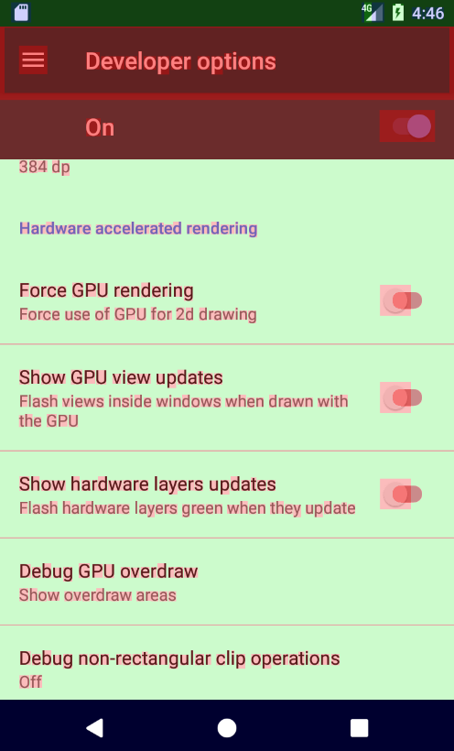
GPU Overdrawing
Not so good
OK

