Slide 1
Android Training for Java Developers
5. Handle Activity Lifecycle
DMYTRO DMYTRENKO dmytrenko.d@gmail.com https://github.com/ddmytrenko

Slide 2
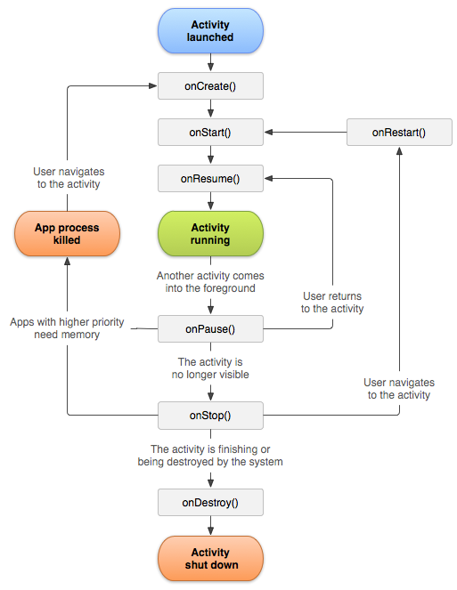
Activity Lifecycle
https://developer.android.com/guide/components/activities/activity-lifecycle.html

Slide 3
Activity Lifecycle: callbacks
Core set of callbacks you will probably implement in your app:
onCreate()
onStart()
onResume()
onPause()
onStop()
onDestroy()

Slide 4
Handle Activity Lifecycle
DEMO

Slide 5
Saving & Restoring Activity State

Slide 6
Bundle
https://developer.android.com/reference/android/os/Bundle.html
A mapping from String keys to various Parcelable, Serializable,
and “simple” values.

Slide 7
Parcel
https://developer.android.com/reference/android/os/Parcel.html
Special container for a message (data and object references).

Slide 8
Parcelable
https://developer.android.com/reference/android/os/Parcelable.html
Interface for classes whose instances can be written to and restored
from a Parcel. Classes implementing the Parcelable interface
must also have a non-null static field called CREATOR of a type that
implements the Parcelable.Creator interface.

Slide 9
Saving & Restoring Activity State: callbacks
onSaveInstanceState(Bundle savedInstanceState)
onRestoreInstanceState(Bundle savedInstanceState)

Slide 10
Saving & Restoring Activity State
DEMO

