Slide 1
Angular 2
(NO) NewS FROM THE BLEEDING EDGE?

Slide 2
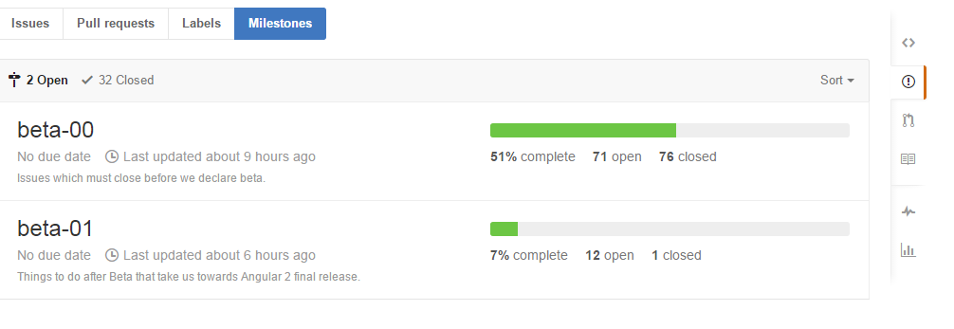
It’s still just around the courner….

Slide 3
Angular.io
The Cheat Sheet is excellent.
https://angular.io/docs/ts/latest/guide/cheatsheet.html
The Tour of heroes is good, but incomplete https://angular.io/docs/ts/latest/tutorial/
The rest of it is here →→→

Slide 4
Tour of Heroes – by John Papa
The tutorial on angular.io is based on this repo
https://github.com/johnpapa/angular2-tour-of-heroes/tree/master/src/app
At the AngularConnect conference in London there was a walkthrough of the tutorial.
https://www.youtube.com/watch?v=LS3aewTkfHI

