Slide 1
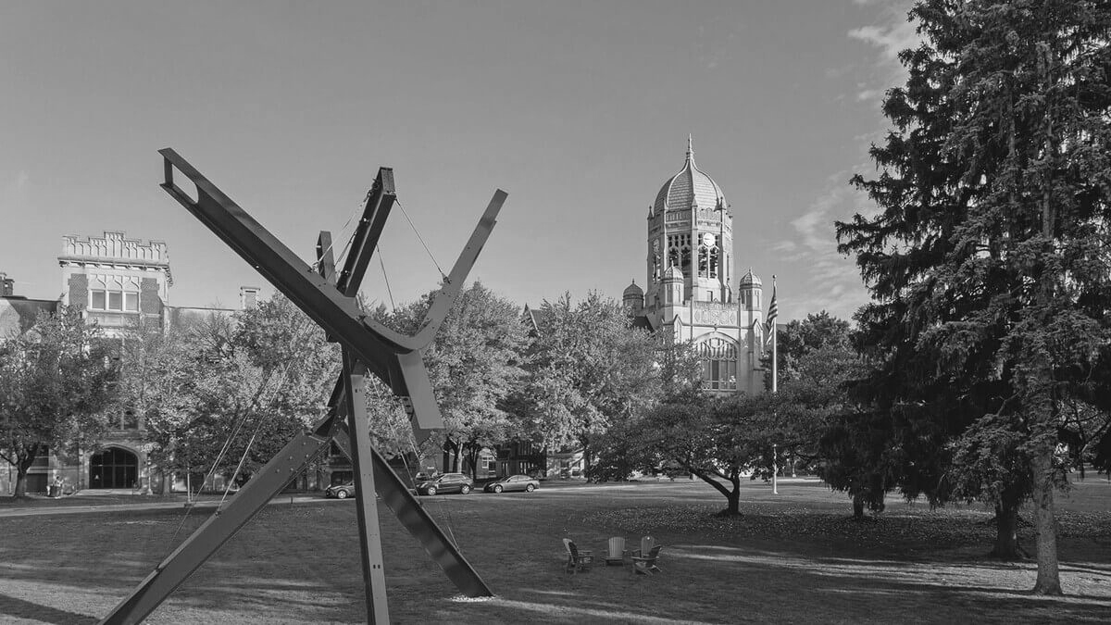

September 29, 2026
CSI 210: Software Engineering
Abhilasha Talwar, Andrew Jarrah, O’glenn Togar, Hudson Plaskoff
Notes:
all

Slide 2
OVERVIEW
Core Problem
Solution (Our Project)
Users and Stakeholders
Key Features
Current Project Vision
Next Steps
Planning Materials
PathFinder
September 29, 2026
Notes:
Abhilasha

Slide 3
Fragmented systems across Workday (course registration and tracking academic progress), the Muhlenberg Catalog (course of study overviews), and other resources intended for academic planning by students at Muhlenberg.
PROBLEM
PathFinder
September 29, 2026
Notes:
Hudson

Slide 4
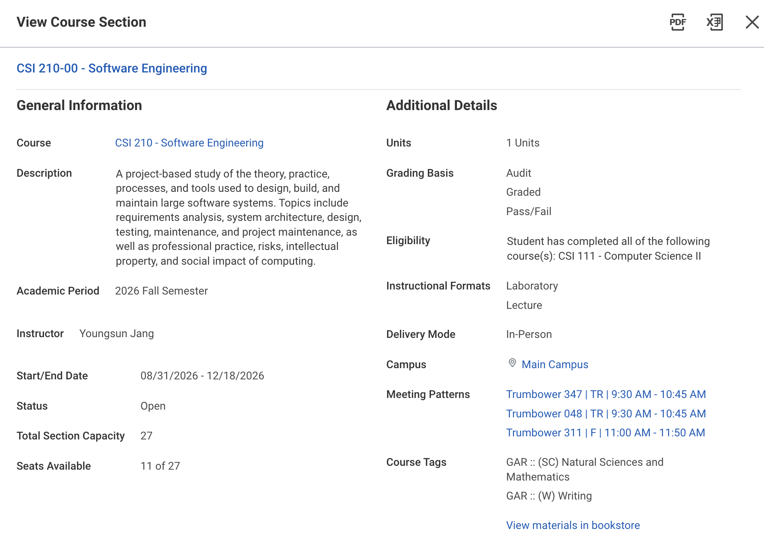
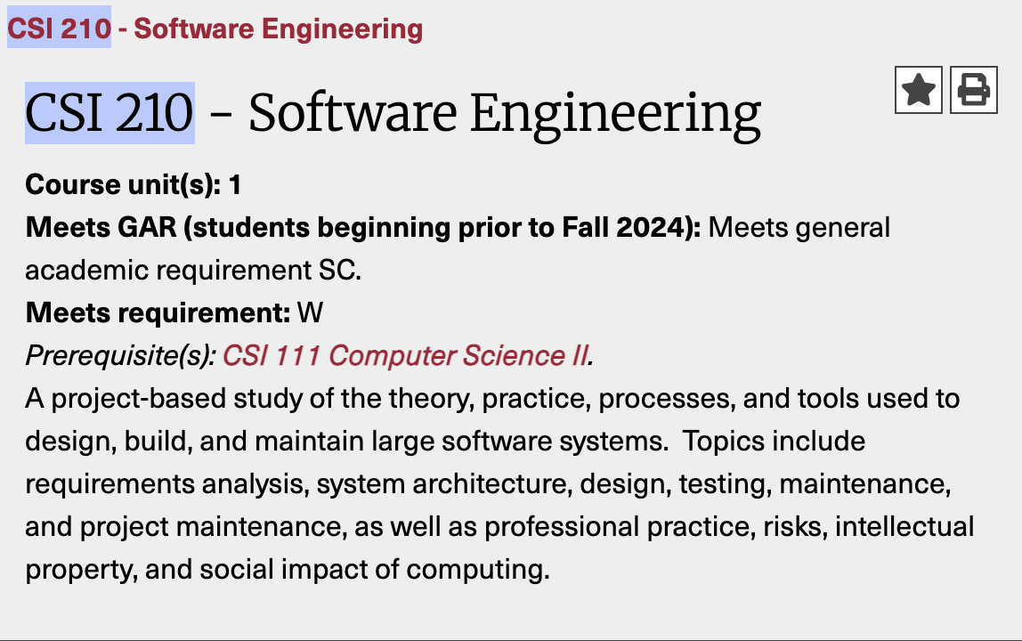
WORKDAY
CATALOG
PathFinder
September 29, 2026
Notes:
Hudson

Slide 5
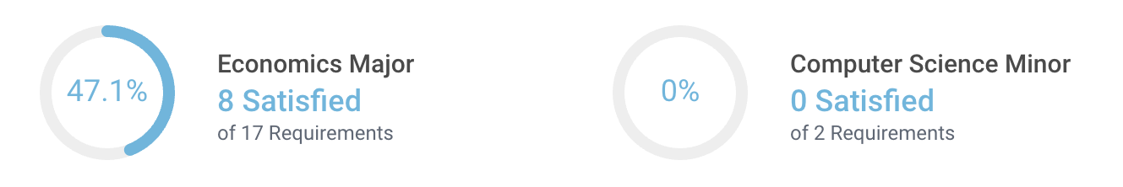
WORKDAY
PathFinder
September 29, 2026
Notes:
Hudson

Slide 6
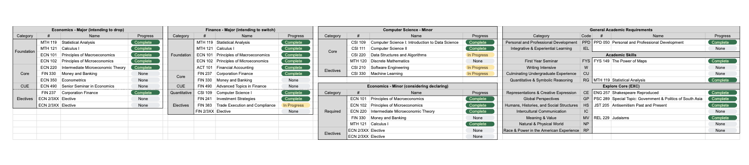
IMPROVISED SOLUTIONS
PathFinder
September 29, 2026
Notes:
Hudson

Slide 7
Unified and informative system for tracking your academic progress that is easily accessible to both students and advisors.
SOLUTION
PathFinder
September 29, 2026
Notes:
Hudson

Slide 8
STUDENTS
ADVISORS
ADMINISTRATION
STAKEHOLDERS
Individual progress
Advisee progress
School-wide progress
PathFinder
September 29, 2026
Notes:
Abhilasha

Slide 9
FR-1
FR-2
FR-3
FR-4
FR-5
KEY FEATURES
Course Progress
Opportunity Finder
Student Info Card
HAL Chatbot
Advisee View
Checking progress of the courses required to complete your declared area(s) of study.
Finding overlap between your current and possible areas of study to find the easiest possibilities for declaring a new major or minor.
Quick view of relevant student information, including your declared area(s) of study, GPA, advisor, and more.
Easier way to interpret or query information about Muhlenberg’s course offerings, areas of study, or your specific progress.
Display multiple advisees at the same time for easier ongoing reviews of academic progress.
PathFinder
September 29, 2026
Notes:
O’glenn

Slide 10




CEO
Front-End
Back-End
Database
CURRENT TEAM PROGRESS
Abhilasha Talwar
Data cleaning and refinement
Overall structure and compilation
Andrew Jarrah
Front end Via JS
O’glenn Togar
Researching backend software
Hudson Plaskoff
Registrar’s office
Course sheet
PathFinder
September 29, 2026
Notes:
Andrew

Slide 11
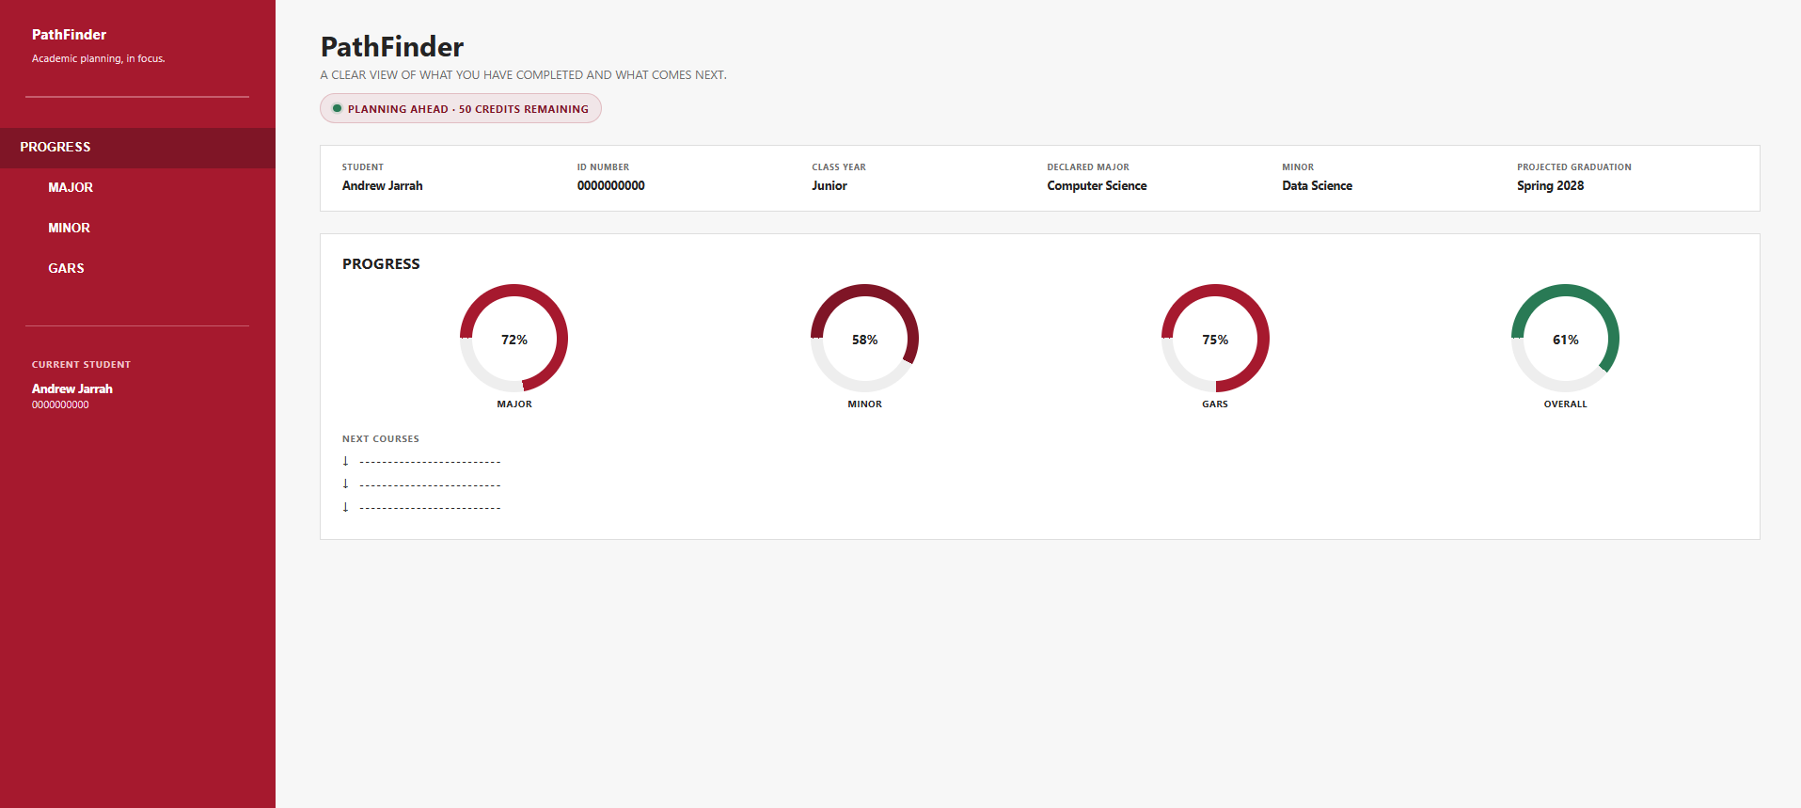
FRONT-END (JAVASCRIPT)
PathFinder
September 29, 2026
Notes:
Andrew

Slide 12
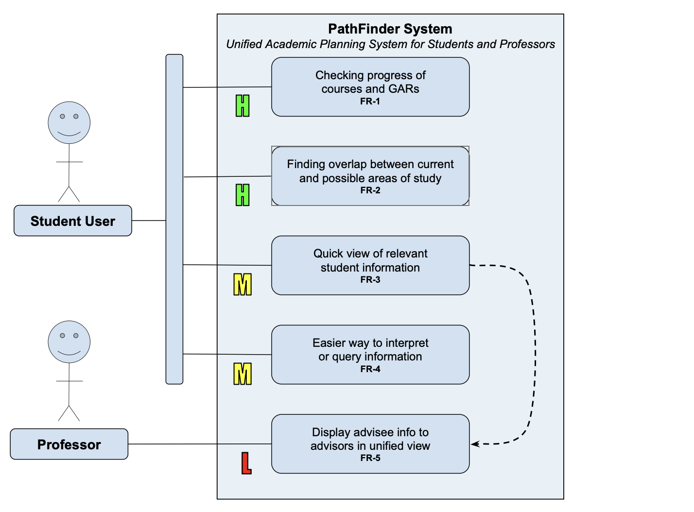
VISION
PathFinder
September 29, 2026
Notes:
Abhilasha

Slide 13
FRONT-END
BACK-END
DATABASE
NEXT STEPS
Continuing to work on the dashboard view
Researching and understanding the implementation
Unified format for data and SQLite database
PathFinder
September 29, 2026
Notes:
O’glenn

Slide 14
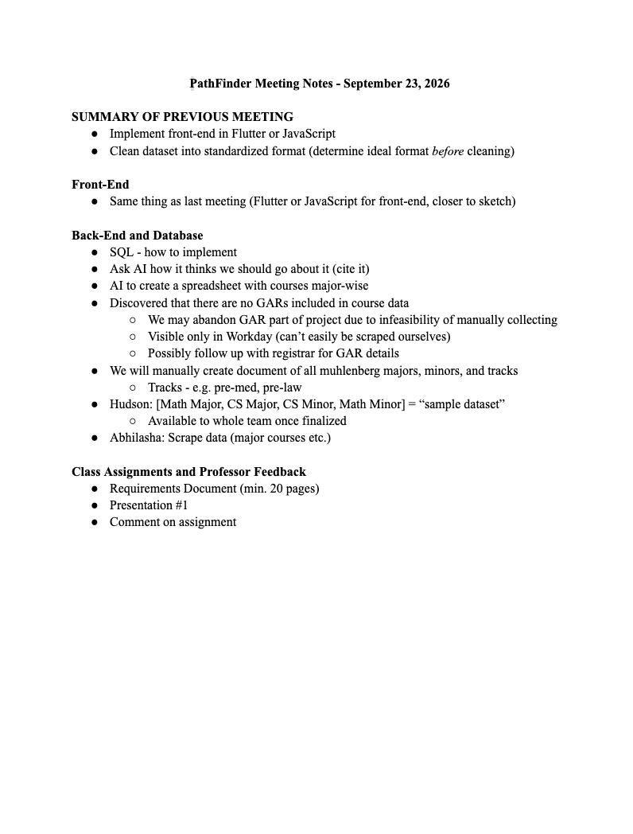
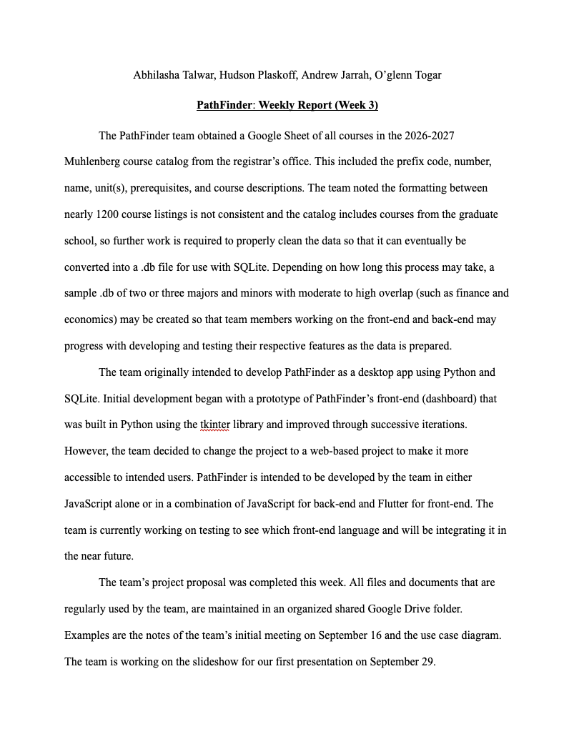
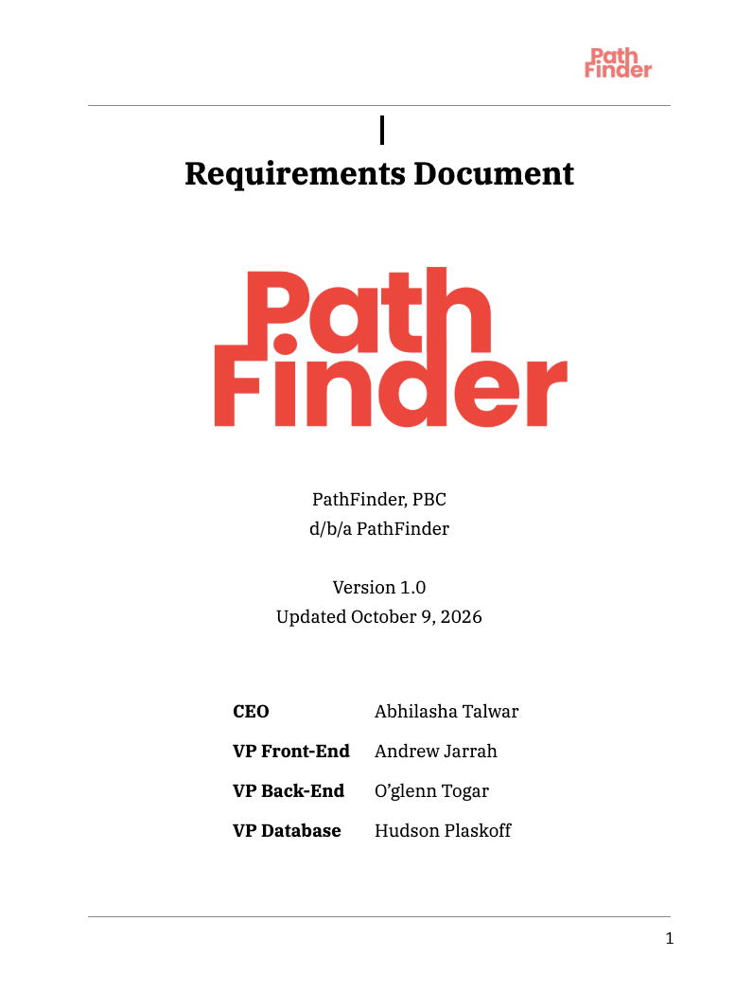
PLANNING MATERIALS
PathFinder
September 29, 2026
Notes:
O’glenn

Slide 15
Thank You!
Notes:
all

