Slide 1


October 27, 2026
CSI 210: Software Engineering
Implementation Update
Abhilasha Talwar, Andrew Jarrah, O’glenn Togar, Hudson Plaskoff
Notes:
all

Slide 2
OVERVIEW
Database
Back-End
Front-End
Demonstration
PathFinder
October 27, 2026
Notes:
Abhilasha

Slide 3
DATABASE
Notes:
all

Slide 4
Course data from registrar (Excel file)
Researched PostgreSQL implementation
Test DB with Math & Computer Science
Formatted course data (CSV file)
Uploaded course data to Supabase
DATABASE PROGRESS
PathFinder
October 27, 2026
Notes:
Hudson

Slide 5
REFORMATTED COURSE DATA
SUBJECT | NUMBER | NAME | COURSE UNIT(S) | PREREQUISITE(S) | PREREQUISITE OR COREQUISITE | DESCRIPTION | OPEN TO
ID | PREFIX | NUMBER | NAME | UNITS | PREREQUISITES_TEXT | DESCRIPTION | GAR
int8 | text | text | text | float8 | text | text | text
Primary key
PRE AXX
YES 000
PRE MJR/MNR
null for all rows
Unique identifier
for each row
Any A-level course in department PRE
Permission of course instructor
Major or minor in department PRE
No data for
GARs currently
PathFinder
October 27, 2026
Notes:
Hudson

Slide 6
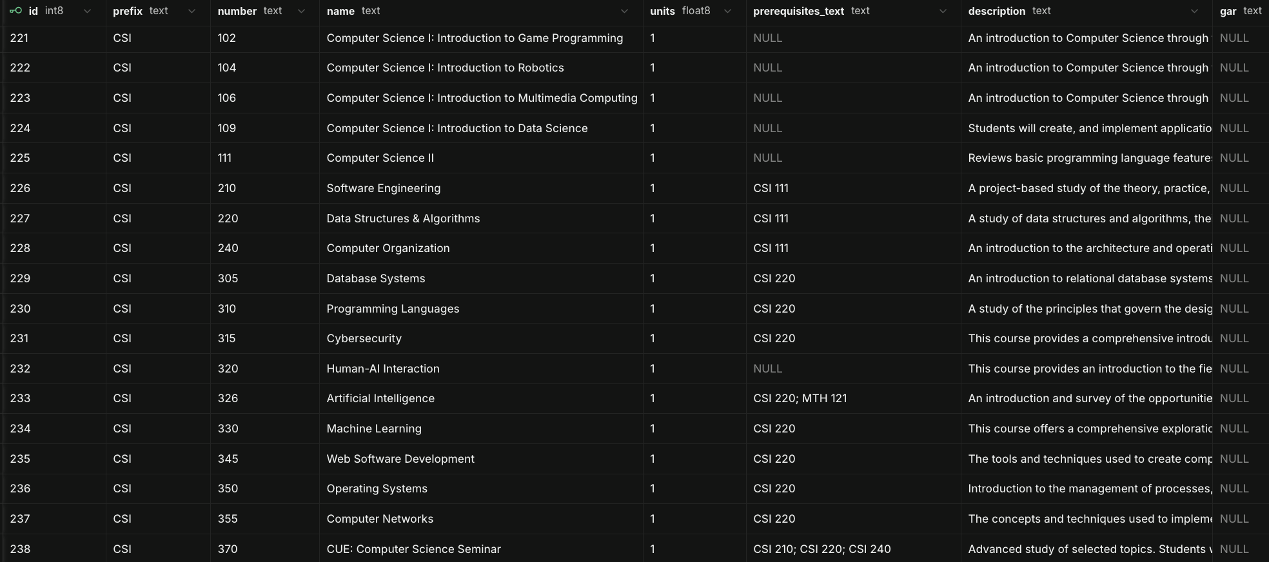
SUPABASE COURSES DB
PathFinder
October 27, 2026
Notes:
Hudson

Slide 7
COURSES
PROGRAMS
REQUIREMENTS
REQUIREMENTS_ITEMS
INTENDED FINAL DATABASE
Completed
Contains all 1165 courses listed
To-Do
Majors and minors
To-Do
Breaks down major and minor program requirements into subsections
To-Do
Defines major and minor subsection requirements
PathFinder
October 27, 2026
Notes:
Andrew

Slide 8
BACK-END
Notes:
all

Slide 9
Server operational: The back-end server is up and running successfully.
Database integration complete: The server connects to the database and can retrieve data as expected.
Front-end integration pending: The server is not yet connected to the frontend, so end-to-end behavior can’t be fully demonstrated or validated at this time.
Deployment ready: The environment is configured and prepared for migration. Once all components are in place, the back-end can be fully connected to the front-end and database.
BACK-END PROGRESS
PathFinder
October 27, 2026
Notes:
Hudson

Slide 10
FRONT-END
Notes:
all

Slide 11
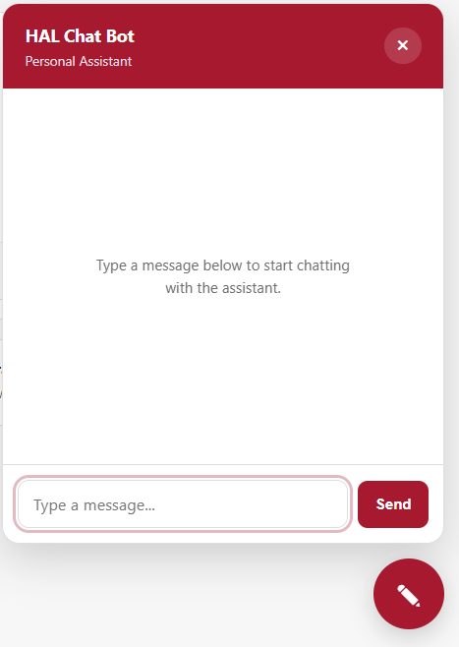
Front-End Progress Overview
Main dashboard completed: The dashboard displays student information, academic progress, and the individual requirement sections.
Improved layout and usability: The interface has been refined to be more polished and easier to navigate.
Responsive design implemented: The layout adapts to different screen sizes, improving usability across devices.
Interactive features added: Interactive navigation and a quick chat feature make the interface feel more complete.
Prototype maturity: This version is a more realistic and functional front-end prototype, giving a clearer picture of what the final product could look like.
Notes:
all

Slide 12
PROTOTYPE
REVISED VERSION
CURRENT VERSION
FRONT-END PROGRESS
Started with a simple layout to map out the app
Created the basic page structure and navigation
Focused on the overall idea of tracking academic progress
Improved the design to make it cleaner and easier to use
Adjusted spacing, colors, and layout for a more polished look
Added clearer sections for major and minor progress
Built the main dashboard with student information and progress cards
Added responsive styling so the app works on different screen sizes
Included interactive navigation and a quick chat feature for the interface - HAL AI
PathFinder
October 27, 2026
Notes:
O’glenn

Slide 13
DEMONSTRATION
Notes:
all

Slide 14
Thank You!
Notes:
all

