Slide 1
BAZARNEPAL.COM
Site for online shopping, selling, online directory, news and information, finding and posting job, renting
By Arpana

Slide 2
Contents:
What is bazarnepal.com?
How it is different from other sites?
How can it help users and how can users be connected with us through the websites?
What kind of facilities are provided to the users?
Brief on services we provide

Slide 3
What is bazarnepal.com?
Bazarnepal.com is ecommerce sites where people can buy or sell online also rent online
Nowadays , shopping online trend is growing as people don’t need to bother about which shop is good and what’s the best price
So, online shopping is a trending method for buying and selling goods as it does not consume much time and also every goods is found in one place which also guarantees about the original quality of the products

Slide 4
How it is different from the other site?
Other ecommerce sites is based for only one service like shopping or job or news but our sites does five in one
That is we have online shopping, online directory, Information/News, job portal and rental services too
Once you register to our sites or say ,make an account you can do is shop, sell, find a job and post a job, rent goods, service or property

Slide 5
How can it help users and how can users be connected with us through the websites?
Users can get varieties of service in one platform
They can choose the service they want as they desire from the list of services provided
They can also get offers and gifts if they use our services more
They are provided with points which will help them to get coupons and gifts
Members of ours will be benefited more as they put their details more by getting popup, reminders, offers and gifts and many more

Slide 6
What kinds of facilities are provided to the users?
Buying and selling products
Finding and posting jobs
Renting
Information/News
Online Directory

Slide 7
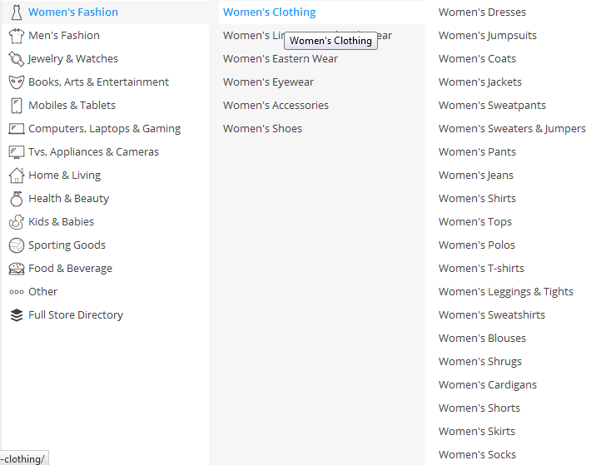
Buying products

Slide 8
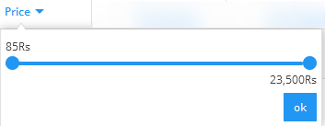
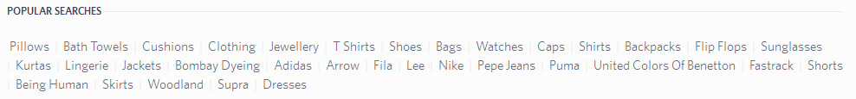
Search options

Slide 9
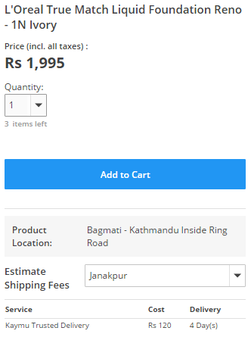
Adding to a cart

Slide 10
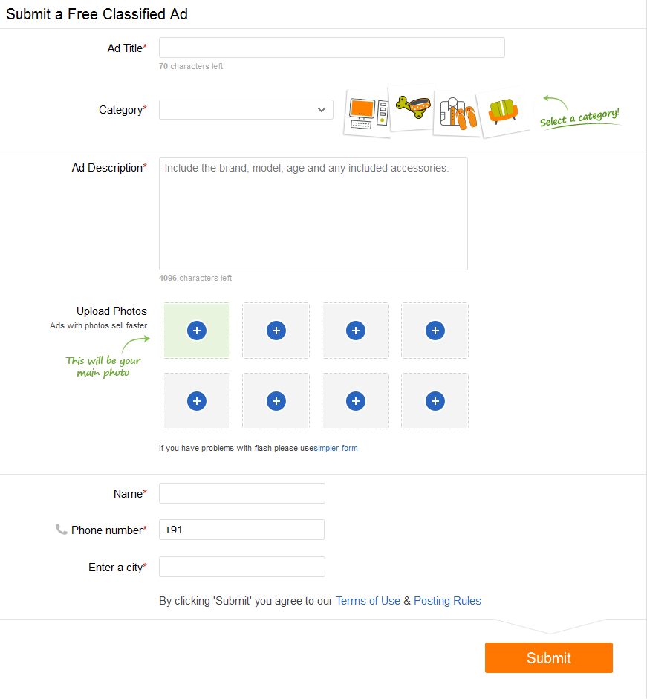
Selling a product

Slide 11
Member Function
Members are those who regularly visits our sites and wants us to do there things done.
They will have inventory records, inventory management, daily needs, monthly needs, shopping plans, saving and expenditure
Advice and popup
Offers and Discount and Gifts
Points and Coupons

Slide 12
Job portal
This is another popular and trending site nowadays
Where one can find jobs and also apply for it
They can place a resume and register and find the jobs according to it
Advance search can be done by category, industry, level, education, type and location
Hot jobs, top jobs, recent jobs, direct recruitment, outsourcing, etc.

Slide 13
Renting
Renting, also known as hiring or letting, is an agreement where a payment is made for the temporary use of a good, service or property owned by another.
who want to give their goods or service or property can post on our site
who wants to take a good or service or property can find rents in our sites
much focus on house, flat, vehicles, machines, lands
Terms like paying guest, home stay, pooling is being popular

Slide 14
Information/News
Current rate/ Forex
Share
Gold and Silver price
Vegetable wholesale and retail price
Livestock
Meats
Grocery
Business news : new products, new brands, business expo etc.

Slide 15
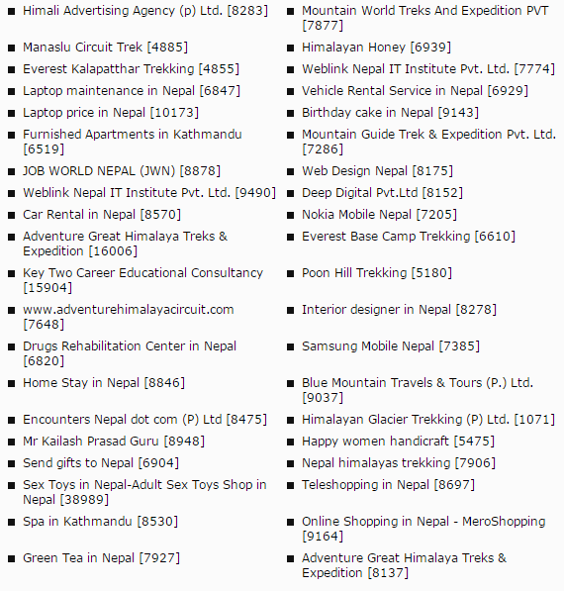
Online Directory
Restaurants
Tours and travels
Entertainment
Cinemas

Slide 16
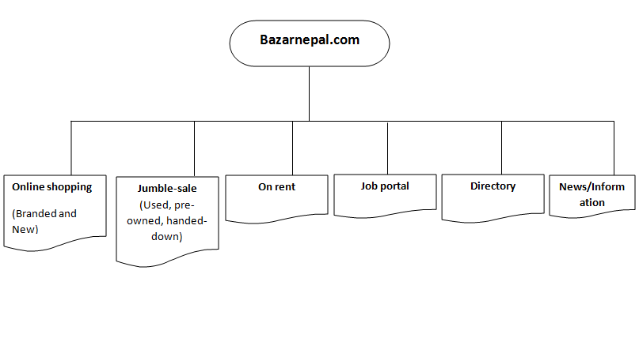
WE PROVIDE:

Slide 17
Your views and questions please.
Thank you

