Slide 1
AngularJS
NL Java COE
by Nitin Shah

Slide 2
Agenda
Introduction
Discuss AngularJS pros and cons
Getting started
Routing
MVC
Display working project, structure and approaches
Questions ?

Slide 3
Introduction
AngularJS is an open source framework of JavaScript that strives to make single-page applications run with ease and success.
It uses the Model-View-Controller (MVC) utility to improve browser-based web applications.
AngularJS has been regarded by many as a next generation tool that tries to integrate a number of functionality and work in an interconnected manner.
There are two principles that largely guide the working of AngularJS. It believes that declarative programming should be solely used for designing user interface and imperative programming should be left for establishing domain logic. Operating on the basis of these two principles and loaded with a bunch of exceptional features, AngularJS framework displays a lot of good points

Slide 4
AngularJS pros
MVC capability: AngularJS does not require writing lengthy codes to connect the MVC components of split apps, which saves oodles of time and effort. Just split the app and let Angular do the rest for you by managing the components and also connecting them all by itself.
Two-way data binding: AngularJS comes with this great feature which reduces writing codes substantially. Data binding tries to get rid of writing codes manually by relieving the backend server from creating templates. MVC pipeline is also maintained by the framework itself.
Directives: Angular Directives add more functionality to the simple HTML. Directives help to enable the developer to specify custom and reusable HTML tags that change the behavior of some elements. Some directives featured in AngularJS are ng-app, ng-bind, ng-controller, ng-switch, ng-view, etc.
DOM manipulations: AngularJS keeps DOM manipulation codes inside the directives and not in the view. This augments in generating a clean and clear user interface.
Test-ready: The fact that AngularJS comes linked with Dependency Injection (DI) makes it ready for unit testing by injecting mock data into controller and measuring the output and behavior.

Slide 5
AngularJS cons (not all perfect )
However, AngularJS is not all perfect. A couple of not-so-great aspects of AngularJS are:
Difficult to adapt the existing code: AngularJS requires the developer to re-implement the entire transformation code which makes it extremely hard to play around while adapting existing code.
Too heavy: AngularJS is a bulky framework that might be a good option to build large applications. But in case of simpler requirements of data binding, it can get a little too much to deal with and could confuse you with an excess of functionality that might be totally useless. Lighter frameworks like KnockoutJS or BackboneJS might be a better option in such a situation.
AngularJS is a robust and viable framework for building generic web apps. Whether it lives up to the expectations of being the most dominant JS framework for web development is yet to be seen.

Slide 6
Getting started
AngularJS Basics
AngularJS Expressions
AngularJS Directives
AngularJS Controllers
AngularJS Filters
AngularJS XMLHttpRequest
AngularJS Tables
AngularJS - Reading from SQL Resources
AngularJS HTML DOM
AngularJS Events
AngularJS Modules
AngularJS Forms
AngularJS Bootstrap
AngularJS Applications
http://www.w3schools.com/angular/angular_examples.asp

Slide 7
Routing
Use different views for different URL fragments
Makes use of template partials
Templates that are not a whole web page (i.e. part of a page)
Used in conjunction with the ng-view directive
ng-view determines where the partial will be placed
Can only have one ng-view per page

Slide 8
Routing
Enable by injecting the $routeProvider
myApp = angular.module(‘myApp’, [‘ngRoute’]); myApp.config([‘$routeProvider’, function($routeProvider) { … }]);
$routeProvider.when(<path>, {<route>});
Defines a new route that uses the given path
The path may have parameters
Parameters start with a colon (‘:’)
Ex
‘/user/:userId’
Typical route fields:
controller = The name of the controller that should be used
templateUrl = A path to the template partial that should be used
$routeProvider.otherwise({<route>});
Typical route fields:
redirectTo: ‘<path>’
API: http://docs.angularjs.org/api/ngRoute.$routeProvider

Slide 9
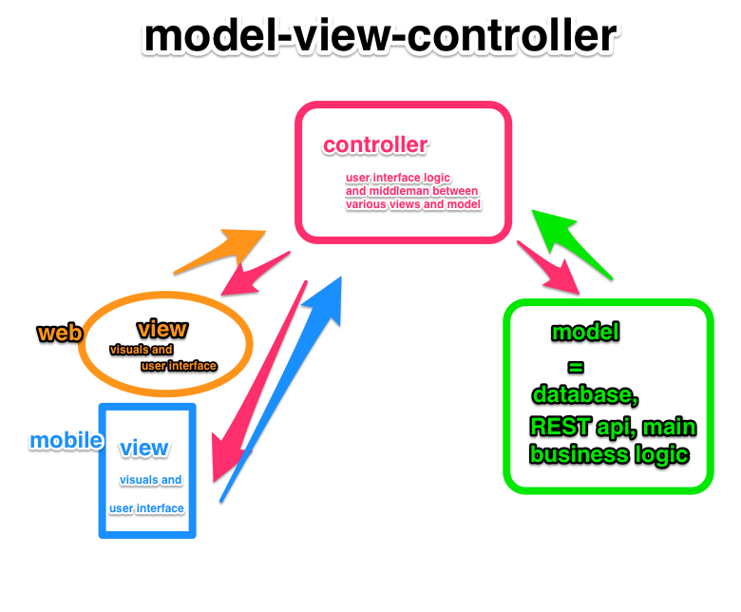
MVC
Model
The data
Controller
The behavior
Modifying / updating the models
View
The interface
How the data is presented
to the user
JavaScript
HTML
https://www.airpair.com/angularjs/posts/top-10-mistakes-angularjs-developers-make

Slide 10











Thanks……..

