Slide 1
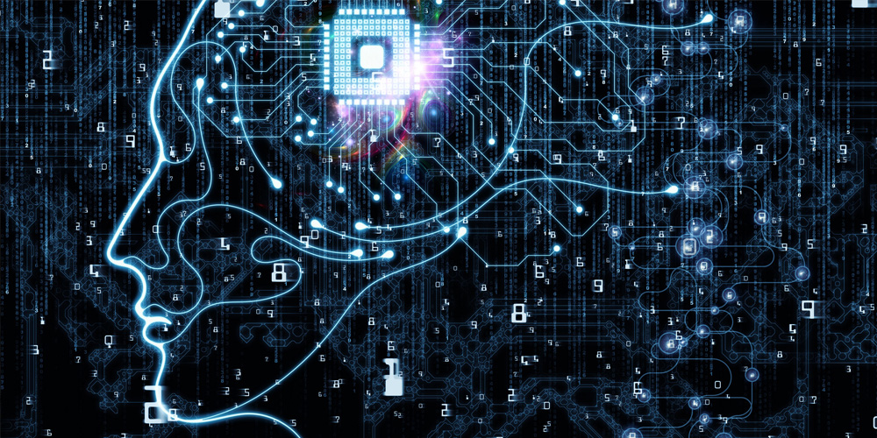
Machine Learning and AI
Notes:
10-15 mins on this slide Day 1- part 1
Introduction about yourself, experience etc.. Making students familiar with the environment. Making them curious about the workshop.
What is machine learning, Here is what people said(Most Obvious answer):
I don’t know, may be learning from machines?
Making machines learn something a.k.a. programming machine software
Learning with help of computers
Learning through online courses (!!!)
Before commenting on what machine learning is let’s first see why Machine learning.

Slide 2
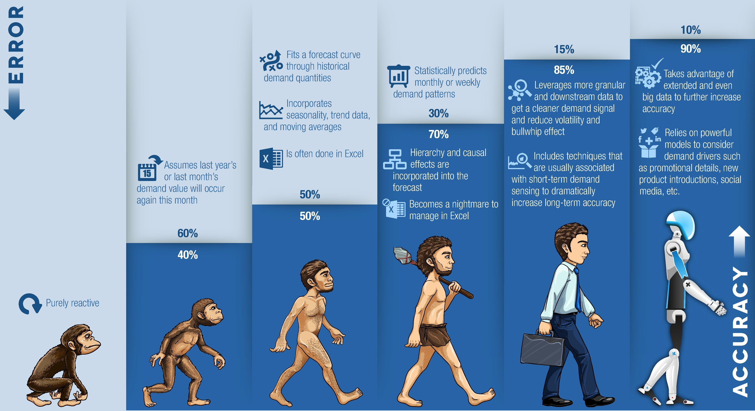
Notes:
10 mins – importance of machine learning, day to day life examples like google ad sense, weather forecast, youtube suggestions etc.
Why Machine learning ?
The benefit of machine learning is that it can predict ?
If you’re just tagging your friend’s faces in pictures, you’re not using a machine learning model.
If you upload a new photo and suddenly it tells you who each person is, then you’re cooking with machine learning gas.
The whole point of machine learning is to predict things based on patterns and other factors it has been trained with.
It can be anything; housing prices based on zip code and number of bedrooms, likelihood of a flight delay based on time of year and weather, tagging of objects or people in pictures etc.
Here you can give n-number of use cases
But How it predicts ?

Slide 3
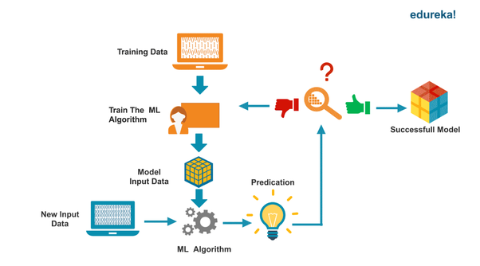
How it predicts?
Notes:
10 mins
Machine learning requires training..
You have to tell a machine learning model what its trying to predict. Think about how a human child learns.
The first time they see a banana, they have no idea what it is. You then tell them it is a banana.
The next time they see one (not the one you trained them on because you already ate it) they’ll identify it as a banana.
Machine learning works in a similar way. You show it as many pictures of a banana as you possibly can, tell it its a banana, and then test it with a picture of a banana it wasn’t trained on. This is an over simplification a bit because I’m leaving out the part where you also have to tell it what isn’t a banana, and show it different kinds of bananas, different colors, pictures from different perspectives and angles etc. elaborate with multiple examples.

Slide 4
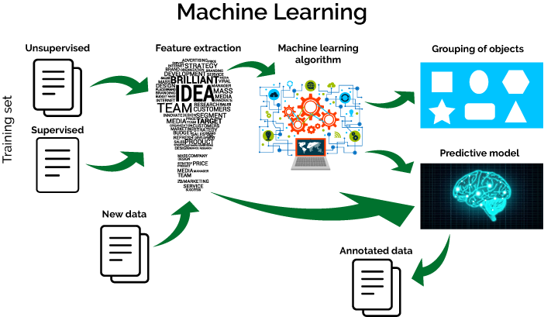
What is ML?
Notes:
5-10 mins
Most people seem a bit intimidated or confused by machine learning. What is it? Where is it going? Can I have some money now please?
“Basically Machine Learning refers to the techniques involved in dealing with vast data in the most intelligent fashion (by developing algorithms) to derive actionable insights.”
All valid questions. The truth is, you’ve been training machine learning models for years now, probably without realizing it.
Do you use an iPhone or Apple photos? Or how about Facebook? You know how it shows you a group of faces and asks you to identify them? Well, by tagging those photos, you are training a facial recognition model to identify new faces.
Congratulations, you can now say you have experience training machine learning models!

Slide 5
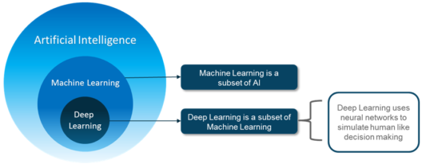
How ML differs from AI and DL?
Notes:
10 mins
People tend to throw all of these terms around casually. To sound like an expert, learn the difference.
AI — Artificial Intelligence just means a computer that is as good as (or better than) humans at doing specific tasks. It can also mean a robot that can make decisions based on lots of input, not unlike the Terminator or C3PO. Its a very broad term that isn’t very useful.
ML — Machine learning is a method for achieving AI. It means making a prediction about something based on training from sets of parsed data. There are lots of different ways a ML platform can implement training sets to predict things.
NL — Neural networks is one of these ways a machine learning model can predict things. Neural networks work a bit like your brain, by tuning itself through lots and lots of training to understand what a banana is supposed to look like. You create layers of nodes that get very deep.

Slide 6
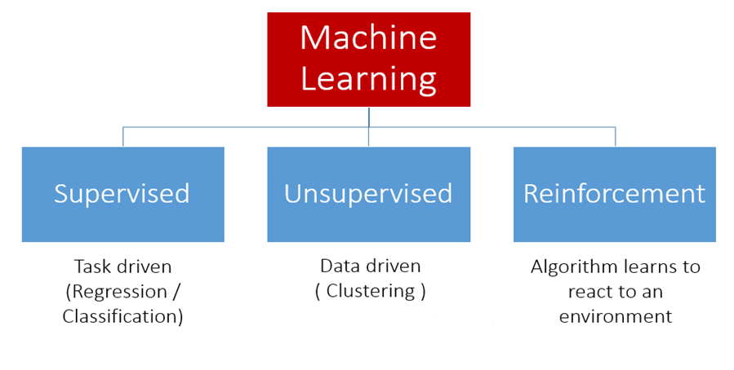
Types of ML algorithms
Notes:
10 mins
1. Supervised Learning
How it works: This algorithm consist of a target / outcome variable (or dependent variable) which is to be predicted from a given set of predictors (independent variables). Using these set of variables, we generate a function that map inputs to desired outputs. The training process continues until the model achieves a desired level of accuracy on the training data. Examples of Supervised Learning: Regression, Decision Tree, Random Forest, KNN, Logistic Regression etc.
2. Unsupervised Learning
How it works: In this algorithm, we do not have any target or outcome variable to predict / estimate. It is used for clustering population in different groups, which is widely used for segmenting customers in different groups for specific intervention. Examples of Unsupervised Learning: Apriori algorithm, K-means
3. Reinforcement Learning:
How it works: Using this algorithm, the machine is trained to make specific decisions. It works this way: the machine is exposed to an environment where it trains itself continually using trial and error. This machine learns from past experience and tries to capture the best possible knowledge to make accurate business decisions. Example of Reinforcement Learning: Markov Decision Process. Used mostly in Games, self drive cars , navigation systems.

Slide 7
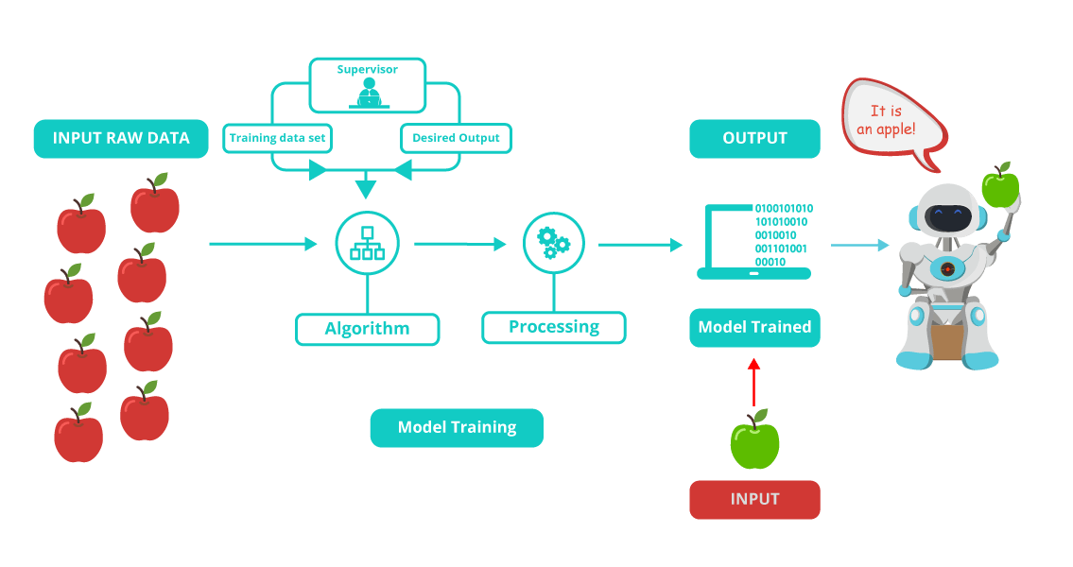
Supervised Learning
Notes:
15 mins
Predictive model as the name suggests is used to predict the future outcome based on the historical data. Predictive models are normally given clear instructions right from the beginning as in what needs to be learnt and how it needs to be learnt. These class of learning algorithms are termed as Supervised Learning.
For example: Supervised Learning is used when a marketing company is trying to find out which customers are likely to churn. We can also use it to predict the likelihood of occurrence of perils like earthquakes, tornadoes etc. with an aim to determine the Total Insurance Value. Some examples of algorithms used are: Nearest neighbour, Naïve Bayes, Decision Trees, Regression etc.

Slide 8
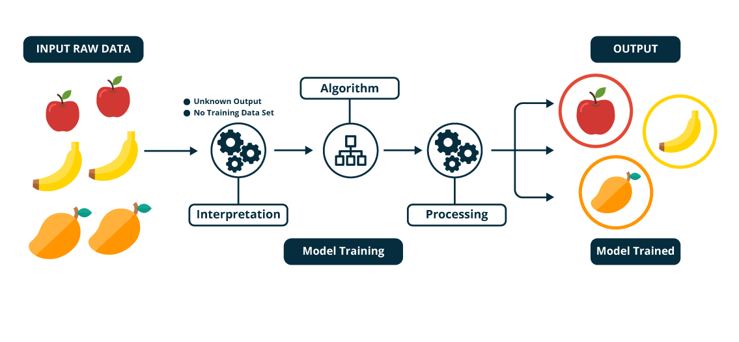
Unsupervised learning
Notes:
15 mins
Unsupervised learning / Descriptive models:
It is used to train descriptive models where no target is set and no single feature is important than the other. The case of unsupervised learning can be: When a retailer wishes to find out what are the combination of products, customers tends to buy more frequently. Furthermore, in pharmaceutical industry, unsupervised learning may be used to predict which diseases are likely to occur along with diabetes. Example of algorithm used here is: K- means Clustering Algorithm

Slide 9
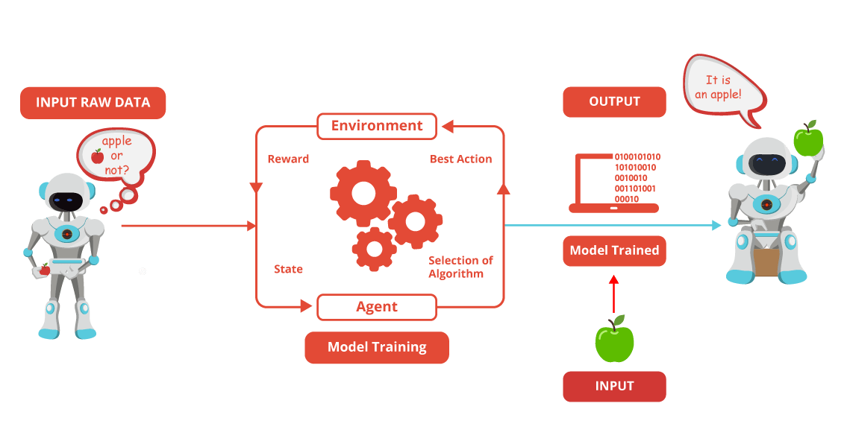
Reinforcement Learning
Notes:
15 mins
It is an example of machine learning where the machine is trained to take specific decisions based on the business requirement with the sole motto to maximize efficiency (performance). The idea involved in reinforcement learning is: The machine/ software agent trains itself on a continual basis based on the environment it is exposed to, and applies it’s enriched knowledge to solve business problems. This continual learning process ensures less involvement of human expertise which in turn saves a lot of time!
An example of algorithm used in RL is Markov Decision Process.
Important Note: There is a subtle difference between Supervised Learning and Reinforcement Learning (RL). RL essentially involves learning by interacting with an environment. An RL agent learns from its past experience, rather from its continual trial and error learning process as against supervised learning where an external supervisor provides examples.
A good example to understand the difference is self driving cars. Self driving cars use Reinforcement learning to make decisions continuously – which route to take? what speed to drive on? are some of the questions which are decided after interacting with the environment. A simple manifestation for supervised learning would be to predict fare from a cab going from one place to another.

Slide 10
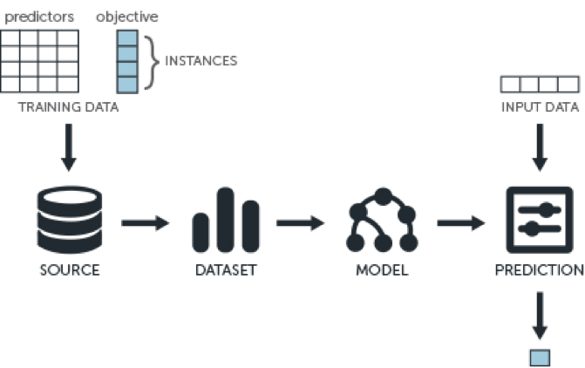
What are the steps used in Machine Learning?
Notes:
20 mins
Collecting data: Be it the raw data from excel, access, text files etc., this step (gathering past data) forms the foundation of the future learning. The better the variety, density and volume of relevant data, better the learning prospects for the machine becomes.
Preparing the data: Any analytical process thrives on the quality of the data used. One needs to spend time determining the quality of data and then taking steps for fixing issues such as missing data and treatment of outliers. Exploratory analysis is perhaps one method to study the nuances of the data in details thereby burgeoning the nutritional content of the data.
Training a model: This step involves choosing the appropriate algorithm and representation of data in the form of the model. The cleaned data is split into two parts – train and test (proportion depending on the prerequisites); the first part (training data) is used for developing the model. The second part (test data), is used as a reference.
Evaluating the model: To test the accuracy, the second part of the data (holdout / test data) is used. This step determines the precision in the choice of the algorithm based on the outcome. A better test to check accuracy of model is to see its performance on data which was not used at all during model build.
Improving the performance: This step might involve choosing a different model altogether or introducing more variables to augment the efficiency. That’s why significant amount of time needs to be spent in data collection and preparation.

Slide 11
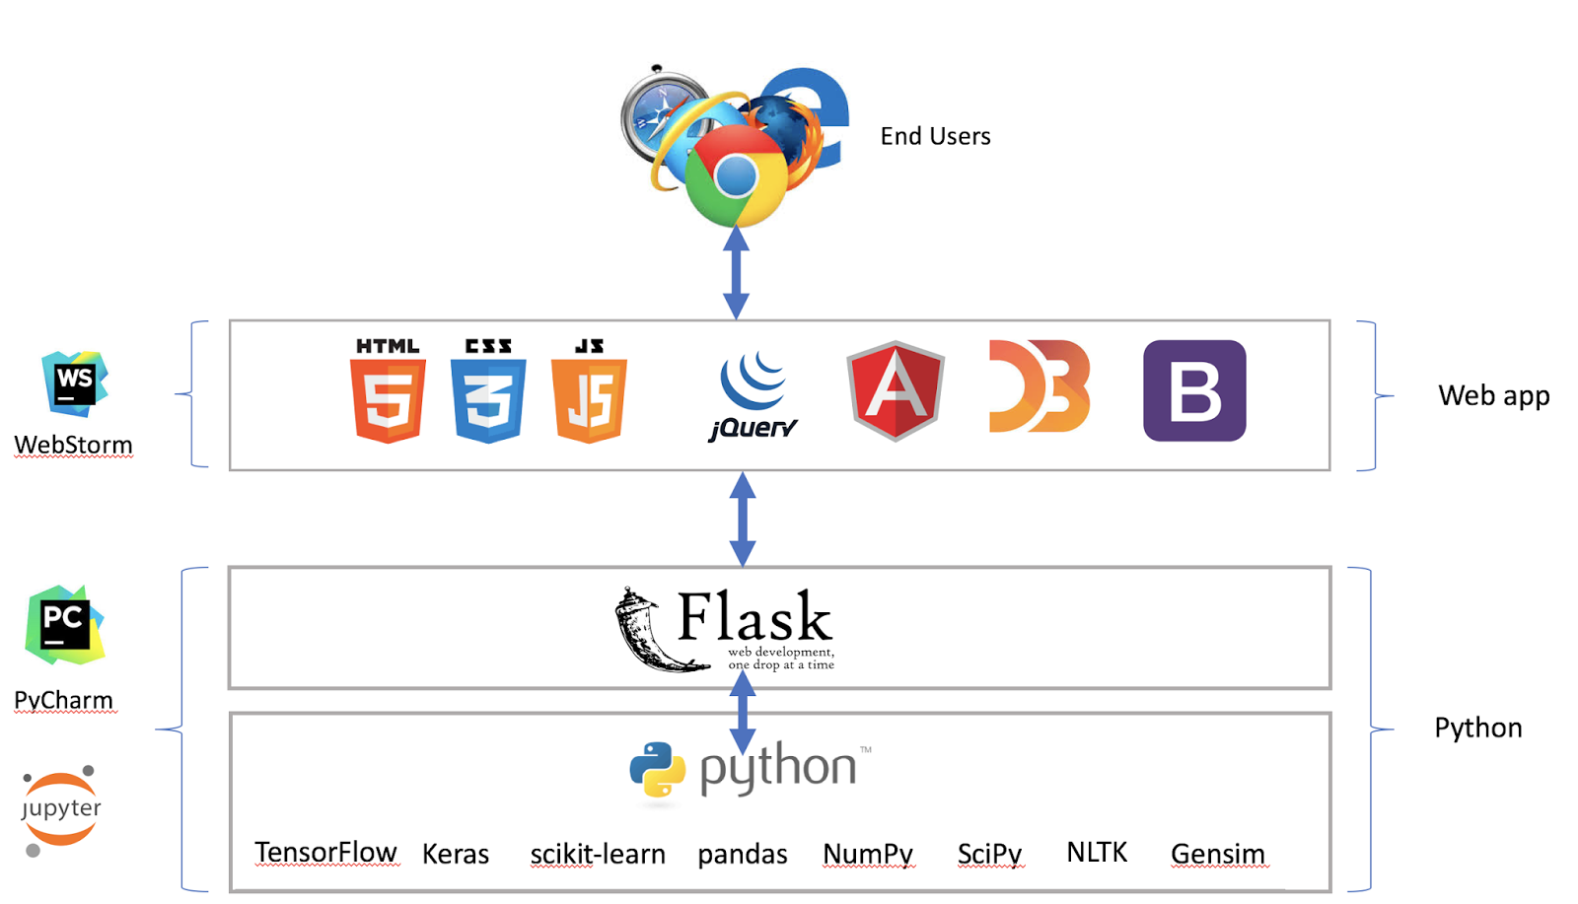
Getting started!
Notes:
20 mins
Describe the tools and technologies used to write machine learning algorithms.
For ex :
You can code using python, R , scala , java , javascript etc
IDEs can be used like pyCharm , jupyter for python
Webstorm for UI development
For the below sessions we will be concentrating on python tech stack.
And we will be taking hands-on sessions on different ML algorithms.

Slide 12
Installation steps!
Python
NumPy , Pandas , SciPy (packages)
Scikit-learn
PyCharm IDE
Notes:
45 mins
Guide the installation of python
What is sci-kit learn
What is an IDE etc
python basics if needed, as we have to take all hands-on sessions using python and sci-kit learn

