Slide 1
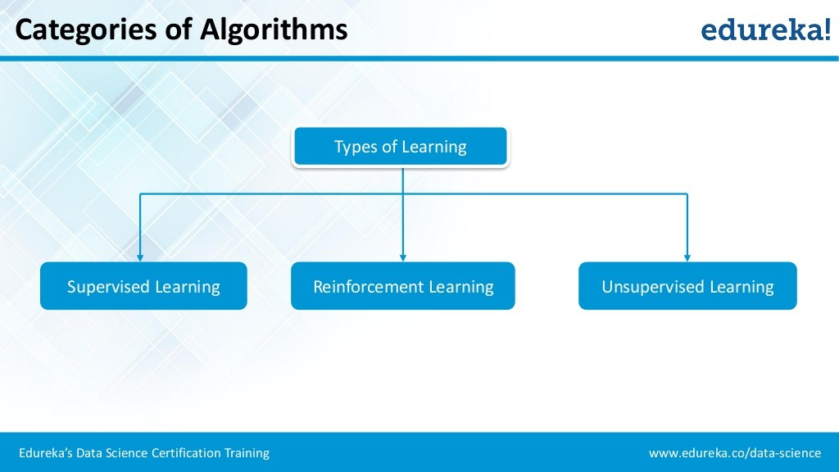
Machine Learning and AI

Slide 2
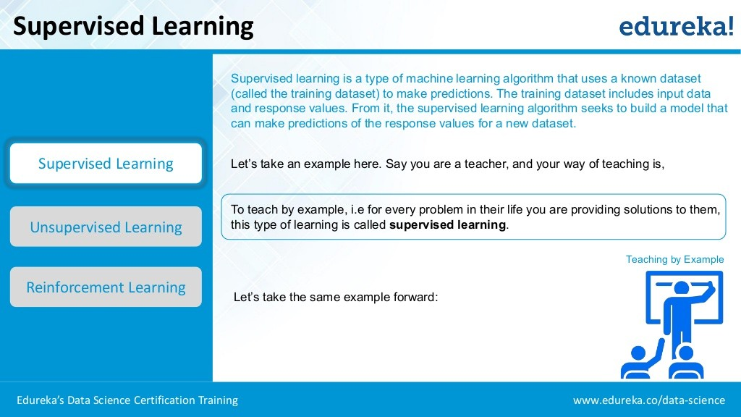
Machine Learning and AI

Slide 3
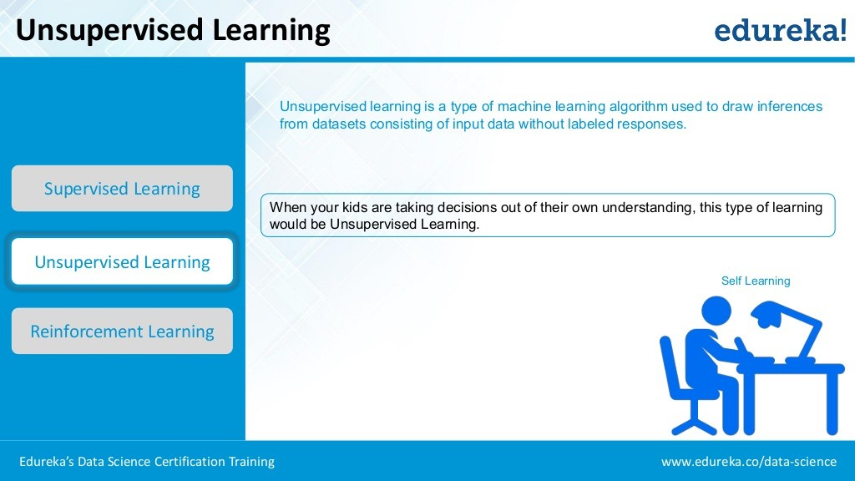
Machine Learning and AI

Slide 4
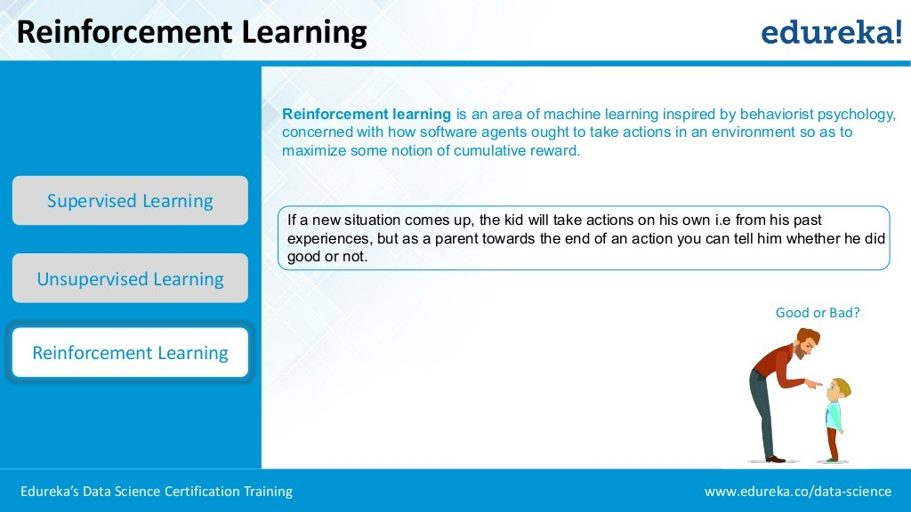
Machine Learning and AI

Slide 5
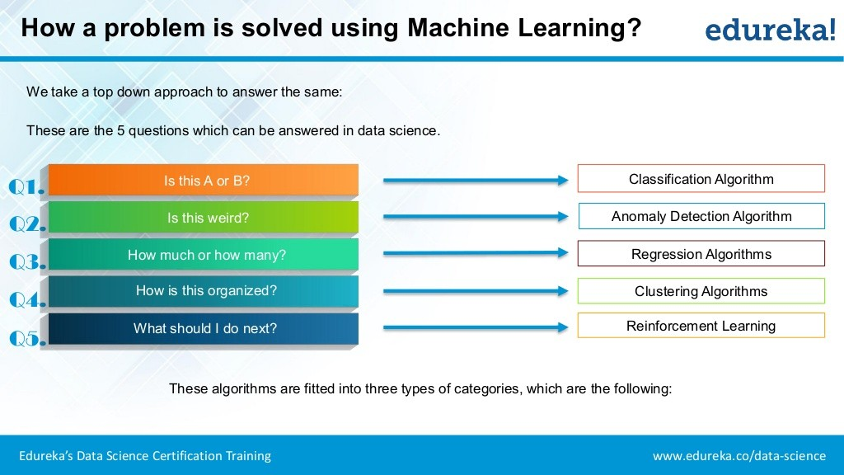
Machine Learning and AI

Slide 6
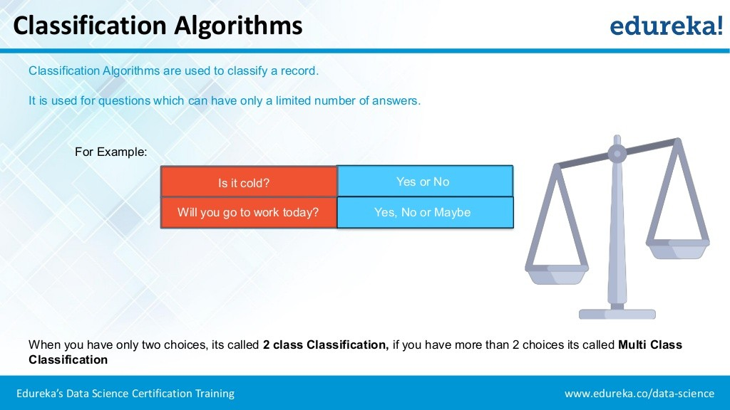
Machine Learning and AI

Slide 7
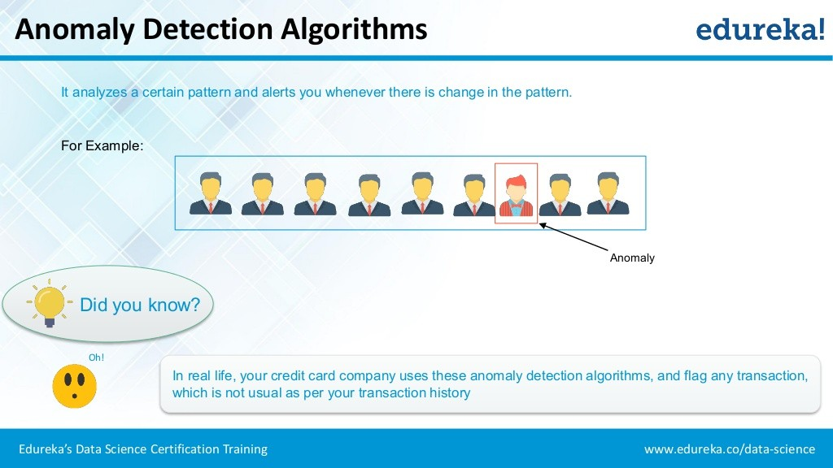
Machine Learning and AI

Slide 8
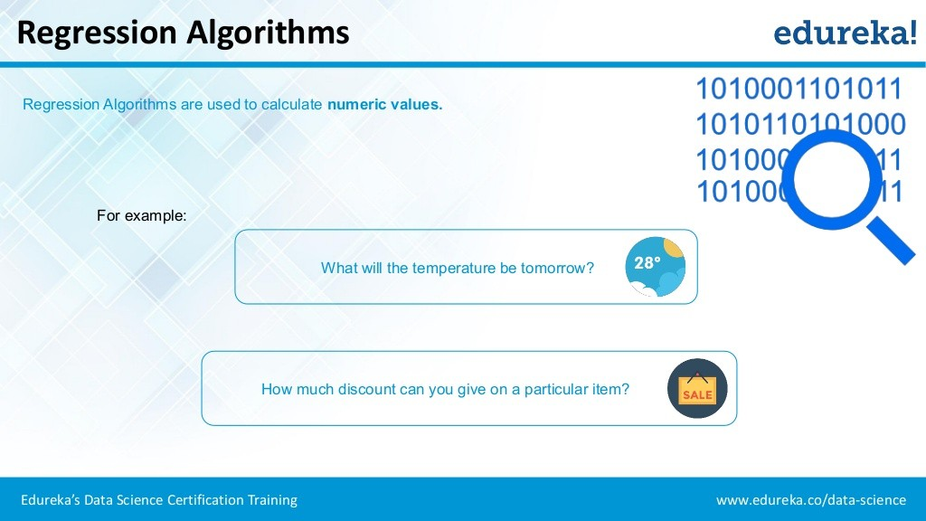
Machine Learning and AI

Slide 9
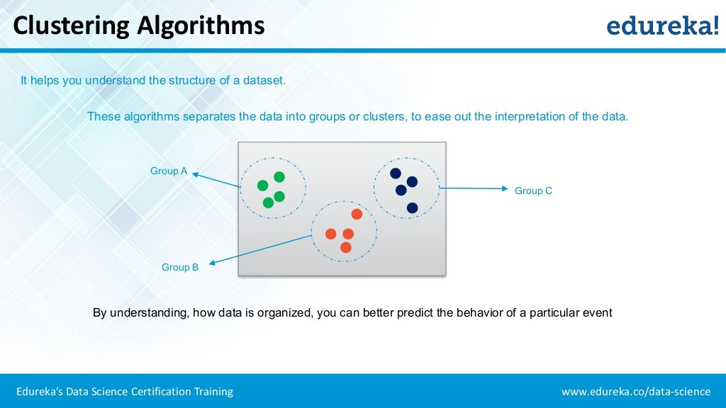
Machine Learning and AI

Slide 10
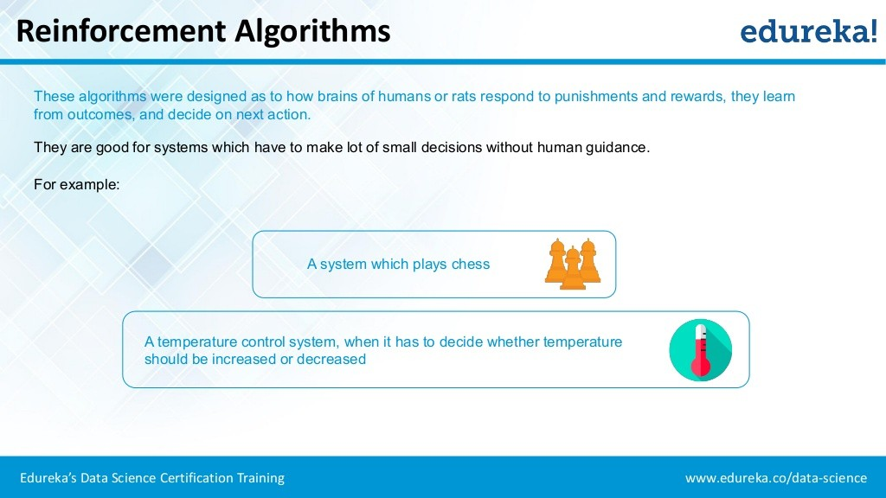
Machine Learning and AI

