Slide 1
CPE 150: Introduction to Programming
Chapter 2: Control Structures
Copyright notice: 1- care has been taken to use only those web images deemed by the instructor to be in the public domain. If you see a copyrighted image on any slide and are the copyright owner, please contact the instructor. It will be removed.
2- These slides are inspired, based, and modified with permission from the authors of the C++ How to Program (4th Edition) textbook

Slide 2
Topics To Be Covered In Chapter 2
2.1 Introduction
2.2 Algorithms
2.3 Pseudocode
2.4 Control Structures
2.5 if Selection Structure
2.6 if/else Selection Structure
2.7 while Repetition Structure
2.8 Counter-Controlled Repetition
2.9 Sentinel-Controlled Repetition
2.10 Nested Control Structures
2.11 Assignment Operators
2.12 Increment and Decrement Operators
2.13 Essentials of Counter-Controlled Repetition
2.14 for Repetition Structure
2.15 Examples Using the for Structure
2.16 switch Multiple-Selection Structure
2.17 do/while Repetition Structure
2.18 break and continue Statements
2.19 Logical Operators
2.20 Confusing Equality (==) and Assignment (=) Operators
2.21 Structured-Programming Summary

Slide 3
2.1 Introduction
Before writing a program
  Have a thorough understanding of problem
  Carefully plan your approach for solving it
While writing a program
  Know what “building blocks” are available
  Use good programming principles
After writing a program
  Clear and documented
  Correct
  General
  High Efficiency

Slide 4
2.2 Algorithms
Computing problems
  Solved by executing a series of actions in a specific order
Algorithm a procedure determining
  Actions to be executed
  Order to be executed
  Example: recipe
Program control
  Specifies the order in which statements are executed

Slide 5
2.3 Pseudocode
Pseudocode
  Artificial, informal language used to develop algorithms
  Similar to everyday English
Not executed on computers
  Used to think out program before coding
    Easy to convert into C++ program
  Only executable statements
    No need to declare variables

Slide 6
2.4 Control Structures
Flowchart
  Graphical representation of an algorithm
  Special-purpose symbols connected by arrows (flowlines)
  Rectangle symbol (action symbol)
    Any type of action
  Oval symbol
    Beginning or end of a program, or a section of code (circles)
Single-entry/single-exit control structures
  Connect exit point of one to entry point of the next
  Control structure stacking
  Control structure nesting

Slide 7
2.4 Control Structures
Sequential execution
  Statements executed in order
Transfer of control
  Next statement executed not next one in sequence
3 control structures (Bohm and Jacopini)
  Sequence structure
    Programs executed sequentially by default
  Selection structures
    if, if/else, switch
  Repetition structures
    while, do/while, for

Slide 8
2.5 if Selection Structure
Selection structure
  Choose among alternative courses of action
  Pseudocode example:
      If student’s grade is greater than or equal to 60
      Print “Passed”
  If the condition is true
    Print statement executed, program continues to next statement
  If the condition is false
    Print statement ignored, program continues
  Indenting makes programs easier to read
    C++ ignores whitespace characters (tabs, spaces, etc.)

Slide 9
2.5 if Selection Structure
Translation into C++
      If student’s grade is greater than or equal to 60
      Print “Passed”
      if ( grade >= 60 )
      cout << "Passed";
Diamond symbol (decision symbol)
  Indicates decision is to be made
  Contains an expression that can be true or false
    Test condition, follow path
if structure
  Single-entry/single-exit

Slide 10
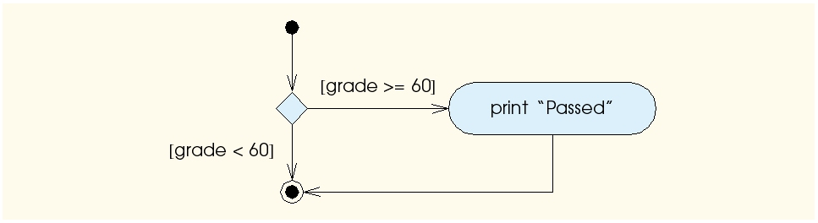
2.5 if Selection Structure
Flowchart of pseudocode statement
A decision can be made on any expression.
zero - false
nonzero - true
Example:
3 - 4 is true

Slide 11
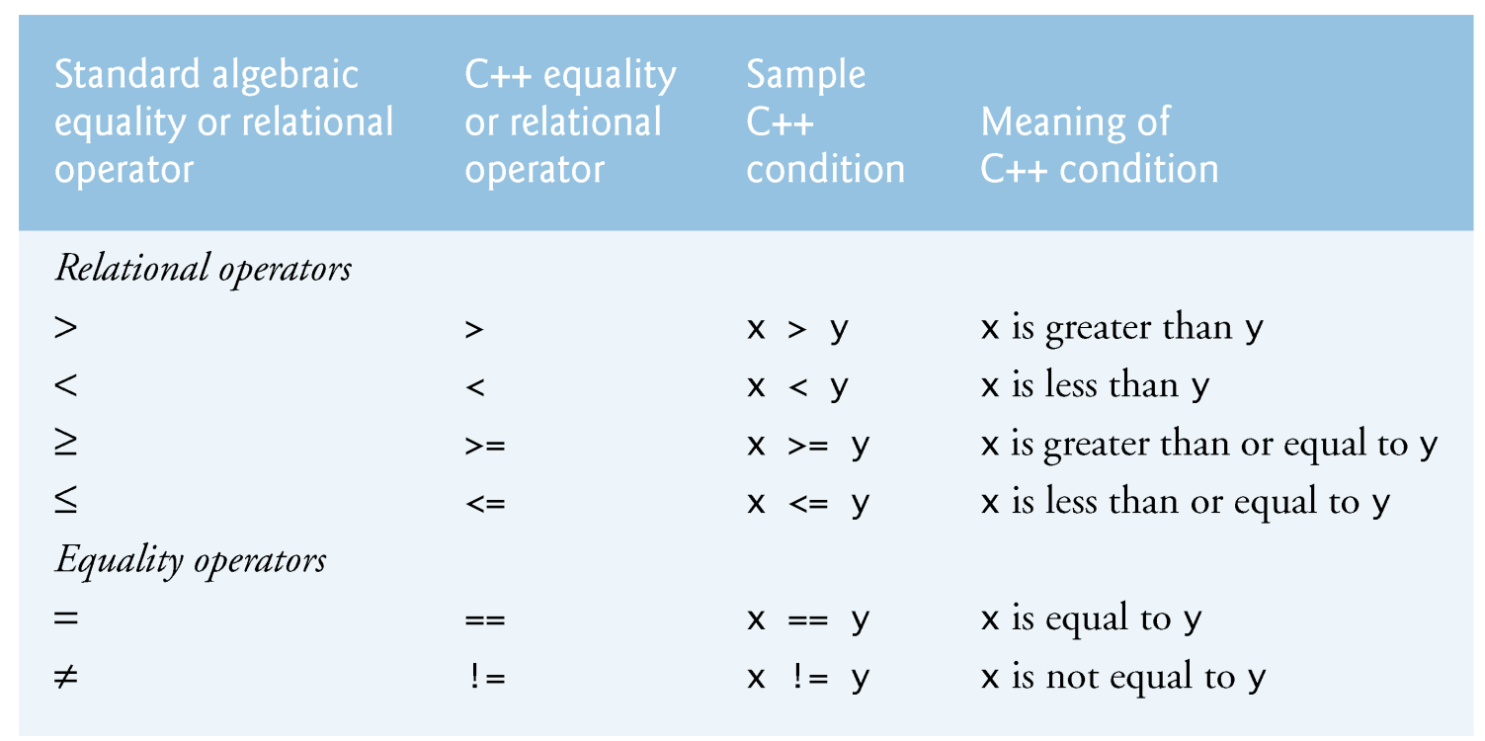
Decision Making: Equality and Relational Operators

Slide 12
1 // Fig. 1.14: fig01_14.cpp
2 // Using if statements, relational
3 // operators, and equality operators.
4 #include <iostream>
5
6 using std::cout; // program uses cout
7 using std::cin; // program uses cin
8 using std::endl; // program uses endl
9
10 // function main begins program execution
11 int main()
12 {
13 int num1; // first number to be read from user
14 int num2; // second number to be read from user
15
16 cout << "Enter two integers, and I will tell you\n"
17 << "the relationships they satisfy: ";
18 cin >> num1 >> num2; // read two integers
19
20 if ( num1 == num2 )
21 cout << num1 << " is equal to " << num2 << endl;
22
23 if ( num1 != num2 )
24 cout << num1 << " is not equal to " << num2 << endl;
25
26 if ( num1 < num2 )
27 cout << num1 << " is less than " << num2 << endl;
28
29 if ( num1 > num2 )
30 cout << num1 << " is greater than " << num2 << endl;
32 if ( num1 <= num2 )
33 cout << num1 << " is less than or equal to "
34 << num2 << endl;
35
36 if ( num1 >= num2 )
37 cout << num1 << " is greater than or equal to "
38 << num2 << endl;
39
40 return 0; // indicate that program ended successfully
41
42 } // end function main
Statements may be split over several lines.
using statements eliminate need for std:: prefix.
Declare variables.
Can write cout and cin without std:: prefix.
Sample Run 1:
Enter two integers, and I will tell you
the relationships they satisfy: 22 12
22 is not equal to 12
22 is greater than 12
22 is greater than or equal to 12
if structure compares values of num1 and num2 to test for equality.
If condition is true (i.e., values are equal), execute this statement.
if structure compares values of num1 and num2 to test for inequality.
If condition is true (i.e., values are not equal), execute this statement.
Sample Run 2:
Enter two integers, and I will tell you
the relationships they satisfy: 7 7
7 is equal to 7
7 is less than or equal to 7
7 is greater than or equal to 7

Slide 13
2.19 Logical Operators
Used as conditions in loops, if statements
&& (logical AND)
  true if both conditions are true
  if ( gender == 1 && age >= 65 )
  ++seniorFemales;
|| (logical OR)
  true if either of condition is true
  if ( semesterAverage >= 90 || finalExam >= 90 )
  cout << "Student grade is A" << endl;

Slide 14
2.19 Logical Operators
! (logical NOT, logical negation)
  Returns true when its condition is false, & vice versa
  if ( !( grade == sentinelValue ) )
  cout << "The next grade is " << grade << endl;
  Alternative:
  if ( grade != sentinelValue )
  cout << "The next grade is " << grade << endl;

Slide 15
2.20 Confusing Equality (==) and Assignment (=) Operators
Common error
  Does not typically cause syntax errors
Aspects of problem
  Expressions that have a value can be used for decision
    Zero = false, nonzero = true
  Assignment statements produce a value (the value to be assigned)

Slide 16
2.20 Confusing Equality (==) and Assignment (=) Operators
Example
    if ( payCode == 4 )
    cout << "You get a bonus!" << endl;
  If paycode is 4, bonus given
If == was replaced with =
    if ( payCode = 4 )
    cout << "You get a bonus!" << endl;
  Paycode set to 4 (no matter what it was before)
  Statement is true (since 4 is non-zero)
  Bonus given in every case

Slide 17
2.20 Confusing Equality (==) and Assignment (=) Operators
Lvalues
  Expressions that can appear on left side of equation
  Can be changed (I.e., variables)
    x = 4;
Rvalues
  Only appear on right side of equation
  Constants, such as numbers (i.e. cannot write 4 = x;)
Lvalues can be used as rvalues, but not vice versa

Slide 18
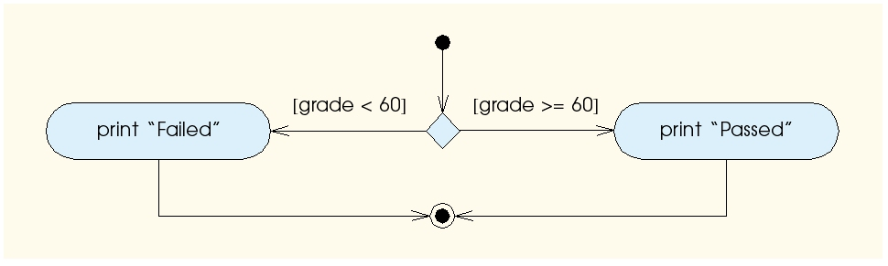
2.6 if/else Selection Structure
if
  Performs action if condition true
if/else
  Different actions if conditions true or false
Pseudocode
    if student’s grade is greater than or equal to 60
    print “Passed”
    else
    print “Failed”
C++ code
    if ( grade >= 60 )
    cout << "Passed";
    else
    cout << "Failed";

Slide 19
2.6 if/else Selection Structure
Ternary conditional operator (?:)
  Three arguments (condition, value if true, value if false)
cout << ( grade >= 60 ? “Passed” : “Failed” );
Condition
Value if true
Value if false

Slide 20
2.6 if/else Selection Structure
Nested if/else structures
  One inside another, test for multiple cases
  Once condition met, other statements skipped
  if student’s grade is greater than or equal to 90
  Print “A”
  else
  if student’s grade is greater than or equal to 80
  Print “B”
  else
  if student’s grade is greater than or equal to 70
  Print “C”
  else
  if student’s grade is greater than or equal to 60
  Print “D”
  else
    Print “F”

Slide 21
2.6 if/else Selection Structure
Example
if ( grade >= 90 ) // 90 and above
cout << "A";
else if ( grade >= 80 ) // 80-89
cout << "B";
else if ( grade >= 70 ) // 70-79
cout << "C";
else if ( grade >= 60 ) // 60-69
cout << "D";
else // less than 60
cout << "F";

Slide 22
2.6 if/else Selection Structure
Compound statement
  Set of statements within a pair of braces
  if ( grade >= 60 )
  cout << "Passed.\n";
  else {
  cout << "Failed.\n";
  cout << "You must take this course again.\n";
  }
  Without braces,
  cout << "You must take this course again.\n";
  always executed
Block
  Set of statements within braces

Slide 23
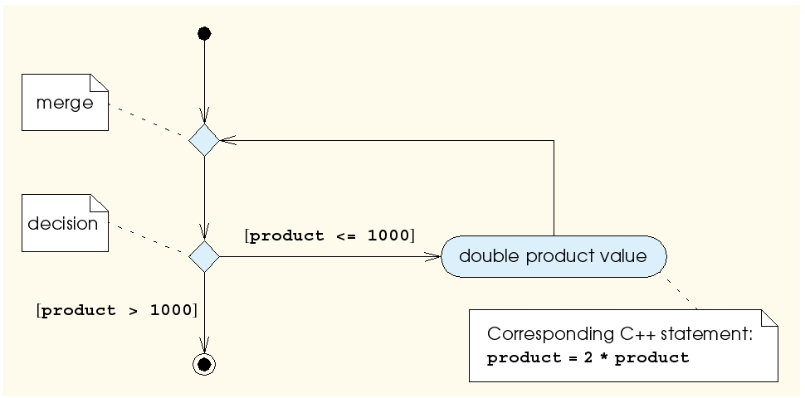
2.7 while Repetition Structure
Repetition structure
  Action repeated while some condition remains true
  Psuedocode
    while there are more items on my shopping list
    Purchase next item and cross it off my list
  while loop repeated until condition becomes false
Example
      int product = 2;
      while ( product <= 1000 )
      product = 2 * product;

Slide 24
2.8 Counter-Controlled Repetition
Counter-controlled repetition
  Loop repeated until counter reaches certain value
Definite repetition
  Number of repetitions known
Example
  A class of ten students took a quiz. The grades (integers in the range 0 to 100) for this quiz are available to you. Determine the class average on the quiz.

Slide 25
2.8 Counter-Controlled Repetition
Pseudocode for example:
    Set total to zero
    Set grade counter to one
    While grade counter is less than or equal to ten
    Input the next grade
    Add the grade into the total
    Add one to the grade counter
    Set the class average to the total divided by ten
    Print the class average
Next: C++ code for this example

Slide 26
1 // Fig. 2.7: fig02_07.cpp
2 // Class average program with counter-controlled repetition.
3 #include <iostream>
5 using std::cout;
6 using std::cin;
7 using std::endl;
9 // function main begins program execution
10 int main()
11 {
12 int total; // sum of grades input by user
13 int gradeCounter; // number of grade to be entered next
14 int grade; // grade value
15 int average; // average of grades
16
17 // initialization phase
18 total = 0; // initialize total
19 gradeCounter = 1; // initialize loop counter
21 // processing phase
22 while ( gradeCounter <= 10 ) { // loop 10 times
23 cout << "Enter grade: "; // prompt for input
24 cin >> grade; // read grade from user
25 total = total + grade; // add grade to total
26 gradeCounter = gradeCounter + 1; // increment counter
27 }
28
29 // termination phase
30 average = total / 10; // integer division
31
32 // display result
33 cout << "Class average is " << average << endl;
34
35 return 0; // indicate program ended successfully
36
37 } // end function main
The counter gets incremented each time the loop executes. Eventually, the counter causes the loop to end.
Enter grade: 98
Enter grade: 76
Enter grade: 71
Enter grade: 87
Enter grade: 83
Enter grade: 90
Enter grade: 57
Enter grade: 79
Enter grade: 82
Enter grade: 94
Class average is 81

Slide 27
2.9 Sentinel-Controlled Repetition
Suppose problem becomes:
  Develop a class-averaging program that will process an arbitrary number of grades each time the program is run
  Unknown number of students
  How will program know when to end?
Sentinel value
  Indicates “end of data entry”
  Loop ends when sentinel input
  Sentinel chosen so it cannot be confused with regular input
    -1 in this case

Slide 28
2.9 Sentinel-Controlled Repetition
Top-down, stepwise refinement
  Begin with pseudocode representation of top
      Determine the class average for the quiz
  Divide top into smaller tasks, list in order
      Initialize variables
      Input, sum and count the quiz grades
      Calculate and print the class average

Slide 29
2.9 Sentinel-Controlled Repetition
Many programs have three phases
  Initialization
    Initializes the program variables
  Processing
    Input data, adjusts program variables
  Termination
    Calculate and print the final results
  Helps break up programs for top-down refinement

Slide 30
2.9 Sentinel-Controlled Repetition
Refine the initialization phase
      Initialize variables
        goes to
      Initialize total to zero
      Initialize counter to zero
Processing
  Input, sum and count the quiz grades
        goes to
    Input the first grade (possibly the sentinel)
    While the user has not as yet entered the sentinel
    Add this grade into the running total
    Add one to the grade counter
    Input the next grade (possibly the sentinel)

Slide 31
2.9 Sentinel-Controlled Repetition
Termination
    Calculate and print the class average
        goes to
    If the counter is not equal to zero
    Set the average to the total divided by the counter
    Print the average
    Else
    Print “No grades were entered”
Next: C++ program

Slide 32
1 // Fig. 2.9: fig02_09.cpp
2 // Class average program with sentinel-controlled repetition.
3 #include <iostream>
5 using std::cout;
6 using std::cin;
7 using std::endl;
8 using std::fixed;
10 #include <iomanip> // parameterized stream manipulators
11
12 using std::setprecision; // sets numeric output precision
13
14 // function main begins program execution
15 int main()
16 {
17 int total; // sum of grades
18 int gradeCounter; // number of grades entered
19 int grade; // grade value
20
21 double average; // number with decimal point for average
22
23 // initialization phase
24 total = 0; // initialize total
25 gradeCounter = 0; // initialize loop counter
26
27 // processing phase
28 // get first grade from user
29 cout << "Enter grade, -1 to end: "; // prompt for input
30 cin >> grade;
32 // loop until sentinel value read from user
33 while ( grade != -1 ) {
34 total = total + grade; // add grade to total
35 gradeCounter = gradeCounter + 1; // increment counter
36
37 cout << "Enter grade, -1 to end: "; // prompt for input
38 cin >> grade; // read next grade
39
40 } // end while
41
42 // termination phase
43 // if user entered at least one grade ...
44 if ( gradeCounter != 0 ) {
45
46 // calculate average of all grades entered
47 average = static_cast< double >( total ) / gradeCounter;
48
49 // display average with two digits of precision
50 cout << "Class average is " << setprecision( 2 )
51 << fixed << average << endl;
52
53 } // end if part of if/else
54
55 else // if no grades were entered, output appropriate message
56 cout << "No grades were entered" << endl;
57
58 return 0; // indicate program ended successfully
59 } // end function main
static_cast<double>() treats total as a double temporarily (casting).
Required because dividing two integers truncates the remainder.
gradeCounter is an int, but it gets promoted to double.
fixed forces output to print in fixed point format (not scientific notation). Also, forces trailing zeros and decimal point to print.
Include <iostream>
Data type double used to represent decimal numbers.
Enter grade, -1 to end: 75
Enter grade, -1 to end: 94
Enter grade, -1 to end: 97
Enter grade, -1 to end: 88
Enter grade, -1 to end: 70
Enter grade, -1 to end: 64
Enter grade, -1 to end: 83
Enter grade, -1 to end: 89
Enter grade, -1 to end: -1
Class average is 82.50
setprecision(2)prints two digits past decimal point (rounded to fit precision).
Programs that use this must include <iomanip>

Slide 33
2.10 Nested Control Structures
Problem statement
  A college has a list of test results (1 = pass, 2 = fail) for 10 students. Write a program that analyzes the results. If more than 8 students pass, print "Raise Tuition".
Notice that
  Program processes 10 results
    Fixed number, use counter-controlled loop
  Two counters can be used
    One counts number that passed
    Another counts number that fail
  Each test result is 1 or 2
    If not 1, assume 2

Slide 34
2.10 Nested Control Structures
Top level outline
    Analyze exam results and decide if tuition should be raised
First refinement
    Initialize variables
    Input the ten quiz grades and count passes and failures
    Print a summary of the exam results and decide if tuition should be raised
Refine
      Initialize variables
        to
      Initialize passes to zero
      Initialize failures to zero
      Initialize student counter to one

Slide 35
2.10 Nested Control Structures
Refine
    Input the ten quiz grades and count passes and failures
        to
    While student counter is less than or equal to ten
    Input the next exam result
    If the student passed
    Add one to passes
    Else
    Add one to failures
    Add one to student counter

Slide 36
2.10 Nested Control Structures
Refine
    Print a summary of the exam results and decide if tuition should be raised
        to
    Print the number of passes
    Print the number of failures
    If more than eight students passed
    Print “Raise tuition”
Program next

Slide 37
1 // Fig. 2.11: fig02_11.cpp
2 // Analysis of examination results.
3 #include <iostream>
4
5 using std::cout;
6 using std::cin;
7 using std::endl;
8
9 // function main begins program execution
10 int main()
11 {
12 // initialize variables in declarations
13 int passes = 0; // number of passes
14 int failures = 0; // number of failures
15 int studentCounter = 1; // student counter
16 int result; // one exam result
17
18 // process 10 students using counter-controlled loop
19 while ( studentCounter <= 10 ) {
20
21 // prompt user for input and obtain value from user
22 cout << "Enter result (1 = pass, 2 = fail): ";
23 cin >> result;
25 // if result 1, increment passes; if/else nested in while
26 if ( result == 1 ) // if/else nested in while
27 passes = passes + 1;
28
29 else // if result not 1, increment failures
30 failures = failures + 1;
31
32 // increment studentCounter so loop eventually terminates
33 studentCounter = studentCounter + 1;
34
35 } // end while
36
37 // termination phase; display number of passes and failures
38 cout << "Passed " << passes << endl;
39 cout << "Failed " << failures << endl;
40
41 // if more than eight students passed, print "raise tuition"
42 if ( passes > 8 )
43 cout << "Raise tuition " << endl;
44
45 return 0; // successful termination
46
47 } // end function main

Slide 38
Enter result (1 = pass, 2 = fail): 1
Enter result (1 = pass, 2 = fail): 2
Enter result (1 = pass, 2 = fail): 2
Enter result (1 = pass, 2 = fail): 1
Enter result (1 = pass, 2 = fail): 1
Enter result (1 = pass, 2 = fail): 1
Enter result (1 = pass, 2 = fail): 2
Enter result (1 = pass, 2 = fail): 1
Enter result (1 = pass, 2 = fail): 1
Enter result (1 = pass, 2 = fail): 2
Passed 6
Failed 4
Enter result (1 = pass, 2 = fail): 1
Enter result (1 = pass, 2 = fail): 1
Enter result (1 = pass, 2 = fail): 1
Enter result (1 = pass, 2 = fail): 1
Enter result (1 = pass, 2 = fail): 2
Enter result (1 = pass, 2 = fail): 1
Enter result (1 = pass, 2 = fail): 1
Enter result (1 = pass, 2 = fail): 1
Enter result (1 = pass, 2 = fail): 1
Enter result (1 = pass, 2 = fail): 1
Passed 9
Failed 1
Raise tuition

Slide 39
2.11 Assignment Operators
Assignment expression abbreviations
  Addition assignment operator
    c = c + 3; abbreviated to c += 3;
Statements of the form
    variable = variable operator expression;
  can be rewritten as
    variable operator= expression;
Other assignment operators
      d -= 4 (d = d - 4)
      e *= 5 (e = e * 5)
      f /= 3 (f = f / 3)
      g %= 9 (g = g % 9)

Slide 40
2.12 Increment and Decrement Operators
Increment operator (++)
  Increment variable by one: c++
  can be used instead of c += 1
Decrement operator (--)
  Decrement variable by one: c--
  can be used instead of c -= 1
  Preincrement
    When the operator is used before the variable (++c or –-c)
    Variable is changed, then the expression it is in is evaluated.
  Posincrement
    When the operator is used after the variable (c++ or c--)
    Expression the variable is in executes, then the variable is changed.

Slide 41
2.12 Increment and Decrement Operators
If c = 5, then
  cout << ++c;
    c is changed to 6, then printed out
  cout << c++;
    Prints out 5 (cout is executed before the increment.
    c then becomes 6

Slide 42
2.12 Increment and Decrement Operators
When variable not in expression
  Preincrementing and postincrementing have same effect
    ++c;
    cout << c;
  and
    c++;
    cout << c;
  are the same

Slide 43
1 // Fig. 2.14: fig02_14.cpp
2 // Preincrementing and postincrementing.
3 #include <iostream>
4
5 using std::cout;
6 using std::endl;
7
8 // function main begins program execution
9 int main()
10 {
11 int c; // declare variable
12
13 // demonstrate postincrement
14 c = 5; // assign 5 to c
15 cout << c << endl; // print 5
16 cout << c++ << endl; // print 5 then postincrement
17 cout << c << endl << endl; // print 6
18
19 // demonstrate preincrement
20 c = 5; // assign 5 to c
21 cout << c << endl; // print 5
22 cout << ++c << endl; // preincrement then print 6
23 cout << c << endl; // print 6
24
25 return 0; // indicate successful termination
26
27 } // end function main
5
5
6
5
6
6

Slide 44
2.13 Essentials of Counter-Controlled Repetition
Counter-controlled repetition requires
  Name of control variable/loop counter
  Initial value of control variable
  Condition to test for final value
  Increment/decrement to modify control variable when looping

Slide 45
1 // Fig. 2.16: fig02_16.cpp
2 // Counter-controlled repetition.
3 #include <iostream>
5 using std::cout;
6 using std::endl;
8 // function main begins program execution
9 int main()
10 {
11 int counter = 1; // initialization
12
13 while ( counter <= 10 ) { // repetition condition
14 cout << counter << endl; // display counter
15 ++counter; // increment
16
17 } // end while
18
19 return 0; // indicate successful termination
20
21 } // end function main
1
2
3
4
5
6
7
8
9
10

Slide 46
2.13 Essentials of Counter-Controlled Repetition
The declaration
      int counter = 1;
  Names counter
  Declares counter to be an integer
  Reserves space for counter in memory
  Sets counter to an initial value of 1

Slide 47
2.14 for Repetition Structure
General format when using for loops
  for ( initialization; LoopContinuationTest; increment )
  statement
Example
  for( int counter = 1; counter <= 10; counter++ )
    cout << counter << endl;
  Prints integers from one to ten
No semicolon after last statement

Slide 48
1 // Fig. 2.17: fig02_17.cpp
2 // Counter-controlled repetition with the for structure.
3 #include <iostream>
4
5 using std::cout;
6 using std::endl;
7
8 // function main begins program execution
9 int main()
10 {
11 // Initialization, repetition condition and incrementing
12 // are all included in the for structure header.
13
14 for ( int counter = 1; counter <= 10; counter++ )
15 cout << counter << endl;
16
17 return 0; // indicate successful termination
18
19 } // end function main
1
2
3
4
5
6
7
8
9
10

Slide 49
2.14 for Repetition Structure
for loops can usually be rewritten as while loops
Initialization and increment
  For multiple variables, use comma-separated lists
    for (int i = 0, j = 0; j + i <= 10; j++, i++)
    cout << j + i << endl;
    initialization;
    while ( loopContinuationTest){
    statement
    increment;
    }

Slide 50
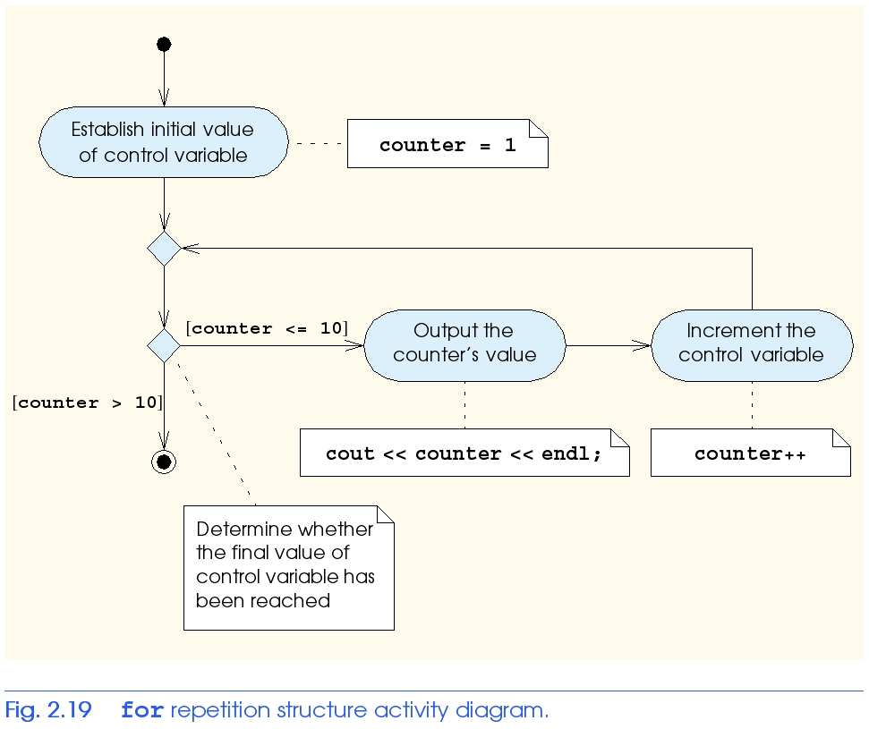
2.14 for Repetition Structure

Slide 51
1 // Fig. 2.20: fig02_20.cpp
2 // Summation with for.
3 #include <iostream>
4
5 using std::cout;
6 using std::endl;
7
8 // function main begins program execution
9 int main()
10 {
11 int sum = 0; // initialize sum
12
13 // sum even integers from 2 through 100
14 for ( int number = 2; number <= 100; number += 2 )
15 sum += number; // add number to sum
16
17 cout << "Sum is " << sum << endl; // output sum
18 return 0; // successful termination
19
20 } // end function main
Sum is 2550

Slide 52
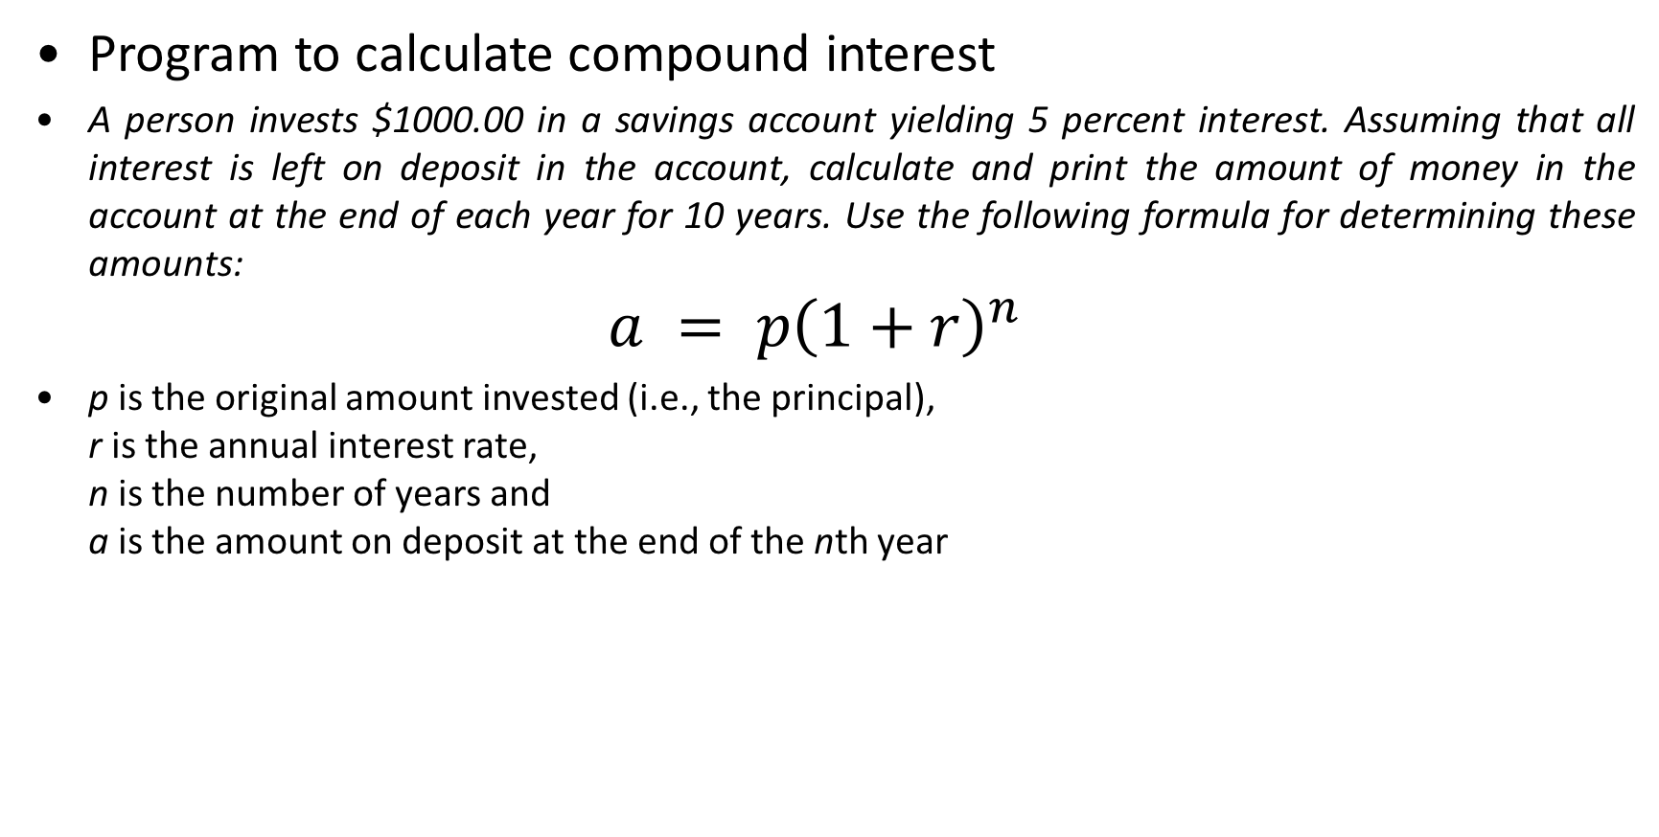
2.15 Examples Using the for Structure
Program to calculate compound interest
A person invests $1000.00 in a savings account yielding 5 percent interest. Assuming that all interest is left on deposit in the account, calculate and print the amount of money in the account at the end of each year for 10 years. Use the following formula for determining these amounts:
$$a = p{\left(1+r\right)}^{n}$$
p is the original amount invested (i.e., the principal),
r is the annual interest rate,
n is the number of years and
a is the amount on deposit at the end of the nth year

Slide 53
1 // Fig. 2.21: fig02_21.cpp
2 // Calculating compound interest.
3 #include <iostream>
5 using std::cout;
6 using std::endl;
7 using std::ios;
8 using std::fixed;
10 #include <iomanip>
11
12 using std::setw;
13 using std::setprecision;
14
15 #include <cmath> // enables program to use function pow
16
17 // function main begins program execution
18 int main()
19 {
20 double amount; // amount on deposit
21 double principal = 1000.0; // starting principal
22 double rate = .05; // interest rate
23
24 // output table column heads
25 cout << "Year" << setw( 21 ) << "Amount on deposit" << endl;
26
27 // set floating-point number format
28 cout << fixed << setprecision( 2 );
29
30 // calculate amount on deposit for each of ten years
31 for ( int year = 1; year <= 10; year++ ) {
32
33 // calculate new amount for specified year
34 amount = principal * pow( 1.0 + rate, year );
35
36 // output one table row
37 cout << setw( 4 ) << year
38 << setw( 21 ) << amount << endl;
39
40 } // end for
41
42 return 0; // indicate successful termination
43
44 } // end function main
Sets the field width to at least 21 characters. If output less than 21, it is right-justified.
<cmath> header needed for the pow function (program will not compile without it).
pow(x,y) = x raised to the yth power.
Year Amount on deposit
1 1050.00
2 1102.50
3 1157.63
4 1215.51
5 1276.28
6 1340.10
7 1407.10
8 1477.46
9 1551.33
10 1628.89
Numbers are right-justified due to setw statements (at positions 4 and 21).

Slide 54
2.16 switch Multiple-Selection Structure
switch
  Test variable for multiple values
  Series of case labels and optional default case
switch ( variable ) {
case value1: // taken if variable == value1
statements
break; // necessary to exit switch
case value2:
case value3: // taken if variable == value2 or == value3
statements
break;
default: // taken if variable matches no other cases
statements
break;
}

Slide 55
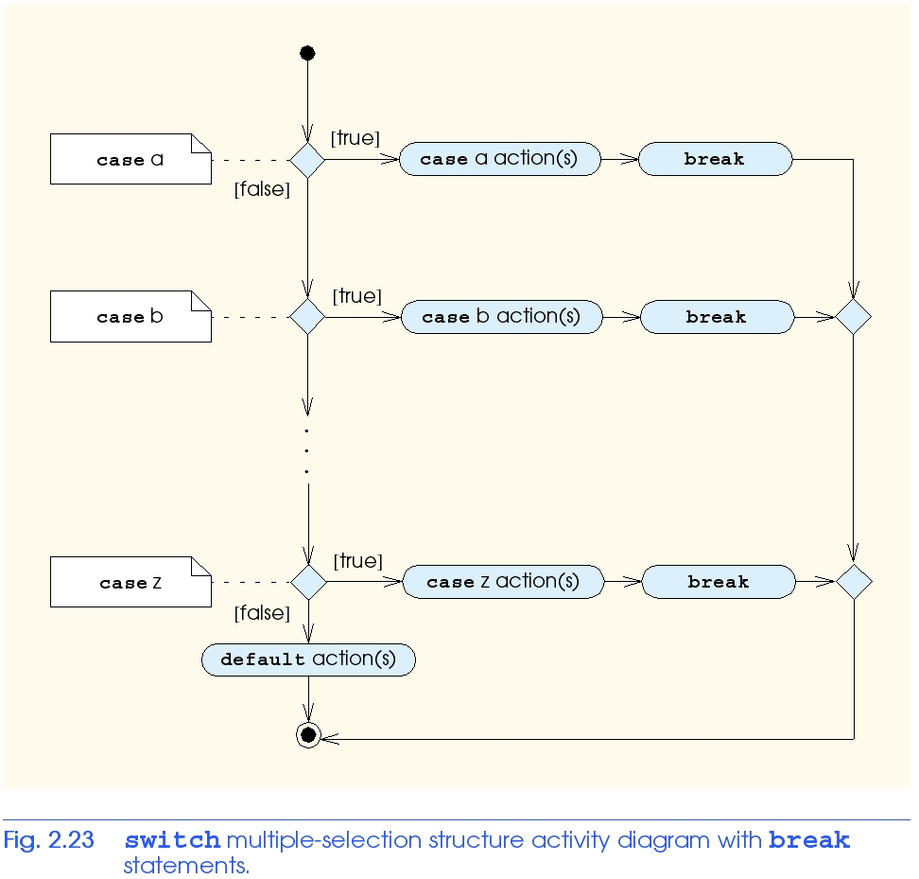
2.16 switch Multiple-Selection Structure

Slide 56
2.16 switch Multiple-Selection Structure
Example upcoming
  Program to read grades (A-F)
  Display number of each grade entered
Details about characters
  Single characters typically stored in a char data type
    char a 1-byte integer, so chars can be stored as ints
  Can treat character as int or char
    97 is the numerical representation of lowercase ‘a’ (ASCII)
    Use single quotes to get numerical representation of character
    cout << "The character (" << 'a' << ") has the value "
    << static_cast< int > ( 'a' ) << endl;
    Prints
    The character (a) has the value 97

Slide 57
1 // Fig. 2.22: fig02_22.cpp
2 // Counting letter grades.
3 #include <iostream>
4
5 using std::cout;
6 using std::cin;
7 using std::endl;
8
9 // function main begins program execution
10 int main()
11 {
12 int grade; // one grade
13 int aCount = 0; // number of As
14 int bCount = 0; // number of Bs
15 int cCount = 0; // number of Cs
16 int dCount = 0; // number of Ds
17 int fCount = 0; // number of Fs
18
19 cout << "Enter the letter grades." << endl
20 << "Enter the EOF character to end input." << endl;
21
22 // loop until user types end-of-file key sequence
23 while ( ( grade = cin.get() ) != EOF ) {
24
25 // determine which grade was input
26 switch ( grade ) { // switch structure nested in while
27
28 case 'A': // grade was uppercase A
29 case 'a': // or lowercase a
30 ++aCount; // increment aCount
31 break; // necessary to exit switch
32
33 case 'B': // grade was uppercase B
34 case 'b': // or lowercase b
35 ++bCount; // increment bCount
36 break; // exit switch
37
38 case 'C': // grade was uppercase C
39 case 'c': // or lowercase c
40 ++cCount; // increment cCount
41 break; // exit switch
42
Assignment statements have a value, which is the same as the variable on the left of the =. The value of this statement is the same as the value returned by cin.get().
This can also be used to initialize multiple variables:
a = b = c = 0;
break causes switch to end and the program continues with the first statement after the switch structure.
cin.get() uses dot notation (explained chapter 6). This function gets 1 character from the keyboard (after Enter pressed), and it is assigned to grade.
cin.get() returns EOF (end-of-file) after the EOF character is input, to indicate the end of data. EOF may be ctrl-d or ctrl-z, depending on your OS.
Compares grade (an int) to the numerical representations of A and a.

Slide 58
43 case 'D': // grade was uppercase D
44 case 'd': // or lowercase d
45 ++dCount; // increment dCount
46 break; // exit switch
48 case 'F': // grade was uppercase F
49 case 'f': // or lowercase f
50 ++fCount; // increment fCount
51 break; // exit switch
53 case '\n': // ignore newlines,
54 case '\t': // tabs,
55 case ' ': // and spaces in input
56 break; // exit switch
58 default: // catch all other characters
59 cout << "Incorrect letter grade entered."
60 << " Enter a new grade." << endl;
61 break; // optional; will exit switch anyway
62
63 } // end switch
64
65 } // end while
67 // output summary of results
68 cout << "\n\nTotals for each letter grade are:"
69 << "\nA: " << aCount // display number of A grades
70 << "\nB: " << bCount // display number of B grades
71 << "\nC: " << cCount // display number of C grades
72 << "\nD: " << dCount // display number of D grades
73 << "\nF: " << fCount // display number of F grades
74 << endl;
76 return 0; // indicate successful termination
77 } // end function main
This test is necessary because Enter is pressed after each letter grade is input. This adds a newline character that must be removed. Likewise, we want to ignore any whitespace.
Enter the letter grades.
Enter the EOF character to end input.
a
B
c
C
A
d
f
C
E
Incorrect letter grade entered. Enter a new grade.
D
A
b
^Z
Totals for each letter grade are:
A: 3
B: 2
C: 3
D: 2
F: 1
Notice the default statement, which catches all other cases.

Slide 59
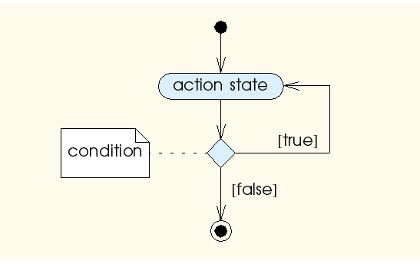
2.17 do/while Repetition Structure
Similar to while structure
  Makes loop continuation test at end, not beginning
  Loop body executes at least once
Format
    do {
    statement
    } while ( condition );

Slide 60
1 // Fig. 2.24: fig02_24.cpp
2 // Using the do/while repetition structure.
3 #include <iostream>
4
5 using std::cout;
6 using std::endl;
7
8 // function main begins program execution
9 int main()
10 {
11 int counter = 1; // initialize counter
12
13 do {
14 cout << counter << " "; // display counter
15 } while ( ++counter <= 10 ); // end do/while
16
17 cout << endl;
18
19 return 0; // indicate successful termination
20
21 } // end function main
Notice the preincrement in loop-continuation test.
1 2 3 4 5 6 7 8 9 10

Slide 61
2.18 break and continue Statements
break statement
  Immediate exit from while, for, do/while, switch
  Program continues with first statement after structure
Common uses
  Escape early from a loop
  Skip the remainder of switch

Slide 62
1 // Fig. 2.26: fig02_26.cpp
2 // Using the break statement in a for structure.
3 #include <iostream>
4
5 using std::cout;
6 using std::endl;
7
8 // function main begins program execution
9 int main()
10 {
11
12 int x; // x declared here so it can be used after the loop
13
14 // loop 10 times
15 for ( x = 1; x <= 10; x++ ) {
16
17 // if x is 5, terminate loop
18 if ( x == 5 )
19 break; // break loop only if x is 5
20
21 cout << x << " "; // display value of x
22
23 } // end for
24 cout << "\nBroke out of loop when x became " << x << endl;
25 return 0; // indicate successful termination
26 } // end function main
Exits for structure when break executed.
1 2 3 4
Broke out of loop when x became 5

Slide 63
2.18 break and continue Statements
continue statement
  Used in while, for, do/while
  Skips remainder of loop body
  Proceeds with next iteration of loop
while and do/while structure
  Loop-continuation test evaluated immediately after the continue statement
for structure
  Increment expression executed
  Next, loop-continuation test evaluated

Slide 64
1 // Fig. 2.27: fig02_27.cpp
2 // Using the continue statement in a for structure.
3 #include <iostream>
4
5 using std::cout;
6 using std::endl;
7
8 // function main begins program execution
9 int main()
10 {
11 // loop 10 times
12 for ( int x = 1; x <= 10; x++ ) {
13
14 // if x is 5, continue with next iteration of loop
15 if ( x == 5 )
16 continue; // skip remaining code in loop body
17
18 cout << x << " "; // display value of x
19
20 } // end for structure
21
22 cout << "\nUsed continue to skip printing the value 5"
23 << endl;
24
25 return 0; // indicate successful termination
26
27 } // end function main
Skips to next iteration of the loop.
1 2 3 4 6 7 8 9 10
Used continue to skip printing the value 5

Slide 65
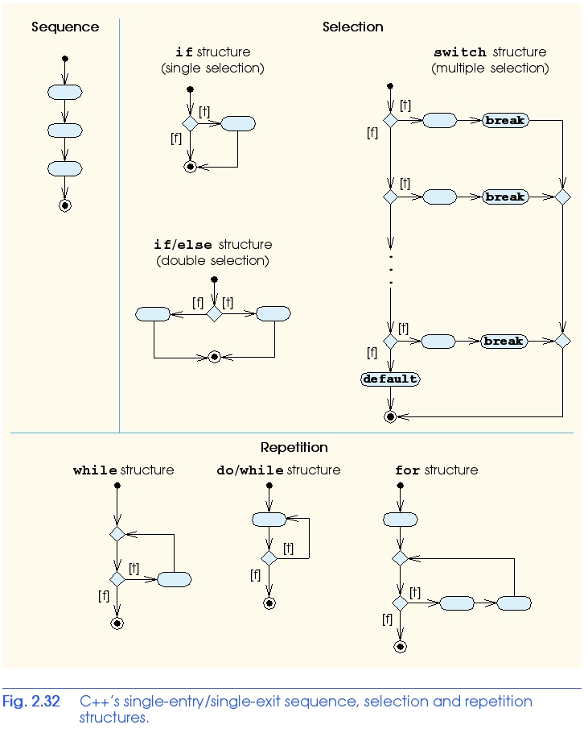
2.21 Structured-Programming Summary
All programs broken down into
  Sequence
  Selection
    if, if/else, or switch
    Any selection can be rewritten as an if statement
  Repetition
    while, do/while or for
    Any repetition structure can be rewritten as a while statement

