Slide 1
CPE 150: Introduction to Programming
Chapter 3: Functions
Copyright notice: 1- care has been taken to use only those web images deemed by the instructor to be in the public domain. If you see a copyrighted image on any slide and are the copyright owner, please contact the instructor. It will be removed.
2- These slides are inspired, based, and modified with permission from the authors of the C++ How to Program (4th Edition) textbook

Slide 2
Topics To Be Covered In Chapter 3
3.1 Introduction
3.2 Program Components in C++
3.3 Math Library Functions
3.4 Functions
3.5 Function Definitions
3.6 Function Prototypes
3.7 Header Files
3.8 Random Number Generation
3.9 Example: A Game of Chance and Introducing enum
3.10 Storage Classes
3.11 Scope Rules
3.12 Recursion
3.13 Example Using Recursion: The Fibonacci Series
3.14 Recursion vs. Iteration
3.15 Functions with Empty Parameter Lists
3.16 Inline Functions 3.17 References and Reference Parameters 3.18 Default Arguments 3.19 Unary Scope Resolution Operator 3.20 Function Overloading 3.21 Function Templates
18.9 Character-Handling Library

Slide 3
3.1 Introduction
Divide and conquer
Construct a program from smaller pieces or components
Each piece more manageable than the original program

Slide 4
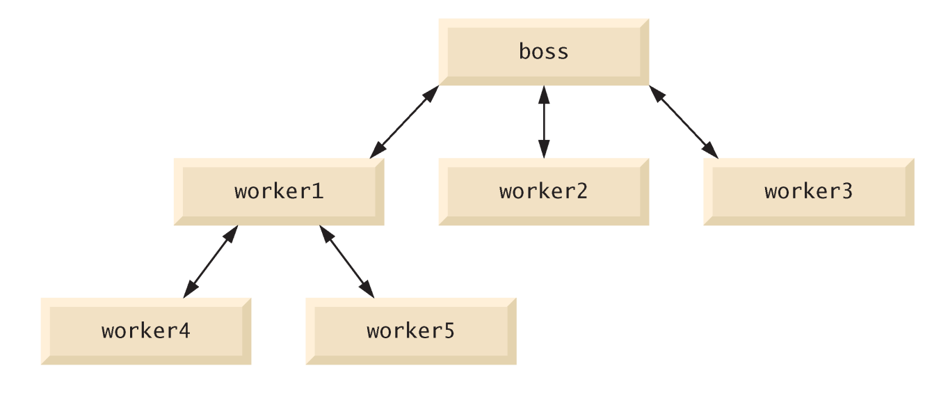
3.2 Program Components in C++
Modules: functions and classes
Programs use new and “prepackaged” modules
New: programmer-defined functions, classes
Prepackaged: from the standard library
Functions invoked by function call
Function name and information (arguments) it needs
Function definitions
Only written once
Hidden from other functions
Boss to worker analogy
A boss (the calling function or caller) asks a worker (the called function) to perform a task and return (i.e., report back) the results when the task is done.

Slide 5
3.3 Math Library Functions
Perform common mathematical calculations
Include the header file <cmath>
Functions called by writing
functionName (argument);
or
functionName(argument1, argument2, …);
Example
cout << sqrt( 900.0 );
sqrt (square root) function The preceding statement would print 30
All functions in math library return a double

Slide 6
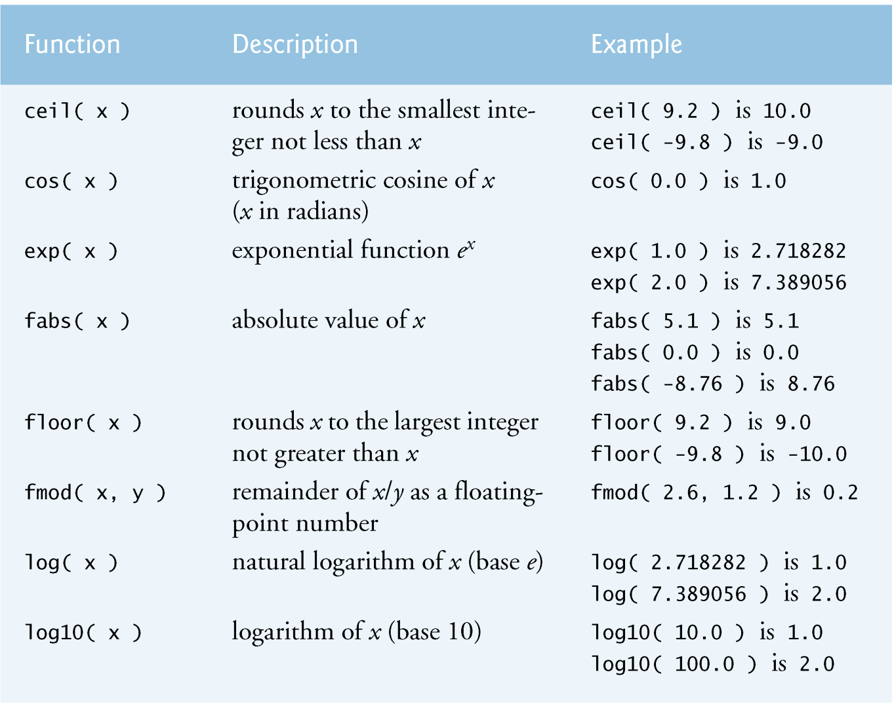
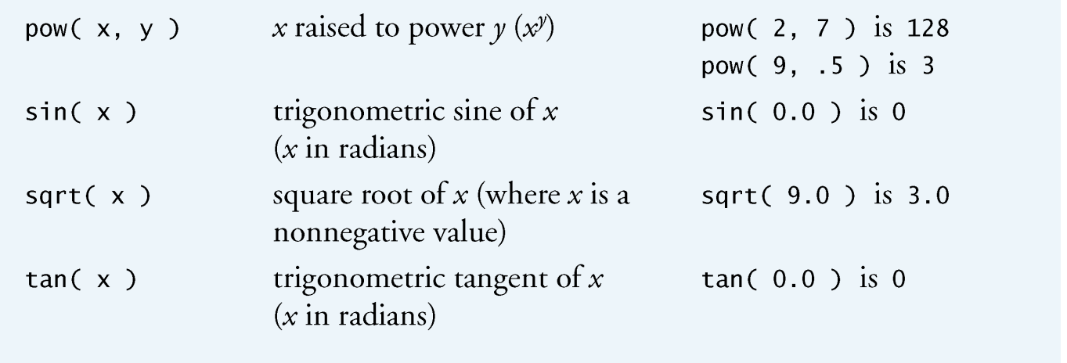
3.3 Math Library Functions
Function arguments can be
Constants
sqrt( 4 );
Variables
sqrt( x );
Expressions
sqrt( sqrt( x ) ) ;
sqrt( 3 - 6x );

Slide 7
3.4 Functions
Functions
Modularize a program
Software reusability
Call function multiple times
Local variables
Known only in the function in which they are defined
All variables declared in function definitions are local variables
Parameters
Local variables passed to function when called
Provide outside information

Slide 8
3.5 Function Definitions
Function prototype
Tells compiler argument type and return type of function
int square( int );
Function takes an int and returns an int
Explained in more detail later
Calling/invoking a function
square(x);
Parentheses an operator used to call function
Pass argument x
Function gets its own copy of arguments
After finished, passes back result

Slide 9
3.5 Function Definitions
Format for function definition
return-value-type function-name( parameter-list ) { declarations and statements }
Parameter list
Comma separated list of arguments
Data type needed for each argument
If no arguments, use void or leave blank
Return-value-type
Data type of result returned (use void if nothing returned)

Slide 10
3.5 Function Definitions
Example function
int square( int y )
{
return y * y;
}
return keyword
Returns data, and control goes to function’s caller
If no data to return, use return;
Function ends when reaches right brace
Control goes to caller
Functions cannot be defined inside other functions
Next: program examples

Slide 11
1 // Fig. 3.3: fig03_03.cpp
2 // Creating and using a programmer-defined function.
3 #include <iostream>
5 using std::cout;
6 using std::endl;
7
8 int square( int ); // function prototype
10 int main()
11 {
12 // loop 10 times and calculate and output
13 // square of x each time
14 for ( int x = 1; x <= 10; x++ )
15 cout << square( x ) << " "; // function call
16
17 cout << endl;
19 return 0; // indicates successful termination
20
21 } // end main
22
Function prototype: specifies data types of arguments and return values. square expects and int, and returns an int.
Parentheses () cause function to be called. When done, it returns the result.
23 // square function definition returns square of an integer
24 int square( int y ) // y is a copy of argument to function
25 {
26 return y * y; // returns square of y as an int
27
28 } // end function square
Definition of square. y is a copy of the argument passed. Returns y * y, or y squared.
1 4 9 16 25 36 49 64 81 100

Slide 12
1 // Fig. 3.4: fig03_04.cpp
2 // Finding the maximum of three floating-point numbers.
3 #include <iostream>
4
5 using std::cout;
6 using std::cin;
7 using std::endl;
8
9 double maximum( double, double, double ); // function prototype
10
11 int main()
12 {
13 double number1;
14 double number2;
15 double number3;
16
17 cout << "Enter three floating-point numbers: ";
18 cin >> number1 >> number2 >> number3;
19
20 // number1, number2 and number3 are arguments to
21 // the maximum function call
22 cout << "Maximum is: "
23 << maximum( number1, number2, number3 ) << endl;
24
25 return 0; // indicates successful termination
26
27 } // end main
28
29 // function maximum definition;
30 // x, y and z are parameters
31 double maximum( double x, double y, double z )
32 {
33 double max = x; // assume x is largest
34
35 if ( y > max ) // if y is larger,
36 max = y; // assign y to max
37
38 if ( z > max ) // if z is larger,
39 max = z; // assign z to max
40
41 return max; // max is largest value
42
43 } // end function maximum
Comma separated list for multiple parameters.
Function maximum takes 3 arguments (all double) and returns a double.
Enter three floating-point numbers: 99.32 37.3 27.1928
Maximum is: 99.32
Enter three floating-point numbers: 1.1 3.333 2.22
Maximum is: 3.333
Enter three floating-point numbers: 27.9 14.31 88.99
Maximum is: 88.99

Slide 13
18.9 Character-Handling Library
Character-handling library functions
Perform useful tests and manipulations of character data
Manipulates characters as ints
char cannot store EOF (usually -1)
All functions take an int argument and return an int
Included in <cctype> header file

Slide 14
18.9 Character-Handling Library

Slide 15
18.9 Character-Handling Library
Character-handling library functions (Cont.)
Function isdigit
Returns true if argument is a digit (0-9)
Function isalpha
Returns true if argument is an uppercase or lowercase letter (A-Z, a-z)
Function isalnum
Returns true if argument is an uppercase letter, lowercase letter or digit (A-Z, a-z, 0-9)
Function isxdigit
Returns true if argument is a hexadecimal digit (A-F, a-f, 0-9)

Slide 16
18.9 Character-Handling Library
Character-handling library functions (Cont.)
Function islower
Returns true if argument is a lowercase letter (a-z)
Function isupper
Returns true if argument is an uppercase letter (A-Z)
Function tolower
Returns its uppercase-letter argument as a lowercase letter
Returns its argument unchanged if it is not an uppercase letter
Function toupper
Returns its lowercase-letter argument as an uppercase letter
Returns its argument unchanged if it is not a lowercase letter

Slide 17
18.9 Character-Handling Library
Character-handling library functions (Cont.)
Function isspace
Returns true if argument is a white-space character
Such as space (' '), form feed ('\f'), newline ('\n'), carriage return ('\r'), horizontal tab ('\t'), vertical tab ('\v')
Function iscntrl
Returns true if argument is a control character
Such as horizontal tab ('\t'), vertical tab ('\v'), form feed ('\f'), alert ('\a'), backspace ('\b'), carriage return ('\r'), newline ('\n')

Slide 18
18.9 Character-Handling Library
Character-handling library functions (Cont.)
Function ispunct
Returns true if argument is a printing character other than a space, digit or letter
Such as $, #, (, ), [, ], {, }, ;, : or %
Function isprint
Returns true if argument is a displayable character (including the space character)
Function isgraph
Returns true if argument is a graphical, displayable character (not including the space character)

Slide 19
1 // Fig. 18.17: fig18_17.cpp
2 // Using functions isdigit, isalpha, isalnum and isxdigit.
3 #include <iostream>
4
5 using std::cout;
6 using std::endl;
7
8 #include <cctype> // character-handling function prototypes
9
10 int main()
11 {
12 cout << "According to isdigit:\n"
13 << ( isdigit( '8' ) ? "8 is a" : "8 is not a" )
14 << " digit\n"
15 << ( isdigit( '#' ) ? "# is a" : "# is not a" )
16 << " digit\n";
17
18 cout << "\nAccording to isalpha:\n"
19 << ( isalpha( 'A' ) ? "A is a" : "A is not a" )
20 << " letter\n"
21 << ( isalpha( 'b' ) ? "b is a" : "b is not a" )
22 << " letter\n"
23 << ( isalpha( '&' ) ? "& is a" : "& is not a" )
24 << " letter\n"
25 << ( isalpha( '4' ) ? "4 is a" : "4 is not a" )
26 << " letter\n";
27
28 cout << "\nAccording to isalnum:\n"
29 << ( isalnum( 'A' ) ? "A is a" : "A is not a" )
30 << " digit or a letter\n"
31 << ( isalnum( '8' ) ? "8 is a" : "8 is not a" )
32 << " digit or a letter\n"
33 << ( isalnum( '#' ) ? "# is a" : "# is not a" )
34 << " digit or a letter\n";
35
36 cout << "\nAccording to isxdigit:\n"
37 << ( isxdigit( 'F' ) ? "F is a" : "F is not a" )
38 << " hexadecimal digit\n"
39 << ( isxdigit( 'J' ) ? "J is a" : "J is not a" )
40 << " hexadecimal digit\n"
41 << ( isxdigit( '7' ) ? "7 is a" : "7 is not a" )
42 << " hexadecimal digit\n"
43 << ( isxdigit( '$' ) ? "$ is a" : "$ is not a" )
44 << " hexadecimal digit\n"
45 << ( isxdigit( 'f' ) ? "f is a" : "f is not a" )
46 << " hexadecimal digit" << endl;
47
48 return 0;
49
50 } // end main
Use the conditional operator (?:) with the return value of each function to determine the correct string to print

Slide 20
According to isdigit:
8 is a digit
# is not a digit
According to isalpha:
A is a letter
b is a letter
& is not a letter
4 is not a letter
According to isalnum:
A is a digit or a letter
8 is a digit or a letter
# is not a digit or a letter
According to isxdigit:
F is a hexadecimal digit
J is not a hexadecimal digit
7 is a hexadecimal digit
$ is not a hexadecimal digit
f is a hexadecimal digit

Slide 21
1 // Fig. 18.18: fig18_18.cpp
2 // Using functions islower, isupper, tolower and toupper.
3 #include <iostream>
4
5 using std::cout;
6 using std::endl;
7
8 #include <cctype> // character-handling function prototypes
9
10 int main()
11 {
12 cout << "According to islower:\n"
13 << ( islower( 'p' ) ? "p is a" : "p is not a" )
14 << " lowercase letter\n"
15 << ( islower( 'P' ) ? "P is a" : "P is not a" )
16 << " lowercase letter\n"
17 << ( islower( '5' ) ? "5 is a" : "5 is not a" )
18 << " lowercase letter\n"
19 << ( islower( '!' ) ? "! is a" : "! is not a" )
20 << " lowercase letter\n";
21
22 cout << "\nAccording to isupper:\n"
23 << ( isupper( 'D' ) ? "D is an" : "D is not an" )
24 << " uppercase letter\n"
25 << ( isupper( 'd' ) ? "d is an" : "d is not an" )
26 << " uppercase letter\n"
27 << ( isupper( '8' ) ? "8 is an" : "8 is not an" )
28 << " uppercase letter\n"
29 << ( isupper( '$' ) ? "$ is an" : "$ is not an" )
30 << " uppercase letter\n";
32 cout << "\nu converted to uppercase is "
33 << static_cast< char >( toupper( 'u' ) )
34 << "\n7 converted to uppercase is "
35 << static_cast< char >( toupper( '7' ) )
36 << "\n$ converted to uppercase is "
37 << static_cast< char >( toupper( '$' ) )
38 << "\nL converted to lowercase is "
39 << static_cast< char >( tolower( 'L' ) ) << endl;
41 return 0;
43 } // end main
According to islower:
p is a lowercase letter
P is not a lowercase letter
5 is not a lowercase letter
! is not a lowercase letter
According to isupper:
D is an uppercase letter
d is not an uppercase letter
8 is not an uppercase letter
$ is not an uppercase letter
u converted to uppercase is U
7 converted to uppercase is 7
$ converted to uppercase is $
L converted to lowercase is l

Slide 22
1 // Fig. 18.19: fig18_19.cpp
2 // Functions isspace, iscntrl, ispunct, isprint, isgraph.
3 #include <iostream>
4
5 using std::cout;
6 using std::endl;
7
8 #include <cctype> // character-handling function prototypes
9
10 int main()
11 {
12 cout << "According to isspace:\nNewline "
13 << ( isspace( '\n' ) ? "is a" : "is not a" )
14 << " whitespace character\nHorizontal tab "
15 << ( isspace( '\t' ) ? "is a" : "is not a" )
16 << " whitespace character\n"
17 << ( isspace( '%' ) ? "% is a" : "% is not a" )
18 << " whitespace character\n";
19
20 cout << "\nAccording to iscntrl:\nNewline "
21 << ( iscntrl( '\n' ) ? "is a" : "is not a" )
22 << " control character\n"
23 << ( iscntrl( '$' ) ? "$ is a" : "$ is not a" )
24 << " control character\n";
25
26 cout << "\nAccording to ispunct:\n"
27 << ( ispunct( ';' ) ? "; is a" : "; is not a" )
28 << " punctuation character\n"
29 << ( ispunct( 'Y' ) ? "Y is a" : "Y is not a" )
30 << " punctuation character\n"
31 << ( ispunct( '#' ) ? "# is a" : "# is not a" )
32 << " punctuation character\n";
33
34 cout << "\nAccording to isprint:\n"
35 << ( isprint( '$' ) ? "$ is a" : "$ is not a" )
36 << " printing character\nAlert "
37 << ( isprint( '\a' ) ? "is a" : "is not a" )
38 << " printing character\n";
39
40 cout << "\nAccording to isgraph:\n"
41 << ( isgraph( 'Q' ) ? "Q is a" : "Q is not a" )
42 << " printing character other than a space\nSpace "
43 << ( isgraph( ' ' ) ? "is a" : "is not a" )
44 << " printing character other than a space" << endl;
45
46 return 0;
47
48 } // end main

Slide 23
According to isspace:
Newline is a whitespace character
Horizontal tab is a whitespace character
% is not a whitespace character
According to iscntrl:
Newline is a control character
$ is not a control character
According to ispunct:
; is a punctuation character
Y is not a punctuation character
# is a punctuation character
According to isprint:
$ is a printing character
Alert is not a printing character
According to isgraph:
Q is a printing character other than a space
Space is not a printing character other than a space

Slide 24
3.6 Function Prototypes
Function prototype contains
Function name
Parameters (number and data type)
Return type (void if returns nothing)
Only needed if function definition after function call
Prototype must match function definition
Function prototype
double maximum( double, double, double );
Definition
double maximum( double x, double y, double z )
{
…
}

Slide 25
3.6 Function Prototypes
Function signature
Part of prototype with name and parameters
double maximum( double, double, double );
Argument Coercion
Force arguments to be of proper type
Converting int (4) to double (4.0)
cout << sqrt(4)
Conversion rules
Arguments usually converted automatically
Changing from double to int can truncate data
3.4 to 3
Mixed type goes to highest type (promotion)
int * double
Function signature

Slide 26
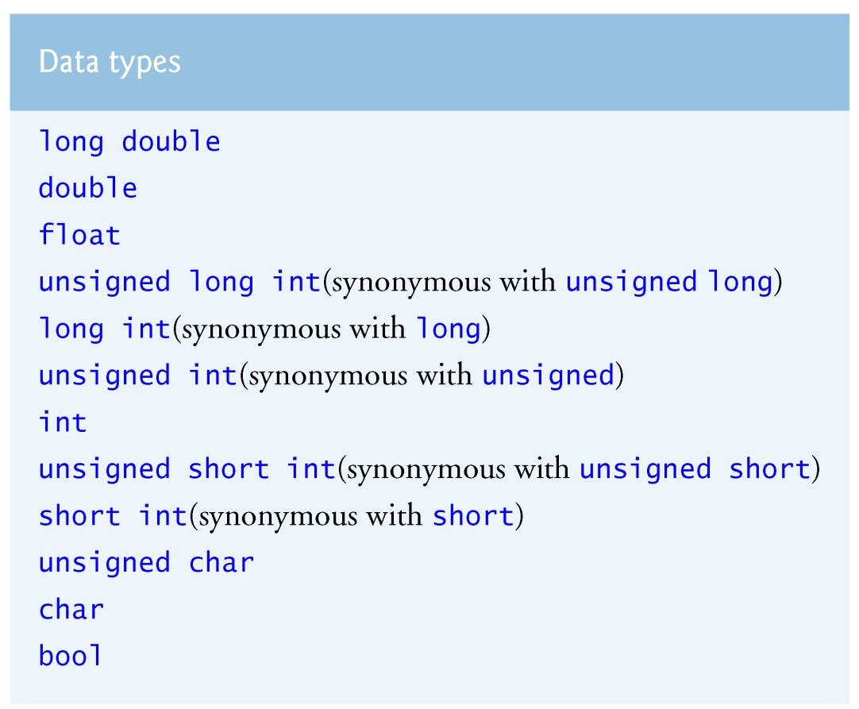
3.6 Function Prototypes

Slide 27
3.15 Functions with Empty Parameter Lists
Empty parameter lists
void or leave parameter list empty
Indicates function takes no arguments
Function print takes no arguments and returns no value
void print();
void print( void );

Slide 28
1 // Fig. 3.18: fig03_18.cpp
2 // Functions that take no arguments.
3 #include <iostream>
5 using std::cout;
6 using std::endl;
7
8 void function1(); // function prototype
9 void function2( void ); // function prototype
10
11 int main()
12 {
13 function1(); // call function1 with no arguments
14 function2(); // call function2 with no arguments
16 return 0; // indicates successful termination
18 } // end main
19
20 // function1 uses an empty parameter list to specify that
21 // the function receives no arguments
22 void function1()
23 {
24 cout << "function1 takes no arguments" << endl;
26 } // end function1
27
28 // function2 uses a void parameter list to specify that
29 // the function receives no arguments
30 void function2( void )
31 {
32 cout << "function2 also takes no arguments" << endl;
33
34 } // end function2
function1 takes no arguments
function2 also takes no arguments

Slide 29
3.7 Header Files
Header files contain
Function prototypes
Definitions of data types and constants
Header files ending with .h
Programmer-defined header files
#include “myheader.h”
Library header files
#include <cmath>

Slide 30
3.8 Random Number Generation
rand function (<cstdlib>)
i = rand();
Generates unsigned integer between 0 and RAND_MAX (usually 32767)
Scaling and shifting
Modulus (remainder) operator: %
10 % 3 is 1
x % y is between 0 and y – 1
Example
i = rand() % 6 + 1;
“Rand() % 6” generates a number between 0 and 5 (scaling)
“+ 1” makes the range 1 to 6 (shift)
Next: program to roll dice

Slide 31
1 // Fig. 3.7: fig03_07.cpp
2 // Shifted, scaled integers produced by 1 + rand() % 6.
3 #include <iostream>
4
5 using std::cout;
6 using std::endl;
7
8 #include <iomanip>
9
10 using std::setw;
11
12 #include <cstdlib> // contains function prototype for rand
13
14 int main()
15 {
16 // loop 20 times
17 for ( int counter = 1; counter <= 20; counter++ ) {
18
19 // pick random number from 1 to 6 and output it
20 cout << setw( 10 ) << ( 1 + rand() % 6 );
21
22 // if counter divisible by 5, begin new line of output
23 if ( counter % 5 == 0 )
24 cout << endl;
25
26 } // end for structure
27
28 return 0; // indicates successful termination
29
30 } // end main
6 6 5 5 6
5 1 1 5 3
6 6 2 4 2
6 2 3 4 1
Output of rand() scaled and shifted to be a number between 1 and 6.

Slide 32
3.8 Random Number Generation
Next
Program to show distribution of rand()
Simulate 6000 rolls of a die
Print number of 1’s, 2’s, 3’s, etc. rolled
Should be roughly 1000 of each

Slide 33
1 // Fig. 3.8: fig03_08.cpp
2 // Roll a six-sided die 6000 times.
3 #include <iostream>
4
5 using std::cout;
6 using std::endl;
7
8 #include <iomanip>
9
10 using std::setw;
11
12 #include <cstdlib> // contains function prototype for rand
13
14 int main()
15 {
16 int frequency1 = 0;
17 int frequency2 = 0;
18 int frequency3 = 0;
19 int frequency4 = 0;
20 int frequency5 = 0;
21 int frequency6 = 0;
22 int face; // represents one roll of the die
23
24 // loop 6000 times and summarize results
25 for ( int roll = 1; roll <= 6000; roll++ ) {
26 face = 1 + rand() % 6; // random number from 1 to 6
29 switch ( face ) {
31 case 1: // rolled 1
32 ++frequency1;
33 break;
35 case 2: // rolled 2
36 ++frequency2;
37 break;
39 case 3: // rolled 3
40 ++frequency3;
41 break;
43 case 4: // rolled 4
44 ++frequency4;
45 break;
47 case 5: // rolled 5
48 ++frequency5;
49 break;
51 case 6: // rolled 6
52 ++frequency6;
53 break;
55 default: // invalid value
56 cout << "Program should never get here!";
58 } // end switch
60 } // end for
Default case included even though it should never be reached. This is a matter of good coding style

Slide 34
62 // display results in tabular format
63 cout << "Face" << setw( 13 ) << "Frequency"
64 << "\n 1" << setw( 13 ) << frequency1
65 << "\n 2" << setw( 13 ) << frequency2
66 << "\n 3" << setw( 13 ) << frequency3
67 << "\n 4" << setw( 13 ) << frequency4
68 << "\n 5" << setw( 13 ) << frequency5
69 << "\n 6" << setw( 13 ) << frequency6 << endl;
70
71 return 0; // indicates successful termination
72
73 } // end main
Face Frequency
1 1003
2 1017
3 983
4 994
5 1004
6 999

Slide 35
3.8 Random Number Generation
Calling rand() repeatedly
Gives the same sequence of numbers
Pseudorandom numbers
Preset sequence of "random" numbers
Same sequence generated whenever program run
To get different random sequences
Provide a seed value
Like a random starting point in the sequence
The same seed will give the same sequence
srand(seed);
<cstdlib>
Used before rand() to set the seed

Slide 36
1 // Fig. 3.9: fig03_09.cpp
2 // Randomizing die-rolling program.
3 #include <iostream>
4
5 using std::cout;
6 using std::cin;
7 using std::endl;
8
9 #include <iomanip>
10
11 using std::setw;
12
13 // contains prototypes for functions srand and rand
14 #include <cstdlib>
15
16 // main function begins program execution
17 int main()
18 {
19 unsigned seed;
20
21 cout << "Enter seed: ";
22 cin >> seed;
23 srand( seed ); // seed random number generator
24
25 // loop 10 times
26 for ( int counter = 1; counter <= 10; counter++ ) {
27
28 // pick random number from 1 to 6 and output it
29 cout << setw( 10 ) << ( 1 + rand() % 6 );
30
31 // if counter divisible by 5, begin new line of output
32 if ( counter % 5 == 0 )
33 cout << endl;
34
35 } // end for
36
37 return 0; // indicates successful termination
38
39 } // end main
rand() gives the same sequence if it has the same initial seed.
Enter seed: 67
6 1 4 6 2
1 6 1 6 4
Enter seed: 432
4 6 3 1 6
3 1 5 4 2
Enter seed: 67
6 1 4 6 2
1 6 1 6 4
Setting the seed with srand().

Slide 37
3.8 Random Number Generation
Can use the current time to set the seed
No need to explicitly set seed every time
srand( time( 0 ) );
time( 0 );
<ctime>
Returns current time in seconds
General shifting and scaling
Number = shiftingValue + rand() % scalingFactor
shiftingValue = first number in desired range
scalingFactor = width of desired range

Slide 38
3.9 Example: Game of Chance and Introducing enum
Enumeration
Set of integers with identifiers
enum typeName {constant1, constant2…};
Constants start at 0 (default), incremented by 1
Constants need unique names
Cannot assign integer to enumeration variable
Must use a previously defined enumeration type
Example
enum Status {CONTINUE, WON, LOST};
Status enumVar;
enumVar = WON; // cannot do enumVar = 1

Slide 39
3.9 Example: Game of Chance and Introducing enum
Enumeration constants can have preset values
enum Months { JAN = 1, FEB, MAR, APR, MAY, JUN, JUL, AUG, SEP, OCT, NOV, DEC};
Starts at 1, increments by 1
Next: craps simulator
Roll two dice
7 or 11 on first throw: player wins
2, 3, or 12 on first throw: player loses
4, 5, 6, 8, 9, 10
Value becomes player's "point"
Player must roll his point before rolling 7 to win

Slide 40
1 // Fig. 3.10: fig03_10.cpp
2 // Craps.
3 #include <iostream>
4
5 using std::cout;
6 using std::endl;
7
8 // contains function prototypes for functions srand and rand
9 #include <cstdlib>
10
11 #include <ctime> // contains prototype for function time
12
13 int rollDice( void ); // function prototype
14
15 int main()
16 {
17 // enumeration constants represent game status
18 enum Status { CONTINUE, WON, LOST };
19
20 int sum;
21 int myPoint;
22
23 Status gameStatus; // can contain CONTINUE, WON or LOST
24
25 // randomize random number generator using current time
26 srand( time( 0 ) );
27
28 sum = rollDice(); // first roll of the dice
29
30 // determine game status and point based on sum of dice
31 switch ( sum ) {
32
33 // win on first roll
34 case 7:
35 case 11:
36 gameStatus = WON;
37 break;
38
39 // lose on first roll
40 case 2:
41 case 3:
42 case 12:
43 gameStatus = LOST;
44 break;
45
46 // remember point
47 default:
48 gameStatus = CONTINUE;
49 myPoint = sum;
50 cout << "Point is " << myPoint << endl;
51 break; // optional
52
53 } // end switch
switch statement determines outcome based on die roll.
Function to roll 2 dice and return the result as an int.
Enumeration to keep track of the current game.

Slide 41
55 // while game not complete ...
56 while ( gameStatus == CONTINUE ) {
57 sum = rollDice(); // roll dice again
59 // determine game status
60 if ( sum == myPoint ) // win by making point
61 gameStatus = WON;
62 else
63 if ( sum == 7 ) // lose by rolling 7
64 gameStatus = LOST;
65
66 } // end while
68 // display won or lost message
69 if ( gameStatus == WON )
70 cout << "Player wins" << endl;
71 else
72 cout << "Player loses" << endl;
74 return 0; // indicates successful termination
76 } // end main
77
78 // roll dice, calculate sum and display results
79 int rollDice( void )
80 {
81 int die1, die2, workSum;
85 die1 = 1 + rand() % 6; // pick random die1 value
86 die2 = 1 + rand() % 6; // pick random die2 value
87 workSum = die1 + die2; // sum die1 and die2
90 cout << "Player rolled " << die1 << " + " << die2
91 << " = " << workSum << endl;
93 return workSum; // return sum of dice
95 } // end function rollDice
Sample Run 1
Player rolled 2 + 5 = 7
Player wins
Player rolled 6 + 6 = 12
Player loses
Player rolled 3 + 3 = 6
Point is 6
Player rolled 5 + 3 = 8
Player rolled 4 + 5 = 9
Player rolled 2 + 1 = 3
Player rolled 1 + 5 = 6
Player wins
Sample Run 2
Function rollDice takes no arguments, so has void in the parameter list.
Player rolled 1 + 3 = 4
Point is 4
Player rolled 4 + 6 = 10
Player rolled 2 + 4 = 6
Player rolled 6 + 4 = 10
Player rolled 2 + 3 = 5
Player rolled 2 + 4 = 6
Player rolled 1 + 1 = 2
Player rolled 4 + 4 = 8
Player rolled 4 + 3 = 7
Player loses

Slide 42
3.10 Storage Classes
Variables have attributes
Have seen name, type, size, value
Storage class
How long variable exists in memory
Scope
Where variable can be referenced in program
Linkage
For multiple-file program (see Ch. 6), which files can use it

Slide 43
3.10 Storage Classes
Automatic storage class
Variable created when program enters its block
Variable destroyed when program leaves block
Only local variables of functions can be automatic
Automatic by default
keyword auto explicitly declares automatic
register keyword
Hint to place variable in high-speed register
Good for often-used items (loop counters)
Often unnecessary, compiler optimizes
Specify either register or auto, not both
register int counter = 1;

Slide 44
3.10 Storage Classes
Static storage class
Variables exist for entire program
For functions, name exists for entire program
May not be accessible, scope rules still apply (more later)
static keyword
Local variables in function
Keeps value between function calls
Only known in own function
extern keyword
Default for global variables/functions
Globals: defined outside of a function block
Known in any function that comes after it

Slide 45
3.11 Scope Rules
Scope
Portion of program where identifier can be used
File scope
Defined outside a function, known in all functions
Global variables, function definitions and prototypes
Function scope
Can only be referenced inside defining function
Only labels, e.g., identifiers with a colon (case:)

Slide 46
3.11 Scope Rules
Block scope
Begins at declaration, ends at right brace }
Can only be referenced in this range
Local variables, function parameters
static variables still have block scope
Storage class separate from scope
Function-prototype scope
Parameter list of prototype
Names in prototype optional
Compiler ignores
In a single prototype, name can be used once

Slide 47
1 // Fig. 3.12: fig03_12.cpp
2 // A scoping example.
3 #include <iostream>
4
5 using std::cout;
6 using std::endl;
7
8 void useLocal( void ); // function prototype
9 void useStaticLocal( void ); // function prototype
10 void useGlobal( void ); // function prototype
11
12 int x = 1; // global variable
13
14 int main()
15 {
16 int x = 5; // local variable to main
17
18 cout << "local x in main's outer scope is " << x << endl;
19
20 { // start new scope
21
22 int x = 7;
23
24 cout << "local x in main's inner scope is "
25 << x << endl;
26 } // end new scope
27
28 cout << "local x in main's outer scope is " << x << endl;
29
30 useLocal(); // useLocal has local x
31 useStaticLocal(); // useStaticLocal has static local x
32 useGlobal(); // useGlobal uses global x
33 useLocal(); // useLocal reinitializes its local x
34 useStaticLocal(); // static local x retains its prior value
35 useGlobal(); // global x also retains its value
36
37 cout << "\nlocal x in main is " << x << endl;
38
39 return 0; // indicates successful termination
40
41 } // end main
42
43 // useLocal reinitializes local variable x during each call
44 void useLocal( void )
45 {
46 int x = 25; // initialized each time useLocal is called
47
48 cout << endl << "local x is " << x
49 << " on entering useLocal" << endl;
50 ++x;
51 cout << "local x is " << x
52 << " on exiting useLocal" << endl;
53
54 } // end function useLocal
55
Declared outside of function; global variable with file scope.
Local variable with function scope.
Create a new block, giving x block scope. When the block ends, this x is destroyed.
Automatic variable (local variable of function). This is destroyed when the function exits, and reinitialized when the function begins.

Slide 48
56 // useStaticLocal initializes static local variable x only the
57 // first time the function is called; value of x is saved
58 // between calls to this function
59 void useStaticLocal( void )
60 {
61 // initialized only first time useStaticLocal is called
62 static int x = 50;
63
64 cout << endl << "local static x is " << x
65 << " on entering useStaticLocal" << endl;
66 ++x;
67 cout << "local static x is " << x
68 << " on exiting useStaticLocal" << endl;
69
70 } // end function useStaticLocal
71
72 // useGlobal modifies global variable x during each call
73 void useGlobal( void )
74 {
75 cout << endl << "global x is " << x
76 << " on entering useGlobal" << endl;
77 x *= 10;
78 cout << "global x is " << x
79 << " on exiting useGlobal" << endl;
80
81 } // end function useGlobal
local x in main's outer scope is 5
local x in main's inner scope is 7
local x in main's outer scope is 5
local x is 25 on entering useLocal
local x is 26 on exiting useLocal
local static x is 50 on entering useStaticLocal
local static x is 51 on exiting useStaticLocal
global x is 1 on entering useGlobal
global x is 10 on exiting useGlobal
Static local variable of function; it is initialized only once, and retains its value between function calls.
local x is 25 on entering useLocal
local x is 26 on exiting useLocal
local static x is 51 on entering useStaticLocal
local static x is 52 on exiting useStaticLocal
global x is 10 on entering useGlobal
global x is 100 on exiting useGlobal
local x in main is 5
This function does not declare any variables. It uses the global x declared in the beginning of the program.

Slide 49
3.19 Unitary Scope Resolution Operator
Unary scope resolution operator (::)
Access global variable if local variable has same name
Not needed if names are different
Use ::variable
y = ::x + 3;
Good to avoid using same names for locals and globals

Slide 50
1 // Fig. 3.24: fig03_24.cpp
2 // Using the unary scope resolution operator.
3 #include <iostream>
4
5 using std::cout;
6 using std::endl;
7
8 #include <iomanip>
9
10 using std::setprecision;
11
12 // define global constant PI
13 const double PI = 3.14159265358979;
14
15 int main()
16 {
17 // define local constant PI
18 const float PI = static_cast< float >( ::PI );
19
20 // display values of local and global PI constants
21 cout << setprecision( 20 )
22 << " Local float value of PI = " << PI
23 << "\nGlobal double value of PI = " << ::PI << endl;
24
25 return 0; // indicates successful termination
26
27 } // end main
Access the global PI with ::PI.
Cast the global PI to a float for the local PI. This example will show the difference between float and double.
Local float value of PI = 3.1415927410125732
Global double value of PI = 3.14159265358979

Slide 51
3.17 References and Reference Parameters
Call by value
Copy of data passed to function
Changes to copy do not change original
Prevent unwanted side effects
Call by reference
Function can directly access data
Changes affect original

Slide 52
3.17 References and Reference Parameters
Reference parameter
Alias for argument in function call
Passes parameter by reference
Use & after data type in prototype
void myFunction( int &data )
Read “data is a reference to an int”
Function call format the same
However, original can now be changed

Slide 53
1 // Fig. 3.20: fig03_20.cpp
2 // Comparing pass-by-value and pass-by-reference
3 // with references.
4 #include <iostream>
5
6 using std::cout;
7 using std::endl;
8
9 int squareByValue( int ); // function prototype
10 void squareByReference( int & ); // function prototype
11
12 int main()
13 {
14 int x = 2;
15 int z = 4;
16
17 // demonstrate squareByValue
18 cout << "x = " << x << " before squareByValue\n";
19 cout << "Value returned by squareByValue: "
20 << squareByValue( x ) << endl;
21 cout << "x = " << x << " after squareByValue\n"
22 << endl;
23 // demonstrate squareByReference
24 cout << "z = " << z << " before squareByReference"
<< endl;
25 squareByReference( z );
26 cout << "z = " << z << " after squareByReference"
27 << endl;
28 return 0; // indicates successful termination
29 } // end main
30
31 // squareByValue multiplies number by itself, stores the
32 // result in number and returns the new value of number
33 int squareByValue( int number )
34 {
35 return number *= number; // caller's argument not modified
36
37 } // end function squareByValue
38
39 // squareByReference multiplies numberRef by itself and
40 // stores the result in the variable to which numberRef
41 // refers in function main
42 void squareByReference( int &numberRef )
43 {
44 numberRef *= numberRef; // caller's argument modified
45
46 } // end function squareByReference
Notice the & operator, indicating pass-by-reference.
Changes number, but original parameter (x) is not modified.
Changes numberRef, an alias for the original parameter. Thus, z is changed.
x = 2 before squareByValue
Value returned by squareByValue: 4
x = 2 after squareByValue
z = 4 before squareByReference
z = 16 after squareByReference

Slide 54
3.17 References and Reference Parameters
Pointers (chapter 5)
Another way to pass-by-reference
References as aliases to other variables
Refer to same variable
Can be used within a function
int count = 1; // declare integer variable count
int &cRef = count; // create cRef as an alias for count
++cRef; // increment count (using its alias)
References must be initialized when declared
Otherwise, compiler error
Dangling reference
Reference to undefined variable

Slide 55
1 // Fig. 3.21: fig03_21.cpp
2 // References must be initialized.
3 #include <iostream>
4
5 using std::cout;
6 using std::endl;
7
8 int main()
9 {
10 int x = 3;
11
12 // y refers to (is an alias for) x
13 int &y = x;
14
15 cout << "x = " << x << endl << "y = " << y << endl;
16 y = 7;
17 cout << "x = " << x << endl << "y = " << y << endl;
18
19 return 0; // indicates successful termination
20
21 } // end main
y declared as a reference to x.
x = 3
y = 3
x = 7
y = 7

Slide 56
1 // Fig. 3.22: fig03_22.cpp
2 // References must be initialized.
3 #include <iostream>
4
5 using std::cout;
6 using std::endl;
7
8 int main()
9 {
10 int x = 3;
11 int &y; // Error: y must be initialized
12
13 cout << "x = " << x << endl << "y = " << y << endl;
14 y = 7;
15 cout << "x = " << x << endl << "y = " << y << endl;
16
17 return 0; // indicates successful termination
18
19 } // end main
Uninitialized reference – compiler error.
D:\cpphtp4_examples\ch03\Fig03_22.cpp(11) : error C2530: 'y' :
references must be initialized

Slide 57
3.18 Default Arguments
Function call with omitted parameters
If not enough parameters, rightmost go to their defaults
Default values
Can be constants, global variables, or function calls
Set defaults in function prototype
int myFunction( int x = 1, int y = 2, int z = 3 );
myFunction(3)
x = 3, y and z get defaults (rightmost)
myFunction(3, 5)
x = 3, y = 5 and z gets default

Slide 58
1 // Fig. 3.23: fig03_23.cpp
3 #include <iostream>
5 using std::cout;
6 using std::endl;
7
8 // function prototype that specifies default arguments
9 int boxVolume( int length = 1, int width = 1, int height = 1 );
10
11 int main()
12 {
13 // no arguments--use default values for all dimensions
14 cout << "The default box volume is: " << boxVolume();
16 // specify length; default width and height
17 cout << "\n\nThe volume of a box with length 10,\n"
18 << "width 1 and height 1 is: " << boxVolume( 10 );
20 // specify length and width; default height
21 cout << "\n\nThe volume of a box with length 10,\n"
22 << "width 5 and height 1 is: " << boxVolume( 10, 5 );
24 // specify all arguments
25 cout << "\n\nThe volume of a box with length 10,\n"
26 << "width 5 and height 2 is: " << boxVolume( 10, 5, 2 )
27 << endl;
29 return 0; // indicates successful termination
31 } // end main
32
33 // function boxVolume calculates the volume of a box
34 int boxVolume( int length, int width, int height )
35 {
36 return length * width * height;
38 } // end function boxVolume
Set defaults in function prototype.
Function calls with some parameters missing – the rightmost parameters get their defaults.
The default box volume is: 1
The volume of a box with length 10,
width 1 and height 1 is: 10
The volume of a box with length 10,
width 5 and height 1 is: 50
The volume of a box with length 10,
width 5 and height 2 is: 100

Slide 59
3.16 Inline Functions
Inline functions
Keyword inline before function
Asks the compiler to copy code into program instead of making function call
Reduce function-call overhead
Compiler can ignore inline
Good for small, often-used functions
Example
inline double cube( const double s )
{ return s * s * s; }
const tells compiler that function does not modify s
Discussed in chapters 6-7

Slide 60
1 // Fig. 3.19: fig03_19.cpp
2 // Using an inline function to calculate the volume of a cube.
4 #include <iostream>
6 using std::cout;
7 using std::cin;
8 using std::endl;
9
10 // Definition of inline function cube. Definition of function
11 // appears before function is called, so a function prototype
12 // is not required. First line of function definition acts as
13 // the prototype.
14 inline double cube( const double side )
15 {
16 return side * side * side; // calculate cube
17
18 } // end function cube
19
20 int main()
21 {
22 cout << "Enter the side length of your cube: ";
23
24 double sideValue;
25
26 cin >> sideValue;
27
28 // calculate cube of sideValue and display result
29 cout << "Volume of cube with side "
30 << sideValue << " is " << cube( sideValue ) << endl;
32 return 0; // indicates successful termination
34 } // end main
Enter the side length of your cube: 3.5
Volume of cube with side 3.5 is 42.875

Slide 61
3.20 Function Overloading
Function overloading
Functions with same name and different parameters
Should perform similar tasks
I.e., function to square ints and function to square floats
int square( int x) {return x * x;}
float square(float x) { return x * x; }
Overloaded functions distinguished by signature
Based on name and parameter types (order matters)
Name mangling
Encodes function identifier with parameters
Type-safe linkage
Ensures proper overloaded function called

Slide 62
1 // Fig. 3.25: fig03_25.cpp
2 // Using overloaded functions.
3 #include <iostream>
5 using std::cout;
6 using std::endl;
7
8 // function square for int values
9 int square( int x )
10 {
11 cout << "Called square with int argument: " << x << endl;
12 return x * x;
13
14 } // end int version of function square
15
16 // function square for double values
17 double square( double y )
18 {
19 cout << "Called square with double argument: " << y << endl;
20 return y * y;
21
22 } // end double version of function square
23 int main()
25 {
26 int intResult = square( 7 ); // calls int version
27 double doubleResult = square( 7.5 ); // calls double version
29 cout << "\nThe square of integer 7 is " << intResult
30 << "\nThe square of double 7.5 is " << doubleResult
31 << endl;
33 return 0; // indicates successful termination
35 } // end main
Overloaded functions have the same name, but the different parameters distinguish them.
Called square with int argument: 7
Called square with double argument: 7.5
The square of integer 7 is 49
The square of double 7.5 is 56.25

Slide 63
1 // Fig. 3.26: fig03_26.cpp
2 // function square for int values
5 int square( int x )
6 {
7 return x * x;
8 }
9
10 // function square for double values
11 double square( double y )
12 {
13 return y * y;
14 }
15
16 // function that receives arguments of types
17 // int, float, char and int *
18 void nothing1( int a, float b, char c, int *d )
19 {
20 // empty function body
21 }
22 // function that receives arguments of types
24 // char, int, float * and double *
25 char *nothing2( char a, int b, float *c, double *d )
26 {
27 return 0;
28 }
29
30 int main()
31 {
32 return 0; // indicates successful termination
34 } // end main
Mangled names produced in assembly language.
$q separates the function name from its parameters. c is char, d is double, i is int, pf is a pointer to a float, etc.
_main
@nothing2$qcipfpd
@nothing1$qifcpi
@square$qd
@square$qi

Slide 64
3.12 Recursion
Recursive functions
Functions that call themselves
Can only solve a base case
If not base case
Break problem into smaller problem(s)
Launch new copy of function to work on the smaller problem (recursive call/recursive step)
Slowly converges towards base case
Function makes call to itself inside the return statement
Eventually base case gets solved
Answer works way back up, solves entire problem

Slide 65
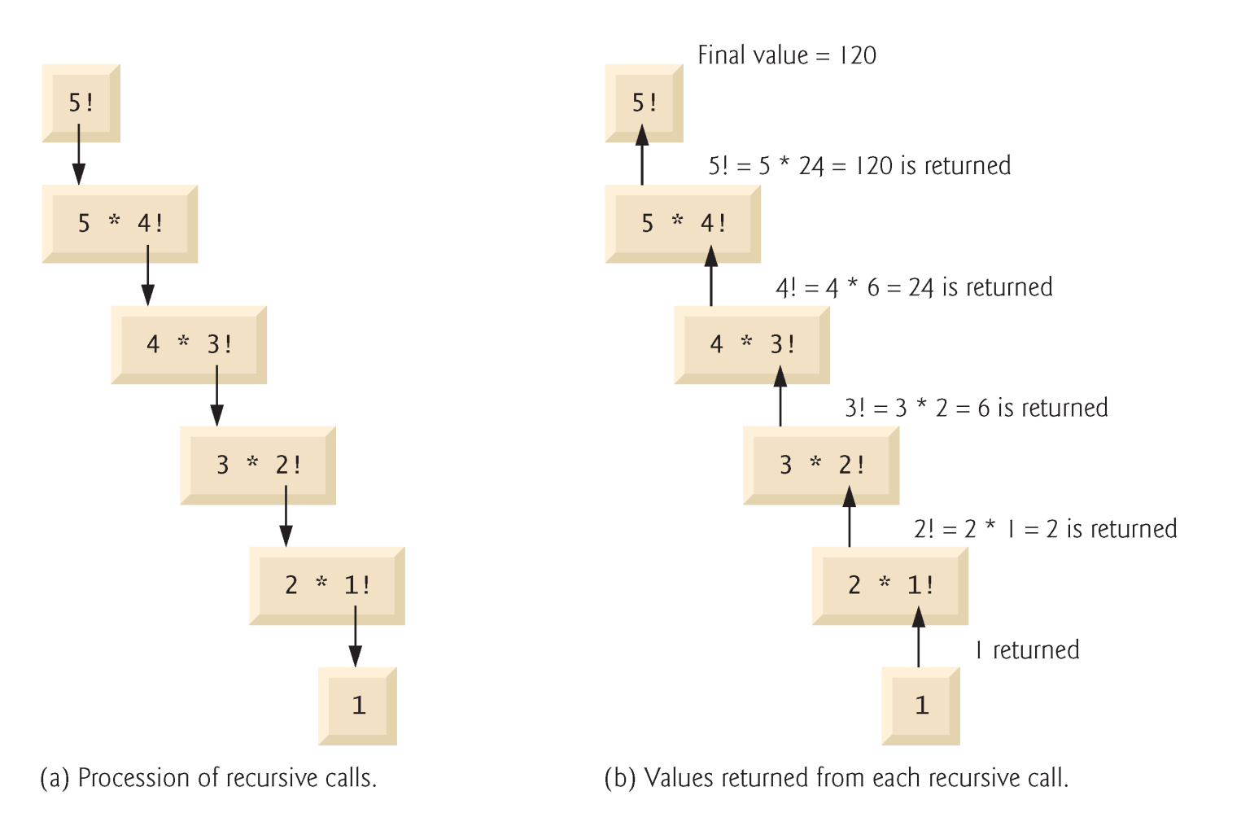
3.12 Recursion
Example: factorial
n! = n * ( n – 1 ) * ( n – 2 ) * … * 1
Recursive relationship ( n! = n * ( n – 1 )! )
5! = 5 * 4!
4! = 4 * 3!…
Base case (1! = 0! = 1)

Slide 66
1 // Fig. 3.14: fig03_14.cpp
2 // Recursive factorial function.
3 #include <iostream>
4 #include <iomanip>
5 using std::cout;
6 using std::endl;
7 using std::setw;
11
12 unsigned long factorial( unsigned long ); // function prototype
13
14 int main()
15 {
16 // Loop 10 times. During each iteration, calculate
17 // factorial( i ) and display result.
18 for ( int i = 0; i <= 10; i++ )
19 cout << setw( 2 ) << i << "! = "
20 << factorial( i ) << endl;
21
22 return 0; // indicates successful termination
24 } // end main
26 // recursive definition of function factorial
27 unsigned long factorial( unsigned long number )
28 {
29 // base case
30 if ( number <= 1 )
31 return 1;
33 // recursive step
34 else
35 return number * factorial( number - 1 );
37 } // end function factorial
Data type unsigned long can hold an integer from 0 to 4 billion.
0! = 1
1! = 1
2! = 2
3! = 6
4! = 24
5! = 120
6! = 720
7! = 5040
8! = 40320
9! = 362880
10! = 3628800
The base case occurs when we have 0! or 1!. All other cases must be split up (recursive step).

Slide 67
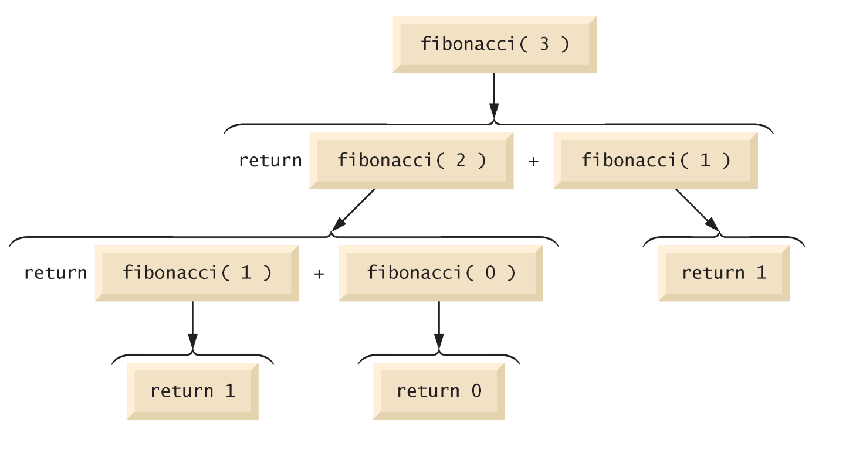
3.13 Example Using Recursion: Fibonacci Series
Fibonacci series: 0, 1, 1, 2, 3, 5, 8...
Each number sum of two previous ones
Example of a recursive formula:
fib(n) = fib(n-1) + fib(n-2)
C++ code for Fibonacci function
long fibonacci( long n )
{
if ( n == 0 || n == 1 ) // base case
return n;
else
return fibonacci( n - 1 ) +
fibonacci( n – 2 );
}

Slide 68
3.13 Example Using Recursion: Fibonacci Series
Order of operations
return fibonacci( n - 1 ) + fibonacci( n - 2 );
Do not know which one executed first
C++ does not specify
Only &&, || and ?: guaranteed left-to-right evaluation
Recursive function calls
Each level of recursion doubles the number of function calls
30th number = 2^30 ~ 4 billion function calls
Exponential complexity

Slide 69
1 // Fig. 3.15: fig03_15.cpp
2 // Recursive fibonacci function.
3 #include <iostream>
4
5 using std::cout;
6 using std::cin;
7 using std::endl;
8
9 unsigned long fibonacci( unsigned long ); // function prototype
10
11 int main()
12 {
13 unsigned long result, number;
14
15 // obtain integer from user
16 cout << "Enter an integer: ";
17 cin >> number;
18
19 // calculate fibonacci value for number input by user
20 result = fibonacci( number );
21
22 // display result
23 cout << "Fibonacci(" << number << ") = " << result << endl;
24
25 return 0; // indicates successful termination
26
27 } // end main
28
29 // recursive definition of function fibonacci
30 unsigned long fibonacci( unsigned long n )
31 {
32 // base case
33 if ( n == 0 || n == 1 )
34 return n;
35
36 // recursive step
37 else
38 return fibonacci( n - 1 ) + fibonacci( n - 2 );
39
40 } // end function fibonacci
The Fibonacci numbers get large very quickly, and are all non-negative integers. Thus, we use the unsigned long data type.
Enter an integer: 0
Fibonacci(0) = 0
Enter an integer: 1
Fibonacci(1) = 1
Enter an integer: 2
Fibonacci(2) = 1
Enter an integer: 3
Fibonacci(3) = 2
Enter an integer: 4
Fibonacci(4) = 3
Enter an integer: 5
Fibonacci(5) = 5
Enter an integer: 6
Fibonacci(6) = 8
Enter an integer: 10
Fibonacci(10) = 55
Enter an integer: 20
Fibonacci(20) = 6765
Enter an integer: 30
Fibonacci(30) = 832040

Slide 70
3.14 Recursion vs. Iteration
Repetition
Iteration: explicit loop
Recursion: repeated function calls
Termination
Iteration: loop condition fails
Recursion: base case recognized
Both can have infinite loops
Balance between performance (iteration) and good software engineering (recursion)

Slide 71
3.21 Function Templates
Compact way to make overloaded functions
Generate separate function for different data types
Format
Begin with keyword template
Formal type parameters in brackets <>
Every type parameter preceded by typename or class (synonyms)
Placeholders for built-in types (i.e., int) or user-defined types
Specify arguments types, return types, declare variables
Function definition like normal, except formal types used

Slide 72
3.21 Function Templates
Example
template < class T > // or template< typename T >
T square( T value1 )
{
return value1 * value1;
}
T is a formal type, used as parameter type
Above function returns variable of same type as parameter
In function call, T replaced by real type
If int, all T's become ints
int x;
int y = square(x);

Slide 73
1 // Fig. 3.27: fig03_27.cpp
2 // Using a function template.
3 #include <iostream>
4
5 using std::cout;
6 using std::cin;
7 using std::endl;
8
9 // definition of function template maximum
10 template < class T > // or template < typename T >
11 T maximum( T value1, T value2, T value3 )
12 {
13 T max = value1;
14
15 if ( value2 > max )
16 max = value2;
17
18 if ( value3 > max )
19 max = value3;
20
21 return max;
22
23 } // end function template maximum
24
25 int main()
26 {
27 // demonstrate maximum with int values
28 int int1, int2, int3;
30 cout << "Input three integer values: ";
31 cin >> int1 >> int2 >> int3;
32
33 // invoke int version of maximum
34 cout << "The maximum integer value is: "
35 << maximum( int1, int2, int3 );
37 // demonstrate maximum with double values
38 double double1, double2, double3;
40 cout << "\n\nInput three double values: ";
41 cin >> double1 >> double2 >> double3;
42
43 // invoke double version of maximum
44 cout << "The maximum double value is: "
45 << maximum( double1, double2, double3 );
46 // demonstrate maximum with char values
48 char char1, char2, char3;
49
50 cout << "\n\nInput three characters: ";
51 cin >> char1 >> char2 >> char3;
52
53 // invoke char version of maximum
54 cout << "The maximum character value is: "
55 << maximum( char1, char2, char3 )
56 << endl;
58 return 0; // indicates successful termination
60 } // end main
maximum called with various data types.
Formal type parameter T placeholder for type of data to be tested by maximum.
maximum expects all parameters to be of the same type.
Input three integer values: 1 2 3
The maximum integer value is: 3
Input three double values: 3.3 2.2 1.1
The maximum double value is: 3.3
Input three characters: A C B
The maximum character value is: C

